Slide 1
MTSS: Social & Emotional Learning
Parent Emotions
Students Emotions
Emotions Matter
Community Emotions
Staff Emotions

Slide 2
Outcomes
Understand the value & role of emotions
Identify strategies for personal and professional emotional regulation
Develop a plan for integrating, monitoring, & measuring
SEL into your 2020 launch that will sustain beyond COVID-19 (COVID-1619) to help create a healthy school climate
Understand the role of leader in setting SEL thermostat

Slide 3
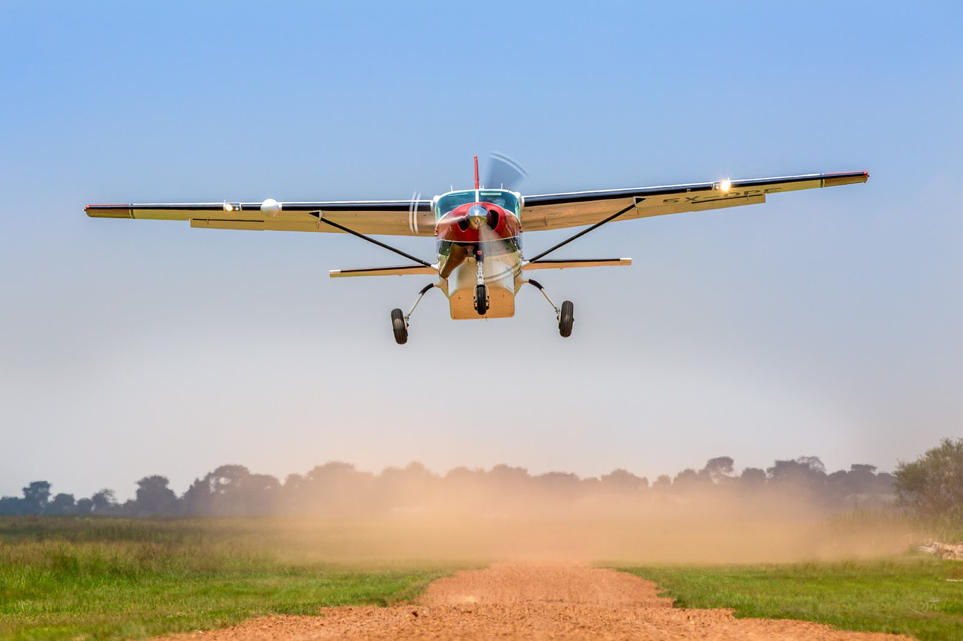
SEL - Helping Students Achieve Their Full Purpose

Slide 4
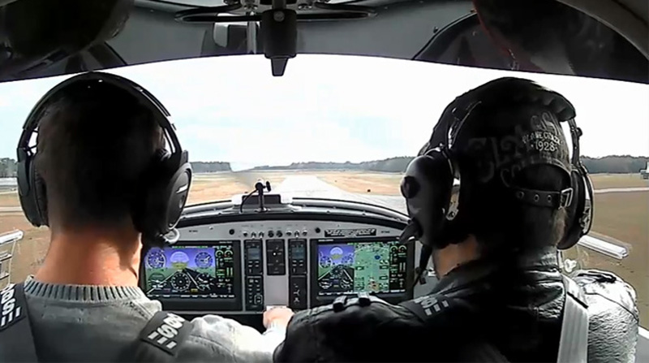
SEL - Helping Students Achieve Their Full Purpose

Slide 5
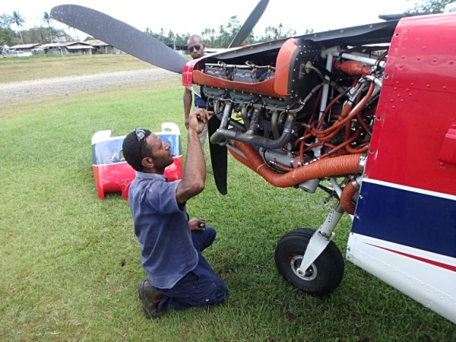
SEL - Helping Students Achieve Their Full Purpose

Slide 6
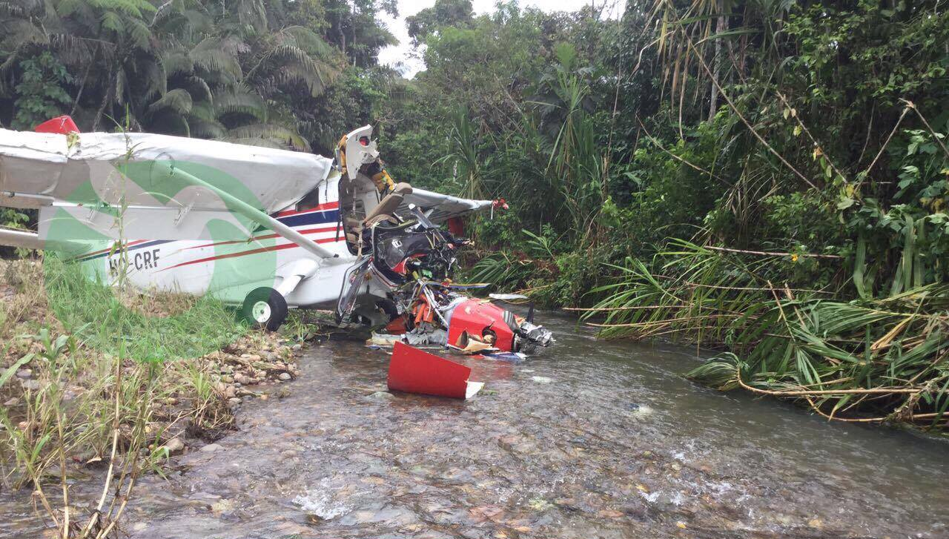
SEL - Helping Students Achieve Their Full Purpose

Slide 7
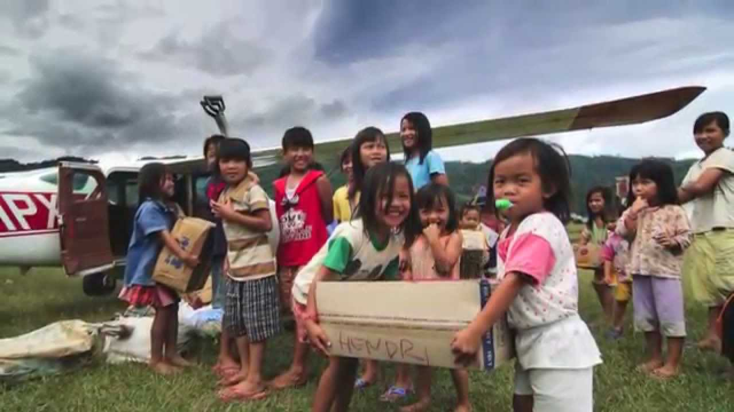
SEL - Helping Students Achieve Their Full Purpose

Slide 8
Emotional Intelligence and Leaders
Parent Emotions
Understand the driving force of emotions within ALL of our stakeholders.
Students Emotions
Emotions Matter
Community Emotions
In chat box: How do you feel? One word.
Staff Emotions

Slide 9
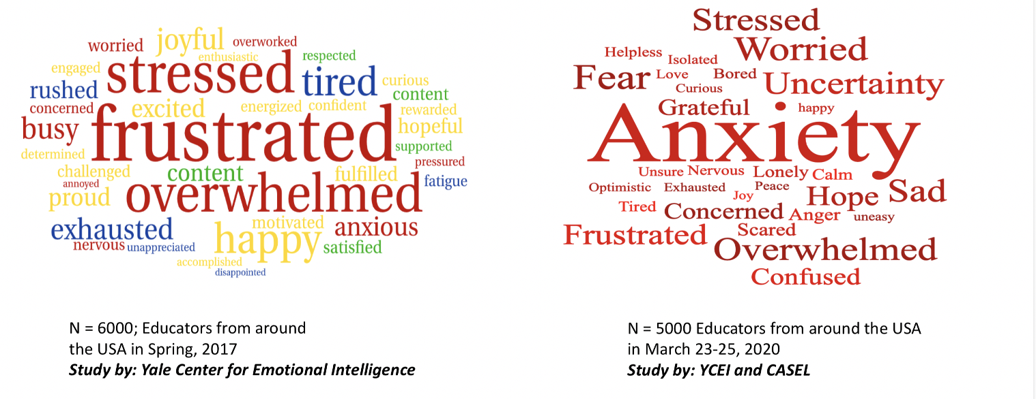
Data on Feelings of Educators
Yale Center for Emotional Intelligence

Slide 10
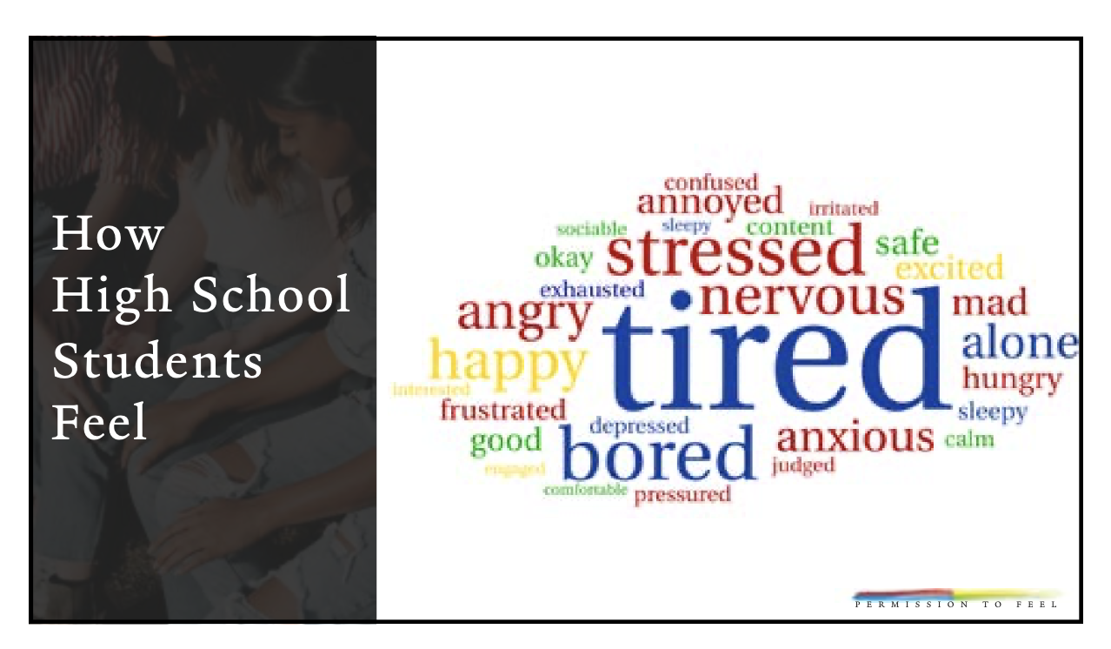
Data on Feelings of High School Students Pre- COVID
Yale Center for Emotional Intelligence

Slide 11
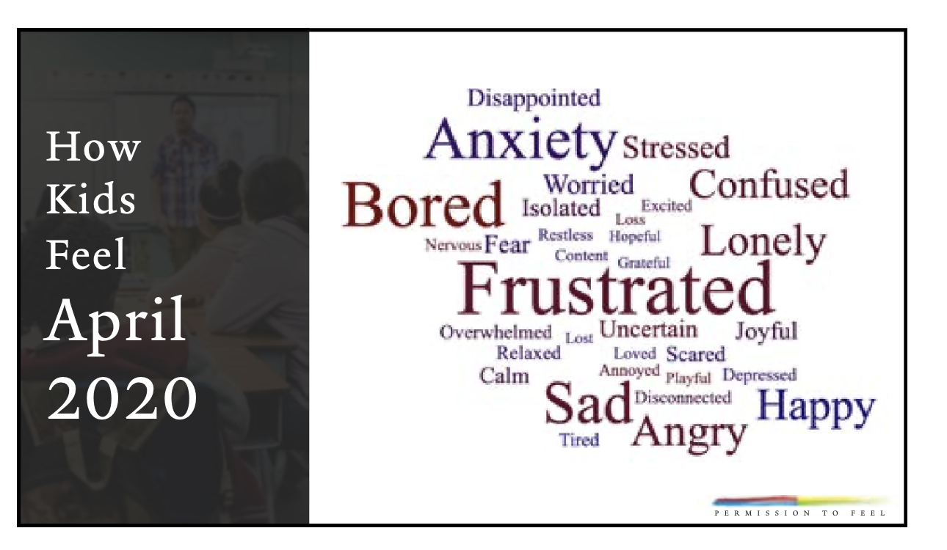
COVID: ALL KIDS
Yale Center for Emotional Intelligence

Slide 12
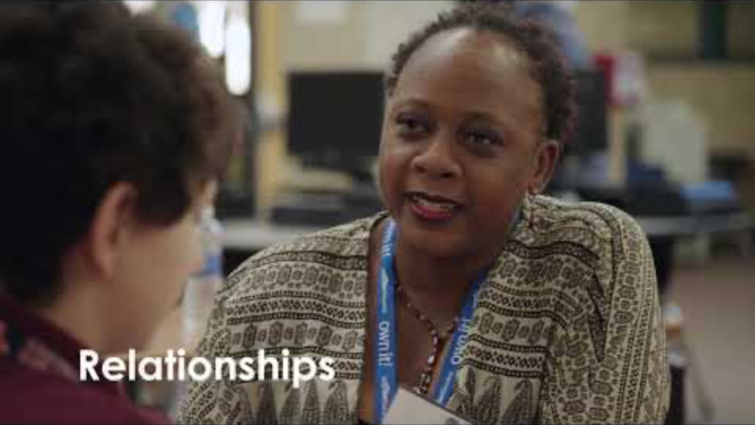
Why do Emotions Matter?

Slide 13
Theory of Action : Emotion Science
Understanding what you feel and why
Strategies to monitor and shift outcomes
Knowing how you want to feel
Self Regulation

Slide 14
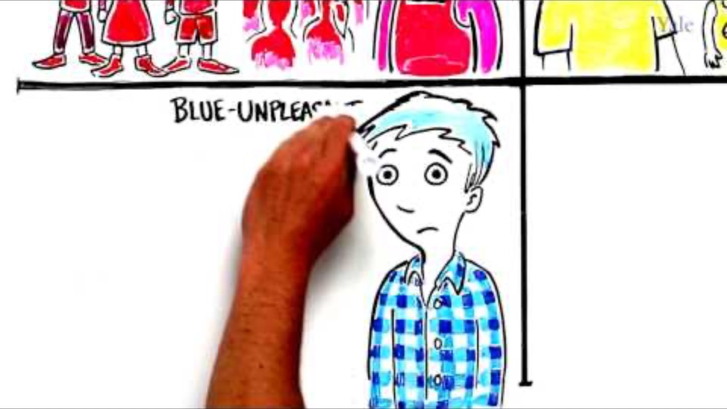
How Understanding Emotions Can Help Students Learn

Slide 15
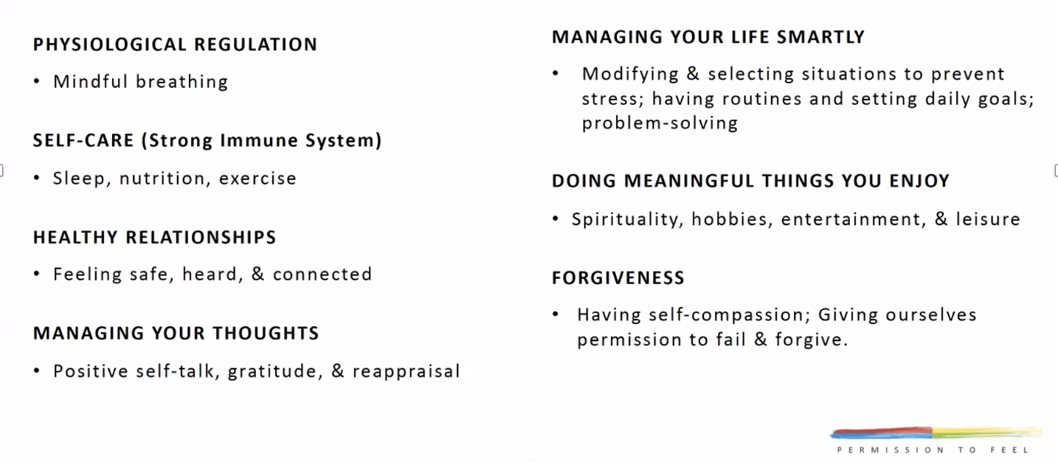
The Big 7 Strategies for being Best Self
Identify strategies for personal and professional emotional regulation
Yale Center for Emotional Intelligence

Slide 16
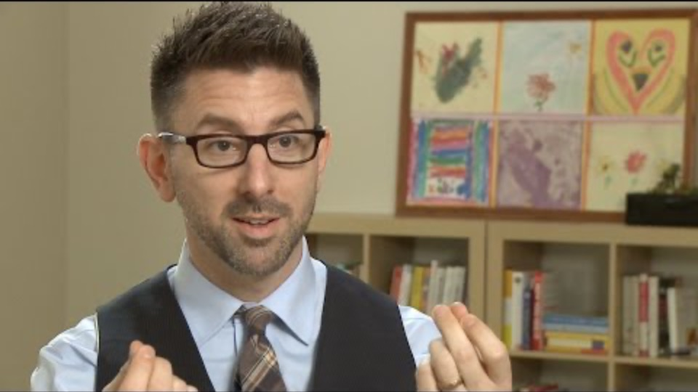
Meta-Moment: Self-Regulation, Managing Thoughts and more!

Slide 17
SEL Core Practices in Virtual World
School-wide Values (example: Charters)
  For Staff
  For Students & Family
SEL Classroom Routines that foster Relationships (RULER Strategies)
  Emotional Check-ins (how are you feeling)
  Community Circles
  School or Class Charter Check-in (check in on school/class values)
  Reflections on SEL competencies
    Focused journal prompts
  Focused Breathing (and/or mindfulness strategies)
Alignment to Danielson
  Welcoming Opening Activities
  Collaborative learning with high levels of student discourse
  Closure that fosters self-reflection on learning and connection to home/future learning

Slide 18
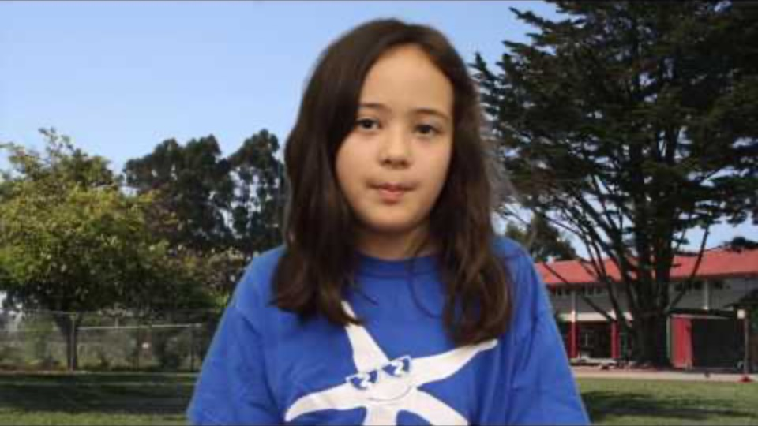
Construct Charters: School, Staff, Class, and Family.
How do we want to feel?
How will we accomplish that?
Two key questions

Slide 19
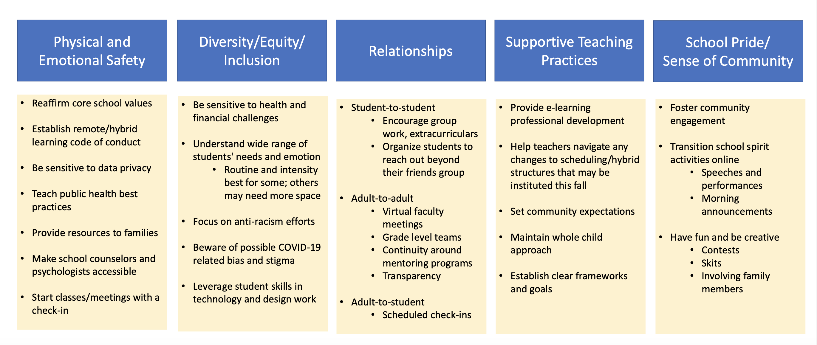
Using SEL to support a positive school climate
THINK and INK (in the chat)…using this chart, what SEL ideas can you implement right away?
We will have time in breakouts in a few minutes.
Yale Center for Emotional Intelligence

Slide 20
Distance Learning Classroom Expectations
Draft in process adapted from draft created by Sequoia

Slide 21
Breakout Sessions: SEL strategies for fostering school climate:
In your breakouts!

Slide 22
Opportunity to Collaborate
BREAKOUT ROOMS – by level
High School Principals & AP’s
Middle School Principals & AP’s
Elementary Principals
Elementary AP’s
Non-School District Leaders
TASK: Identify 2-3 actionable activities that can be used to launch the school year in each of the 5 categories to build school climate
SHARE OUT
Identify someone in your group to share your group’s favorite idea from any 3 of the categories

Slide 23
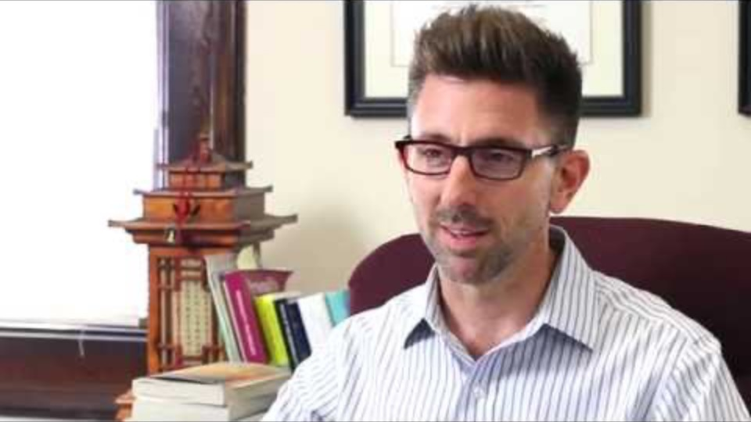
Teachers have Opportunity to Impact!

Slide 24
SEL - Helping Students Achieve Their Full Purpose

Slide 25
SEL - Helping Students Achieve Their Full Purpose

Slide 26
SEL - Helping Students Achieve Their Full Purpose

Slide 27
Next Steps:
Learning Improvement Day MTSS Content
  SEL will be emphasized
    Tier 2 Training throughout the year with support from District MTSS Facilitators
    (Stefani Koetje, Terry Coleman, Kristen Walker)
  Power point will be provided
  Support available—let us know!
Continued focus on developing Tier 1 SEL
  Developing adult SEL while supporting
  student and family SEL
  On boarding additional strategies

Slide 28
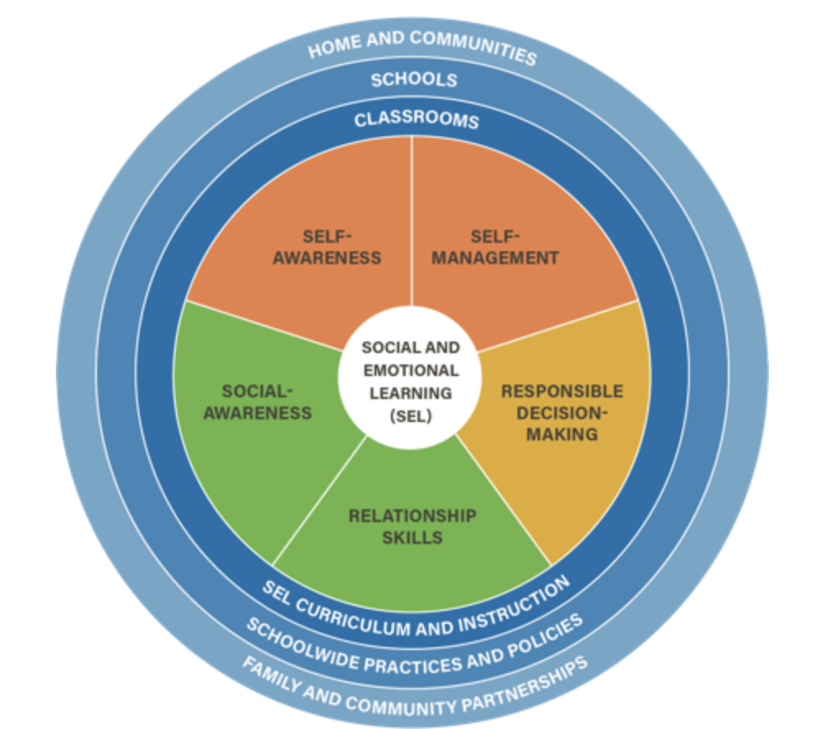
CASEL: Three Signature Practices
In the Classroom and School-wide
1. Welcoming Inclusion Activities
School-wide: eye contact, smile, greet!
Classroom: greet by name, morning meetings, class circles
2. Engaging Practices
School-wide: demonstrate engagement—waves, smiles--acknowledgement
Classroom: brain breaks (stretches), student discourse—sharing and listening, foster interactions
3. Optimistic Closure
School-wide: interest, “let me know about that?” “Is there anything else?”
Classroom: Questions that prompt reflection of learning and connects to the next day

