Slide 1

Use of Restorative Practices in our work to SECURE Equitable Outcomes for Students
Finance
November 2022

Slide 2
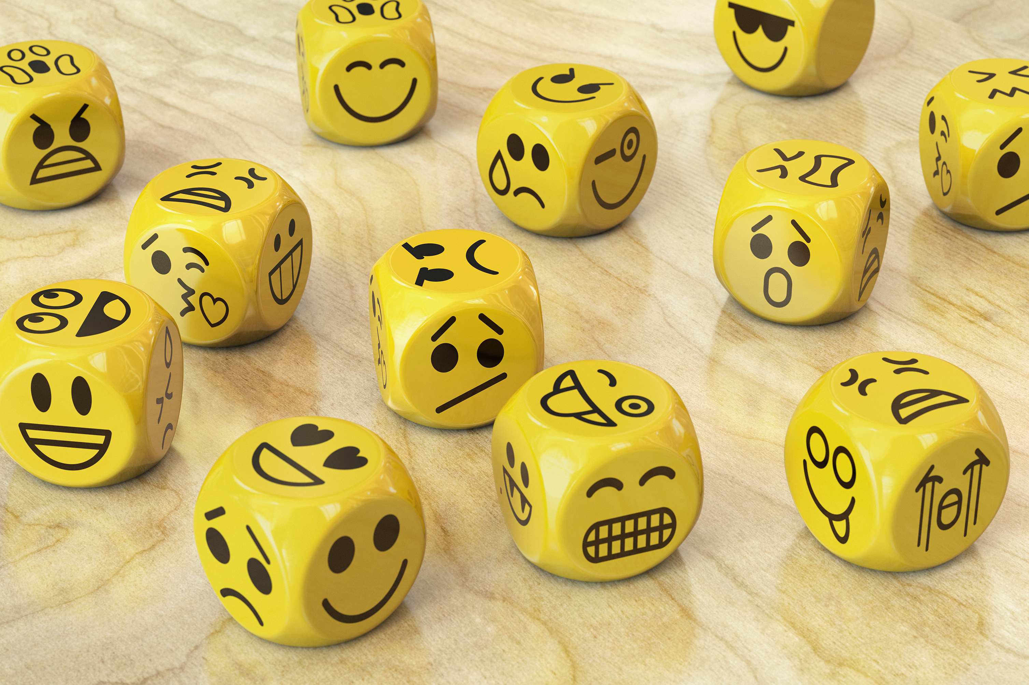
Opening Circle
INTRODUCE YOURSELF
NAME SOMETHING THAT BRINGS YOU JOY
two words that describe how you feel right now

Slide 3
Learning Outcomes
What restorative practices is and isn’t
Overview of Four Foundations of RP
  "Deeper" dive into TWO of the Four Foundations
Neuroscience of why RP works

Slide 4
Circle Protocols
Opportunity to process and connect:
  Brief, most important idea that resonates with you
  One word, one phrase, 1-2 sentences
  Remember, you “choose” what you share in a circle…
Increase Opportunity to Respond:
  Open and close with large circle
  Smaller circles at your tables for processing

Slide 5

Circle:
What is your WHY behind your Willingness to do this work?
(One Sentence)

Slide 6
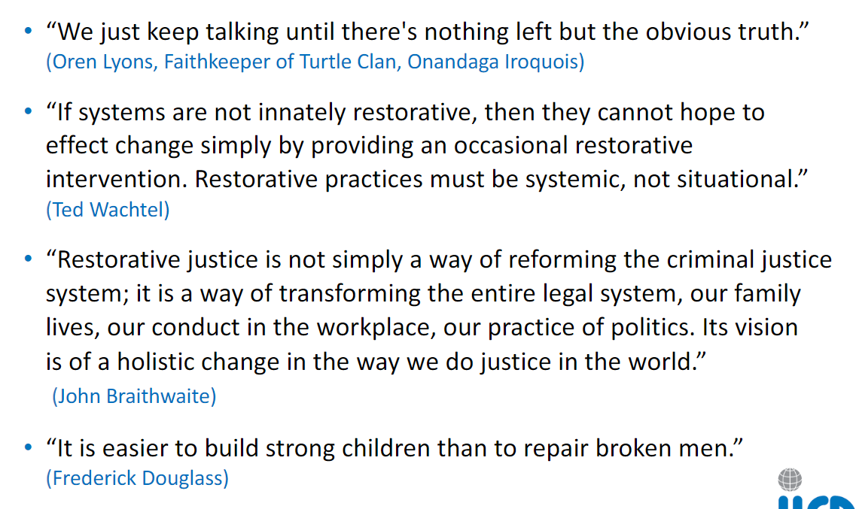


Slide 7
Reflections
Which statement most resonates with you?

Slide 8
Polarized
Political
Racial
Cultural
COVID
Urban/Rural
Religious
We can’t restore hope and bring about healing without first building or restoring community!

Slide 9
What Restorative Practices is/is Not
NOT | IS | SO
Restorative Justice
a process for reducing discipline incidents
a process for making sure we do not have disproportionality in our discipline
Building Relationships and Classroom Community
Student-Teacher
Student-Student
Classroom-Student-Teacher
Educator-Educator
When harm occurs Relationships and Community can be RESTORED!

Slide 10

Worldwide Influence
The Science of Relationships & Community!
Influenced and inspired by indigenous communities around the world

Slide 11
Polarized
Political
Racial
Cultural
COVID
Urban/Rural
Religious
Within the Construct of our Current Times

Slide 12
Context of your Personal Life
Have you experienced this polarization with a family member or friend? This sense that difference of opinion has become an increasingly bigger deal...
How did this conflict make you feel?

Slide 13
Context of your Department or your work at schools
Have you experienced this professionally? Unusually high emotions? Intensity of interaction? Avoidance?
How does this prompt you to feel?
Are strong enough relationships and sense of community to weather and willingness lean-in to conflict?

Slide 14
How we feel
How we perceive
How we interact
Proactive
Relationships
Community
Empathic
Respond
Restore

Slide 15
Four Components of Restorative Practices
Social Discipline Window
Fair Process
Psychology of Affect
Restorative Practices Continuum

Slide 16
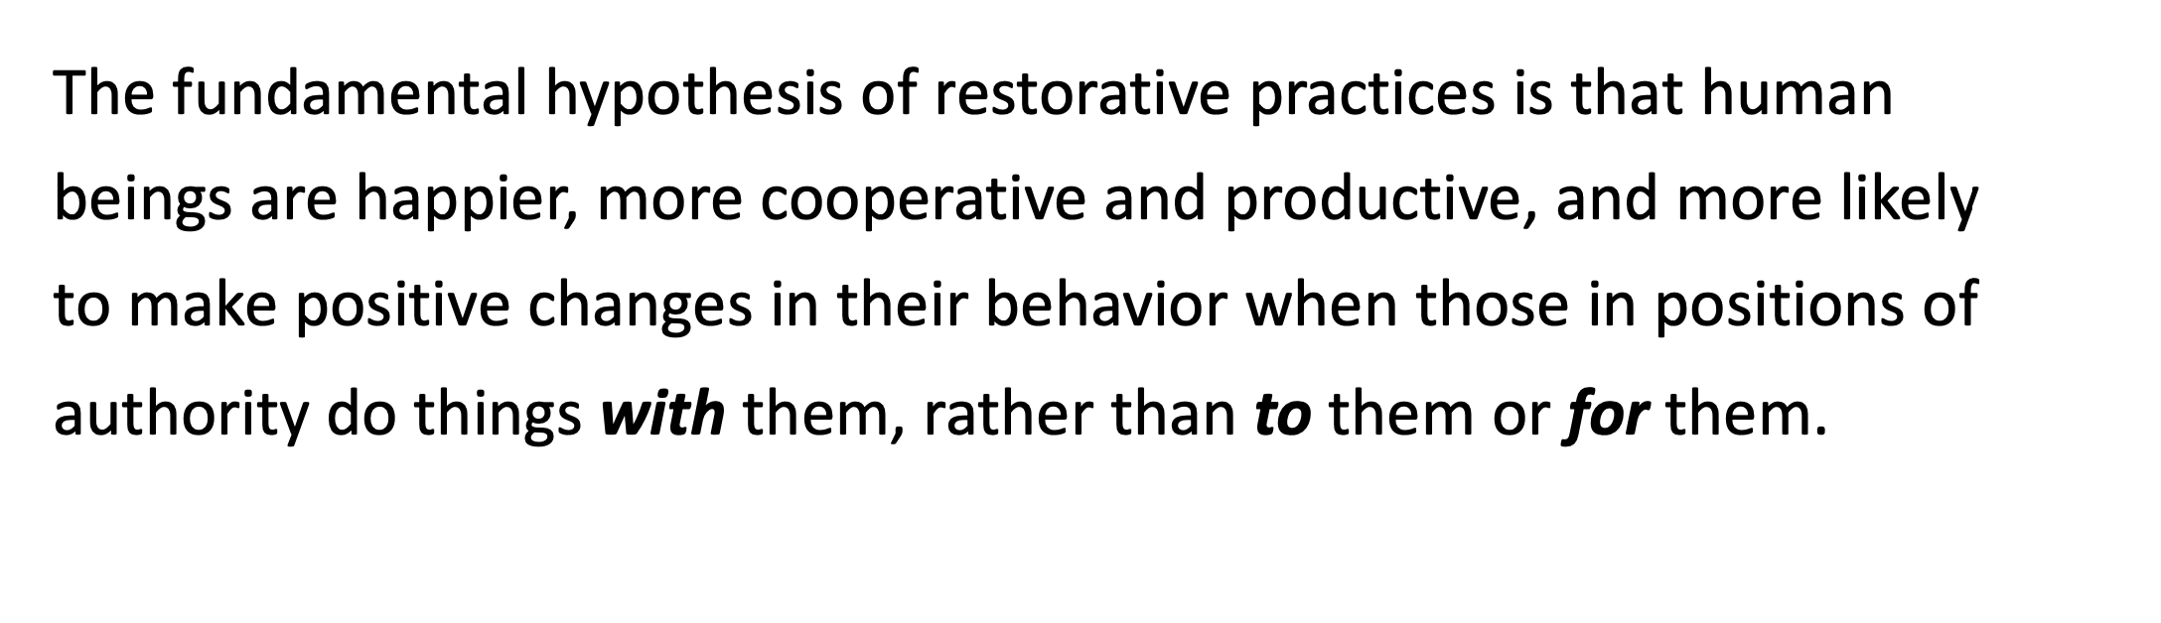
Fundamental Hypothesis

Slide 17
Aim of Restorative Practices
To develop community and to manage conflict and tensions by repairing harm and restoring relationships
80/20 Rule--Need to be explicit!
80% of your time is devoted to building relationship and fostering community
20% of your time is dedicated to responding to conflict, repairing and restoring

Slide 18
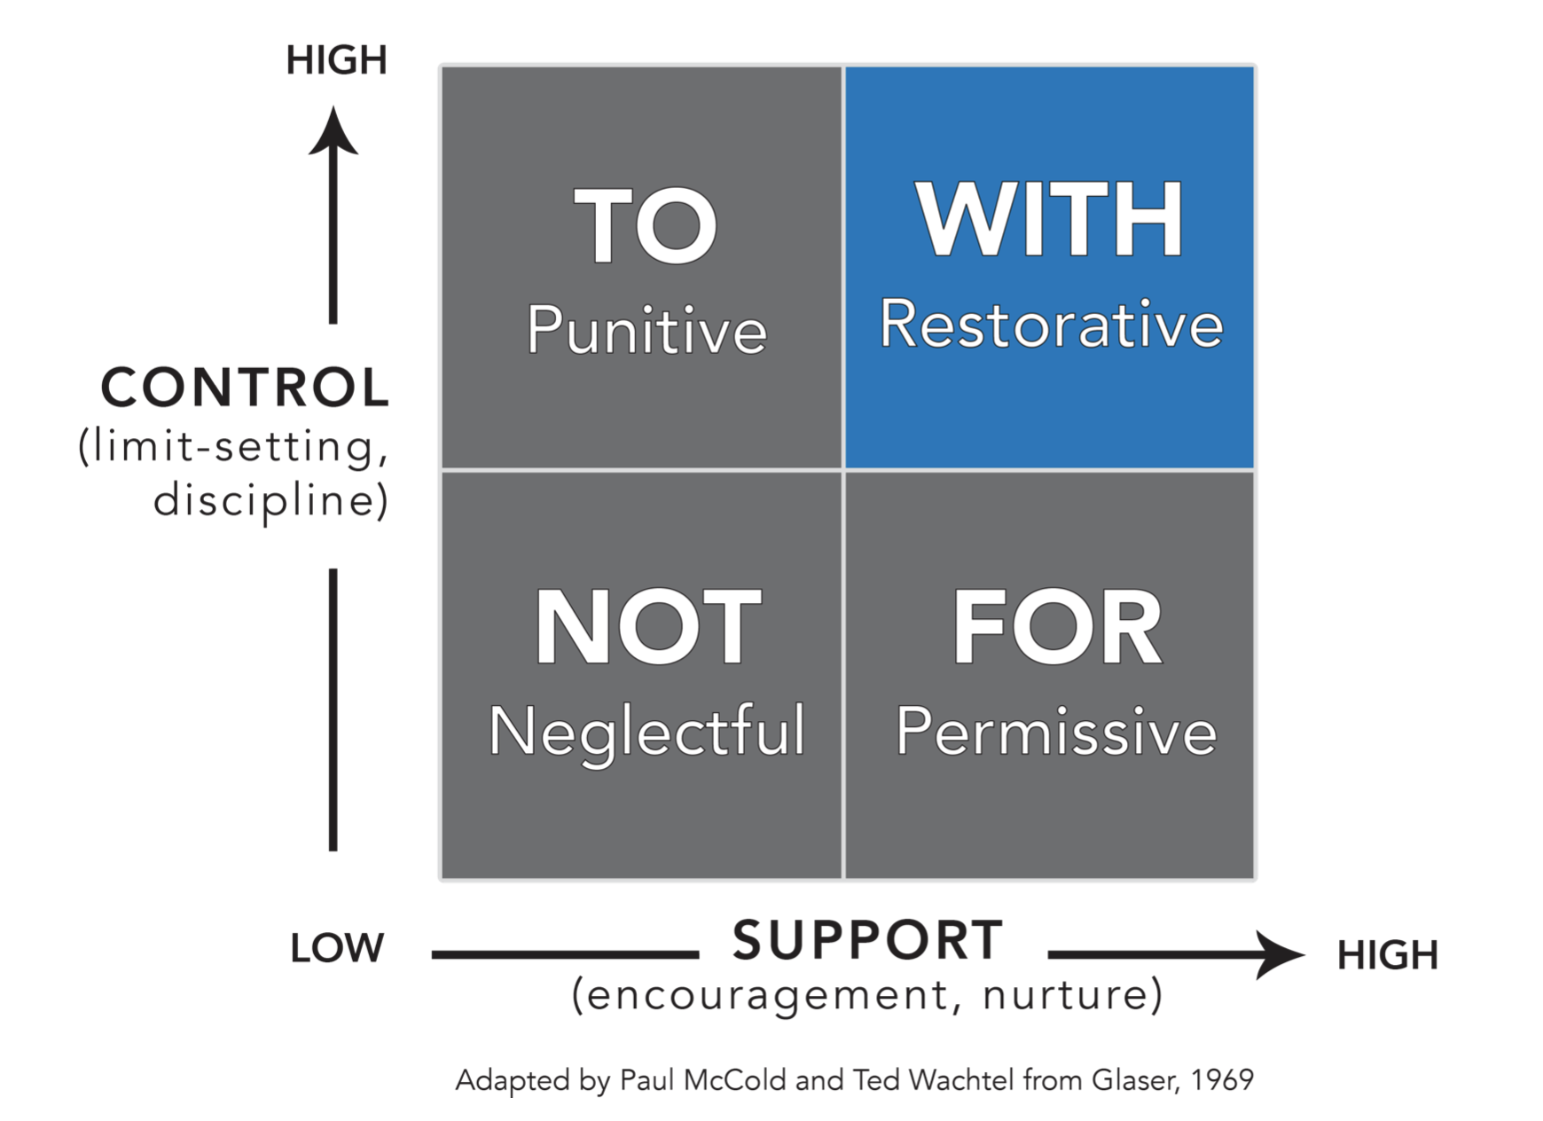
Social Discipline Window

Slide 19
In consideration of ALL that we’ve been through Since March 2020…
Which window in the Social Discipline Window have you been operating from?

Slide 20
In consideration of examining issues of Bias, Stereotypes and Race (ism)
How do we stay in the WITH window?

Slide 21

What are the ramps/access points for our educators when we talk about culturally responsive teaching, bias and race?
It is hard to be in an authentic relationships with someone who does not see your assets
Relationships and common experiences allows us to see the humanity even when seeing bad behaviors (or hearing disparaging thoughts)…

Slide 22
How we feel
How we perceive
How we interact
Proactive
Relationships
Community
Empathic
Respond
Restore

Slide 23
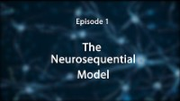
Everything Dr. Perry says about the child’s brain is also true about the adult brain.

Slide 24
Circle
Are we able to Regulate, Relate and Reason as we LEAN IN to challenging conversations?

Slide 25
Four Components of Restorative Practices
Social Discipline Window
Psychology of Affect

Slide 26
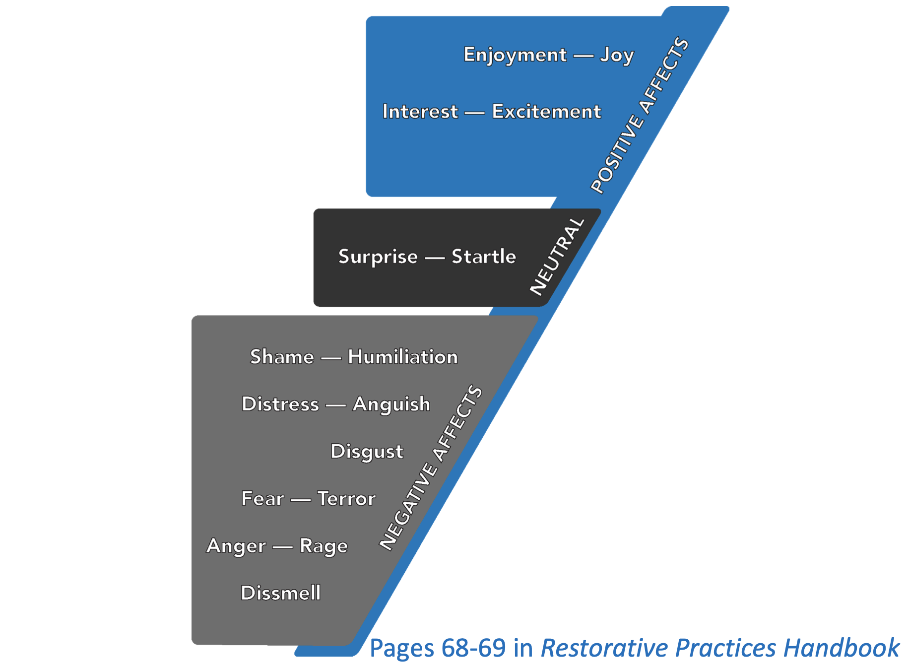
The Nine Affects

Slide 27
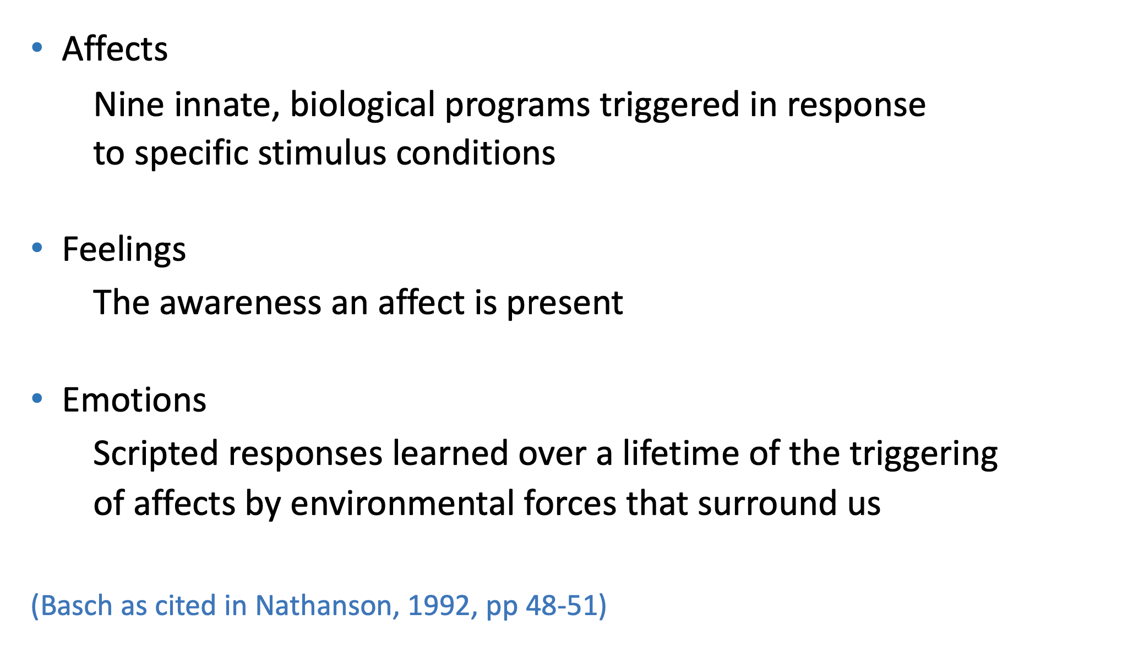
Affects, Feelings, and Emotions
Biology
Psychology
Biography

Slide 28
Circle Prompt #1:
Think about a time (or a pattern) at work when you moved from positive affect to a negative affect.
In your circle, what time/circumstance. (brief)
Circle Prompt #2 :
Think about a time (or a pattern) at school when you noticed a colleague move from a positive affect to a negative affect.
In your circle, what time/circumstance.

Slide 29
The Nine Affects
Empathic Responses

Slide 30
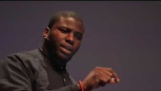
Okieriete Onaodowan

Slide 31
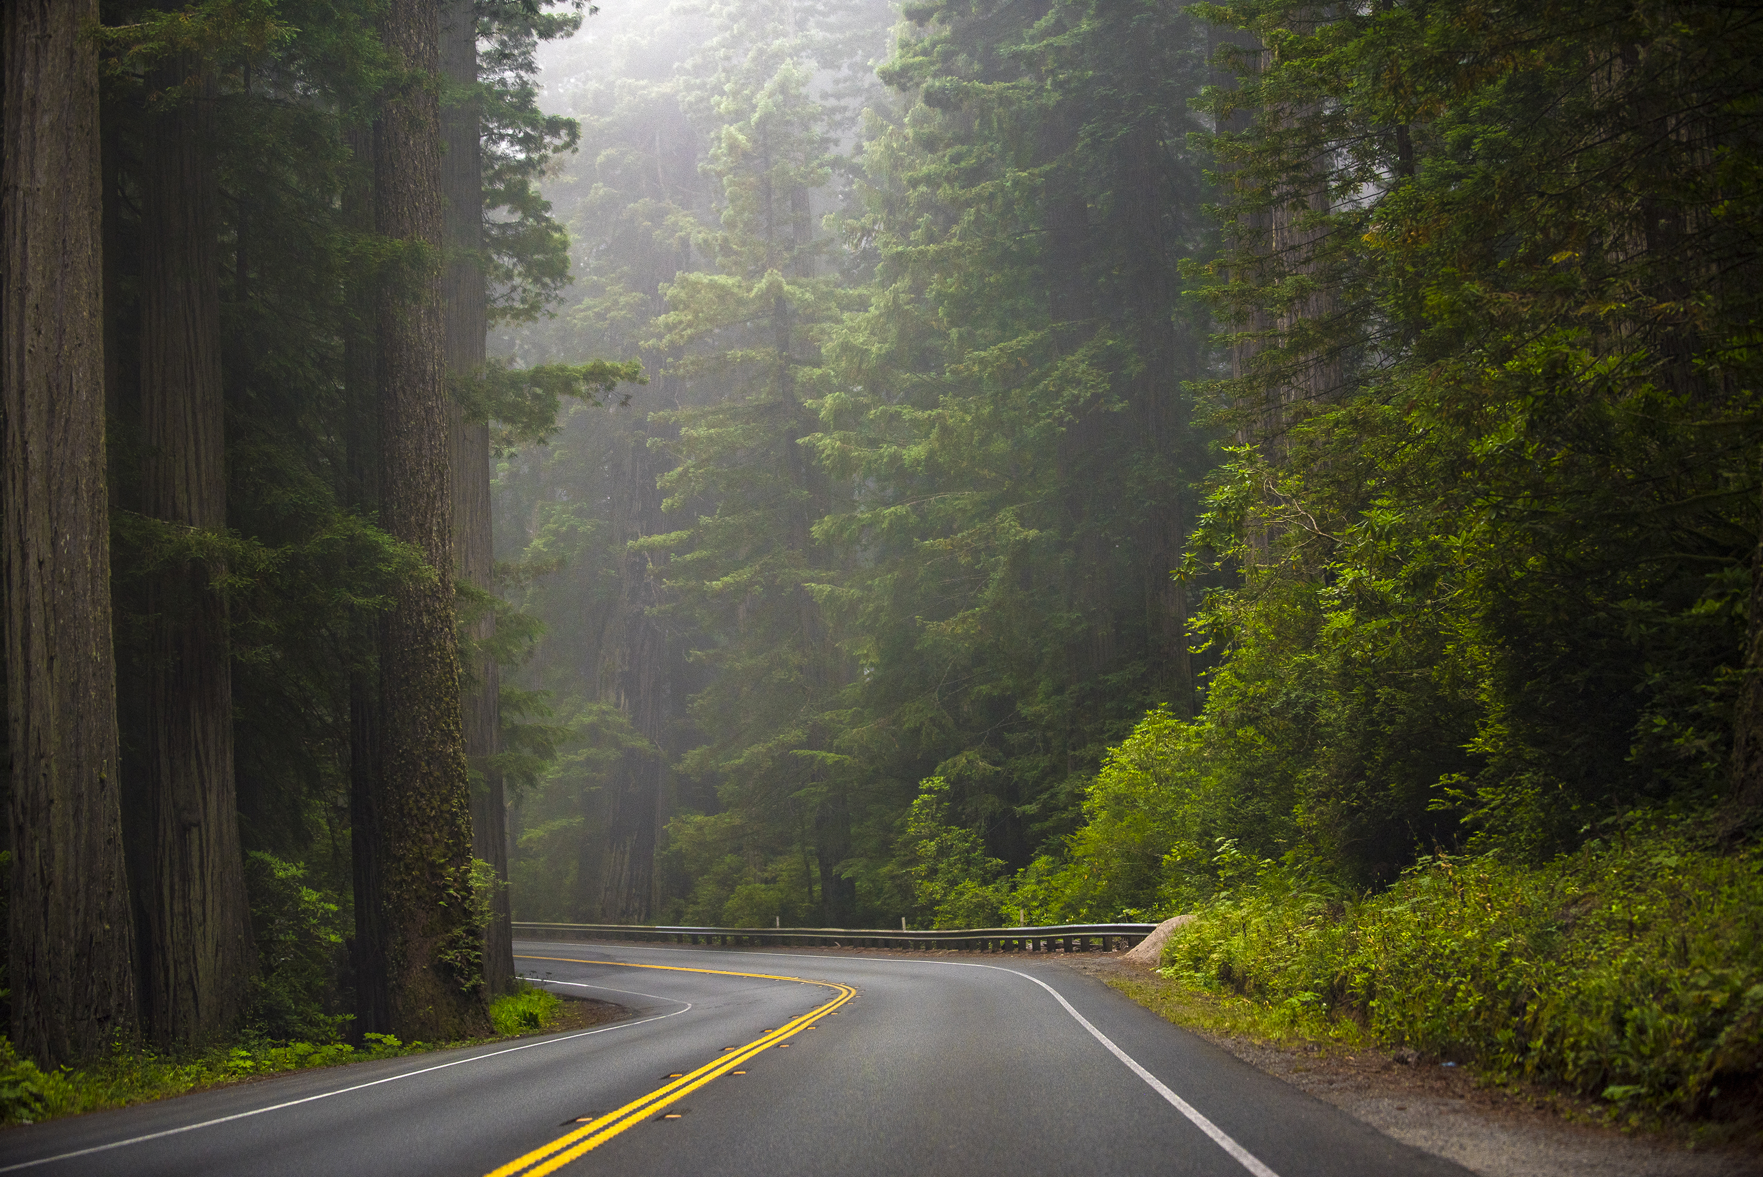
Circle—all of us together!
On your drive home, what is the one thing you’ll still be mulling over…

