Slide 1
FAFSA Overview
A Presentation for the FAFSA Completion Project Participants
Valerie Lefor | January 22, 2013

Slide 2
Agenda
What is the FAFSA?
When does the student complete the FAFSA?
Where does the student go to complete the FAFSA?
Who is an eligible student?
How does an student complete the FAFSA?(Detailed information about completing the FAFSA)
What are the student’s Next Steps?
What are some of the student Frequently Asked Questions?
What are some additional resources?
Notes:
The subsequent slides will explain the answers to these questions.

Slide 3
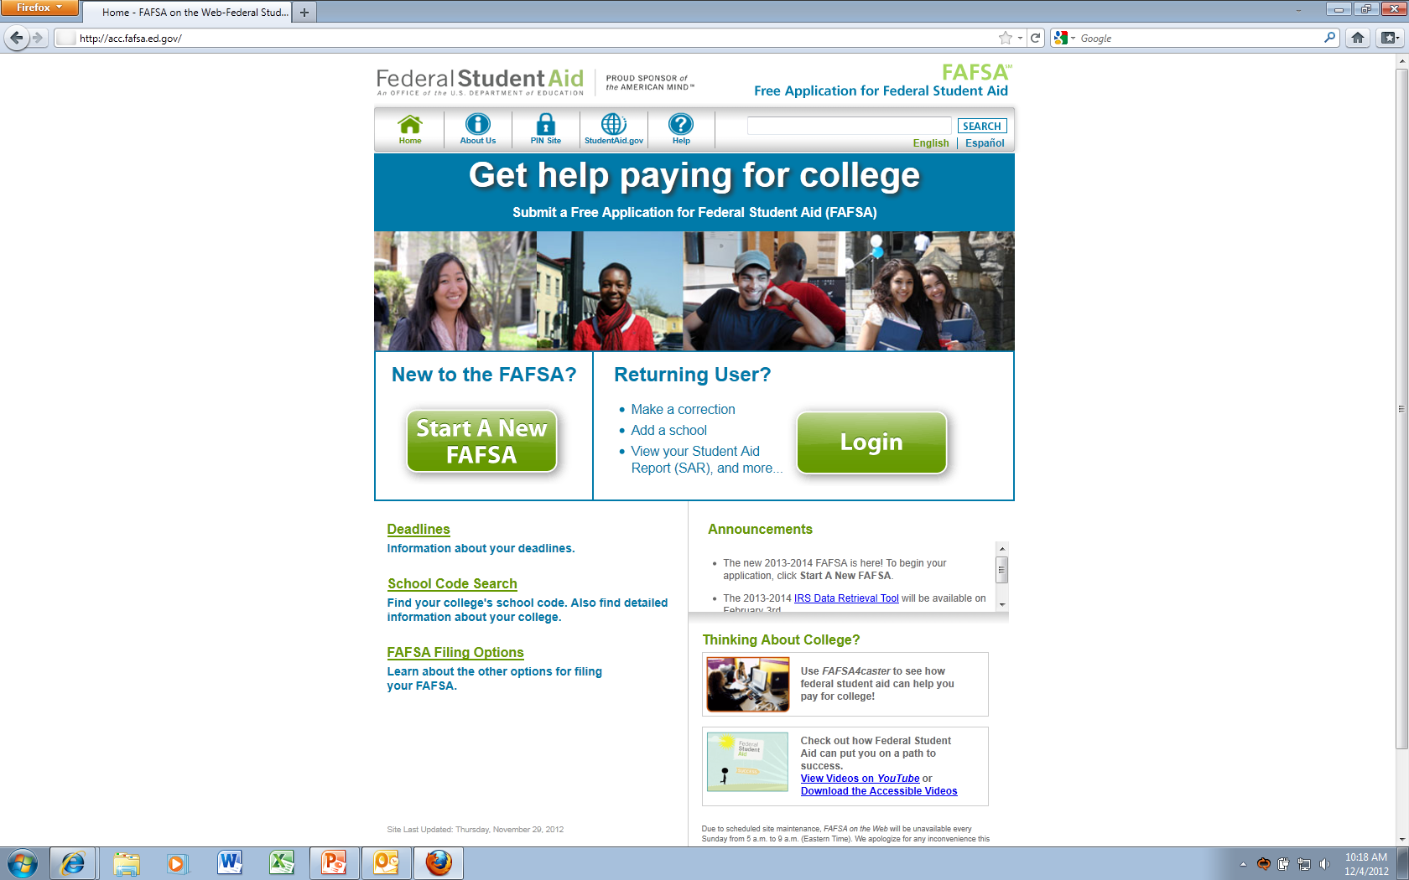
What is the FAFSA?
Free Application for Federal Student Aid
www.fafsa.gov
Used to apply for grants, some loans, and campus based aid.
Available in English and Spanish
It’s FREE to apply!

Slide 4
When does the student complete the FAFSA?
The FAFSA isavailable in early January each year, and there are different deadlines for different programs.
Be sure to check for deadlines.
The application needs to be completed annually.
Notes:
Deadlines hyperlink off of the FAFSA homepage. The student should check the deadlines for the state they live in and for the college or career school they wish to attend.

Slide 5
Where does the student go to complete the FAFSA?
Online at www.fafsa.gov is faster and easier than using paper.
If needed, students can download a PDF FAFSA or order a paper FAFSA.
Notes:
There are several ways to complete the FAFSA. If the student does not have access to the internet, they can order a paper FAFSA, download a PDF FAFSA, or go the library to use the internet there. Please note that if an applicant completes a paper FAFSA, the information is not recorded in the reports for the completion total for the FAFSA Completion Project.

Slide 6
Who is eligible?
General eligibility requirements:
Demonstrate financial need (for most programs);
Be a U.S. citizen or an eligible noncitizen;
Have a valid Social Security number
Be registered with Selective Service, if you’re a male
Be enrolled or accepted for enrollment as a regular student in an eligible degree or certificate program;
Maintain satisfactory academic progress in college or career school;
Not be in default
Have a high school diploma or a recognized equivalent such as a General Educational Development (GED) certificate or a high school education in a homeschool setting approved under state law.
Notes:
Details about the Social Security Number (SSN): They must have a valid SSN with the exception of students from the Republic of the Marshall Islands, Federated States of Micronesia, or the Republic of Palau.
Details about Selective Service: A male student must register between the ages of 18 and 25.
As a noncitizen, the student must have a valid SSN.
The student must be enrolled at least half-time to be eligible for Direct Loan Program funds.

Slide 7
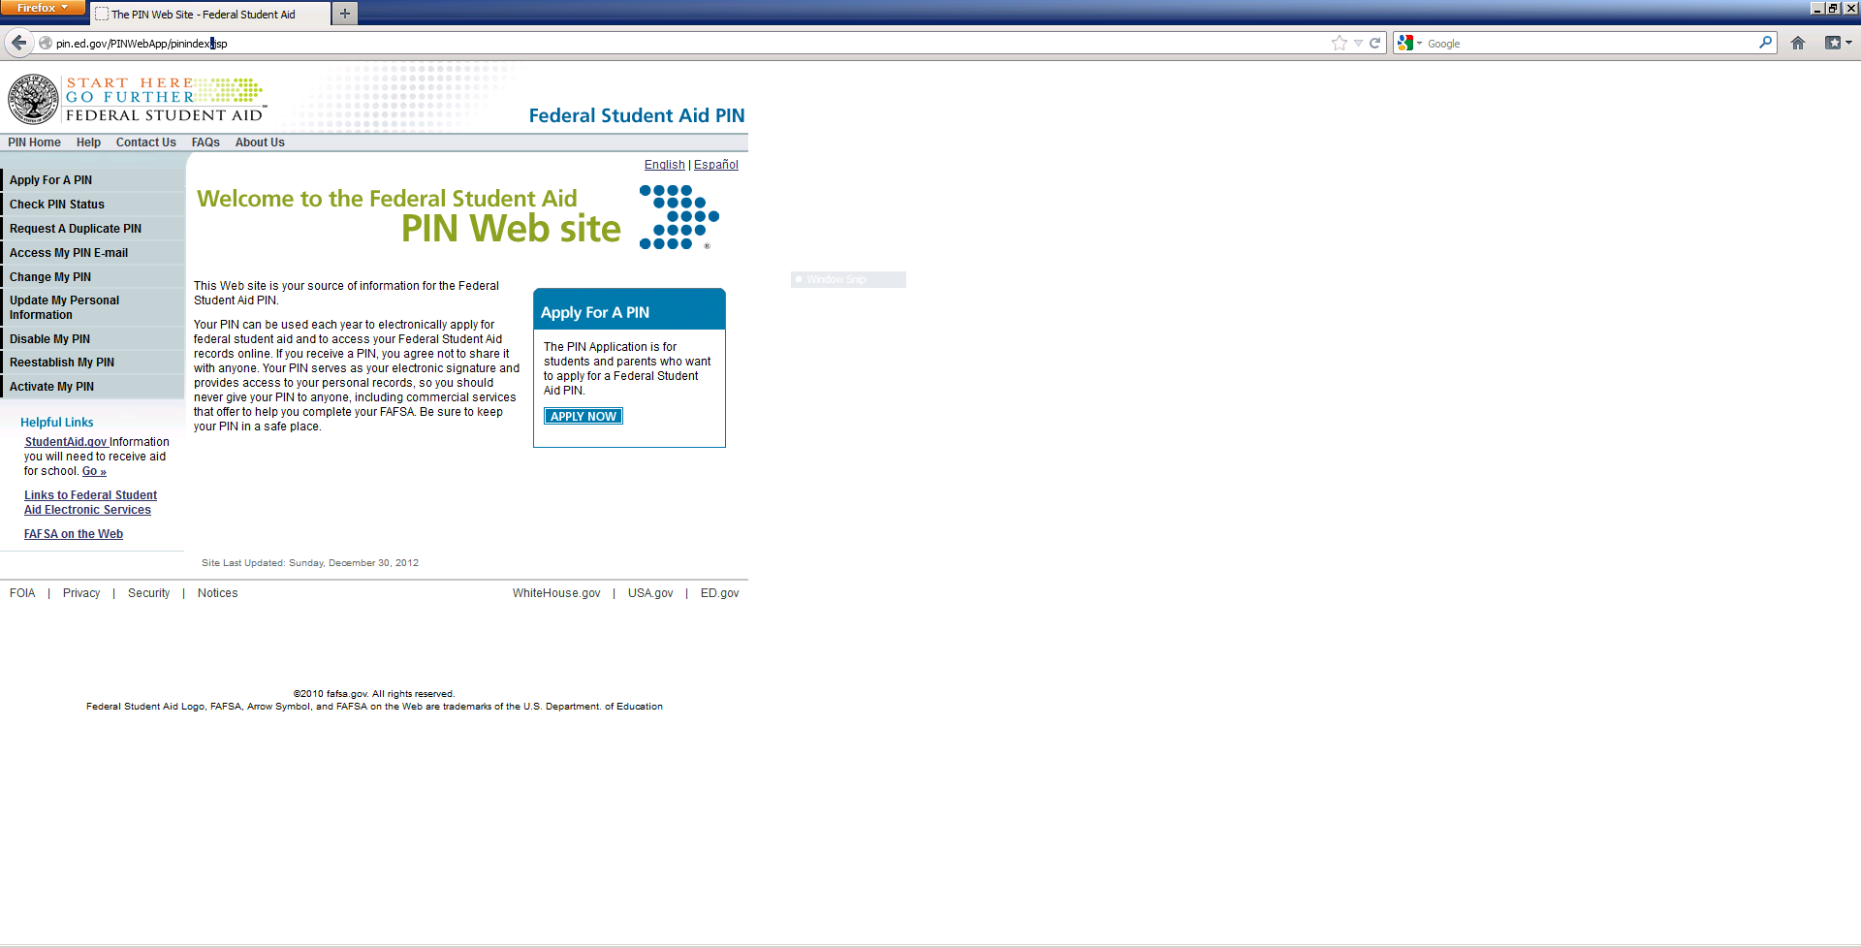
Federal Student Aid PIN
www.pin.ed.gov
This is the way that the student and parents can sign the application electronically.
Please note that the PIN should not be shared with anyone!
Notes:
It takes 1-3 days for a new PIN to process with the Social Security Administration (SSA). New students are able to sign with the PIN on a new application before the final check and validation has been done with the SSA.

Slide 8
Details for completing the FAFSA

Slide 9
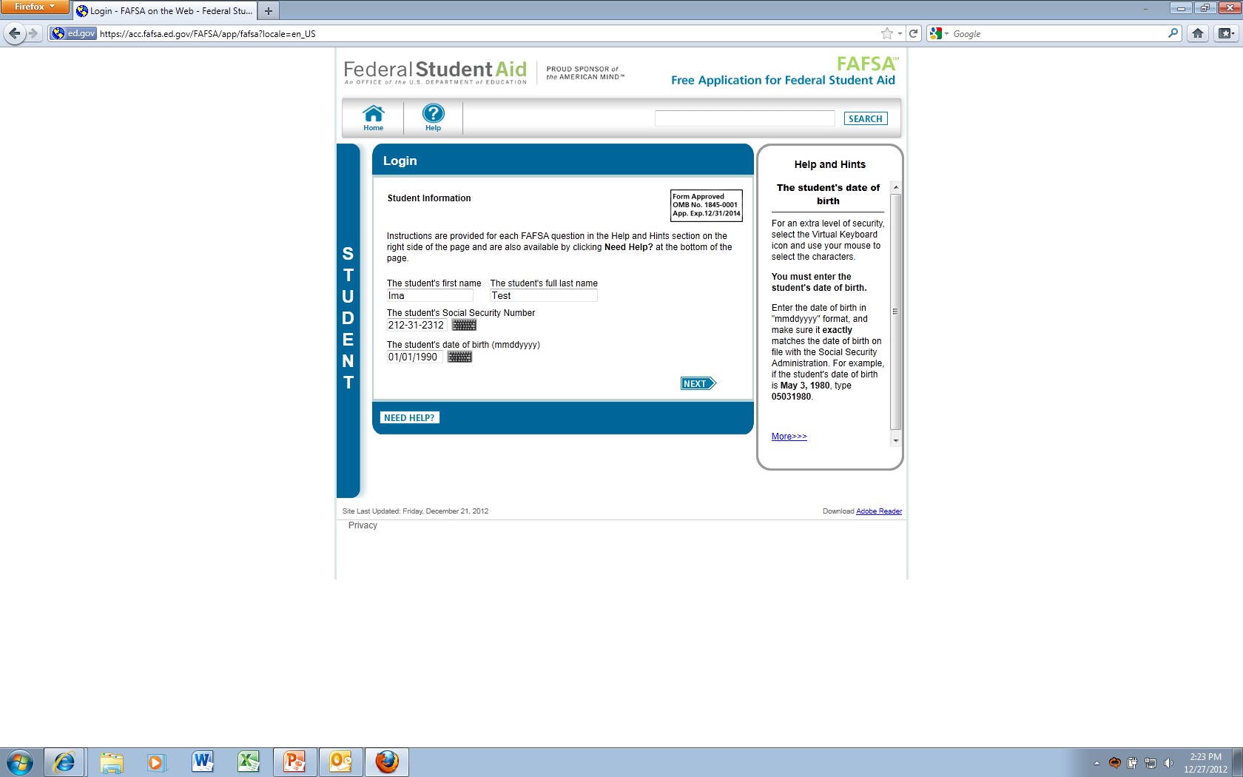
Login Page
Notes:
Items that are entered on this page: Name, Social Security Number, and Date of Birth. The information entered on this page should be the legal information for the student.

Slide 10
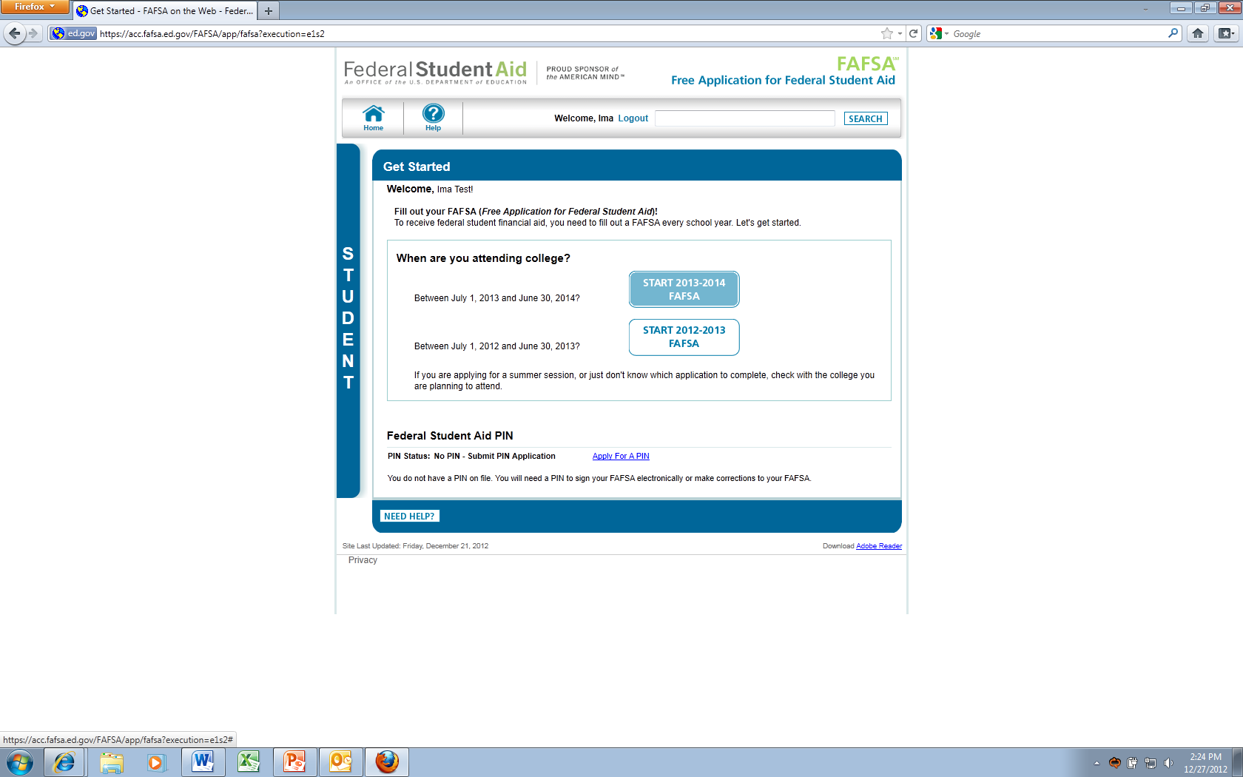
Get started page
Notes:
Select the 2013-2014 School Year. Also tells the student PIN status. If the student has not applied for a PIN ahead of time, they are able to do so from this page. They can apply selecting the Apply for a PIN link or by visiting www.pin.ed.gov.

Slide 11
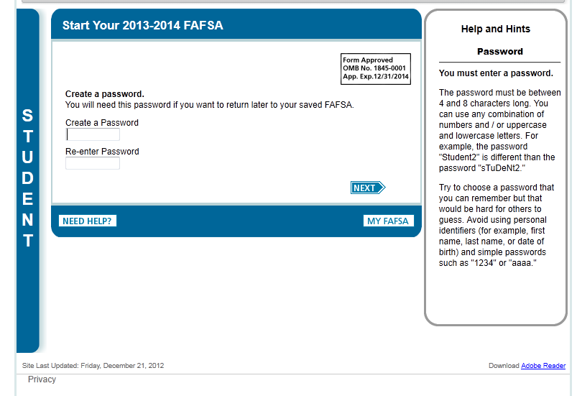
Password
Notes:
Create a password to access a saved application. This is so that the student can log back in later if needed and is not able to complete the application in one sitting. The application will remain on file for 45 days or until June 30th, 2014. (When the application is turned off.) If the student starts an application and does not finish, but has provided an email address they will receive email reminders after 7 days and 14 days.

Slide 12
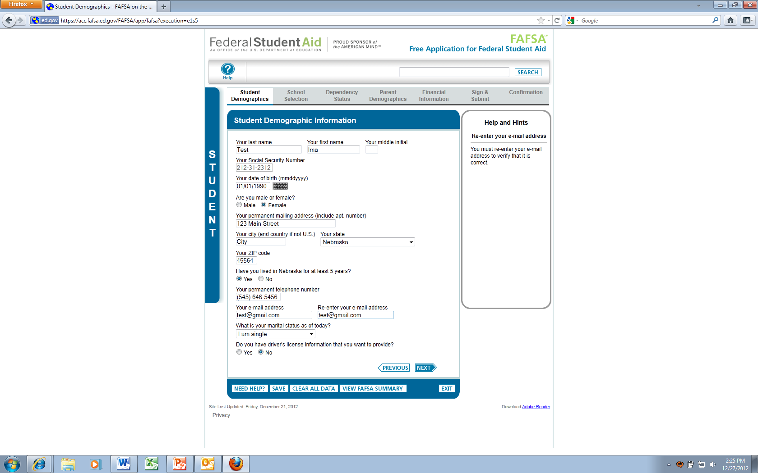
Student Demographic Page
Notes:
Information from Login page carried over, asks about Male/Female, Address, State of Legal Residence, Phone, Email, Marital Status, Drivers License. It is important that the student enters an email address as they may receive important communication through that account. Note: Blue border explains that this is a student page, later on you will see it change to purple when it is a parent page. There are Help and Hints on the page that change to help know how to answer the question.
What address should homeless students use for permanent mailing address? An incarcerated student or homeless youth may use his college’s administrative address. If he or she is submitting a paper FAFSA, he or she will need to inform the college or career school that they are using that address. The student will include with the FAFSA a letter from the school indicating that he or she is incarcerated or homeless and is using the school’s address.

Slide 13
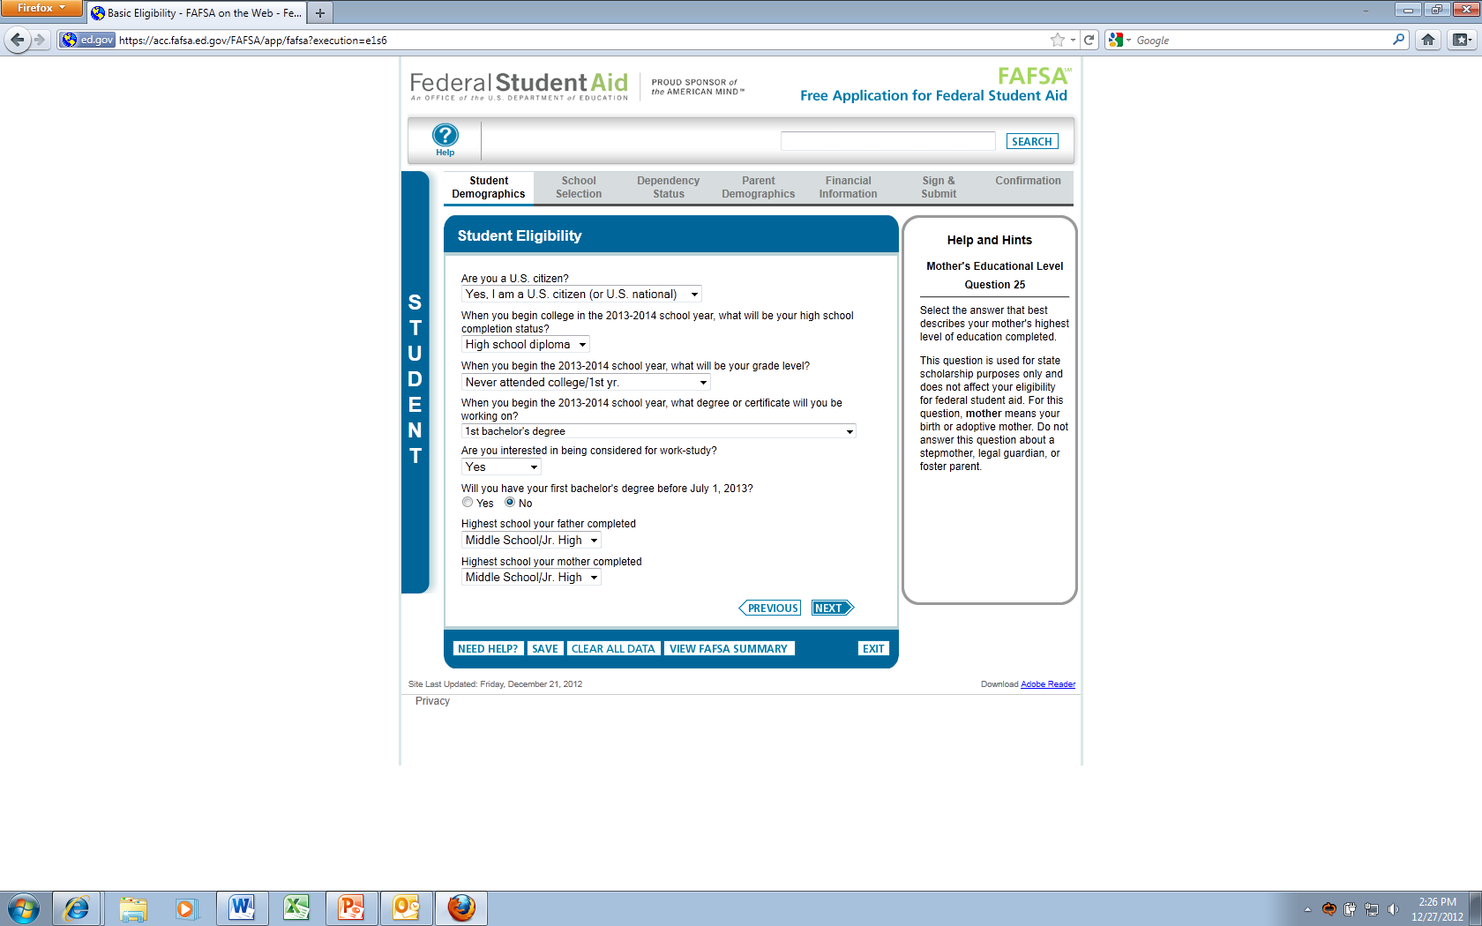
Student eligibility page
Notes:
US Citizenship question is asked on this page. The next few slides will highlight the eligible noncitizen details. Also asks for : High school status, grade level, what degree they will be working on, work study, and information about parents.

Slide 14
Eligible noncitizen
The student is a:
U.S. national (includes natives of American Samoa or Swains Island) or
U.S. permanent resident with a Form I-551, I-151, or I-551C (Permanent Resident Card, Resident Alien Card, or Alien Registration Receipt Card), also known as a green card.
The student has an Arrival-Departure Record (I-94) from U.S. Citizen and Immigration Services (USCIS) showing:
“Refugee,”
“Asylum Granted,”
“Cuban-Haitian Entrant (Status Pending),”
“Conditional Entrant” (valid only if issued before April 1, 1980), or
“Parolee” (you must be paroled for at least one year, and he or she must be able to provide evidence from the USCIS that he or she are not in the United States for a temporary purpose and that he or she intend to become a U.S. citizen or permanent resident).
Notes:
If you fall in one of the categories, the student is considered an “eligible noncitizen.”

Slide 15
Eligible noncitizen
The student holds a T-visa (for victims of human trafficking) or his or her parent holds a T-1 visa. The college or career school’s financial aid office will ask to see the visa and/or certification letter from the U.S. Department of Health and Human Services.
The student is a “battered immigrant-qualified alien” who is a victim of abuse by his or her citizen or permanent resident spouse, or he or she is the child of a person designated as such under the Violence Against Women Act.
The student is a citizen of the Federated States of Micronesia, the Republic of the Marshall Islands, or the Republic of Palau.
Notes:
Last Bullet: If this is the case, you are eligible only for Federal Pell Grants, Federal Supplemental Educational Opportunity Grants, or Federal Work-Study. Check with the college or career school financial aid office for more information.

Slide 16
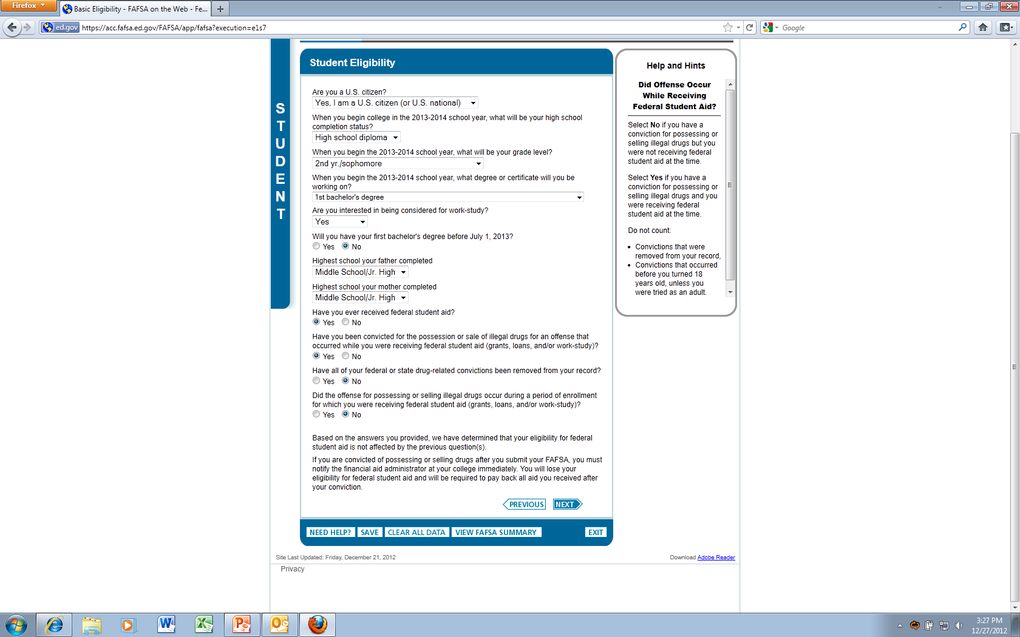
Drug conviction question
Notes:
If the answer is yes, the student will be provided a questions on FOTW to help the student determine whether his or her conviction affects his or her eligibility for federal student aid. If he or she is convicted of a drug-related offense after he or she submits the FAFSA, he or she might lose eligibility for federal student aid, and he or she might be liable for returning any financial aid he or she received during a period of ineligibility.

Slide 17
Drug conviction
Yes; eligibility might be suspended if the offense occurred while the student was receiving federal student aid (grants, loans, or work-study). When he or she completes the FAFSA, he or she will be asked whether they had a drug conviction for an offense that occurred while they were receiving federal student aid.
If eligibility for federal student aid has been suspended due to a drug conviction, the student can regain eligibility early by successfully completing an approved drug rehabilitation program or by passing two unannounced drug tests administered by an approved drug rehabilitation program.
If the student regains eligibility during the award year, notify the financial aid office immediately so he or she can get any aid he or she is eligible for.

Slide 18
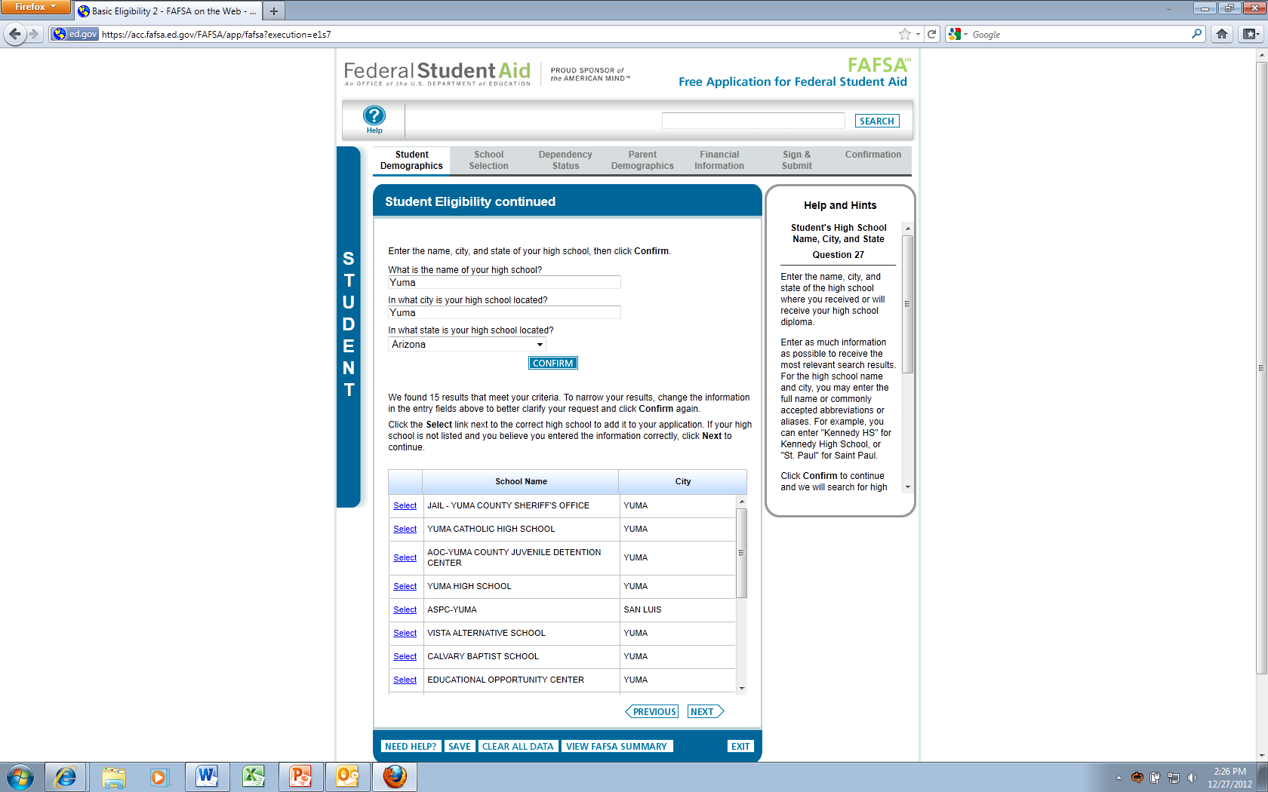
Student eligibility page 2
Notes:
High School Question asked on this page. This is a required question for any student who indicated that they received a high school diploma.

Slide 19
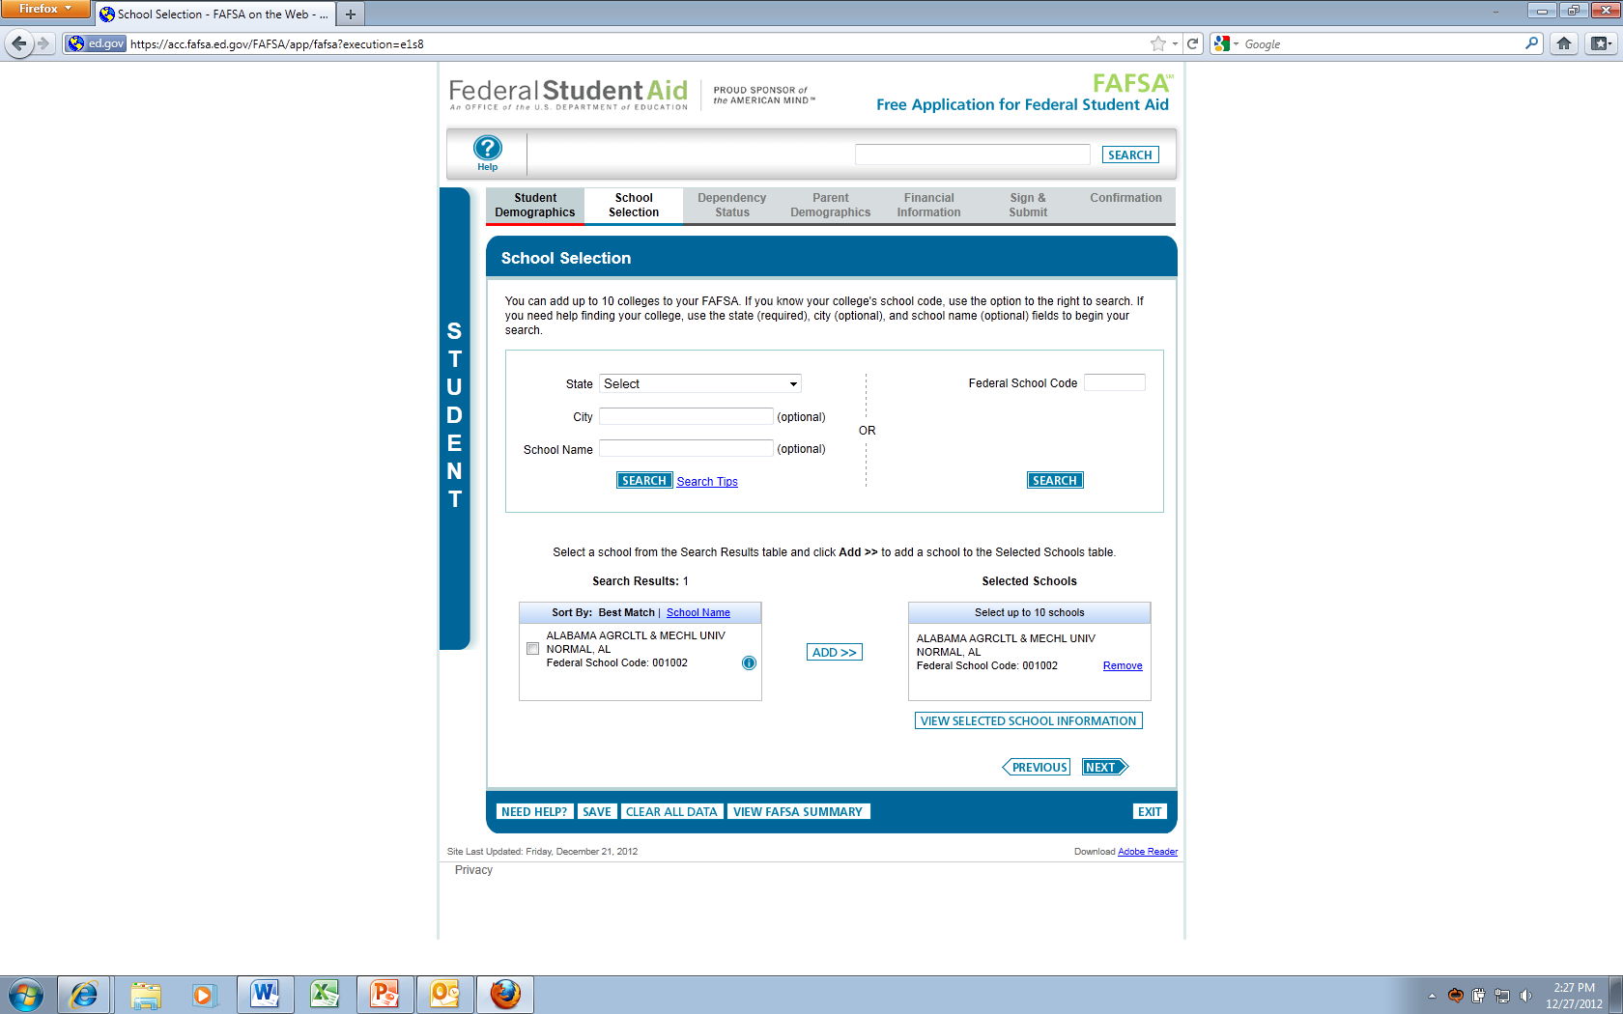
School selection page
Notes:
Federal School Code-where the information is sent (the college). Up to 10 colleges or career schools can be added.

Slide 20
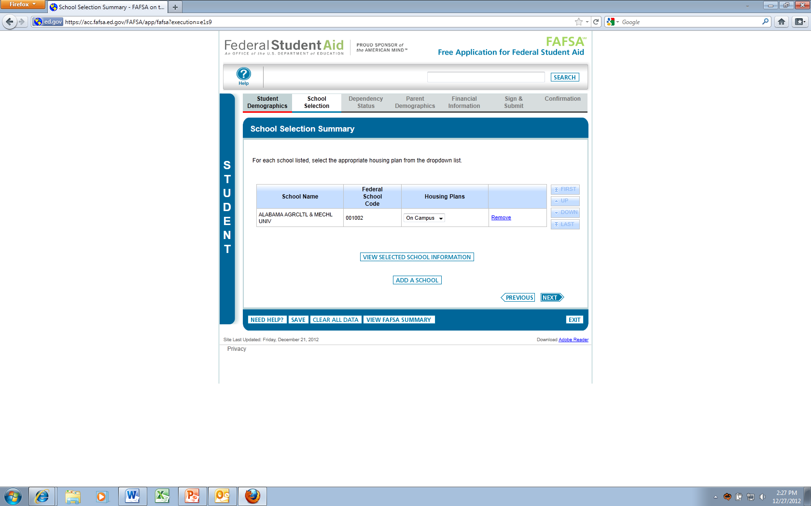
School selection summary
Notes:
Housing Plans: On Campus, Off Campus, With Parent.

Slide 21
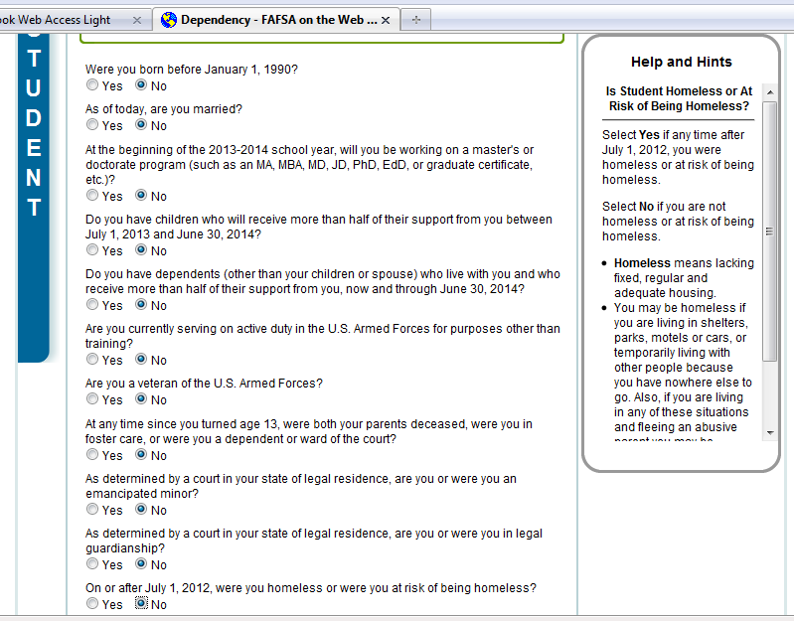
Dependency status
If a dependent student, the student will report their own and his or her parents’ information.
If an independent student, the student will report his or her own information (and, if married, his or her spouse’s).
Notes:
What if the student answered Yes to one or more of the questions above?
If so, then for federal student aid purposes, the student is considered to be an independent student and will not provide information about his or her parents on the FAFSA.
What if the student answered No to every question?
If so, then for federal student aid purposes, he or she is considered to be a dependent student, and he or she must provide information about his or her parents on the FAFSA.

Slide 22
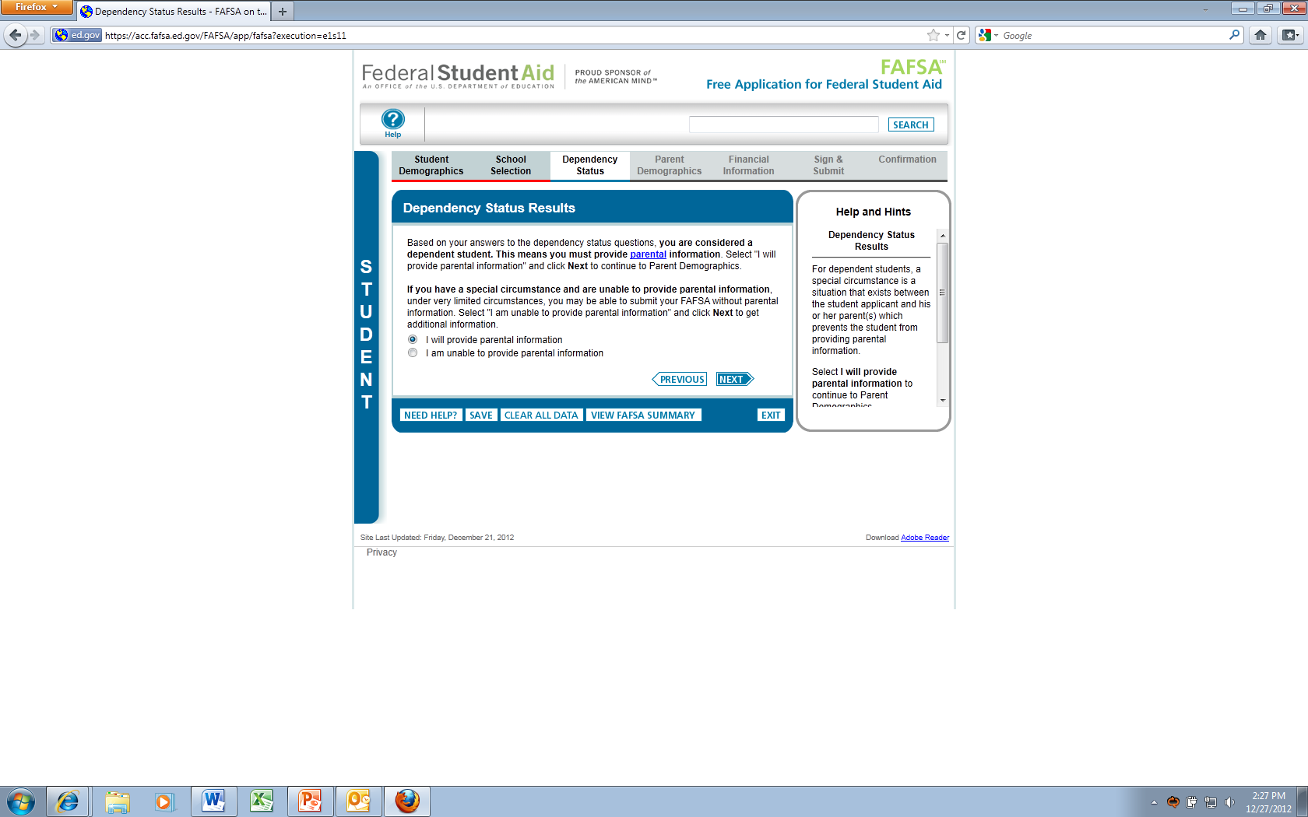
Dependency status results
Notes:
Dependency Results page displays asking about if the student is able to provide parental information.

Slide 23
Special circumstances
There are a few situations in which a FAFSA may be submitted without parent information despite being considered a dependent student:
The students parents are incarcerated.
The student has left home due to an abusive family environment.
The student does not know where his or her parents are and are unable to contact them (and he or she has not been adopted).
The student is older than 21 but not yet 24, is unaccompanied, and is either homeless or self-supporting and at risk of being homeless.

Slide 24
Special circumstances
What if the student’s parents are unwilling to provide their information on the FAFSA?
An student can’t be considered independent of his or her parents just because they refuse to help with the FAFSA.
Still, we do understand that in some cases, the parents are not supporting the dependent student at all and refuse to provide their information on the student’s FAFSA.
The process that should be followed in this situation is explained in the next slide.

Slide 25

Special circumstances
If in that situation, here’s the process:
When FAFSA on the Web asks whether he or she is able to provide information about his or her parents, say no.
On the next screen, select the option that says he or she doesn’t have a special circumstance but he or she still can’t provide parent information.
Notes:
The FAFSA explains that if the students parents don’t support him or her and refuse to provide their information on the FAFSA, the student may submit your FAFSA without their information. However, he or she won’t be able to get any federal student aid other than an unsubsidized loan—and even that might not happen. The decision is up to the financial aid office at the college or career school he or she plan to attend. If the student agrees to this, he or she may submit your FAFSA without parent information.
The FAFSA information will be sent to the colleges he or she lists, but he or she won’t get an Expected Family Contribution (EFC).
The student must immediately contact his or her school’s financial aid office to discuss the possibility of getting an unsubsidized loan. The financial aid office may ask for a written statement from the students parents, indicating that they refuse to provide their information on the FAFSA and that they no longer support the student. (Forms of support include allowing the student to live in the parents home, including he or she on their car or health insurance, providing a car to drive on a regular basis, and payment of his or her tuition or fees.)

Slide 26
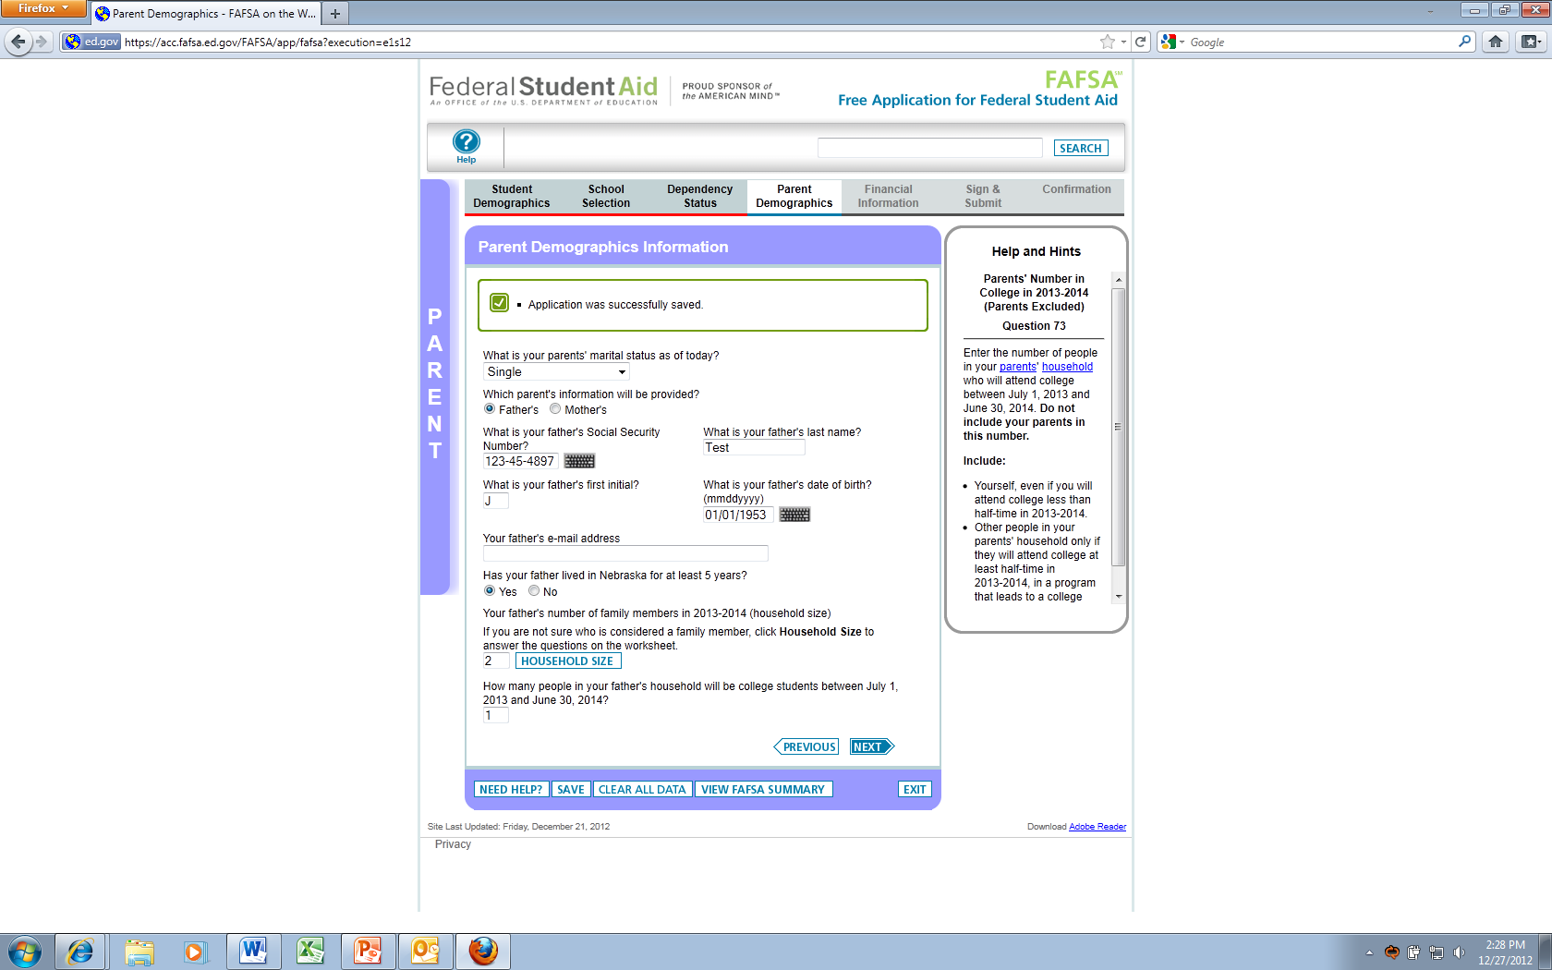
Parent demographic page
Notes:
Note the change to purple borders-parent information. Household size is example of a question that is part of the EFC formula.

Slide 27
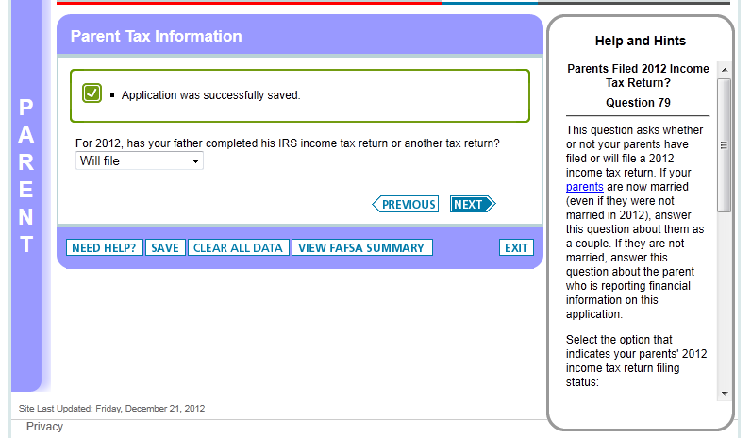
Parent finances 1
Notes:
Financial information that asks about the 2012 tax information from the parents.

Slide 28
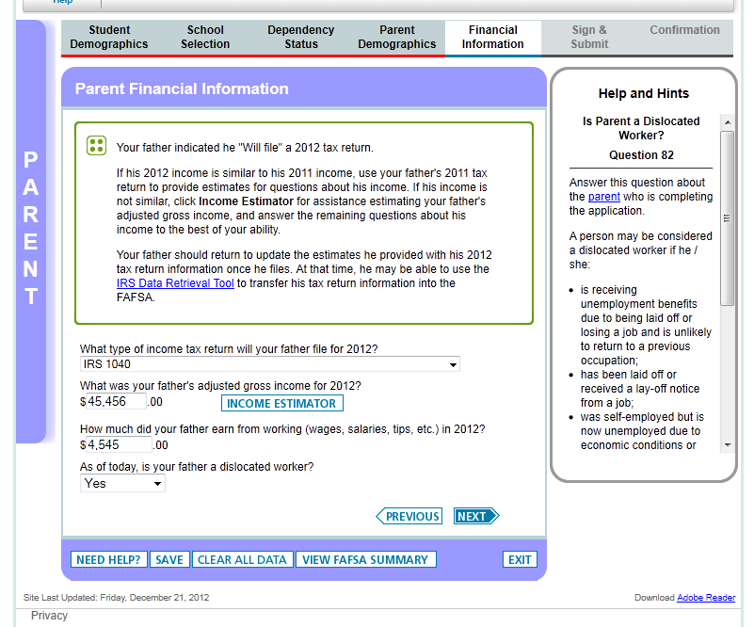
Parent finances 2
Notes:
What if the student has not filed or his or her parents have not filed their taxes yet? An alert message will let the parents know that they are able to estimate their tax information. Once they have done their taxes, they can come back to the FAFSA and make a correction with the updated information.
In most cases, the students will be dependent students and required to provide parental information. Depending on the way that the financial questions are answered, he or she may see a simplified path on their application. We do this to prevent asking unnecessary questions to determine the student’s eligibility.

Slide 29
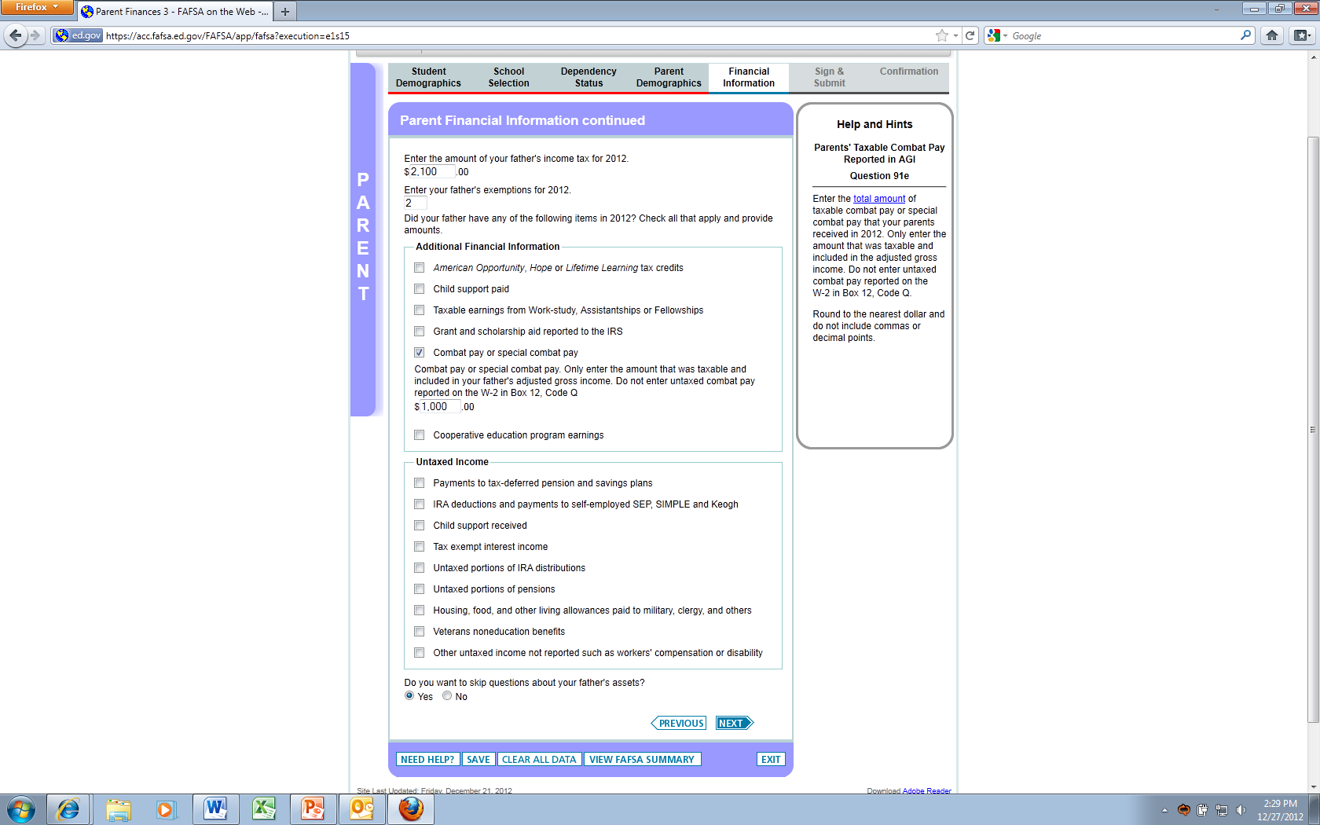
Parent finances 3
Notes:
Additional financial information that includes the amount of income tax, exemptions, and additional financial questions. If help is needed to understand what should be included in each field, look at the help and hints on the right side of the page.

Slide 30
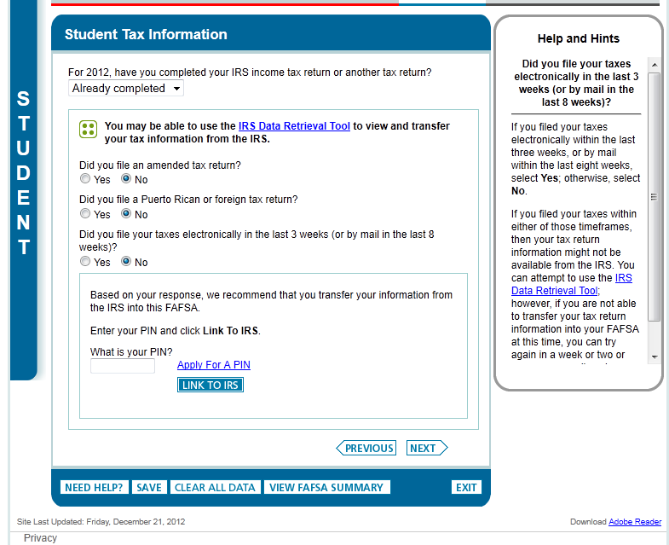
Student finances 1
Notes:
Back to student. Financial information for the student is collected here. The student may see the option to use the IRS Data Retrieval Tool on this page.

Slide 31
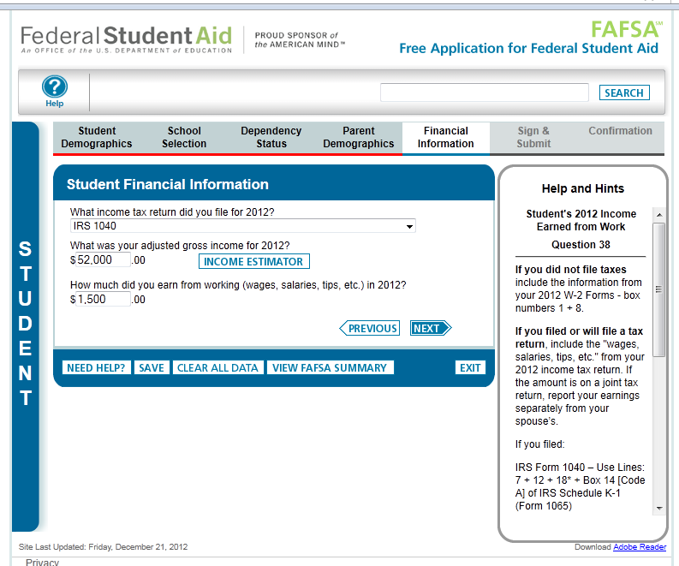
Student finances 2
Notes:
Financial questions that ask about type of tax return filed, adjusted gross income, and income earned from working.

Slide 32
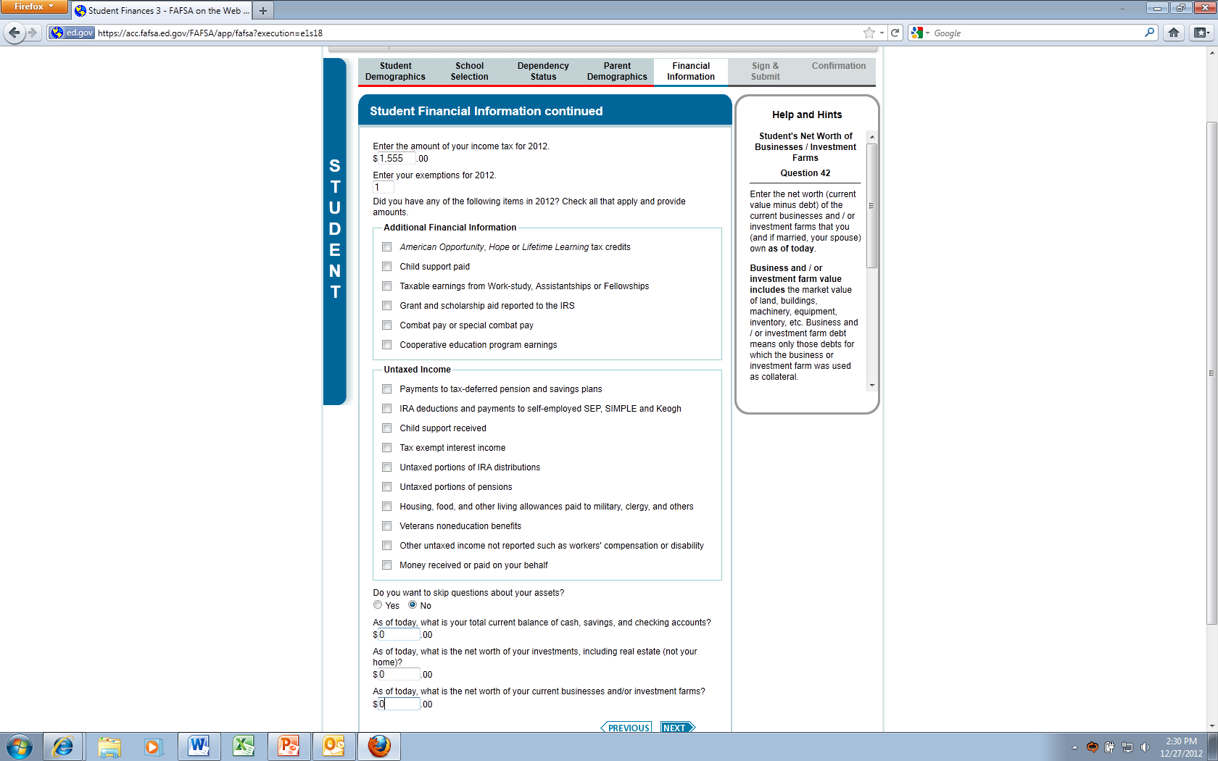
Student finances 3
Notes:
Finances 3 page that asks about income tax, exemptions, and additional financial questions.

Slide 33
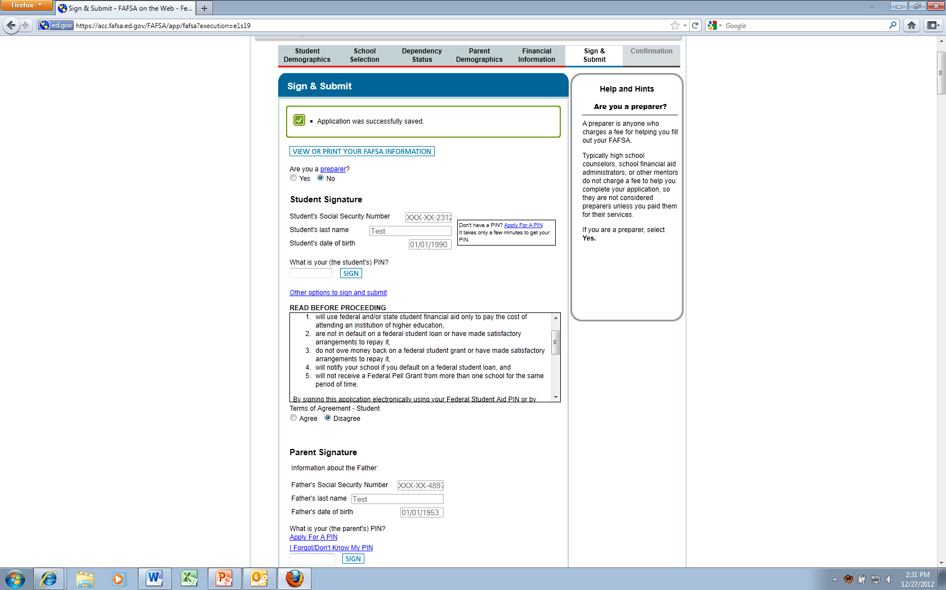
Sign and submit
Notes:
Signature collected here. If the student is signing electronically, this is where they would enter their PIN. The preparer question is only if someone is being paid to enter the FAFSA for the student.

Slide 34
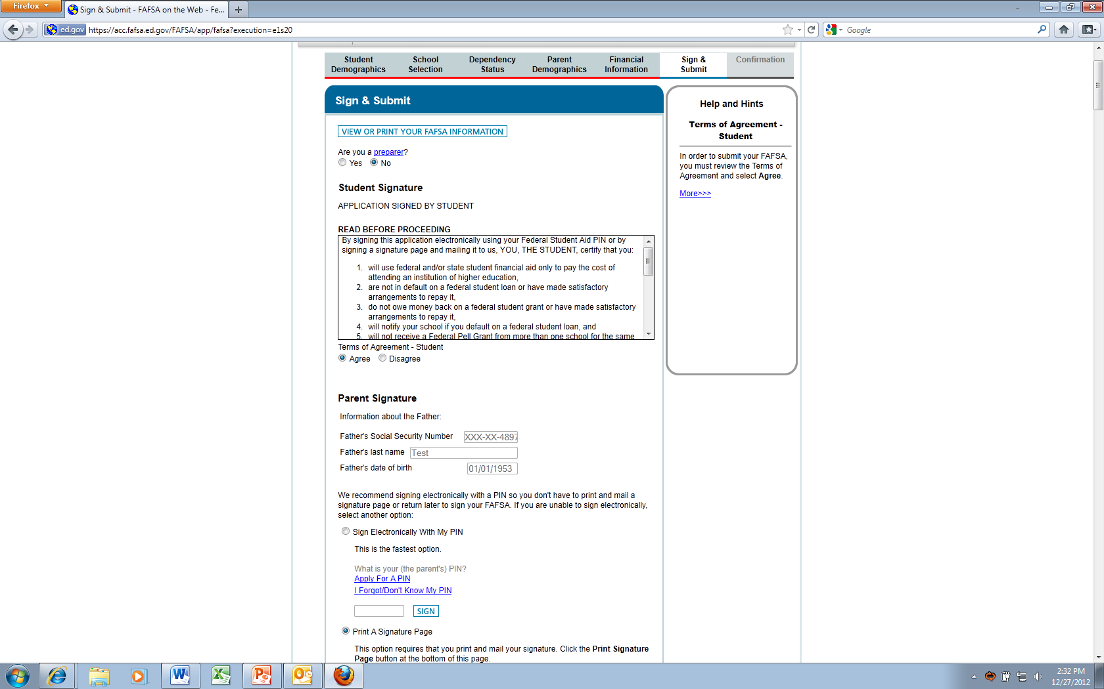
Sign and submit
Notes:
Options to sign. Encourage electronically! However, there are option to submit without doing so electronically.

Slide 35
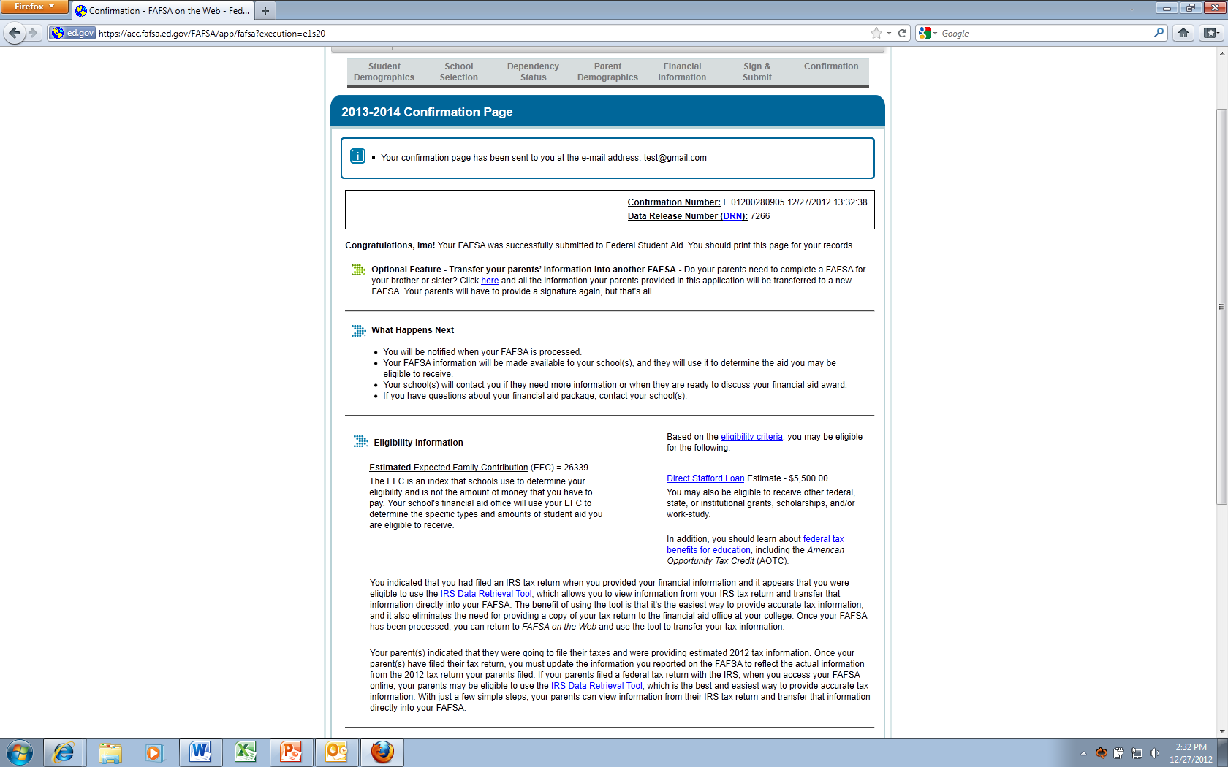
Confirmation page
Notes:
Confirmation Page. Print and keep a copy. Brother/Sister Feature (see green arrow above) is available so that if the parent has another child in school, they can transfer their information into another application.

Slide 36
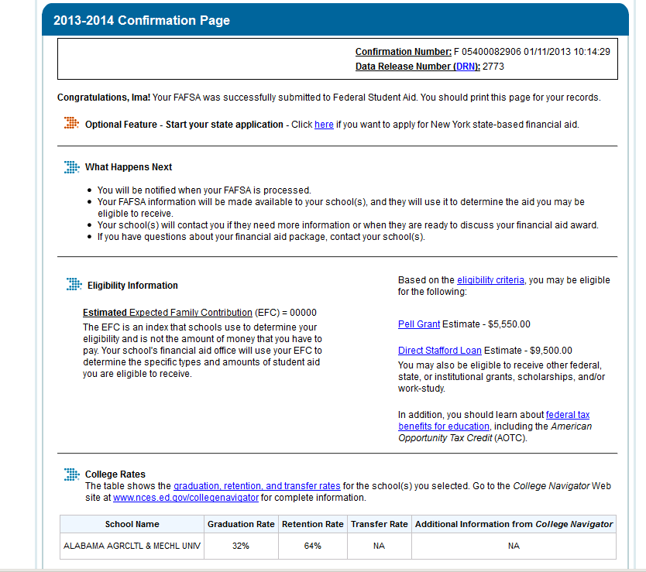
Confirmation Page (cont.)
Notes:
State API Feature is available by the orange arrow. For some states they ask that you populate your state aid form with information from the FAFSA. States that participate: NY, NJ, Vermont, MN, PA, Iowa, MS, and CA. Note: this functionality is only available from this page.

Slide 37
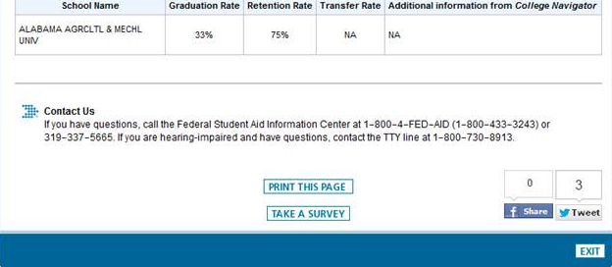
Confirmation Page (cont.)
Notes:
Additional information is available to the student. This includes the graduation, retention, and transfer rates for the colleges or career schools they selected. There is also information for the Federal Student Aid Information Center. You can also see the Facebook and twitter icons.

Slide 38
FAFSA processing timeframes
3-5 days for the application to process. Once the application has processed, this information is made available to the colleges listed on the student’s application. It is also available to the FAFSA Completion project districts.
Once processed student can log back in to see Student Aid Report (SAR)-summary of information about what was submitted. If student included an email address on the application, we receive an email copy.
Notes:
Usually it takes 24 hours or less for processing student record, but the 3-5 days accounts for weekends, holidays, etc.

Slide 39
Student’s Next Steps
What happens once the FAFSA is submitted

Slide 40
Student’s Next Steps (Actual Text)
  You* will be notified when your FAFSA is processed.
  Your FAFSA information will be made available to your school(s), and they will use it to determine the aid you may be eligible to receive.
  Your school(s) will contact you if they need more information or when they are ready to discuss your financial aid award.
  If you have questions about your financial aid package, contact your school(s).
*Note: ‘You’ in this text is referring to the student.
Notes:
This text will appear on the confirmation page, email, when the student exits the application on the ‘My FAFSA’ page and on the SAR.
The SAR is the Student Aid Report for the student and is a paper or electronic document that gives him or her some basic information about his or her eligibility for federal student aid as well as listing answers to the questions on his or her FAFSA.
Whether the student receives his or her SAR online or on paper depends on whether he or she provide an e-mail address on the FAFSA.
If the student provided a valid e-mail address, he or she will receive an e-mail with instructions on how to access an online copy of his or her SAR
If the student doesn’t provide a valid e-mail address on the FAFSA, he or she will receive either a SAR or a SAR Acknowledgement via postal mail.
The SAR lists the FAFSA information and provides space for the student to make corrections. The student will receive a paper SAR if he or she files a paper FAFSA and doesn’t provide an e-mail address.
The SAR Acknowledgement lists the FAFSA information, but he or she will need to make any corrections at FAFSA on the Web (the FAFSA website at www.fafsa.gov). He or she will receive a SAR Acknowledgement if he or she files an electronic FAFSA and doesn’t provide an e-mail address.

Slide 41
Frequently asked questions at FSAIC
These are the types of questions that might be answered by the Federal Student Aid Information Center (FSAIC):
Is my application on file?
My PIN is locked can you help me unlock it?
Is my application on file?
I would like my loan information please.
How much financial aid will receive?
Notes:
Federal Student Aid Information Center can be reached by calling 1-800-4-FED-AID.

Slide 42
Additional information for students
Publications Available at:
StudentAid.gov/checklist (College Prep Checklist)
StudentAid.gov/funding (Funding Your Education)
FAFSA PDF and Worksheet:
http://www.fafsa.ed.gov/options.htm
Worksheet can be accessed by searching ‘worksheet’ on the FAFSA pages.
Federal Student Aid Information Center
1-800-4-FED-AID

