Slide 1

Early College Programs

Slide 2
When?
Who?
Where?
What?
Why?
How?

Slide 3
Momentum for
College and Career
Why?
Rigorous Coursework in High School
“The academic intensity of the student’s high school curriculum still counts more than anything else in precollegiate history in providing momentum toward completing a bachelor’s degree.” – The Toolbox Revisited (2006)
Prepares students for college and career success
Encourages engagement in school
Earning Credits toward College Graduation
Student are more likely to complete a college degree if they complete 20 credits during the first year of enrollment.
“It is all the more reason to begin the transition process in high school with expanded dual enrollment programs offering true postsecondary course work so that students enter higher education with a minimum of 6 additive credits to help them cross that 20-credit line. Six is good, 9 is better, and 12 is a guarantee of momentum.” – The Toolbox Revisited (2006)
Adelman, C. (2006). The Toolbox Revisited: Path to Degree Completion from High School Through College. Washington, D.C.: U.S Department of Education.

Slide 4
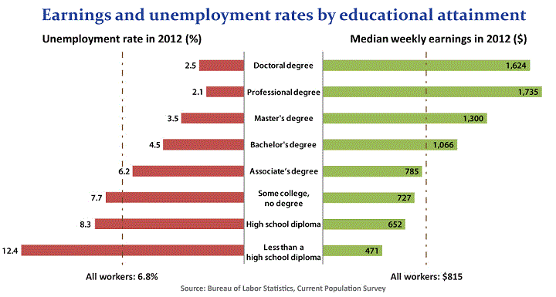
Why?
Source: Bureau of Labor Statics, Current Population Survey, downloaded 10152013
from http://www.bls.gov/emp/ep_chart_001.htm

Slide 5
Why?
Saves Money
Washington State College Graduates Class of 2011
  average debt upon graduation - $22,244
  proportion with debt – 56%
National Unemployment
  Unemployment rate – 8.8%
  Underemployment rate – 19.1%
  Had jobs not requiring college degree – 37.8%
Strong economic returns for investment in college degree
  Counterparts with HS diploma unemployment rate of HS grads – 19.1%
Source: The Institute For College Access & Success, The Project on Student Debt (October, 2012)

Slide 6
Why?
Saves Money
Five Washington State Public Colleges and Universities | The Cost of 15 Credits (2013-14)
Everett Community College | $1599.60
Central Washington University | $2,647
University of Washington | $5366.04
Western Washington University | $2,501
Washington State University (Semester System – 12 credits) | $5,698
Everett Public Schools Early College Programs | The Cost of 15 Credits (2013-14)
Advanced Placement (3 exams @ $89 each) | $267.00
EvCC College in High School (5 cr. class @ $198 each) | $594.00
UW in the High School (5 cr. class @ $310 each + $42 fee) | $972.00
Tech Prep (Most classes are free) | Free

Slide 7
Why?
Most common colleges for CHS students (initial enrollment):
1. Everett Community College
2. Edmonds Community College
3. University of Washington - Seattle
4. Western Washington University
5. Washington State University
6. Shoreline Community College
7. Central Washington University
8. Cascadia Community College
9. Seattle Pacific University
10. Eastern Washington University

Slide 8
Why?
Most common colleges for EHS students (initial enrollment):
1. Everett Community College
2. University of Washington - Seattle
3. Western Washington University
4. Washington State University
5. Edmonds Community College
6. Central Washington University
7. Shoreline Community College
8. Pacific Lutheran University
9. Eastern Washington University
10. Seattle Pacific University

Slide 9
Why?
Most common colleges for JHS students (initial enrollment):
1. University of Washington - Seattle
2. Edmonds Community College
3. Cascadia Community College
4. Western Washington University
5. Washington State University
6. Everett Community College
7. Shoreline Community College
8. Central Washington University
9. Bellevue College
10. Seattle Pacific University

Slide 10
Why?
Most common colleges for SHS students (initial enrollment):
1. Everett Community College
2. Edmonds Community College
3. Cascadia Community College
4. Central Washington University
5. Shoreline Community College

Slide 11
Who?
10th Graders - AP World History
11th and 12th Graders - College in High School courses
All Grades – Tech Prep
Students who are ready for challenging courses
Students with strong reading, writing and math skills

Slide 12
What?
Advanced Placement
Each course culminates in an Exam
Students earn college credit based on exam score
Credits fulfill general college graduation requirements

Slide 13
What?
Tech Prep
Credits Vary
Entry courses for certificate programs, Associates in Technical Arts, or Associates Transferable Degree
Offered in partnership with Everett Community College, Skagit Valley Community College and Lake Washington Technical College

Slide 14
What?
College in High School
Courses are 5 credits
Often fulfills general college graduation requirements
Offered in partnership with Everett Community College and University of Washington

Slide 15
What?
Courses Offered at CHS
Advanced
Placement
AP English Language and Composition
AP English Literature and Composition
AP Studio Art
AP Calculus AB
AP Statistics
AP Chemistry
AP Environmental
Science
AP Government and Politics: US
AP Psychology
AP US History
AP World History
Pre-Calculus
Calculus
Statistics
College In High School
ECC English (Literature and Composition)
Principals of Marketing
World History
US History
Government
Anatomy & Physiology
Chemistry
Environmental Science
French 2, 3 and 4
German 2, 3 and 4
Spanish 2, 3 and 4
Tech
Prep
Fashion Merchandizing
Introduction to Sports
Medicine
Sports Medicine I and II
Digital Photography II
Publications I (Yearbook I)
Independent Living
Career Choices
Graphic Design I
Auto Tech
Computer Applications:
Computer Literacy
Computer Applications:
PowerPoint
Video Production

Slide 16
What?
Courses Offered at EHS
Advanced
Placement
AP English Literature
and Composition
AP Studio Art
AP Spanish Language
AP Calculus AB
AP Statistics
AP Chemistry
AP Government and Politics: US
AP US History
AP World History
Pre-Calculus
Calculus
Statistics
ECC English (Literature and Composition)
Speech
World History
US History
College In High School
French 2, 3 and 4
German 2, 3 and 4
Spanish 2, 3 and 4
Oceanography
Chemistry
Tech
Prep
Independent Living
Career Choices
Digital Photography II
Computer Applications:
Computer Literacy
Computer Applications:
PowerPoint
Auto Tech

Slide 17
What?
Courses Offered at JHS
Advanced
Placement
AP English Language and Composition
AP English Literature and Composition
AP Studio Art
AP Calculus AB
AP Statistics
AP Biology
AP Chemistry
AP Physics
AP Macroeconomics
AP Government and Politics: US
AP Psychology
AP US History
AP World History
Pre-Calculus
Calculus
Statistics
ECC English (Literature and Composition)
UW English (Literature and Exposition)
College In High School
French 2, 3 and 4
German 2, 3 and 4
Spanish 2, 3 and 4
UW IT Computer Science Engineering
Principles of Marketing
Tech
Prep
Fashion Merchandizing
Introduction to Sports
Medicine
Digital Photography II
Publications I (Yearbook I)
Independent Living
Career Choices
Sports and Entertainment Marketing
Computer Applications:
Computer Literacy
Computer Applications:
PowerPoint
Introduction to Graphic Design
Graphic Design I
Graphic Design II
Graphic Design III

Slide 18
Contacts
Everett Public Schools
  http://docushare.everett.k12.wa.us/docushare/dsweb/View/Collection-2661
Everett Community College
  http://www.everettcc.edu/ccec/collegeinhs/index.cfm?id=2606
University of Washington
  http://www.outreach.washington.edu/uwhs/

Slide 19
When?
Ready for classes:
Complete pre-requisites first
Match to High School Graduation Requirements
When to take classes:
During the regular school day

Slide 20
Where?
All three programs are offered at the high school
Unlike Running Start, students can stay involved with their school.

Slide 21
How?
Register for designated
high school courses.
Advanced Placement
Register for exam in the Spring
Scores reported to colleges selected by student
College in High School and Tech Prep
Register through teacher or online for college courses in Fall and Winter
Obtain transcript from college to transfer credits

Slide 22
Questions you should ask yourself:
Where are you going to college?
What is your area of focus or major in college?
What is the difference between college general education requirements and degree requirements?
Do you have to pay for every Early College Class?

Slide 23
Early College Programs
Questions?

