Slide 1

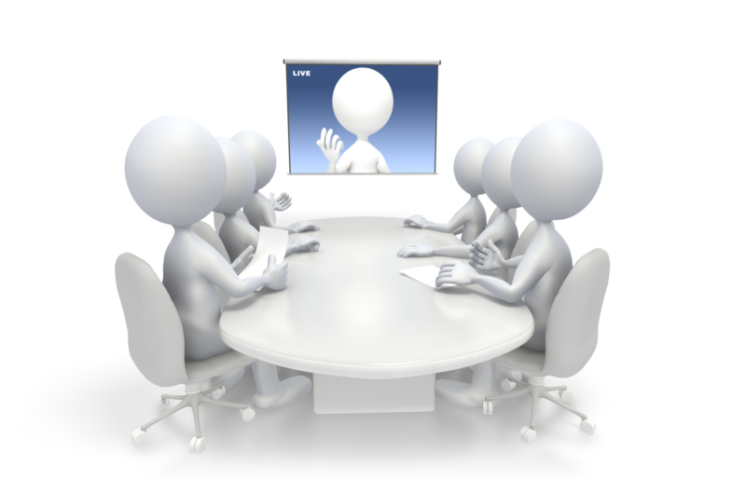
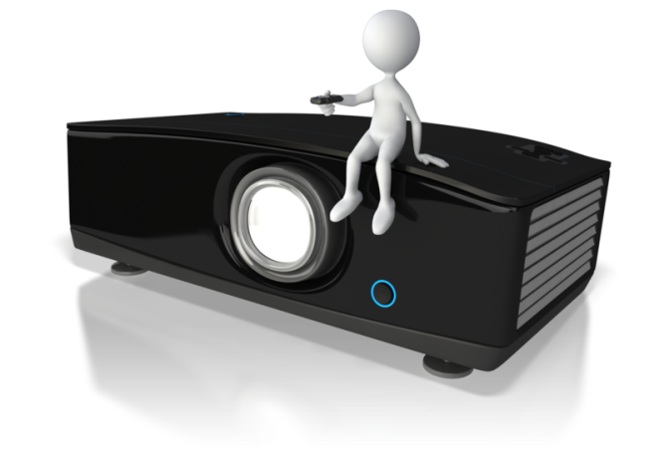
CRC Technology Training
November 2013

Slide 2

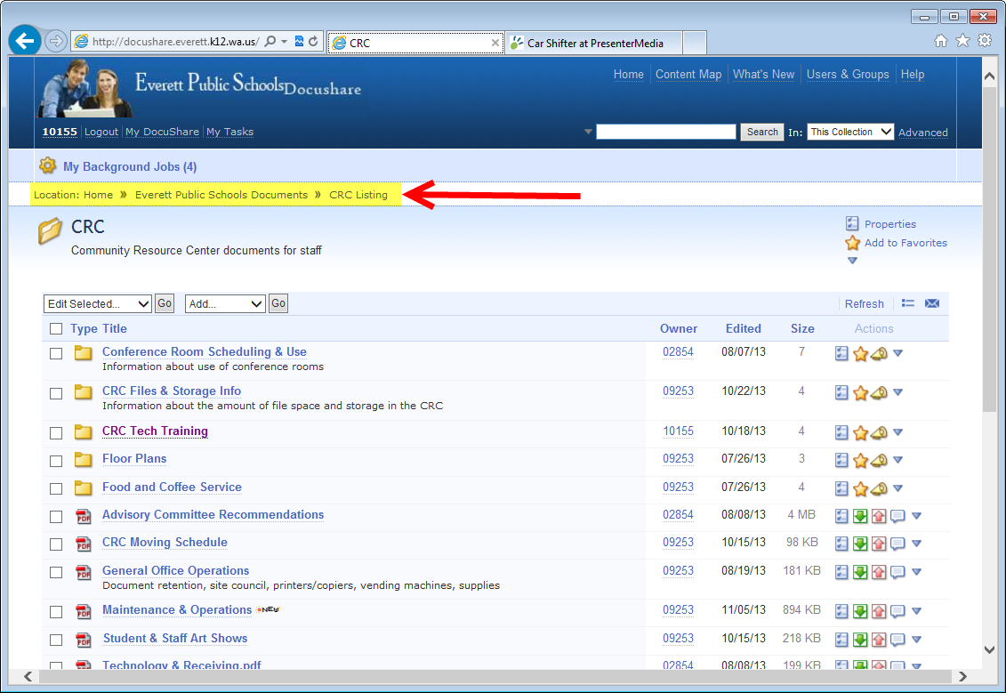
Help and How-To

Slide 3

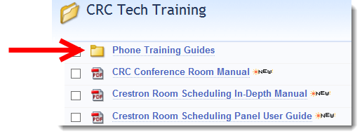



Phones
Example: http://docushare.everett.k12.wa.us/docushare/dsweb/Get/Document-48296/4038-4039%20Phone%20Model%20Directions.pdf

Slide 4

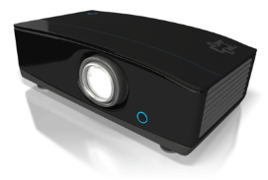
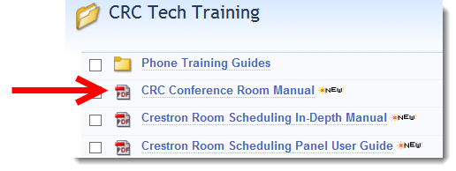

Conference Rooms
Notes:
Press the Crestron touchscreen located next to the entry door to the room. The touchscreen might be in sleep mode and blank. Touching a sleeping touch screen will bring up this page
Press the start page to display the Home page.
The home page provides access to the controllable devices in the room.
The touch panel has volume control, power OFF, and input icons.

Slide 5
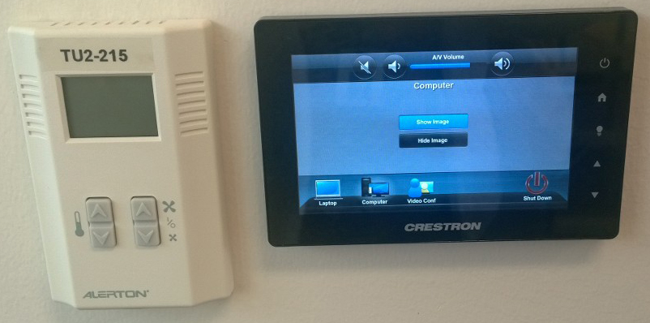
Conference Rooms
Laptop
Computer – physically located in data center
Video Conferencing
Notes:
This room has three sources.
Laptop (VGA and HDMI)
PC
Video Conferencing
Selecting any of these inputs will turn the projector ON and lower the projection screen.

Slide 6
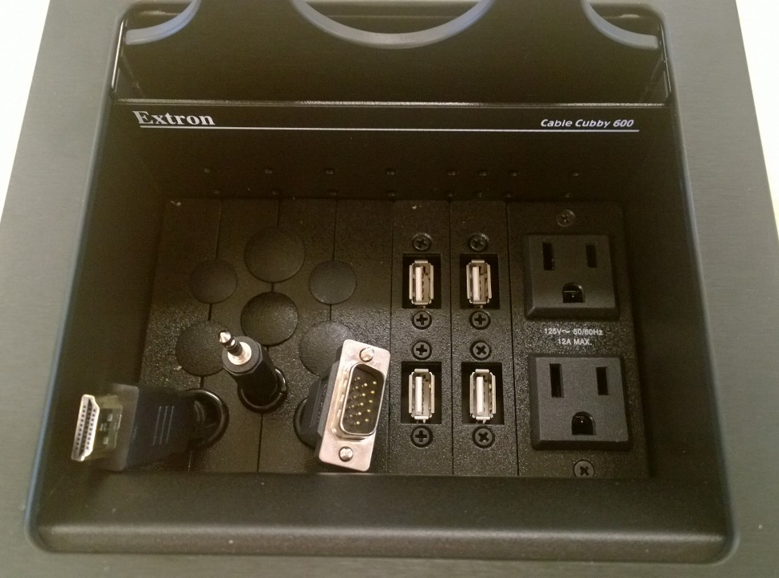
Conference Rooms
Use your own laptop
VGA & Audio Cable
HDMI
Notes:
This room has three sources.
Laptop (VGA and HDMI)
PC
Video Conferencing
Selecting any of these inputs will turn the projector ON and lower the projection screen.

Slide 7
Conference Rooms
Use room computer
USB Ports
Notes:
This room has three sources.
Laptop (VGA and HDMI)
PC
Video Conferencing
Selecting any of these inputs will turn the projector ON and lower the projection screen.

Slide 8
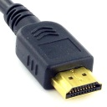
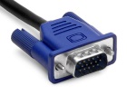
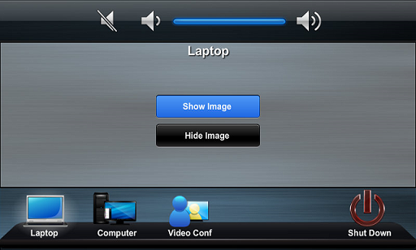
Laptops
HDMI connection
Plug the HDMI cable into the laptop’s HDMI port. The image will be displayed on the screen.
The HDMI cable carries both the audio and video signals on the same cable.
VGA connection
Plug the VGA cable into the laptop’s VGA port. The image will be displayed on the screen.
Plug the audio cable into the headphone jack of the laptop if audio is required.
Use the volume icons on the touch panel to
raise and lower the audio if necessary.
The show image icon will display
the image on the projection screen.
The hide image icon will hide the image.
This is icon is used when you need to
blank the image for a minute without
turning the projector off.
HDMI
VGA
Notes:
The laptop inputs are located in the cable cubby on the top of the table. There is a HDMI connection and a VGA (with audio) connection in the cable cubby.
Press the laptop icon on the touch panel to turn the projector ON and lower the screen.
Laptop HDMI – HDMI is an audio / video cable that transmits audio and video to the system. Not all laptops send audio.
Ensure the laptops video output is enabled if there is no image on the projection screen.
Ensure the laptops audio output is not muted or turned down if there is no sound from the room speakers.
Laptop VGA – VGA video and audio is transmitted to the system using two cables.
Ensure the laptops video output is enabled if there is no image on the projection screen.
Ensure the laptops audio output is not muted or turned down if there is no sound from the room speakers.

Slide 9
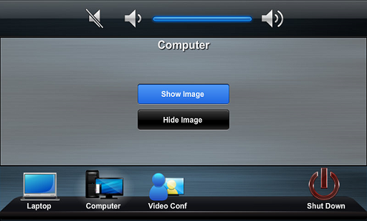
Computer
Notes:
There is a CRC networked computer in the room.
The computer is already connected to the AV system.
Press the computer icon on the touch panel to turn the projector ON and to lower the screen.
The show image icon will display the image on the projection screen.
The hide image icon will hide the image. This is icon is used when you need to blank the image for a minute without turning the projector off.
The wireless keyboard and mouse are used to operate the computer.
Use the volume icons on the touch panel to raise and lower the audio if necessary.

Slide 10
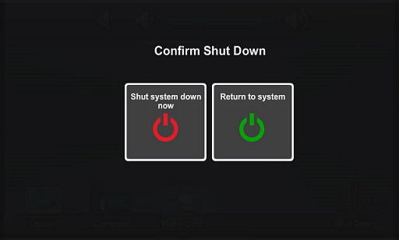
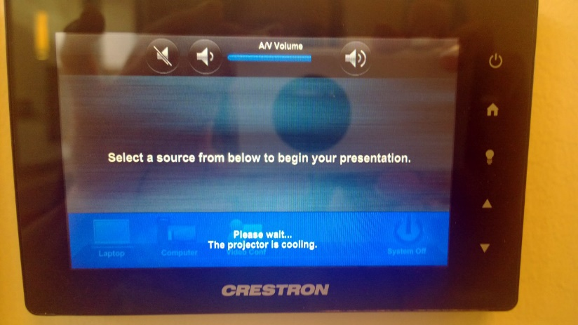
Conference Rooms
When the system is turned OFF the projection screen raises and the projector will undergo a shutdown sequence with the fan running for 2-3 minutes.
During this cool down period the projector cannot be turned ON.
Notes:
Press the OFF icon to turn the system OFF.
After pressing the OFF icon a page will appear asking if you are sure you want to turn the system OFF. If you are sure press Yes, if you mistakenly pressed the OFF icon press No and the system will remain On.
When the system is turned OFF the projection screen raises and the projector enters the cool down cycle. This cool down cycle takes approximately three minutes to complete. During this cool down period the projector cannot be turned ON.

Slide 11
Conference Rooms
The A/V (audio / video) system should remain powered up at all times.
The projector should be turned off when not in use. This will lengthen the life of the projector lamp.
On startup, the projector will turn on and will reach full brightness in approximately a minute.
In general most hang-ups are going to be due to something very simple. Here are some general guidelines to follow.
Replace the batteries in the wireless PC mouse and keyboard if the devices have limited range or does not work.
Keep your volumes at nominal levels. This will help prevent extremely loud or low volume conditions. In addition, volumes set at nominal levels help avoid feedback.

Slide 12
Video Conferencing
Upcoming training will become available

Slide 13
Help and How-To

