Slide 1
READ 180
Day 3 Training
April 24, 2012
Everett Public Schools

Slide 2
Welcome
“The more that you read, the more things you will know.
The more that you learn, the more places you'll go.”
-Dr. Seuss

Slide 3
Agenda
Morning
Afternoon
TAP & Classroom Technology Innovation Grants
Headphones & All Things Technical
EPS READ 180 Program Overview
READ 180 and Rigor
ITS, DTZ
Reader’s Theater
Planning with Rigor
Evaluation

Slide 4
Technology Action Plan & Classroom Technology Innovation Grants
4
Notes:
Handout: Classroom Technology Innovation Grant Application

Slide 5
Headphones & All Things Technical
5
Reminders from the wonderful Terie Messick

Slide 6
Headphones & All Things Technical
Headphone troubleshooting
Purchasing headphones
Other computer issues
Adding and deleting students
Software problems
“I need help with the
READ 180 technology when _____________________________”
6
Notes:
Handout: Headphone setting directions

Slide 7
EPS READ 180 Overview
Notes:
Handouts:
Implementation Calendar
45-50 minute Model
rBook Scope and Sequence

Slide 8
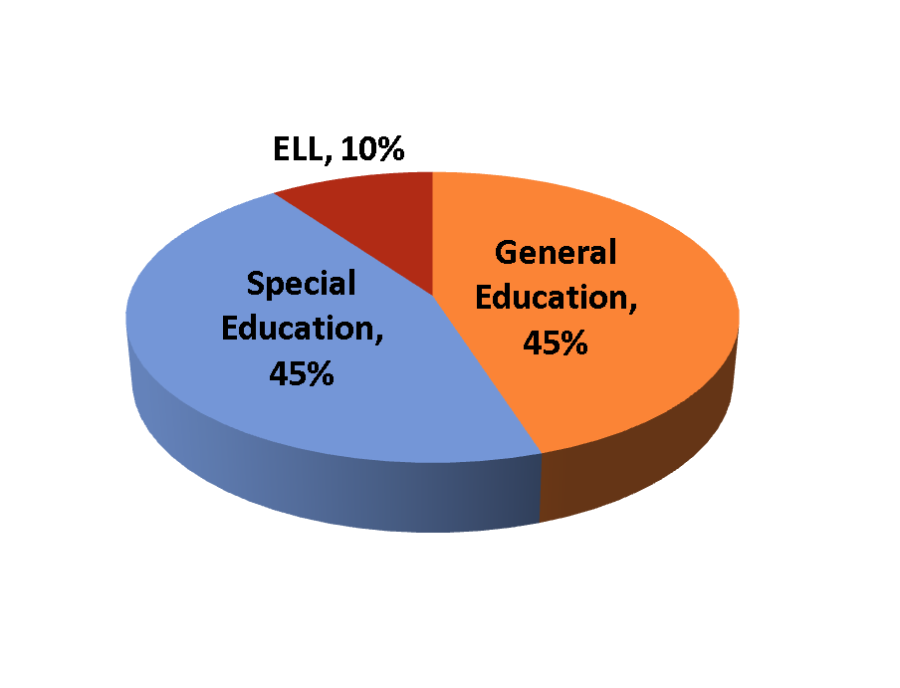
“Snapshot” of EPS READ 180
916 students
  58% Male
  21% Hispanic
Students in grades 6 -12
  75% Middle School
  25% High School
Teachers at nine schools (34)
  7 Reading Support
  21 Special Education
  4 ELL

Slide 9
Mid-Year Gains Analysis Summary
An analysis was performed from data for 9 schools that used READ 180 during the 2011-2012 school year. The data included in the analysis started with the beginning of the school year through the third SRI window (March 16th, 2012)
Evidence of Success:
  195 of 629 READ 180 students (31%) had 2.0 + years of reading gain during the time frame.
  316 of 629 READ 180 students (50%) had 1.0 + years of reading gain during the time frame.
  5 READ 180 schools had at least 1.0+ years of reading gain.
Items for Later Discussion:
  Students with the most READ 180 Segments completed
  demonstrated the greatest Lexile gains.
  Software session use is low for mid-year export.

Slide 10
READ 180 Segment Completion Gains
Slide Notes:
A Segment is a unit of READ 180 content. There are 48 Segments in READ 180 Enterprise Edition and 60 in READ 180 Next Generation.

Slide 11
Summary Reading Gains for READ 180 Students
Year of Growth MS Grades 6-8
Year of Growth HS Grades 9-12
Slide Notes:
READ 180 approximate annual growth is 70 Lexiles at grades 6-8 and 50 at grades 9-12.

Slide 12
Scholastic READ 180
Notes on Software Usage
Mean Software Sessions: In a daily implementation model, there should be at least 50+ and preferably 60+ per sessions per school year.
Mean Software Hours: In a 5 day per week, daily 45-minute implementation model (5 X 90) a school should have 15+ hours of software usage.
Mean Sessions per Week: In a “5 X 45” implementation model expect 1.5 or more sessions per week. Anything under 1 is very low.
Median Minutes per Session: In a 45 minute class period the session range is typically 8.0 – 20.0 minutes.
Mean Segments Completed: Segment completion is a measure of both instructional time and student instructional effort. In READ 180 Next Generation there are 60 Segments.

Slide 13
SRI Grade Level Proficiency Bands
Grade | Below Basic | Basic | Proficient | Advanced
1 | N/A | 99 and Below | 100 to 400 | 401 and Above
2 | 99 and Below | 100 to 299 | 300 to 600 | 601 and Above
3 | 249 and Below | 250 to 499 | 500 to 800 | 801 and Above
4 | 349 and Below | 350 to 599 | 600 to 900 | 901 and Above
5 | 449 and Below | 450 to 699 | 700 to 1000 | 1001 and Above
6 | 499 and Below | 500 to 799 | 800 to 1050 | 1051 and Above
7 | 549 and Below | 550 to 849 | 850 to 1100 | 1101 and Above
8 | 599 and Below | 600 to 899 | 900 to 1150 | 1151 and Above
9 | 649 and Below | 650 to 999 | 1000 to 1200 | 1201 and Above
10 | 699 and Below | 700 to 1024 | 1025 to 1250 | 1251 and Above
11 | 799 and Below | 800 to 1049 | 1050 to 1300 | 1301 and Above
Source: Meta Metrics Inc. and Scholastic Inc.

Slide 14
Annual Lexile Growth Expectations by Grade Level
Scholastic and MetaMetrics analyzed Lexile growth from a large urban district whose demographics resembled those of the nation.
Six years of growth data was collected for more than 350,000 students in Grades 3-10.
Trends revealed:
  Annual growth expectations are greater for students in lower Lexile ranges than in higher Lexile ranges.
  Average growth tends to be greater in the lower grades, and lower in the higher grades.
This chart was designed to set growth expectations for groups of students. A student’s initial Lexile measure should be used to set an individual’s growth goal.

Slide 15

SRI Assessment Windows
Last SRI assessment window is May 21st – June 8th
Four SRI assessment windows per year:
  Beginning of school year (end of September)
  November
  March
  June

Slide 16
READ 180 and Rigor

Slide 17
Connecting the Dots: Rigor, Text Complexity and College and Career Readiness
How do you know if a student is college-or career-ready?
According to ACT’s Reading Between the Lines, “what appears to differentiate those who are more likely to be ready from those who are less likely is their proficiency in understanding complex texts.”
17
Notes:
Mark, highlight, circle:
Handout: Washington’s College- and Career-Ready Commitment

Slide 18
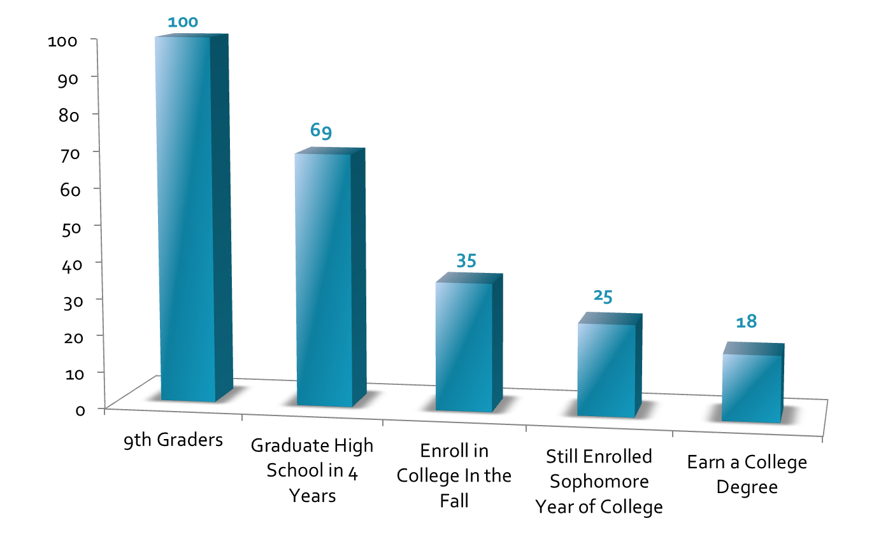
Of every one hundred 9th graders in Washington…
Source: National Center for Higher Education Management Systems (2008).
Student Pipeline - Transition and Completion Rates from 9th Grade to College. http://www.higheredinfo.org

Slide 19
College and Career Ready Students – as defined in the Common Core Standards
Demonstrate independence
Build strong content knowledge
Respond to the varying demands of audience, task, purpose, and discipline
Comprehend as well as critique
Value evidence
Use technology and digital media strategically and capably
Understand other perspectives and culture
^{CCSS for English Language Arts} & Literacy in History/Social Studies, Science, and Technical Subjects p. 7

Slide 20
What is the Common Core?
What do the Common Core State Standards say about college and career readiness?
What does they mean for READ 180 students?
Notes:
Handout:
Common Core Standards (Anchor Standards for College and Career Readiness)

Slide 21
Rigor!
Read the Article The 4 Rs: Rigor, Relationships, Relevance, and Results
  Purpose for reading – To answer:
  What are some characteristics of rigor?
  Mark the text:
    Number the paragraphs
    Circle key terms, cited authors, and essential words or numbers
    Underline author’s claims and other information relevant to the reading purpose
Notes:
“Marking the Text” is an AVID strategy that asks students to think critically about their reading.
While students read the text they are analyzing ideas, evaluating ideas, and circling and underlining essential information.
This leads to increasing comprehension and retaining the textual material.
7 minutes to read and mark the text

Slide 22
Rigor!
Reread paragraphs 2 and 3
  Purpose for reading – Connect ideas within the text
    How does this idea relate to other ideas in the text?
    What is the author attempting to communicate by using these terms?
    Based on my markings, what do I understand?
Notes:
“Rereading the Text” is an AVID strategy that actively engages students with the text.
Rereading becomes a literacy strategy that must be explicitly learned and practiced in order for it to become a habit as much as it is a skill.
Rereading provides multiple opportunities for readers to see what the text has to offer and to comprehend essential information in the text.
Over time, students will begin to make decisions o their own, deliberately selecting strategies that will assist in their understanding of the reading.
3 minutes

Slide 23
Rigor!
What are the characteristics of rigor?
Whip it!
“I think one characteristic of rigor is
_____________________.”
Notes:
Scribe the characteristics on the board or chart paper.
4 minutes

Slide 24
Rigor!
“Rigor begins with an instructional plan that requires a teacher to support students in continuous improvement, in deepening awareness, in building competence and confidence, in engaging in meaningful work; all leading to creativity, thoughtful demonstrations of students’ knowledge, cognitive skills, and the ability to solve problems.”
Everett Public School’s ILT (Instructional Leadership Team)

Slide 25
Rigor!
Washington State Evaluation Criterion #1: Centering instruction on high expectations for student achievement
  Component: Engaging Students in Learning
Washington State Evaluation Criterion #2: Demonstrating Effective Teaching Practices
  Component: Using Questioning Strategies and Discussion Techniques
Notes:
1 minute

Slide 26
Criterion #1: Centering instruction on high expectations for student achievement.
Component | Proficient | Distinguished
Engaging Students in Learning | The teacher clearly communicates instructional purpose of the lesson, including where it is situated within broader learning, and explains procedures and directions clearly. Teacher’s explanation of content is well scaffolded, clear and accurate, and connects with students’ knowledge and experience. During the explanation of content, the teacher invites student intellectual engagement. Teacher’s spoken and written language is clear and correct and uses vocabulary appropriate to the students’ ages and interests.
The teacher links the instructional purpose of the lesson to student interests; the directions and procedures are clear and anticipate possible student misunderstanding. The teacher’s explanation of content is thorough and clear, developing conceptual understanding through artful scaffolding and connecting with students’ interests. Students contribute to extending the content
and help explain concepts to their classmates. The teacher’s spoken and written language is expressive, and the teacher finds opportunities to extend students’ vocabularies.

Slide 27
Criterion #2: Demonstrating Effective Teaching Practices
Component | Proficient | Distinguished
Using Questioning and Discussion Techniques | Although the teacher may use some low-level questions, he or she asks the students questions designed to promote thinking and understanding. Teacher creates a genuine discussion among students, providing adequate time for students to respond and stepping aside when appropriate. Teacher successfully engages most students in the discussion, employing a range of strategies to ensure that most students are heard. | Teacher uses a variety or series of questions or prompts to challenge students cognitively, advance high-level thinking and discourse, and promote metacognition. Students formulate many questions, initiate topics, and make unsolicited contributions. Students themselves ensure that all voices are heard in the discussion.

Slide 28
Rigor! PVF-Paired Verbal Fluency
Find an “eye contact partner” that is not sitting near you
Determine who is Partner A and who is Partner B
Each Partner will take turns discussing their thoughts around the homework questions and rigor.
  1st A-B cycle will be exactly 1 minute each
  2nd A-B cycle will be exactly 30 seconds each
How do you structure engagement so all students respond?
How do you ensure students are using academic language and target vocabulary?
How do you ensure there is clear accountability built in for every lesson, task, or activity?
Notes:
Each Partner will take turns discussing their thoughts around the homework questions and rigor.
How do they connect?
How did you answer the questions?
How is what you are doing rigorous within each category?
Signal will be given at the 1 min, 30 sec,…at that time you can add on to the conversation or you can start over with your own information.
How do you structure engagement so all students respond?
Examples might include choral, partner, written, and individual responses. How are you implementing these? What is your take?
How do you ensure students are using academic language and target vocabulary?
Examples might include sentence starters, prompts, rBook exercises, and teacher modeling. How are you implementing these? What is your take?
How do you ensure there is clear accountability built in for every lesson, task, or activity?
Examples might include that every student is required to say, write and/or do something as an “evidence check” of engagement. How are you implementing this? What is your take?
PVF is a technique used for partner discussion or reflection. Partners take turns in timed rounds, talking “of the top of their heads” about an assigned topic or prompt. While one person talks, the other listens until time elapses and partners switch roles
Thank your partner, stack and pack, and form a small group of 4.
5 minutes

Slide 29
Rigor!
Create groups of 4
Discuss your homework and PVF with your partners
  What were the take a ways from your PVF?
  What strategies did you bring with you around your HW?
  What makes those strategies rigorous?
Notes:
Better groups of 3 than 5
5 mins

Slide 30
Rigor! Card Sort
Sort the Instructional Strategies and Practices
More Rigorous to Less Rigorous
Read, Discuss, Share your reasoning…
  Why are some more rigorous than others? What makes it rigorous?
Leave them grouped easily so others can see
Notes:
10 minutes

Slide 31
Rigor! Gallery Walk
Each group will rotate to each table analyzing how the others categorized and sorted the strategies and practices
Using sticky notes, write down questions you have about their thinking
After rotations are over each group will read their notes and collaborate on an answer to share with the whole group
Notes:
Sticky notes
The questioning your peers is similar to a strategy called guided peer reciprocal questioning. Where peers get to question each other for further understanding of their thinking or another's.
10 minutes

Slide 32
Rigor, Text Complexity, and Thinking Just About Lexiles
Notes:
Lexile sort four texts in paird

Slide 33
Rigor is Not a Four Letter Word
Read pp. 39-46
Skim Text Complexity rubrics
Take notes about Lexiles and text complexity on text complexity graphic organizer
Share notes with partner
Revisit Lexile sort: What would you change based on the reading and the conversation with your partner?
Notes:
Read passage from Rigor is not a Four Letter Word
Text Complexity rubrics
Take notes on text complexity graphic organizer

Slide 34
Rigor, Text Complexity, and Thinking Just About Lexiles
530L
730L
1000L
1230L
Notes:
Lexile sort four texts in paird

Slide 35
A-ha’s
What a-ha’s did you have from the reading? From the rubrics? From the calibration exercise?
What stood out?
What was new to you?
What do you still want to know about text complexity?
What does this mean for rigor? READ 180?

Slide 36
So What Is a Lexile?
Lexile units are based on word frequency and sentence length. Word frequency is calculated based on words in Lexile databank (almost one billion).
Lexiles range from 0 (beginning reading) to 2000 (highly technical texts).
www.lexile.com

Slide 37
Text Complexity Grade Bands
Text Complexity Grade Band in Standards | Previous Lexile Range | Lexile Ranges Aligned to CCR Expectations
K-1 | N/A | N/A
2-3 | 450-725 | 450-790
4-5 | 645-845 | 770-980
6-8 | 860-1010 | 955-1155
9-10 | 960-1115 | 1080-1305
11-CCR | 1070-1220 | 1215-1355

Slide 38
So What Is Text Complexity?
Quantitative measures –readability and other scores of text complexity often best measured by computer software.
Qualitative measures –levels of meaning, structure, language conventionality and clarity, and knowledge demands often best measured by an attentive human reader.
Reader and Task considerations –background knowledge of reader, motivation, interests, and complexity generated by tasks assigned often best made by educators employing their professional judgment.

Slide 39
ITS, DTZ –
One more time!
39

Slide 40
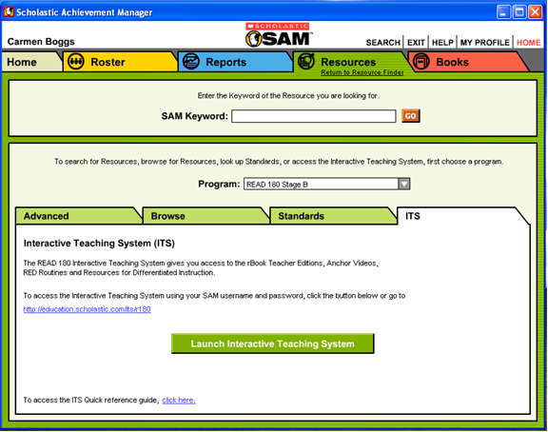
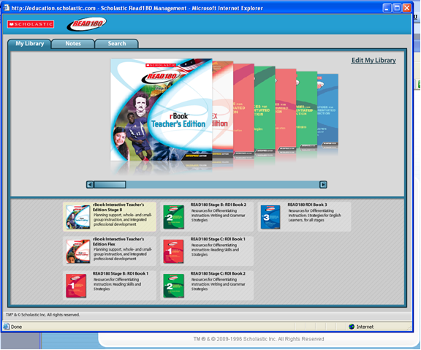
Interactive Teaching System (ITS)
http://education.scholastic.com/its/r180
The READ 180 Teacher Shared Space is a great resource too!
40

Slide 41

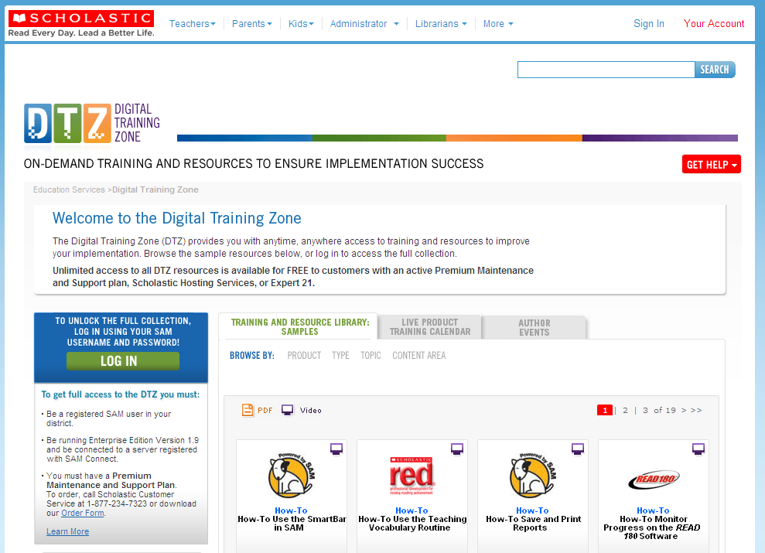
Digital Training Zone (DTZ)
http://teacher.scholastic.com/products/edservicesondemand/digitaltrainingzone.asp
41

Slide 42
Reader’s Theater
42
With Jesica Thomson

Slide 43
What is Reader’s Theater?
Take a look . . .
Life Underground
http://www.youtube.com/watch?v=PPYM88uKbu0
Mohammed Ali
http://www.youtube.com/watch?v=VLdTc_l6Gbc
Wild West
http://www.youtube.com/watch?v=SHRzzU6lRHM

Slide 44
READ 180:
Planning with Rigor
44

Slide 45
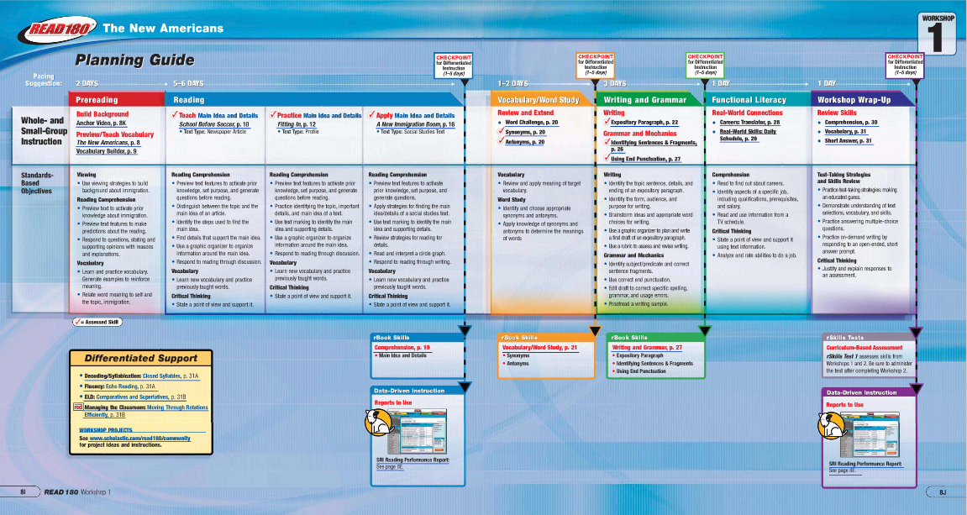
rBook: Workbook + Planner

Slide 46
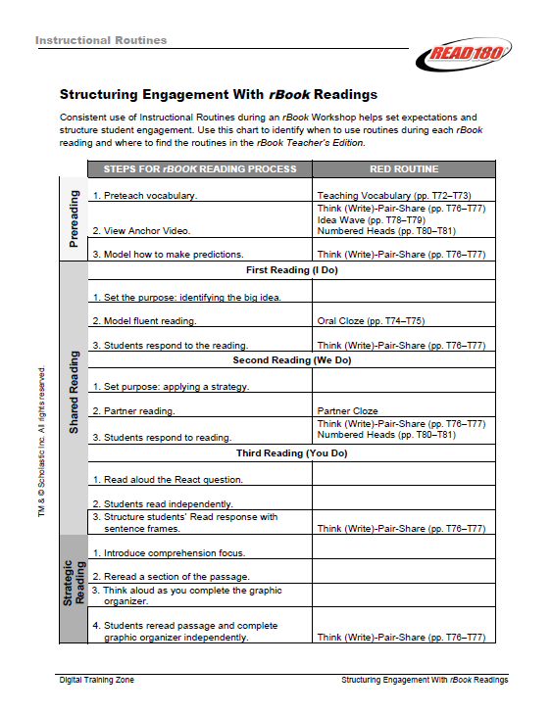
EXPLICIT INSTRUCTIONAL MODEL
& THE RED ROUTINES
Five Red Routines for reading
  Teaching Vocabulary
  Oral Cloze
  T-W-P-S
  Idea Wave
  Numbered Heads
Two Red Routines for writing
  The Writing Process
  Peer Feedback
Three rBook readings
  I do
  We do
  You do

Slide 47
Planning with Rigor!
Where do we see rigor already?
How do we add rigor?
How do we hold students accountable?

Slide 48
Evaluations
Thank you for a wonderful day together!

