Slide 1

Credit Wisdom

Slide 2





Managing Money & Credit:
A Lifelong Skill
Notes:
Practical life skill of managing money an credit. No matter where you are in life or what you do, you will need to manage your money.
Student
In the work force
With a family
Pictures represent some of the basics in life that people want to buy:
Computer - Technology
Education
Car
Home
Family vacation

Slide 3


Why Credit is Important
FICO or credit score:
Credit Card Issuers & Lenders
  Determine APR
Auto Insurers
  Determine Premium
Employers
  Are you a worthy hire?
Landlords
  Are you a reliable tenant?
Notes:
But these days auto insurers are using credit-based scores to calculate premiums. Employers are using credit checks to determine whether you’re a worthy hire. And landlords are using them to figure out whether you’ll be a reliable tenant. Some utility companies are linking credit scores to the size of the deposit you must pay to have your power turned on.
Source: Consumer Reports, “Credit scores: What you don’t know can be held against you ,” August 2005.

Slide 4

The Three Cs of Credit
Character: The way you handle money and have repaid debt in the past.
Capacity: Your ability to pay the debt after considering other monthly expenses.
Capital: The value of your assets or what you own.
Notes:
The Three Cs of Credit:
Three Cs of Credit One way lenders evaluate credit worthiness.
The three Cs represent:
Character: The way you handle money and have repaid debt in the past.
Capacity: Your ability to pay the debt after considering other monthly expenses.
Capital: The value of your assets or what you own.

Slide 5


What’s Next? Life After High School
Notes:
Source: Higher Education Coordinating Board, 2005
Emphasis is that this information is applicable to you no matter what you do right after high school. You are going to be on your own, making independent decisions.

Slide 6
Learning Boosts Earning
Education | Average Annual Income
Professional | $71,258
Doctorate | $60,729
Master's | $48,772
Bachelor's | $40,387
Associate | $26,536
Some college, no degree | $20,998
High school graduate only | $18,571
Not a high school graduate | $10,839
Notes:
So will you make more money by going to college? YES!
The average earnings of college graduates in 1996 were 55% higher than those of high school graduates.
The average income for a family headed by a high school graduate declined 4.5% between 1973 and 1996.
During that same time (1973-1996), the income of families headed by college graduates grew 13.8%.
During that same time, the earnings of families headed by a parent who went to school beyond a college degree rose 38.8%.
Source: John G. Ramsey, "Marks of Distinction: Educational Credentials of the American Dream," Vital Speeches of the Day, New York, August 1, 1999.
(Professional – Bachelors) Source: Olivia Crosby, "Degrees to Dollars: Earnings of college graduates in 1998," Occupational Outlook Quarterly, Winter 2000/2001.
(Associates – Not a High School Graduate) Source: Income in 1999 by Educational Attainment for People 18 years Old and Over, released by US Census Bureau, December 19, 2000.

Slide 7
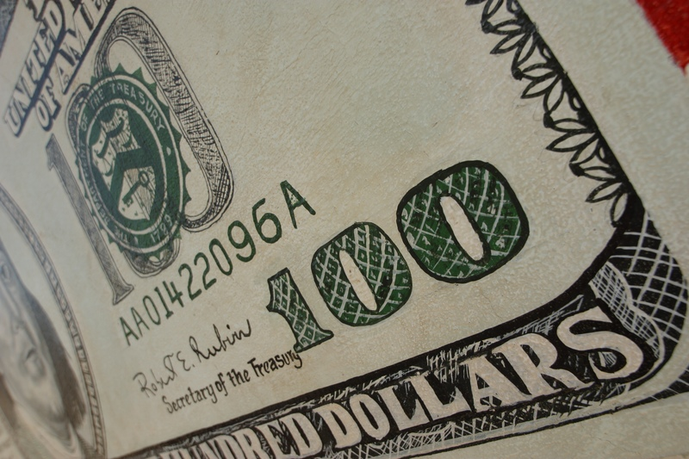
Your Paycheck
50% of U.S. young adults work
Earn a minimum of $5.15 per hour
Work an average of 20 hours / week
$412 - Monthly
$4,946 - Annual
Notes:
This slide makes it relevant to teenagers. Can also talk about other sources of income like allowance or gift money.
Federal Minimum wage as of April 21, 2006 - is $5.15 per hr. (Minimum wage will vary by state. For example, the minimum wage in the state of Washington is $7.63)
20 hr per wk - 4 1/3 wks in a month - $446 gross per month
monthly take home after deducting for soc sec and medicare of 7.65% is $412 Net
Annual wage 20hr per wk - 52 wk - $5,356 Gross
Annual take home after deduction for soc sec and medicare of 7.65% is $4,946 Net

Slide 8

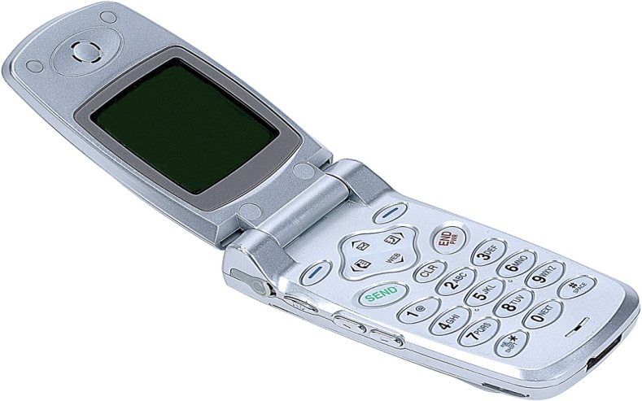
Where Does All the Money Go?
Food, Snacks & Beverages
Movies
School Events
Music, CDs, Concerts
Clothing, Cosmetics & Shoes
Cars, Gas & Insurance
Cell Phones
Notes:
Ask if we left anything out. Where else do you spend your money?

Slide 9


Credit Cards – The Perceived Great Equalizer
Credit lets you buy more than they can afford.
  Credit and credit cards
  Current World Problem
Needs are essentials
  Food
  Shelter
  Clothing
  Reliable transportation
Wants are extras
  Eating out
  Big, expensive house
  Shop till you drop
  Brand new or an expensive car
Notes:
What happens when you need or want to buy more than you can afford?
People use credit! Others don’t know that you truly can’t afford what you are buying.
Now is a good time to differentiate between credit and credit cards
Credit – home loans, auto loans
Credit cards – buying retail items
Current World Problem: Primarily in the US
It’s hard for people to differentiate between needs and wants

Slide 10

Who Uses Credit Cards?
U.S. population = 298 million
Use credit cards = 150 million
Pay off monthly = 50 million
Carry a balance = 100 million
2/3 of credit card users don’t pay off their balance
$9,300 = average debt per household
Notes:
½ of US (150 million people) use credit cards
1/3 (50 million) pay off monthly. Called deadbeats
2/3 (100 million) carry a balance
Average card debt per household with at least one credit card topped $9,300 in 2004. That’s more than triple the average in 1990.
Source: “Credit cards: They really are out to get you,” Consumer Reports, November 2005

Slide 11

Personal Savings Rate Declining
1974 to 1984
  10%
1985-1994
  Fell to 4.8%
2004
  1.8%
2005
  -0.5%
2006
  -0.7%
Hasn’t been negative since the Great Depression
Notes:
Saving has in inverse relationship to using credit. As credit use increases, saving decreases.
The personal savings rate is, essentially, the amount of after-tax income left once household bills are paid. As a percentage of income, it's declining. The personal savings rate used to be 10 percent of disposable income from 1974 to 1984, according to the Bureau of Labor Statistics. It fell to 4.8 percent by 1994, and was negative for all of 2005. As of January, the personal savings rate was minus 0.7 percent.
Americans not only spent all of their after-tax income in 2005 but had to dip into previous savings or increase borrowing.
The savings rate has been negative for an entire year only twice before — in 1932 and 1933 — two years when the country was struggling to cope with the Great Depression, a time of massive business failures and job layoffs.
One major reason that consumers felt confident in spending all of their disposable incomes and dipping into savings last year was that a booming housing market made them feel more wealthy. As their home prices surged at double-digit rates, that created what economists call a “wealth effect” that supported greater spending
Source: The Bureau of Labor Statistics, March 2006

Slide 12


Saving for the Future
Save 10% of every monthly check
Use savings for:
  Emergencies
  Big purchases
    Trip with friends
    Car
  Down payment on a home
  Retirement
Notes:
Pay yourself first by saving 10%. More if you can. Get in the habit of living on less than you earn.
If you save, you won’t have to use credit to buy the things in life that you want.

Slide 13


Advantages & Disadvantages of Credit Card
Advantages
  Convenient
  On-line purchases
  Kick-backs i.e. cash, airline miles, etc.
  Can rent a car
Disadvantages
  Doesn’t seem like real money
  Easy to overspend

Slide 14



Use Credit Wisely
You should use credit to buy:
  House
  Car
  Education (student loan)
and you’ll avoid trouble
Notes:
Always ask what the APR is on the loan
Get the APR in writing
The annual APR is more important than the monthly payment (use example of buying a car)

Slide 15
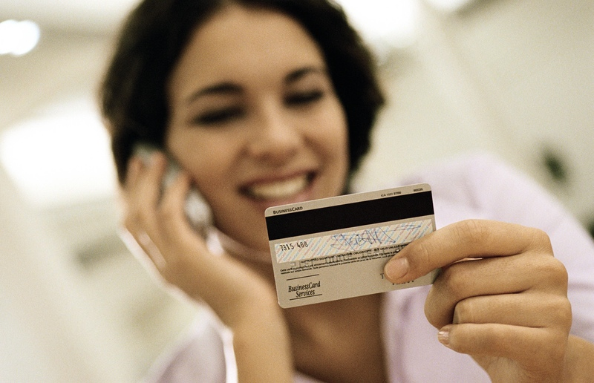
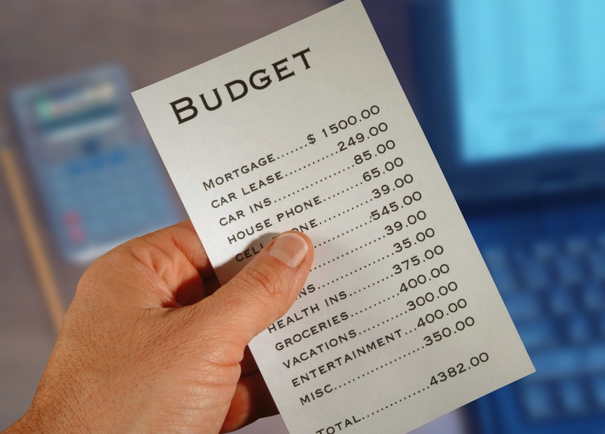
Only Buy What You Can Afford
Pay off monthly balances
  Avoid interest
  Avoid late fees
Know your budget
Know yourself
  Are you an impulse buyer?
Notes:
6 Tips for Managing Credit Cards
Only Buy What You Can Afford. This is the most important point to drive home. If you buy what you can afford now, you will have more than the person who is buying more than they can afford.
You can only increase your standard of living above what you can afford for so long before it will catch up to you. When it catches up to you, you’ll have to cut way back and live below your original standard to pay back your debt.

Slide 16





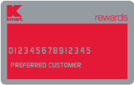



Limit the Number of Cards
Americans have an average of 8 credit cards
Notes:
6 Tips for Managing Credit Cards
You are offered to save 10% on your purchase that day if you open up a card. Don’t do it!
You need 1 credit card, maybe two if you choose a brand that isn’t accepted everywhere.
It will cost you more in the long-run to have more cards. The number of cards you have decreases your credit score because it tells lenders that you can spend more money and that is an increased risk for them.

Slide 17


Pay More than the Minimum
If you have a credit card balance:
  Make a plan to pay as much as you can every month
  Start with the credit card with the highest interest rate
  Pay off the credit cards as quickly as you can
Notes:
6 Tips for Managing Credit Cards
If you have credit card debt, it should be a priority to pay it off right away.
Remember the example from paying the minimum on the 10 dates. Hardly any of your money is going towards the principal.

Slide 18

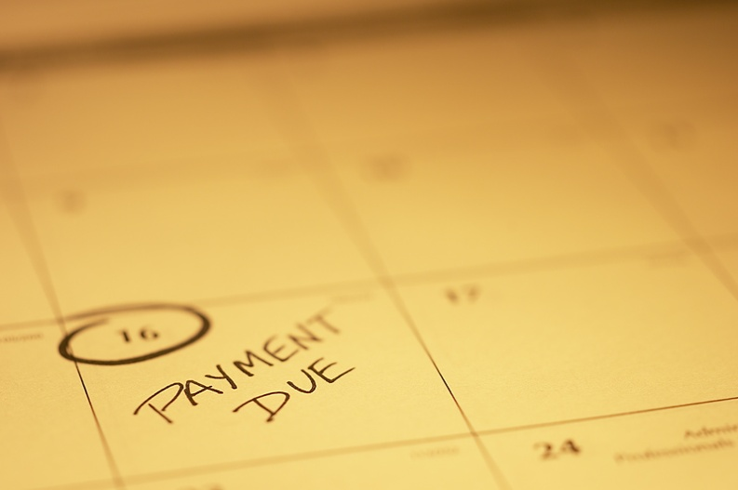
Always Pay on Time
Avoid late fees
Keep your money in your pocket
Maintain a good credit score
  Late payments have the biggest negative impact.
Easiest way to make money is to save money.
Notes:
6 Tips for Managing Credit Cards
% 5 Factors
35% Payment History (recency and frequency)
30% Outstanding Balances
15% Length of Credit History
10% New Credit
10% Types of Credit
100% FICO Score

Slide 19
Is it Priceless? The Power of Compounding Interest
Scenario: 10 dates & you would owe $570 Interest Rate: 18% Minimum Monthly Payment: 2.5% or $14
The true cost of paying the minimum
It will take you 8 years and 1 month to pay for those 10 dates. In that time, you will pay $470.32 in interest.
You’d be 26 years old!
Notes:
This slide is based off of the previous one, assuming you had 10 dates at $57 dollars each when you are 18 years old.
And this assumes, you have no more dates. No more spending
Source: http://www.bankrate.com/brm/calc/MinPayment.asp
Minimum Payment: The minimum amount a cardholder can pay to keep the account from going into default.

Slide 20
The True Cost of Paying the Minimum Payment
Payment Schedule: It will take you 8 years and 1 month to be rid of your debt. In that time, you will pay $470.32 in interest.
Month | Minimum Payment | Interest Paid | Principal Paid | Remaining Balance
1 | $14.25 | $8.55 | $5.70 | $564.30
2 | $14.11 | $8.46 | $5.64 | $558.66
3 | $13.97 | $8.38 | $5.59 | $553.07
4 | $13.83 | $8.30 | $5.53 | $547.54
5 | $13.69 | $8.21 | $5.48 | $542.06
6 | $13.55 | $8.13 | $5.42 | $536.64
Notes:
This is an amortization table that breaks down how slowly you make progress paying off the balance when you only make the minimum payment. Most important fact is to pay your credit card off every month and not pay interest.
Source: www.bankrate.com

