Slide 1

Cascade High School
Senior Planning Guide
2012- 2013

Slide 2

You are extremely close to achieving YOUR Goal of a HS diploma & continuing with your Career Goal!
This is not the time to give up BUT to keep moving forward one step at a time…

Slide 3

Senioritis…Is Not an Option!
Friends… Don’t let friends…Make poor choices!!!

Slide 4



Brainstorm Ideas
What will you need to complete this year in preparation for YOUR career after graduation???

Slide 5

Today’s Goal
*Give you tips about what
needs to be done this year
*Introduction to some valuable websites
*Begin implementing YOUR journey for beyond high school

Slide 6
Am I On Track to Graduate?
Do I currently have 16 credits?
Am I enrolled in Senior Seminar?
Will I have the required 22 credits to graduate in June?
English - 3.5 Math - 3.0 Science - 2.0 US Hist - 1.0 World Hist - 1.0 WSH .5/waived
Gov’t - 0.5 PE - 1.5 Health - 0.5 Fine Arts - 1.0 CTE - 1.0 Sr. Sem. - 0.5
What should I do if I am not on track???
See your counselor IMMEDIATELY!!!

Slide 7
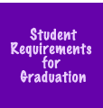
HSPE
Class of 2013
Must Pass Reading & Writing
Must Passed one Math end-of-course exam
  Or can Take SAT or ACT & get a qualifying score
Passed ALL – Done ☺

Slide 8
Check your email
Make sure your email address is appropriate
  Suggestion: Set up an email account specifically for your university/college, scholarship, military or employment applications that you will check regularly
Make sure your email doesn’t block “mass emails” from colleges/universities

Slide 9
Ordering A Transcript
Complete the Request for Transcript Form on Mrs. Cristina Garcia’s, our Registrar’s, counter
Please allow at least 24 hours
If 18 yrs. or older will need
to request transcript yourself

Slide 10

HS & Beyond Night
Thursday, October 25th 2012
Keynote speaker: Dr. Derek Greenfield
Over 65 Colleges, Universities, Career Professionals and the
Various Military Branches
http://www.youtube.com/watch?v=fkLX7R3mong
5 – 6 Pizza
5 – 8 Career & College Fair in the Gym
6 – 6:30 Keynote Speaker
6:40 – 7:15 Session 1
7:25 – 8:00 Session 2

Slide 11
Testing Dates: ACT
ACT Administrations: www.actstudent.org
Register Early Picture Required
Test Dates Registration Deadlines
Dec. 8, 2012 Nov. 2
Feb. 9, 2013 Jan. 11
Apr. 13, 2013 Mar. 8
Jun. 8, 2013 May 3
Most four-year universities require an entrance test be taken. The SAT and the ACT are equally acceptable tests at the majority of colleges.

Slide 12
Testing Dates: SAT
SAT Administrations: www.collegeboard.com
Register Early Picture Required
Test Dates Test Registration Deadlines
Dec. 1, 2012 SAT & Subject Nov. 1
Jan. 26, 2013 SAT & Subject Dec. 28
Mar. 9, 2013 SAT Only Feb. 18
May 4, 2013 SAT & Subject Apr. 5
Jun. 1, 2013 SAT & Subject May. 2

Slide 13

www.washingtoncouncil.org

Slide 14
The next few slides
*Common Application for 4-Year University
*CheckOutACollege – Survey, Information on
Community and Technical Colleges
*Common Application for the Community and Technical Colleges
*Military Information
*WorkSource Development
*Free Resume Templates

Slide 15
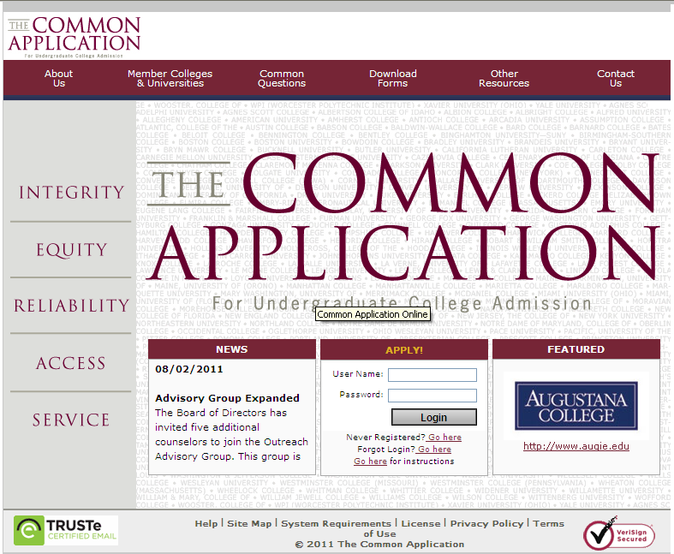
https://www.commonapp.org/CommonApp/default.aspx

Slide 16
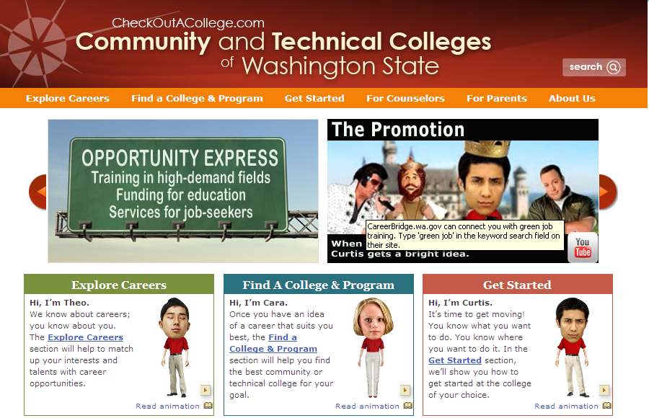
www.CheckOutACollege.com

Slide 17
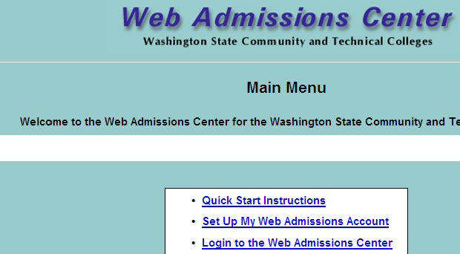
https://www.public.ctc.edu/ApplicantWebClient/Applicant/ApplWelcome.aspx

Slide 18

http://www.todaysmilitary.com/military-careers/entering-the-military?

Slide 19

http://www.worksourceonline.com

Slide 20
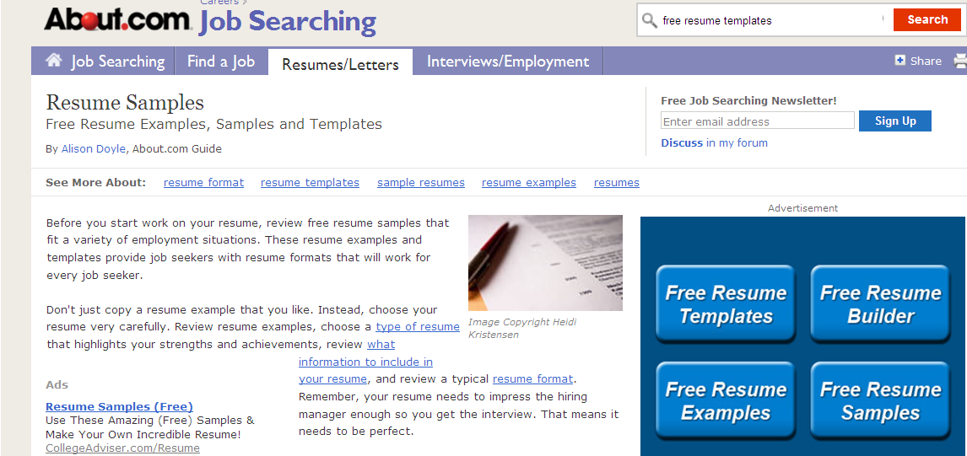
http://jobsearch.about.com/od/sampleresumes/a/sampleresume2.htm

Slide 21
If you are not in Senior Seminar class this semester and want a jump start on CE, then visit:
www.everettce.com
Any work completed now will just be checked off next semester!

