Slide 1
1994-2014
20 Year Staff Then And Now
Jackson High School

Slide 2
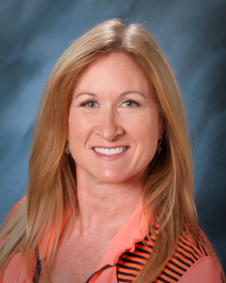
Mrs. Barnes
1994
2014

Slide 3
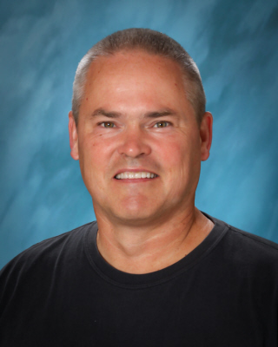
Mr. Hutt
1994
2014

Slide 4
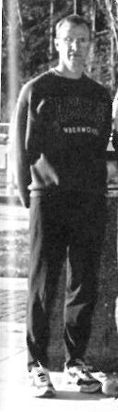
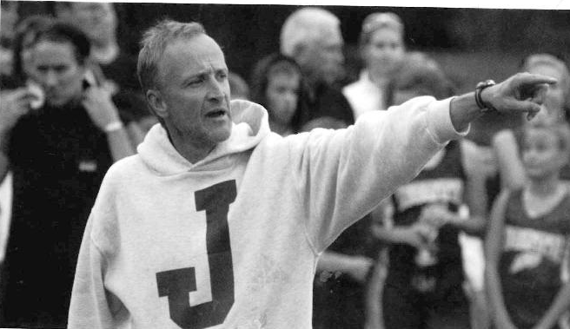
Mr. Hruschka
1994
2014

Slide 5
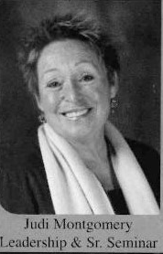
Ms. Montgomery
1994
2014

Slide 6

Ms. Peterson
1994
2014

Slide 7

Mrs. Powell
1994
2014

Slide 8
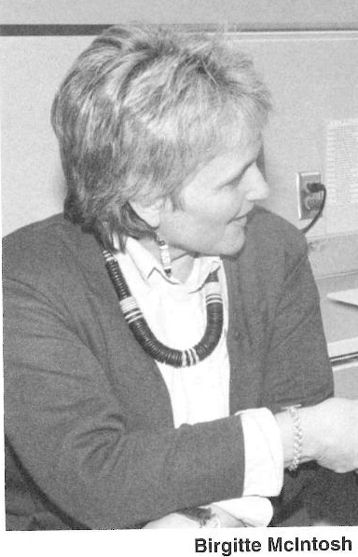
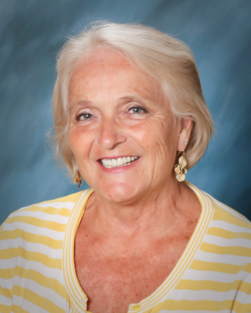
Ms. McIntosh
1994
2014

Slide 9
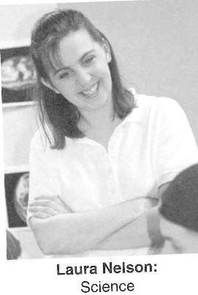

Ms. Nelson
1994
2014

Slide 10
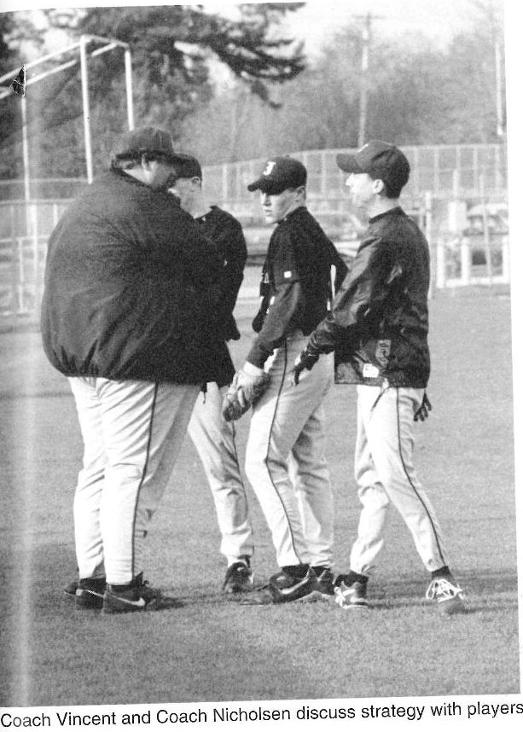
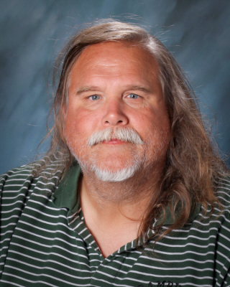
Coach Nick
1994
2014

Slide 11
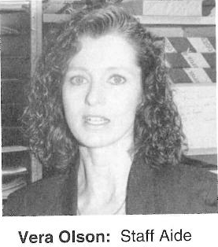
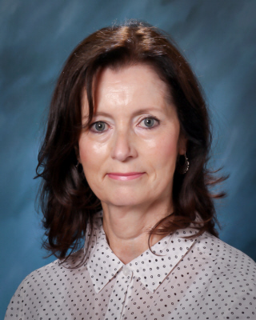
Ms. Olson
1994
2014

Slide 12
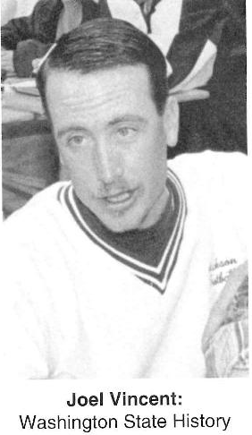
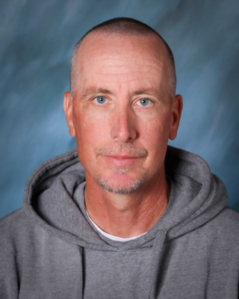
Mr. Vincent
1994
2014

Slide 13
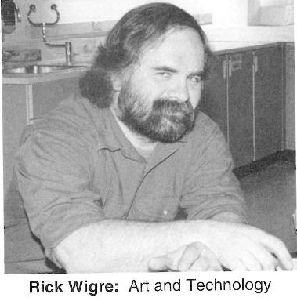
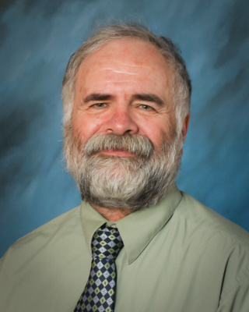
Mr. Wigre
1994
2014

Slide 14
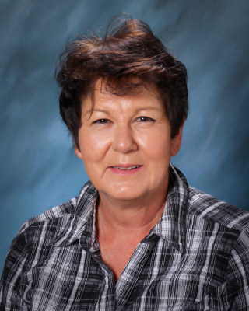
Ms. Wright
1994
2014

Slide 15
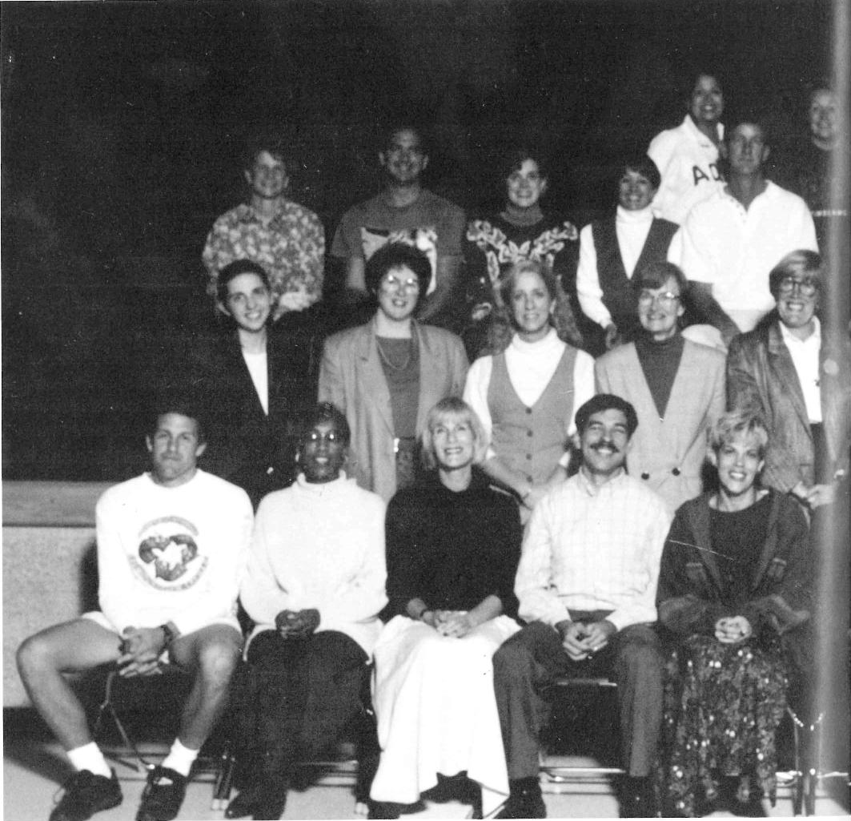
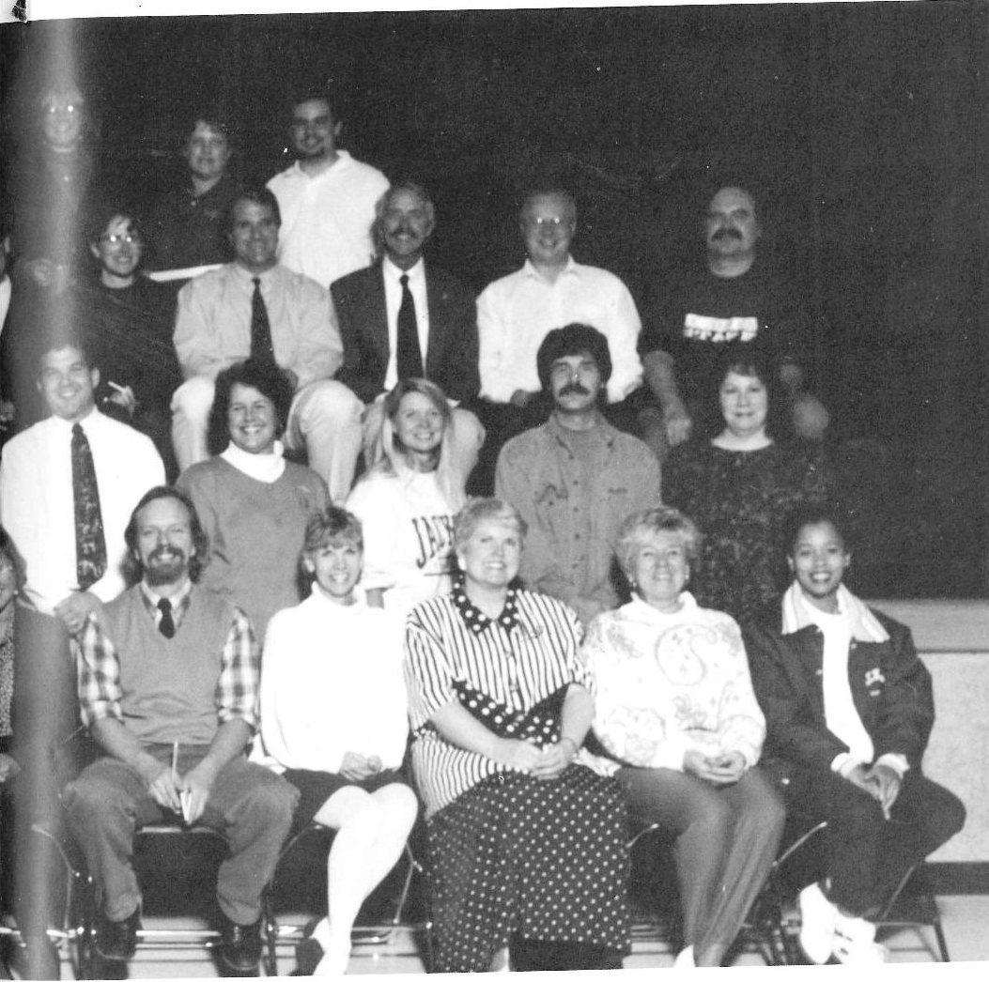
Staff 1994

