Slide 1


Early College Programs
Becky Ballbach
Director of Student Support Programs
October 21, 2014

Slide 2
Why?
How?
Who?
Where?
What?
When?
Notes:
WHY: what are the advantages to taking college level courses in high school
WHO: what students are eligible to take these programs and what students will benefit from these programs
WHAT: what do these courses offer students in terms of experience, learning, and college readiness
WHEN: when are students prepared to take these classes, and when are they offered
WHERE: where does the student go or sit to take these classes?
HOW: how do students register for these courses

Slide 3

Momentum for
College and Career
Why?
Rigorous Coursework in High School
“The academic intensity of the student’s high school curriculum still counts more than anything else in precollegiate history in providing momentum toward completing a bachelor’s degree.” – The Toolbox Revisited (2006)
Prepares students for college and career success
Encourages engagement in school
Earning Credits toward College Graduation
Student are more likely to complete a college degree if they complete 20 credits during the first year of enrollment.
“It is all the more reason to begin the transition process in high school with expanded dual enrollment programs offering true postsecondary course work so that students enter higher education with a minimum of 6 additive credits to help them cross that 20-credit line. Six is good, 9 is better, and 12 is a guarantee of momentum.” – The Toolbox Revisited (2006)
Adelman, C. (2006). The Toolbox Revisited: Path to Degree Completion from High School Through College. Washington, D.C.: U.S Department of Education.
Notes:
When students learn to sit in a challenging class, to participate in the learning, and to take ownership for their own learning, they become better learners and global citizens.
Challenging courses get more student buy-in, because students overall appreciate being challenged and engaging in their learning
48% of students who enter college their freshman year graduate within 5 years of entering…if a student goes into freshman year already having earned college credits, they are more likely to continue to completion

Slide 4
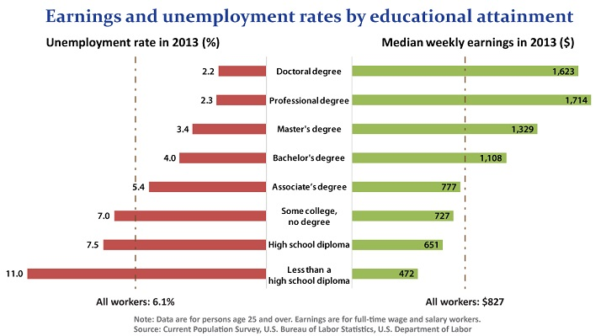
Why?
Source: Bureau of Labor Statics, Current Population Survey, downloaded 10072014
from http://www.bls.gov/emp/ep_chart_001.htm
Notes:
Self-explanatory…..

Slide 5
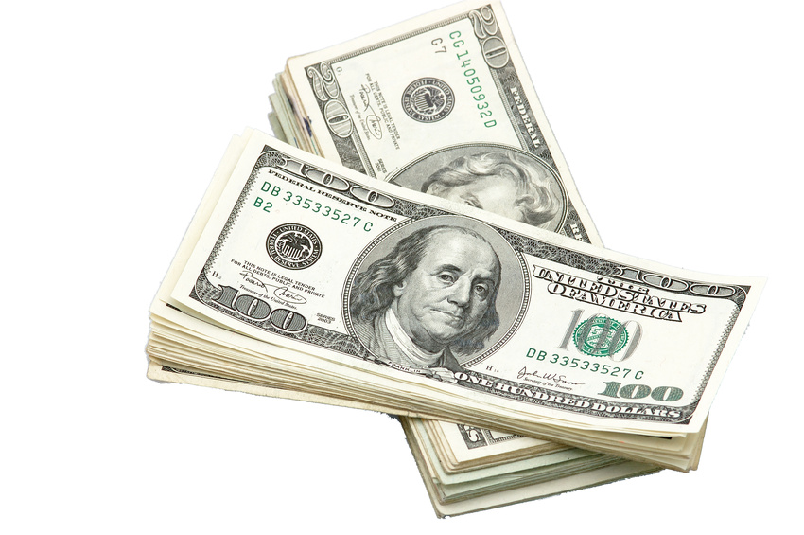
Why?
$aves Money
Washington State College Graduates Class of 2012
  average debt upon graduation - $29,400
  proportion with debt – 71%
National Unemployment
  Unemployment rate – 6.8%
  Underemployment rate – 14.7%
  Had jobs not requiring college degree – 28.4%
Strong economic returns for investment in college degree
  Unemployment rate of HS grads is 17.9% compared to 7.7% for college graduates
Source: The Institute For College Access & Success, The Project on Student Debt (October, 2014)
Notes:
At the same time that debt has been going up, colleges across the country have been hiking tuition, and fees and families' incomes have been shrinking.
Student loan debt has risen at an average rate of 6% per year from 2008 to 2012.
Seven in 10 seniors graduated with student loan debt, and a fifth of that debt was owed to private lenders, which often charge high interest rates.
To make matters worse, the job market still hasn't recovered, leaving many graduates with little or no income.
Still, the employment prospects of college grads are a lot better than those without college education. High school grads without college degrees faced an unemployment rate of 17.9% in 2012, compared to 7.7% for young college graduates.

Slide 6
Why?
$aves Money
Five Washington State Public Colleges and Universities | The Cost of 15 Credits (2014-15)
Everett Community College | $1333.35
Central Washington University | $2647.00
University of Washington | $4132.00
Western Washington University | $2501.00
Washington State University (Semester System – 12 credits) | $5698.00
Everett Public Schools Early College Programs | The Cost of 15 Credits (2014-15)
Advanced Placement (3 exams @ $89 each) | $273.00
EvCC College in High School (5 cr. class @ $198 each) | $594.00
UW in the High School (5 cr. class @ $320 each + $44 fee) | $1092.00
Tech Prep (Most classes are free) | Free
Notes:
CiHS tuition is ~1/3 to 1/4 the cost of that same course’s tuition on campus.

Slide 7
Why?
Most common colleges for JHS students (initial enrollment):
1. University of Washington - Seattle
2. Edmonds Community College
3. Cascadia Community College
4. Western Washington University
5. Washington State University
6. Everett Community College
7. Central Washington University
8. Shoreline Community College
9. Bellevue College
10. Seattle Pacific University
Notes:
Top 10 list…

Slide 8

Who?
10th Graders - AP World History
11th and 12th Graders – AP and College in High School courses
All Grades – Tech Prep
Students who are ready for challenging courses
Students with strong reading, writing and math skills
Notes:
Here is the state legislation regarding “college in the high school” programs: http://apps.leg.wa.gov/rcw/default.aspx?cite=28A.600.290
The component regarding grade level eligibility, which had been interpreted in different ways, was clarified this past winter through legislative discussion and by OSPI. Legislative intent and agency agreement is that only students in 11th and 12th grade are eligible to register for college credit in “college in the high school” programs.
Because this is a state policy, there is no flexibility and there are no exceptions.
Only 11th and 12th graders can register for UW credit through our program this school year.
Students in 9th and 10th grades who are taking courses available for UW credit this year will not be able to retroactively receive the UW credit when they enter the 11th or 12th grade or after the legislation changes.
The UW cannot change this legislation; only the legislature can do so. Parents and others with concerns and requests should contact their local legislators.

Slide 9
What?
Advanced Placement
Each course culminates in an Exam
Students earn college credit based on exam score
Credits fulfill general and/or major-specific college graduation requirements
Notes:
It is HIGHLY recommended students taking an AP course sit for the final AP exam in that subject area.
ALL high stakes exams student will take, including ACT, SAT, MCAT, LSAT, etc. are timed, and the more practice, the better.
Latest research has shown that even students who score a 1 on the exam outperform their peers in college who took the AP course but did not sit for the exam.
Added benefit: Student will receive college credit for passing the AP exam.

Slide 10
What?
Tech Prep
Credits Vary
Entry courses for certificate programs, Associates in Technical Arts, or Associates Transferable Degree
Offered in partnership with Everett Community College, Skagit Valley Community College and Lake Washington Institute of Technology

Slide 11
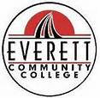

What?
College in High School
Courses are 5 credits
Often fulfills general and/or major-specific college graduation requirements
Offered in partnership with Everett Community College and University of Washington

Slide 12
What?
Courses Offered at JHS
AP English Language and Composition
AP English Literature and Composition
AP Studio Art
AP Calculus AB
AP Computer Science
AP Calculus BC
AP Statistics
AP Biology
AP Chemistry
AP Environmental Science
AP Physics
AP Microeconomics
AP Government and
Politics: US
AP Psychology
AP Spanish Language
AP US History
AP World History
AP Art 2nd/3rd
Advanced
Placement
ECC English (Literature and Composition)
ECC Political Science
UW English (Literature and Exposition)
UW Psychology
Pre-Calculus
Calculus
Statistics
College In High School
French 2, 3 and 4 Spanish 2, 3 and 4 German 2, 3 and 4
UW IT Computer Science Engineering
Tech
Prep
Introduction to Sports
Medicine
Digital Photography II
Publications I (Yearbook I)
Independent Living
Career Choices
Computer Applications:
Computer Literacy
Computer Applications:
PowerPoint
Introduction to Graphic Design
Graphic Design I
Graphic Design II
Graphic Design III
Sports Medicine I, II
Web Design

Slide 13
Contacts
Everett Public Schools
  http://docushare.everett.k12.wa.us/docushare/dsweb/View/Collection-2661
Everett Community College
  http://www.everettcc.edu/ccec/collegeinhs/index.cfm?id=2606
University of Washington
  http://www.outreach.washington.edu/uwhs/

Slide 14
When?
Ready for classes:
Complete pre-requisites first
Match to High School Graduation Requirements
When to take classes:
During the regular school day
Notes:
When a student has completed all pre-requisites for the course
When a student wants to take on the challenge of a more rigorous course and work load

Slide 15

Where?
All three programs
are offered at the
high school.
Unlike Running Start, students can stay involved with their school.

Slide 16
How?
Register for designated
high school courses.
Advanced Placement
Register for exam in the Spring
Scores reported to colleges selected by student
College in High School and Tech Prep
Register through teacher or online for college courses in Fall and Winter
Obtain transcript from college to transfer credits

Slide 17
Questions you should ask yourself:
Where are you going to college?
What is your area of focus or major in college?
What is the difference between college general education requirements and degree requirements?
Do you have to pay for every Early College Class?
Notes:
What will they accept as far as AP scores and/or college transcripts
Will the subject-specific AP exam or college course transcript be accepted in your area of focus or major
Dif btw GenEd and degree requirements:
All colleges require students to complete a specific # of genEd credits for graduation to insure students are becoming global citizens
All colleges also require students to complete a specific # of major-specific courses to obtain their specialized BA or BS degree
Yes

Slide 18
Early College Programs
?Questions?

