Slide 1
FATS and Cholesterol
Health

Slide 2
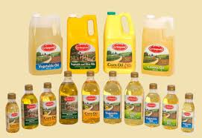
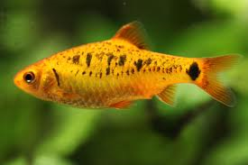
Polyunsaturated Fat
Better than Saturated Fats
Found in Vegetable Oils and Fish
Tend to lower cholesterol

Slide 3
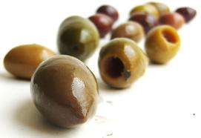
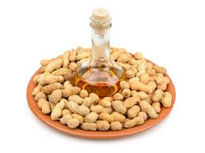
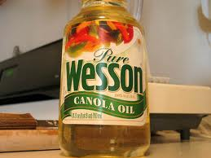
Monounsaturated Fats
The best type of fat
Found in olives, avocados, nuts, olive, canola and peanut oils.
Tend to lower LDL and raise HDL levels in cholesterol.

Slide 4
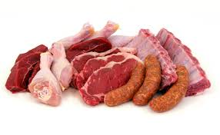
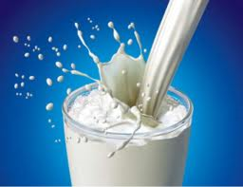
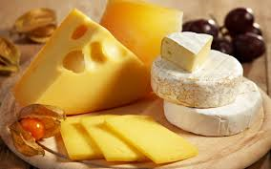
Saturated Fat
One of the worse types of fat for you
Found in Animal Sources like milk, cream cheese, butter, meat and poultry

Slide 5
Cholesterol
A Fatlike Substance that resembles fat but its chemical make-up is very different
Is an essential part of each cell membrane in the human body
Used by the liver to make bile and to get rid of waste

Slide 6
Cholesterol Levels
According to the Mayo Clinic, ideal total cholesterol is below 200 milligrams per deciliter.
HDL cholesterol should be at or above 60 milligrams per deciliter
LDL cholesterol for people not at high risk for heart disease is below 130 milligrams per deciliter.
Normal cholesterol levels are the same for everyone and are not determined by age, except LDL cholesterol levels for people who are at high risk for heart disease.
According to the American Heart Association, adults 20 years of age and older should get their cholesterol levels, along with other heart disease risk factors, assessed every four to six years.

