Slide 1
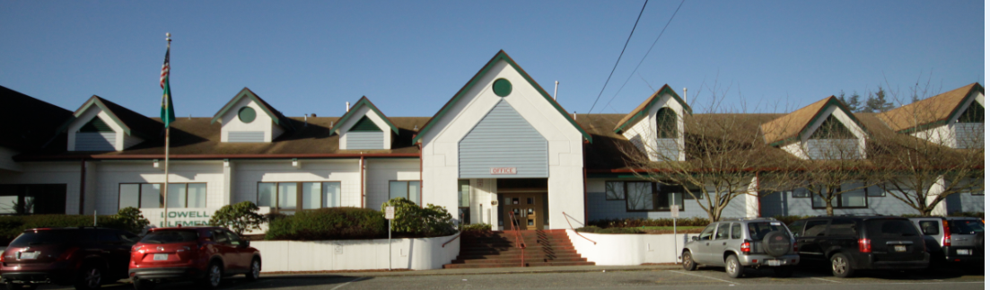
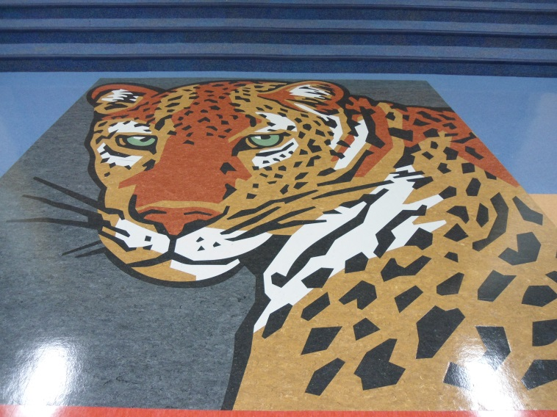
Welcome to Lowell
Notes:
Cindy
Welcome to Lowell built in ________ and remodeled in 1992.
We are so excited you are here today because we love our school, believe we have a great school and we can’t wait to share all of the wonderful things we are doing to help each and every student be successful.
Before we get started though, I want to set the structure for our presentation today.
First of all, I want to emphasize that we see our SOSR as a collaboration with each of you. So, if you have any feedback or questions along the way, just let us know.
In addition, if you remember our SOSR from last year we took you on a journey to our past and reflected on our last five years of progress. We showed you how we have grown into a school that focuses on continuous improvement in, for example, our PLCs, our data analysis, our professional development, etc… We continue to do these great things, but today’s presentation will only focus on this year’s refinements to the great learning path we think we are already on.
So, without further ado, let’s get started by first orienting you to the folder in front of you.
Inside, you will see…
First, a packet of slides that list the refinements we have made in the areas of reading, math, writing and science this year. When we get to describing these in the presentation, we will remind you to take out these slides and you will have the opportunity to take notes.
Second, at the very back of your packet you will see a list of the support we are requesting and we will reference this list at the end of our presentation.
Finally, you will see an invitation to our upcoming school events. We welcome visitors to Lowell and in order to make this happen we wanted to make you aware of when the events are occurring.
So, now that you are oriented to the folder, we will now move onto the presentation.
First of all, I want to begin by sharing with you some of the demographics of Lowell.

Slide 2
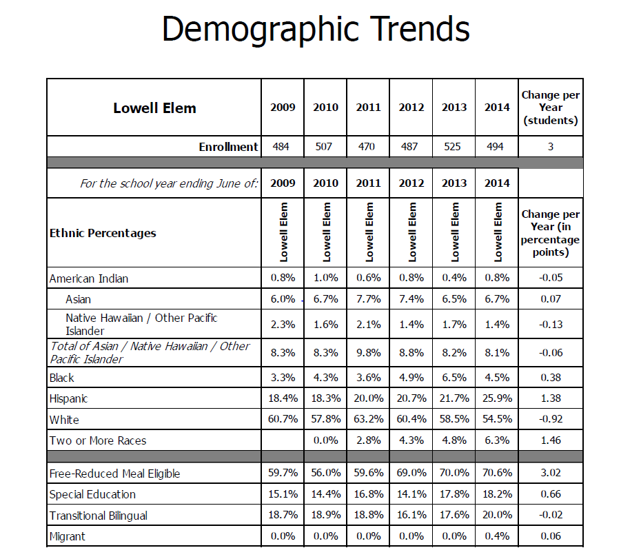
Notes:
Cindy
Overall, you can see our…
Enrollment has remained pretty steady at about 500 students
Of note, our Hispanic enrollment increased from last year 1.38% and has been increasing over the last six years from a total Hispanic population of 18.4% to now 25.9%
Lowell’s free and reduced lunch rate is now 70.6%, an increase of 3.02 percentage points over last year
In addition, we had an almost 1% decrease in white students
And a 1.46% increase in students identifying as two or more races
This is a quick overview of our demographics at Lowell, now I want to take you deeper and allow you to see the specific people that make Lowell special.

Slide 3
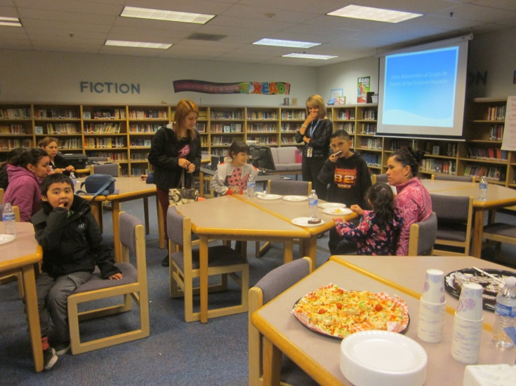
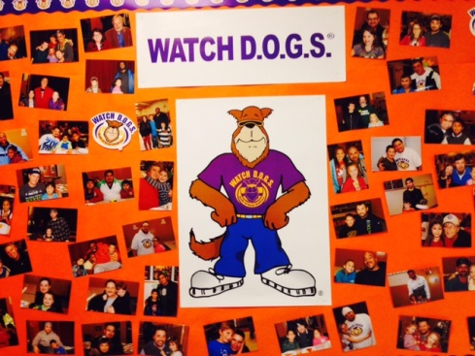
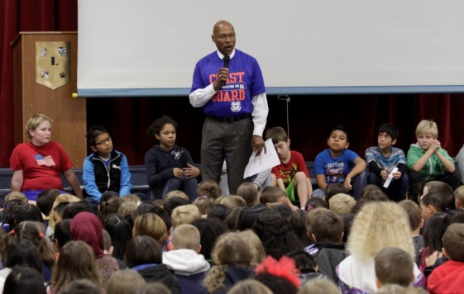
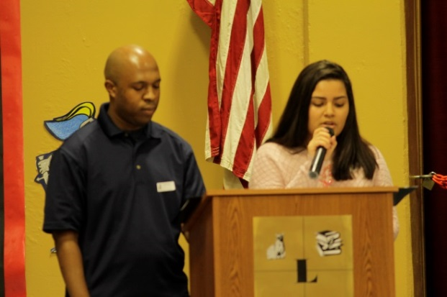
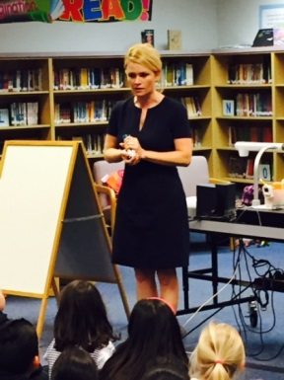
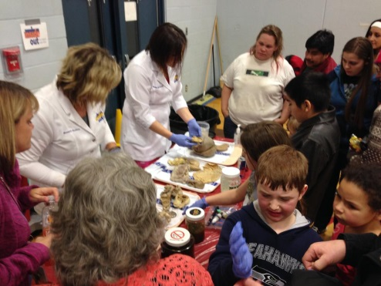
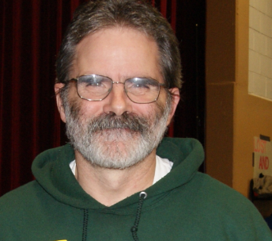
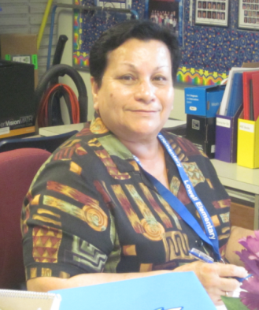
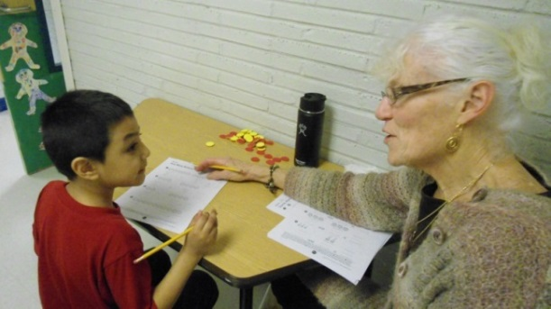
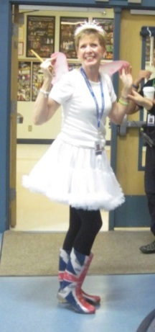
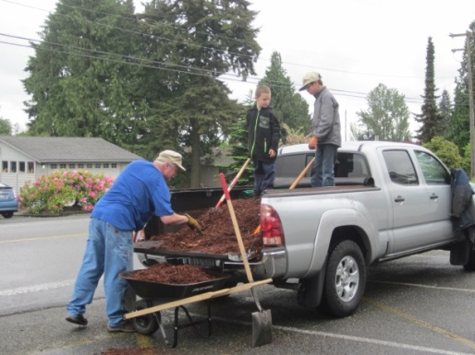
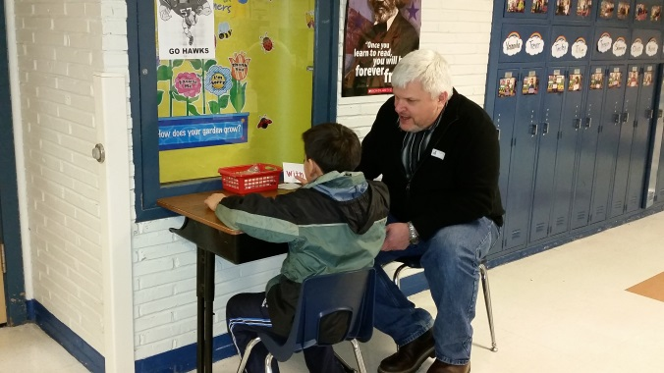
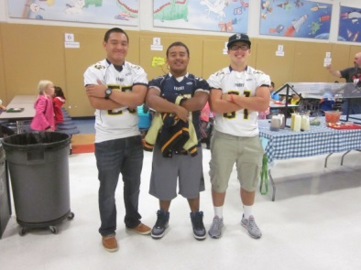
Meet our Parents and Community
Notes:
Cindy
First off, we think it vital we start our SOSR off with our parents and community partners. They do so much to support us and we think it fitting to honor them first.
Since I started at Lowell five years ago, I was amazed at the great parent and community support. For example, you can see right in the middle of the slide two volunteers, Dave and Anita, who serve our students every day with unwavering support. They are amazing people and there are many more of them here at Lowell.
Unfortunately, today I won’t get to speak about everything our parents and community do for us, but let me highlight a few of the enhancements we have made from last year to this year in order to build an even stronger parent and community support system.
One thing we are especially proud of this year is the expansion of our parent group. Besides our PTA, we have parent focus groups who provide feedback about our school climate and if we are a welcoming environment.
This year, the enhancement we made was to expand our parent focus groups and we added Hispanic, Russian and Arabic groups.
So far, we have held the Hispanic focus group meeting (point to picture) and it was a huge success. For example, through this meeting I was able to clarify many misunderstandings about volunteering and our Make Your Day citizenship program.
Another community and family involvement expansion we are very proud of is our Watchdog Program headed by Dave Deubler, our health room assistant. Last year we had about 20 Watchdogs assist at school and most of them volunteered more than three times. This year though our Watch Dog program has blown up. We had over 100 dads and dad like figures attend our kick off event and we will have a total of over 50 male volunteers serve in our building this year. And many of these Watch dogs are repeat volunteers coming to our school multiple times to help out.
Next, we have also made a concerted effort this year to invite in outside diverse perspectives to positively influence our students. For example, we had…
John Lovick the Snohomish County Executive speak at our Vet Day assembly
Shannon O Donnell from KOMO 4 speak to our 2nd graders about weather
We partnered with Molina Health to run a Family Fitness Night
We had a Jackson HS and UW student come to our MLK assembly and speak about diversity
We partnered with two local churches, Madison Community Church and New Life Center
And have utilized retired Lowell teachers and former Lowell students (EHS Sidekicks) to come into our school and assist.
We are proud of these new partnerships and believe they will continue to grow positive perceptions of our school.

Slide 4
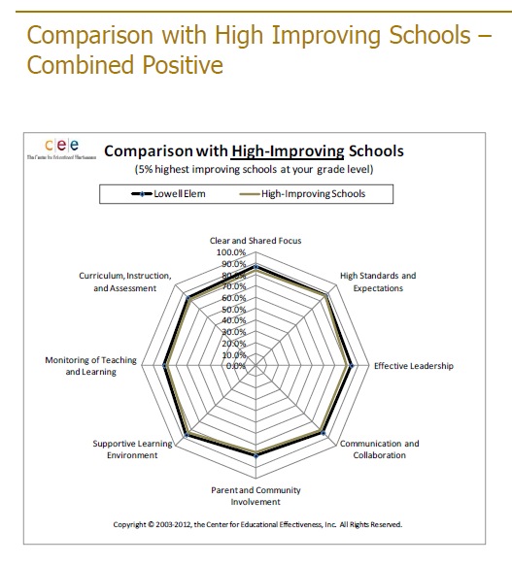
Notes:
Cindy
This positive perception is shown quite clearly in our 2014 Educational Effectiveness Survey results.
Even with large increase in the amount of EES surveys returned, from under 50 in 2012 to 232 respondents in 2014, our parents continue to feel overwhelmingly positive about our school.
On all the categories for characteristics of high improving schools, parents over 80% of the time feel it is ‘almost always true’ or ‘often true’ that we exhibit each one of these categories.
As you can see, we are on par with high improving schools. It is almost a perfect match. Our parents are telling us we are doing a good job and positive perceptions are high.
In addition to parents and community, we have another great group of people who are working hard for our students. Meet our Lowell staff.

Slide 5
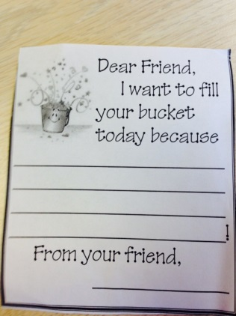
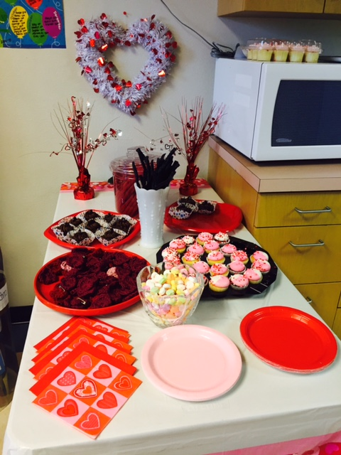
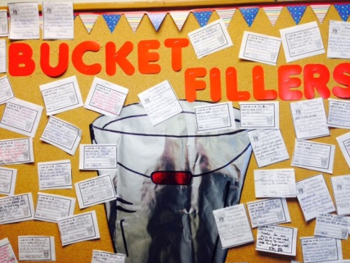
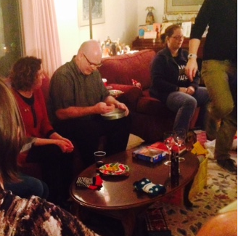
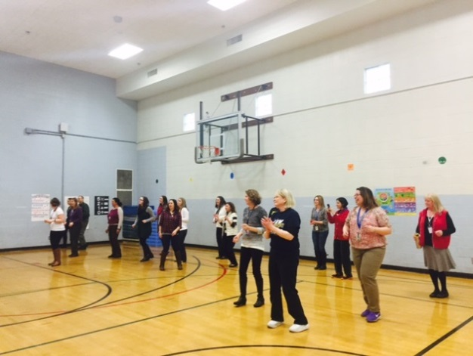
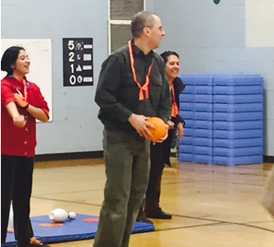
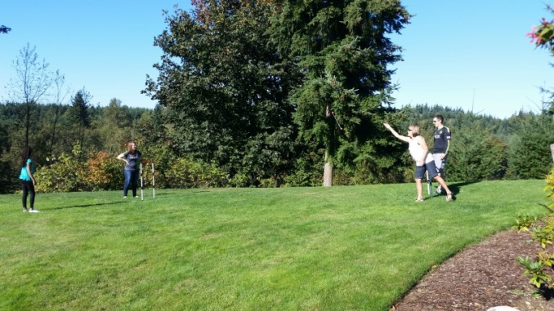
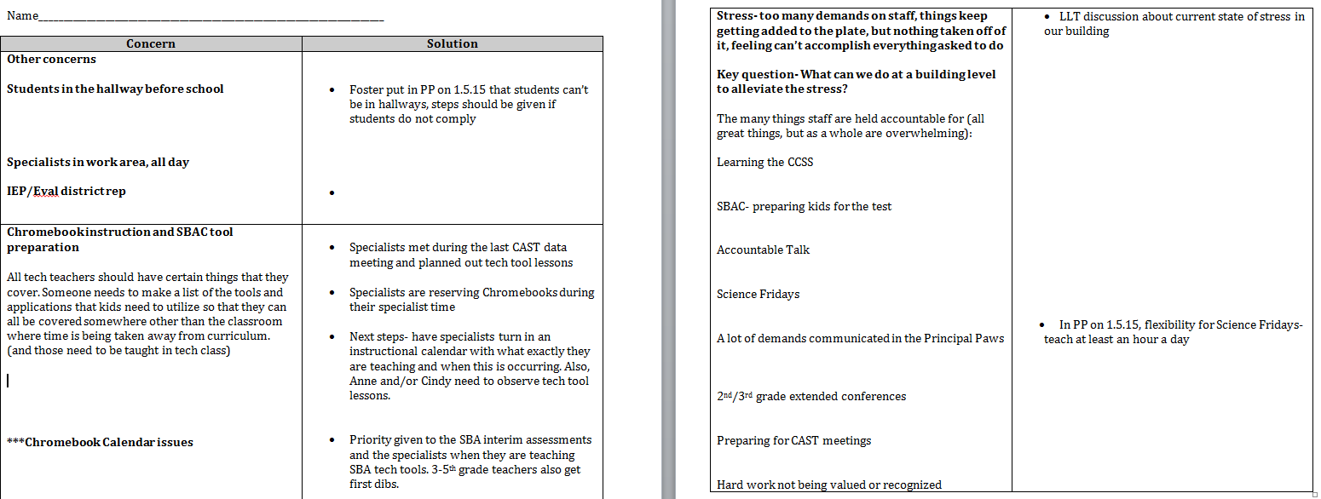
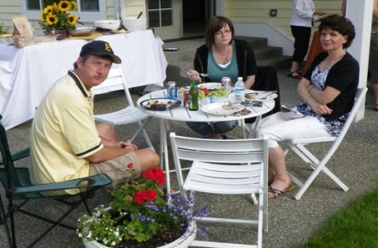
Meet the Lowell Staff
Notes:
Cindy
One of the most outstanding things about the Lowell staff is we are a group of people who really like and care about each other.
However, this hasn’t happened by chance. Our Lowell Leadership Team, LLT, has done a lot of intentional work to build a positive climate and a strong culture of respect. We know that in order for a school to thrive, staff have to have relationships with each other and truly care about each other.
How has the LLT built this positive, trusting atmosphere?
We have made sure to add fun, relationship building activities into our school.
For example, this year we created a Staff Climate Activity calendar where different work groups volunteered to sponsor at least one climate building activity each month.
Four of those activities are featured on the slide-
the special education sponsored a holiday party (featuring a fun dice game for gift prizes)
you can see the welcome back to school party at Craig Langley, our PE teacher’s, house
the Valentine’s Day party the paraeducators just sponsored helping us to celebrate Valentine’s Day
and here is the specialists event last month featuring a some fun games in the gym and even this even involved a bit of dancing.
Although fun, we believe events like these are crucial in keeping in positive morale.
In addition to fun events, the LLT spends time each month reviewing school climate and any concerns that may be hurting this climate.
You can see here (point to slide) a problem/solution document we used at our December leadership team meeting to highlight concerns and possible solutions to these concerns. For example, anxiety was high in December and we looked to figure out all of the stressors and solutions for reducing this stress.
In addition, this year the leadership team decided to carry throughout the year the theme of filling each other’s buckets. This idea was taken from the book- How Full is Your Bucket?- and it puts intentional focus on looking for the good in each other and making public this recognition. For example, we have a bucket filler display in the office and bucket filler compliments posted each day in our daily staff bulletin.
We actively work to keep a positive climate at Lowell. This is only successful due to the hard work of our leadership team. We want to make sure nothing undercuts the good work that is happening at Lowell.

Slide 6
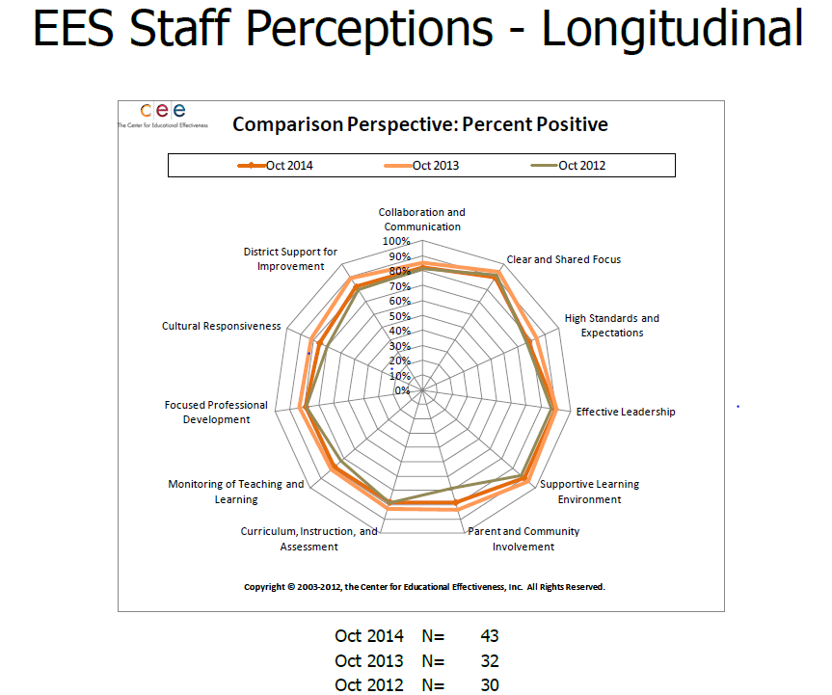
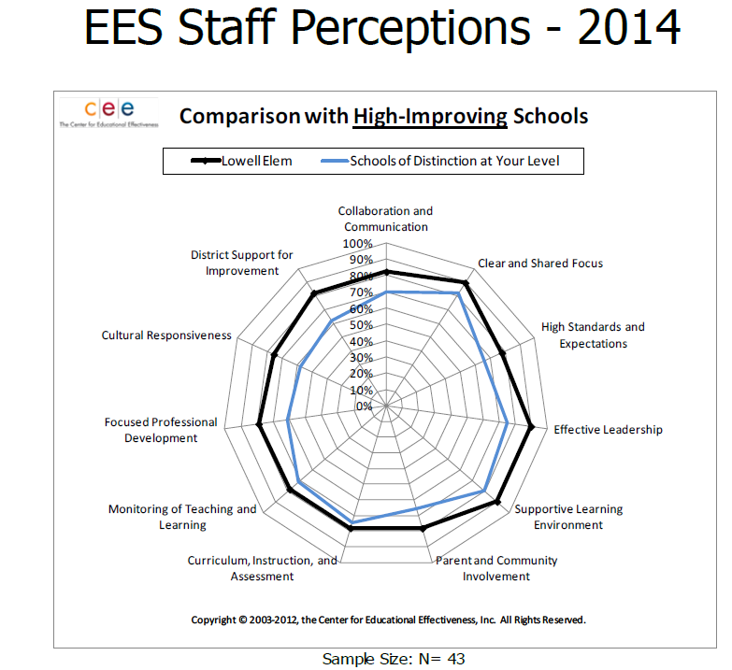
Notes:
Cindy
Here you can see in our EES data that this hard work seems to be paying off. Our staff feel very positively about our school.
In fact, our staff’s perceptions are outperforming high improving schools.
This isn’t a one time thing either.
You can see on the longitudinal graph that we have consistently maintained a high rate of positive staff perception of our school over multiple years.

Slide 7
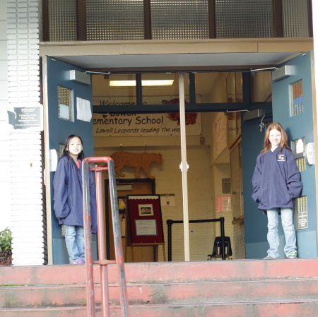
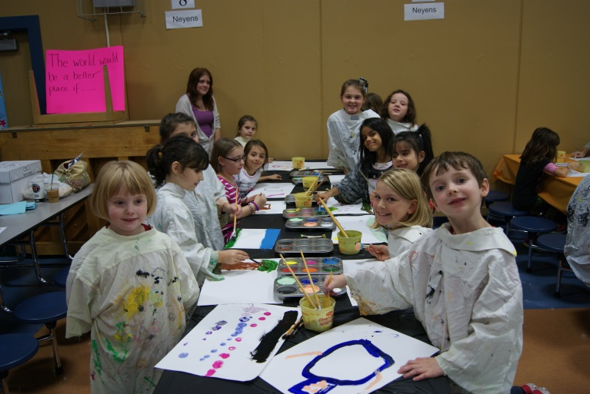
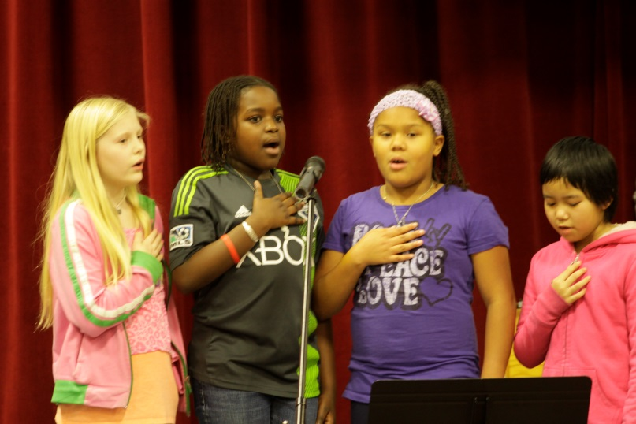
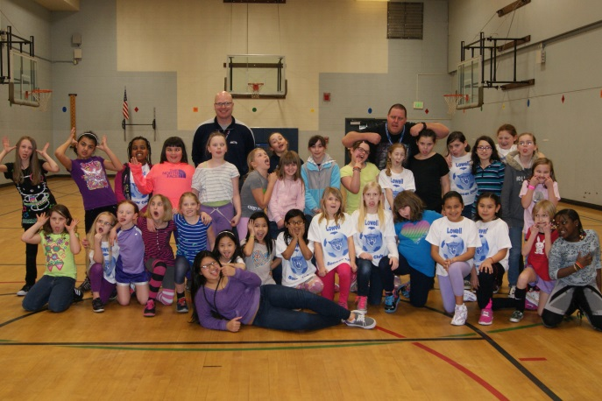
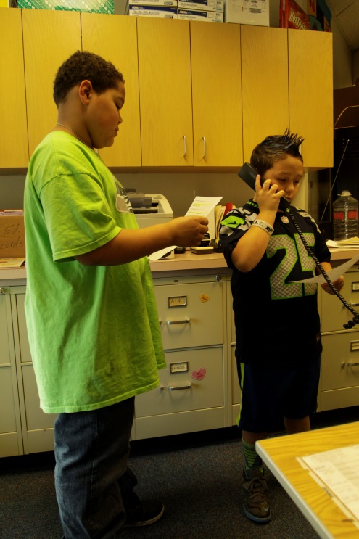
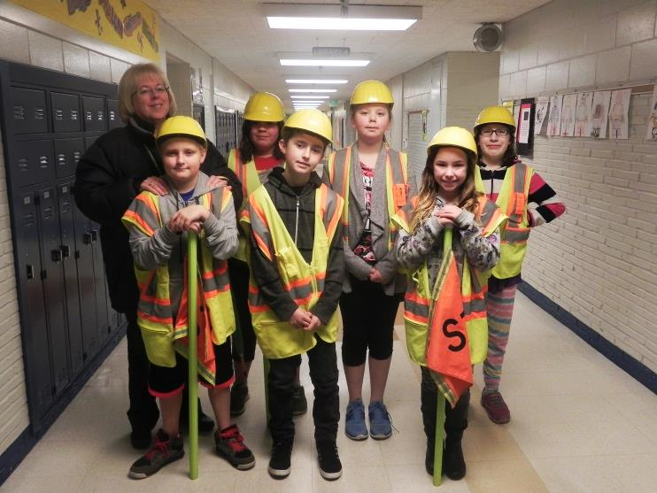
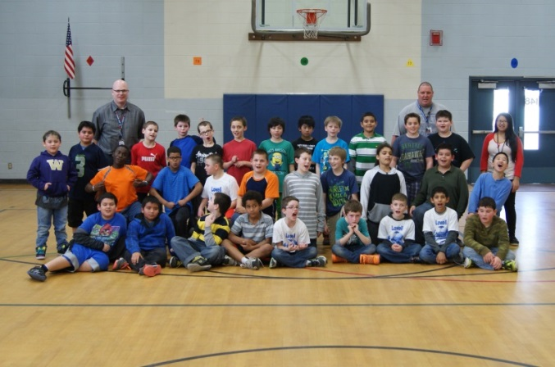
Meet Lowell Students
Notes:
Cindy
Finally, I also want you to meet our fabulous Lowell students. We have amazing students here at Lowell and we could share a multitude of examples proving this to you. But today, I am going to just focus on some of the things we are doing this year to enhance the student experience at Lowell.
We are extremely proud of our increase in having students take leadership roles. For example, we have started an Ambassadors program where students serve as ambassadors welcoming students and parents into our school each morning and to each assembly we have.
In addition, we have student leaders who participate in assemblies, here is a picture of 4th graders leading the school in singing the National Anthem.
And also we have students assist with morning announcements (point to picture). We know that student leadership is a growth area for us and we continue to look for opportunities for more of our students.
Also, we have seen a tremendous increase in our soccer club and PTA art reflections participation. Currently, we have an average of about 100 students participating in the 4th/5th grade soccer club. This over half of the total students. Since we no longer have art class, we hosted an art class after school so students could create art to submit to the PTA reflections contest and attendance at this event was also sky high.
Finally, later on in our presentation Lisa is going to speak to you about our new robotics club and our great success with this.
Our students need engaging after school activities and we are very proud that this year we can offer more opportunities for our students.

Slide 8
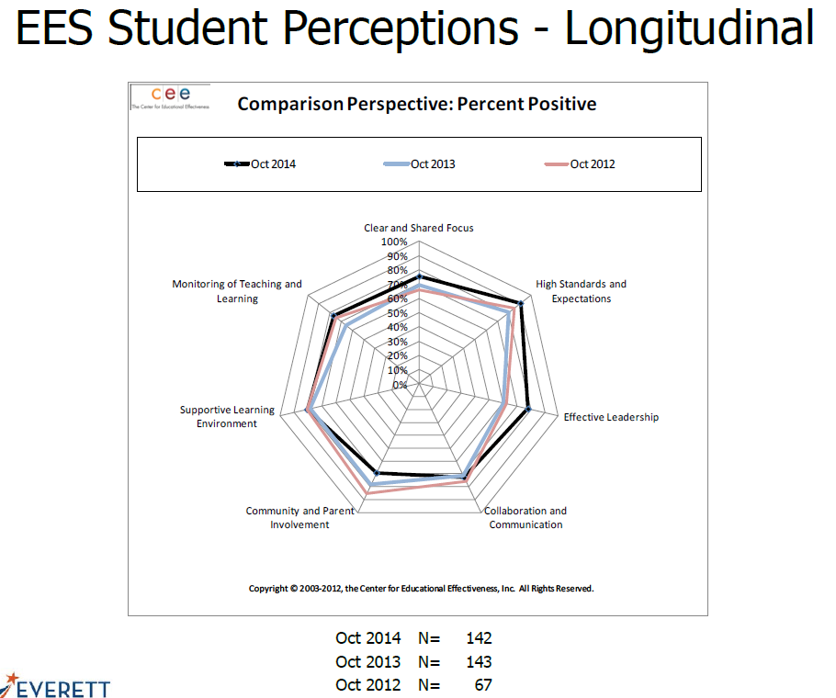
Notes:
Cindy
We love our students and our students love our school.
They feel good about school and like being here.
Our EES survey results are quite positive.
Like our parents and staff, a majority of our students score us high on the characteristics of high performing schools.
Although we are always looking for ways to improve the student experience at Lowell, we are encouraged that we are doing the right things for our students.

Slide 9
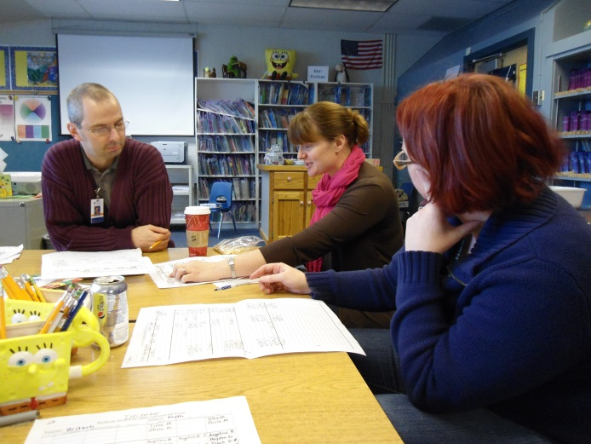
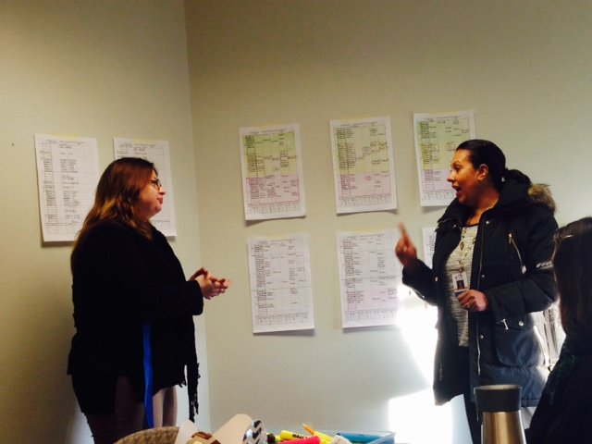
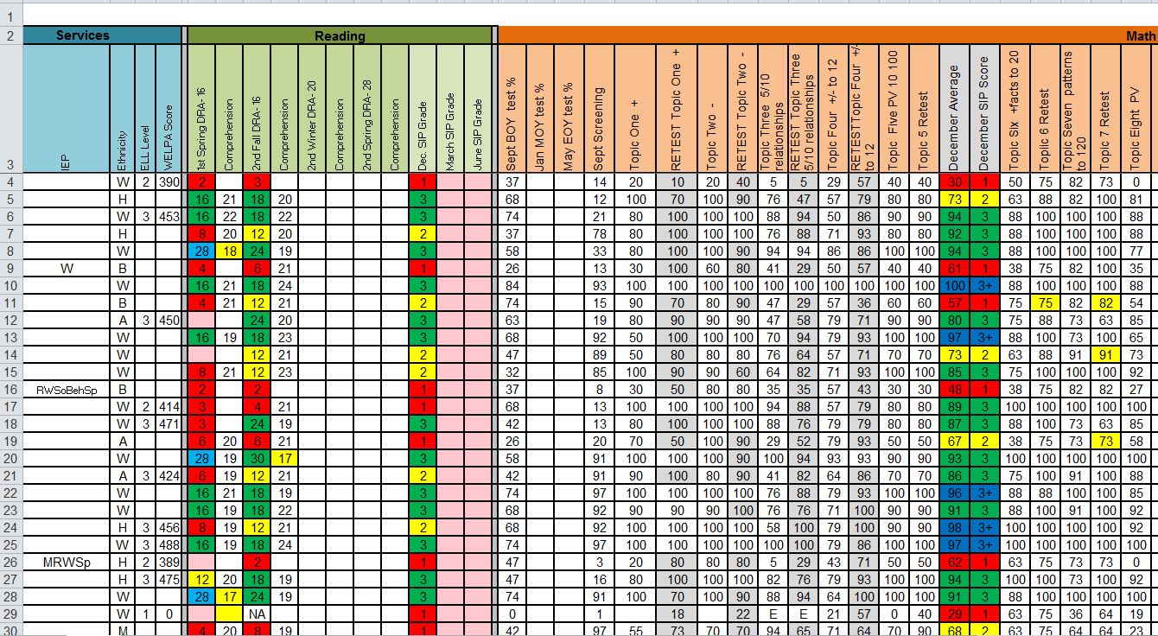
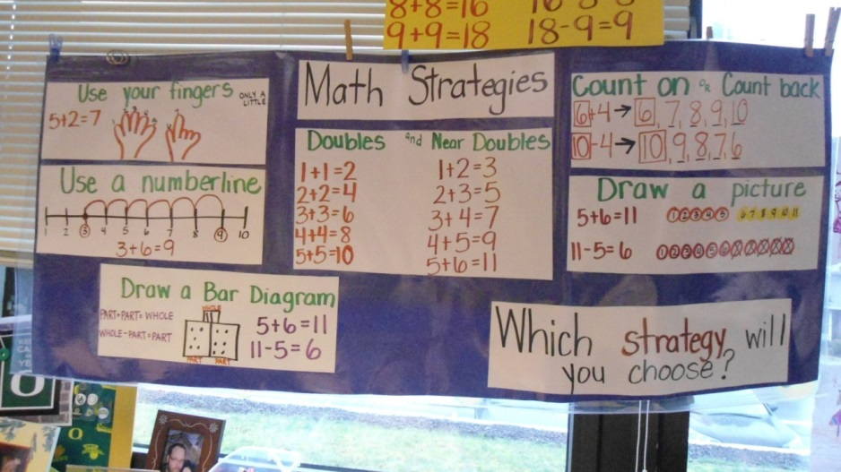
Eight Step Instructional Process
Notes:
Cindy
So, those are the great people who make Lowell special. We wanted to start with them so that when we move on now you keep these people in your mind and remember it is their hard work on a daily basis that make all of the good things happen.
Lowell is an 8 Step school. Without a doubt, Lowell systematically integrates the 8 Step Instructional Process into everything we do. We have made the 8 Step process a part of our every day and it is not something we have to remind teachers of. The 8 Steps are embedded.
The 8 Steps are how we structure our school because we believe so strongly in the continuous improvement model. We know in order to be a successful school we have to continually implement best practices.
It is because of this that we are not going to overtly go step by step today and point out everything we do in each step. However, you will see the 8 Steps integrated in our presentation.
However, on this slide you can see a few examples of the eight steps.
Step 1, disaggregating data, drives everything we do. You already know that we create CAST sheets containing academic data and teachers here are still breaking down this data into student sub group categories.
We hold CAST meetings to monitor, which is Step 8, this data.
We also still make sure we have instructional focus, Step 2, and teachers post I Can statements and visual strategy charts, like the one here, that expand on each I Can statement.
Because of our focus on continuous improvement, we always look to reflect and refine. We never settle, always looking for ways to push farther using the 8 Steps as our instructional model.

Slide 10
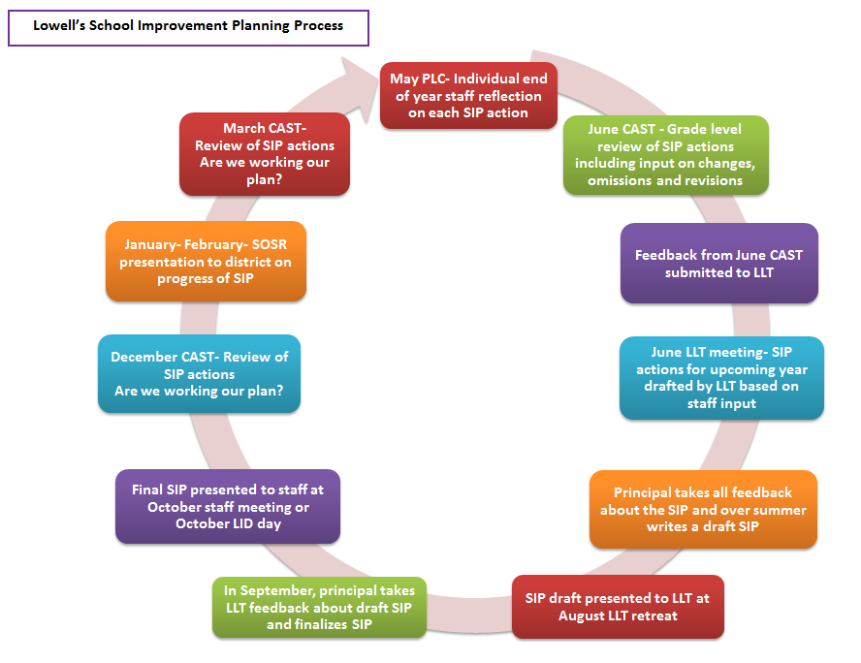
Notes:
Cindy
In addition to our focus on the 8 Steps, we also apply the idea of continuous improvement to the school improvement planning process we use here at Lowell.
The School Improvement Plan we create each year for our school is not a static document. Instead, it drives our work. Our school improvement process is a year long endeavor.
You can see on this visual we use to track the SIP process here at Lowell, that we are currently at the step where we present our SOSR and sharing our School Improvement Plan actions and the progress we have made on each of these actions.

Slide 11
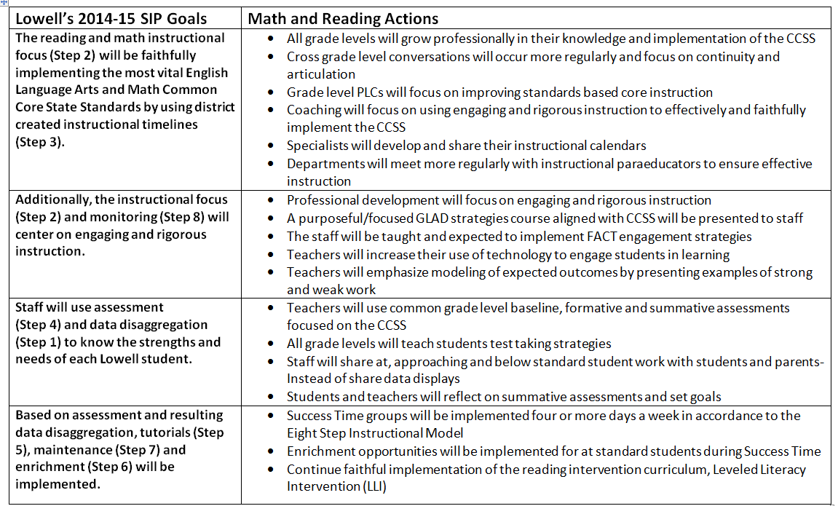
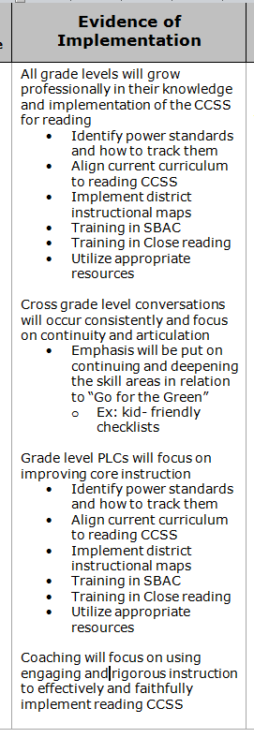
Notes:
Cindy
So, each of the changes, refinements, you hear us talk about today in reading, math, writing and science, are not just random ideas we came up with, but instead systematic actions our staff proposed through our School Improvement planning process.

Slide 12
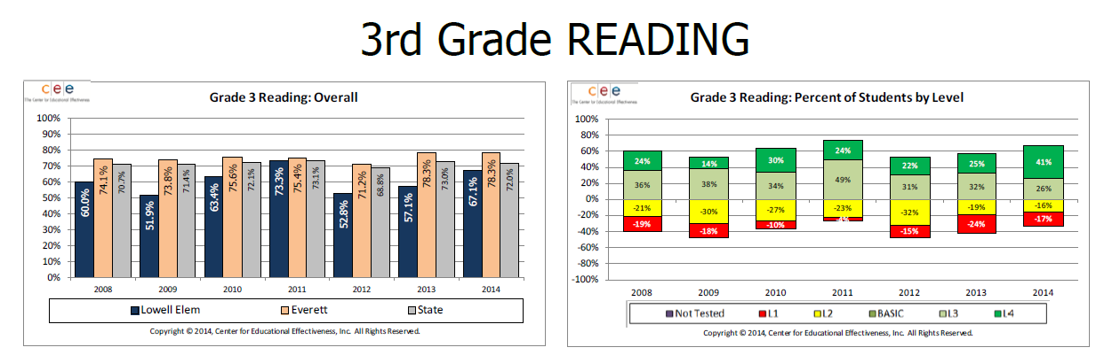
Notes:
Anne
However, before we begin sharing the SIP actions we have implemented, we are first going to share the academic data that drove the need for these actions.
We will begin by looking at the 2014 Reading MSP results for our school.
This slide shows you the results for last year’s 3rd grade students.
Their passing rate last year was 67.1%
Looking at the last five years our 3rd grade reading has been up and down from 63% to 67% and has dipped to a low of 52.8% in 2012
We have seen a large increase in Level 4s over the last 5 years from 22% at last year where 41% of our 3rd graders scored at a level 4.
Also, we have stayed stable in Level 2 and saw a decrease in our Level 1s

Slide 13
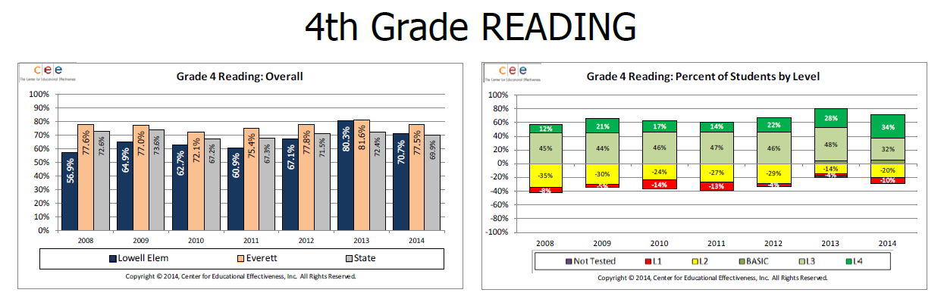
Notes:
Anne
Moving onto 4th grade reading,
Last year’s 4th graders had a passing rate of 70.7%
The last five years we have seen a steady increase in the 4th grade passing rate from 62% to 70.7%, with a high of 80.3% in 2013
There has been an increase in Level 4s- from 28% to 34%
Also, an increase in Level 2s from 14% to 20%
If asked- looks like L3s dropped to 2s

Slide 14
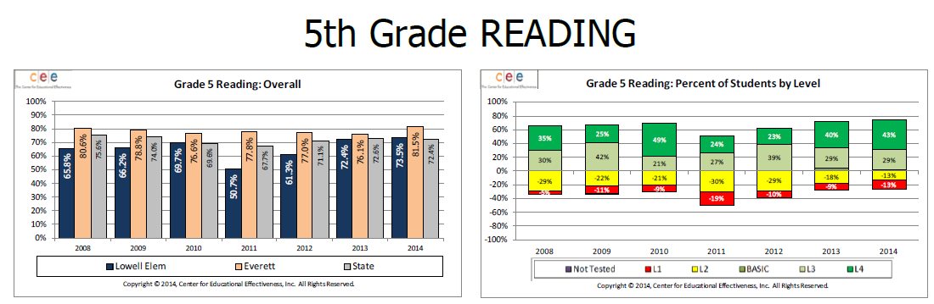
Notes:
Anne
Finally, our last year 5th graders had a MSP passing rate of 73.5%
Over the last five years there has been a steady increase in the percentage of students passing the 5th grade reading MSP from 50.7% to 73.5%
From 2013 to 2014 we stayed stable in our Level 1 through Level 4 percentages

Slide 15
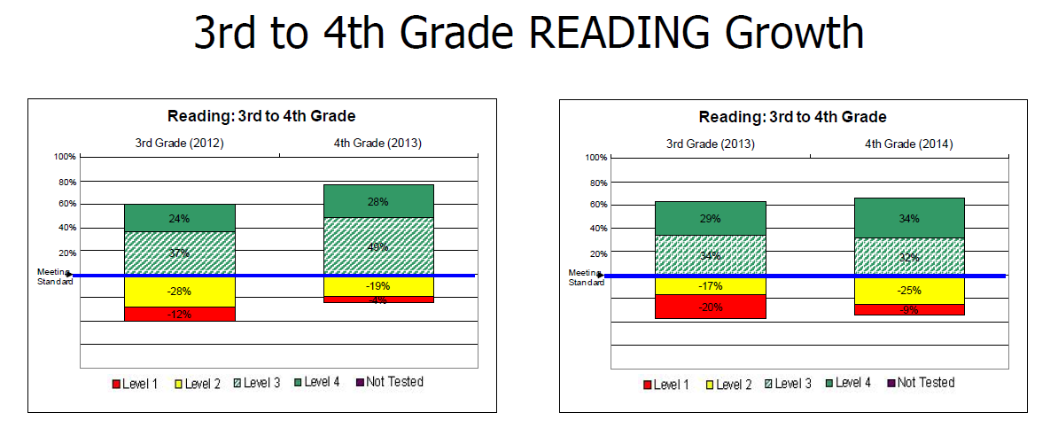
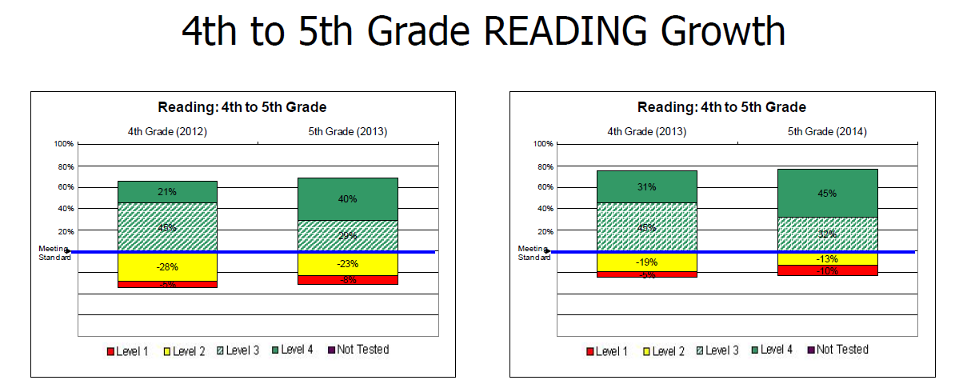
Notes:
Anne
In terms of growth from one grade to the next grade, you can see that when 3rd graders moved onto 4th grade and took the reading MSP there was an
Increase in Level 4s
That we stayed stable in Level 3s
And had a decrease in Level 1s- they moved up to Level 2
When our 4th grade readers moved up to 5th grade there was a
Big increase in Level 4s- from 31% to 45%
6% decrease in Level 2s
Slight increase in Level 1s
*** Make sure to have handy in paper form the 2012- 2013 slides just in case are asked, maybe have them also in a separate PPT in case asked

Slide 16
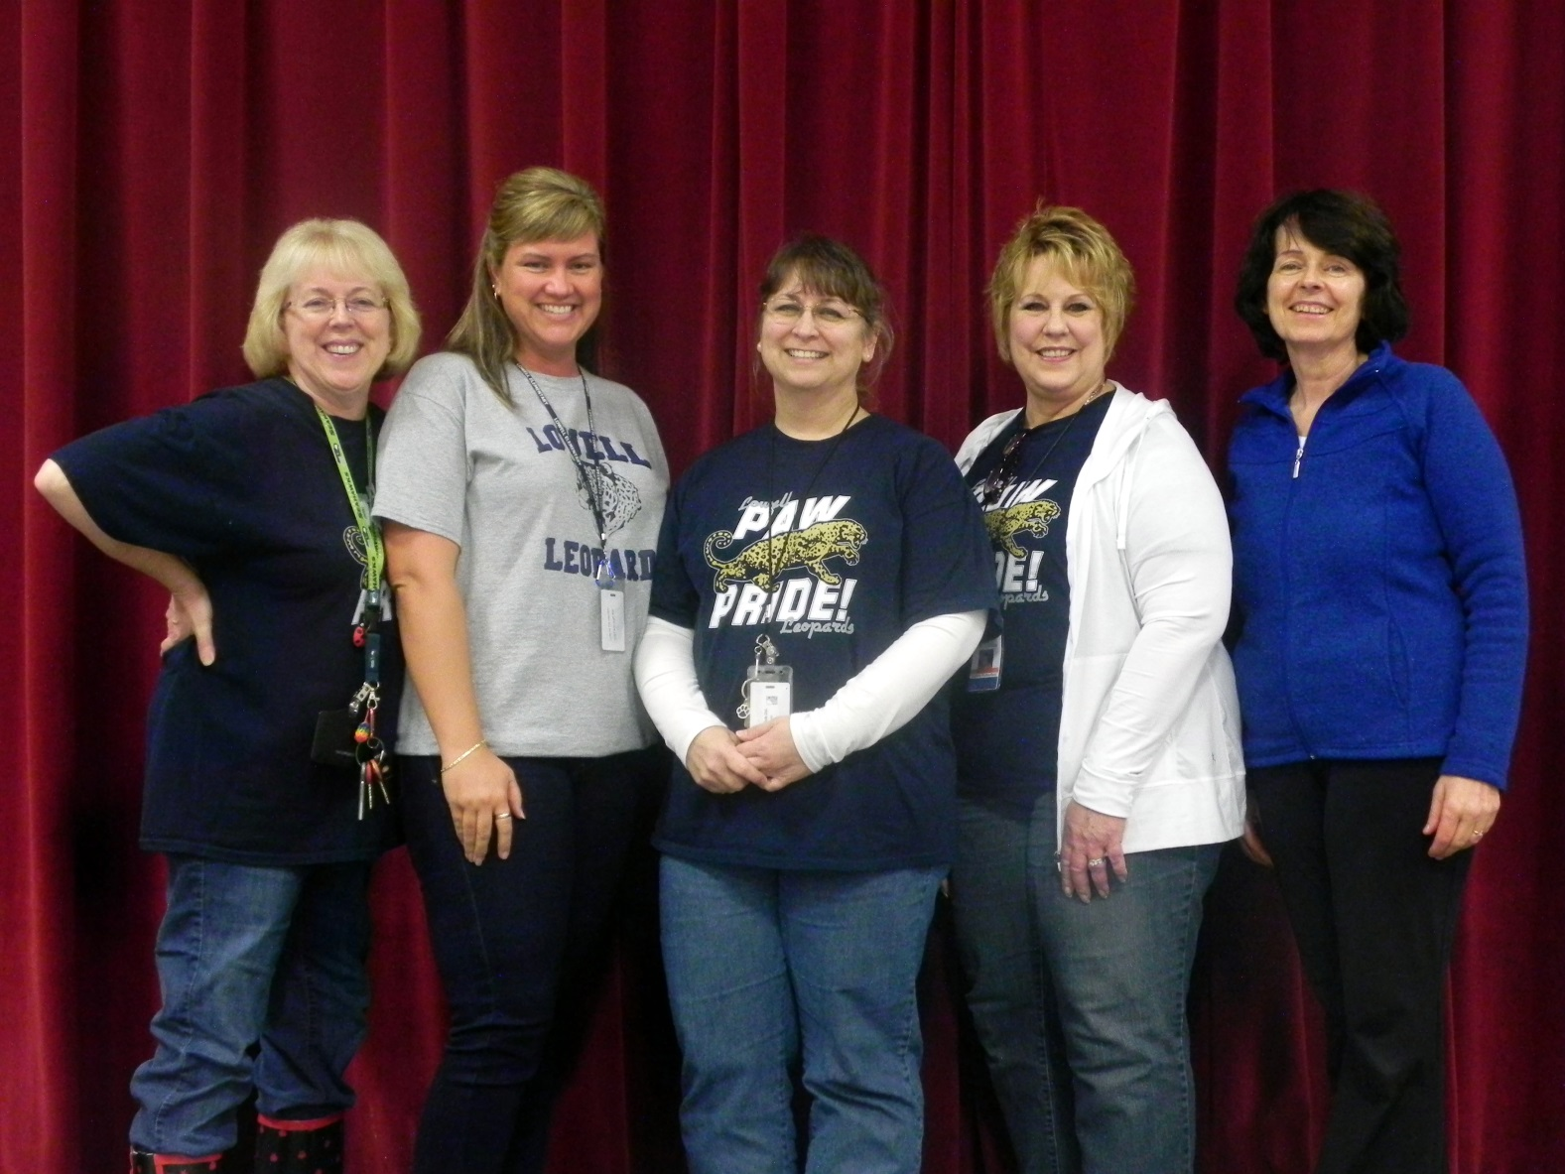
Meet the Reading Team
Notes:
Thank you Anne. We’ve done a lot in reading, but as Cindy and Anne have said, we’re only going to focus on a few of the refinements we’ve made. I’d like to introduce you to our reading team. Going from left to right is Colleen Rader, Wendy Shaver, me, Debbie Rutherford, and Francis Fritze. Between the five of us we provide small group reading intervention to 107 students. These groups occur in addition to the core reading instruction provided by the classroom teachers. I also work with teachers during Professional Learning Community meetings, which we call PLCs. I do literacy coaching with the teachers that can involve co-planning, brainstorming, discussions and modeling lessons. Lisa will be telling you more about coaching a little later.

Slide 17
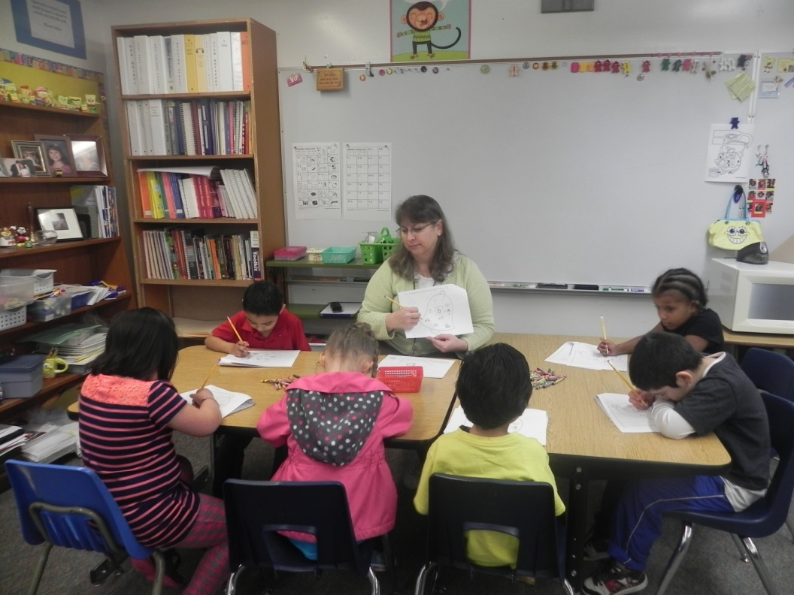
Early Intervention
Notes:
One main change we made is to emphasize early intervention in reading.
When we created our school schedule we started with Success Time and made sure that kindergarten classes were included. In October, I used the letter names and sounds data from the assessment done by the kindergarten teachers to create intervention groups using a curriculum called Explode the Code which focuses on learning letter names and sounds. I looked at our data from last year and in Nov. of 2013 we had 60% of kindergarten students on standard for letter names and sounds, by Jan. of 2014 it had dropped to 54%. This does not necessarily mean that they forgot letters, the goal for number of letter names and sound increased. So they didn’t learn anything more between Nov. and Jan. This year we had 48% on standard in Nov. and 71% on standard in Jan so I feel that it was a successful intervention.
We also tested all of the kindergarteners in January using the Developmental Reading Assessment or DRA. The students who were below the winter target of level 1 on the DRA were placed in Leveled Literacy Intervention groups, LLI, I’ll tell you more about that curriculum in a moment. We are serving 100% of students who are below standard on the DRA in Kindergarten and 1st grade. We are focusing on early intervention to close the achievement gap while that gap is still small. The literacy coaching in the primary grades has focused on guided reading plans that accelerate the learning of struggling readers.

Slide 18


Leveled Literacy Intervention
Notes:
Leveled Literacy Intervention is a curriculum that our district purchased last year. We had increases in reading levels the last two years.
For instance, we usually have a “winter dip” in scores in the 1st grade. You can see on the graph that in the 2012-2013 school year we had 1st graders scoring at levels A, 1 and 2 during the winter testing window. Levels A, 1, and 2 are at the kindergarten level on the DRA. In the 2013-2014 school year we had no 1st graders at level A. This year, for the first time ever, we have no 1st graders at levels A, 1, or 2. The lowest scores are at level 3, which is beginning 1st grade level.
We are serving students in Kindergarten through 4th grade in LLI groups. The students love it because they are actually reading, the teachers love it because they are seeing increases in reading ability.
In order to help the classroom teachers monitor the LLI students’ progress I modified the recording forms that came with the curriculum so that they included DRA equivalents, a DRA aim line to show where the student should be, and the actual DRA test scores for that student along with the test data from LLI. I created files for all of the students in LLI groups and put the files into our shared reading folder so that the classroom teachers would be able to access this data.

Slide 19


Leveled Literacy Intervention
Notes:
With the way we set up our schedule we were able to maximize the time that the paras have for small group instruction. All five of us are working with groups from 8:40 to 11:00, with Francis and Debbie working with groups throughout the day. This is the form that I use for scheduling and tracking of students. If a student qualifies for an LLI group next year or is moved out this year and then we need to move him back in, I can check my form to see where he left off and place him in the best possible group.

Slide 20





Accelerated Reader
Notes:
We’ve also been working on increasing the volume of reading done by our students. One way we are increasing reading is through Accelerated Reader, or AR for short. A big change we made is in introducing Certification Awards. In order to earn a certificate a student must earn a certain number of points by reading a certain number of books in a certain reading level and getting at least 80% correct on the quiz. 2nd grade students can also earn the Einstein Award for reading and passing quizzes on non-fiction books.
We started having grade level assemblies to celebrate these accomplishments. When students earn a certificate they also earn a reading charm.
I have worked with teachers on how to use the AR reports to monitor their classes, confer with students, and set certification goals. Rob Raymond, our librarian, has worked with 1st and 2nd grade students to train them on how to find a good fit book, and how to log onto the AR website and take an AR quiz.

Slide 21




AR Data
Notes:
As you can see from the data in the top bar graph, we have a pattern of lower at the beginning of the year, higher in the middle and then sloping down at the end of the year. It makes sense that it’s low at the beginning, kindergarteners are not reading yet, nor are many of the first graders. June is usually lower because it’s not a whole month of reading and the library shuts down for inventory. Our big months are January through May. I hope that with the grade level assemblies, certificates and charms, the students will be motivated to read more.
The second bar graph shows how are students do on the quizzes in AR. We tend to hover right around 50% of our students with an average of 85% on quizzes. If a student has an average of between 85% and 92% that means that he’s reading books that are just right for him. I’m hoping that now that we are focusing on Certification goals, more students will be scoring in that just right range.

Slide 22

Notes:
Cindy
Thank you Mary for highlighting the important refinements we are making in the area of reading.
Now, I am moving us on to look at our MSP writing data. As you can see, last year was another increase in our students meeting standard in writing. Our last year’s passing rate was 56.1%.
The last five years we have seen a steady increase in our writing assessment passing rate percentage- from 35% to 56.1%
Also notice there has been a large decrease in our L1s from 44% to 15%.

Slide 23





David Matteson Writing
Notes:
Mary
There are two main ways we’re working on increasing the volume of writing at Lowell. The first way is with David Matteson writing, Building Foundations that Last. This is the focus for the primary grades Nearly all of our K and 1st teachers are trained in David Matteson writing. The one teacher who is not trained is working with his grade level observing and planning during PLC to learn as much as he can. One of our former 1st grade teachers is now teaching 2nd grade and teaching her team how to implement this also. We’re very excited about the amount of writing that our younger students are doing as well as how organized that writing is.

Slide 24




Writing From Sources
Notes:
The second way we’re increasing writing is at the intermediate level. We are having our students write across the subject areas from sources. 3, 4, and 5th grade teachers came together and developed a unified approach to note taking. I’ve gone in and modeled note taking lessons. We are creating anchor posters for the students so that they know what is expected in a finished piece of writing. The first challenge we had was in teaching the students how to take notes. They need practice in choosing words and short phrases and not copying full sentences from the text onto their note taking page. The next challenge we face is teaching our students how to integrate the information from their notes into their writing. Finally, we are teaching them how to use the same notes for narrative, informational, and opinion pieces.

Slide 25



Learning About the SBA
Notes:
The 345 literacy teachers and I had a full release day to learn more about the Smarter Balanced Assessment for English Language Arts, the Digital Library, and planning and creating materials for writing instruction. We’ve studied the SBA rubrics for writing and had some time to do common scoring of short writing pieces. I think this day did a lot to calm the teachers’ fears about the new test.

Slide 26

Notes:
Anne
Thank you Mary for highlighting the refinements we are making at Lowell in writing. Now, we are going to move onto math and look at the data for math and the important enhancements we are making this year to make our math instruction even stronger.
Starting with the 3rd grade, last year our MSP passing rate in math was 65.8%
The last five years we have seen a steady increase in passing rate- 49.3 to 65.8
Also, there has been a decrease in L2s
And an increase in our L3s and L4s

Slide 27

Notes:
Anne
In 4th grade we had a passing percentage of 68.3%
Over the last five years we’ve had a steady increase from a low of 42% to 68.3%
We have seen an increase in our L1s and L3s- some L2s moved to ones, but we also had some of those L2s move up to L3.

Slide 28

Notes:
Anne
In 5th grade, our passing rate last year was 61.8%
Our last five years in 5th grade math have been up and down- from a low of 49.3% to a high of 69.4%. Last year we rebounded from a passing rate of 53.9% in 2013 to a passing rate last year of 61.8%
Unfortunately, we had an increase in L1s from 18 to 22%
Alternatively, we were fortunate to also have an increase in L4s from 18 to 29%

Slide 29


Notes:
Anne
Looking at growth from one grade to the next grade, you can see that when 3rd graders moved onto 4th grade and took the math MSP there was an
Increase in L1s
And we stayed stable in L3 and L4
When our 4th grade mathematicians moved up to 5th grade we stayed stable in all levels- L1- L4. This shows that even when the math gets harder, the passing rates at each score level can maintain.
Those are our MSP math results from 2014, now Lisa is going do discuss how we are refining our math instruction to move even more students to standard.

Slide 30

Meet the Math Team
Notes:
Meet the Marvelous Math Team!
Lowell’s Math team consists of a Part time math para, Michelle Gordon, who pulls K-3 math groups during morning Success Times
Cindy Kuntz who pulls K-3 math groups during success time, runs the ambassador program Cindy referred to earlier, preps for our monthly math award assemblies, and so much more.
As my teammates work on interventions and prep work, I have transitioned this year into making my role more about the opportunity to assist teachers in strengthening their core math instruction, in the hopes of eventually reducing the need for intervention and re-teaching. We are hoping to make changes through the use of instructional coaching. Instructional coaching is the most successful when there is trust and respect amongst teaching colleagues. Mary in reading and myself in math have built that trust and respect. We also worked on honing our own coaching knowledge, by reading books and articles and meeting with Coach Chris from Abeo. This year it seems to have all come together and we can now utilize that trust and apply those coaching skills.

Slide 31



Instructional Coaching and PLCs
Notes:
One coaching quote that stood out for me was “…there is no more powerful way to initiate significant change than to convene a conversation (Wheatley)
Coaching and PLCs this year have been changed to revolve around discussion. Mary and I have been spending less time giving information and more time helping teachers process through information and best teaching practices. This year we began ‘coaching cycles’, which model the continuous improvement cycle and demonstrate all aspects of the 8 step instructional process. We spend 8-9 weeks coaching two grade levels. From September thru November, I worked with first and third grade teachers on math instruction, while Mary worked with K and 2nd on reading. During a coaching cycle, we meet only with the grades we are coaching during our Friday PLC time.
In a math coaching cycle, the grade level team reflects on the upcoming topic and each teacher chooses a standard that they would like help with. After discussing that standard we set a goal on what best practice we could use to increase the number of students reaching that standard. We then planned backwards to think through the curriculum and lessons to ensure that every student meets that learning target. The time I spend in the classrooms is collecting evidence of student learning around this standard, supporting teachers using best practices, modeling instruction, and getting a deeper understanding of the class context. I am in each of the teacher’s classrooms at least twice a week during their math instruction. In the past I have pulled kids out for intervention services so have never seen the core curriculum being delivered. This year I am in the classrooms and this has made a huge difference. At PLCS we can discuss the student’s response to the curriculum, what we need to do differently, and plan accordingly. Since I am in all of the classrooms during instruction I can be involved in the discussion, in the planning, in enforcing best practices, and highlight teachers and students in their learning process. We can assist each other in identifying and addressing student misconceptions and share ideas to strengthen the lessons. In Friday PLC we reflect on that week and on its specific lessons . At the end of our cycle we reflected on how the entire cycle went to improve the next one. Here is an example of one teacher’s reflection – and my two stars and a wish for them as they go forth. This year I have seen the increase in excitement for math, the increase knowledge in math content and student learning progression. I have been part of the planning and instruction team and together we have created a stronger math curriculum for our students.

Slide 32







Reflection and Accountable Talk
Notes:
Lisa
Two of the areas we put emphasis on throughout the whole coaching process were the need for teachers and students to reflect and engage in accountable talk.
Reflection is woven throughout everything we do here at Lowell, and has become an integral part of our staff interactions as Cindy stated earlier. We’ve always reflected on lessons, practices, climate, student behavior and growth. We reflect in our daily staff bulletin, weekly PLCs, staff meeting, CAST, and daily conversations. Students have been reflecting on their formative, summative assessments, and their progress reports. This year we are trying to better include the primary students in this successful strategy of reflection and goal setting. Here is an example of a first grader who used a simple template and colored their results then were able to understand and reflect independently on their results.
Another Teaching practice our staff is focusing on is accountable talk. It has many different names but can be applied through out all content areas. Last year Jana rained us on how to have accountable talk in math. This year Christy shared reading ideas and Allison presented science applications for accountable talk. Teachers are using student anchor charts on what accountable talk looks like and sentence starters to help students structure their accountable talk discussions. During my coaching, I am seeing this best practice used in all classrooms and am seeing improvement in the way kids talk to each other, listen to each other, clearer explanation of their thinking , and better overall increased accountability for the content. Students know that at any time they could be asked to either add on, repeat or restate what was just said by teacher or another student. At any time, they can ask questions or have something repeated to check their own understanding. Our staff has spent time setting the groundwork for this important skill and now can benefit from its regular use. Teachers are able to ask higher level, more complex questions in all content areas as students now have the skills to respond.

Slide 33







Math SBA Training
Go For the Green!
Notes:
Lisa
One more thing I wanted to mention in math was our intentional work on helping teachers and students prepare for the SBA and in turn relieve some of the stress surrounding this new mandated test. Our technology teachers have increased keyboarding practice and have been purposefully teaching the online SBA testing tools. Teachers have been using Chromebooks regularly in their classrooms for various reasons including taking every Math topic test. Grades 3 – 5 math teachers have been meeting regularly during LIF to collaboratively complete the modules on SBAC, to navigate through the digital library and to discuss the process of taking a practice test. All 3rd thru 5th grade students have already practiced multiple times logging on using their state id. Recently those teachers, the special education teacher, me, and the newly hired math intervention met for a day to better get to know the test and to discuss prioritized standards that students need to master. We planned how and when to give the interim tests and the practice performance assessments. We want our teachers and students to have a working knowledge of the test so that they can focus on the job of doing their best to show mastery of the math content. As a school, we have worked on best teaching practices for solving word problems and have agreed on rubrics for each grade level so that we are aligned and articulated on the K – 5 vocabulary and procedures for problem solving. CAST and staff meetings were used to help with this endeavor – you can see the results on our GO FOR THE GREEN chart in the hallway on the way out today if interested. Our slogan “go for the Green!” is used as the title and also as a mantra for each and every student at Lowell. We will give you the knowledge so that you can be successful, reach standard , and reach the green.

Slide 34

Notes:
Anne
Finally, the last content area MSP data we would like to share with you is science.
Last year our science MSP passing rate was 61.8%
Over the last five years we have had big increases in our passing percentages- from 32.8% to 75%, however, last year when we had a dip in our scores
This moved some of our L3 students to move down to L2, causing an increase in the percentage of students at L2. However, even with the drop in scores last year we did see an increase in L4. We also noticed when looking at our science MSP sub scores that we maintained a 75% passing rate in the area of scientific procedure, but where we took the hit was in science content knowledge where our passing percentage was only 52%. Now, Lisa is going to talk about how we are addressing this content knowledge gap and other ways we are looking to increase science achievement.

Slide 35





Meet the STEM Team
Notes:
Meet our STEM Team which includes representation from each grade level. This team is facilitated by our fifth grade science teacher, Brent Radcliff. This team meets regularly during LIF time to discuss how to improve Lowell’s science instruction. This year at a staff meeting, they presented the scientific process and ways to incorporate teaching this process at every grade level. You can see the first grade chant and scientific process work sample here.
Hence even primary students are now using the scientific process and terminology - at their level. The team shares science chants and templates that help students solidity and transfer their knowledge through the grades. The Stem Team decided this year that they needed to set clear expectations for science instruction and asked staff to teach at least one hour of science from the kits to be taught weekly. They narrowed the focus and prioritized science lessons for each grade level to make this more doable. This work has led to more intentional and more aligned teaching of science content at earlier grades. We hope This background knowledge will help our fifth graders be more successful on the science MSP and reach standard in science.

Slide 36










Notes:
This year, one enhancement to 5th grade science has been the teacher’s emphasis on increasing the amount of writing in science. Mr. Radcliff has incorporated writing standards into his science expectations, and daily has students work and reflect in their science journals. His sharing and models of this has increased writing in science in all grade levels. In addition, Allison Greenburg and Christy Clausen presented to our staff a lesson that integrated science and ELA content. This training provided more ideas for our staff to consider ways to integrate content areas. Note taking was encouraged, using science articles, student s highlight the main ideas in one color, details in another color. They take notes from this highlighting to help them understand the text.
Last year, in its first year, we had four kids from fifth grade participate in the STEM expo. Those four students put many hours in after school to prepare their projects. Allan-Michel even took home first place in his category. This year fourth and fifth grade will participate and we hope to increase the number of students to 12 science students.
Another science opportunity in our building is our on site Robotics Club that meets twice a week and is very motivating to our students. We are very thankful for the support the district t has provided to fund this highly successful club.
As you can see, science instruction is moving forward and being fine tuned across the grade levels.

Slide 37
MSP Sub Group Performance in Reading and Math
Special Education
Low Income
White
English Language Learners
Hispanic
Notes:
Cindy
We have looked at the content area data, but now I want to speak specifically about how our sub groups performed on the MSP.
Today, I am only going to focus on the sub groups that we are accountable for under the No Child Left Behind law and the sub groups we need to make Adequate Yearly Progress or AYP.
These sub groups are- Hispanic, White, ELL, Low Income and Special Education.
This is not to say other sub groups represented at some grade levels in our data, for example African American, are not important.
We are adamant here at Lowell that all children count and are equally important.
But for this presentation we will only highlight our AYP sub groups and specifically in reading and math.

Slide 38



Notes:
Cindy
So, I will start out with our reading MSP ethnic and program gaps.
Looking at 3rd- 5th grade reading starting with our Hispanics students…
In 3rd grade there was only a 7% gap between Hispanics and the overall passing rate.
In 4th grade, there was approximately a 10% gap. And
In 5th grade, there was a 20% gap in between Hispanics and the overall passing rate.
As for our white students on last year’s reading MSP…
Our 3rd grade white students had a 7% gap compared to the overall passing rate of 67.1%
In 4th grade and 5th grade the white students outperformed the overall passing rate by about 8% in both grades
Looking at our ELL students….
In 3rd grade there was a 10% gap between the ELL passing rate and the overall passing rate
In 4th grade a 12% gap was realized
And in 5th grade
The ELL and special education passing rate was the same at 33%, this shows a large gap in passing between ELL and Sped and compared to our overall passing rate of 73%, this is a 40% passing rate gap
As far as our 3rd and 4th grade special education students on the reading MSP, there was also a significant gap.
For 3rd grade the gap was approximately 20%
And in 4th grade the gap was a little over 30%
Finally, our low income students in
3rd grade we had about a 7% gap in their passing rate compared to the overall
4th grade had a 8% gap
And 5th grade a 6% gap.
Now, Anne will share our ethnic and program gaps on last year’s math MSP.
_____________________________________________________________________________________
As a reminder, our overall passing rate in 3rd grade reading was 67.1%
So, starting with our 3rd grade reading ethnic gap-
Hispanics very little gap with their white peers- both in the 60% passing range
Our 3rd grade program gap data shows us that
Low income passed a bit above 60%
57% of our ELL students passed the reading MSP
Special education had a passing percentage of 35%
This passing rate demonstrates a large gap with our special ed 3rd graders
______
Moving onto 4th grade reading
Our 4th grade overall passing rate was 70.7%
For our
4th grade Ethnic Gap we see that
Hispanic had a passing rate of 60%, the white passing rate was 78% out performing the overall passing rate
For the 4th grade Program Gap
Low Income had a 62% passing rate
ELL passed with 58%
And Special education had a 37% passing rate________________________
Lastly, our 5th grade reading gaps
As a reminder we had an overall passing rate of 73.5%
For our
5th grade Ethnic Gap
The Hispanic passing rate was 52%, white students passed with 80%, this demonstrates a large gap between success on the MSP between white and Hispanic students
For our
5th grade Program Gap
Low Income students had a 67% passing rate, this demonstrates a small gap compared to the overall passing rate of 73%
Now Anne will summarize our ethnic and program gaps in math

Slide 39



Notes:
Anne
Moving onto math,
The overall passing rate was 65.8%
For the 3rd grade Ethnic Gap
The Hispanic passing rate was 62%, the white passing rate was 70%. This shows no real gap between Hispanics and the overall passing rate, 8% gap between white and Hispanic, white outperformed the overall passing rate
For the 3rd grade Program Gap
The Low Income passing rate was 69%. They outperformed the overall passing rate.
The ELL students had a passing rate of 57% showing just a small gap
The Special education students had a 50% passing rate , a gap of 15%____________________
For 4th grade the overall passing rate was 68.3%
For the 4th grade Ethnic Gap
The Hispanic passing rate was 80%, the white students passed at 63%. The Hispanics outperformed the overall passing rate, by a wide margin.
For the 4th grade Program Gap
The Low Income passing rate was 59% , approximate a 10% gap compared to the overall passing rate of 68%
The ELL 61% passing rate showed a slight gap between overall and ELL
The Special education students had a 27% passing rate
The shows a large gap in passing between Sped and overall passing rate______________________
Moving onto 5th grade, as a reminder, the overall passing rate was 61.8%
For the 5th grade Ethnic Gap
The Hispanic passing rate was 58%, the white 62%,. There was a small gap for Hispanics to overall and when compared to whites, no real gap for whites compared to overall.
For the 5th grade Program Gap
The Low Income passing rate was 60% passing rate showing no significant gap compared to overall
The ELL passing rate was 45%
The Special education passing rate was 17%
Again this shows a large gap in passing between Sped and overall passing rate
Lisa and Mary will now talk about what we are doing this year to hopefully minimize the gaps in math and reading performance of our sub groups compared to the general population.

Slide 40



What we have done to address gaps in sub groups
Pic of teachers discussing data charts
Over 110 students signed up for FREE tutoring!
Notes:
Lisa
We continue to use a template to track our math, writing and reading data for our sub groups – Each teacher uses the data on the CAST sheets to graph students by sub groups (POINT TO GRAPH AND READ All, Low income, special education, hispanic, white, English Language Learners ELL) which allows the teacher to better know the class, the students, and the students’ abilities. Percentages are calculated on how many students are on standard in each sub group and how many more students are needed to reach our safe harbor goal for that sub group. Staff creates these charts four times a year using current data and then share the changes in the data during their CAST meetings. Their grade level team, the principal, reading specialist, math specialist and special education teacher are all at CAST to discuss the results and offer suggestions. Documentation is made on suggestions and actions to be tried.
Another refinement we are trying out to address sub group gaps is our Learning Lab – every Wednesday 7:45 – 8:25 students can come to our computer lab and get help on homework, get help on a math concept, or practice math facts. Many of the students who come are ELL students who need help understanding the directions or who need the concept re-taught to them. This optional tutoring gives students another opportunity to receive extra help.
For our low income sub group, we put a big emphasis on capitalizing on the free tutoring available to our free and reduced students through the No Child Left Behind Legistration. Over 110 of those students signed up for free tutoring this year!

Slide 41



Meet the Special Education Team
Notes:
Lisa
To work with our special education subgroup, we have an awesome Special Education Team which includes our psychologist Robin Arnold, our Speech Language Pathologist Laurie Muller, our Occupational therapist Grace Jarchow, and our two resource room teachers.. Some of the refinements made with the special education team this year is having the two teachers specialize in grade bands. Meet our part time Terry Norris who works with all of our primary K-2 special education students. Meet Doreen Khan-Calhoun who works with our intermediate 3-5 special education students. This year these teachers pull their groups during success time. This ensures that their students will not miss any core curriculum instruction.
As a staff we have been working on less disconnect between general and special education. Our two special education teachers are now attending our PLCs and are an integral part of our CAST meetings. LIF time has been used to discuss ways to better meet the needs of this sub group, for example we have met several times to plan accommodations for our fact fluency knighting program and this year have seen quite a few special education students honored. Overall our staff feels we have been increasing communication and working closer together to bridge the special education gap.

Slide 42



Meet the ELL Team
Notes:
Another one of our AYP sub groups is English Language Learners. This is our ELL team. Barbara Lie has been our ELL para for many years. Because we have 130 ELL students now, we were able to hire Gabby Sleeman. Now we’re able to serve all of our students more frequently during the week.
46 of our ELL students are also served in LLI groups.
Many of our ELL students use the Imagine Learning English computer program. I noticed that it was hard for teachers to make sense of the report on how much time the student is working on the program, so I started transferring the data into spreadsheets for each teacher. The spread sheet is color coded so that the teacher can quickly look and see if the students are spending an adequate amount of time on the program each week.
We also received 9 additional ILE licenses. The licenses go to students who are level 2 ELL according to their WELPA (Washington English Language Proficiency Assessment) test scores. Barbara and I looked at the reading data for all eligible students to decide who would be added. We chose 3 Native Americans, and the other 6 licenses are being used by students who are ELL level 3 but below standard in reading.

Slide 43

Notes:
Cindy
So, to wrap up our presentation, we want to end on this data chart.
We feel it summarizes well our efforts here at Lowell. Our emphasis on early intervention, improving core instruction and intentionally targeting our AYP sub groups we feel is paying off. You can see Lowell is in the gaining section and this is exactly what we feel we are doing- gaining.
We use all elements of the continuous improvement model and the 8 step instructional process to help us improve. We really believe we are on the right path and with refinements will continue to help more students reach standard. We are open and reflective educators always open to improve what we do. We work very hard each and every day to make sure all of our students gain the skills and knowledge necessary for them to have a successful future.

Slide 44

Support Needed
  Smaller class sizes in primary grades
  Instructional coaching resources
  Success Time resources
  Models that have worked in closing the special education gap
  ELL instruction in kindergarten
  Clocks
  Behavior support
Notes:
Cindy
Now we would want to present the support we would like from the district. However, we first want to start out stating what we are thankful for.
Each year that we have stated our needs in the SOSR, you have responded. So, we want to acknowledge those things you have given us and that we are very thankful for-
Thank you for the the Leveled Literacy Intervention (LLI) program- finally we have a proven reading intervention and we are seeing results in our student’s improving reading skills
Thank you for funding our extended day programs- Robotics and Soccer Club. These extended learning opportunities are providing much needed and meaningful activities for our students after school.
Also, thank you for responding when we have come to you with programs that require support.
You have given us ELL support in the form of an additional para which helps with our 130 student caseload and allows us to maintain vital services.
You have given us another Sped Ed .5 teacher, Terry Norris, to assist with our large special ed numbers.
This year, we were given another reading LLI paraeducator and this has allowed us to run more reading intervention groups, therefore, serving more students
And finally, we want to say thank you for the wonderful part time assistant principal, Ms. Carnell. She has been so helpful in so many ways.
Now, moving onto other ways you can support the continued academic growth here at Lowell-
We would love to maintain and in some cases, lower our primary class sizes
Provide instructional coaching resources- for example, help fund our work with Abeo
We need additional Success Time resources for our enrichment groups
You saw and heard that we have a special education gap in terms of achievement and we would love any assistance you can provide on instructional models that work with special education students
Increase the instruction for our ELL students by providing those services in kindergarten, focusing on early intervention- We would like Imagine Learning English licenses and instructional ELL groups
We would love assistance with behavior support- we have many students, particularly in the primary grades, who struggle with behavior issues. We would like more paraeducator support to do things like, monitor our high flyers, do check ins with students who struggle daily with following expectations, etc…
Clocks???
____________________________________________________________________________________________________________
If audience mentions using the digital library during Success Time- Our response….
Trying to use digital library- but would need time and training to use it effectively during ST as an intervention and enrichment

Slide 45

Feedback and Questions
Notes:
Anne
Thank you so much for your attention to our presentation and we would now like to receive your feedback and questions about what you heard.

