Slide 1
SEXUAL EDUCATION
Female Reproductive System

Slide 2
Structure and Function
The reproductive cells in females are called eggs or ova (singular, ovum).
The functions of the female reproductive system are
  to produce sex hormones
  to produce eggs
  to provide a nourishing environment in which a fertilized egg can develop into a baby

Slide 3
Ovaries
The reproductive glands in which eggs are produced are called ovaries.
The sex hormone estrogen activates certain physical changes at puberty.
Progesterone activates changes to a woman’s reproductive system before and during pregnancy.
Once puberty begins, one of the ovaries releases a ripened egg about once every month in a process called ovulation.

Slide 4
Fallopian Tubes
Fallopian tubes (fuh LOH pee un) are passageways that carry eggs away from the ovaries.
When the ovary releases an egg during ovulation, the fingerlike ends of the fallopian tube draw the egg into the tube.
The fallopian tubes are where fertilization usually occurs.

Slide 5
Uterus
The uterus is a hollow, muscular, pear-shaped organ.
In the uterus, a fertilized egg can develop and grow.
When a baby is ready to be born, the cervix expands to allow the baby to pass through.

Slide 6
Vagina
The vagina, or birth canal, is a hollow, muscular passage leading from the uterus to the outside of the body.
Sperm enter a woman’s body through the vagina.
The walls of the vagina are very elastic, which allows it to expand dramatically during childbirth.

Slide 7
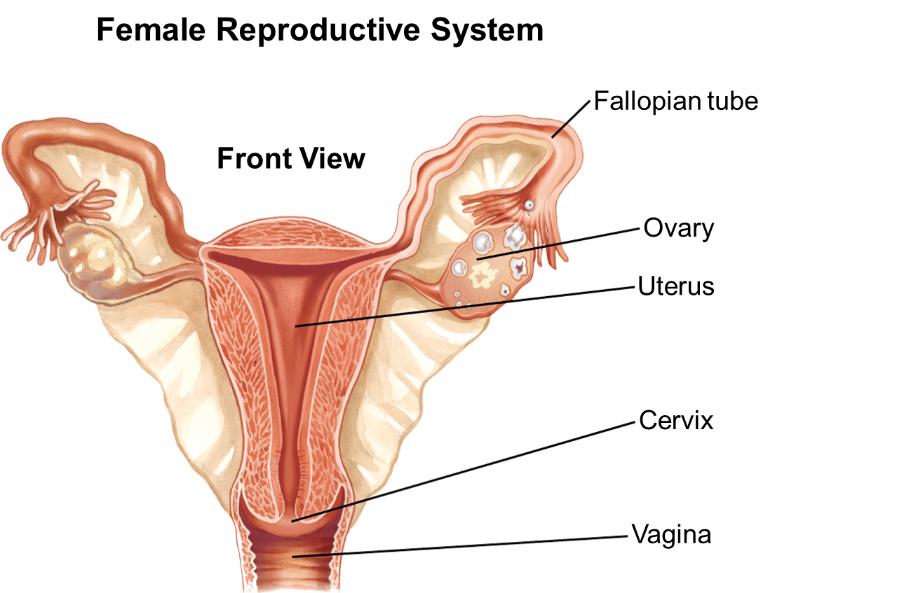

Slide 8
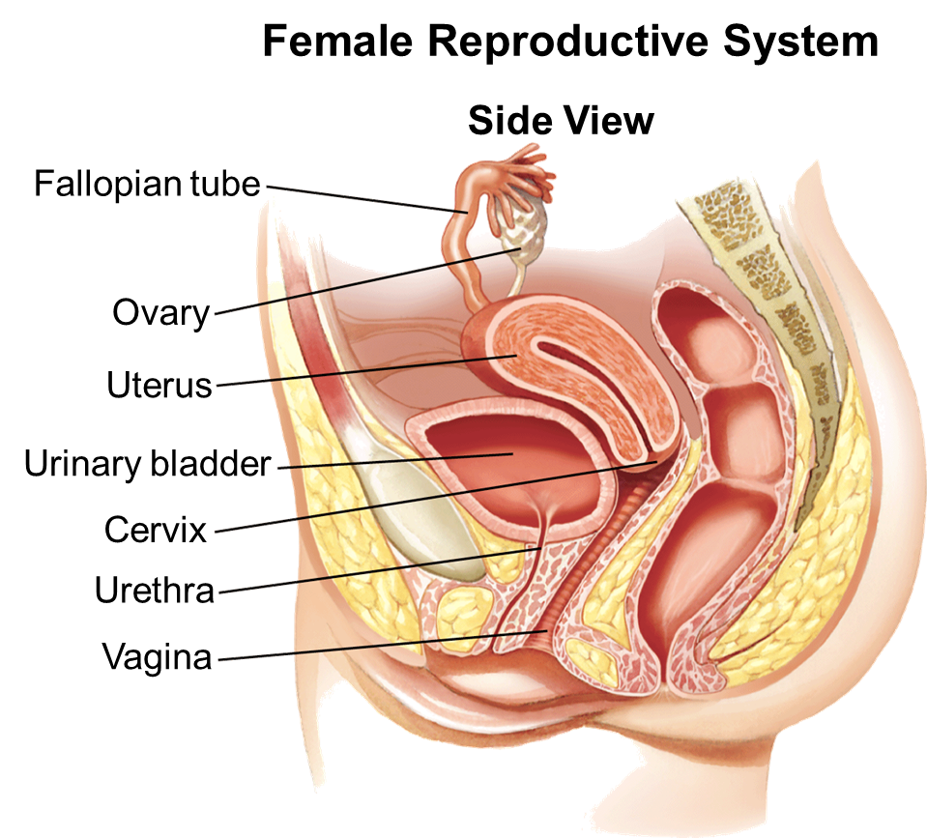

Slide 9
The Menstrual Cycle
Women usually produce only one mature egg cell each month during a process called the menstrual cycle (MEN stroo ul).
During the menstrual cycle, an ovary releases a mature egg.
The egg travels to the uterus.
If the egg is not fertilized, the uterine lining is shed and a new cycle begins.

Slide 10
Factors Affecting the Menstrual Cycle
On average, a woman’s menstrual cycle lasts 28 days.
Factors such as diet, stress, exercise, and weight gain or loss also affect the menstrual cycle.
The menstrual cycle may be irregular at times, especially during puberty.
During menopause, the ovaries slow down their hormone production and no longer release mature eggs.

Slide 11
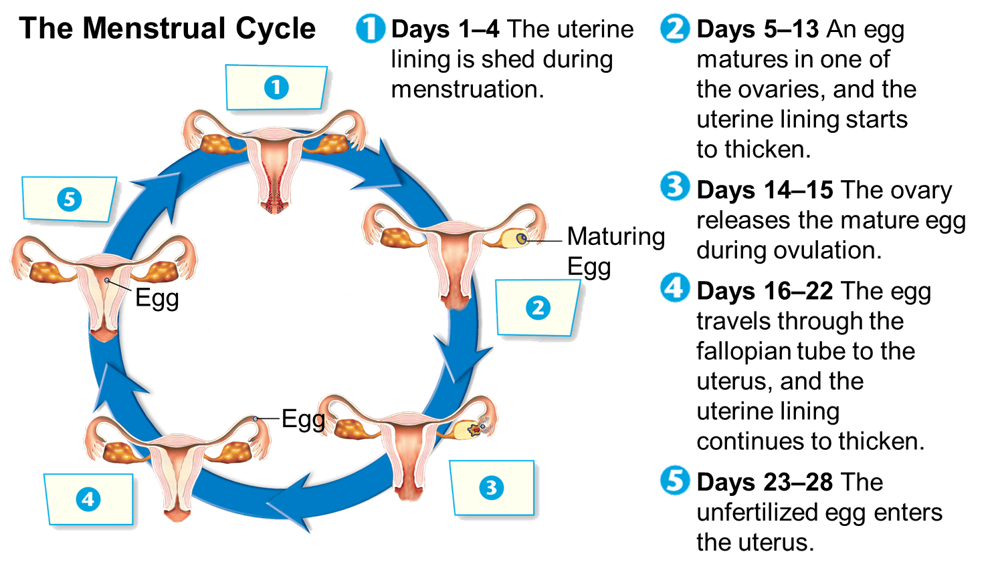

Slide 12
Stages of the Menstrual Cycle
During the first half of the cycle, an egg matures inside one of the ovaries.
At about the middle of the cycle ovulation occurs.
If the egg has not been fertilized by the time it reaches the uterus, the uterine lining breaks down.
The blood and tissue of the thickened lining pass out of the body through the vagina in a process called menstruation.

Slide 13
Menstrual Discomfort
Cramps are caused by contractions of the uterus.
Premenstrual syndrome, or PMS, is marked by nervous tension, mood swings, headaches, bloating, and irritability.
The dramatic change in hormone levels that occurs before menstruation begins may cause PMS.

Slide 14
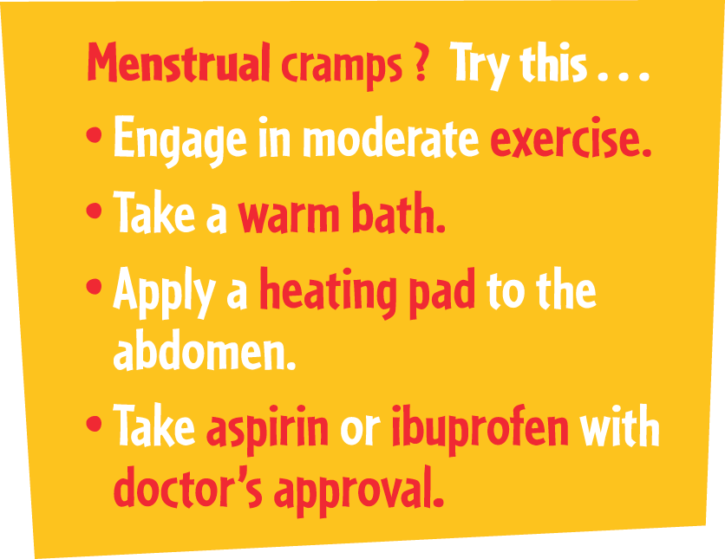

Slide 15
Toxic Shock Syndrome
This syndrome is caused by a bacterial infection.
Symptoms of toxic shock syndrome include
  a sudden high fever
  A rash
  Vomiting
  Diaherra
  Dizziness
To decrease the risk of toxic shock syndrome, women should use tampons with the lowest possible absorbency for their needs and change tampons often.

Slide 16
Keeping Healthy
Caring for the female reproductive system involves
    cleanliness
    sexual abstinence
    prompt treatment for infections
    self-exams
    regular medical checkups

Slide 17
Cleanliness
One important health habit is cleanliness, including daily washing of the external vaginal area.
Cleanliness is especially important during menstruation, as is the regular changing of sanitary pads or tampons.

Slide 18
Sexual Abstinence
A number of serious infections can result from sexual contact.
The only way to eliminate your risk of sexually transmitted infections is to abstain from sexual activity.

Slide 19
Prompt Treatment for Infections
Many women experience vaginitis, a vaginal infection caused by yeast, bacteria, or other microorganisms.
Symptoms include:
    a thick discharge
    odors
    vaginal itching
    a burning sensation during urination

Slide 20
Self-Exams
Symptoms of vaginitis, sores on the genitals, or any unusual pain in the abdomen require a medical exam.
A woman should consult a doctor
    if she notices heavier bleeding than normal during menstruation
    if her periods stop completely
    if she notices bleeding at times between her regular periods
For the early detection of breast cancer, all women, including teens, should perform a monthly breast self-examination.

Slide 21
Medical Checkups
In a Pap smear, a sample of cells is taken from the cervix and examined under a microscope.
A mammogram is an X-ray of the breast that can help detect breast cancer.
Ovarian cysts Ovarian cysts are growths on the ovary.
Endometriosis This is a condition in which tissue from the lining of the uterus—the endometrium—grows outside the uterus, in the pelvic cavity.
Infertility Causes of infertility in women include blocked fallopian tubes and problems with ovulation.

Slide 22
SEXUAL EDUCATION
Male Reproductive System

Slide 23
Structure and Function
In males, the reproductive cells are called sperm.
The functions of the male reproductive system are
  to produce sex hormones
  to produce and store sperm
  to deliver sperm to the female reproductive system
There, a sperm cell may join with an egg, in a process called fertilization

Slide 24
Testes
The testes (TES teez) are the male reproductive glands.
The testes (singular, testis) have two major functions—the production of testosterone and the production of sperm.
The sex hormone testosterone affects the production of sperm and signals certain physical changes at puberty.
The testes, also called testicles, hang outside the body within a sac of skin called the scrotum.

Slide 25
Penis
The penis is the external sexual organ through which sperm leave the body.
The tip of the penis is covered with loose skin, called the foreskin.
In some males the foreskin is removed shortly after birth.

Slide 26
Sperm Production
Sperm production begins when the hypothalamus signals the pituitary gland to release two hormones—luteinizing hormone (LH) and follicle-stimulating hormone (FSH).
LH signals the testes to begin making testosterone.
Testosterone and FSH then signal the production of sperm.

Slide 27
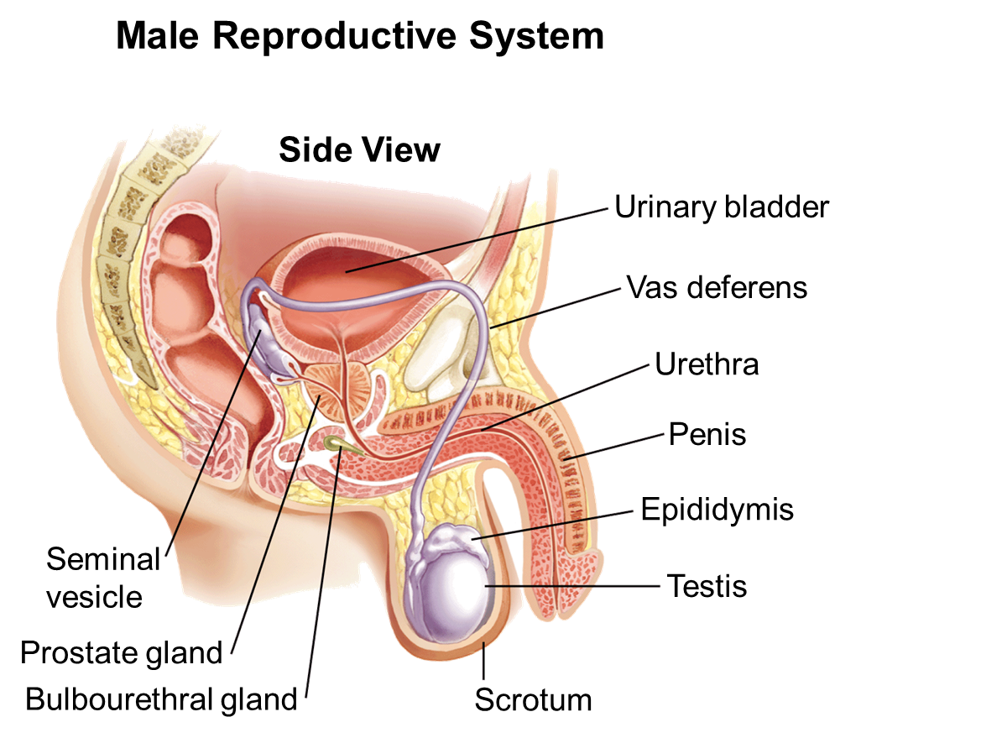

Slide 28
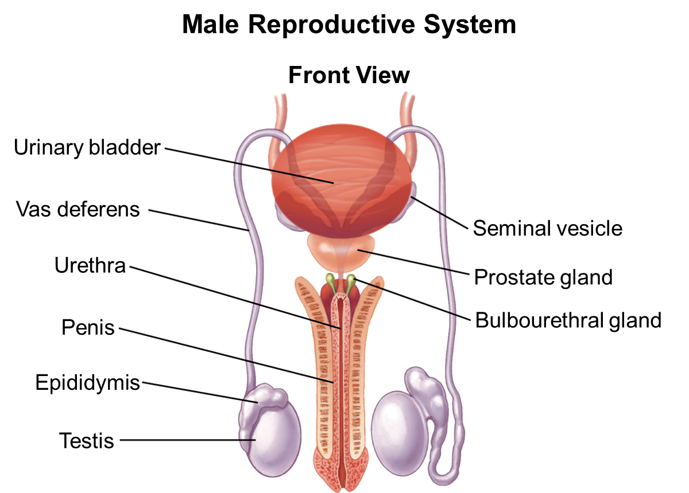

Slide 29
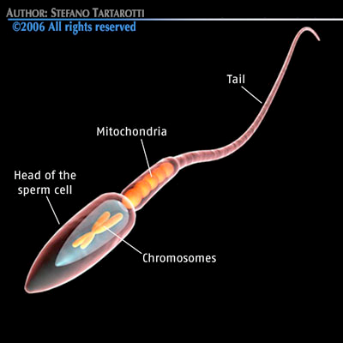
The Pathway of Sperm
During their passage through the male reproductive system, sperm cells mix with fluids produced by the prostate and two other glands.
The mixture of sperm cells
and these fluids is
called semen
(SEE mun).

Slide 30
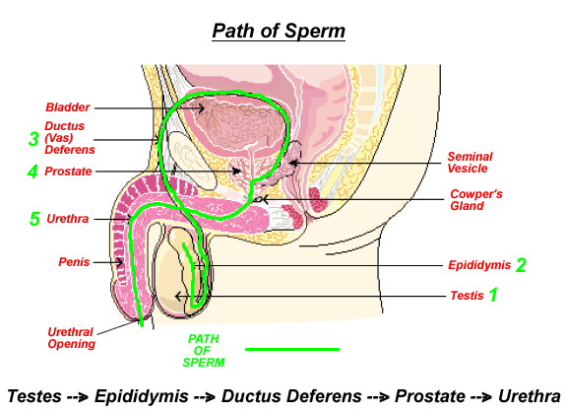

Slide 31
Release of Sperm
The ejection of semen from the penis is called ejaculation.
Ejaculation occurs when muscles in the male reproductive system and at the base of the bladder contract, forcing semen through the urethra.
Several million sperm cells are released during one ejaculation.
Ejaculation can occur when the penis is in an erect state.

Slide 32
Keeping Healthy
Caring for the male reproductive system involves
    cleanliness
    sexual abstinence
    prompt treatment for infections
    self-exams
    regular medical checkups

Slide 33
Cleanliness
It is important to thoroughly clean the external organs—the penis and scrotum—daily, preferably during a shower or bath.
Drying the groin area well after showering can prevent fungal infections that can cause jock itch

Slide 34
Sexual Abstinence
A number of serious infections of the reproductive system and other body systems can result from sexual contact.
The only way to eliminate your risk of sexually transmitted infections is to abstain or refrain
from sexual activity.

Slide 35
Protection From Trauma
During athletic activities, males should wear a protector, also called a “cup,” or supporter.
Tight clothing should be avoided.
Males should be careful when lifting heavy objects.

Slide 36
Self-Exams
It is important for males to monitor their own bodies for any signs of possible medical problems.
Pain when urinating, unusual discharges, or sores on the genitals require a medical examination.
Males should examine their testes for signs of testicular cancer.
Using your thumb and fore finger in a rolling motion. Looking for lumps, changes in size or texture.

Slide 37
Medical Checkups
Medical exams throughout life can help ensure reproductive health.
In many older men, the prostate becomes enlarged or develops cancer.
Another condition a doctor can diagnose is infertility—the condition of being unable to reproduce.
In males, infertility is marked by the inability to produce healthy sperm or the production of too few sperm.

