Slide 1


Module 7: Healthy Practices
Nutrition and Fitness
Child Development class

Slide 2
Objective-
The Student will demonstrate healthy practices.

Slide 3
Discussion Questions in groups:
What can we do to keep children healthy while they are under our care?
Can you think of some food handling and preparation regulations that would be present in a childcare setting? Describe challenges

Slide 4

Discussion Questions contd.
3. What do you think the differences are in changing a diaper in a licensed child care from the way parents diaper their children? Explain and describe the differences.

Slide 5

Hand washing
Frequent hand washing is the single best protection we have against the spread of germs and therefore staying healthy.
Make a list of required times for hand washing:

Slide 6
Required times for handwashing
When arriving at work
After toileting and diapering
After attending to an ill child
Before and after preparing, serving or eating food
Before and after giving medication
After being outdoors engaged in play
As needed

Slide 7
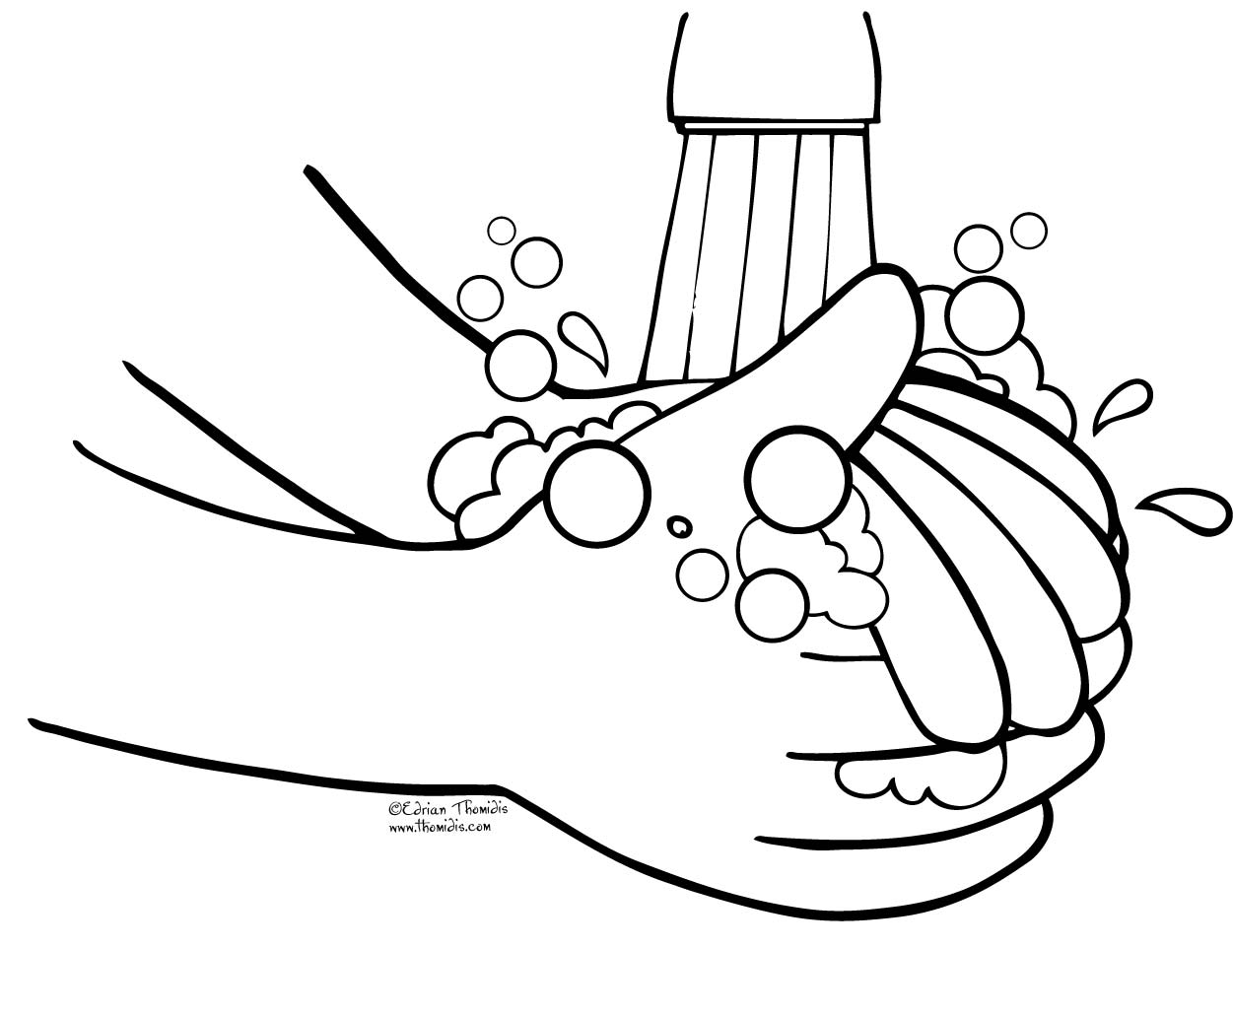
You would wash your hands after:
After wiping a child’s drippy nose
After touching a cut or open sore
After eating

Slide 8
Diaper Changing
This is a task that requires special attention because germs love warm, damp, dark places, and there is no place warmer, damper and darker than a soiled diaper.

Slide 9
Steps to changing a diaper
Wash hands
Gather necessary material.
Put disposable gloves on hands.
Place children gently on table and remove diaper.
Dispose of diaper in a hands-free garbage can with a lid.
Clean the child’s diaper area from front to back, using a clean, damp wipe for each wipe.
Apply topical cream/ointment/lotion when written consent is on file.
Remove gloves
Wash hands or use wet wipe (if no fecal matter on hands)
Put on clean diaper and dress the child.
Wash child’s hands with soap and running water or with wet wipe and dry hands with paper towel.

Slide 10
Diapering steps contd.
12. Place child in a safe place.
13. Clean and disinfect diapering area and any equipment touched.
14. Wash hands.

Slide 11
Food Handling and Snack/Meal Prep.
Children are especially vulnerable to foodborne illnesses due to their smaller body size and underdeveloped immune systems.
It is critical that food safety to be maintained in all areas of food storage and preparation.

Slide 12
Food Preparation Guidelines/Requirements
In programs where food is prepared , at least one staff member must have a Washington State Department of Health Food Handler’s Permit to:
Monitor and oversee food handling and service.
Provide orientation and ongoing training for all staff involved in food handling.

Slide 13
Best Practice with food prep.
All staff preparing, handling, and serving food should maintain a current Food Handler’s Card. This includes all teachers and caregivers who serve children food and snacks.

Slide 14
Foods that may not be served!
Leftover Food previously served outside your center. You can reserve food that was made in your center.
Home-canned, frozen or prepared food unless it is for the person’s own children.
Donated food from restaurants or caterers that was previously served.
Game meat that has not been inspected by the USDA.
Donated meat, fish, poultry that is not from a source inspected for sale.

Slide 15
Preventing Foodborne illnesses
Cooking and storing foods at incorrect temperatures are major contributing factors to foodborne illnesses.

Slide 16
Important numbers to remember for safe holding temperatures are:
45 degrees Fahrenheit for cooler and 140 degrees Fahrenheit for hotter
Danger zone: bacteria will grow very rapidly in foods between 45 degrees Fahrenheit and 140 degrees Fahrenheit

Slide 17
Please note
Foods that are moist and high in protein (such as meats, dairy foods and eggs) are most susceptible to bacterial growth. The warmer and moister the food, the faster the bacteria can grow. This is why there is such a concern about foods sitting at room temperature or warmer.

Slide 18
Objective-
The student will describe basic daily nutrition, exercise and sleep needs of children.

Slide 19
Discussion Questions in groups
What are some of the challenges of providing nutritious snacks and meals for children?
Most child environments do not provide opportunities for children to participate in the recommended 60 minutes of structured and 60 minutes of unstructured active play. Why is this?
Very few of us get enough sleep. How can child care workers help children get enough rest? How can you help yourself get enough sleep?

Slide 20
Nutrition- How much food do children need?
Regulations say that food must be offered every 2 ½ to 3 hours.
Snacks and breakfast must be served upon arriving at morning care and after school.
Children in care for 5 hours need to be served breakfast or lunch and a snack at minimum.

Slide 21
Serving Sizes for Children
1 tablespoon per year of age as a serving size.
For example, a 2 year old’s snack might be two tablespoons of applesauce, and one quarter of half a bagel and a quarter cup of water.

Slide 22
Breakfast guidelines/requirements
Must contain:
  Fruit or vegetable or 100% juice
  A dairy product
  A grain product

Slide 23
Lunch guidelines/requirements
Lunch or dinner must contain:
A dairy product
Source of protein--meat, fish, legumes, tofu
A grain product
Fruit and Vegetable- or two of one of these

Slide 24
Snack Regulations/requirements
Snack must offer a beverage and at least two of the following:
Milk or milk product
Source of protein - meat, fish, legumes, tofu
A grain product
Fruit or Vegetable

Slide 25
Snack and Mealtimes are social
Use family style dining so that each child can serve himself to satisfy his hunger.
Sit down with them.
This will give children opportunities to practice motor and social skills, to engage in conversation, and to have plenty of time to enjoy each other around the table.

Slide 26
Dental Care
Dental decay is the most common childhood disease, and there is much you can do to prevent it.
Wean children from bottles by age one
Avoid prolonged use of a Sippy Cup
Between meals, water only - fluoridated tap water
Limit fruit juice to no more than a half a cup a day
Brush teeth after breakfast
Encourage families to begin regular dental exams when their child turns old enough to brush their teeth.

Slide 27
Fitness and exercise
Promoting physical activity should be part of every child care program. Physical activity provides-
Better concentration
Improved energy level
Improved ability to handle stress
Increased self-confidence and self-esteem
Opportunity to develop friendships
Reduced risk of child diabetes, heart disease, and high blood pressure

Slide 28
Play and physical activity
Provide opportunities for play and activity that are developmentally appropriate, challenging, fun and safe choices for physical activities.

Slide 29
Sleep/rest- How much do they need?
Babies and toddlers younger than 29 months need to follow individual sleep schedules.
Toddlers need about 2 hours of nap time during the day.
Even if a child is not able to fall asleep, they must be provided with alternative quiet activities.

Slide 30
Back to sleep
You can reduce a baby’s risk of dying from sudden death syndrome (SIDS) by placing babies in your care on their back during nap times.
Babies used to being placed on their backs for sleep are placed on their tummies by their child care provider are 18 times more likely to die from SIDS!
Each child must have his/her own separate bedding and it needs to be stored without touching other bedding.

Slide 31
Objective-
The student will identify signs of and care for basic childhood illnesses and injuries.

Slide 32
Discussion Questions in groups-
What childhood illnesses and injuries are you most likely to see?
How can exposure to childhood illnesses be reduced?

Slide 33

Too ill?
Your first responsibility of children when they are in your care is to check for signs of illnesses when they arrive and throughout the day.
Children with the common cold do not need to stay home.
The center must have a clear policy on excluding a child from care. Some illnesses require a child to stay home for lengthy recovery.

Slide 34

When a child becomes ill or injured while in your care:
They must be isolated and should lie down in a quiet space away from the other children but in view of staff.
Staff must supervise ill children at all times.
Contact the parents to come pick up their child.

Slide 35
Your Responsibilities Include:
Keep a confidential, individualized, written record in the child’s file that includes date of an illness or injury, treatment provided, names of the staff providing the treatment.
If you suspect the child has a communicable disease, remember to sanitize all equipment that the ill child used.
If an injury or illness results in a visit to the child’s doctor and includes casting, stitches, or hospitalization, you are required to notify your child care licensor.

Slide 36
Your Responsibilities contd.
Notify parents in writing when their children have been exposed to infectious diseases or parasites. The notification may be either a letter to the families or posting for all in a visible location.

Slide 37
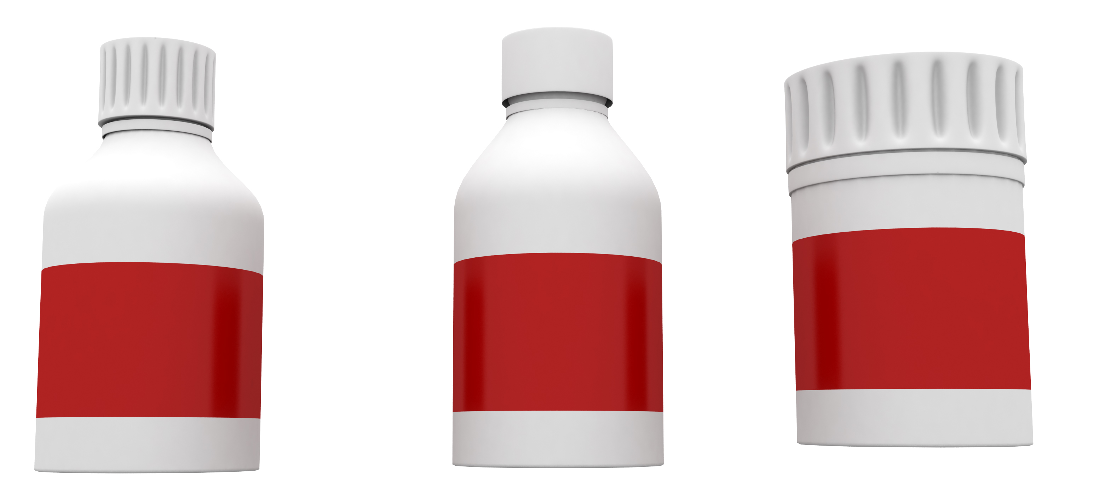
What are your responsibilities when giving medication?
There must be a start and stop date for each medication and you can only give the medication for the duration of the illness.
Return any unused portion to the family or discard.
Read all labels carefully!
Parents must give written consent before you give any child any medication.
Non-prescription medications also require family consent, such as antihistamines, non-aspirin fever reducers, pain relievers, decongestants, ointments for dry skin or diaper area, and sunscreen.

Slide 38

What are your responsibilities when giving medication? contd.
You may not mix medications in formula or food unless you have written directions to do so from a health care provider.
Prescription medication must be in the original bottle.
Only documented staff who have been trained and oriented to your medication policies can give medications to children.

Slide 39

If the child has a condition where the American with Disabilities ACT (ADA) would apply:
You must make reasonable accommodations and that may mean giving a child medication.
The family must provide written instructions to caregivers on the proper administration of the medications or treatment required for the child.
Child care providers are free to choose whether or not to give medications outside those required by the ADA.
Your decision must clearly documented in your health care policy and handbook.
Most physicians prescribe medications to be given twice a day.

Slide 40
Health policy examples
Medical Emergency Authorization from families authorize and give personal consent for medical personnel to begin emergency medical treatment before parents arrive.
Medical personnel cannot legally provide services for a minor without the consent of his/her guardian. For your protection and the safety of the child:
You should not accept a child for care before the parent signs the medical emergency authorization form.
The medical emergency authorization form should be with the child at all times they are in your care. This includes field trips.

Slide 41

Emergency Preparedness-
Health Policies also include basic plans for Emergencies/Disasters/Crisis Preparation. Each plan will be specific to the program and facility.
Disaster plans must include:
What you will do if families are not able to get to their children for two or three days.
Who is designated to be responsible for each part of the plan.
Procedures for accounting for all children and staff during and after the emergency

Slide 42
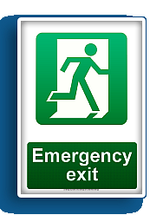
Emergency Preparedness Contd.
Disaster Plans should also include:
Plans for evacuation and meeting after the emergency
Accommodations for children with special needs
Plans for contacting parents, transporting and providing for children
Written documentation of quarterly disaster drills for children and staff

Slide 43

Things to Teach Children related to emergencies
Teaching preschoolers how to “stop, drop, and roll”
Engaging families in collecting emergency supplies to provide for three days of care in your program.
Practice evacuation drills at different times of the day using alternate exits.

