Slide 1
Mary’s Notes on Sandy Hook Slides for Facilitators

Slide 2
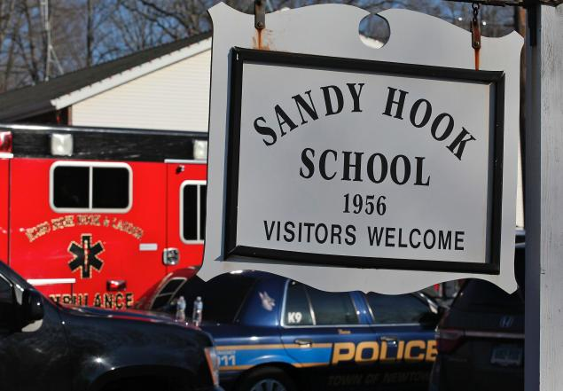
Sandy Hook Challenges
20 students and 6 adults killed
Accountability of children and adults
Extra people on campus
Family reunification
Grid lock even for first responders
Staff not able to retrieve cars or belongings
Parents of students are teachers at other schools
Notes:
Specifics on the challenges..
26 people from one community is a significant number… Everyone was personally impacted… not one was objective and yet they had to keep functioning
Children, staff and adults scattered and it took several hours to locate where everyone was so they could be accounted for. Many children went into neighbors homes and stayed there
Extra people… it was Gingerbread House day in the Kindergarten class so extra parents were either already there or in the parking lot or coming to the school
Grid LOCK… cars couldn’t move on the narrow road leading to the school. Cars were abandoned where they were. Including police and medics
Staff left without keys, purses or personal belongings. Couldn’t get them for several days
Every school district has staff who have children who go to your schools. Parents/teachers struggled with what do they do… leave their students? Go to their own children? Stay at work and hope the other parent can get away from work? Not easy

Slide 3
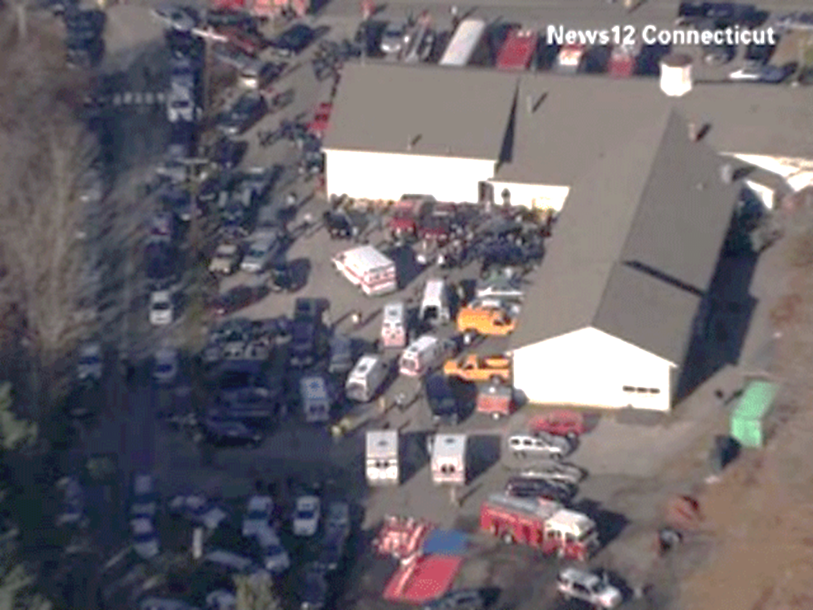
Sandy Hook Challenges
Lockdown called across the district…no information
Key leadership lost
21 funerals in one week
School a crime scene
School site discussion… what to do?
Reopening of alternative Sandy Hook
Ongoing reactions of students, staff and parents
Notes:
District called a lockdown district wide which was in place for at least an hour or more. Other schools not sure what was happening
Principal and District Psychologist were victims. The Principal knew the Family Reunification Plan best and wasn’t there to guide them.
21 Funerals in one week and school district staff expected to attend each one…. Grueling!
School was a crime scene and no one was allowed in for days
On going discussion of what to do with the school site… and who gets to make that decision?
Reopened the alternative Sandy Hook school 7 miles away at a neighboring district with a vacant school. The logistics of getting it cleaned out, painted, carpeted and ready to be occupied was immense.
Students, staff and parents had significant trauma reactions… neurological paths in the brain are altered by extreme trauma. Kids and adults didn’t have the ability to complete tasks, concentrated, remember or at times even function.

Slide 4
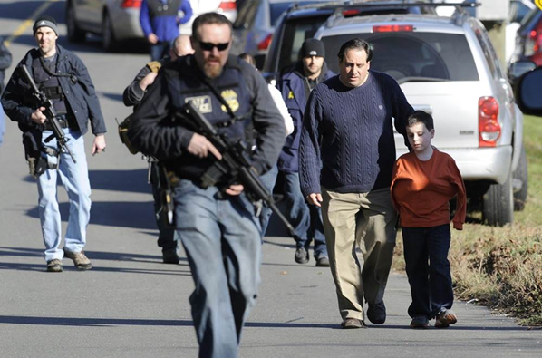
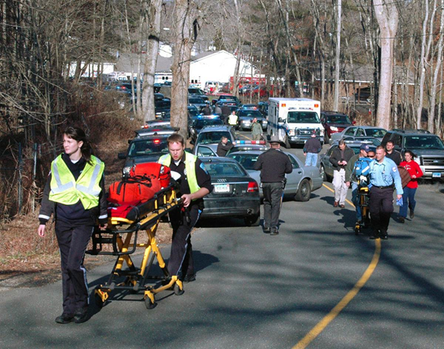
Sandy Hook Challenges
Trying to get medics in
SWAT mixed with parents and students
Notes:
Pictures say it… Medics had to come from a long ways away because of the gridlock, SWAT with guns mixed with parents and kids is not a good idea!

