Slide 1

Module 2: Child Dev. and Growth -Brain Dev.
Power point #3

Slide 2
Objective
The student will describe early brain development.

Slide 3
Discussion Questions
How does the brain develop?
What is executive functioning and toxic stress?
How can providers support early brain development?

Slide 4
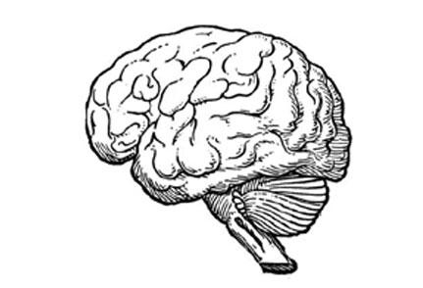
Brain Development basics
Recent research shows that the earliest years are the most critical for brain development and future learning.

Slide 5
The most important findings of the brain are:
It develops through a combination of nature and nurture
Begins development in the prenatal stage
Contains over 100 billion brain cells (neurons) at birth
Grows to fit its’ environment by connections ( or synapses) made between neurons.
Uses synapses to send brain impulses, controlling body, mind, feelings, memory and language.

Slide 6
Important findings about the brain contd.
Is wired on a “use it or lose it” system. Synapses are created and strengthened with use, and wither away if unused.
Is dependent on the quality of the relationship between the infant and primary care giver.

Slide 7

You Cannot Spoil a Baby!
Responding to an infant’s cues quickly and reliably not only promotes security and enhances brain development, but research has shown it also makes babies cry less.

Slide 8
Other findings to note
Research has found that the architecture and functioning of the infant brain is determined by the quality of the first relationships-the attachment between a baby and his/her primary caregiver.
This relationship “sculps” the brain for future learning, behavior, relationships, feelings and health.
For optimal development infants need a secure attachment with one primary caregiver that provides responsive, reliable and affectionate care.

Slide 9
The main ingredient needed
The “Serve and Return” relationship between children and primary caregivers.
This is a reciprocal back-and-forth interaction when children reach out to adults and adults respond in kind.

Slide 10
Video Clip on Serve and Return
http://developingchild.harvard.edu/resources/multimedia/videos/three_core_concepts/serve_and_return/.

Slide 11
Executive Functioning and The Brain
This is the brain’s “Air Traffic Control System”, enabling the brain and body to deal with multiple information and distractions at one time.
Can be broken down into three skill areas: Working Memory, Inhibitory Control, and Mental Flexibility
Is associated with good child outcomes, success in school, and life-long benefits.

Slide 12
Video Clip
http://www.deltraining.com/courses/Executive_Function/content-frame.htm
http://developingchild.harvard.edu/resources/multimedia/videos/inbrief_series/inbrief_executive_function/

