Slide 1

Module 9: Program Planning and Development
Child Development

Slide 2
Objective:
The student will describe staff members’ responsibilities in carrying out the program’s mission statement.

Slide 3

Mission Statements
Give staff and families a clear idea of how the program’s views and philosophy are part of their daily practice.
A mission statement connects the original vision or idea for the program with what the program actually does on a daily basis.
Mission statements can be written by a board and can be a “work in progress” and written over time.

Slide 4
Ideas to help shape your program’s mission statement:
Revisit the ideas of how and why the program began.
Think about how the program should grow.
Describe what is special and valued in the program.
Communicate the services that your program offers to children, families, staff and volunteers.
Include philosophies, beliefs and goals.
Think about when you’d like to re-write or review the mission.

Slide 5
Good mission statements
Are short,memorable and inspiring.
Once completed programs need to decide how the mission statement will be shared:
Posting the statement
Placing it in the program’s handbook
Printing it on flyers or forms that will be distributed to families or the public
Adding it to the program’s newsletter or website.

Slide 6
Mission statements should not:
Be fluffy or include information that does not relate to the program philosophy.
Once the mission statement is written and shared, it is the responsibility of those who work within the program to keep it in mind as they provide day to day care and education for children and families they serve.

Slide 7
Objective
The student will relate program policies to specific Washington licensing rules and laws.

Slide 8
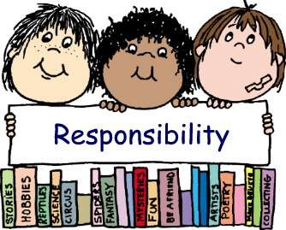
Responsibilities
Each employee and volunteer in a child care program is responsible for completing a number of forms for complying with certain licensing rules and policies in order to maintain their employment with the program.

Slide 9

Employment
If a center employs more than five people, certain written policies must be in place and discussed with each employee that is hired.
Each employee will have a personnel file with required items that will be monitored by the licensor.

Slide 10
Monitoring visits:
During these visits the licensor will review if the program is in compliance with the licensing rules, also known as the WACS (Washington Administrative Code).
You must be familiar with the WACS. if you are working in a child care center and with children.

Slide 11
WAC Sections
The WACS are divided into the following sections:
Licensing
Staffing
Program
Health and nutrition
Care of young children
Safety and environment
Agency practices
Records, reporting and posting

Slide 12
Objective
The student will identify what, where and how records are kept.

Slide 13

Recordkeeping:
Recordkeeping has always been an important part of staff member’s duties and each program may have different ways of managing records.

Slide 14
Examples of Records Include:
The center’s or program’s mission statement
Children’s immunization and attendance records
Incident reports
Children’s individual class work, IEP or assessments
Personnel records
Food program records

Slide 15
Once a program is licensed:
The licensor will do a monitoring visit at least once every 12 months for a child care center provider, and at least once every 18 months if a family home care provider.
Files should be all up to date.

