Slide 1

Module 4: Curriculum and Learning Environments
Power point 2

Slide 2
Objective
The student will identify indoor and outdoor activities that invite participation of all children.

Slide 3
Discussion Qs in groups
What types of play materials, equipment and activities should you provide for children?
2. What are some of the special requirements for infants and toddlers in an early learning environment?
3. Is it necessary to have a daily schedule and routine for children?

Slide 4

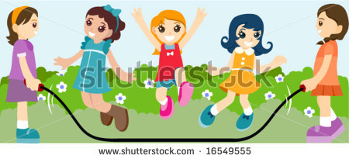
Indoor and Outdoor Spaces
Need to invite all children and engage them in activities and productive play.
Post a daily schedule of lessons and activities for all to see.
Offer a variety of learning materials

Slide 5
Other things to Consider:
Consistently plan for a wide range of learning experiences through lessons, activities and events.
Keep six months of lesson and activity plans available for licensing inspection.
Maintain child-adult ratios during transitions and throughout the day.
Use staff planning time productively to improve the quality of program offerings to children.

Slide 6
Outdoor Environments
Four components to consider when planning a good outdoor play space include:
The space itself
Supervision in the space
Injury protection and prevention
Site maintenance
Outdoor space must have at least 75 square feet per child for the maximum number of children using the outdoor play space at any one time.

Slide 7
The Daily Schedule
Can ensure a balance of activities throughout the children’s day.
Young children cannot tell time but can learn the time of day by the sequence of activities and routine.
Routines and daily rituals provide a sense of security. Children can predict what happens next.
Appropriate routines meet the developmental needs and abilities of the children.
Caregivers discover that routines help children gain a sense of their own identity and self-worth.

