Slide 1
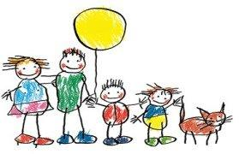
Module 5: Family Partnerships
Child Development

Slide 2
Objective- The student will recognize that families are the primary educators of children.
Please discuss these questions in your groups:
How are families the primary educators of children?
How can child care providers support families in this role?
Why is supporting families so important?

Slide 3
Four Main Types of Learning in young children
According to Katz, most of the learning happens through observations in daily life and are:
Learned feelings
Skills
Knowledge
Attitudes about learning

Slide 4
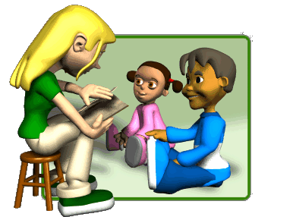
To Achieve High Quality Care
Families must be recognized as the experts
Treated with respect
Acknowledged that they are their child’s is most important teacher

Slide 5
Objective- The Student can explain the elements of positive relationships and communication with families.
Discuss the following questions in your group:
Why is it important to build a partnership with children’s families?
Why do families and child care providers conflict with one another at times?
How can you take the lead in creating positive provider-family relationships?

Slide 6
Partnership-
Is when both parties have equally important and unique roles in children’s lives.
A true partnership is supportive collaboration based on mutual interests.
Both the family and the caregiver want the best for the child.

Slide 7
According to the Care Center Licensing Guidebook p. 89
“Best practice: Teachers and families work closely in partnerships to ensure high quality care and learning experiences for children and parents to feel supported and welcomed as observers and contributors to the program. Caregivers need to listen to parents, seek to understand their goals and preferences for their children and respect cultural and family differences.

Slide 8
Obstacles to Partnerships
Lack of time and few opportunities
Lack of understanding and appreciation of backgrounds
Differences in values and view of children
Mismatch modes of communication

Slide 9
Building Positive Relationships
Establish trust
Welcome families
Have Open Communication
Positive Communication
Encourage Family Involvement
Encourage Competence-Treat as knowledgeable partners

Slide 10
Objective- The student can recognize and value different community resources that support families.
Discuss the following questions in your groups:
What kinds of community resources are typically needed by families with young children?
Why are community resources valuable to families?

Slide 11
Types of Resources typically needed
Housing, food, and social services
Medical, dental, and mental health services
Development screening and assessment
Educational and recreation opportunities
Services for children with special health needs
Language assistance and resources in primary language

Slide 12

Sharing resources with families
Identifying Resources
Linking Families to Services
Connecting Families with other families
Easing transitions from your program to the next

Slide 13


Resources benefiting care providers
The public library
A children’s museum
Child Care Aware
Public health Department
Your School District

Slide 14

Volunteers as Resources
Families come with many different experiences, special talents, and backgrounds that can be beneficial to the learning experience.

