Slide 1
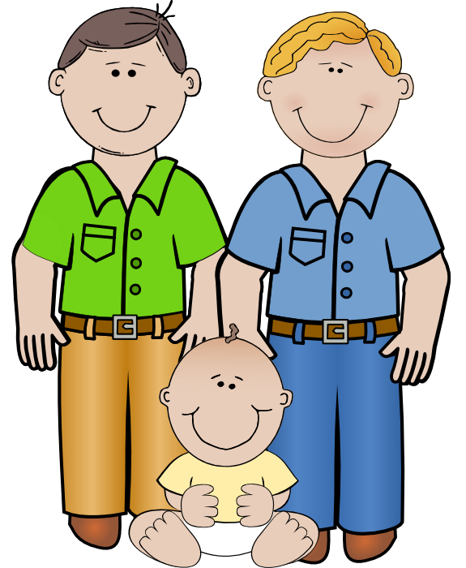
Valuing Each Child and Family
Child Dev. Module 1

Slide 2
Learning Target
The student will describe strategies for interacting collaboratively with all children and adults.

Slide 3

Self-Reflection
Self-Reflection and knowing who you are is a good starting point for working collaboratively with families.

Slide 4
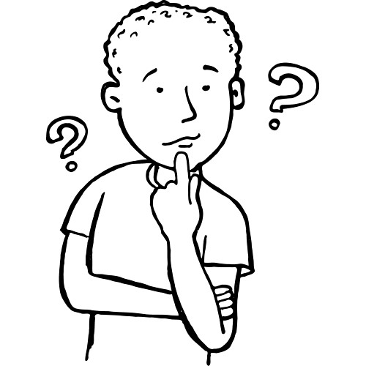
Things to reflect on
How are you unique?
How have you grown to be who you are?
What do you value?
What are your perspectives on children and their families?

Slide 5
Development of Identity
Children will watch every move you make.
Children learn through what they are deliberately taught and by observing.
Cultural patterns and expectations are demonstrated and “taught” to the child through modeled behavior they observe from the adults in their lives.

Slide 6
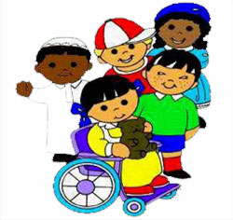
Make sure every child sees themselves reflected in class activities
Support each child’s sense of self and family
Engage children in the acceptance and appreciation of differences and similarities in people, and
Help children better understand beliefs and customs different from their own

Slide 7
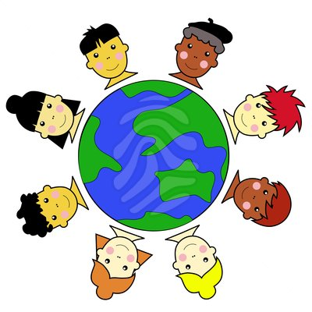
Having a multi-cultural non-biase environment
Do not have posters or other visuals/books that have a stereotype image
Use different types of learning materials that help children feel comfortable with their identity as well as increase awareness of other people

Slide 8


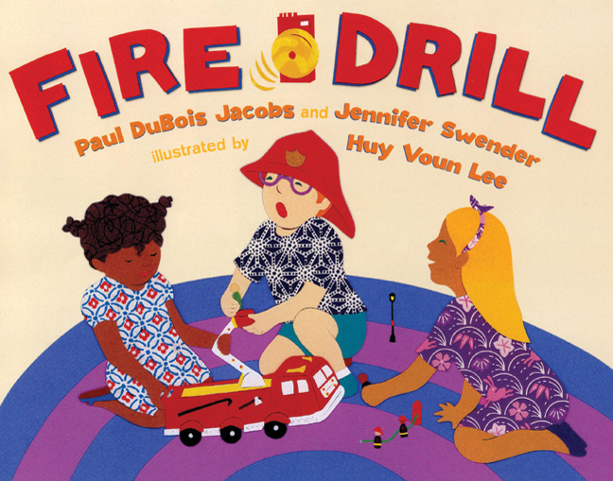
Learning Materials to use
Reflect diversity in books, magazines, dolls, puzzles, paintings, music, and block area props, etc.

