Slide 1

Districtwide School Safety & Emergency Preparedness Tabletop Exercise
March 20, 2015

Slide 2

Purpose
Increase readiness and preparedness to respond to emergencies and safety incidents.
Understand the Incident Command structure and the roles of first responders.
Learn about the impact and role of social media in emergencies and how to best leverage it in that environment.

Slide 3

Introduction
This exercise is a learning opportunity!
In a few moments, a specific, plausible scenario will be presented.
To fully learn from this experience we need each person to actively engage in their assumed role.
This is a discussion-based exercise; the place to answer the “what-ifs”.
There are no wrong answers.

Slide 4

Introduction
Note-taking sheets are provided for you to record your own questions, concerns, etc.
Each table should identify:
  A scribe to document challenges, questions, conclusions, etc.
  A spokesperson at each table for reporting out during the whole-group sharing.

Slide 5
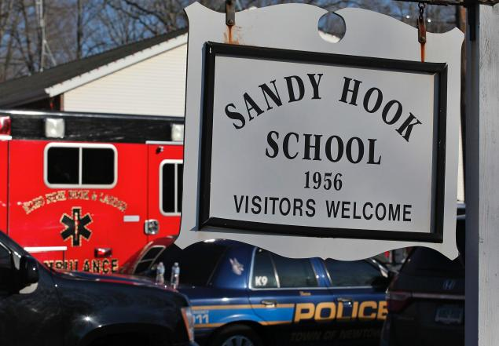
Sandy Hook Challenges
20 students and 6 adults killed
Accountability of children and adults
Extra people on campus
Family reunification
Grid lock even for first responders
Staff not able to retrieve cars or belongings
Parents of students are teachers at other schools
Notes:
Specifics on the challenges…26 people from one community is a significant number. Everyone was personally impacted…not one was objective and yet they had to keep functioning.
Children, staff and adults scattered and it took several hours to locate where everyone was so they could be accounted for. Many children went into neighbors’ homes and stayed there
Extra people… it was Gingerbread House day in the Kindergarten class so extra parents were either already there or in the parking lot or coming to the school
Grid LOCK… cars couldn’t move on the narrow road leading to the school. Cars were abandoned where they were. Including police and medics
Staff left without keys, purses or personal belongings. Couldn’t get them for several days
Every school district has staff who have children who go to your schools. Parents/teachers struggled with what do they do… leave their students? Go to their own children? Stay at work and hope the other parent can get away from work? Not easy

Slide 6
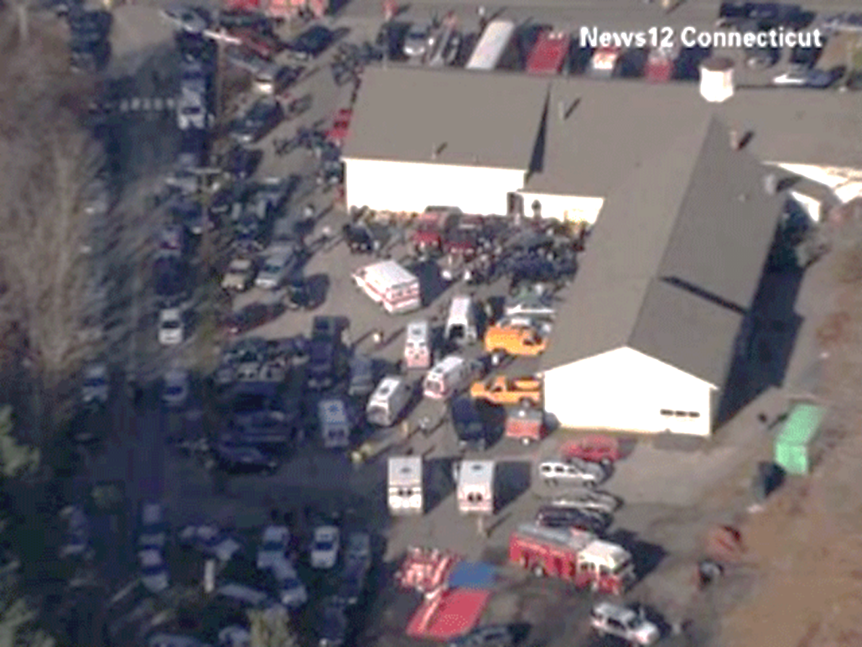
Sandy Hook Challenges
Lockdown called across the district…no information
Key leadership lost
21 funerals in one week
School a crime scene
School site discussion… what to do?
Reopening of alternative Sandy Hook
Ongoing reactions of students, staff and parents
Notes:
District called a lockdown district wide which was in place for at least an hour or more. Other schools not sure what was happening
Principal and District Psychologist were victims. The Principal knew the Family Reunification Plan best and wasn’t there to guide them.
21 Funerals in one week and school district staff expected to attend each one…. Grueling!
School was a crime scene and no one was allowed in for days
On going discussion of what to do with the school site… and who gets to make that decision?
Reopened the alternative Sandy Hook school 7 miles away at a neighboring district with a vacant school. The logistics of getting it cleaned out, painted, carpeted and ready to be occupied was immense.
Students, staff and parents had significant trauma reactions… neurological paths in the brain are altered by extreme trauma. Kids and adults didn’t have the ability to complete tasks, concentrated, remember or at times even function.

Slide 7
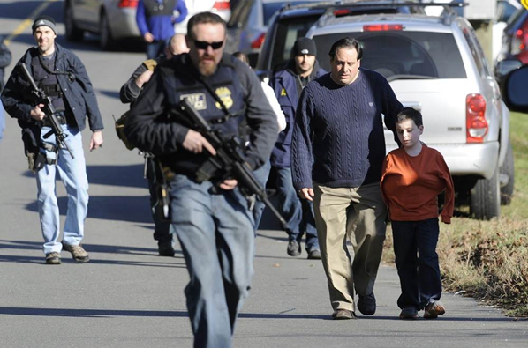
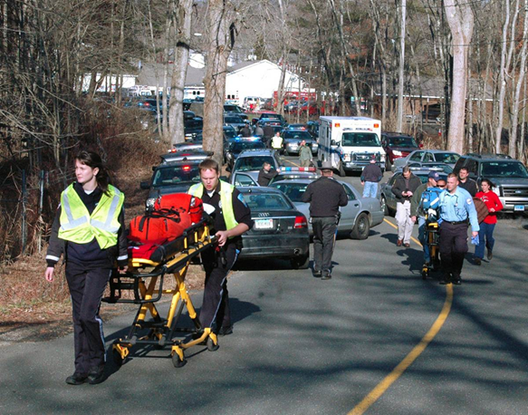
Sandy Hook Challenges
Trying to get medics in
SWAT mixed with parents and students
Notes:
Pictures say it… Medics had to come from a long ways away because of the gridlock, SWAT with guns mixed with parents and kids is not a good idea!

Slide 8
Role Players at Each Table
Principal: Out in the portable
Assistant Principal: Meeting with a student in your office
Office Manager: In the main office
Custodian: Working in the school
Teacher: In a nearby classroom
Paraeducator: Supervising recess on the playground

Slide 9
Role Players at Each Table
Counselor: Meeting with a parent in the building
Substitute Teacher: In the classroom
Cascade High School Administrator: At your school
Evergreen Middle School Staff: At your school
District Office Staff: In your office

Slide 10
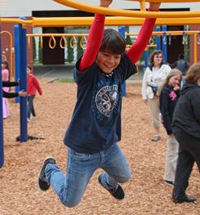
Scenario
It is a Wednesday at approximately 1:40 p.m.
Most students are in class; however, there are two classes outside for recess.
There are a few students in the hallway, bathrooms and library.
The School Resource Officer at Cascade High School is away for the day at a training.

Slide 11
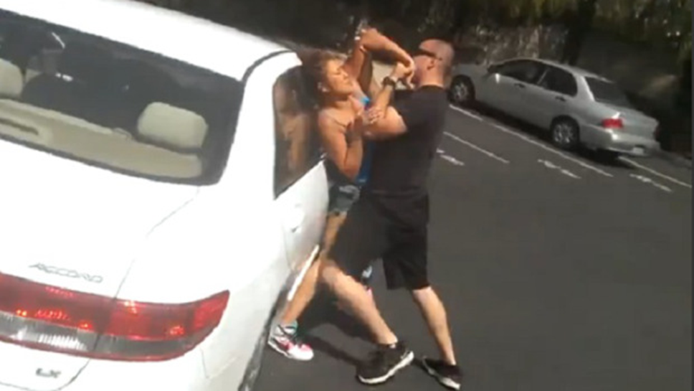
Scenario
A woman is parked in the main parking lot of Emerson Elementary School. A man pulls in beside her and gets out of his truck. They start to argue. The woman yells “PLEASE DON’T!” and starts running toward the front doors of the school.

Slide 12
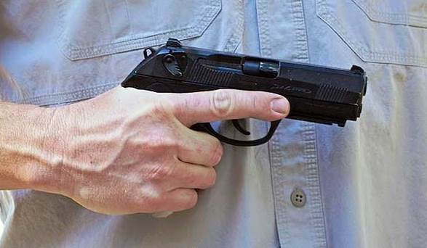
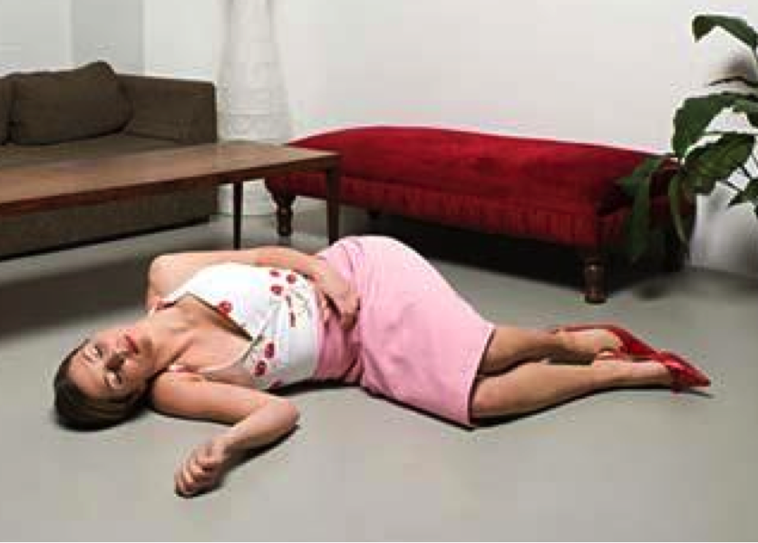
Scenario
The man pulls out a handgun and starts shooting at her.
The woman stumbles inside the front doors of the school and collapses. The man follows her inside.

Slide 13
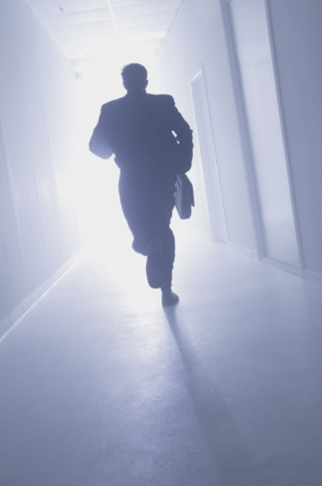

Scenario
He stands over her for a few seconds and then runs down the hall. Multiple gunshots are heard as he runs down the hall.

Slide 14
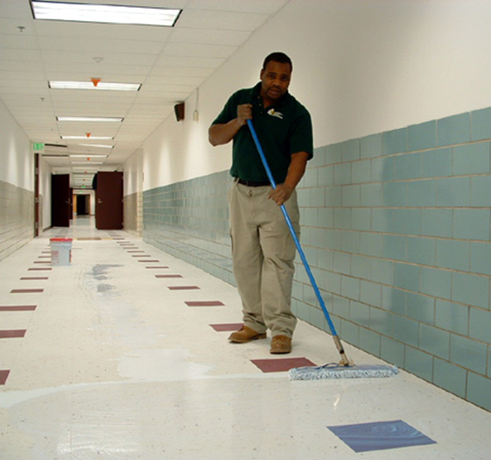
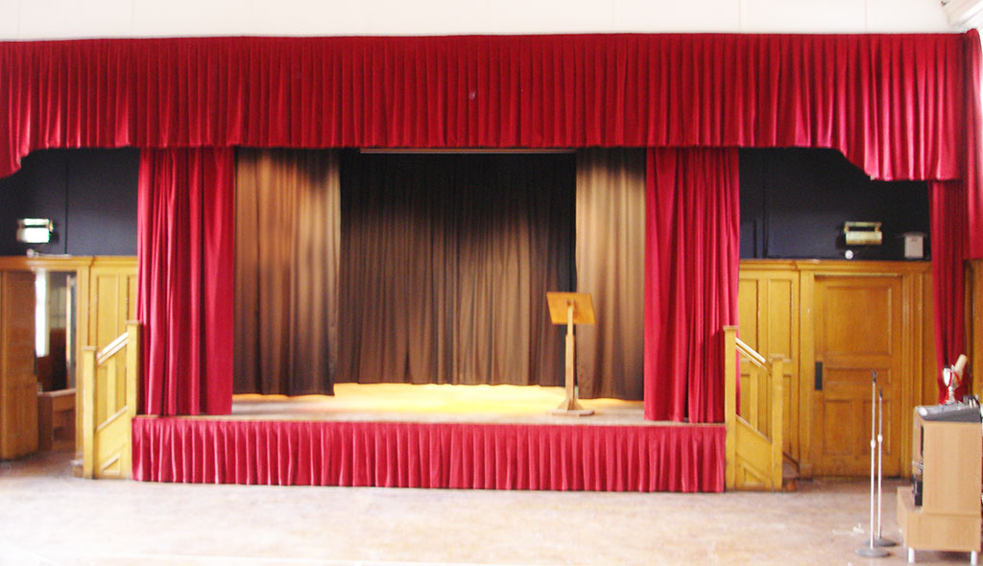
Scenario
As he sees the custodian come towards him, he runs into the cafeteria and up behind the stage curtain into a classroom.

Slide 15
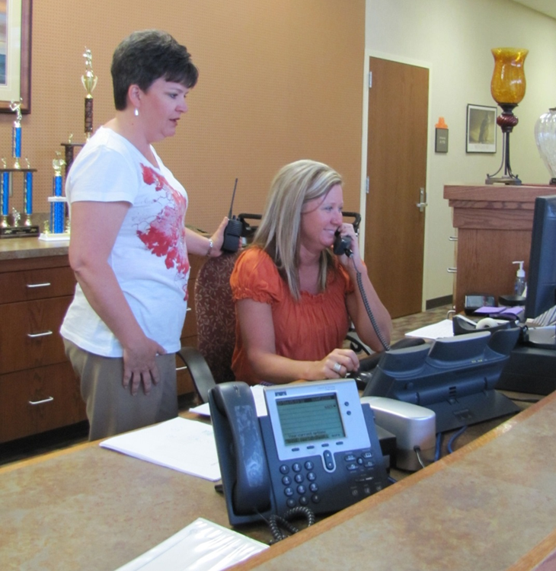
Scenario
The office manager believes she recognizes him as the father of one of your students and also knows he has other children that attend Evergreen Middle School and Cascade High School.

Slide 16
What are the Challenges?
Principal: You are outside in a portable. What would be your first few actions?
Assistant Principal: What would be your first few actions?
Office Manager: What would you be doing?
Custodian: What would be your first priorities?
Teacher: What would be your priorities and what actions would you take?
Paraeducator: How would you be notified and what would you do?

Slide 17
What are the Challenges?
Counselor: What would be your first few actions?
Substitute Teacher: This is your first time in this building and you do not have keys to lockdown your classroom. What do you do?
Cascade High School Administrator: How would you be notified and what would your actions be? What role would you play in this incident?
Evergreen Middle School Staff: How would you be notified and what would your actions be? What role would you play in this incident?
District Office Staff: How would you be notified and what would your actions be? What role would you play in this incident?

Slide 18
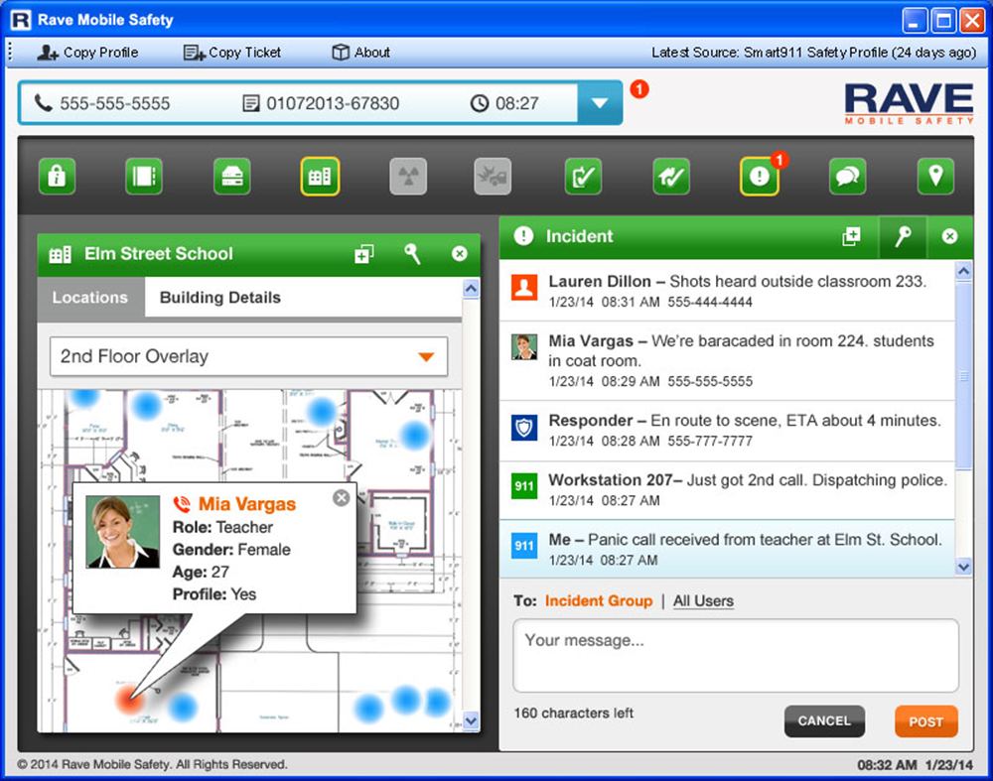
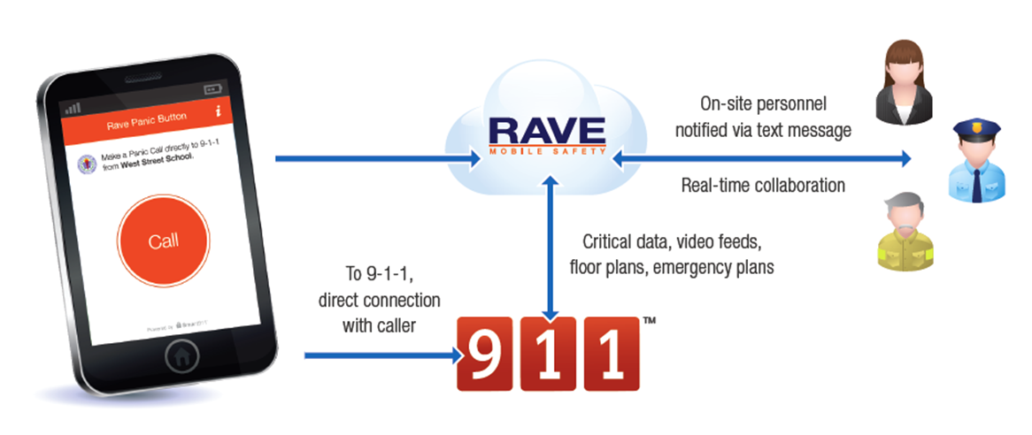
Update: 1:42 p.m.
You receive a RAVE notification that your school is in a lockdown.

Slide 19
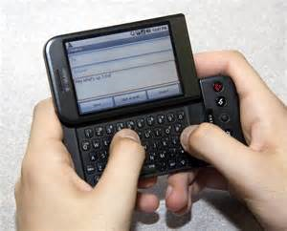

Update: 1:46 p.m.
One law enforcement patrol car arrives on scene.
The school is now in full lockdown.
People in the front office area who witnessed the incident are texting on their cell phones.

Slide 20
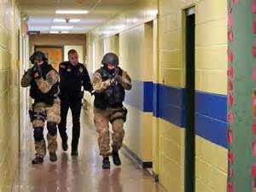
Update: 1:55 p.m.
The school is still in lockdown but the suspect location has been isolated by the responding officers.

Slide 21
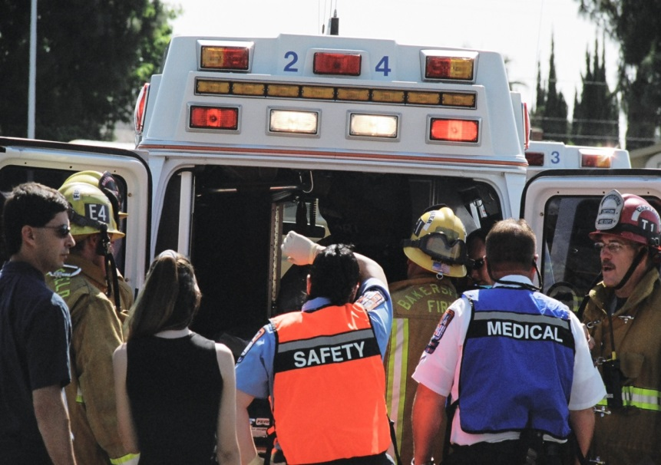
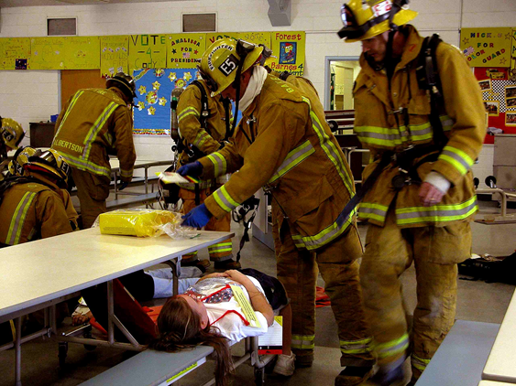
Update: 2:00 p.m.
More police have arrived on scene and have set up an Incident Command System.
Fire/EMS have also arrived and are being escorted by police into the “warm zones” of the school to retrieve the injured.

Slide 22
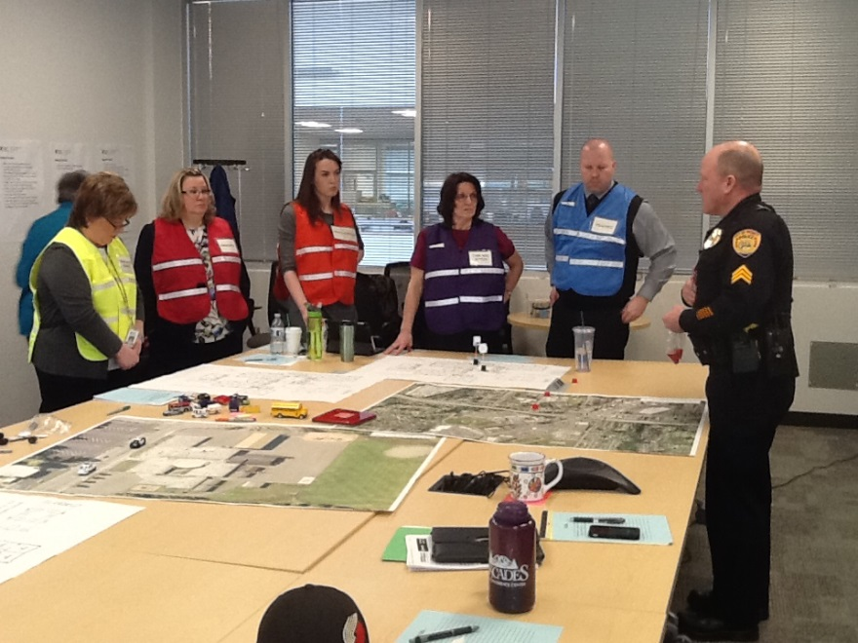
Incident Management Team (IMT)
Assume you have all become the IMT. Use the props and place them on the map.
Where is your IMT and what are they doing?
Who is communicating with parents and how are they doing it?
Where are the majority of your students now?
What support would you hope to get from the district office?

Slide 23

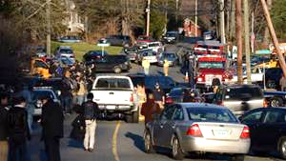
Update: 2:10 p.m.
District office staff have arrived.
The media and parents are also beginning to arrive.
There is a lot of chaos and confusion, and you can’t get adequate or accurate information.

Slide 24
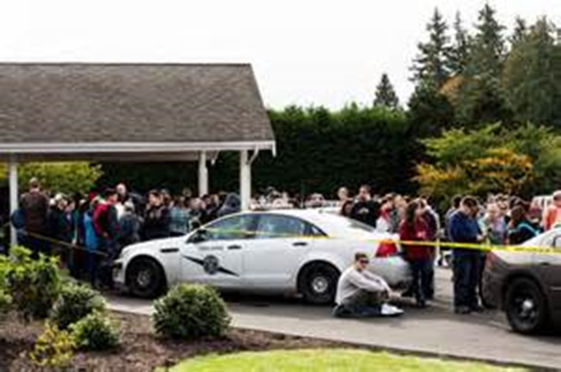
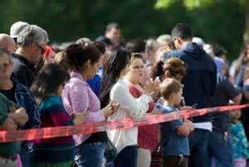
Update: 2:40 p.m.
The school has been cleared.
You receive a RAVE notification that the lockdown has been lifted.
The district has announced that the family reunification site is Everett Memorial Stadium.
Do you go with your students being escorted off the school property?

Slide 25
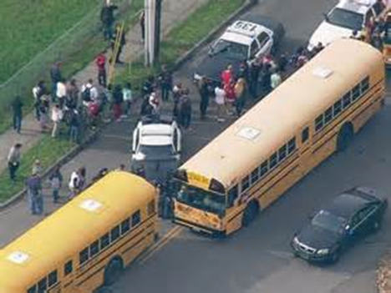
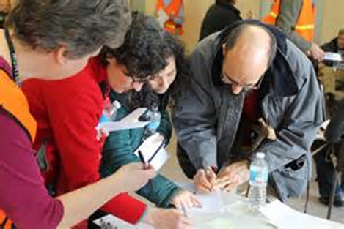
Update: 2:40 p.m.
What are the implications to the bus transportation at this point?
What are the implications to the neighboring schools?
What are the considerations for students, staff, and family members for getting to this site?
How do you protect them from the media?

Slide 26
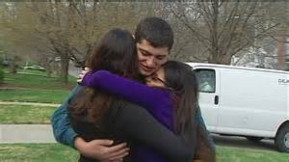
Update: 3:00 p.m.
Remember that the shooter had other children at Cascade High School and Evergreen Middle School.
What implications does that cause?
What do you do about that?

Slide 27
Update: 4:00 p.m.
The gunman has been taken into custody
  by law enforcement. He has been shot but expected to live.
The woman is dead in the front lobby of your school.
There were three students and one adult shot inside the school. One is in critical condition and the others are in serious condition. Some are at Providence and others are at Harborview.

Slide 28

Update: 6:00 p.m.
Your school is now a crime scene. You left the school without your car keys, cell phone, purse, coat, etc.
What will you do about getting home or contacting your family?

Slide 29

Debrief
What surprised you?
What works well at your school?
What community resources are available to help manage this?
What did you hear about that is currently in place that you were not aware of?

