Slide 1
Professional Learning Teams
Cascade High School
September 18, 2015

Slide 2
“The use of professional learning communities is the best, least expensive, most professionally rewarding way to improve schools. . . . Such communities hold out immense, unprecedented hope for schools and the improvement of teaching.”
- Mike Schmoker

Slide 3
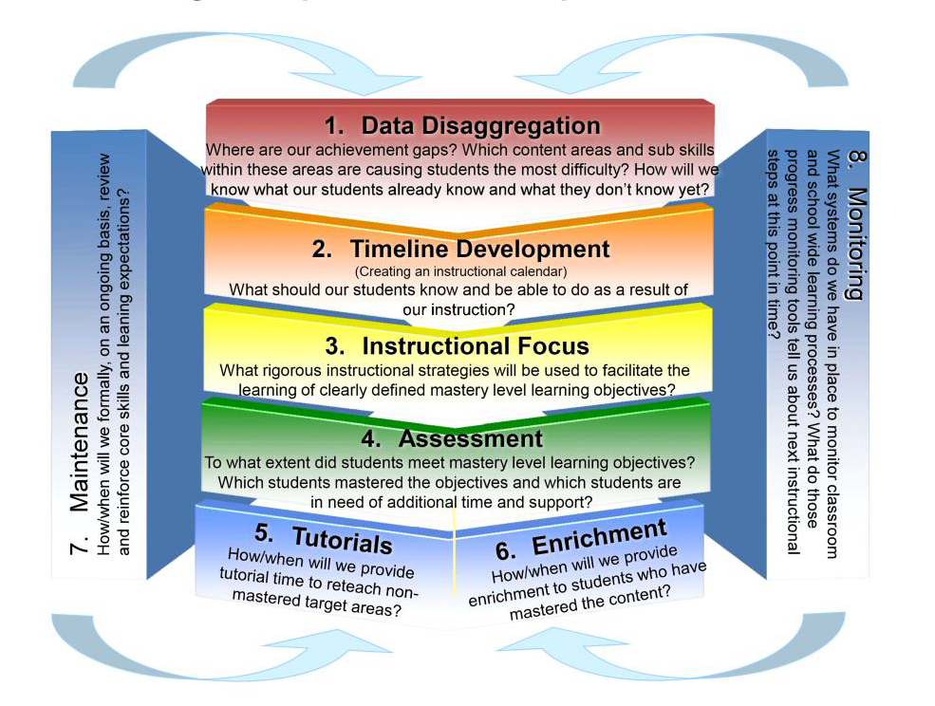
Continuous Improvement Process

Slide 4
Danielson Components
Criterion 8: Exhibiting collaborative and collegial practices focused on improving instructional practice and student learning.
4d: Participating in a professional community
“…actively participates in a culture of professional inquiry.”
4e: Growing and developing professionally
“…seeks out opportunities…to enhance content knowledge and pedagogical skill.”
4f: Showing professionalism
“…maintains an open mind in team or departmental decision making.”

Slide 5
Three Big Ideas drive PLCs (DuFour)
The purpose of our school is to ensure that all students learn at high levels.
Helping all students learn requires a collaborative and collective effort.
To assess our effectiveness in helping all students learn we must focus on results – evidence of student learning – and use results to inform and improve our professional practice and respond to students who need intervention or enrichment.

Slide 6
A Video Example
Reflecting on Teaching and Learning
Note: These teachers are not all teaching the same course.
Question: How do we create a trusting enough environment to look critically at our results – student work –to inform our instruction?

Slide 7
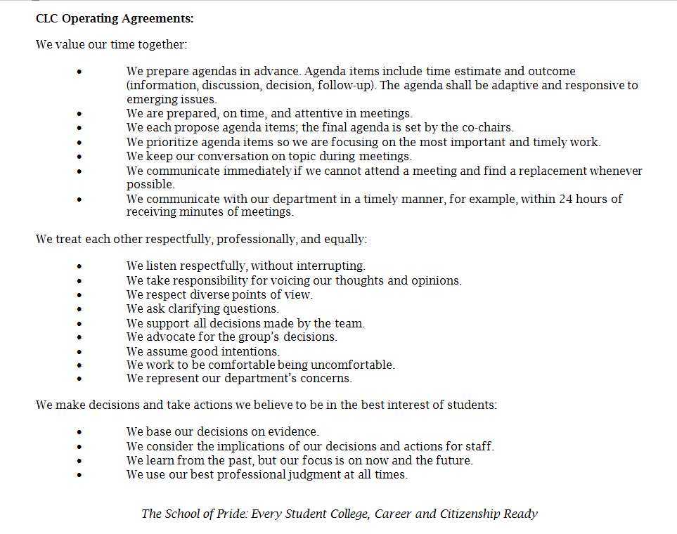
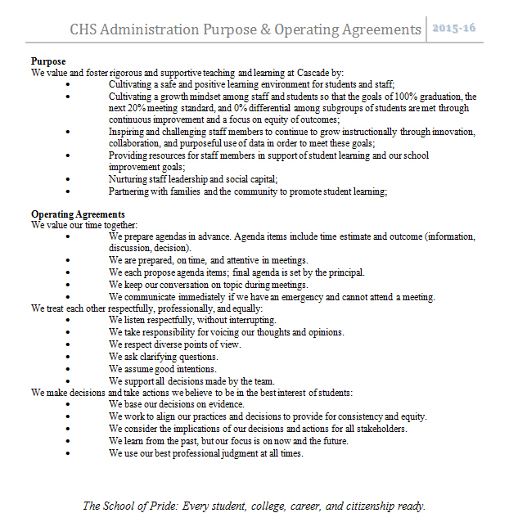
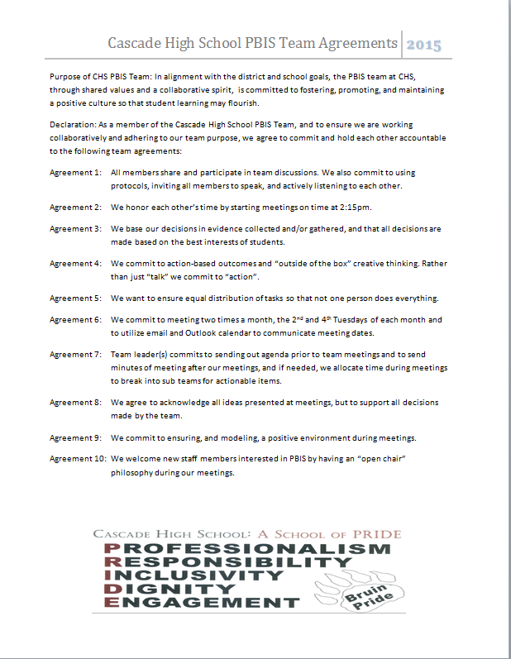
We create such an environment, in part, by creating norms, following them, and revisiting them as needed.

Slide 8
Team Norms/Commitments/Operating Agreements
Why are norms important to team functionality?
How have team practices directly impacted classroom practices?
What have the teams done to maintain an instructional focus?
Norms for Leadership and Learning

Slide 9
Next Steps
Work in teams to create norms/operating agreements/commitments/guidelines.
Consider your goals for the year: Toward what results will your PLC be working?
Also consider how you will handle facilitation, timekeeping, and reporting responsibilities.

Slide 10
A Little about Goals
We have a School Improvement Plan (SIP) with goals.
The teacher evaluation system (TPEP) requires setting goals.
We are asking you to focus on results in Professional Learning Communities (PLC) which means setting goals.
These goals need not be separate. It makes sense to make your PLC goal the same as your team goal for TPEP Criterion 8. It’s not required, but it is encouraged.

Slide 11
Resources and Options
A link to resources has been emailed to you. These include:
  Sample team agreements
  3 suggested protocols for determining norms
  A resource about PLCs from Solution Tree
  A reporting form to report the outcome of your work together today
  This PowerPoint and the links to the videos
Options for today
Work in the PLCs assigned on the sheet you received today
OR
Work in a larger department group
Work on what?
  Setting norms
  Beginning to establish goals
  Consider facilitation and reporting plans

Slide 12
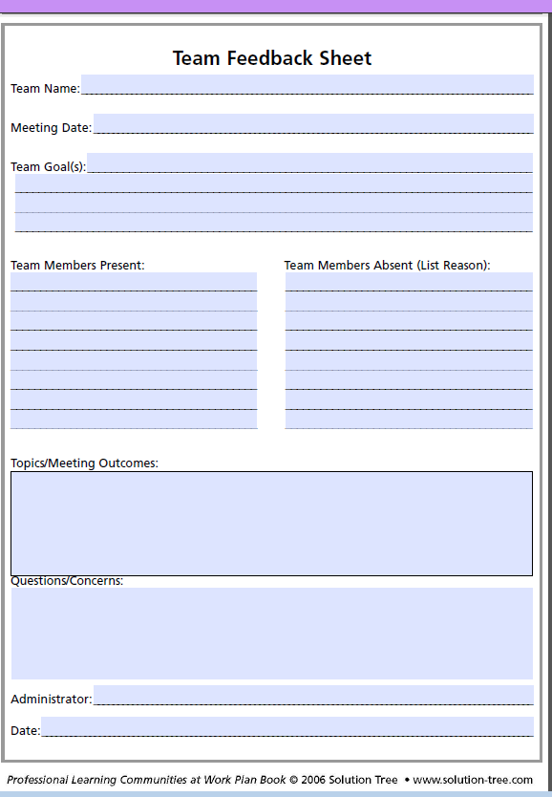
Reporting Back
Please use the Team Feedback Sheet to report to your supervising administrator your outcomes from today:
  Norms
  Goal
  Plans for facilitation and reporting
These may be still in progress!

Slide 13
Final Thought
“PLCs operate under the assumption that the key to improved learning for students is continuous, job-embedded learning for educators.”
- DuFour, DuFour, and Eakers

