Slide 1
Policy and Procedure Updates
Policy and Procedure 3210
Nondiscrimination
Policy and Procedure 3319
Use of Physical Restraint and Isolation

Slide 2
Purpose
Why are we conducting this training?
  To comply with the legislature’s revision of WAC 392-190:
    Enacting additional nondiscrimination policy requirements (policy and procedure 3210);
    Broadening the requirements about the use of physical restraint and isolation to all students (policy and procedure 3319);
    Requiring training for certificated and classified staff; and
    Requiring staff training for policy and procedure 3319 per the EEA collective bargaining agreement.

Slide 3
Nondiscrimination awareness
One of our core values as stated in the strategic plan is to embrace diversity as an essential asset; we are inclusive and treat our differences as a core strength.
Training is required of all staff to remind them of their responsibility to raise awareness of and to eliminate bias.

Slide 4
Nondiscrimination awareness
The district shall provide equal educational opportunity and treatment for all students in all aspects of the academic and activities program without regard to race, color, national origin, creed, religion, sex, sexual orientation, gender expression, gender identity, veteran or military status, the presence of any physical, sensory or mental disability or the use of a trained dog guide or service animal by a student with a disability.

Slide 5
Nondiscrimination awareness
District students shall be free from harassment based on legally protected attributes or characteristics.
Conduct against any student that is based on one of the categories previously mentioned that is sufficiently severe, persistent or pervasive as to limit or deny the student’s ability to participate in or benefit from the district’s course offerings, educational programming or any activity will not be tolerated.

Slide 6
Nondiscrimination awareness
When a district employee knows, or reasonably should know, that such discriminatory harassment is occurring or has occurred, the district will take prompt and effective steps reasonably calculated to end the harassment, prevent its recurrence and remedy its effects.

Slide 7
Nondiscrimination awareness
  Randi Seaberg, HR Director
  Title IX compliance officer
  425.385.4104
  rseaberg@everettsd.org
Carol Stolz, HR Director
Affirmative Action Officer
425.385.4104
stolz@everettsd.org

Slide 8
Restraint and isolation policy and procedure 3319 updates
Physical restraint and isolation should be avoided unless imminent likelihood of serious harm
Now applies to all students
Substantial risk definition
May not be used as a form of discipline or punishment, or when no longer at risk for causing bodily injury
Still requirements regarding special education and Section 504 students

Slide 9
Likelihood of serious harm
Definition
A substantial risk that:
  Physical harm will be inflicted by a person upon his or her own person, as evidenced by threats or attempts to commit suicide or inflict physical harm on oneself;
  Physical harm will be inflicted by a person upon another, as evidenced by behavior that has caused such harm or that places another person or persons in reasonable fear of sustaining such harm; or
  Physical harm will be inflicted by a person upon the property of others, as evidenced by behavior that has caused substantial loss or damage to the property of others.
The person has threatened the physical safety of another and has a history of one or more violent acts.

Slide 10
Use of restraint or isolation
Restraint or isolation may be used:
  When reasonably necessary to control spontaneous behavior that poses an imminent likelihood of serious harm until such time as the likelihood of serious harm has dissipated.
  When the restraint or isolation is carefully monitored to prevent harm to the student.
  When the least amount of restraint or isolation appropriate to protect the safety of students and staff under the circumstances is applied.

Slide 11
Use of restraint or isolation
Restraint or isolation will not be used:
  As a form of discipline or punishment; or
  When the student is no longer at risk of causing imminent bodily injury to themselves or others.

Slide 12
Follow-up after the use of physical restraint or isolation
Notify: The principal or principal’s designee must make a reasonable effort to verbally inform the student’s parent/ guardian within 24 hours of the incident and send written notification as soon as practical, but postmarked no later than 5 business days after the restraint or isolation occurred.
If the school or district customarily provides the parent/guardian with school-related information in a language other than English, the written report must be provided to the parent/guardian in that language.

Slide 13
Reporting requirements for use of isolation or restraint
The Physical Restraint and Isolation Incident Report form is to be completed for all incidences by any school employee or school resource officer who uses isolation or restraint on a student during school-sponsored instruction or activities.
The building principal must be informed as soon as possible, and submit a written report of the incident to the district office within 2 business days .

Slide 14
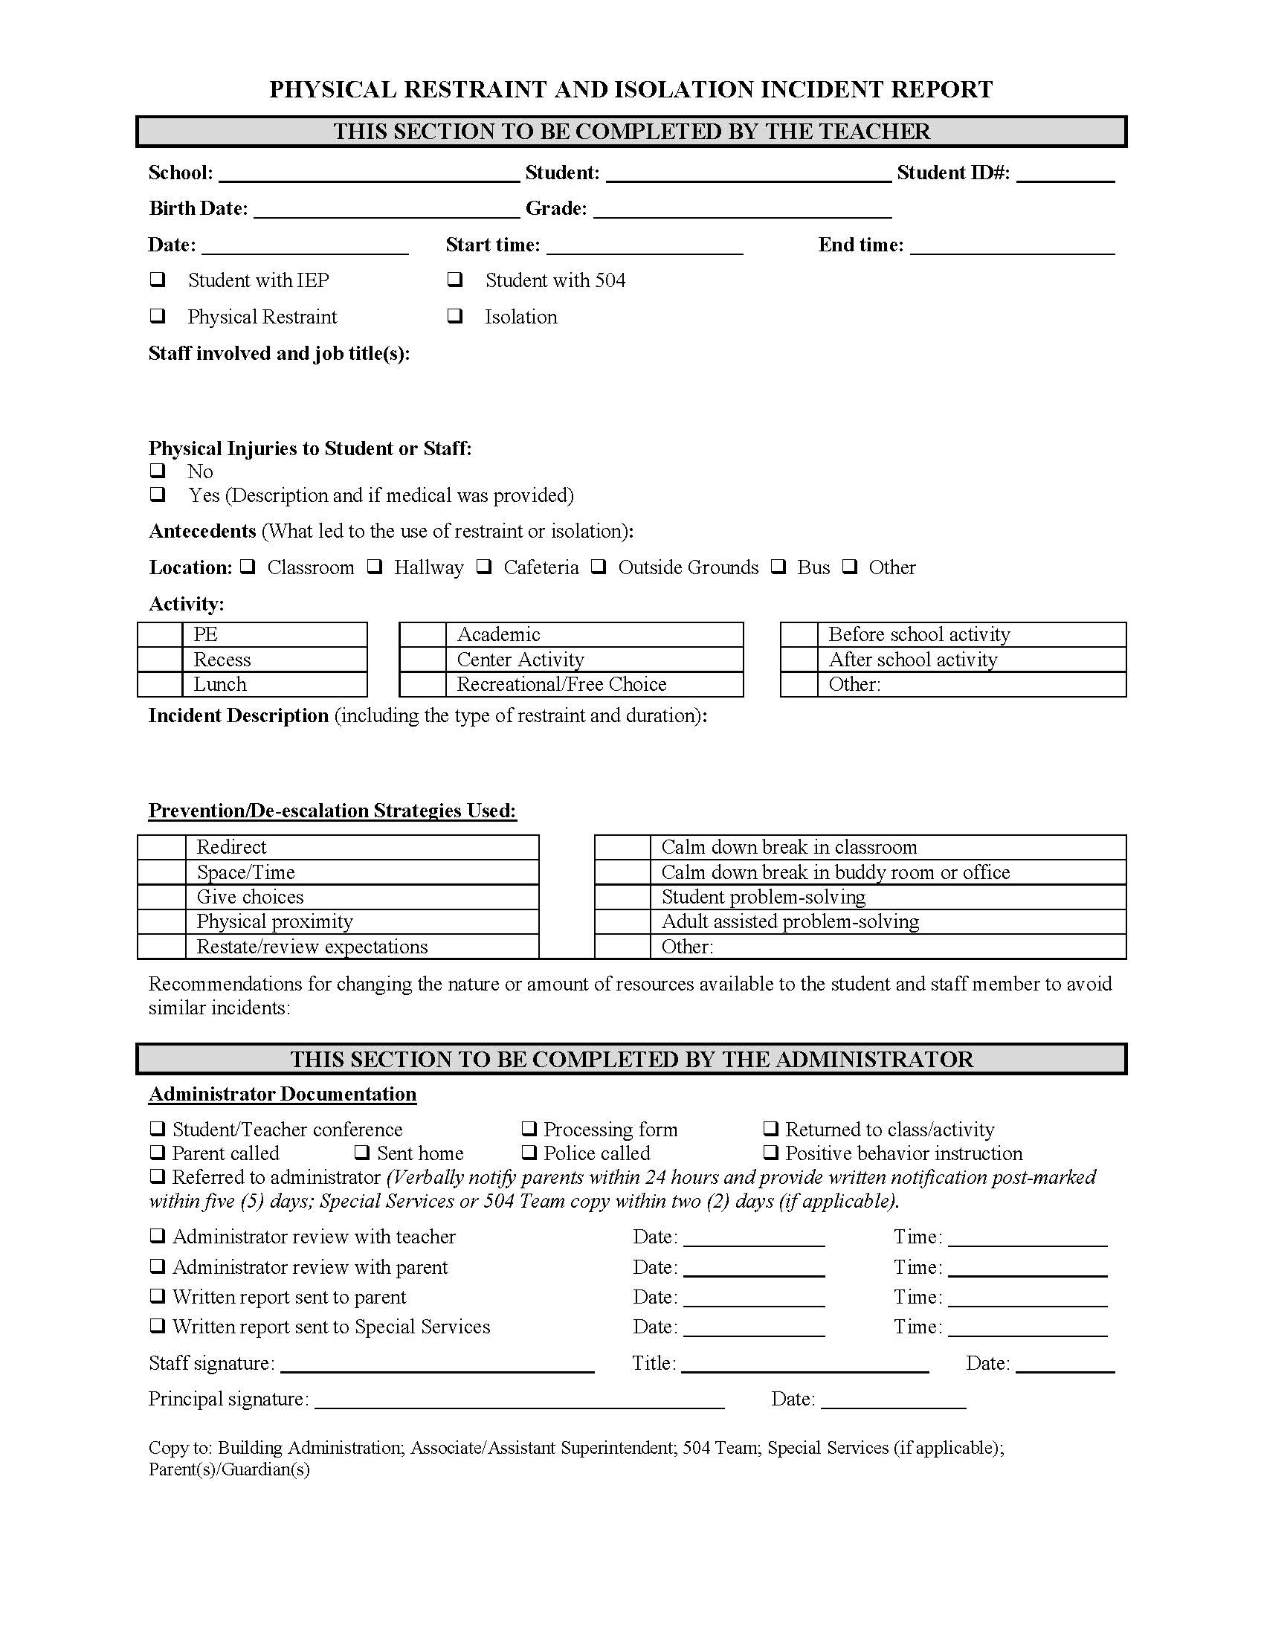
Incident reporting form

Slide 15
Questions

