Slide 1

Everett High School
#EHSInnovatingeducation
To inspire, educate and prepare every student
to be career and college ready.

Slide 2

On a Five Year Mission to Become the Best School in the Universe!

Slide 3

Everett High School
To inspire, educate and prepare every student
to be career and college ready.
Notes:
A sense of pride
A sense of urgency
Focus on SIP
Care for EACH child
Hard work
Fun
Growth Mindset

Slide 4
Demographic Trends

Slide 5
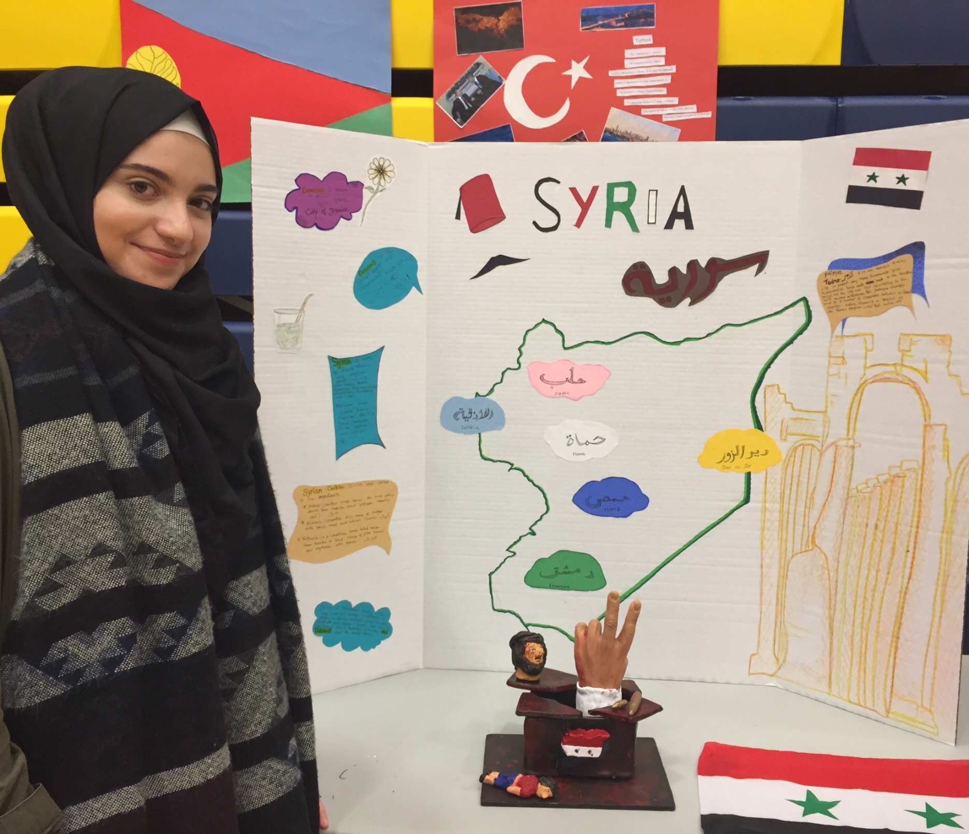

Slide 6
5-year Improvement Trend vs. 2015 Performance

Slide 7

ELA Vision

Slide 8
High School Counts
(Number of students assessed at each grade)
ELA
Math

Slide 9
10th Grade on 11th Grade ELA
Diploma Cut Score

Slide 10
10th Grade on 11th Grade ELA
College & Career Ready Cut Score

Slide 11
11th Grade ELA

Slide 12
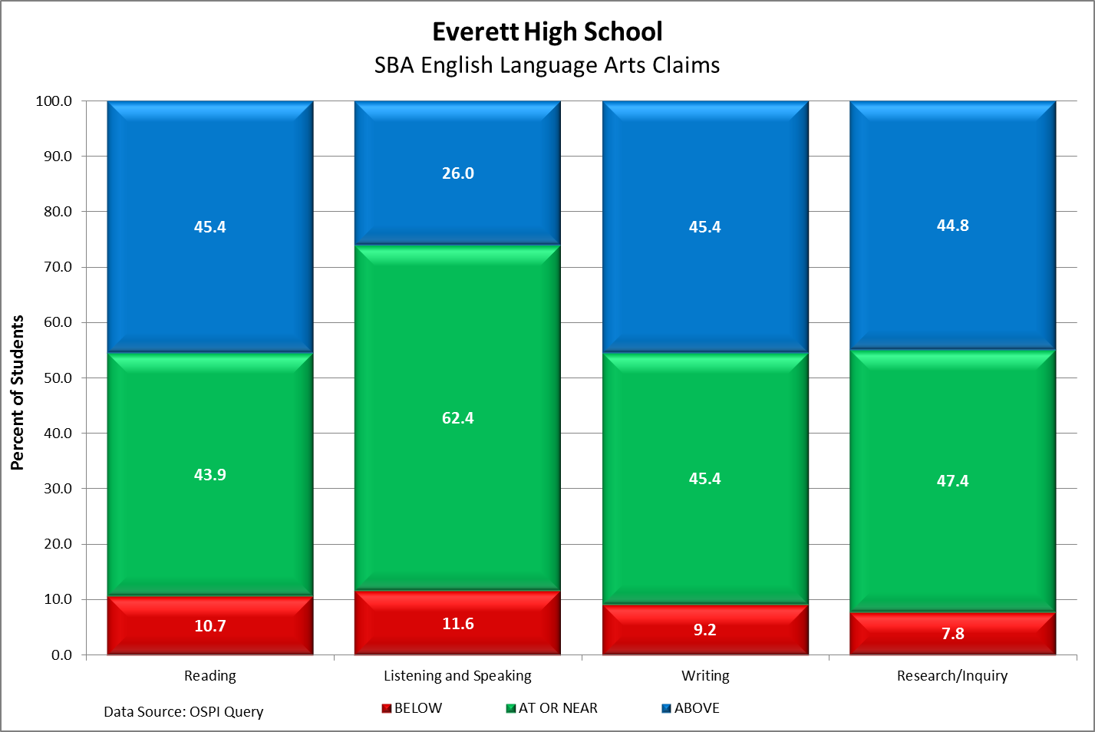
ELA Claims

Slide 13
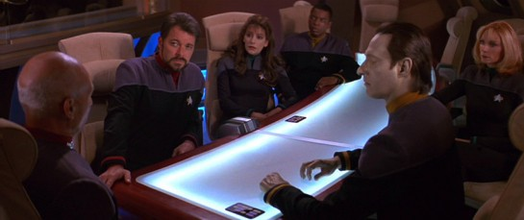
Preparing for the Mission

Slide 14
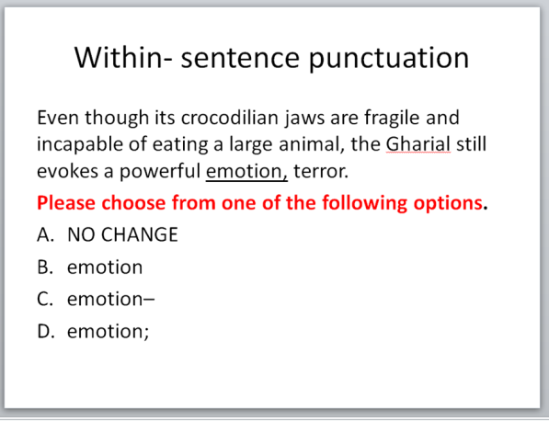
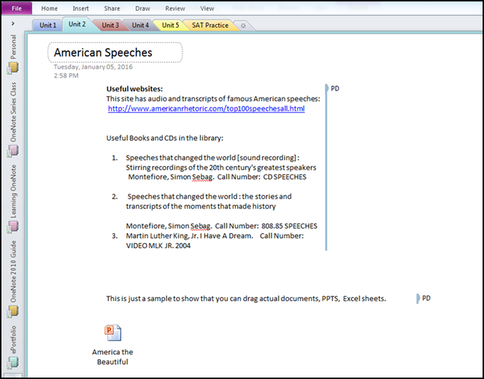
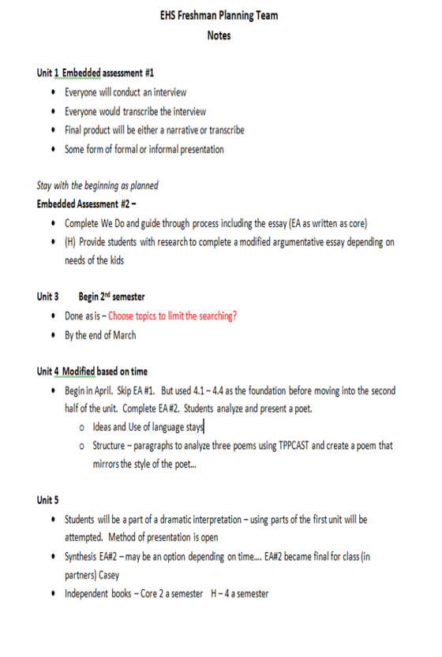
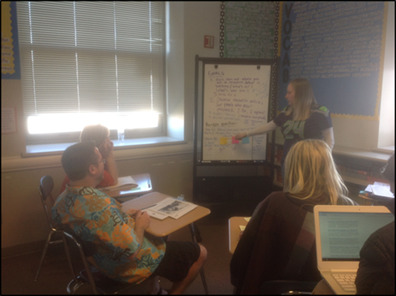
Eight-Step Support for PLC Teams

Slide 15
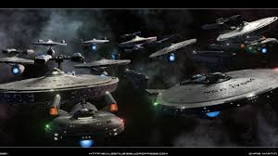
Transmitting Technologies to the Fleet

Slide 16
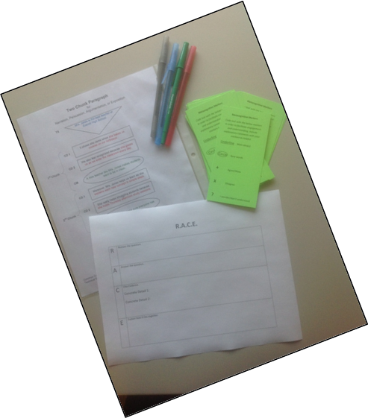
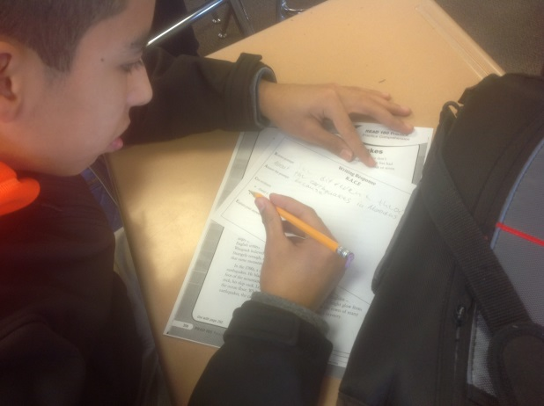
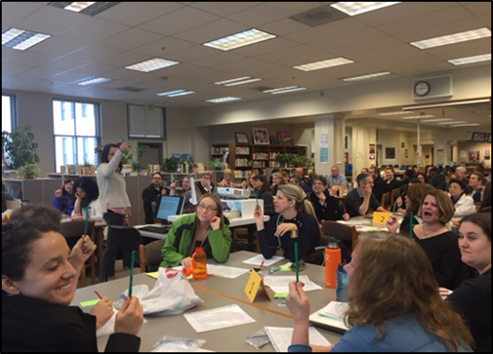
Cross-Content Literacy Structures

Slide 17
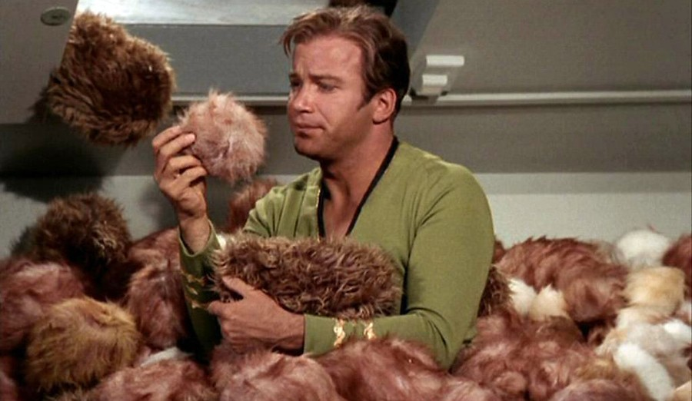
Promoting the Exploration of Strange New Worlds
Through Reading

Slide 18
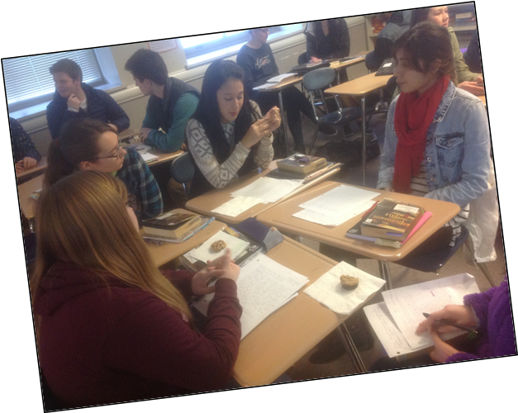
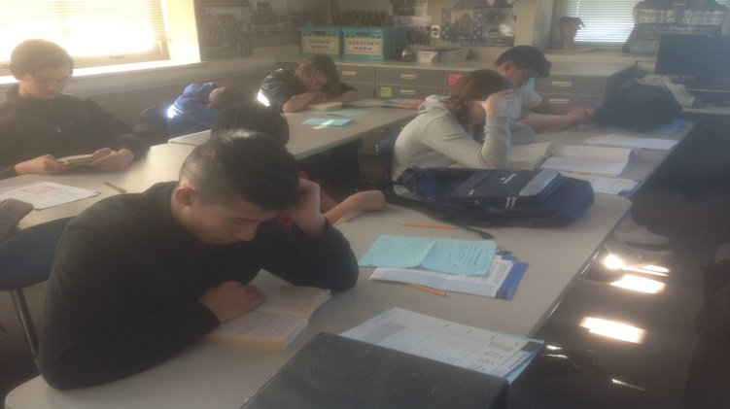
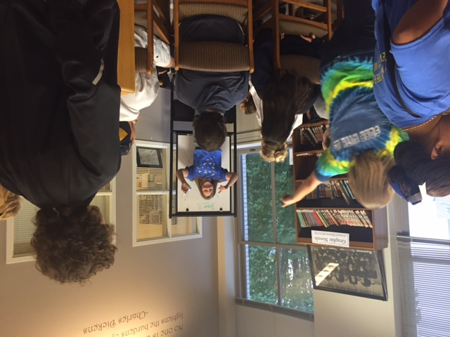
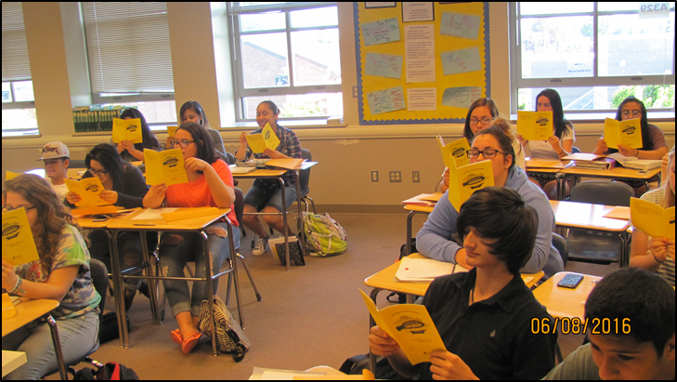
Increased Supplemental Reading

Slide 19

Moving Out of Our World – Social Studies
Connecting in with ELA strategies in the Social Studies classrooms
  RACE strategy
  Metacognitive markers
  Annotating rigorous historical texts

Slide 20
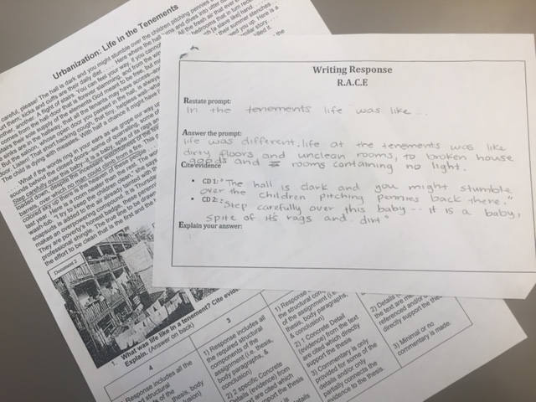
Connection to ELA: RACE Strategy

Slide 21
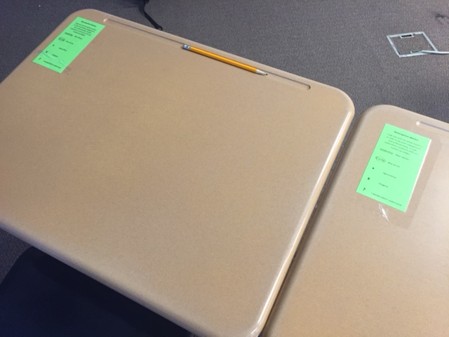
Metacognitive Markers

Slide 22
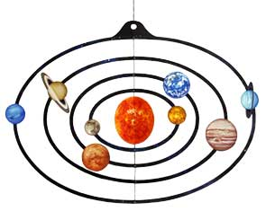

Moving Into the Next Solar System:
Data Talks and Student Work Analysis
More frequent common assessments in each curricular area
Rubric refinement from last year
Discussion between colleagues about student work, scores and calibration leading to a more consistent classroom experience for all students

Slide 23

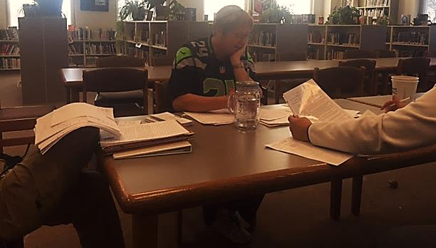
Data Analysis of Student Work: Colleagues Working Together

Slide 24

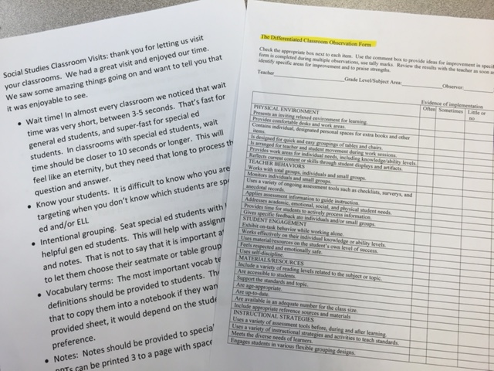

In Another Galaxy : Classroom Visits
Connection to last year - additional assistance for special education students
Our first classroom visits!

Slide 25

Getting Beyond the Milky Way
Using the classroom visits to modify instruction
Semester two changes
  Weekly communication between ELA special education teacher and core teachers
  Assistance in the specialized instruction
  Classroom with reading and writing of core materials from classes beyond English
  Changes are made to the instructional plan for students based on weekly communication and extra assistance so the student can achieve success

Slide 26
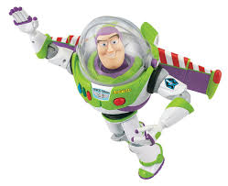
EHS Math:
To Infinity and Beyond

Slide 27
11th Grade Math
Overall
Percent by Level
Ethnicities

Slide 28
9th Grade EOC Math 1 and 2

Slide 29
10th Grade EOC Math 1 and 2

Slide 30
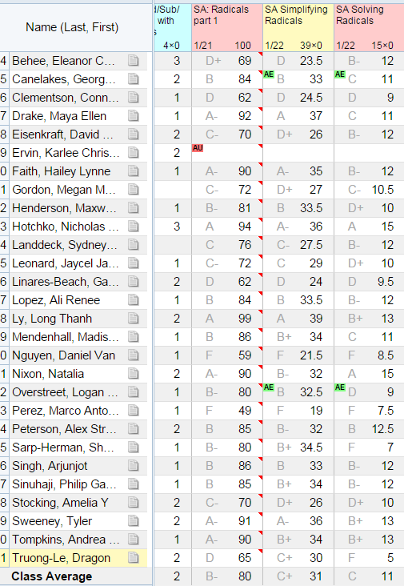

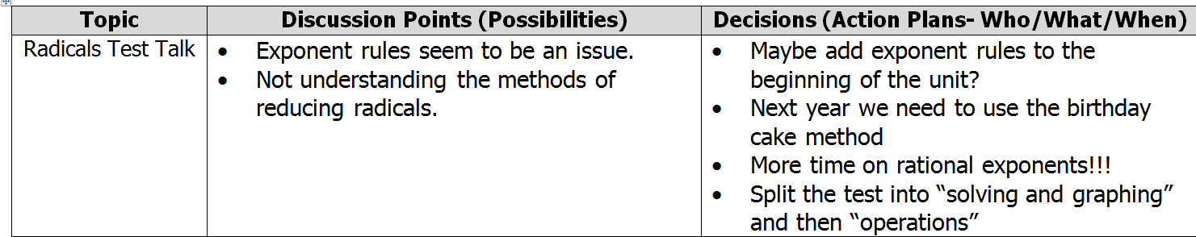
Test Talks Using Data

Slide 31
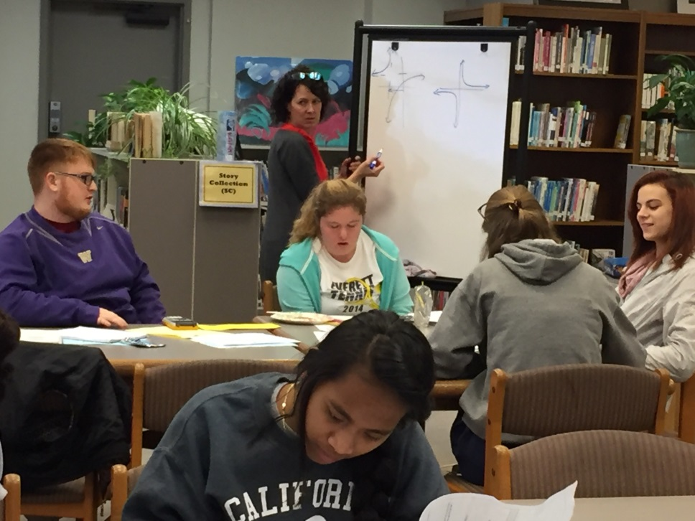
High Leverage Mathematical Practices
Multiple representation
Language: Rich classrooms
Connect to the real world
Well planned lessons: Coherence

Slide 32
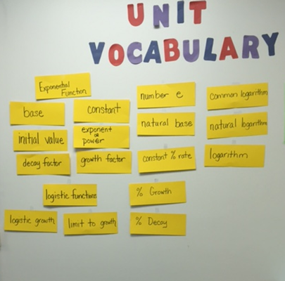
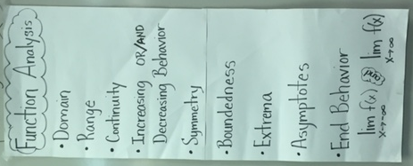
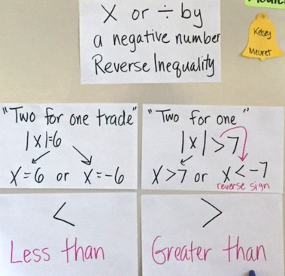
Language – Rich Classrooms

Slide 33
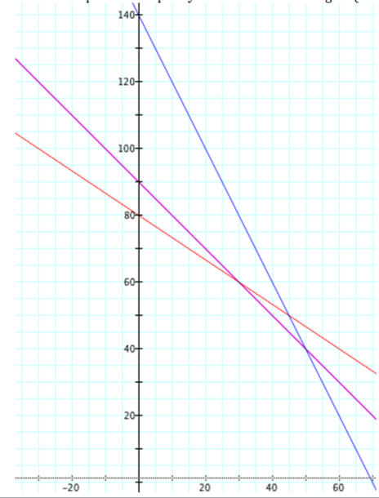
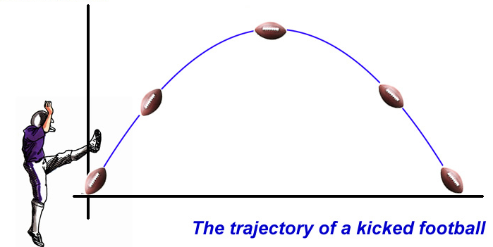
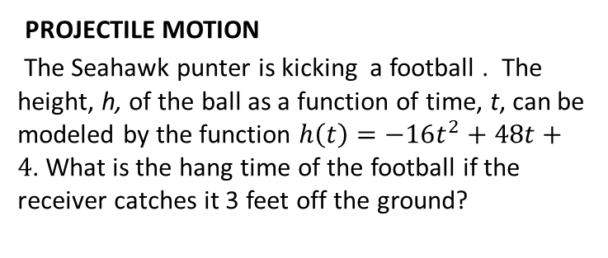
Connect to the Real World
LINEAR PROGRAMMING
A farmer has 90 acres available for planting millet and alfalfa. Seeds cost $4 per acre for millet and $6 per acre for alfalfa. Labor costs are $20 per acre for millet and $10 per acre for alfalfa. The expected income is $110 per acre for millet and $150 per acre for alfalfa. The farmer intends to spend no more than $480 for seed and $1400 for labor. Find the maximum income for the given constraints.
PROJECTILE MOTION
The Seahawk punter is kicking a football . The height, h, of the ball as a function of time, t, can be modeled by the function $h\left(t\right)=−16t^{2}+48t+4$. What is the hang time of the football if the receiver catches it 3 feet off the ground?

Slide 34
Interim Assessments
February 1st: Math Department trained on site and how interim testing works
Tests:
  HSM-IAB-AlgLinFun: Algebra, Linear Functions
  HSM-IAB-Geometry: Geometry ( Rt. Triangle Trig)
  HSM-AB-AlgQuaFun: Algebra, Quadratic Functions
  HSM-IAB-PTDrvRst: Performance task ( Exponential)

Slide 35
Interim Assessment
PLAN for 2015-2016
 | Oct | Nov | Dec | Jan | Feb | March | April | May
Algebra 1 |  |  |  |  |  | Algebra, Linear Functions |  | Algebra, Quadratic Functions
Geometry (12) |  |  |  |  |  |  |  | Geometry
Algebra 2 (90) |  |  |  |  | Algebra, Linear Functions | Algebra, Quadratic Functions | Performance task (exponential) | Geometry | June 1st SBA Grade 11
Pre-Calculus (64) |  |  |  |  | Algebra, Linear Functions | Algebra, Quadratic Functions | Performance task (exponential) | Geometry
PLAN for 2016-2017
 | Oct | Nov | Dec | Jan | Feb | March | April | May
Algebra 1 |  |  | Algebra, Linear Functions |  |  |  |  | Algebra, Quadratic Functions
Geometry |  |  |  |  |  |  |  | Geometry
Algebra 2 | Algebra, Linear Functions |  | Algebra, Quadratic Functions |  |  | Performance task (exponential) |  | Geometry | June 1st SBA Grade 11
Pre-calc | Algebra, Linear Functions |  | Algebra, Quadratic Functions |  |  | Performance task (exponential) |  | Geometry

Slide 36

Math Goal for Students
When I left you, I was but the learner; now I am the master.
-- Darth Vader

Slide 37

Science Vision

Slide 38
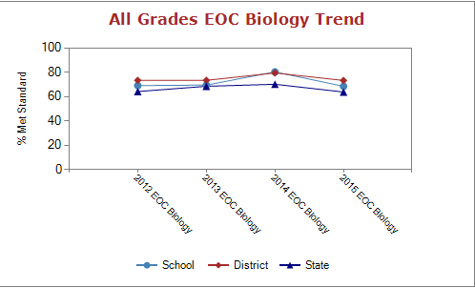
Where We Were:
Overall

Slide 39
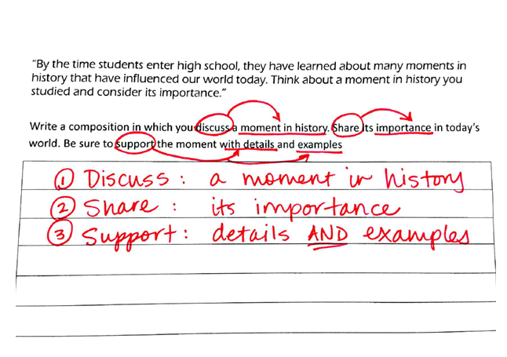
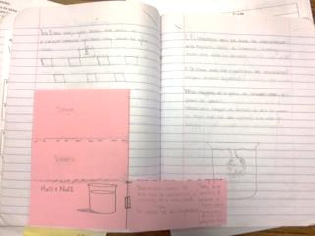
Where We Were…
Notes:
AVID… coord science—infiltration department wide

Slide 40

Where We Are…
Notes:
Getting ready to go into hyperspeed

Slide 41
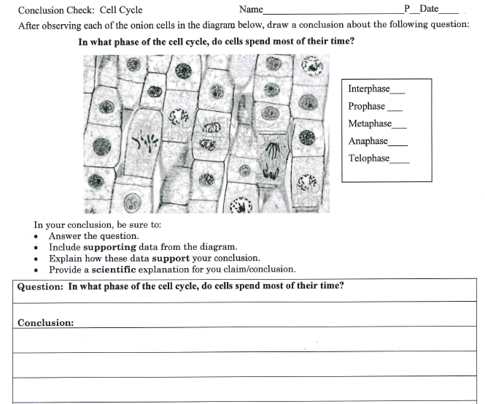
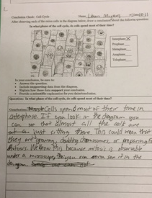
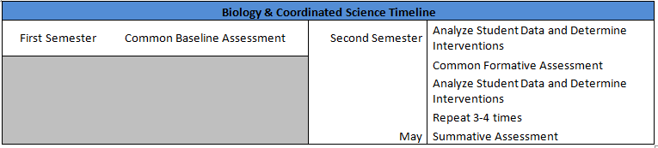
Claim Evidence Reasoning: CER

Slide 42
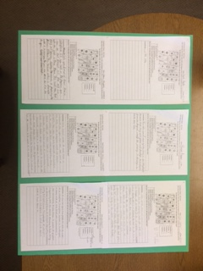
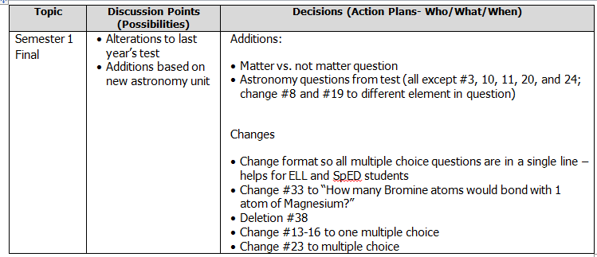
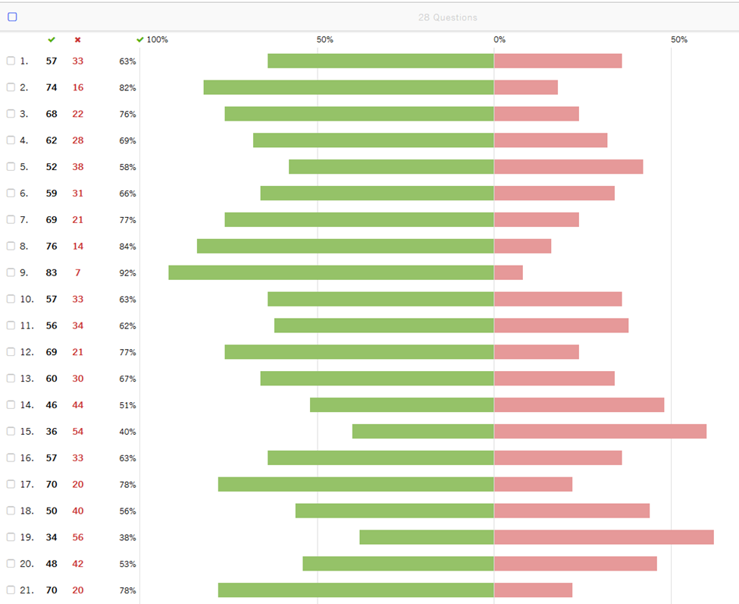
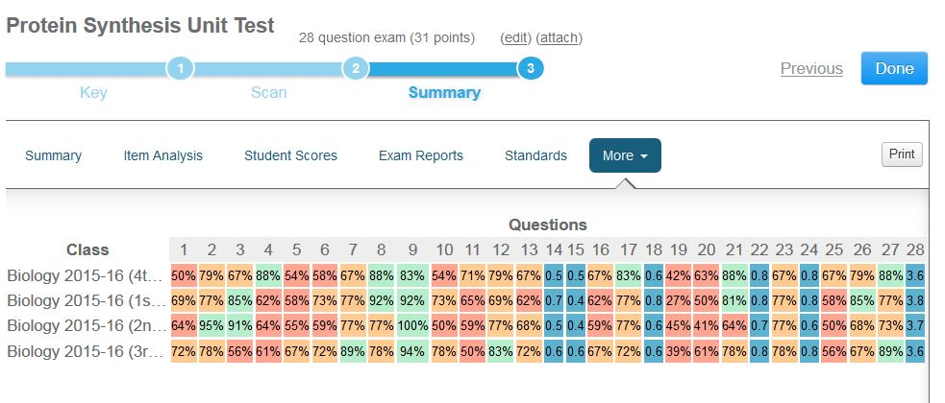
Test Talks Using Data

Slide 43
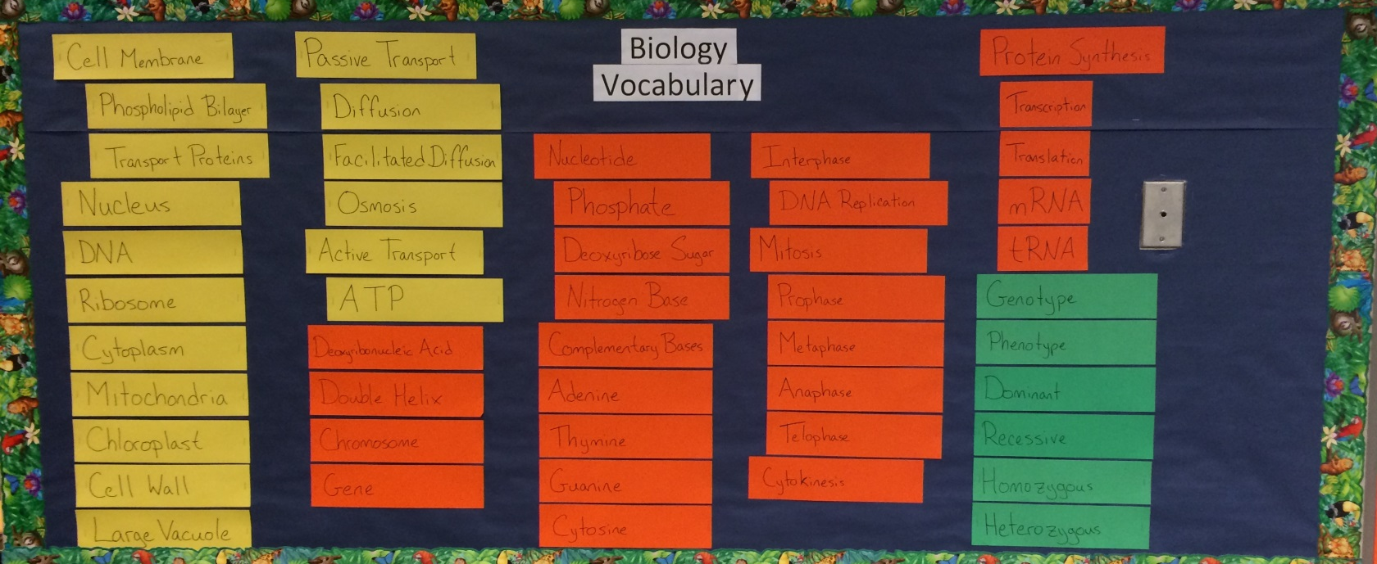
Vocabulary and Language Acquisition

Slide 44
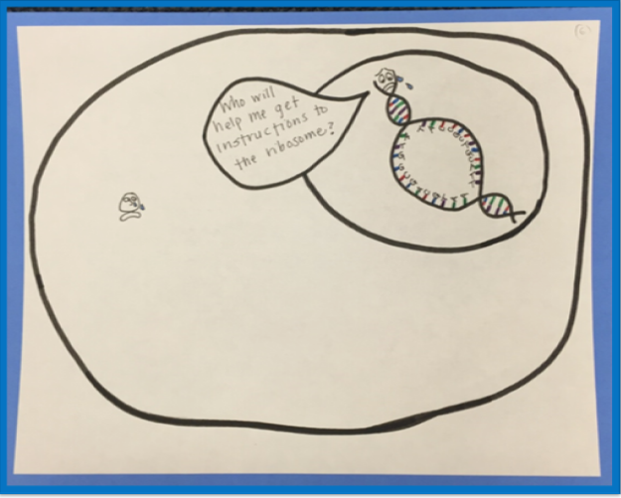
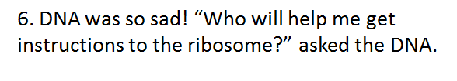
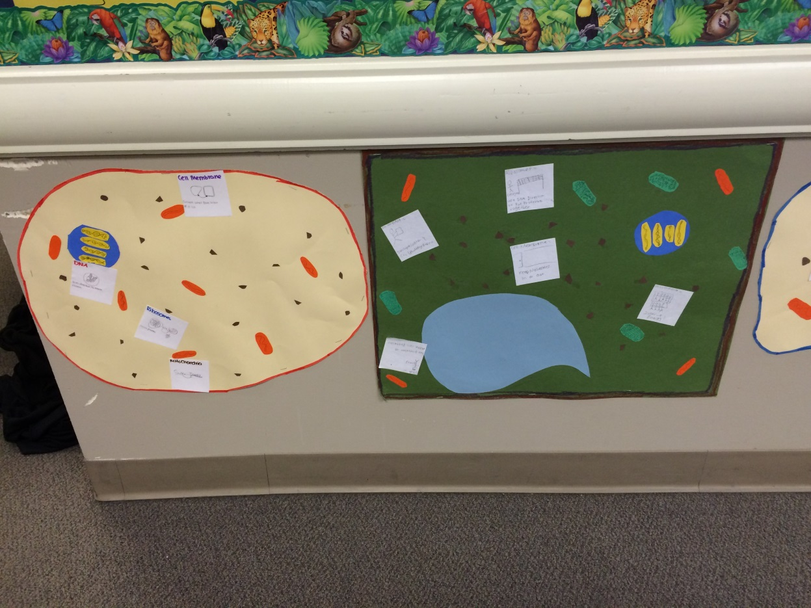
Making Thinking Visible in Instruction

Slide 45

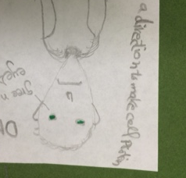
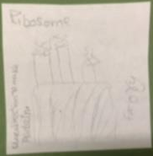
Making Thinking Visible: Assessment
Plant and Animal Cells
Images and descriptions of their role within the cell

Slide 46
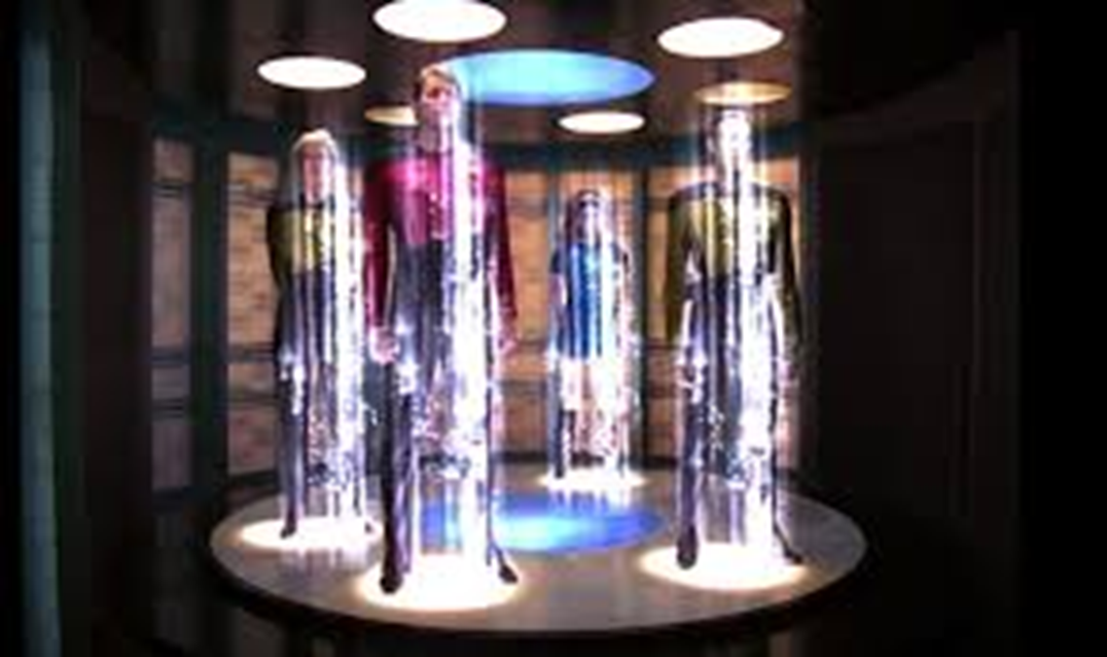
Where We Are Going…
Notes:
NGSS, increase the number of common assessments, GLAD throughout Science Department, “Beam up” the remaining 25.6%, More

Slide 47
English Language Acquisition
Annual Measurable Achievement Objectives for English Language Learners

Slide 48
AMAO-1
Notes:
represents the percent of students who grew at, or above, the expected number of points

Slide 49
AMAO-2

Slide 50
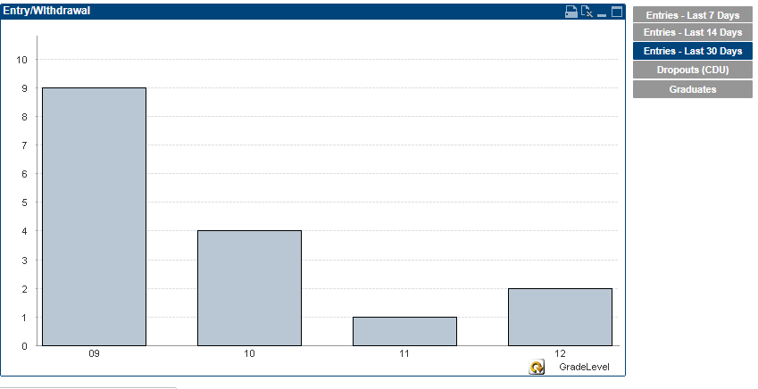
ELL Entries-Last 30 Days

Slide 51
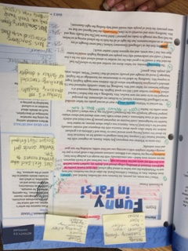

Common Best Practice
Notes:
Marking of the Text
Springboard
Use of Jane Shaeffer

Slide 52

Growth Mindset

Slide 53


Skills and Language Acquisition

Slide 54

Collaborative Spirit
Schoolwide strategies
GLAD trainings
  Cognitive content dictionary
Notes:
Building Wide Best Practices—focus on ELL LID Days
Close collaboration with the district specialist—GLAD strategies training and release time
Cognitive Content Dictionary—Biology and Coordinated Science

Slide 55

Ready to Soar …
Notes:
College and Career Ready
Increased opportunities
Continue to challenge our students--stretch

Slide 56

College in the High School
Notes:
Additional funding to cover the expense for CIHS

Slide 57


Innovation and Problem Solving

Slide 58



College Board Comparison Report
13th
Notes:
When looking at our College Board Comparison—look at schools similar in size and demographics (25 Schools)
Overall #’s
AP—
# of exams taken with 3,4,or 5—7th
Sat (class of 2015)
2nd Critical Reading Mean
3rd in Math
3rd in Writing
PSAT (2017)--sophomores
Critical Reading—9th
Math—15th
Writing Skills—10th
PSAT Juniors (80 who took the exam)
Critical reading—1st, math—2nd, 1st in writing

Slide 59

Advanced Placement Data
Notes:
With this mindset… we have promoted outreach
More students taking AP

Slide 60

Increasing Participation Rates
Notes:
More test takers
More students taking more than one exam
More students taking more than one AP class
More students taking exams

Slide 61

Consistent Qualifying Scores
Notes:
Even with increased numbers, scores are the same
Goal—this year is to improve our scores

Slide 62


Where We Are Going…
Notes:
Speaking of collaboration– EOS
Opportunity gaps within subgroups—lightly shaded areas identify how many within each subcategory
Survey results—highlighted what has helped and what will continue to help guide this work—
Dash—represents the mean for the 140 school within EOS portfolio—notice we are way above
Our staff believes student motivation, confidence in success, and perseverance are predictors of student success in AP
Great reinforcement and indicator for our admin team—overall success of the mindset work we have down and are continuing to do

Slide 63

Where we are going…
Increase course offerings
  AP Art, AP computer science principals, & Capstone Program
  Stem options
  CIHS
EOS: Survey student needs and barriers to access

Slide 64


Slide 65
EES Staff Perceptions 2015
N=87

Slide 66
EES Staff Perceptions: Longitudinal

Slide 67
EES Student Perceptions: Longitudinal

Slide 68
Graduation Rates

Slide 71
Student by Student
Student ID | Comments 1/14 | Advocate
198464 | Red | Navran, Linda
 | Red | Plucker, Piatz
129982 | Red-Intervention | Lancaster, S
187814 | Red-SHS | Stiger
187386 | Red | TO
208924 | Red | Waddel
125244 | Red | Anne LaRue
208513 | RED 2017 - ASSESSMENTS-CREDITS | Waddel, O'Brien
116853 | Red- assessment | Stiger, Gretchen
164181 | Red-Assessment | O'Brien, Elisabeth
116982 | RED- Assessments Moved | Berry, K
116789 | Red-Assessment | Waddel, Michele
125119 | Red- Assessment Submitted | Berry, K
151712 | Red-intervention | Waddel, Michele
130100 | Red- August | Stiger, Gretchen- Linda Navran
179260 | RED- AUGUST? | Piatz, P
198262 | Red -Assessment | Berry, K
116706 | Red-intervention | Lancaster, S
164010 | RED- NO TRANSCRIPTS | Mitch Entler
164720 | RED- PLAN | Waddel, Michele
130025 | RED- PLAN | Waddel, Berry
187311 | RED- PLAN | O'Brien, Elisabeth
130129 | Red-Assessment | Brianna Smith
209082 | Red-Assessment | Piatz, P
116547 | Red-Assessment | Anne LaRue
236023 | Red-Assessment | Meuret
236574 | Red-Assessments | Meuret
158840 | RED-ATTENDANCE | O'Brien, , Waddel, Zintzun
116852 | Red-Assessment | Anne LaRue
116854 | Red-Assessment | Brianna Smith
153457 | Red-Assessment | Stiger, Gretchen
129924 | Red-Assessment | Anne LaRue
116535 | Red-Assessment | Piatz, P

Slide 73




SES Achievement Gap

Slide 74

Make It So…
…Because Failure is Not an Option

Slide 75

Welcoming Culture Action Item
TL5.1.a Professional development directed at positively impacting the student as a learner
September LID- “Best School in the Universe” Theory of Action: If Everett High School can positively impact the role of the student as a learner…Then we will have a positive impact on student learning
    Instructional Core
  Growth ~vs~ fixed mindset
  Creating a Culture of Achievement - Chapter 1: Welcome
  Safe Schools Alert, HIB, Mental Health
October LID- “Best School in the Universe Part II” Theory of Action: If Everett High School can positively impact the role of the student as a learner…Then we will have a positive impact on student learning
  Instructional Core
  Growth ~vs~ fixed mindset
  Creating a Culture of Achievement – Chapter 3: Choice Words
  Attitude is a choice

Slide 76
Welcoming Culture Action Item
TL2.1.a Implement Nesika support class to facilitate success and belonging

Slide 77


Welcoming Culture Action Item
TL1.3.b Student leadership has an active role in creating a positive school climate
2016 EHS Student Leadership Themes –
“There are no strangers here, only friends who have not yet met”
“Be somebody that makes others feel like somebody”
ASB sponsored guest speakers
Scott Backovich- “Be a Catalyst”
Dr. Charles Morgan “Overcoming Barriers”

Slide 78


Discipline and Attendance

Slide 79




Discipline Data: In-School Suspension

Slide 80




Discipline Data: Discretionary Suspension & Expulsion

Slide 81

Discipline Ladder

Slide 82
Discipline Philosophy: Merging Consequences with Support
Know the students
Keep students in class
After school detention as an academic intervention
  Students have the opportunity to serve detention with teachers or tutors in the library
In-school suspension as in-school support
  Keeps the student academically engaged
  Access to staff and assignment resources
  Eliminates the chance of falling behind

Slide 83




Attendance Data

Slide 84


Attendance Roundup and HERO
HERO:
Administer HERO Sweeps daily
Students receive a warning followed by an attendance make up session
Administrative Assistant follow up
Attendance Roundup:
Wednesday and Friday
Admin meet with any student with unexcused absence

Slide 85


Slide 86
EHS Appreciation
Continuous improvement day
Curriculum adoptions (AP)
LIF
College and career focus (PSAT, SAT)
Rich data resources and tools
TPEP
Professional development
Carpeting
Community support (Blue and Gold, PTA, auction)

Slide 87
Support Requests
Technology
Counseling support
Aging facilities: furniture
DECA
Community partnerships
Grading work

