Slide 1


STATE OF SCHOOL REVIEW
Everett Public Schools
December 2015

Slide 2
Demographic Trends

Slide 3
5-year Improvement Trend vs. 2015 Performance

Slide 4
Elementary Counts
(Number of students assessed at each grade)
ELA
Math

Slide 5
3rd Grade ELA

Slide 6
3rd Grade ELA

Slide 7
4th Grade ELA

Slide 8
4th Grade ELA

Slide 9
5th Grade ELA

Slide 10
5th Grade ELA

Slide 11
3rd Grade MATH

Slide 12
3rd Grade MATH

Slide 13
4th Grade MATH

Slide 14
4th Grade MATH

Slide 15
5th Grade MATH

Slide 16
5th Grade MATH

Slide 17
5th Grade SCIENCE

Slide 18
5th Grade SCIENCE

Slide 19
English Language Acquisition
Annual Measurable Achievement Objectives for English Language Learners
The percentage on the AMAO-1 chart (above) represents the percent of students who grew at, or above, the expected number of points.
The percentage on the AMAO-2 chart (left) represents the percent of students who demonstrated English language proficiency by scoring a Level-4 on the WELPA assessment.
AMAO-1 and AMAO-2 charts require a minimum N of 10 students to display data.

Slide 20
EES Staff Perceptions – 2015

Slide 21
EES Staff Perceptions - Longitudinal

Slide 22
Resistance Factor, Change, Accountability

Slide 23
EES Student Perceptions - Longitudinal

Slide 24
EES Parent Perceptions - Longitudinal

Slide 25
STATE OF SCHOOL REVIEW
Everett Public Schools
Cedar Wood Elementary

Slide 26
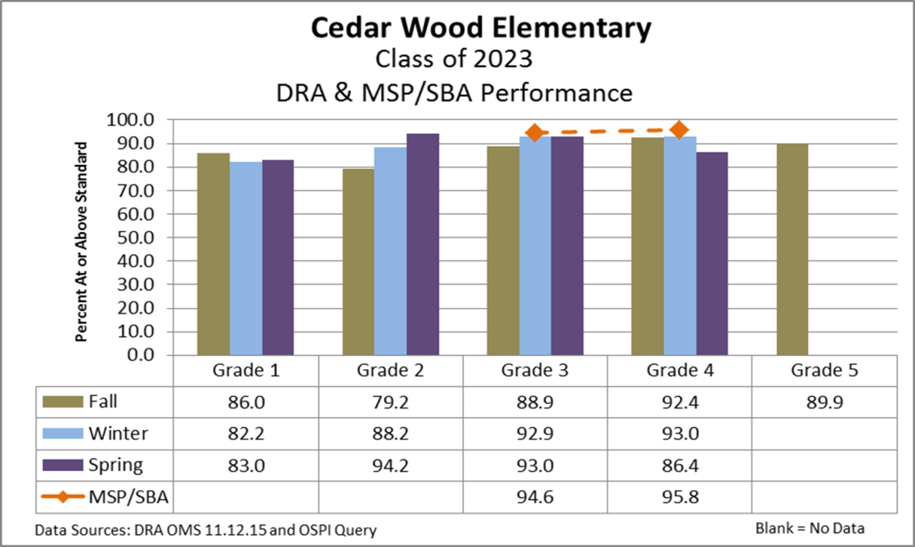
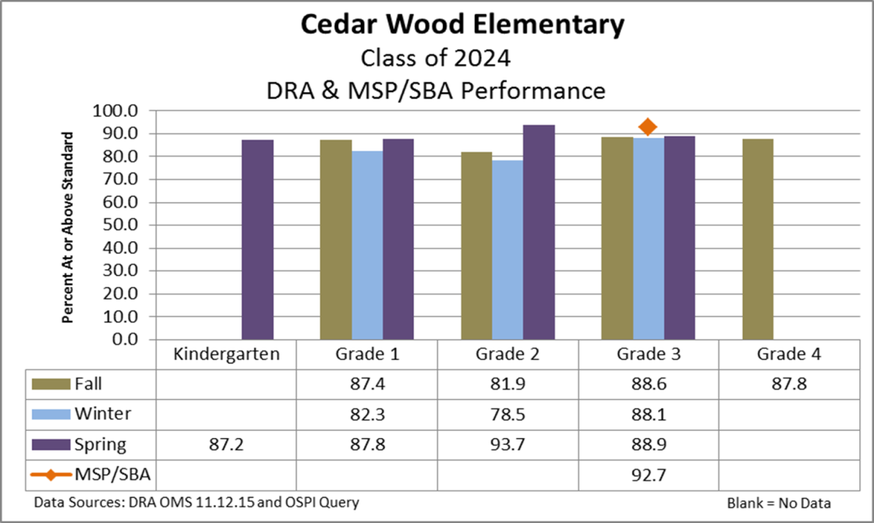
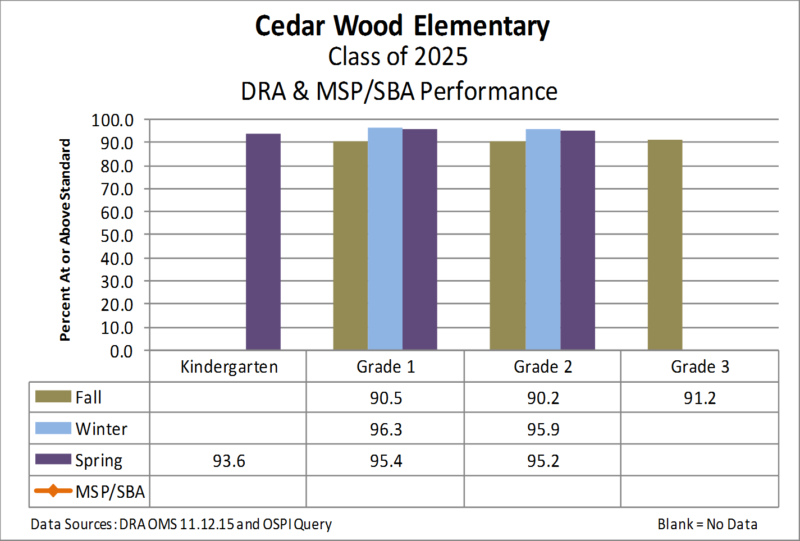
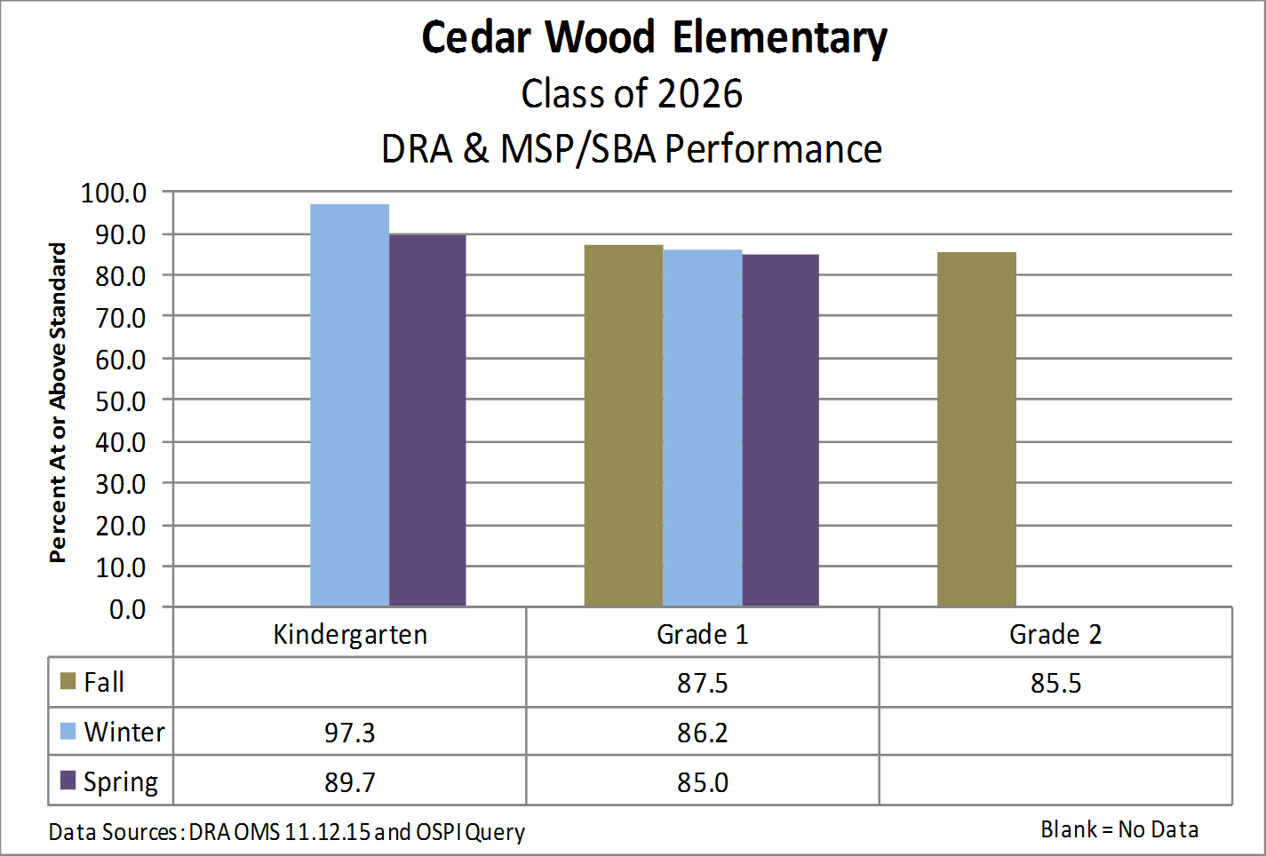
DRA & MSP/SBA Performance

Slide 27
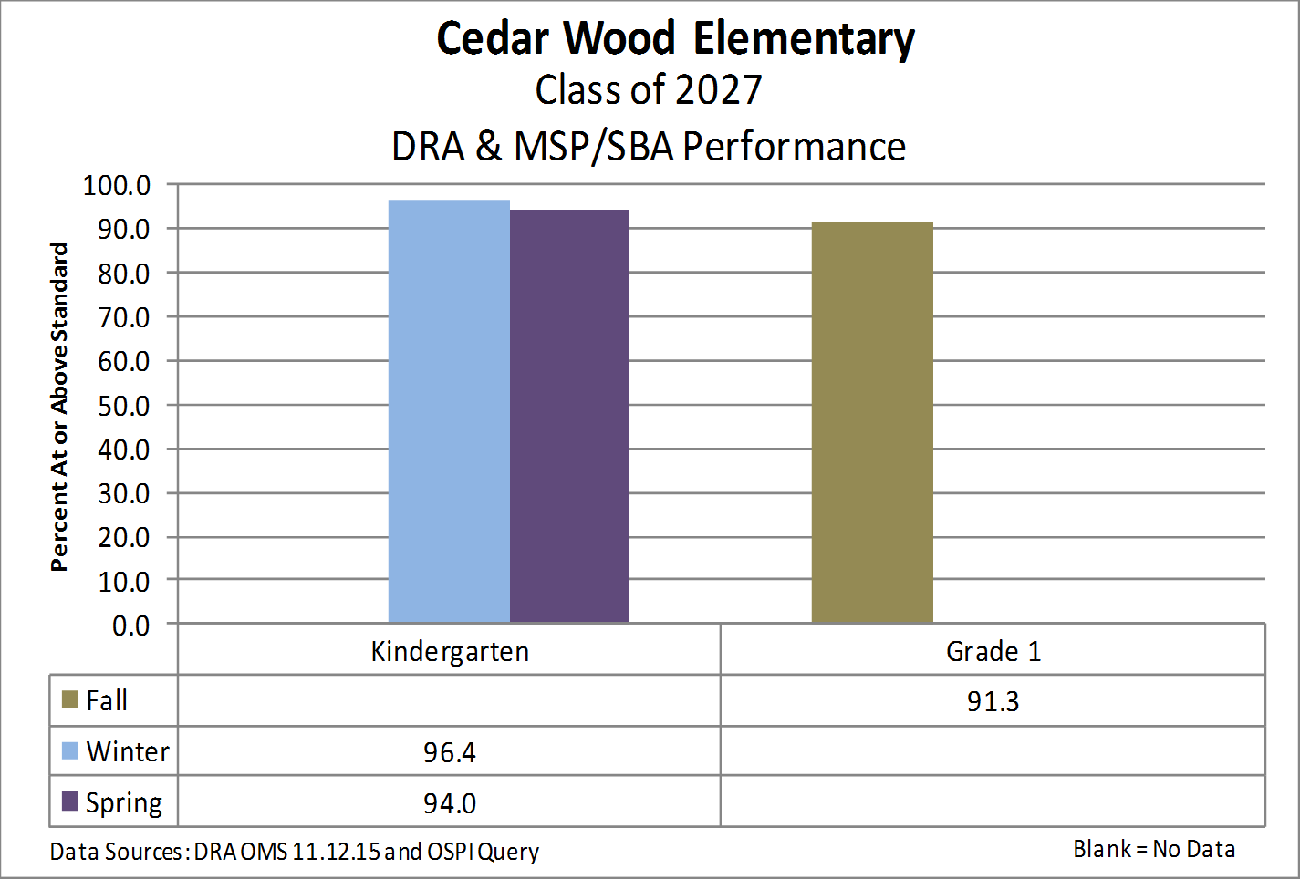
DRA & MSP/SBA Performance

Slide 28
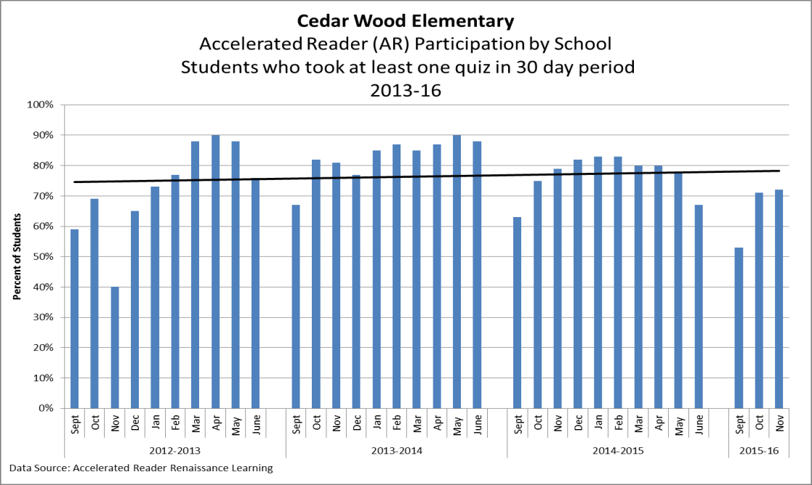
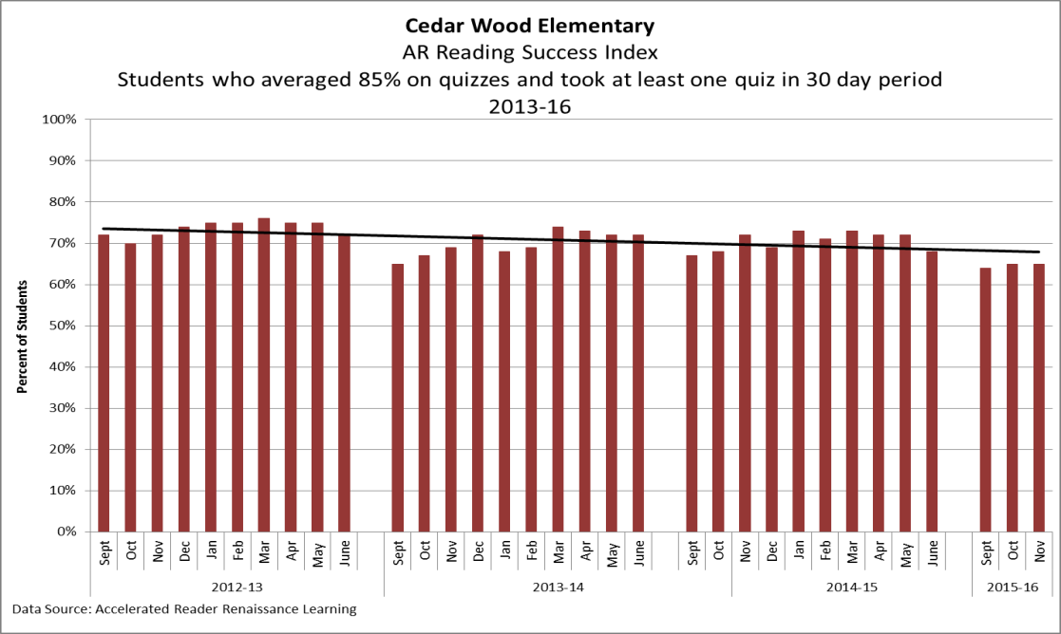
Accelerated Reader Data

Slide 29
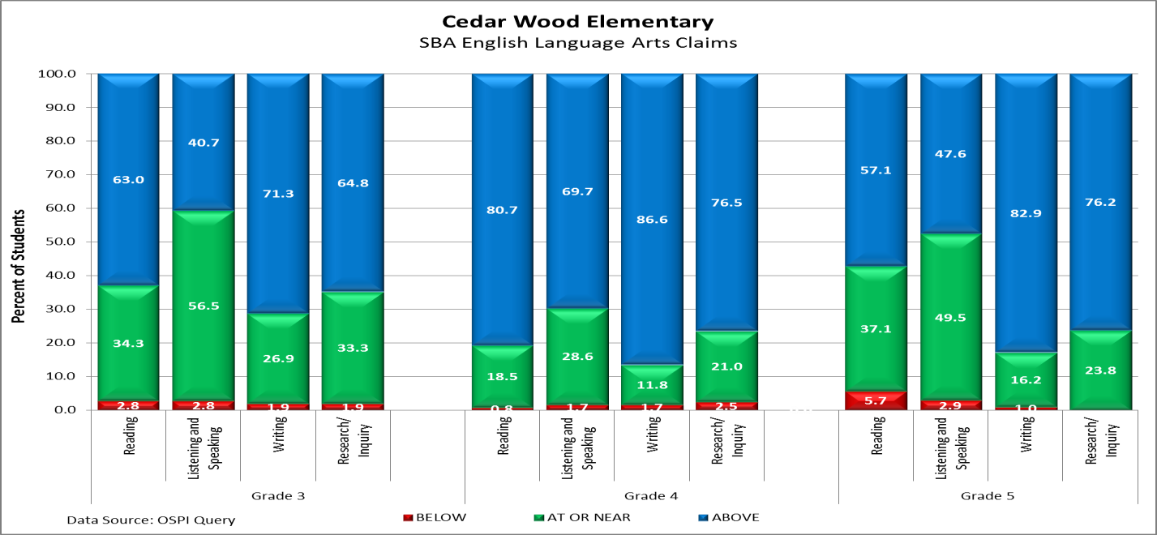
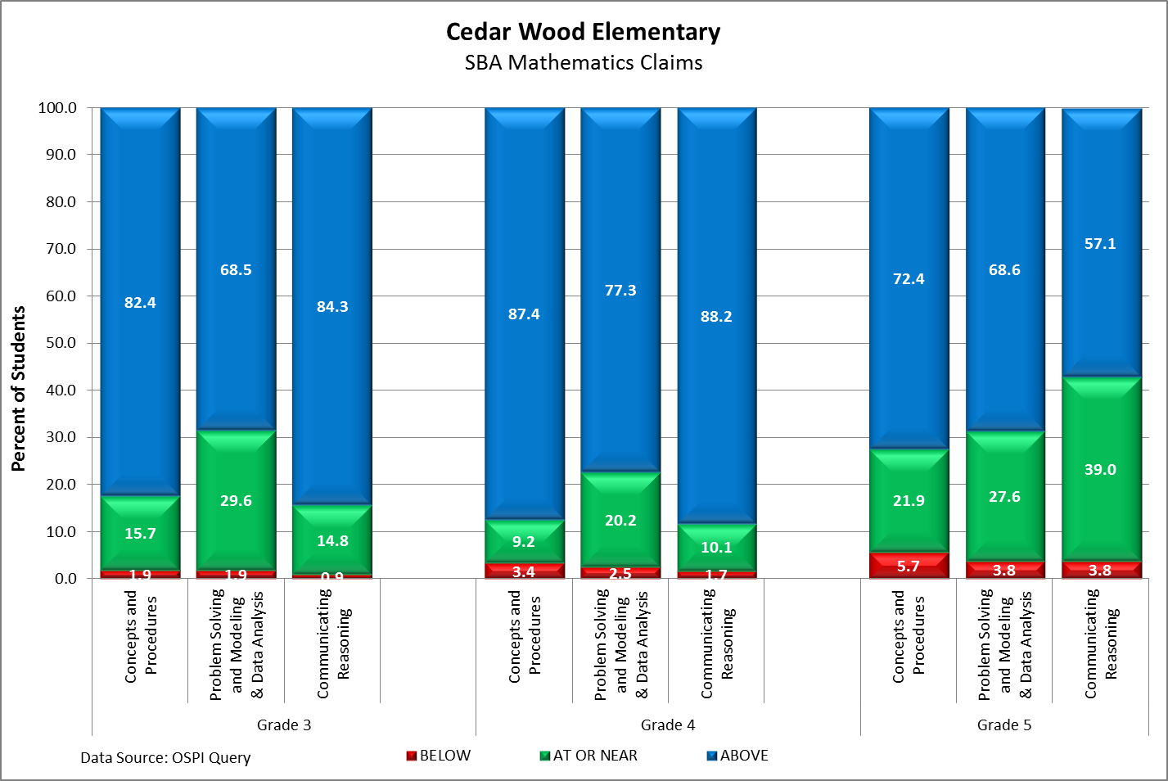
SBA Claims

Slide 30
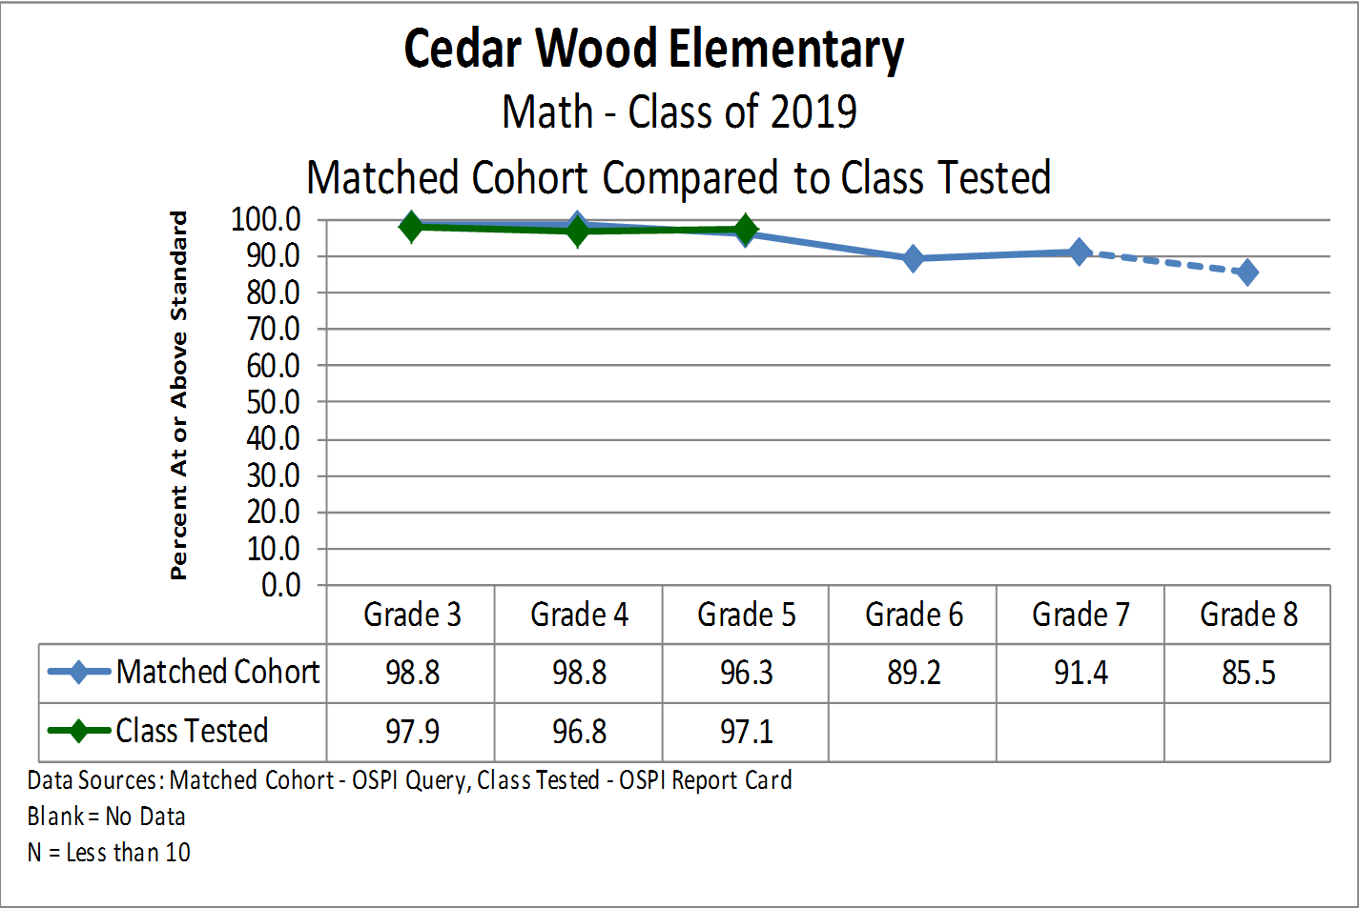
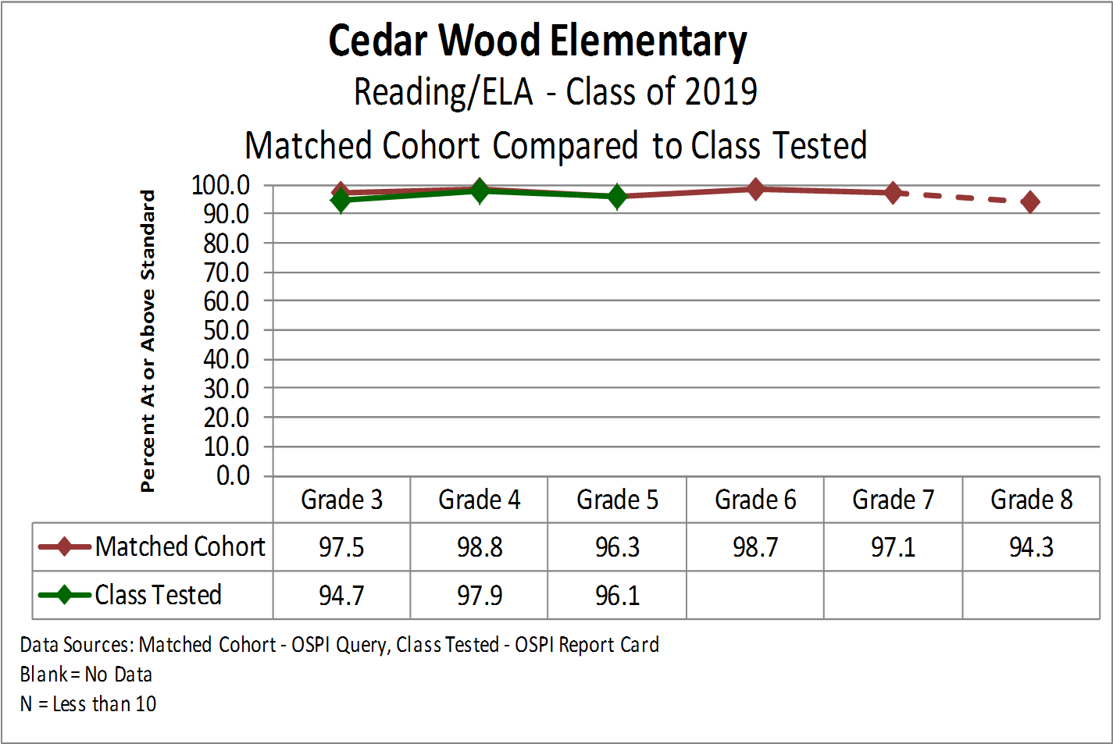
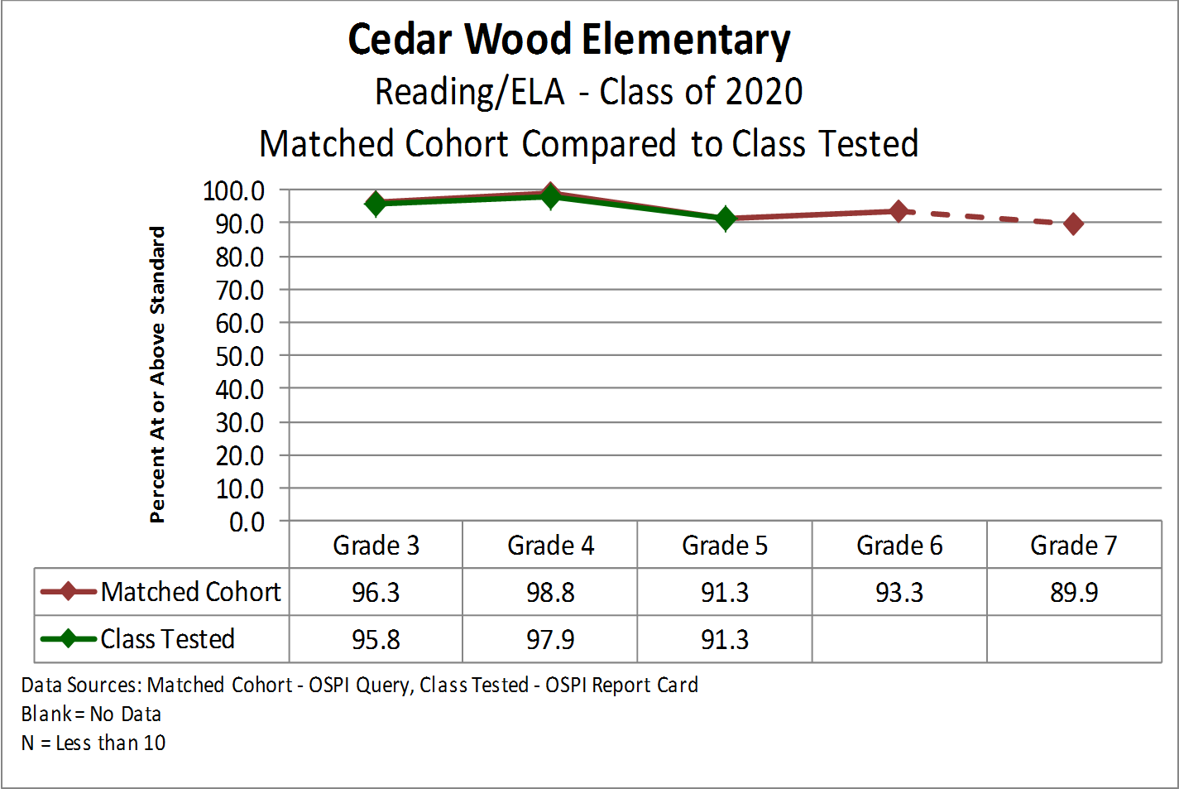
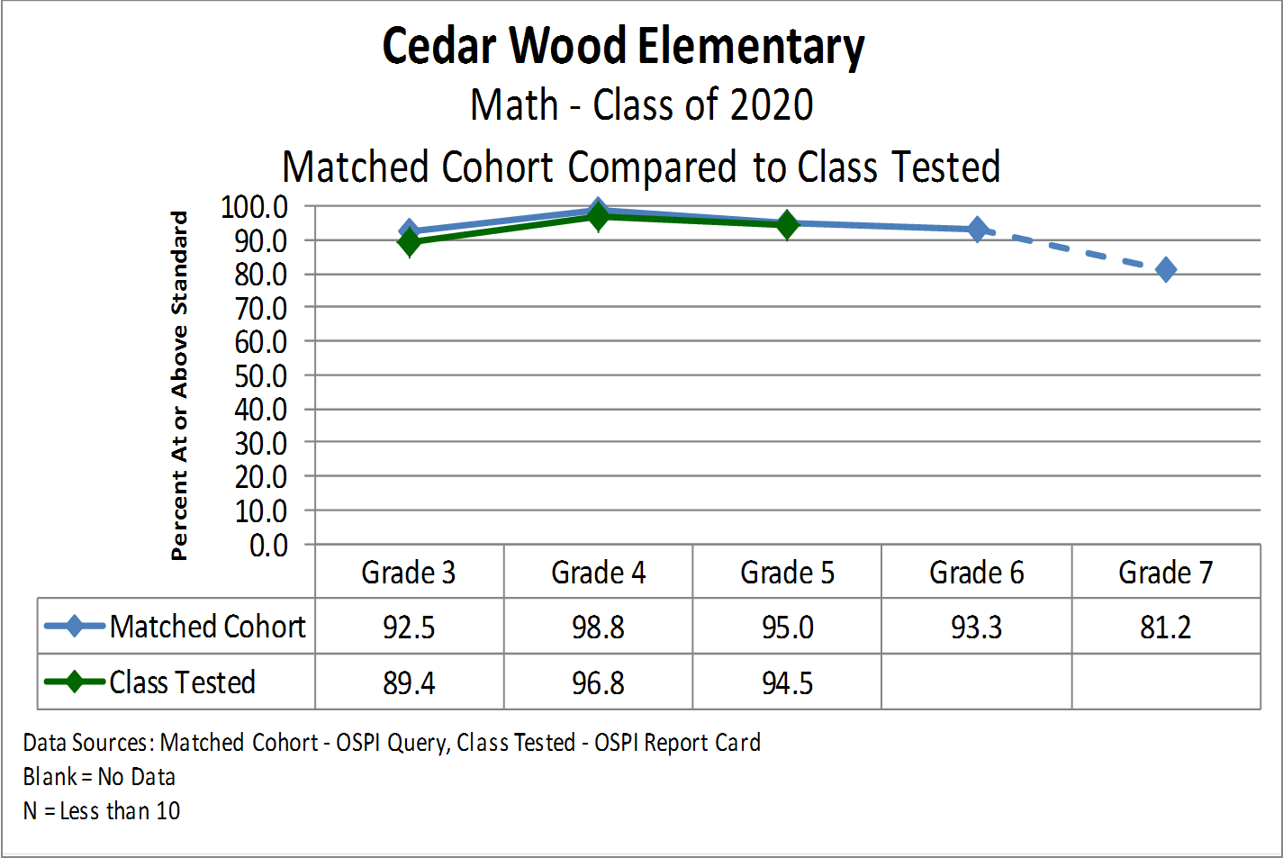
Matched Cohort

Slide 31
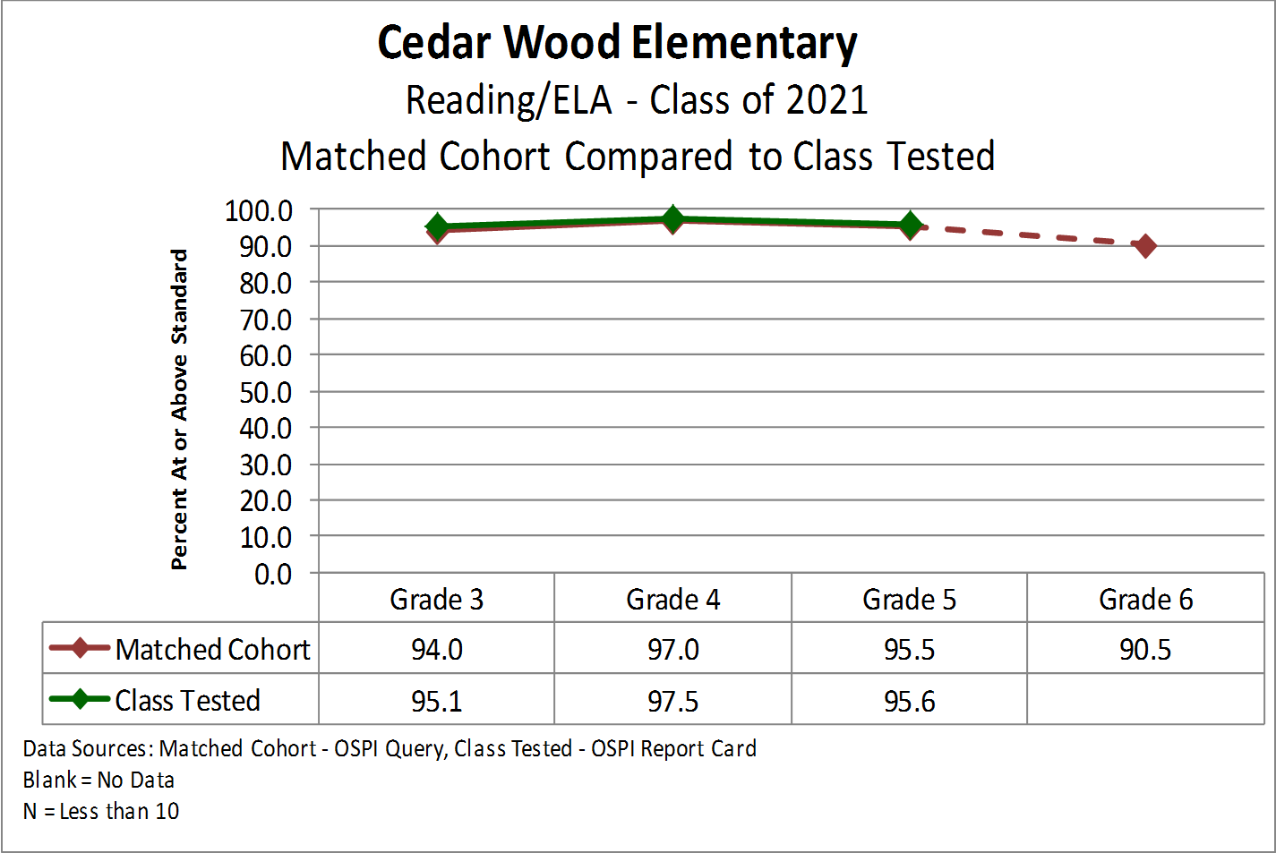
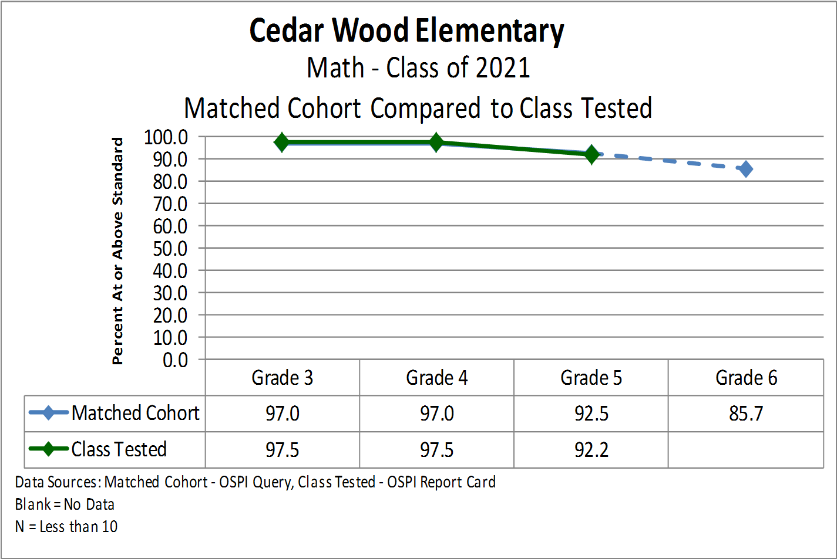
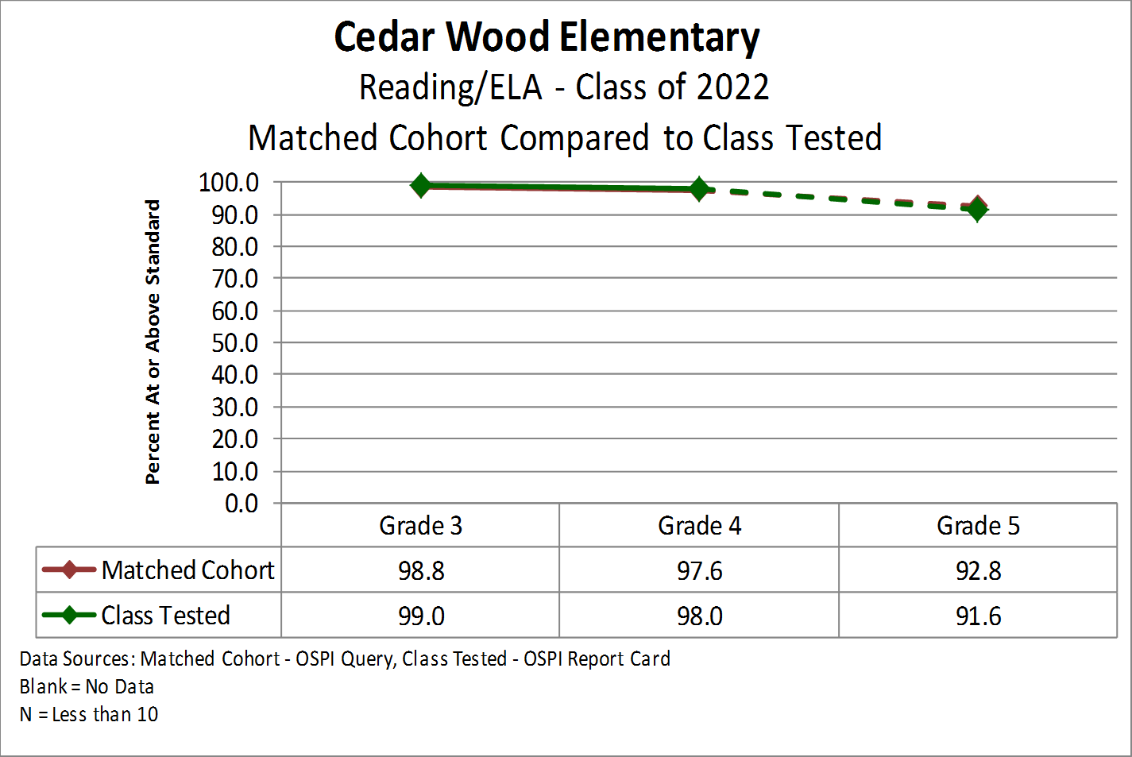
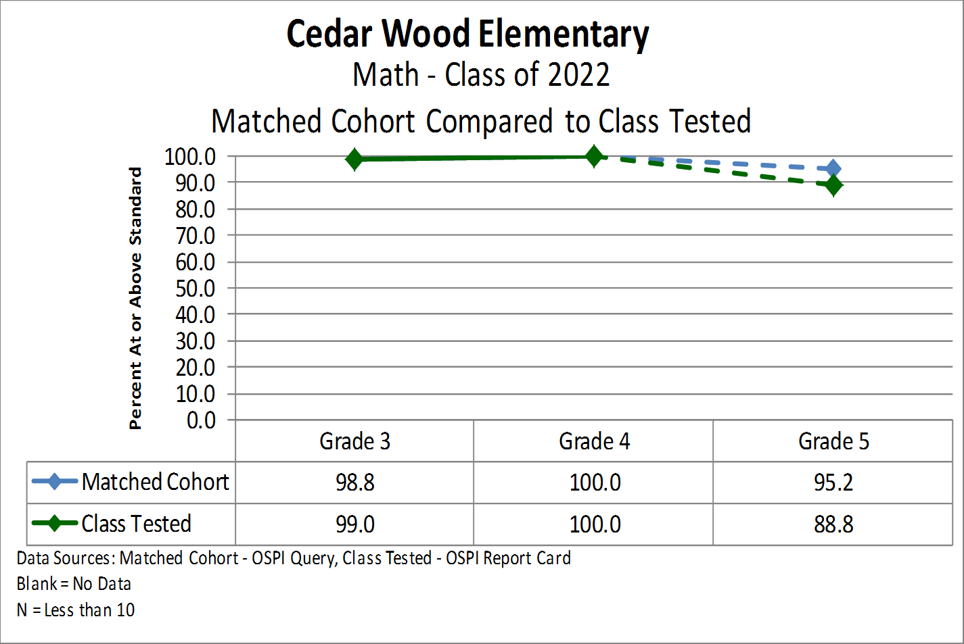
Matched Cohort

Slide 32
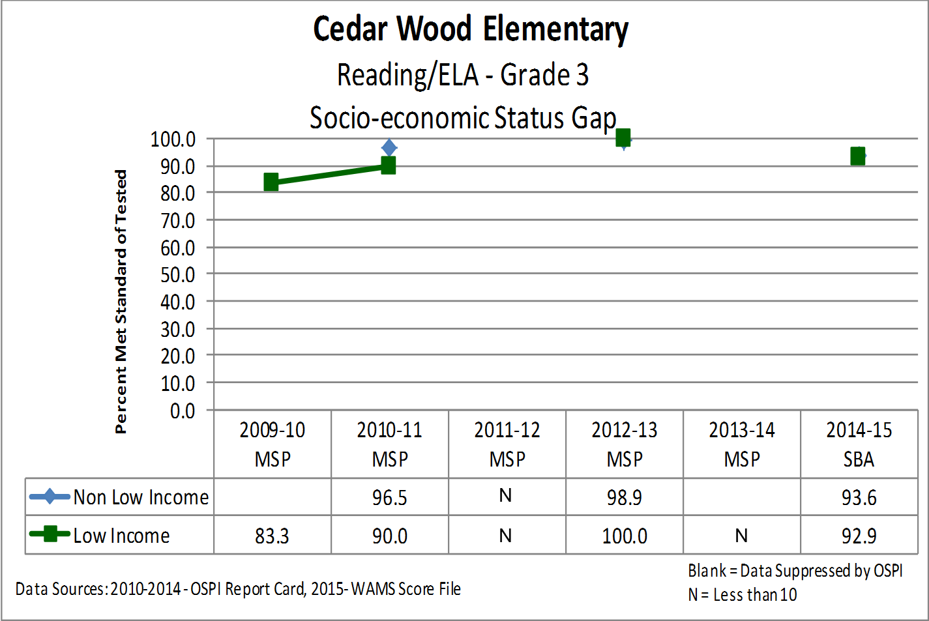
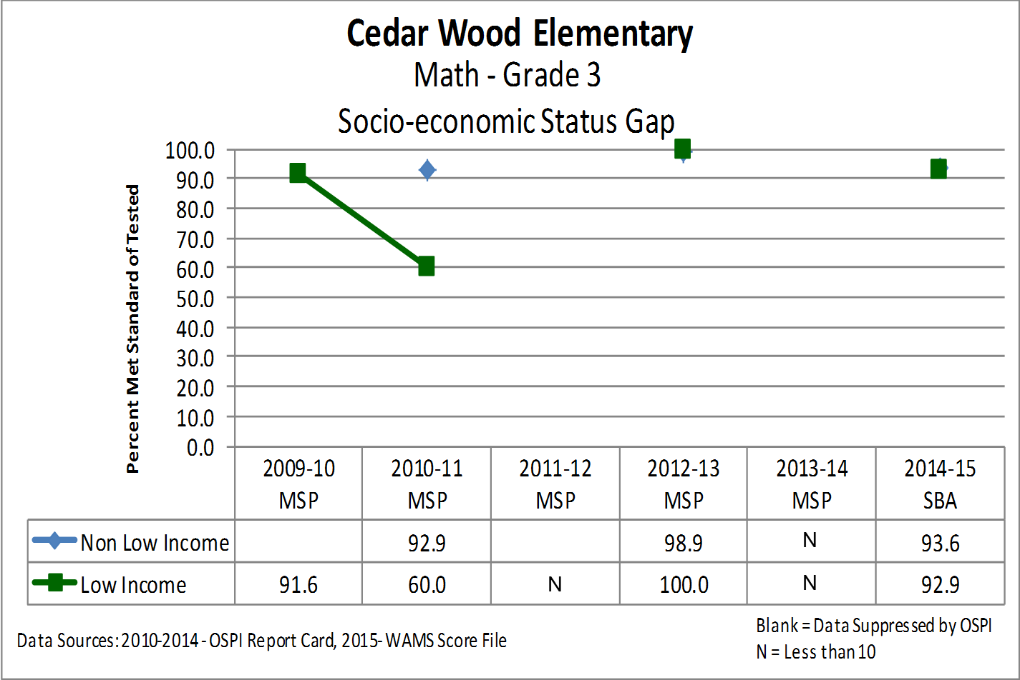
Grade 3 SES Achievement Gap

Slide 33
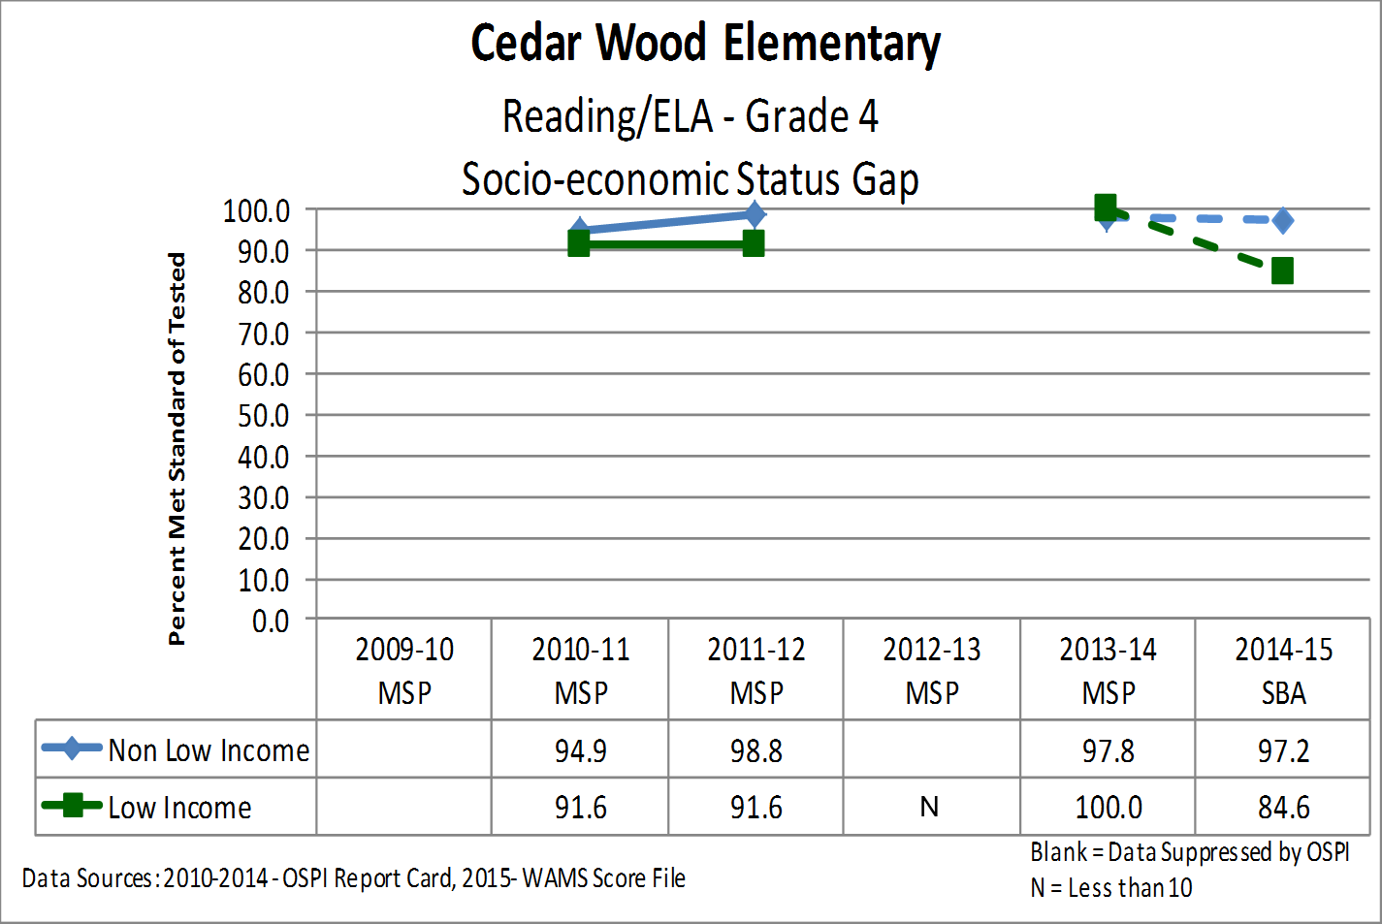
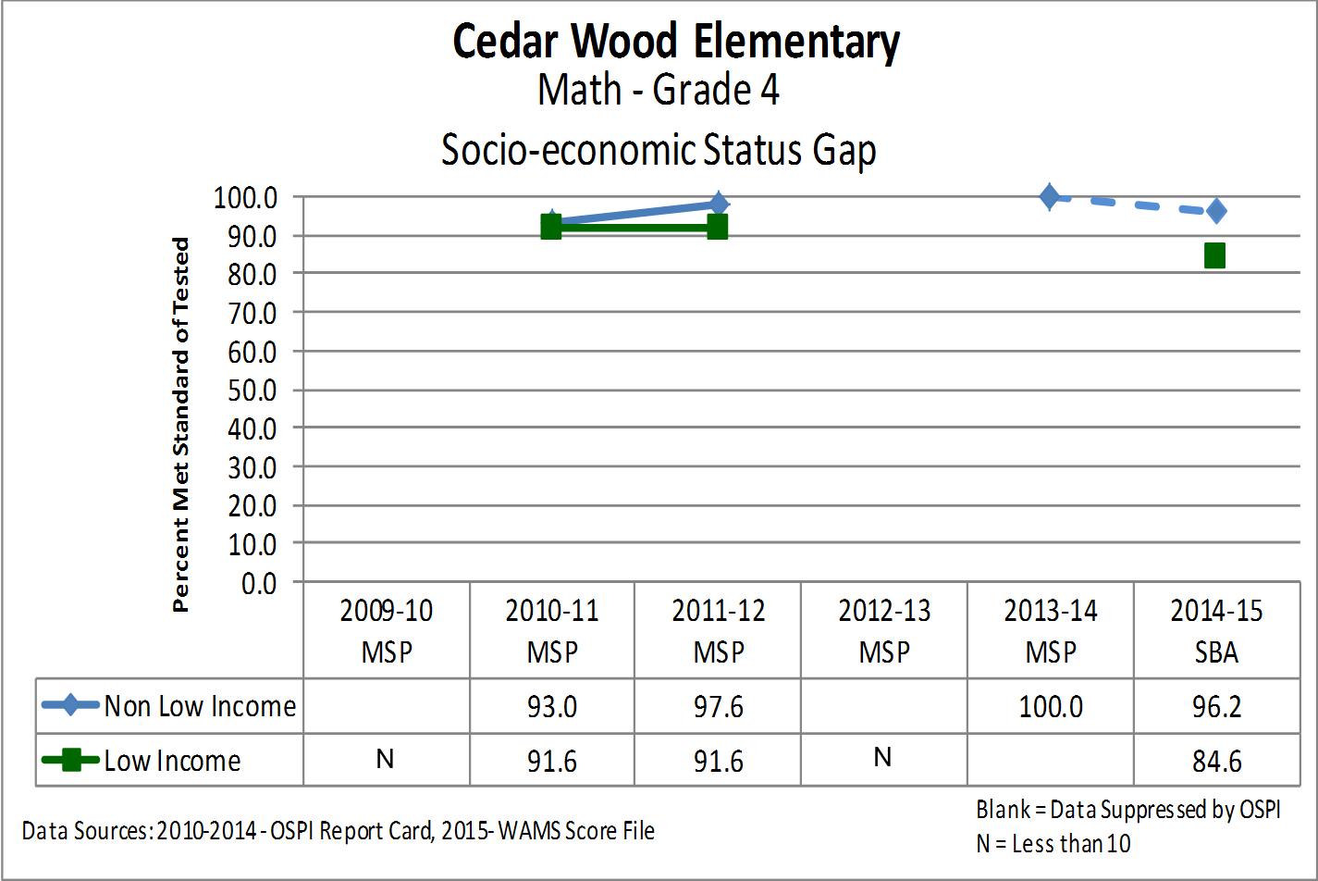
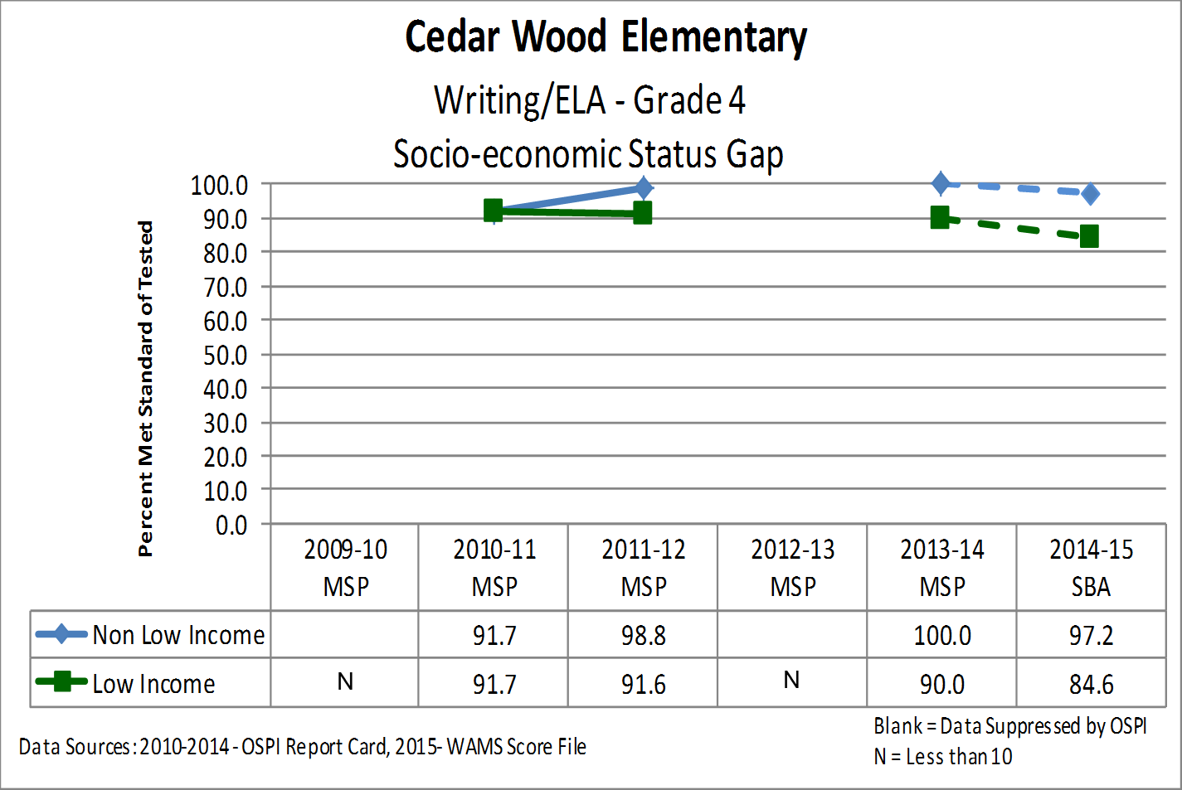
Grade 4 SES Achievement Gap

Slide 34
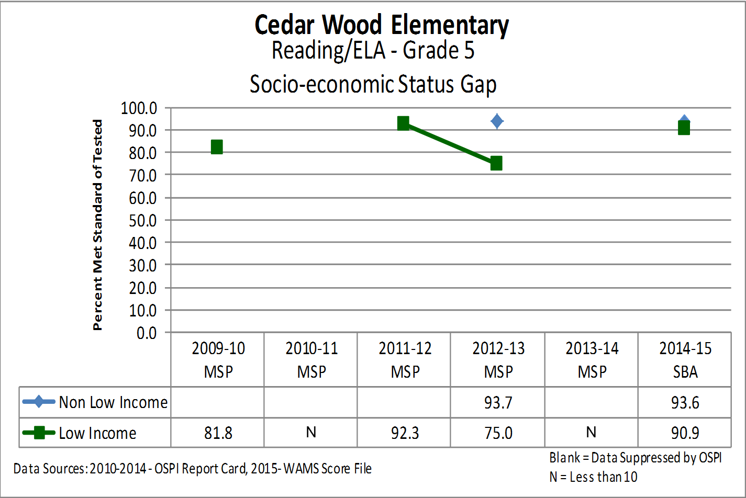
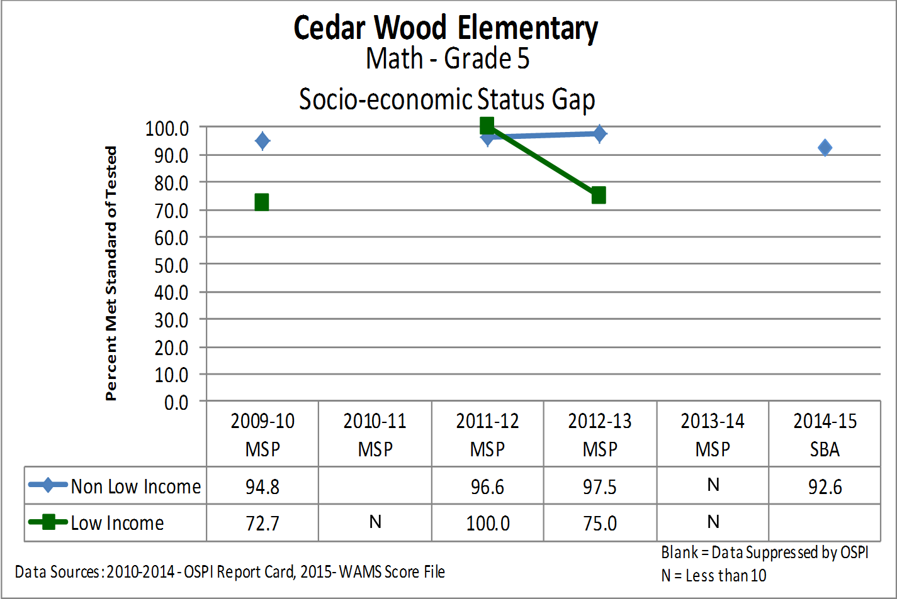
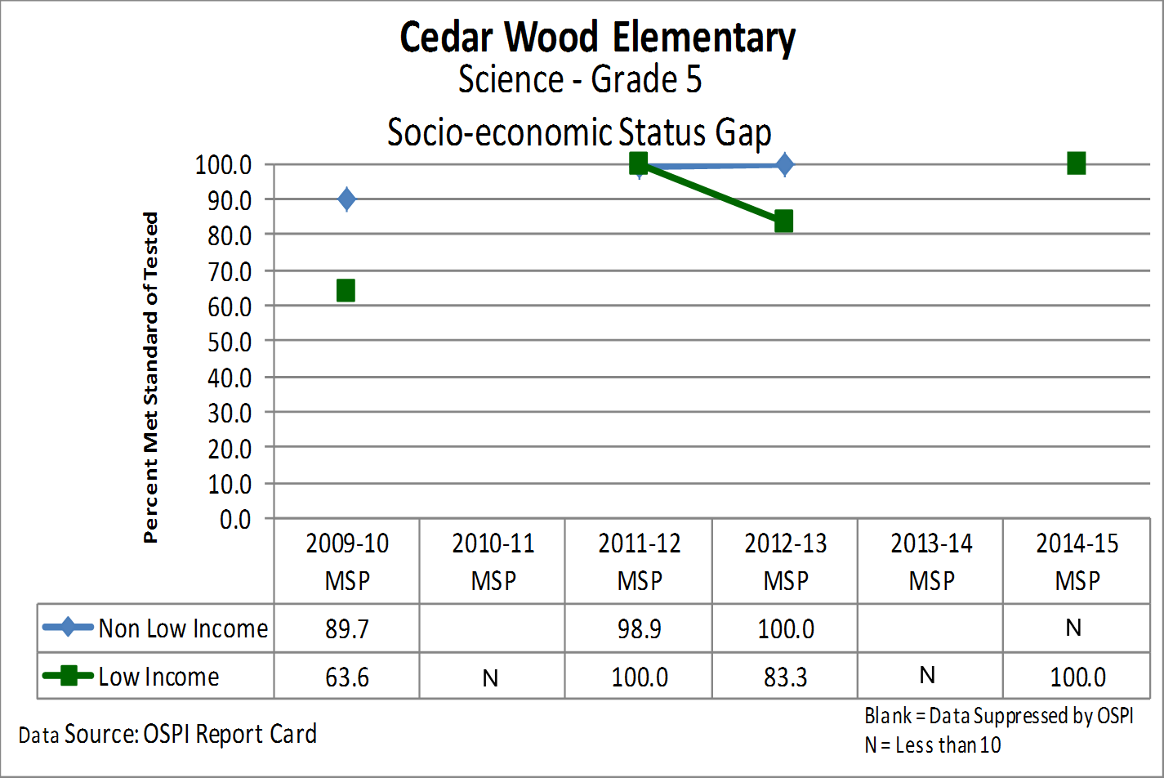
Grade 5 SES Achievement Gap

Slide 35
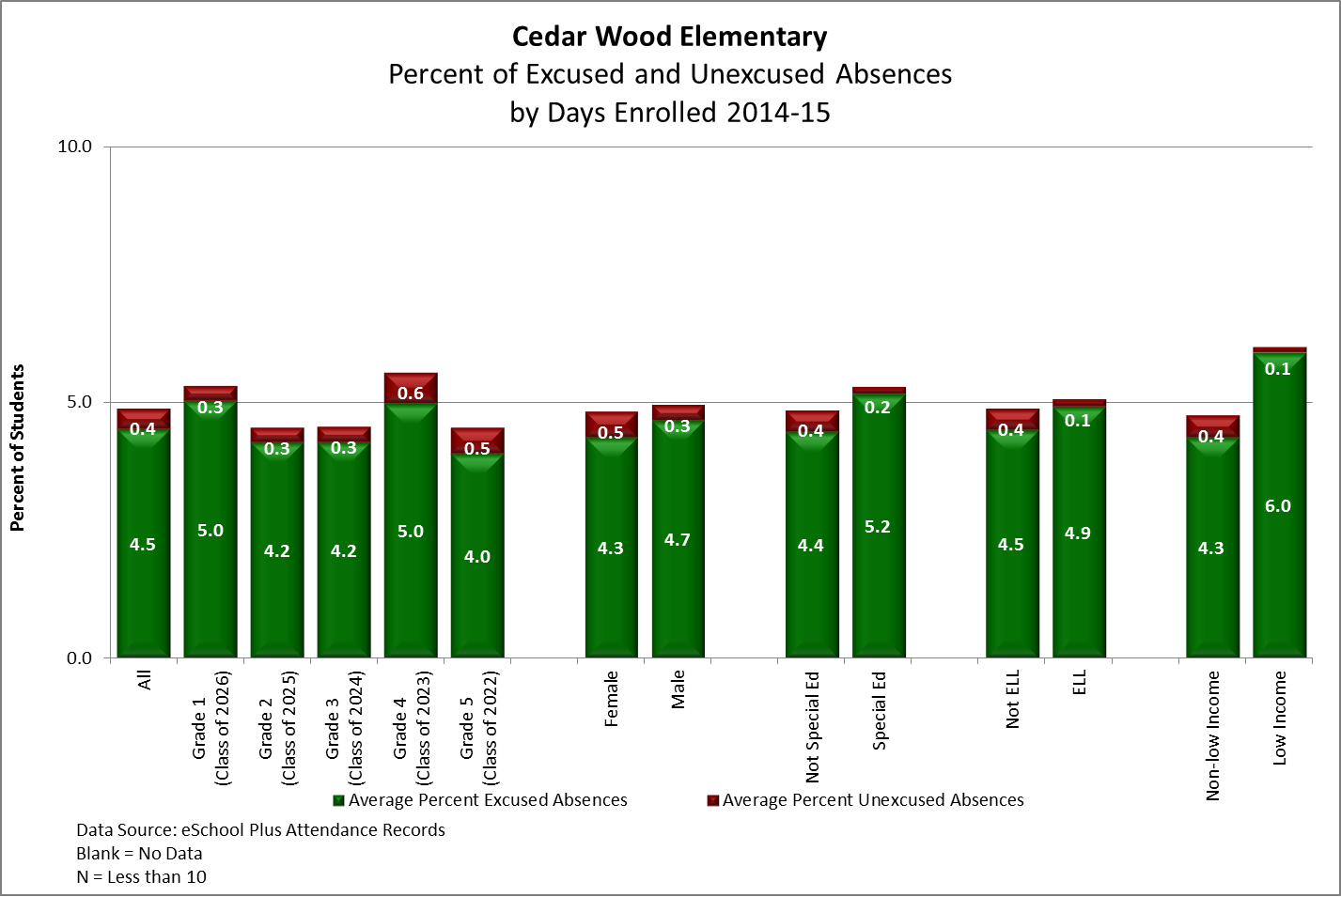
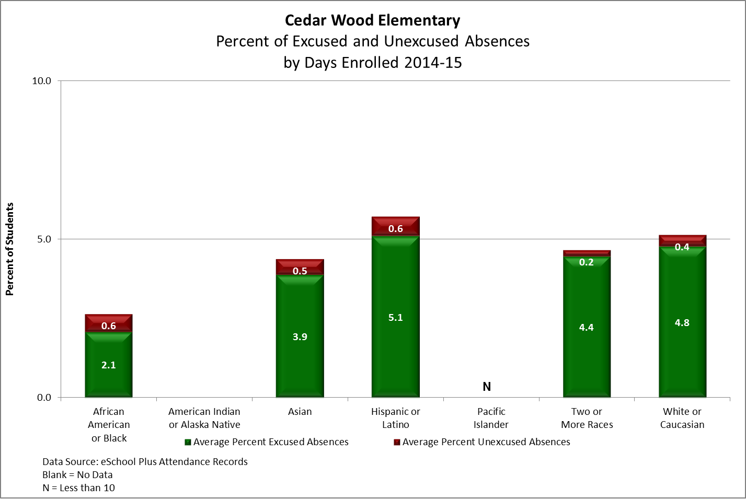
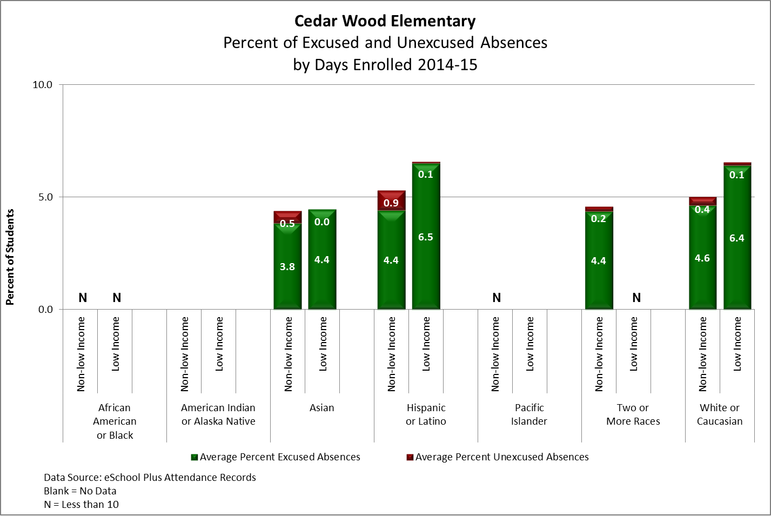
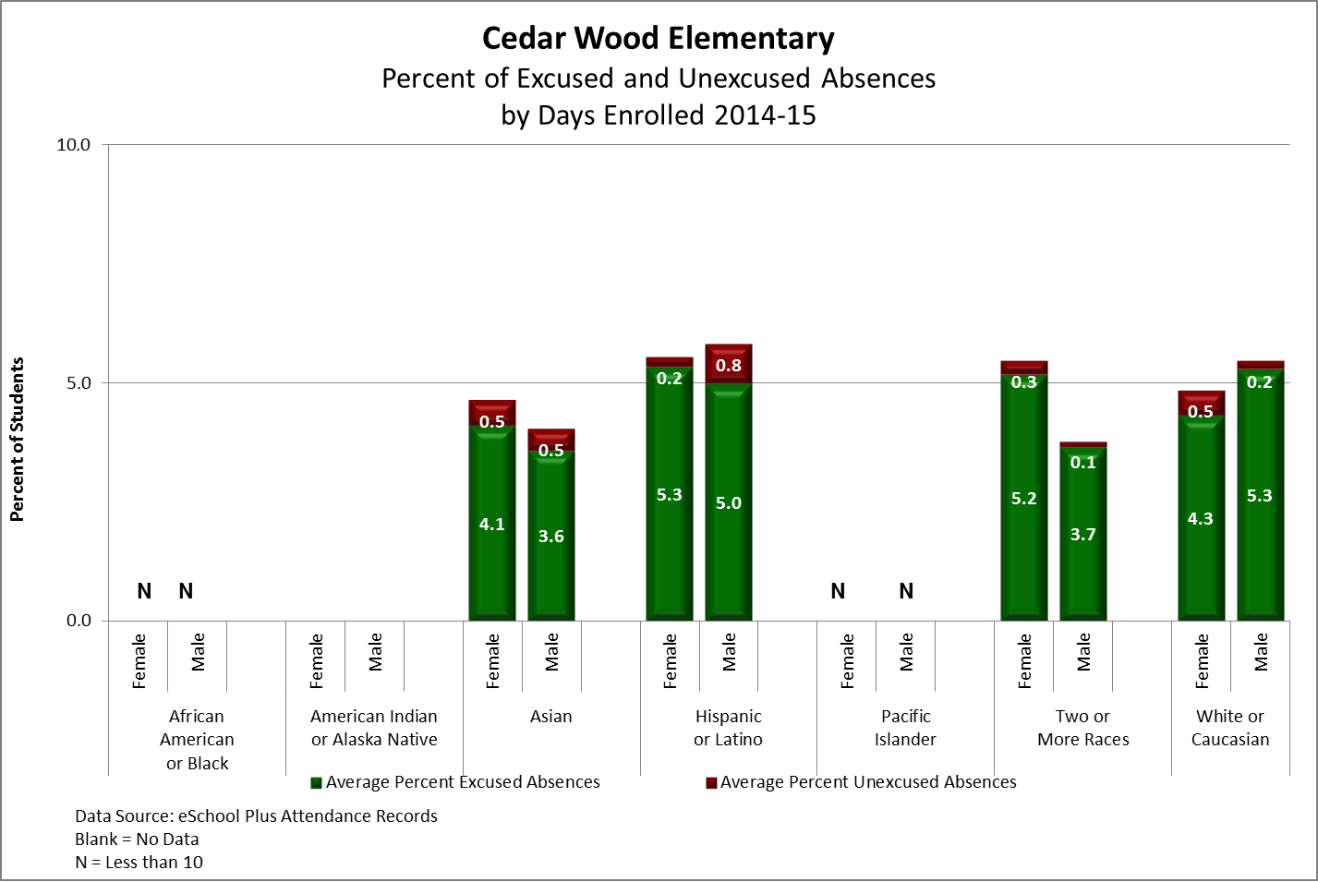
Attendance Data

