Slide 1
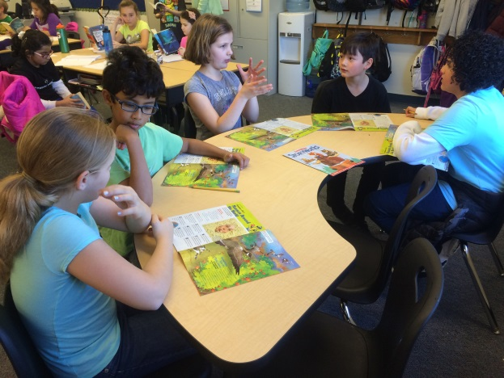
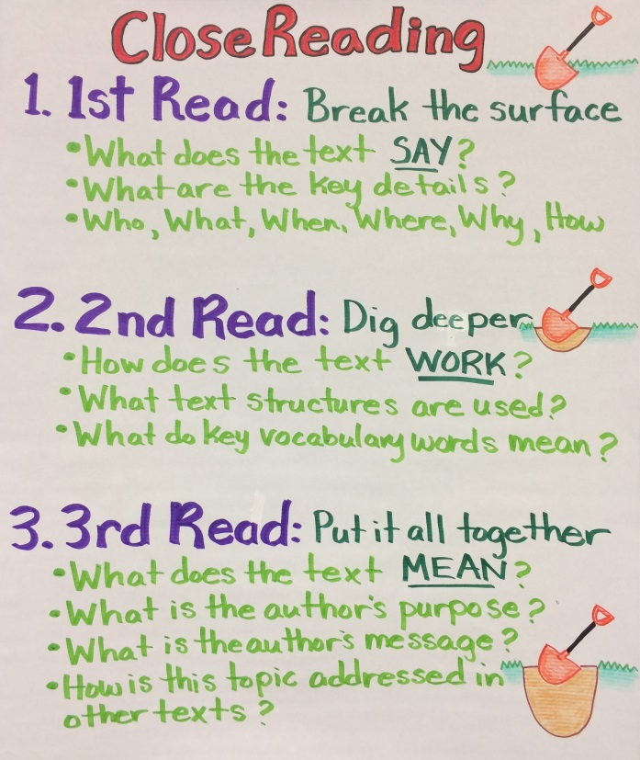
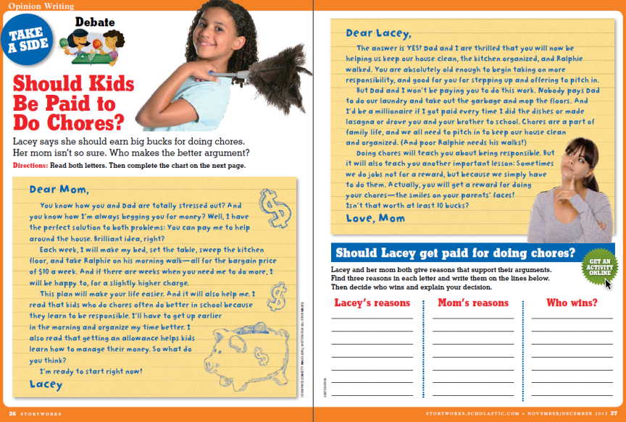
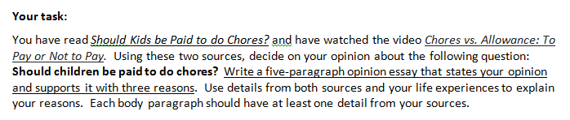
STORYWORKS
Contributes to Balanced Literacy Model:
  Writing to Source:
    Paired texts and debate selections - sources for opinion writing
    Informational texts selections – sources for informational and narrative writing
  Close Reading:
    Close Reading lesson plans
    Variety of genres

