Slide 1
Item Spec Examples
Grade 3 Math
Number & Operations in Base Ten

Slide 2
3.NBT.A Use place value understanding and properties of operations to perform multi-digit arithmetic.
Item Spec Examples

Slide 6
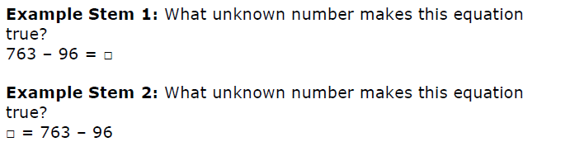

Slide 10


Slide 12
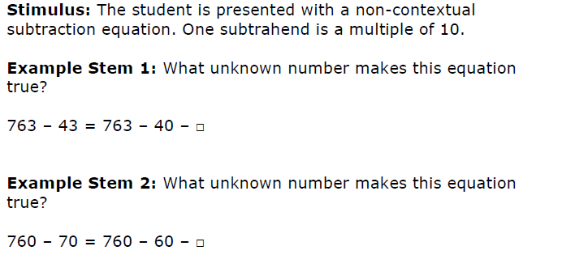

Slide 19
