Slide 1
Item Spec Examples
Grade 3 Math
Measurement & Data

Slide 2
3.MD.A Solve problems involving measurement and estimation of intervals of time, liquid volumes, and masses of objects
Item Spec Examples

Slide 4
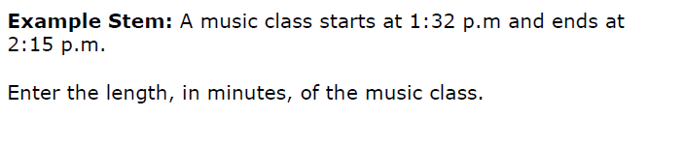

Slide 8
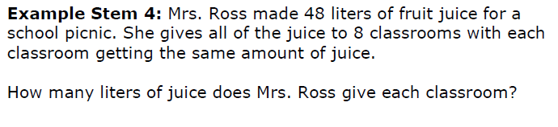

Slide 9
3.MD.B Represent and interpret data
Item Spec Examples

Slide 14
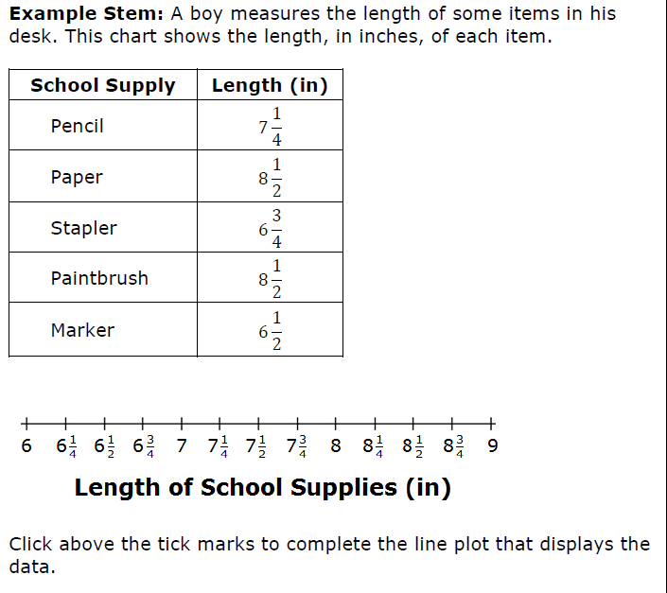

Slide 15
3.MD.C Geometric measurement: understand concepts of area and relate area to multiplication and to addition.
Item Spec Examples

Slide 20
3.MD.D Geometric measurements: recognize perimeter as an attribute of plane figures and distinguish between linear and area measures.
Item Spec Examples

