Slide 1
Item Spec Examples
Grade 4 Math
Measurement and Data

Slide 2
4.MD.A Solve problems involving measurement and conversion of measurements from a larger unit to a smaller unit.
Item Spec Examples

Slide 3
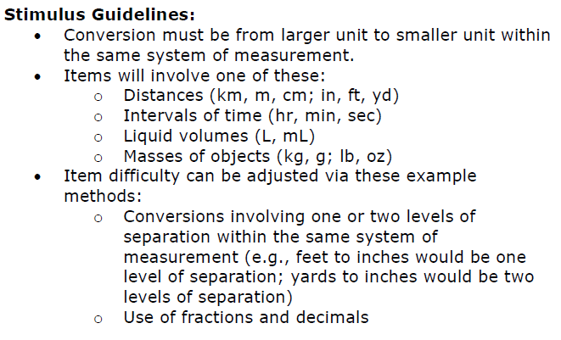

Slide 4
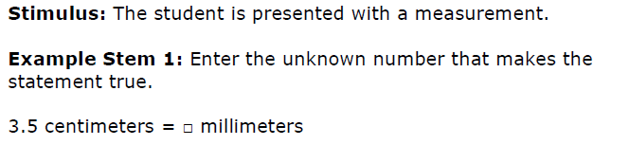

Slide 5
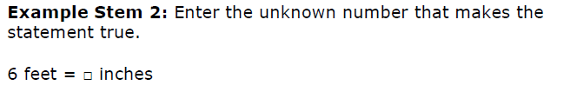

Slide 6
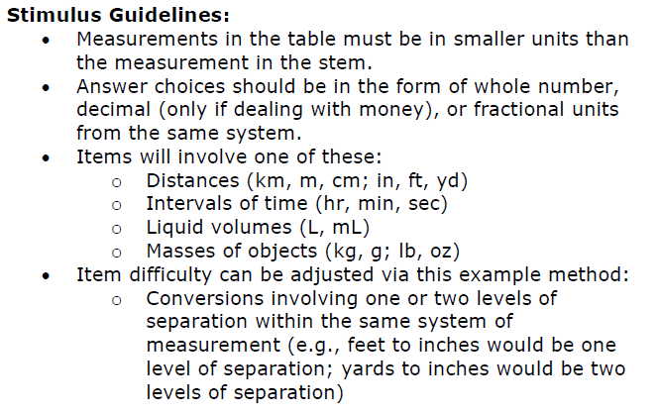

Slide 7
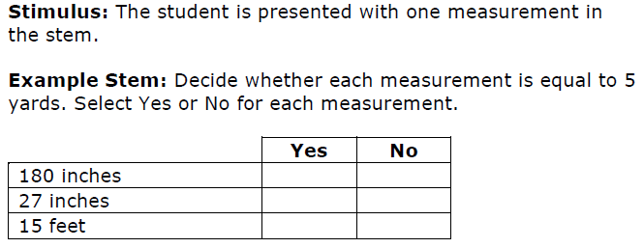

Slide 9
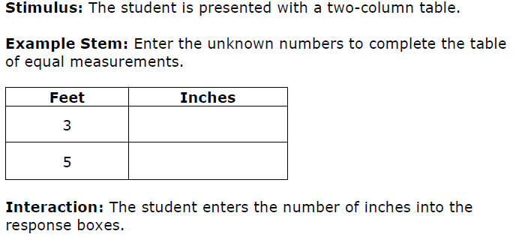

Slide 10
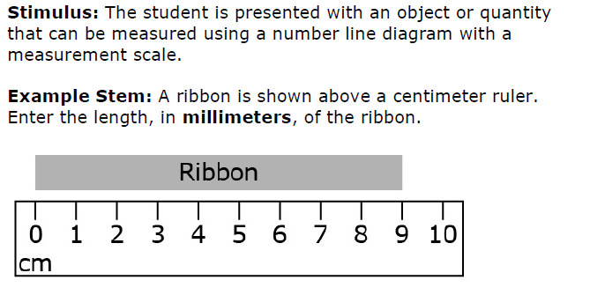

Slide 11
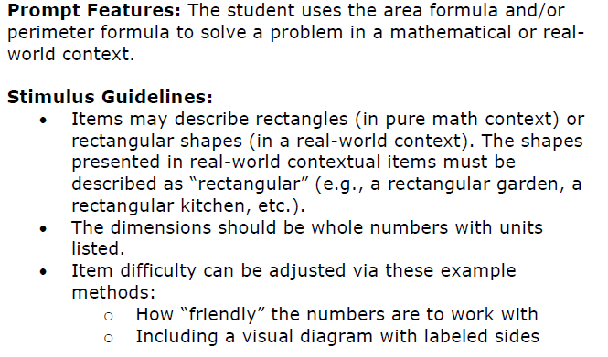

Slide 12
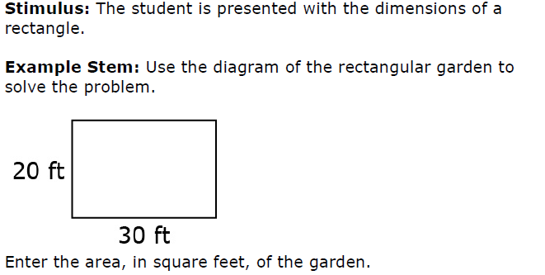

Slide 13
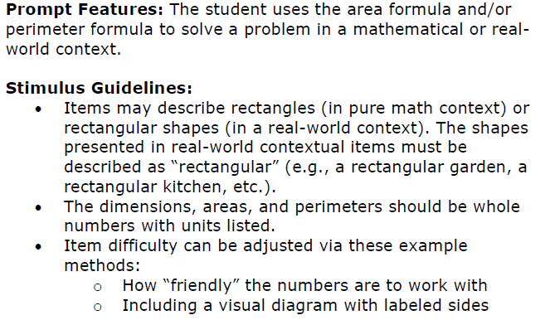

Slide 15
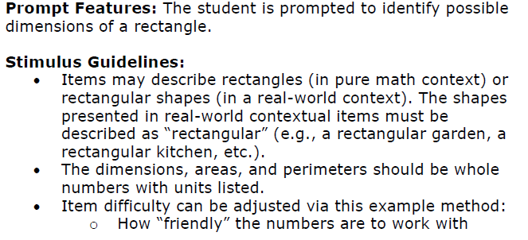

Slide 16
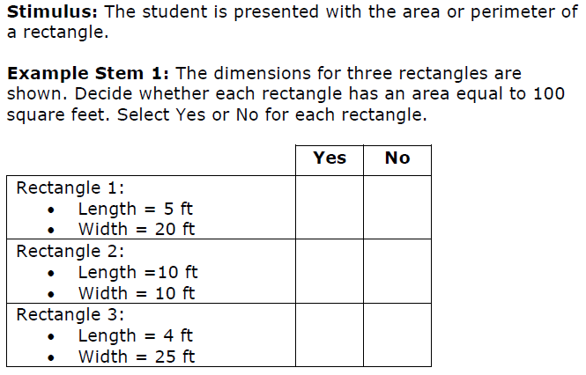

Slide 17
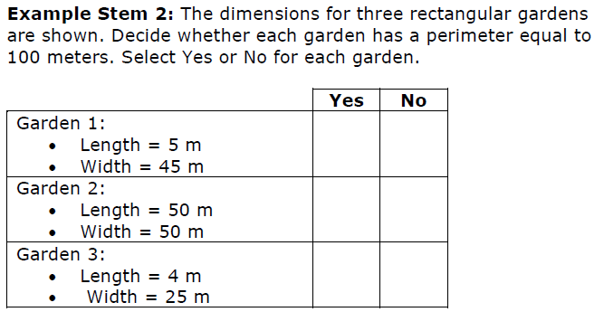

Slide 18
4.MD.B Represent and interpret data.
Item Spec Examples

Slide 20
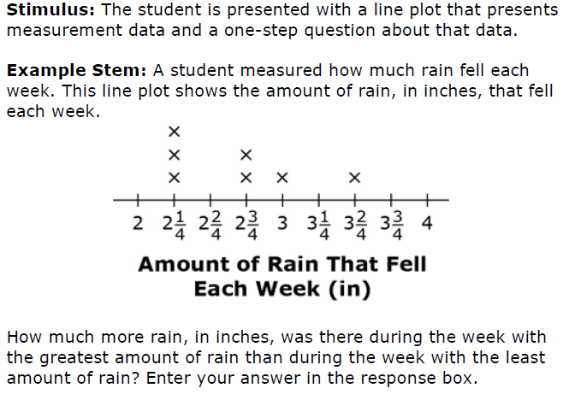

Slide 21
4.MD.C Geometric measurement: understand concepts of angle and measure angles.
Item Spec Examples

Slide 23
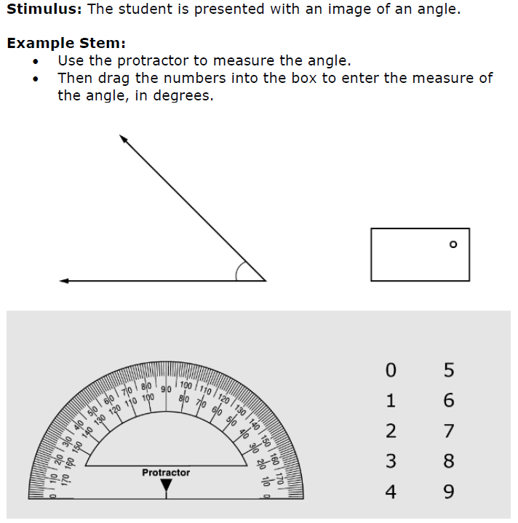

Slide 28
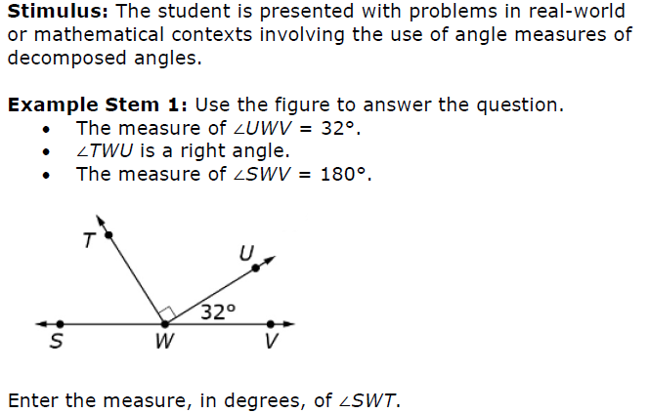

Slide 29
