Slide 1
Item Spec Examples
Grade 4 Math
Geometry

Slide 2
4.G.A Draw and identify lines and angles, and classify shapes by properties of their lines and angles.
Item Spec Examples

Slide 3
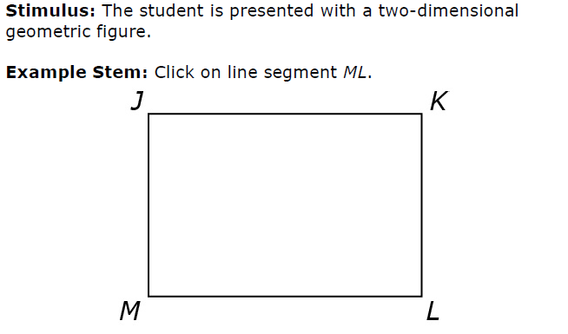

Slide 4
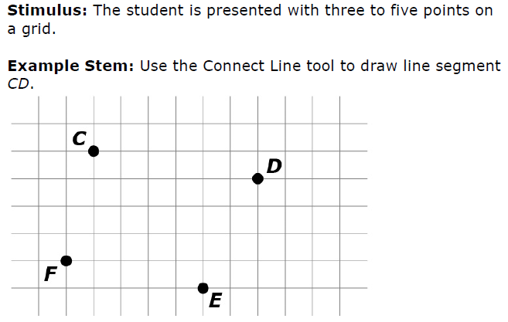

Slide 5
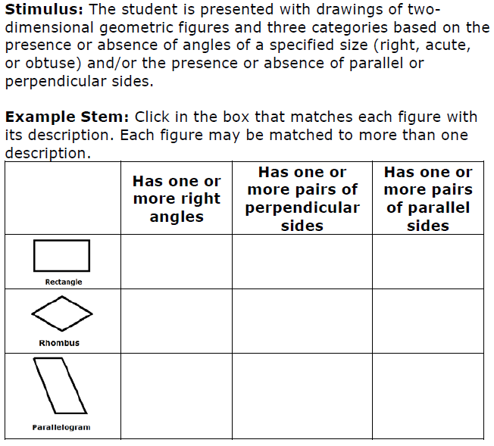

Slide 9
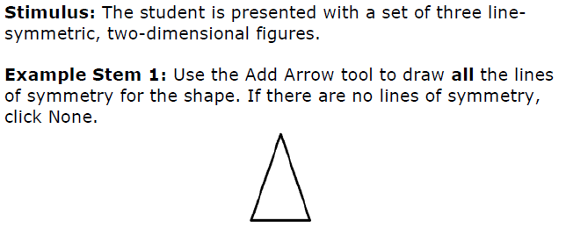

Slide 10
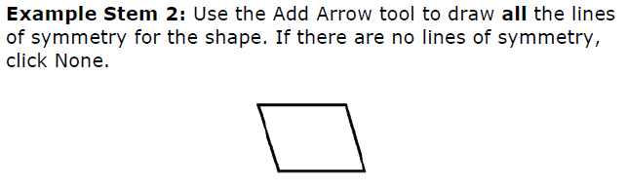

Slide 11
