Slide 1
Item Spec Examples
Grade 4 Math
Operations & Algebraic Thinking

Slide 2
4.OA.A Use the four operations with whole numbers to solve problems.
Item Spec Examples

Slide 3
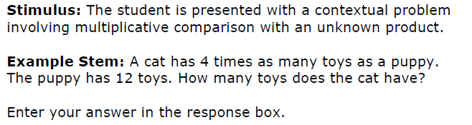

Slide 5
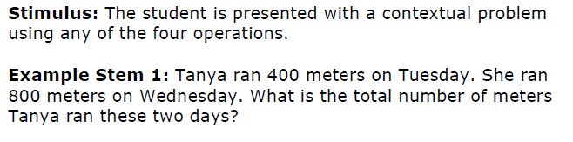

Slide 6


Slide 7
4.OA.B Gain familiarity with factors and multiples.
Item Spec Examples

Slide 8
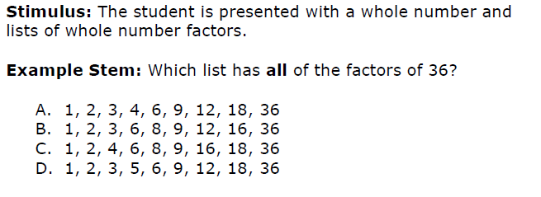

Slide 9
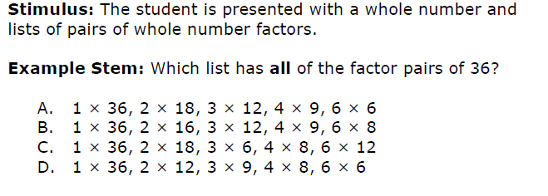

Slide 10
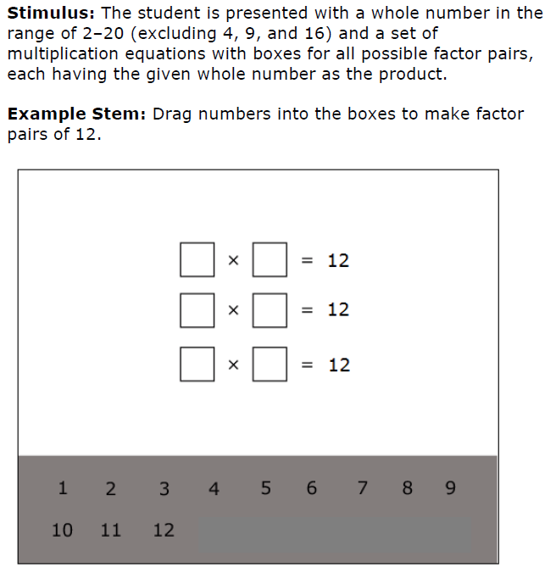

Slide 11
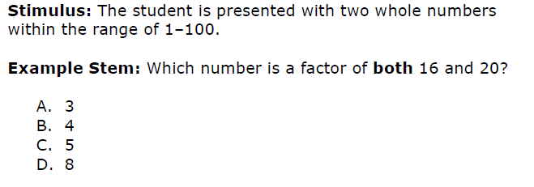

Slide 12
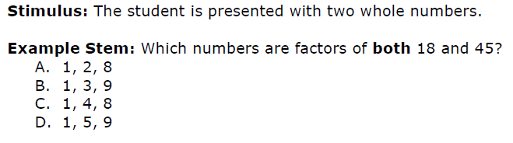

Slide 14
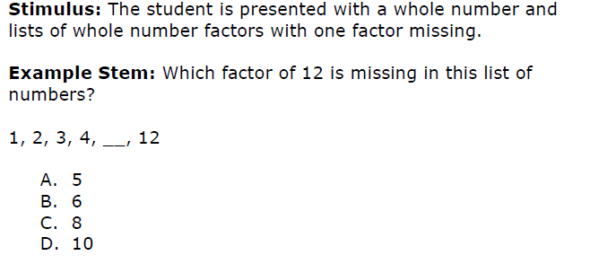

Slide 15
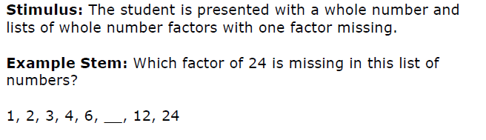

Slide 17
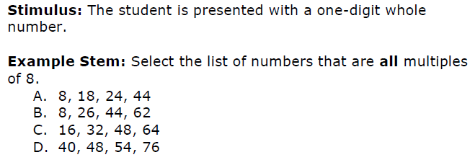

Slide 18
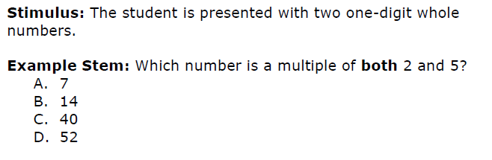

Slide 20
4.OA.C Generate and analyze patterns.
Item Spec Examples

Slide 22
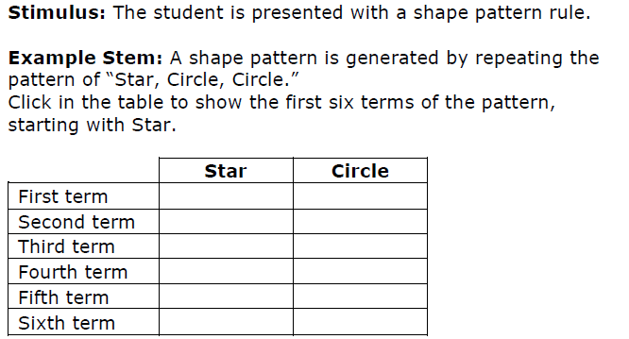

Slide 24
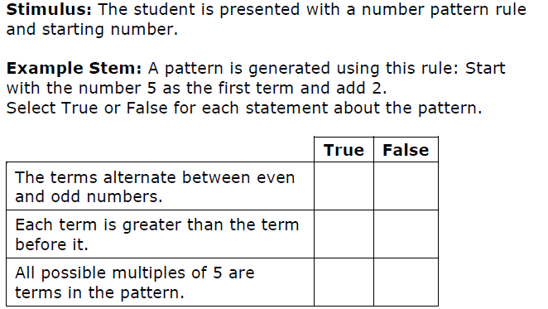

Slide 25
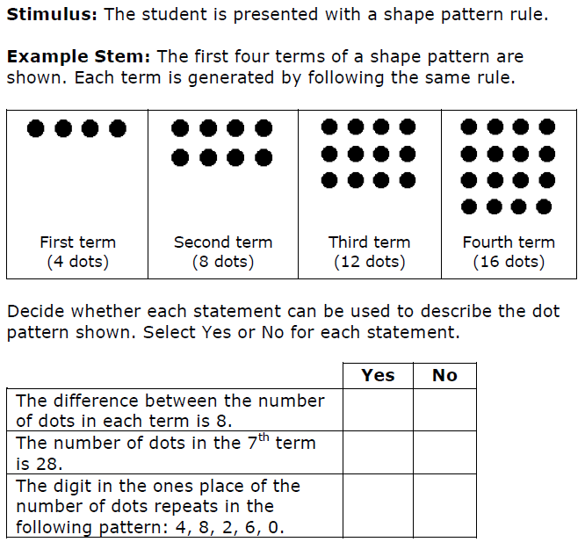

Slide 26
