Slide 1
Item Spec Examples
Grade 4 Math
Numbers and Operations in Base Ten

Slide 2
4.NBT.A Generalize place value understanding for multi-digit whole numbers.
Item Spec Examples

Slide 3
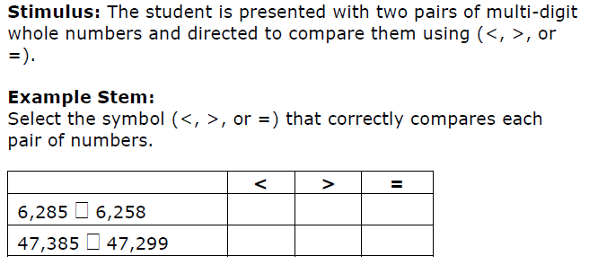

Slide 4
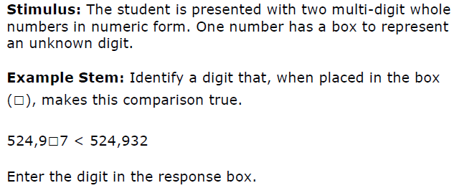

Slide 6
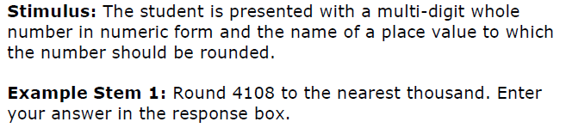

Slide 8
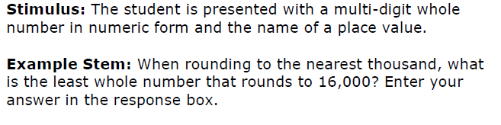

Slide 9
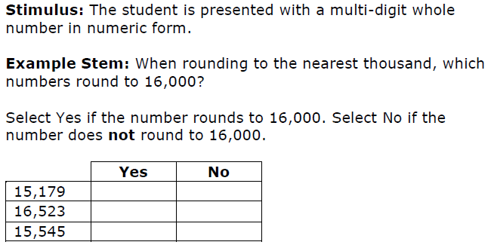

Slide 11
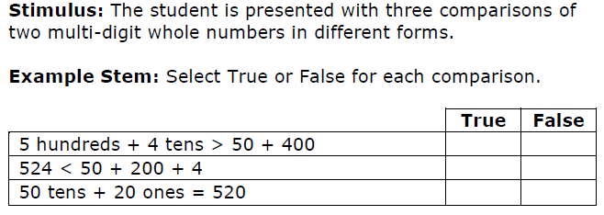

Slide 13
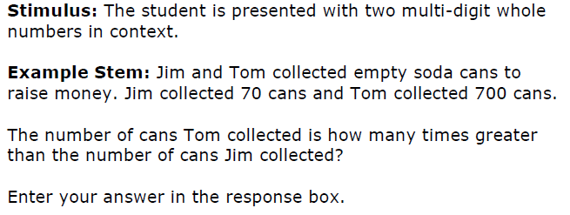

Slide 14
4.NBT.B Use place value understanding and properties of operations to perform multi-digit arithmetic.
Item Spec Examples

Slide 16


Slide 17
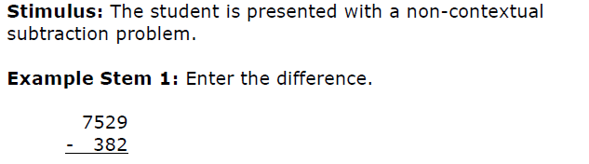

Slide 21


Slide 22
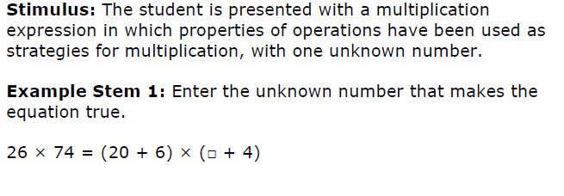

Slide 25
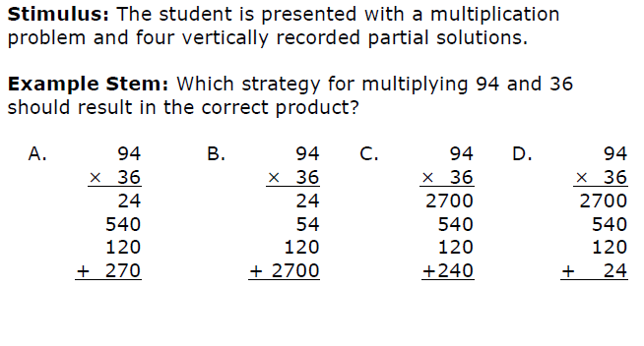

Slide 28
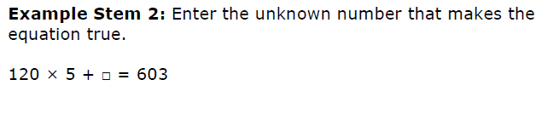

Slide 29
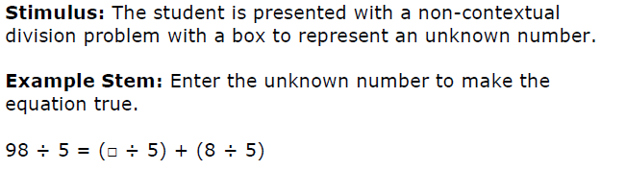

Slide 30
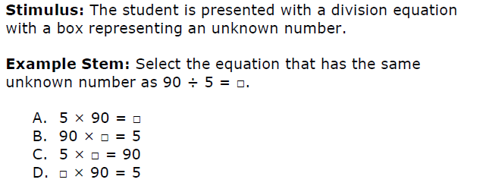

Slide 31
