Slide 1
Full Day Kindergarten
A 21st Century Model for Everett Public Schools
Notes:
The Legislature passed the state biennial operating budget which included funding for the statewide implementation of full-day kindergarten.
72% of kindergarten students are funded this school year and in the 2016-17 school year, 100% will be eligible to receive funding.
Full Day Kindergarten is coming to all Everett Public Schools in the fall of 2016!
Washington State has developed a guide to provide school districts information on effective teaching practices.
The state is encouraging discussion among teachers and administrators to design high quality, developmentally appropriate, rigorous kindergarten classrooms.
EPS has formed a Kindergarten Leadership Team which includes representation from:
K teacher from each school
Building Principals
Reading Specialists
Curriculum Specialists
Content Facilitators
Early Learning Team
The Early Learning team has also been providing information and sharing the work of the leadership team at the monthly principal’s meetings.
Together our team drafted a guide to be used as a framework within the Everett Public Schools.

Slide 2
Kindergarten is a Transition Year
September-October
Looks and feels more like preschool
Transition through kindergarten
May-June
Looks and feels more like 1st grade
Notes:
Kindergarten instruction, environments and activities will shift throughout the year.
The beginning of the year will look and feel more like a preschool and the end of the year will look and feel more like first grade.
Children are constantly making progress as they transition through the year, traveling a path that takes them from the early learning world to the K-12 system.

Slide 3






21st Century Skills
Today’s students are moving beyond the basics and embracing the 6C’s – “super skills for the 21st century!”
1. Communication
Sharing thoughts, questions, ideas and solutions
2. Collaboration
Working together to reach a goal – putting that expertise and smarts to work
3. Creativity
Trying new approaches to get things done equals innovation & invention
4. Critical Thinking
Looking at problems in a new way, linking learning across subjects & disciplines
5. Character
Developing the social, emotional and ethical characteristics to be successful
6. Citizenship
Participating as a productive
member of a community
Notes:
Our goal is for each kindergarten student to be an effective communicator, collaborative worker, creative and complex thinker, self-directed learner and community contributor.
21st century skills will be integrated throughout the kindergarten model.

Slide 4
Required Elements for Washington State-Funded Full-Day Kindergarten
Provide at least a 1,000-hour instructional program.
Provide a curriculum that offers a rich, varied set of experiences to assist students in:
  reading, mathematics, and writing;
  communication skills;
  science, social studies, arts, health,
  physical education, and a
  world language ;
  motor skills;
  social and emotional skills;
  hands-on experiences.
Establish learning environments that are developmentally appropriate and promote creativity.
Demonstrate strong connections and communication with early learning community providers.
Participate in kindergarten program readiness activities with early
learning providers and parents.
Administer WaKIDS.
Whole Child
Literacy
Math
Social-emotional
Physical
Cognitive
Language
Notes:
WA legislation calls out specific critical components of a high-quality full-day kindergarten program.
Full-day kindergarten is not about just increasing the hours in a child’s day, but it is the quality of the time that matters.
(Please refer to slide to highlight key points)

Slide 5

WaKIDS
Washington Kindergarten Inventory of Developing Skills
Family Connection
  Share, learn and support
  Conferences during first 3 days of school
Whole Child Assessment
  Teaching Strategies GOLD
  Objectives in six areas of developing and learning
  Data collected first 9 weeks of school
Early Learning Collaboration
  Smooth transitions
  Foster partnerships
Notes:
When school districts accept state funds for full-day kindergarten, the district agrees to implement WaKIDs which includes these three critical components –
Family Connection
Whole Child Assessment
Early Learning Collaboration
Family connection meetings take place the first 3 days of school, so kindergarten students will officially start school on Monday, September 12, 2016.
Observational assessment takes place the first 9 weeks of school with all data collected and submitted by October 31, 2016.
Early learning connections are made with preschool providers throughout the year to align practices.

Slide 6

Instructional Shifts
Design a flexible environment where exploration is possible, divergent thinking is encouraged, and children’s interests are extended to achieve the kindergarten outcomes
Adjust the environment as children’s interest expand and additional outcomes are targeted
Engage in genuine conversations to guide inquiry experiences that children initiate
Be prepared to initiate and plan conversations and experiences that will lead to achievement of the outcomes
Observe play to determine ranges of children’s development
Support play that will meet individual needs, address interests, and achieve outcomes
Notes:
(Please read the slide to highlight key points)

Slide 7
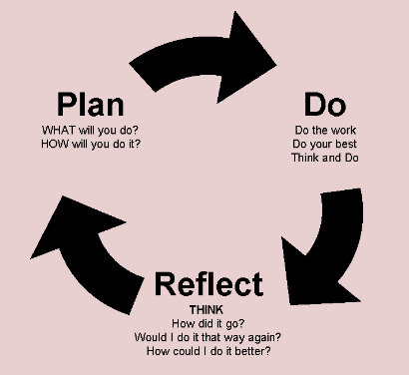
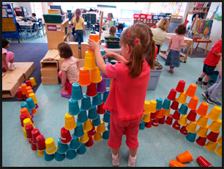

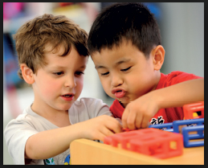
Plan-Do-Reflect
Essential Plan-Do-Reflect Centers
  Block, Dramatic Play, Art, Library, Manipulative
Plan – Choice with intention
Do – Developing competent thinkers, decision makers, and problem solvers
Reflect – Remembering and reflecting with analysis
Notes:
Part of developing the classroom environment as the 2nd teacher required us defining specific areas of the room.
Our team agreed upon broad areas or space to include:
Large group
Small group
Independent
Privacy
It was also necessary for us to define the language we would be using with teachers and students around the term Learning Centers and Learning Stations. The EPS Guide goes into greater depth on these ideas on page…
Many teachers have some form of centers, stations, free choice, workshop, etc. as a part of their past practice. One of our instructional shifts was to identify Plan-Do-Reflect centers as a student directed time to focus on emotional regulation, problem solving, decision making, communication and cooperation skills.
Learning stations would also be incorporated during the kindergarten day as teacher directed times. These stations are used to practice and support content specific goals, such as daily 5 or math stations.
Plan-Do-Reflect is based on a HighScope model of play based learning and one of the main reasons we visited Bellingham Public Schools – to see their version of Plan-Do-Review in action.
Our K Team identified 5 key centers that would need to be included in each kindergarten classroom to support the play based model –
Block
Dramatic Play
Art
Library
Manipulative
The goal of these centers is to integrate the WaKIDS progression of development and learning, 21st century skills, as well as a variety of content.
An example might be in the Block Center – as children are building and constructing with a variety of materials they are increasing spatial reasoning. In addition they would be using possible mentor texts and communication skills to work together as a team.
Each Plan-Do-Reflect time is structured to include intentional student planning, authentic time to choose and play, as well as a closing reflection time
Plan-Do-Reflect is a time for the teacher to observe, support and scaffold learning.
Plan-Do-Reflect is an uninterrupted time during the day. Students are not pulled for services and teachers are not pulling small groups during this time. Classroom teachers are actively engaged with students asking questions, extending thinking and assisting students with academic and social situations.

Slide 8




EPS FDK Guide
Working document
Kindergarten Leadership Team will meet to reflect & refine
Professional development and support will be ongoing
Notes:
(Please refer to slide to highlight key points)

Slide 9

Professional Development for all kindergarten teachers
Kindergarten Institute
  New K Teachers – August 18
  Returning K Teachers – August 25
3 Sessions
  November, February & April
Lab Classrooms
  Joanne McCandless (GAE)
  Jaylene Thomas (MCE)
Early Learning Support
Bev Eickhoff
  Garfield, Hawthorne, Jackson
Anne Fox
  Forest View, Jefferson, View Ridge, Whittier
Chad Golden
  Monroe, Penny Creek
Kelly Marks
  Emerson, Lowell, Madison, Port Gardner, Silver Firs
Mary Kay Rockenstire
  Cedar Wood, Mill Creek, Silver Lake, Woodside
Notes:
K Institute:
New K Teachers - August 18
Returning K Teachers - August 25
Handout Agenda
3 Training Sessions (½ day sub or 4-6) required
November
February
April
Lab Classrooms:
Joanne McCandles (Garfield)
Jaylene Thomas (Mill Creek)
The Early Learning Team is available to support teams. This slide provides an Early Learning contact for teams. Anyone from Early Learning is available to support, but this provides a contact for each school.

Slide 10
Thank You
The Kindergarten Leadership Team

