Slide 1
McKinney-Vento Updates
October 26, 2016
Cynthia Jones and Amy Perusse

Slide 2
Goals today
Why are we here
Brief review of McKinney-Vento
Role of Building Point Person
New student/family supports
  Housing Navigator
  Success Coordinator for students in foster care
KIT Staff Toolkit
Holiday support for KIT students

Slide 3
Why we are here
60 Minutes Hard Times Generation
https://www.youtube.com/watch?v=dK_RnxYdrqU
Notes:
1:10 – 3:30

Slide 4
Staff Training
Present training to building staff between November and April
  The powerpoint is just under 8 minutes long
  It can found in the Shared Folder (P drive) > Counseling > School McKV training 10.26.16
  It can also be found in the Shared Folder (P drive) >McKinney-Vento > School McKV training 10.26.16
If you have additional time,
  The video clip is 2:20
  Show from 1:10 – 3:30

Slide 5
Building Point Person
New state law
Any district with 10 or more Unaccompanied Homeless Youth must have a designated Building Point Person for each MS and HS
We had 240 UHY students last year
We are also asking ES with high numbers to have a Building Point Person
  Lowell, Madison, Hawthorne, Garfield, Jackson

Slide 6
Building Point Person:
Advocate and Referral
Brief overview today: more thorough training to come soon
Not responsible for determining eligibility
  Amy and Cynthia do that
  Need for consistency, training from OSPI
Building Point Person will funnel referrals to Amy
Keep and distribute monthly list of eligible students

Slide 7
Building Point Person:
Advocate and Referral
Periodic check in with students/families
Coordinate support
Advocacy
  Voice for student
  Source of information for staff
  Staff training

Slide 8
Housing Navigator
One of four districts to receive a Homeless Student Stability Program grant
Working with YWCA to help families with students enrolled in EPS obtain or maintain housing
Referral forms can be submitted by BPP, counselor, SSA or FSS, or administrator to Amy
Referrals will be screened and prioritized
Best clients are those who have income and just need a boost
Navigator works with parent to identify strengths and needs and develop a plan to move forward

Slide 9
Foster Care
Students in foster care no longer qualify for McKinney-Vento as of 12/9/16
Every Student Succeeds Act (ESSA) requires establishment of a parallel system of support
Currently hiring a Foster Care Success Coordinator position
Data shows that students in foster care are more likely than their peers to struggle academically

Slide 10
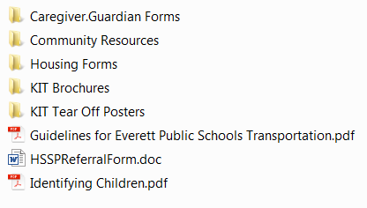
KIT Staff Toolkit

Slide 11
Holiday support
Connect within your school
Partnership with Volunteers of America
  VOA: EPS KIT
Santa’s Workshop shopping day
Christmas House letters sent home with students
Unaccompanied Homeless Youth 13+ gift cards

