Slide 1
Science SOSR
Amy Colburn

Slide 2
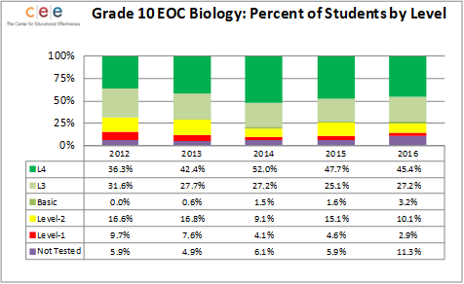
Overview
Positives:
Level 1 and 2 Increasing
To work on:
Number of students not testing increased

Slide 3
Maintenance and Monitoring
Last year:
Focused wholistically on Claim-Evidence-Reasoning (CER)
Students not feeling prepared
What’s new:
Scaffolded for different levels
CER Broken down by section
Provide support for specific students
Transition to NGSS

Slide 4
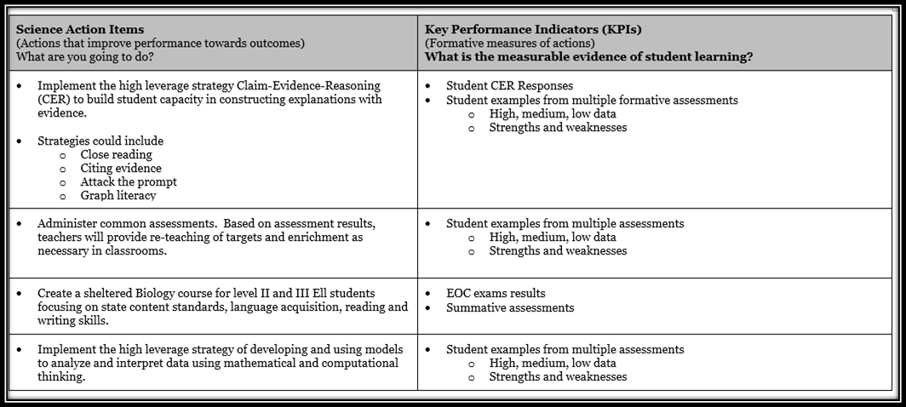
SIP Decisions

Slide 5
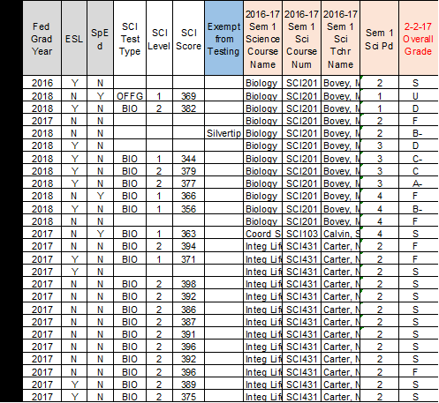
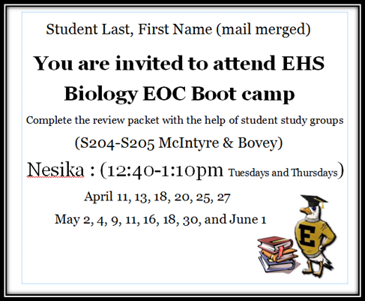
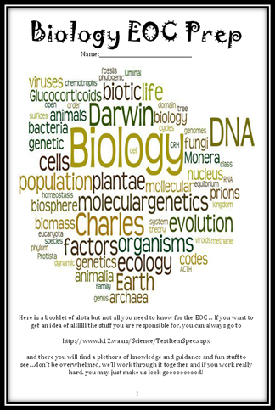
Data Disaggregation

Slide 6
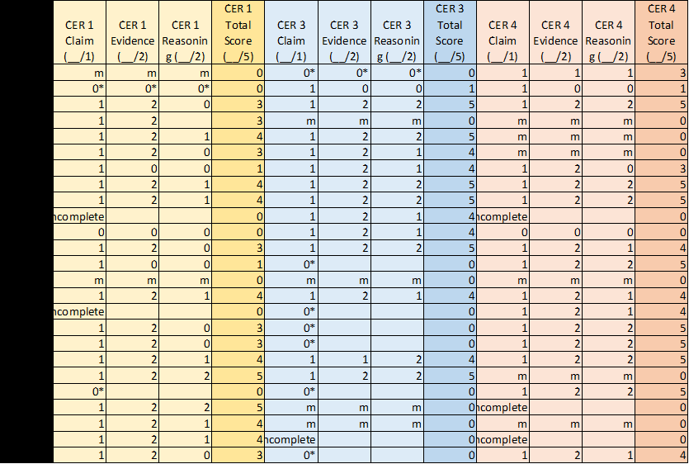
Maintenance and Monitoring

Slide 7
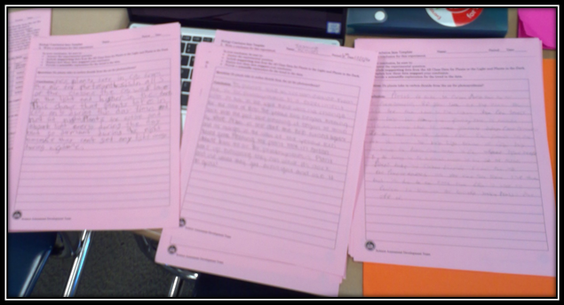
Data Talks - Common Assessments
Peer editing
Color coding
Use of dry erase boards

Slide 8
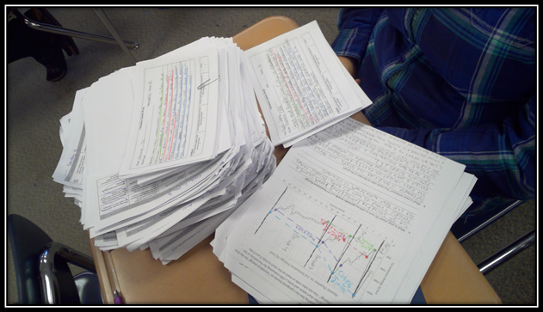
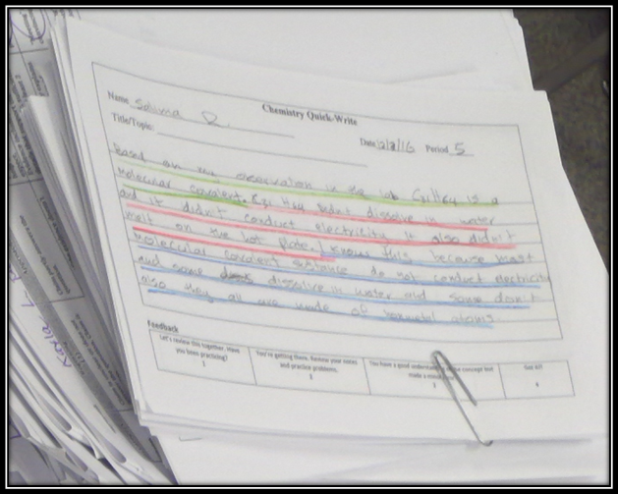
Instructional Focus
Green: Claim
Red: Evidence
Blue: Reasoning

Slide 9
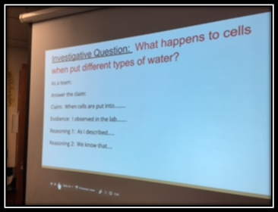
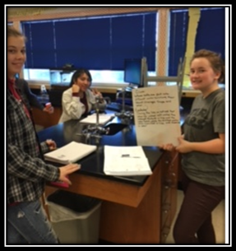
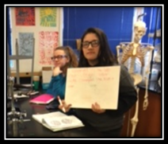
Instructional Focus
Frequent practice
Sentence frames
Instant feedback

Slide 10
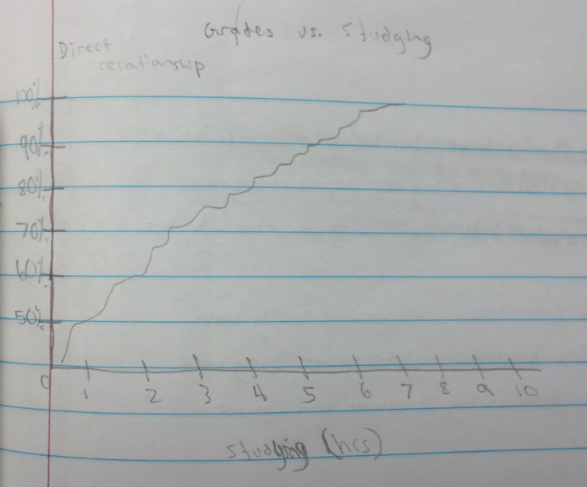
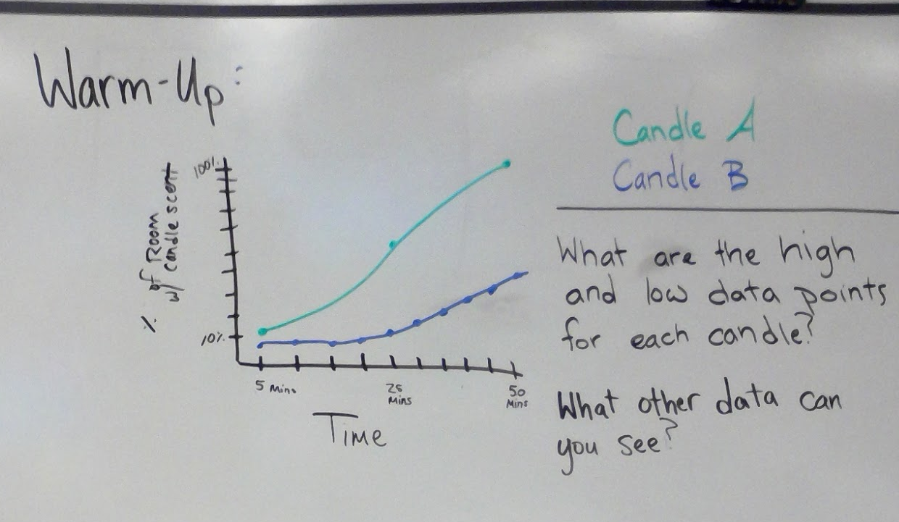
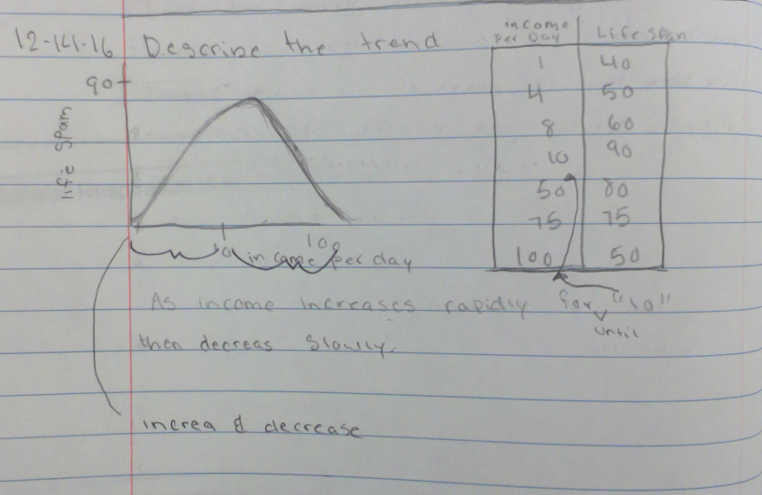
Instructional Focus
Instructional Focus
Using Models
Short quick practice
Data analysis

Slide 11
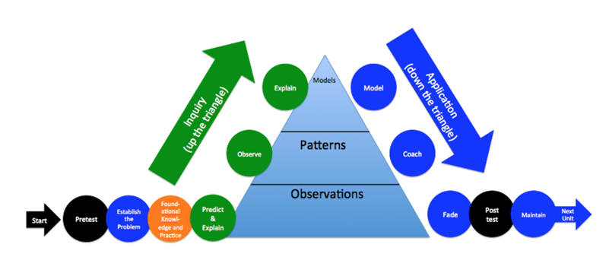
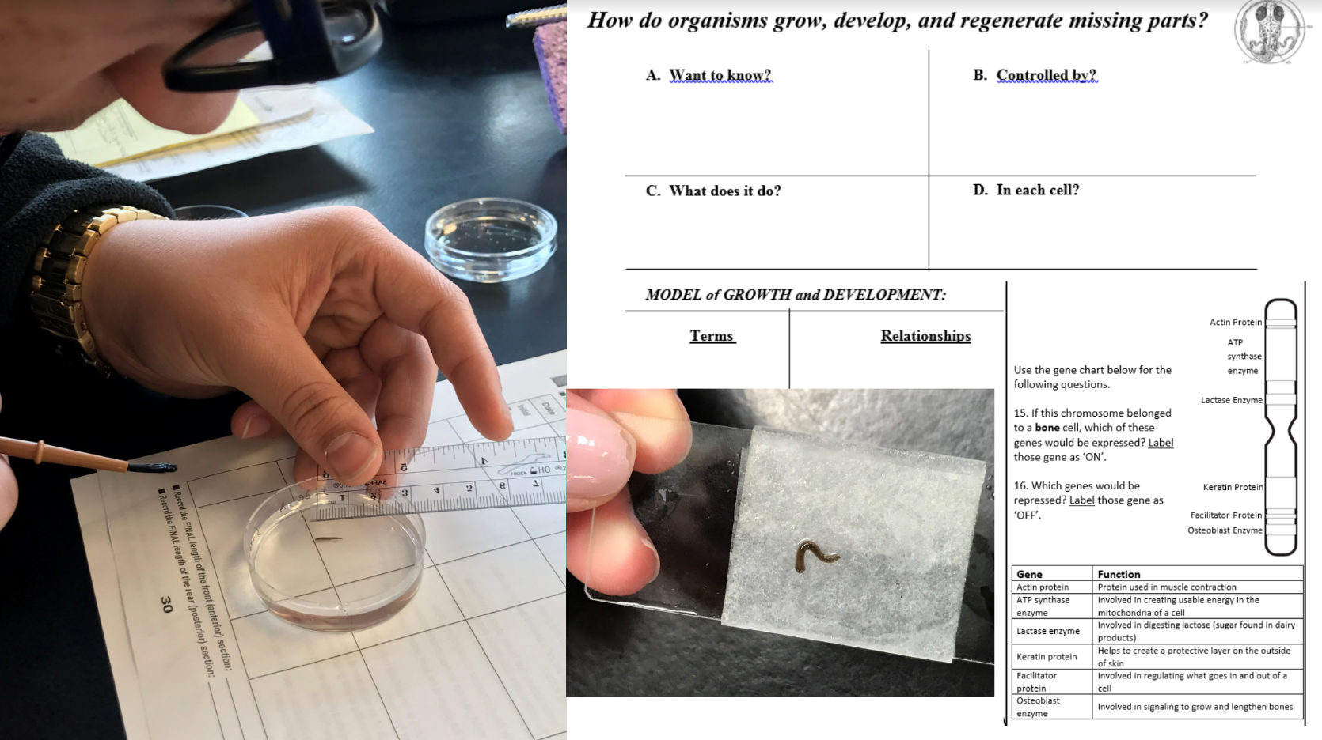
Backwards Design
Biology
Carbon Time

Slide 12
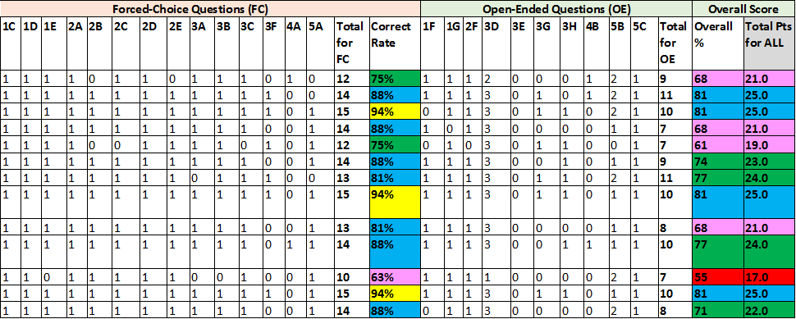
Assessments

Slide 13
Continuous Improvement - where do we go from here?
Continue CER work
Scaffolding for all students to be successful
Focus on modeling in all classes
Backwards design to guide all work
Scope and sequence planning team with district

