Slide 1
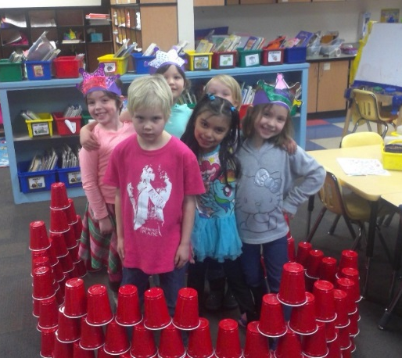
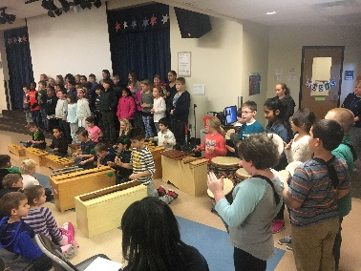
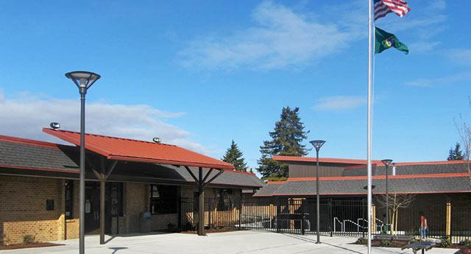
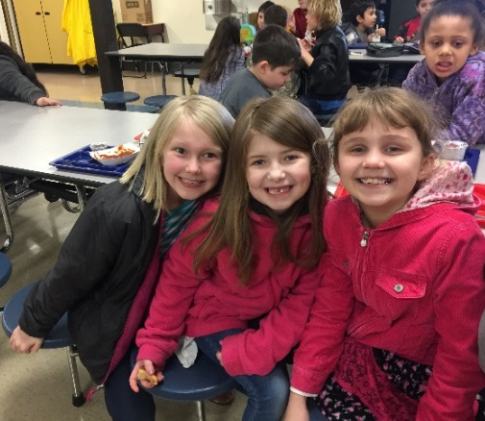
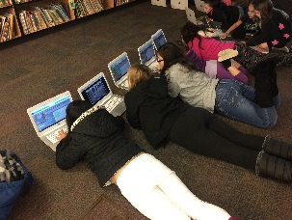
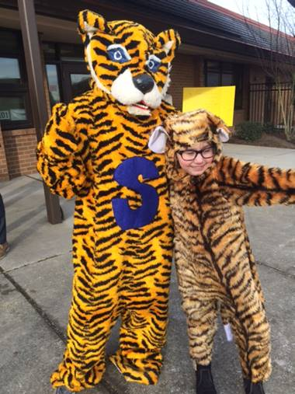
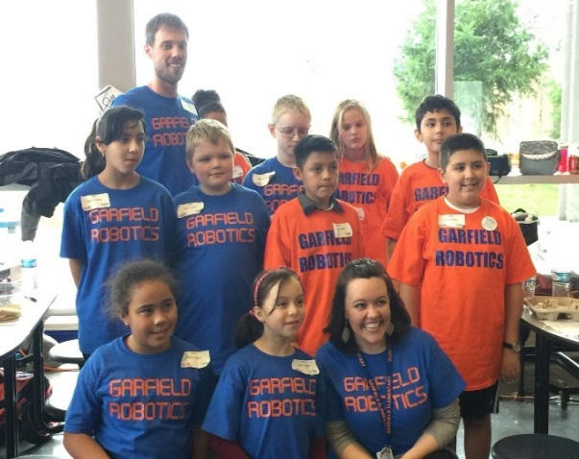

State of School Review
Garfield Elementary School
March 22, 2017
Home of the Tigers!

Slide 2
Garfield State of the School Review Team
Presenter | Position
Monique Beane | Principal
Brent Radcliff | Assistant Principal
Barb Dubin | Social Worker
Kris Green | Reading Specialist
Monica Wagenhoffer | Math Specialist
Becky French | 4th Grade Teacher
Megan Woodworth | Extended Resource Teacher
Alina Houser | Kindergarten Teacher

Slide 3
Demographic Trends
2012 to 2016 represents Spring demographics as published by OSPI. Nov. 2016 data was provided by Everett Public Schools. Change per Year calculated with Nov. 2016 data.

Slide 4
At-a-Glance
All data used to populate charts are provided by Everett Public Schools via EDS. These data may not be an exact match to OSPI Report Card due to test codes and other variables.

Slide 5
2016 Percentile vs. 5-Year Trend of Improvement
Notes:
We moved from the Lower 50% of Schools & Improving to the Top 50% of Schools & Improving. Not only did we move over, we moved up.

Slide 6
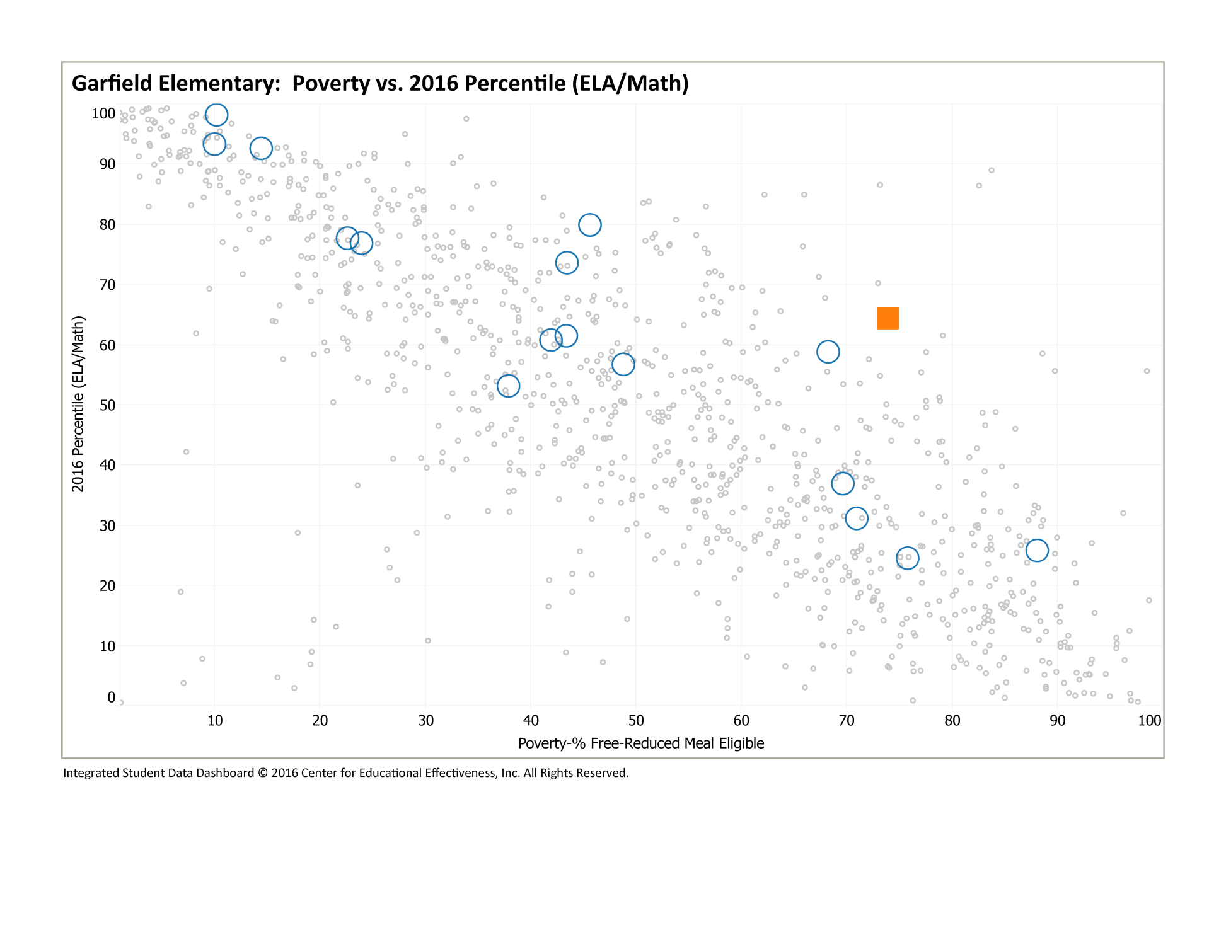
2016 Poverty vs. Percentile
WA Elems
Everett Elems
Garfield Elem
Notes:
We continue to make significant growth. The two schools above us are in the Seattle School District and we are on our way to pass them.

Slide 7
3rd Grade ELA
Notes:
Here I would like to highlight that we are back to pre-SBA scores.
We are excited with our increase in Level 1’s to 2’s and a our Level 3’s to 4’s.
We are excited with the increase in the scores among our Hispanic students and Students with Disabilities.
Our 3rd grade teachers have taught 4th and 5th grade so they know where the students need to go.
The writing scope and sequence is articulated and followed with fidelity.
Focused shared Reading with skills aligned to the SBA and lots of GLAD strategies

Slide 8
3rd Grade ELA
Notes:
Our gender gap is closing and we see an increase in our males.

Slide 9
4th Grade ELA
Notes:
We saw an increase in our Level 3’s and 4’s and with our low-income students.
This is a result of the work that our 4th grade teachers do with Instructional planning and alignment of the calendar based on the CCSS!
Vertical alignment with 3rd-5th grades
and assessments in which we’ve created to match the CCSS and SBA.

Slide 10
4th Grade ELA
Notes:
The increase with our female students has helped to narrow the gender gap.

Slide 11
5th Grade ELA
Notes:
Once again, we are excited with the increase in our 5th grade scores, especially the decrease in our Level 1’s and increase in our Level 3’s and 4’s. 5th grade teachers use common planning time to share materials, collaborate, share immediate feedback, plan interventions, and create common assessments.
They are teaching and planning instruction and lessons with the end standards in mind.
Integrating subjects with common standards in certain units throughout the year

Slide 12
5th Grade ELA

Slide 13
Grade Level ELA Growth
Notes:
Our grade to grade cohort data shows our 3rd to 4th and 4th to 5th students making gains. We saw a significant increase in our 3th to 4th grade Level 1’s and 4th to 5th Level 2’s. Our teachers are working to strengthen students skills for that transition from elementary to middle school.

Slide 14
3rd Grade Math
Notes:
Good afternoon, We have more great results and reason to celebrate in math where we experienced growth in virtually every sector. In third grade I’d like to highlight the increase of level 3’s and 4’s and the significant decrease of level 1’s. The third grade teachers attribute this growth to the incorporation of numerous GLAD strategies, small group interventions, fidelity to the district maps and assessments, teacher modeling, student practice and feedback from teachers to students.

Slide 15
3rd Grade Math
Notes:
We have decreased the gender gap as well, with our boys improving greatly.

Slide 16
4th Grade Math
Notes:
In math our fourth graders performed more than 10% higher than the state average and were within about a half of a percent of the district average. Our fourth grade teachers credit this success to their focus on the Common Core when planning instruction, their use of formative and summative assessments which allowed them to consistently meet the needs of their students during morning math/success time, and their use of best effort strategies.

Slide 17
4th Grade Math
Notes:
While the gender gap in fourth grade widened nominally, both genders outperformed students from the previous year.

Slide 18
5th Grade Math
Notes:
Again, in 5th grade we see a significant increase from the previous year, nearly doubling the number of level 3’s and 4’s. Our fifth grade teachers attribute this success to many things including planning and teaching with standards in mind, integrating subjects with common standards in certain units throughout the year and collaborating by sharing materials, sharing immediate feedback, planning interventions and creating common assessments.

Slide 19
5th Grade Math
Notes:
While the gender gap widened we experienced incredible growth by both boys and girls.

Slide 20
3rd to 4th Grade Math Growth
Notes:
When looking at our cohort data I would like to highlight the increase in performance of our third to fourth grade cohort where our level 4’s increased by 17%.

Slide 21
5th Grade Science
Notes:
Science is another area of celebration for us. Our 5th graders performed better than the state average and nearly as well as the district average. This was possible through grade level collaboration, the team met several times throughout the week to plan lessons and experiments based on science standards and team-taught at least once a week. Additionally, they used formative assessment data to partner students for peer coaching. Of course our robotics club was also very popular and has grown to include even more students this year.

Slide 22
5th Grade Science
Notes:
We also successfully eliminated the gender gap in science.

Slide 23
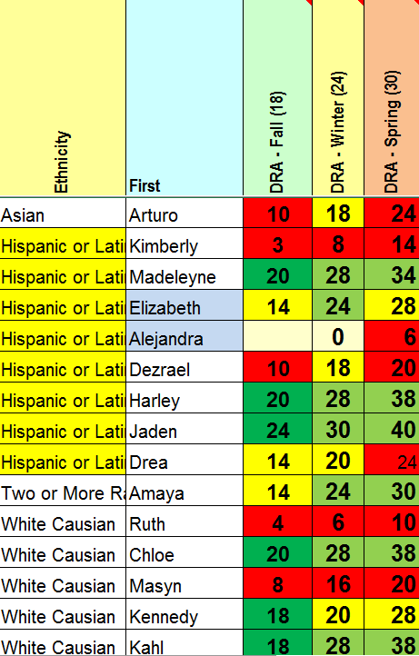
Predictors of SBA Performance
3rd Grade
January | Green | Yellow | Red
Math Topic | 58% | 37% | 5%
Reading Winter DRA | 59% | 13% | 28%
4th Grade
January | Green | Yellow | Red
Math Topic | 58% | 30% | 12%
Reading Winter DRA | 61% | 19% | 20%
5th Grade
January | Green | Yellow | Red
Math Topic | 53% | 32% | 13%
Reading Winter DRA | 56% | 3% | 41%
Notes:
Once we have analyzed our data in our CAST meetings, we use the scores as indicators of student success on the SBA and to identify appropriate support.
We look at our equity targets to monitor student growth and take action quickly. In CAST, grade level data meetings, and OTG meetings we monitor information on attendance and performance and have a concrete response to those not making growth.

Slide 24
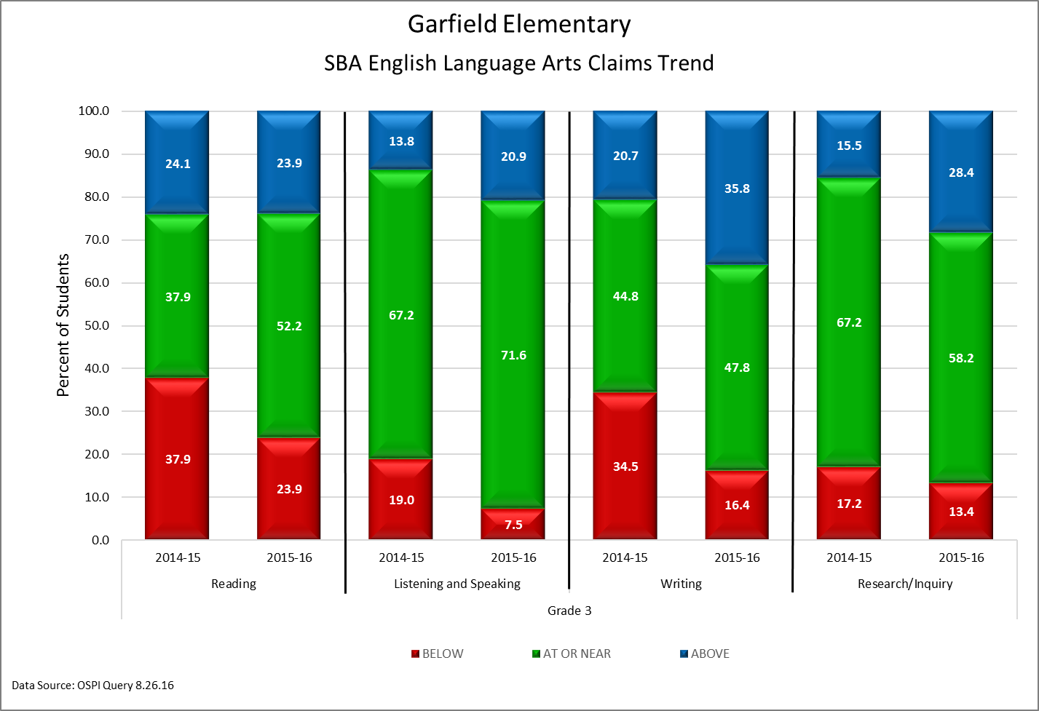
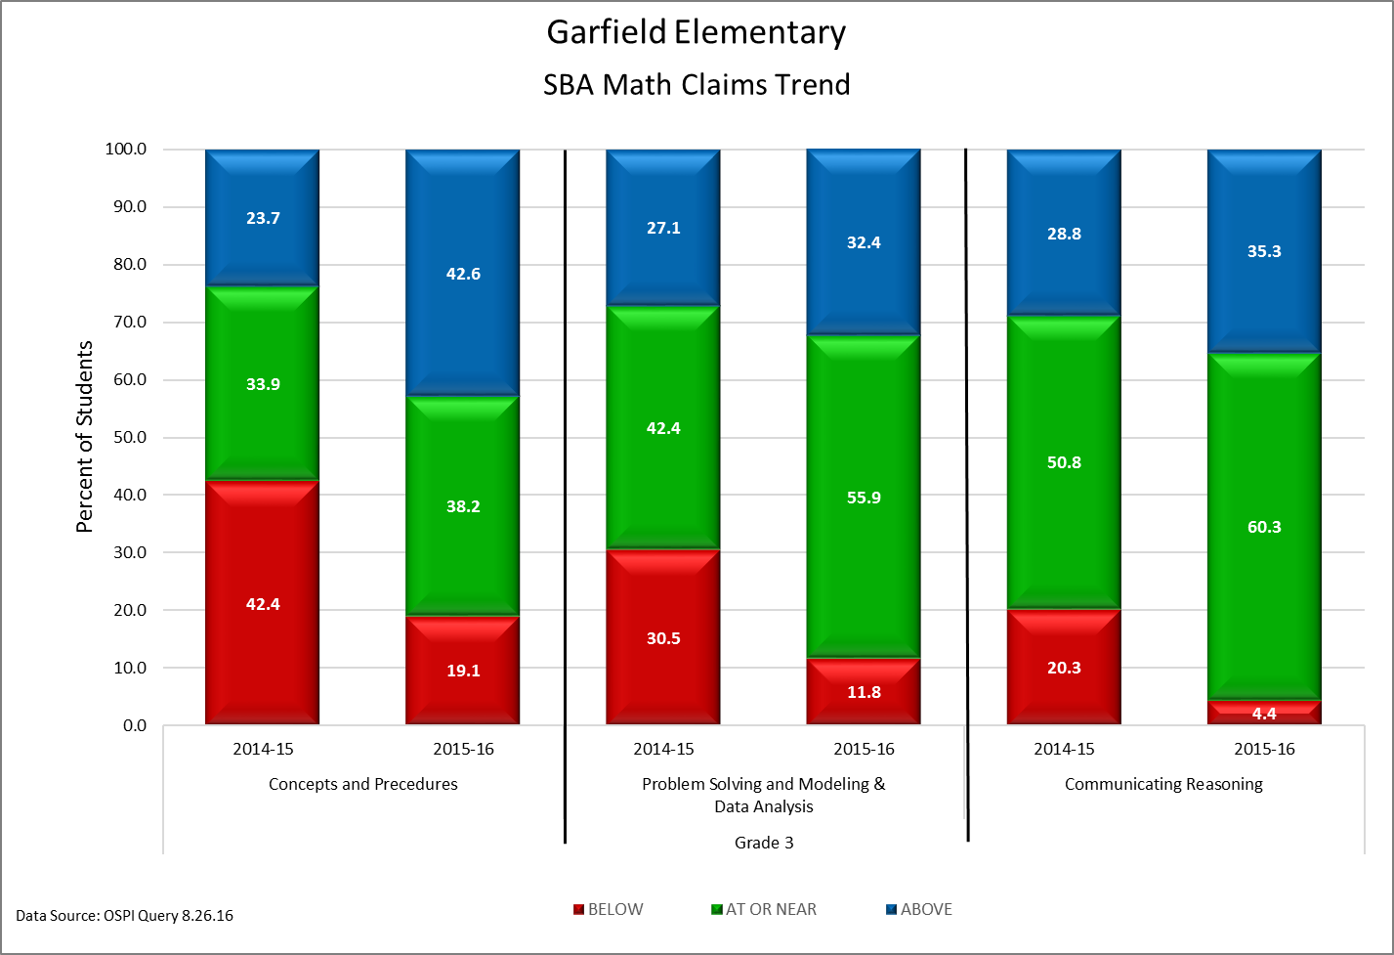
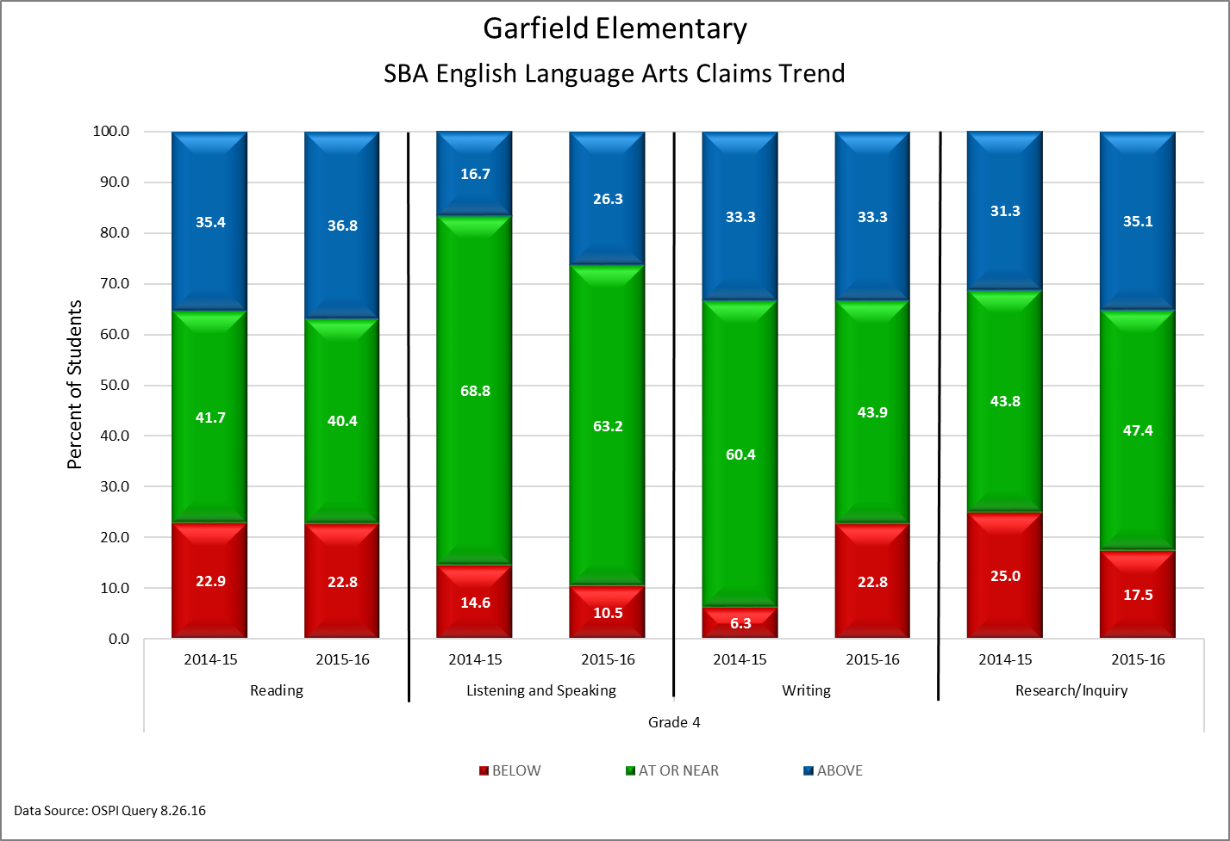
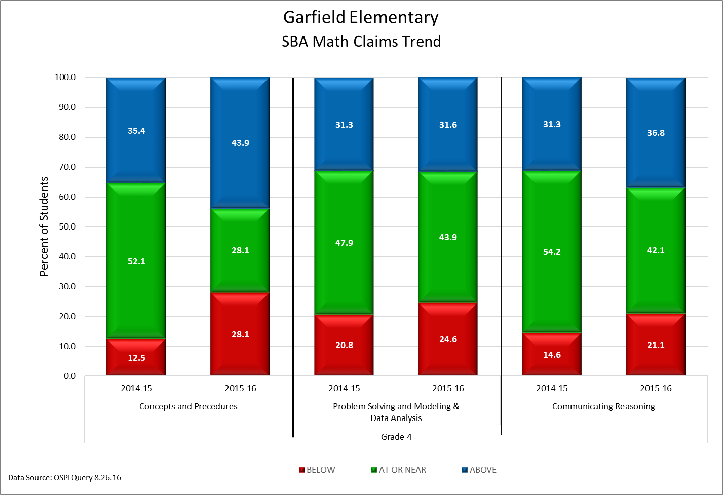
SBA Claims
2 Year Trend
Notes:
This is our SBA Claim data over two years. Grade level teams met to study the claims and this data supports their instructional decisions. Our reading specialist supports teachers in increasing their instructional skills through the coaching model.

Slide 25
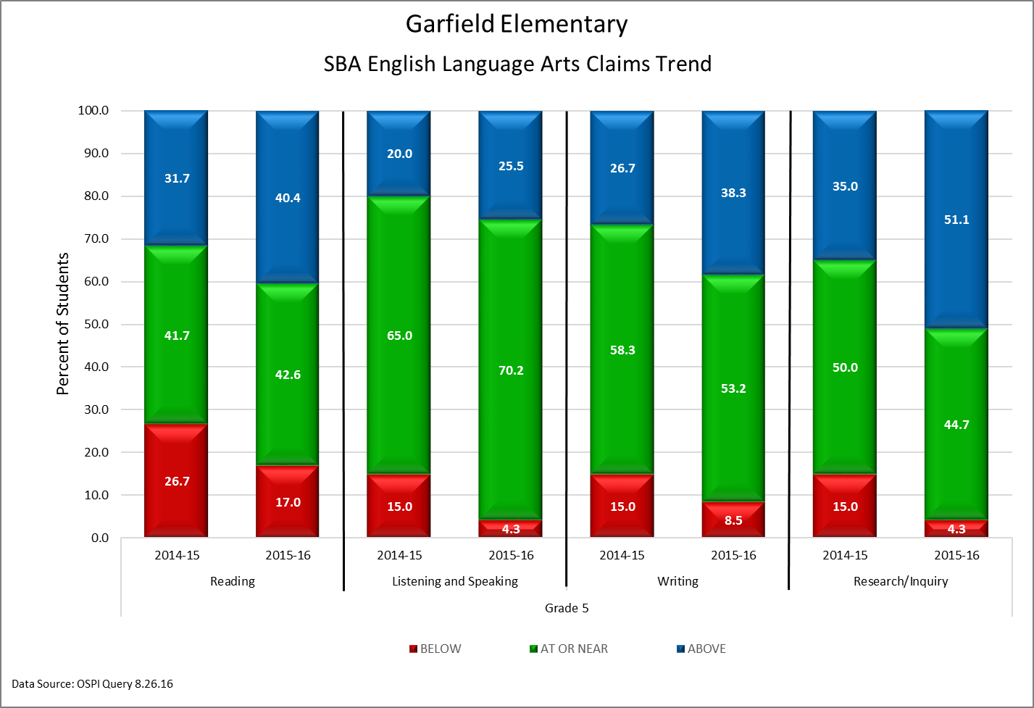
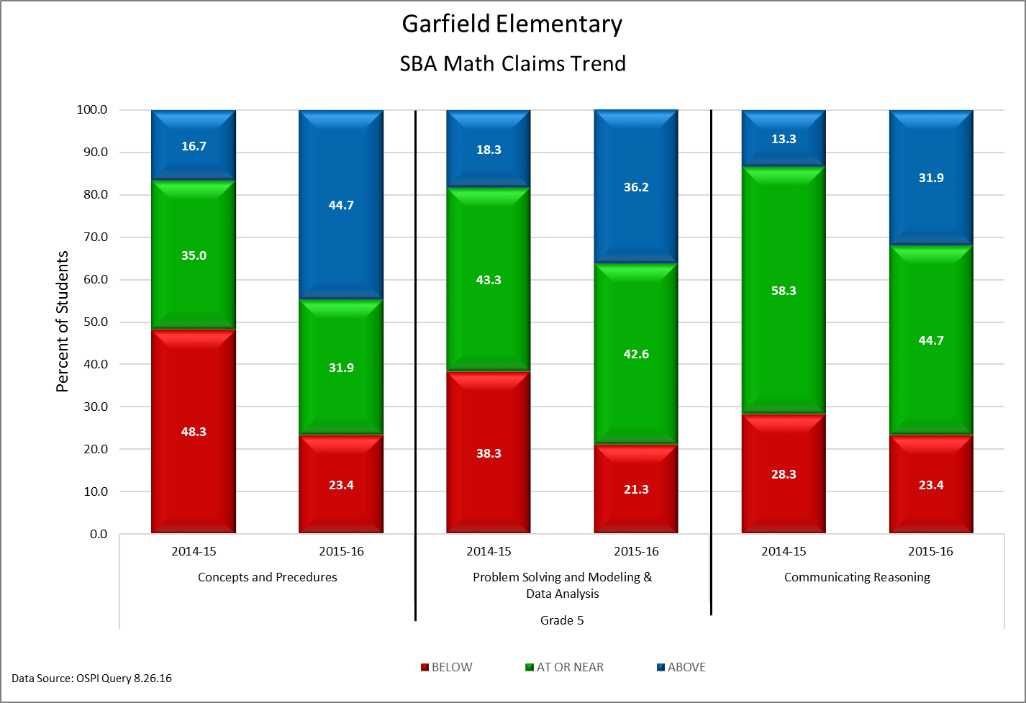
SBA Claims
2 Year Trend
Notes:
We analyze our claim data to drive our instructional plan for the year. Our math specialist will speak more specifically on our actions items that focus on our working around claims two through four.

Slide 26
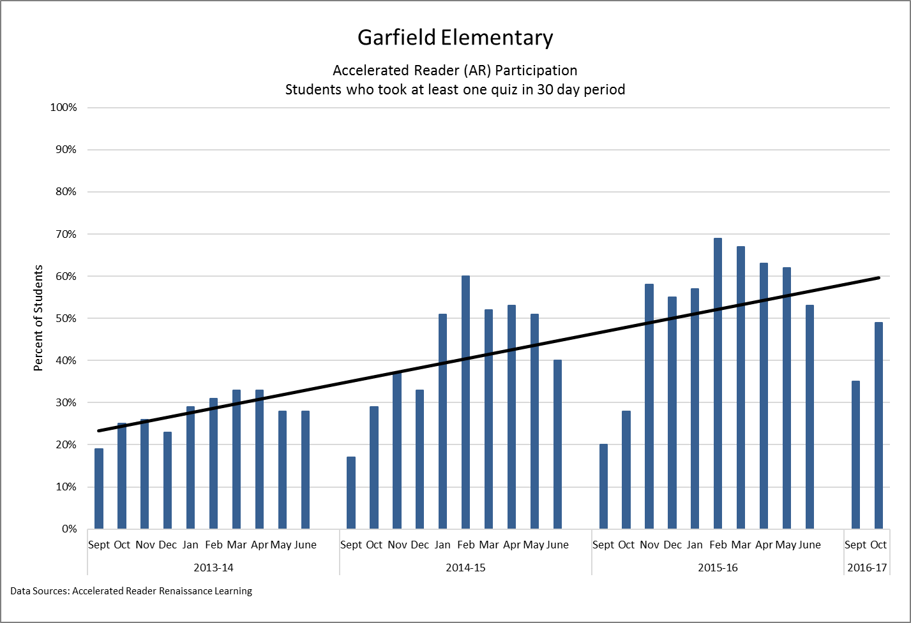
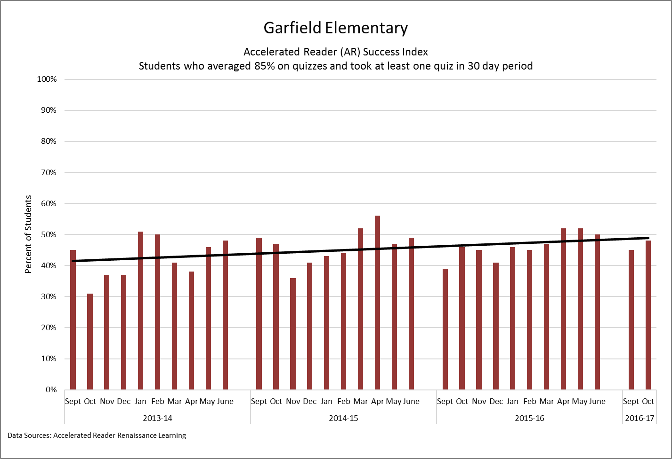
Accelerated Reader Data
Notes:
Our AR participation rate is growing. We focus on school-wide reading at our first assembly of the school year. Each month we recognize the leading classrooms with each receiving an award to be displayed in the classroom.

Slide 27
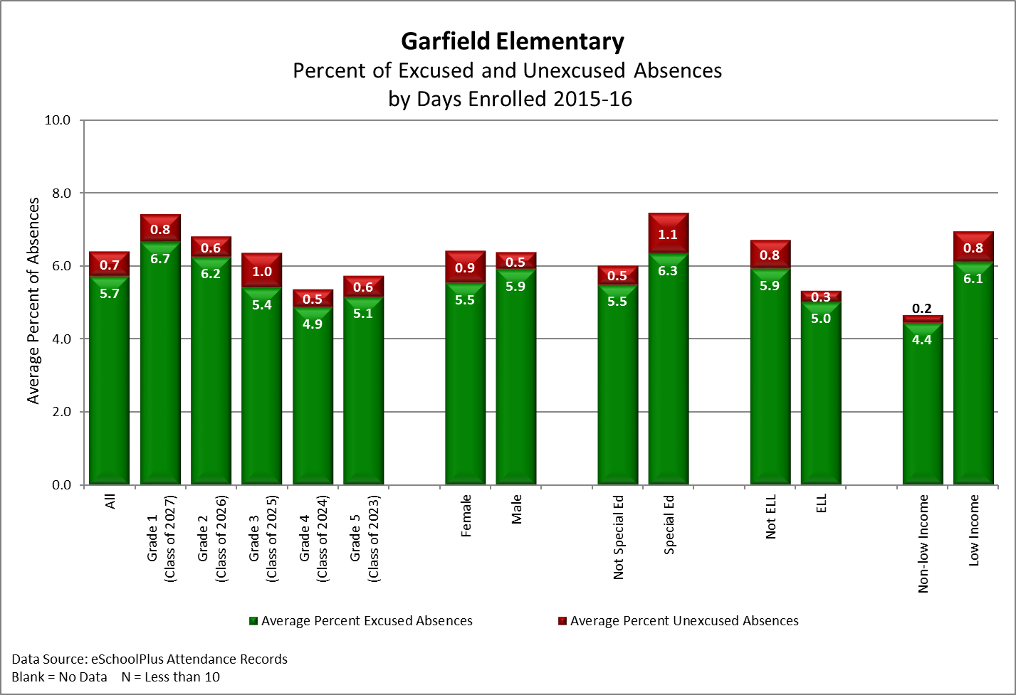
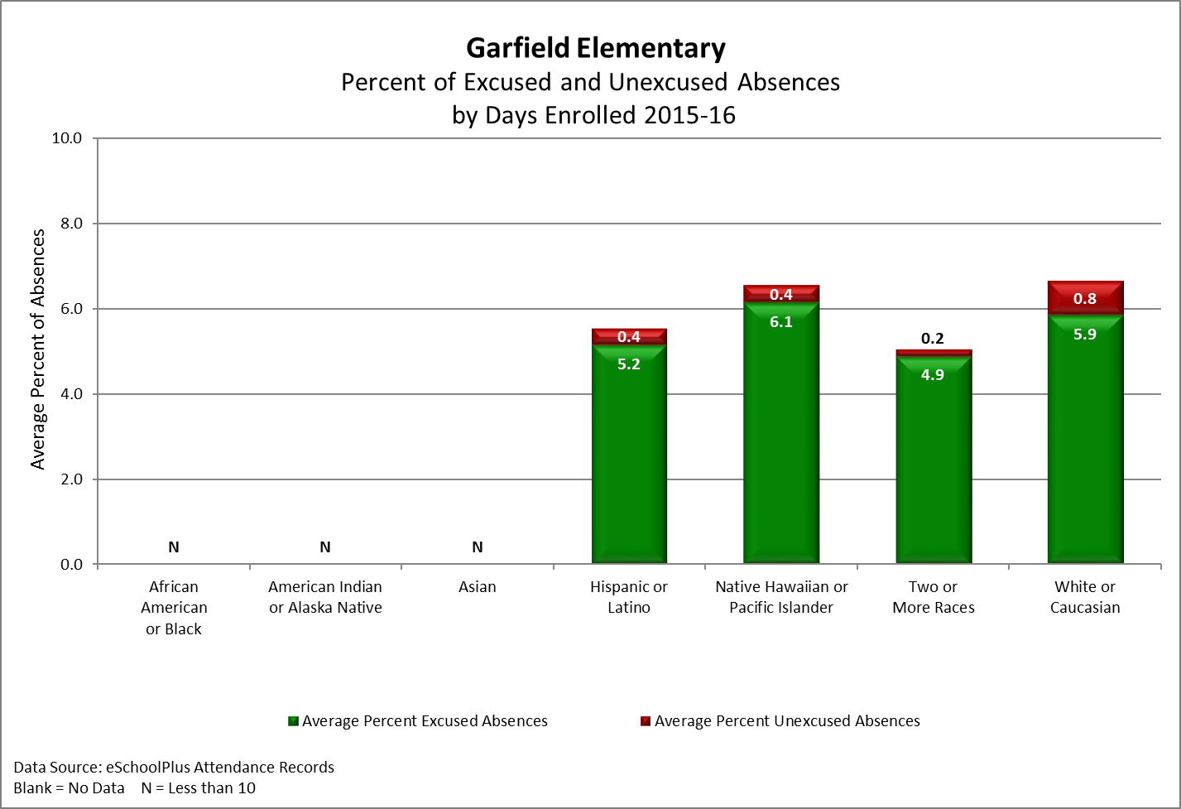
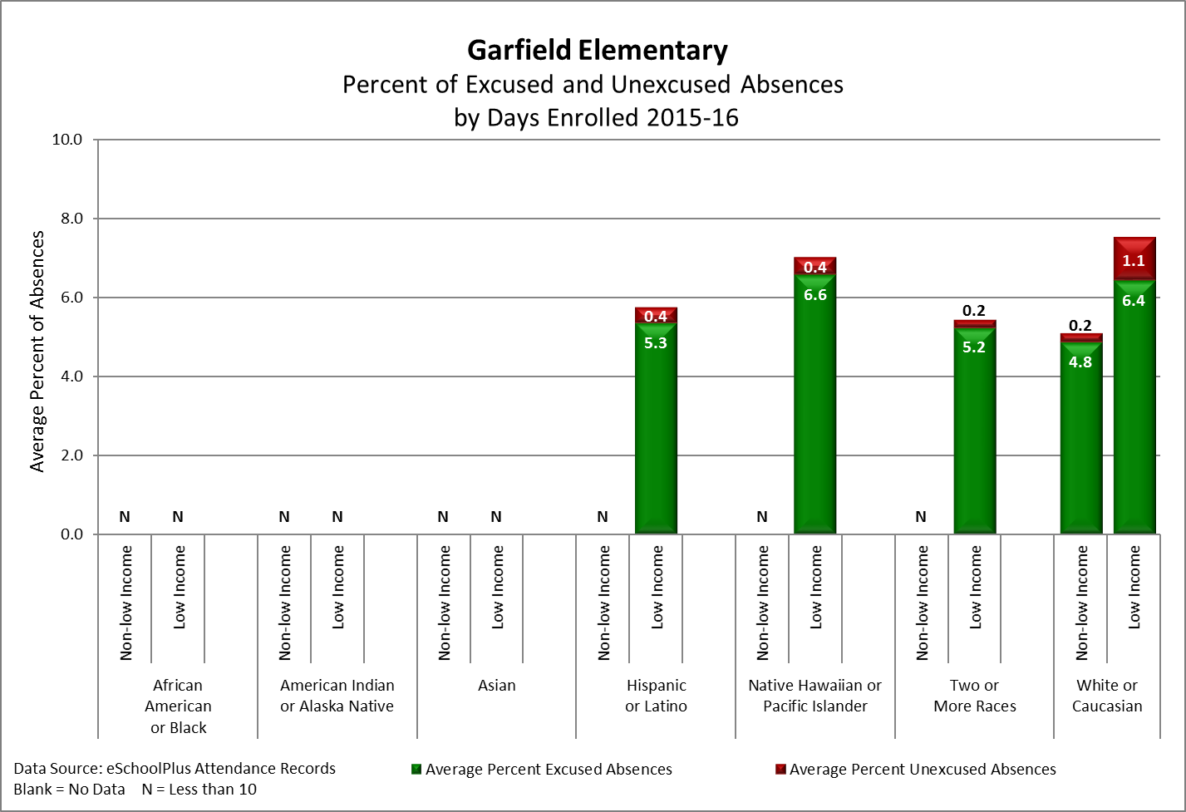
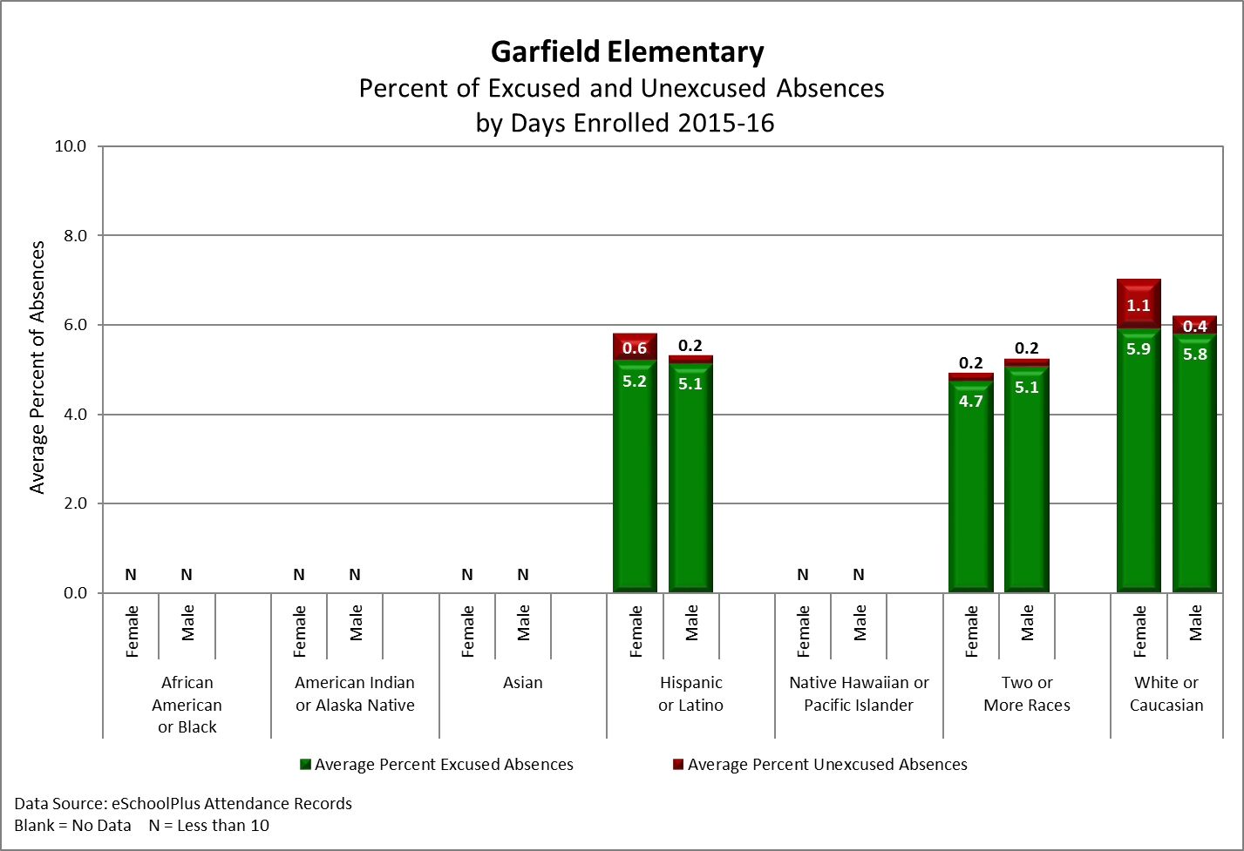
Attendance Data
Notes:
Based on our attendance data we continue to communicate our campaign of ‘Ten or less for School Success’. We recognize classrooms with the highest student attendance each month during our assembly with each class receiving a school mascot to display. We have implemented attendance conferences with families to stress the importants

Slide 28
Providing Evidence of:
School Improvement Action Items,
Key Performance Indicators and
Developing High Performing Teams
Rotations
Notes:
We will now go into our rotation.
Right side of the room will go to room 206, next door.
After 15 minutes we will rotate.

