Slide 1




Welcome to Kindergarten
Everett Public Schools
2017
Notes:
Welcome to Everett Public Schools. We are excited that all students are offered state funded full day kindergarten.
This presentation is written for a parent audience – if children are present during presentation, be sure to adjust your presentation audience focus to tell children about what kindergarten will be like, rather than the parent.

Slide 2


Welcome to School Name
Notes:
Insert a picture of your choosing. This is your welcome page.

Slide 3

Kindergarten begins with our families
The first three days of school have been set aside for teachers to meet individually with each child and family.
An appointment will be scheduled to meet with your teacher.
Family meetings will be held at your student’s school.
Kindergarten students’ first day of school is Monday, September 11, 2017.
Notes:
Welcome to Kindergarten in Everett Public Schools! We’re so glad you’ll be joining us next year. It will be a wonderful and exciting year with lots of new things to do and learn. Kindergarten begins with our families.
(Speak to the slide)

Slide 4
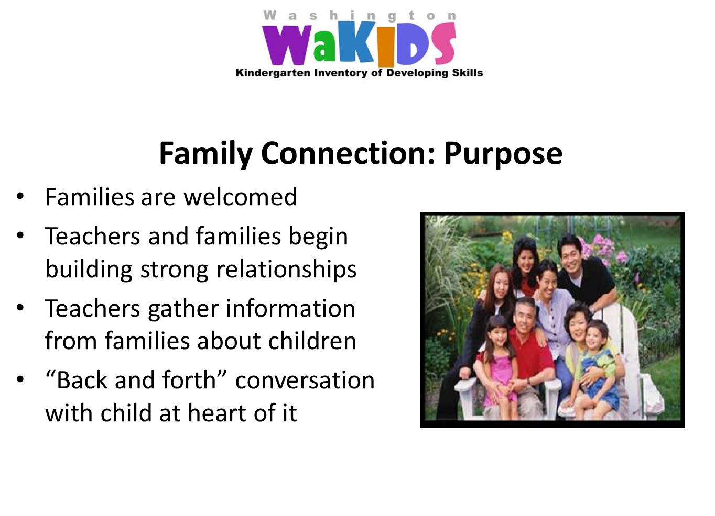
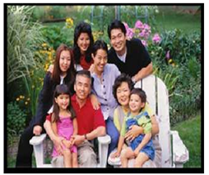
Family Connection: Purpose
  Families are welcomed
  Teachers and families begin building strong relationships
  Teachers gather information from families about children
  “Back and forth” conversation with child at heart of it
Notes:
To begin building a strong relationship between your child’s teacher and your family at the meeting you will share information about your child and get to know one another.

Slide 5
Pathway to Success:
Families and teachers partnering to get to know you and your child
Family
connection
Teachers identifying children’s strengths to target support where it’s needed most
Whole
child assessment
Kindergarten teachers and early learning providers sharing information to help children succeed
Early learning
Collaboration
Creating a pathway toward your child’s success in school.
The
Result
Notes:
While family connections is one of the important components of kindergarten, through WaKIDS there are two other components: Whole child assessment and collaboration between kindergarten and preschool teachers

Slide 6
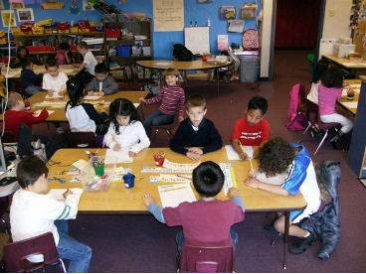
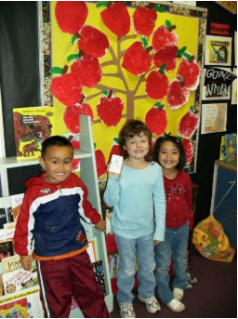
A Day in Kindergarten
Notes:
It’s time for kindergarten, we want to share what your child will do each day and some of the things they will be learning.
Click on either picture to show video of children’s perspectives on transition to kindergarten.
Video from Head Start National Center for Quality Teaching and Learning (NCQTL)
http://eclkc.vzaar.me/4499077
Video is 6 min 15 seconds

Slide 7
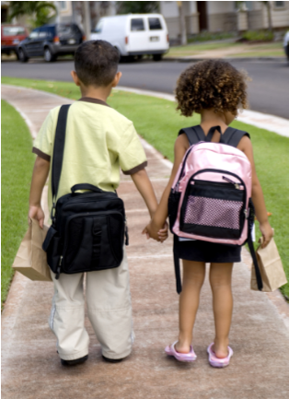
Arrive at School
  How do children get to school?
    Walk
    Parents drive
    Bus for some areas
Notes:
Children get to school in different ways. If you live close to school (one mile or less) and don’t have to cross any major roads, children can walk with an adult. Otherwise they’ll ride a bus. Our transportation department will have information on bus routes and stops right before school starts. Their telephone number (425-385-4144) is in the Parent Booklet that you’ll be getting today. You can also get this information on the school district website (www.everett.k12.wa.us). The transportation department contact information is also listed at the beginning of the booklet.
Please help your child learn how to safely ride the bus. Bus rules to follow include staying in your seat, listening to and following directions, talking quietly and respecting the bus driver.
Parents can also choose to drive their child to school. Each school has a place and way that they want you to drop off children or to park if parents are bringing their child into the school.
We will talk toward the end of the presentation about the first day and your role.
Individual School information:

Slide 8
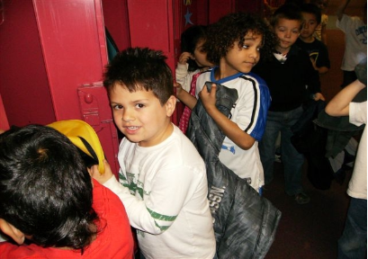
Beginning of the Day
  Put coat & backpack away in personal cubby or locker
  Beginning of the day routine
  Breakfast program available
Notes:
Each day when children arrive there will be a special place to go and wait until the bell rings and the teacher is ready for students to come into the classroom.
Individual School information:
Before school line up procedure -
When children enter the classroom they will put coats and backpacks away. The teacher will have some things set up for children to do every day when they arrive. They might turn in their take-home folder then go to the table or to the rug.

Slide 9
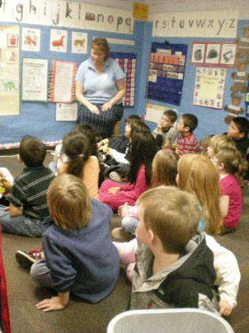
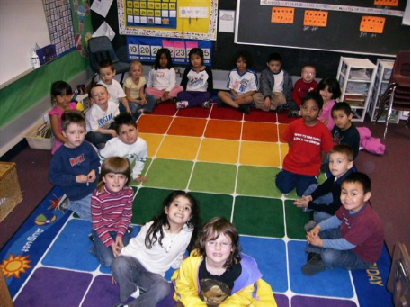
Welcome Time
Notes:
Every day after children arrive they will get a chance to greet their teacher and the other children in the classroom. Usually there are between 20 and 24 children in each class. This is probably more than in preschool. This group time will be an important time to listen and also take turns sharing.
Schools can include information about: morning meeting, circle time, calendar, songs, poems, movement

Slide 10
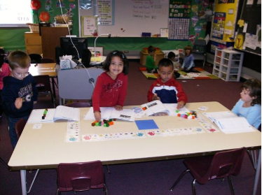
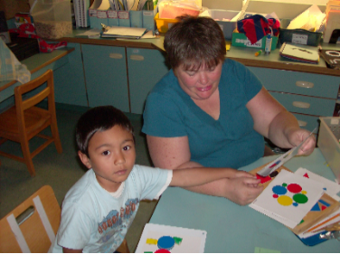
Math
  Numbers
  Counting objects
  Patterns
  Forming groups
  Shapes
  Measurements & graphs
  Solving problems
Notes:
Everyday children will spend time learning math through whole group, small group and math workshop stations. It will be at least 45 minutes most days and they’ll get to use lots of blocks, shapes and counters. All year they’ll learn more about numbers, counting, beginning to add and subtract. They’ll also get to do some measuring, solve problems using numbers and make graphs with classmates (some will probably be like the graphs we just made showing how many in your family and which month children have their birthday).
Possible addition to slide: show examples of fun, hands-on student math work such as manipulatives, graphs made as a class, consumables, subitizing and counting collections materials, etc.

Slide 11
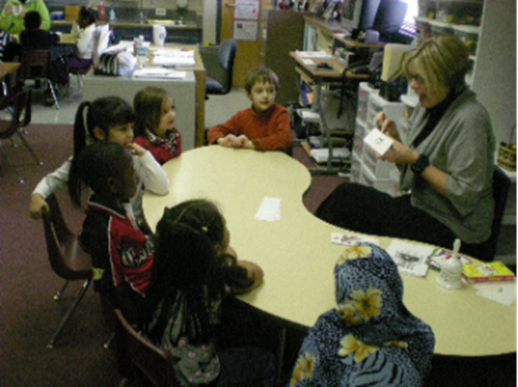
Literacy: Oral language
Listening and understanding
Expressing thoughts,
feelings and ideas
  Learning and using new words
  Retelling familiar stories
  Taking turns in classroom conversations
Notes:
Communication skills begins before birth. Language is important part of one’s identity. It is the precursor to literacy development.
In kindergarten children will be learning about listening and taking turns to share what they know and think.

Slide 12

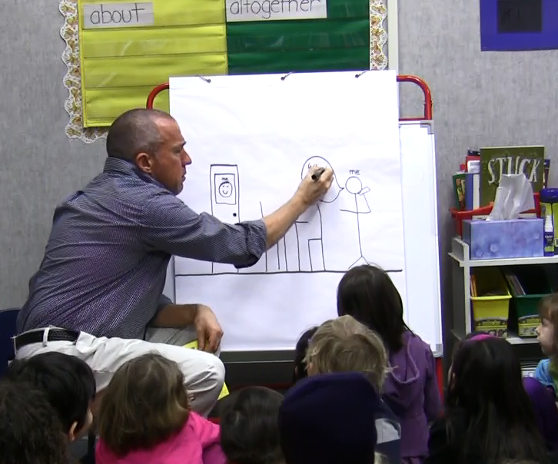
Literacy:
Learning how stories work
Telling about a memory that includes:
  What happened
  Who was there
  Where did it happen
  How did you feel
  What did you say
Notes:
Everett Public Schools is using an aligned instructional writing strategy that develops student writing from PreK to 3rd grade.
If your child has attended a ECEAP, Head Start or community preschool and childcare program that is a partner in this work, the materials and strategies will be familiar to them. The writing instruction focuses on the elements of a personal story and the child’s ability to communicate their stories through pictures and writing.

Slide 13
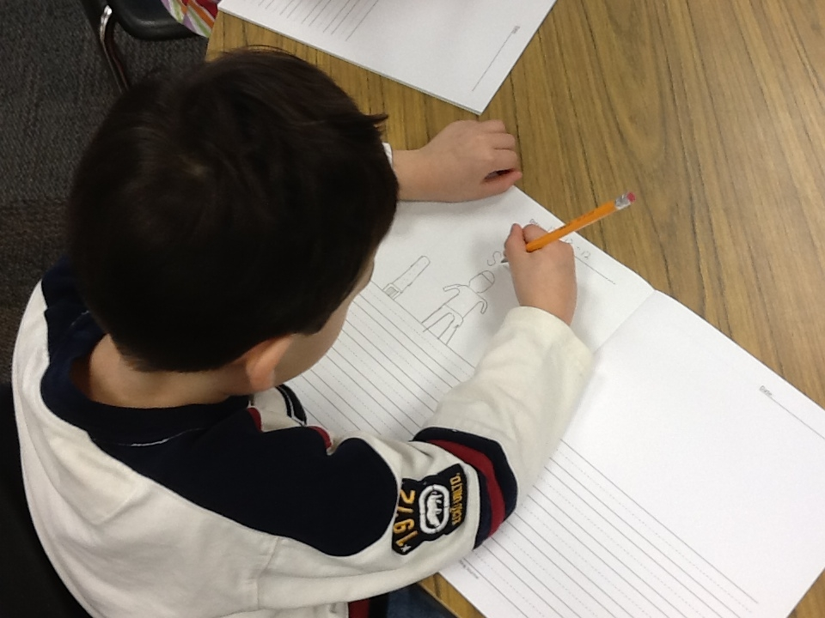
Literacy: Beginning to write
  Telling and drawing one’s own stories
  Sounding out and writing letters and words
  Using writing in a variety of ways
  - Labels
  - Children’s stories
  - Lists
  - Journals
Notes:
Children will learn letter sounds and how to sound out and write words.
They‘ll get a chance to write labels on their pictures, to make lists, to draw and write in their journal and to make drawings and write about what they are learning in science.

Slide 14
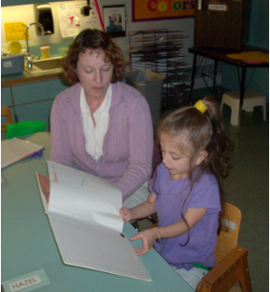
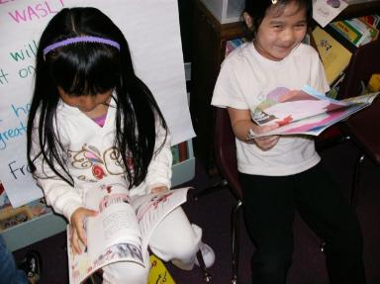
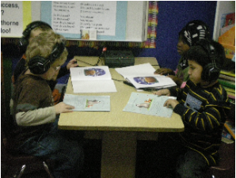
Literacy: Beginning to read
  Read aloud
  Teacher modeled reading
  Small group reading instruction
  Letters, sounds, rhyming, and beginning sight words
  Center activities
Notes:
There will be lots of opportunities to read and hear stories in kindergarten.
Individual schools – add information on literacy instruction strategies used (ie: daily 5, close reading, turn and talk, etc.)

Slide 15
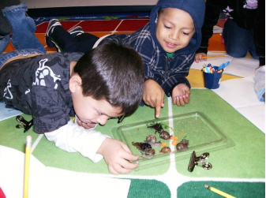
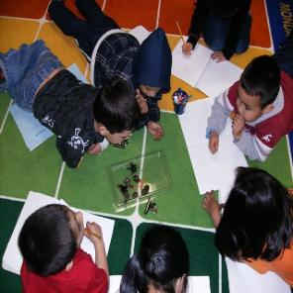
Science
  Learning about living and non-living things
  Asking questions
  Making observations
  Using tools to solve problems
  3 units per year
    Balls & Ramps
    Wood & Paper
    Animals 2x2
Notes:
Science is another really cool part of the day! They’ll get to learn about animals, about how a ball moves on flat surfaces and on ramps and much more. They’ll get to use tools to solve problems.

Slide 16
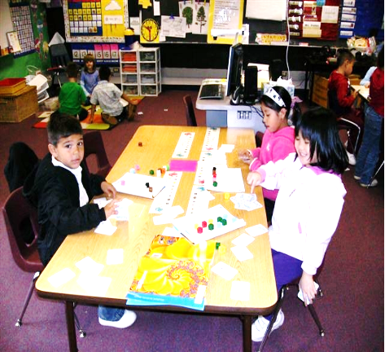
Social Studies
  Citizenship
  Collaboration
  Classroom & school community
  Learning about ourselves and others
Notes:
Individual schools add own information

Slide 17
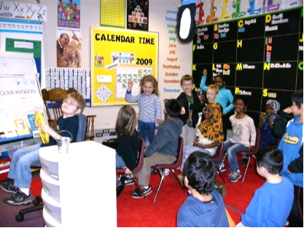
Social Skills
  Following routines
  Sharing and helping
  others
  Recognizing feelings and understanding emotions
  Interacting with more children and adults
  Managing self in a classroom and other parts of a school
  Taking on challenging tasks
  Building character
Notes:
Kindergarten is about learning things like letters, numbers, and science. It’s also about learning how to get along with others and how to manage oneself when there are more children around.

Slide 18
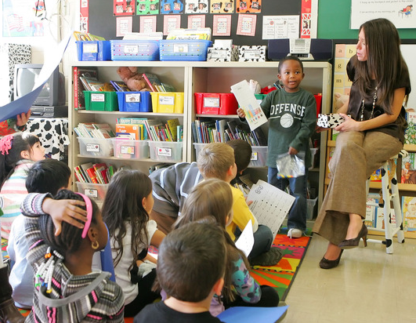
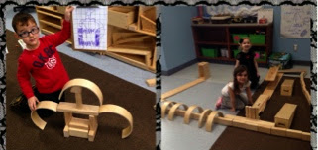
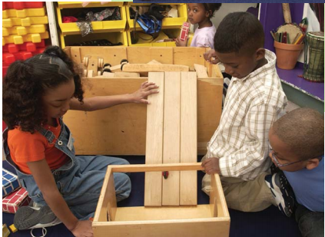
Plan-Do-Reflect
Learning through intentional choice, action and reflection
Students
Teachers
Plan a self-selected project
  based on his/her interests
Construct meaning
Interact with peers
Process new information
Evaluate his/her learning
Inspire others to try new ideas
Become an expert
Provide a rich learning
environment
Observe and support students
Ensure student do the hard work
Coach for risk taking
Listen, interact and question to
extend students’ thinking
Validate students as experts
Notes:
Plan – Do – Reflect is learning through student choice, actions and reflection. This is a learning time that allow students the time to (read from slide)

Slide 19
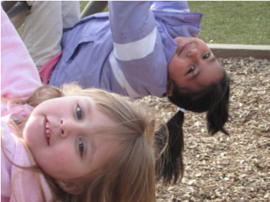
Recess & Outdoor Play
  Physical activity
  Time to play with other children
  Learning to cooperate, take turns and solve problems
Notes:
Going outside for recess is a great time of the day! Children will get to run, play with friends, and use the playground equipment.
It’s also a time to relax, a time to learn how to play with others and develop friendships. Teachers will help children know where to play and how to get to and from the playground.

Slide 20
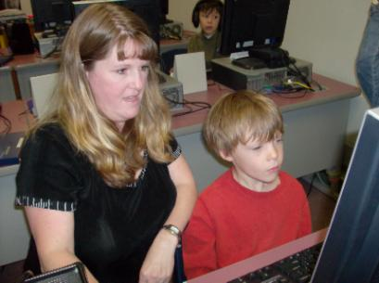
Technology in the Classroom
  Supporting development
  of math, science
  reading and writing
  Developing beginning
  computer skills
  Imagine Learning
  English for students learning English
Notes:
Message for parents: When we think of technology in the classroom often think of kids choosing to work on the computers in our classrooms and going to the computer lab. Technology is much more than that. Technology is embedded in all subject areas. Digital programs are available to use to provide learning support to our English Language Learning. A variety of tools offer ways for students to demonstrate and extend ways of communicate with others (teachers, peers and family members). This promotes relationships building within our entire community.
If presenting with K students in the audience - You’ll get to use the computer in your classroom and perhaps in the computer lab. On the computer you’ll get to do learning games for math, reading and writing, create drawings and listen to books online.
Individual school information:

Slide 21
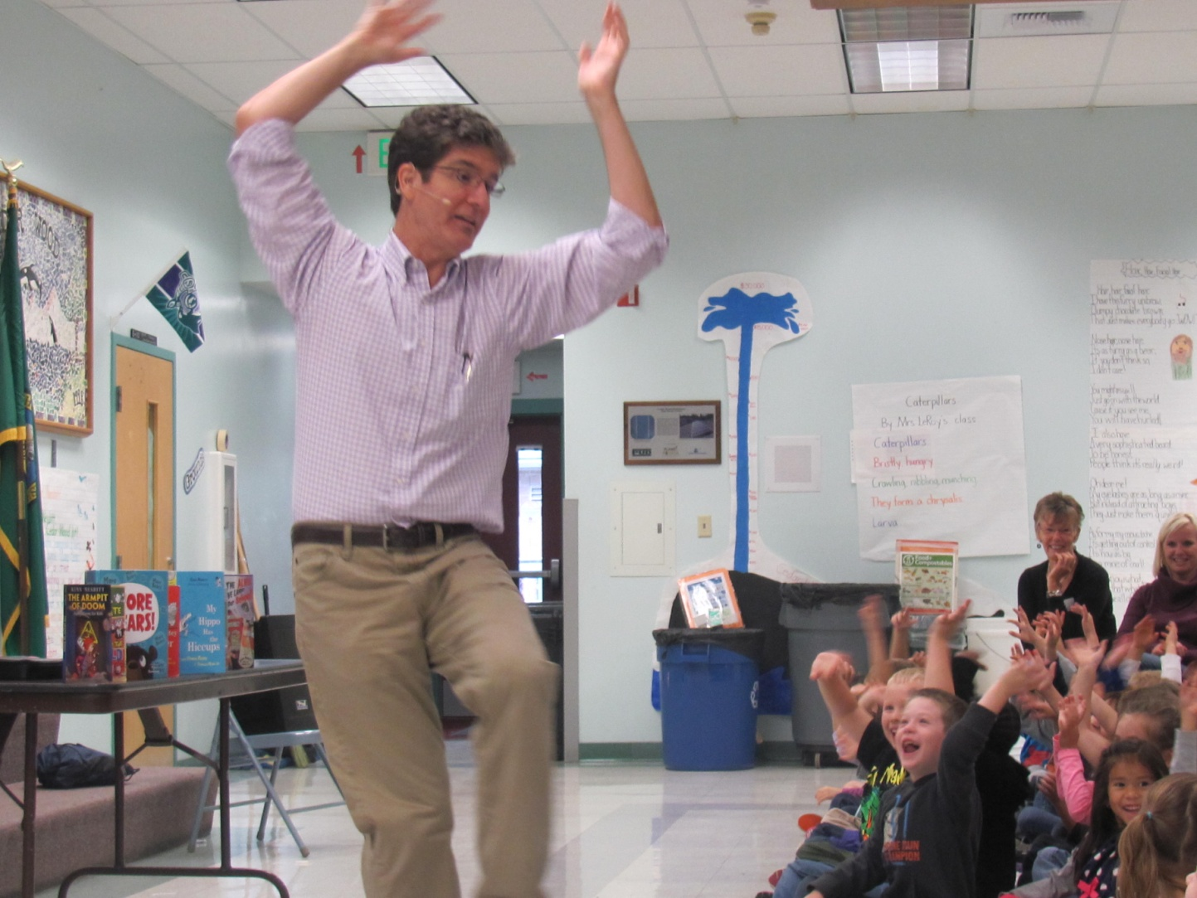
Specialists
Music
Notes:
Kindergarten children go to music in the music room.
Individual school information:
Frequency

Slide 22
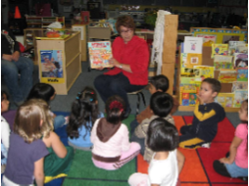
Specialists
Library
Notes:
They also get to go to the library to hear books and learn about how to check out books.
Individual school information:
Frequency

Slide 23
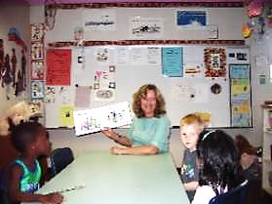
Specialists
Lessons with the Counselor
Notes:
The counselor will come into the classroom and work with the whole class. They’ll learn about sharing how they are feeling, how to use words if they are not happy about something, and how to solve problems with friends. They’ll also learn about how to keep safe at school.
Individual school information:
Frequency

Slide 24
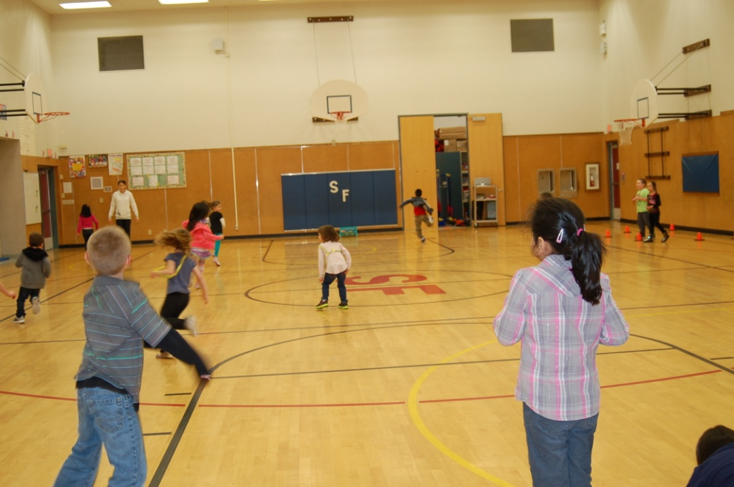
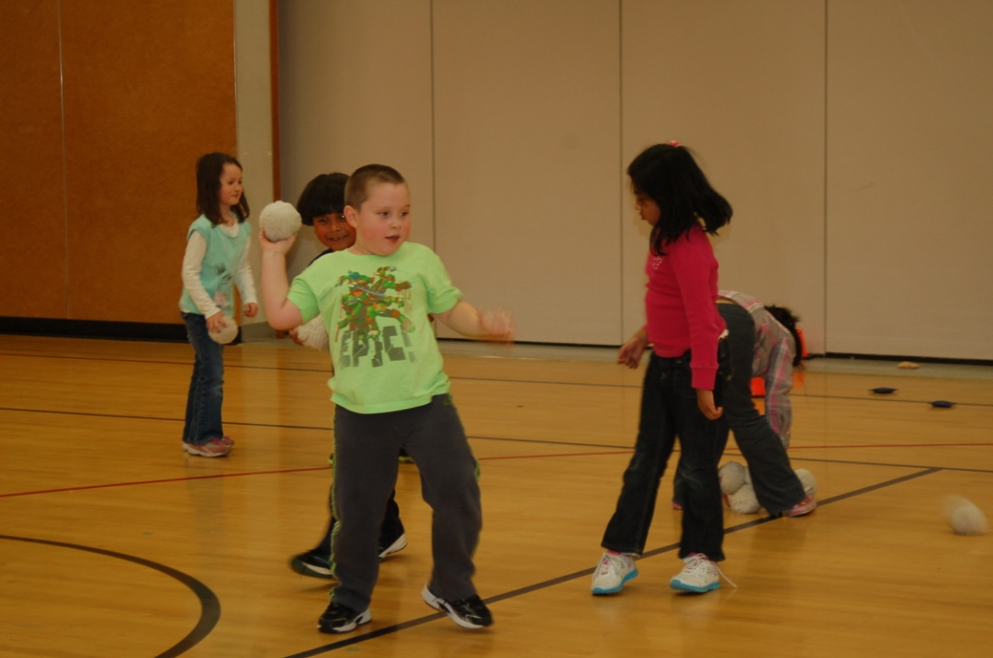
Specialists
Physical Education (PE)
Notes:
Kindergarten children go to physical education or P.E. in the gym.
Individual school information:
Frequency

Slide 25
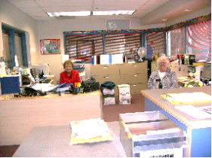
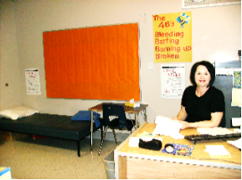
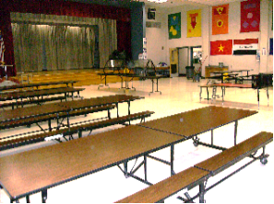
Your School
Main Office
Health Room
Cafeteria
Notes:
Some other important places in the school are the main office, the health room and the cafeteria.
If your child is late or needs help, they can come to the main office. They might visit the health room if they’re aren’t feeling well. Some kindergarteners will eat in the cafeteria with their class.
Schools add own pictures and additional information
Sign-in
Late entry
Early pick-up
Volunteer procedures
Emergency procedures
Lock-down
Fire drills
Earthquake
Child ill at school

Slide 26
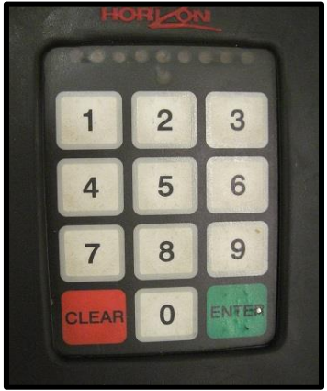
Food at School
  Breakfast and lunch are available
  Snacks vary by school & teacher
  Know Student ID number to go through food line
  Free or Reduced Lunch applications distributed at the beginning of the year
Notes:
In the fall you’ll get your child’s identification # and can help them learn to punch it in. It will be good to learn to find all the numbers on this sheet.
Computer number pads are different than the cafeteria. Please use the # pads in your materials to help your child learn how to key in their student number on both types of key pads.

Slide 27

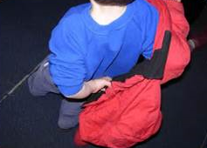
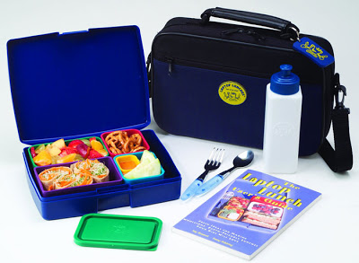
Self-Help Skills
  Independently use the bathroom
  Put on, zip & button coat
  Blow own nose
  Open and close lunch containers
  Clean up small spills
  Put away materials
  Ask for help
  Wash hands
Notes:
It’s important to know how to take care of oneself. You will probably want to practice these skills with your child before they come to kindergarten.

Slide 28


Supporting Your Child’s Success
Notes:
If kindergarteners are still with parents, transition children to classrooms; parents stay and learn more about what they can do to
Help children be ready
Make the transition smoother
While we’re talking about the transition into kindergarten, the whole year of kindergarten is a transition year for students. The beginning of the year will look more like a preschool classroom. Throughout the year this will change and by the end of the year, the classroom will look more like a first grade class.
Here are some things you can do to support a smooth transition and make kindergarten a successful experience for your child

Slide 29

Family Involvement
  Support your child’s
  learning in all areas
  Share family
  stories
  Come to school and
  family events
  Participate in WaKIDS family conference and parent-teacher conferences
  Help with class projects/work
  Volunteer
  Join PTA or Natural Leaders
Notes:
Families are children’s first teachers. As children start school you continue to have the most important role. Schools and parents are partners in supporting children’s learning and growth. We invite you to work with us as a team for your child’s success.
There are many ways you can be involved with your child’s learning and with the school.
Reading 20 minutes a day with your child is one of the most important.
Helping your child with work/projects sent home by the teacher
Individual school information:
Coming to family events (around reading, math, science – some just for fun together)
Coming to Parent-Teacher Conference
Opportunity to let the teacher know more about your child; after all you know your child best
Learn about what children do in classroom and how your child is progressing
Ask questions
Volunteering – in the classroom, at home (cut out materials), or for events at school
PTA – Book fair, Carnival, Grounds Clean-Up

Slide 30
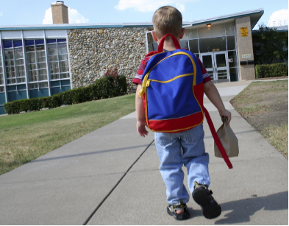
Important Things to Remember
  Being at school on
  time, every day is
  important
  Children learn new
  things each day
  Important
  information and
  skills are taught throughout the entire day
  All children start school at different skill levels
Notes:
Attendance – regular, daily and on-time
All children start school at different skill levels – teachers are trained to address this; they may ask you to help support your child at home

Slide 31
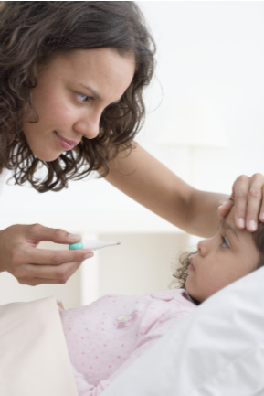
Important Things to Remember
  You know your child best. If they are too sick to attend school please keep them home
  Check your school’s guidelines

Slide 32

Before the First Day…
  Develop a home routine
  Help your child learn their personal information and how to care for him/herself
  Get supplies ready and labeled (see list for your school)
  Visit the school playground over the summer
  Practice drop off and pick up

Slide 33
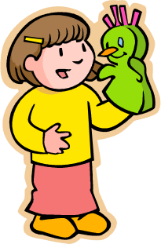
Over the summer…
  Watch your email for playful learning activities to do throughout the summer
  Check with your school for summer reading program or other learning opportunities
Notes:
Individual schools – add information on summer reading programs, open library, Everett Ready or other summer opportunities

Slide 34
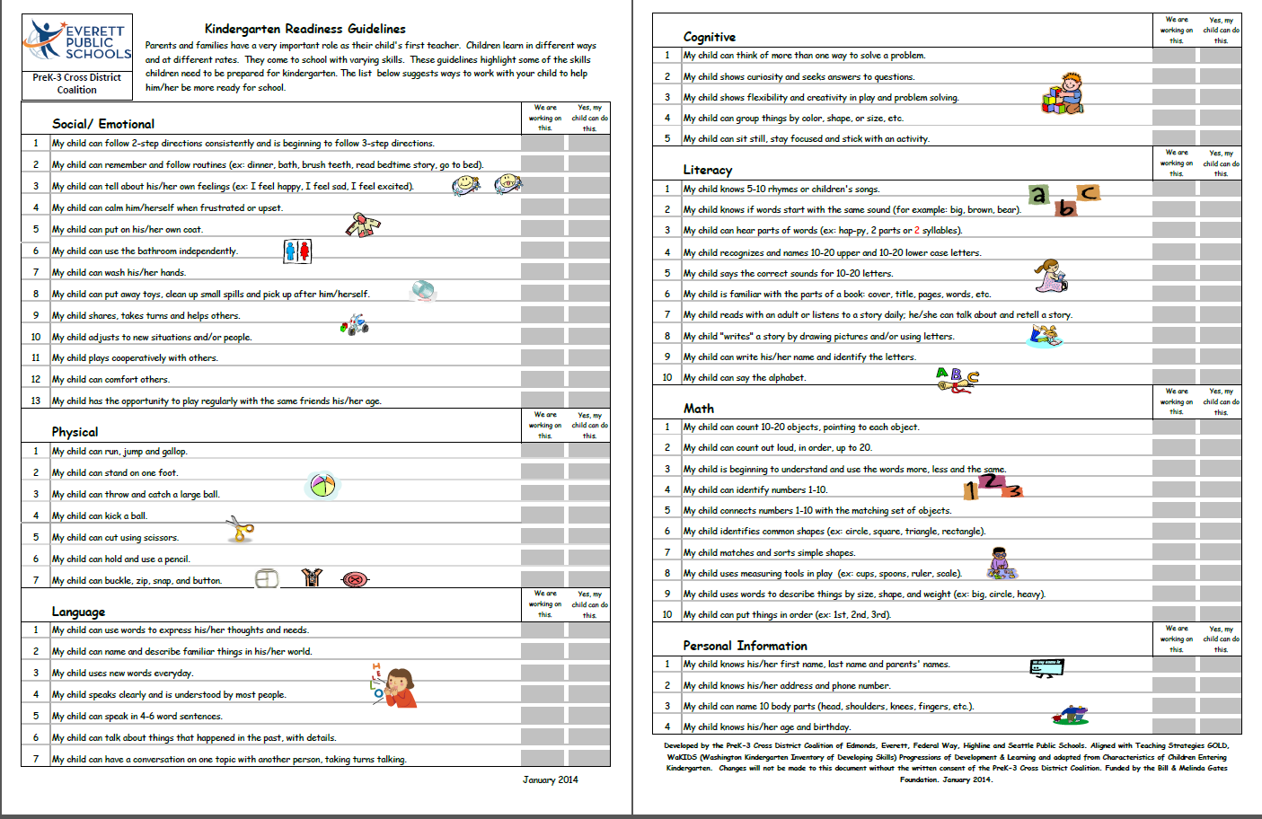
Over the summer…
  Review the “Kindergarten Readiness Guidelines”
  Choose a few things to do each day
  Repeat the same items until your child can do them easily and feels successful
  Make it fun!

Slide 35
First Day for Parents
Schools put in your own information – see notes below for topic ideas
Notes:
Schools fill in the information of how their first day will work: what is the most important information a parent may need.
Examples of information to share:
Where do/can parents say goodbye?
Is there a coffee group they can go to socialize or learn information about kindergarten?
Are parents allowed to go into the classroom with their child?
Where can parents pay for lunches?
How do parents find out their child’s student ID number?
Where will parents pick up their student at the end of the day?
Can my child ride the bus on the first day of school?
Do I have to put my child on the bus? Do I have to meet my child at the bus stop at the end of the day?
If I drop my child off at school can they ride the bus home?
How do I update my phone number, address, emergency contact information, etc.?
Talk about breakfast and lunch on first day.
Provide info on first day packet and contents.

Slide 36
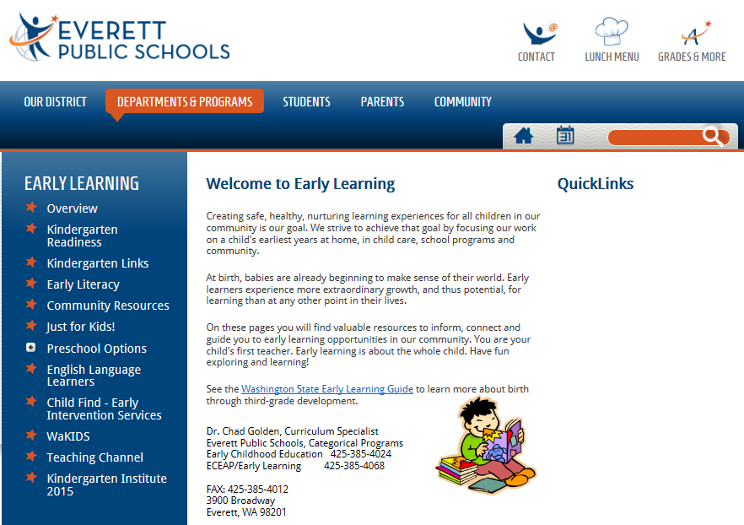
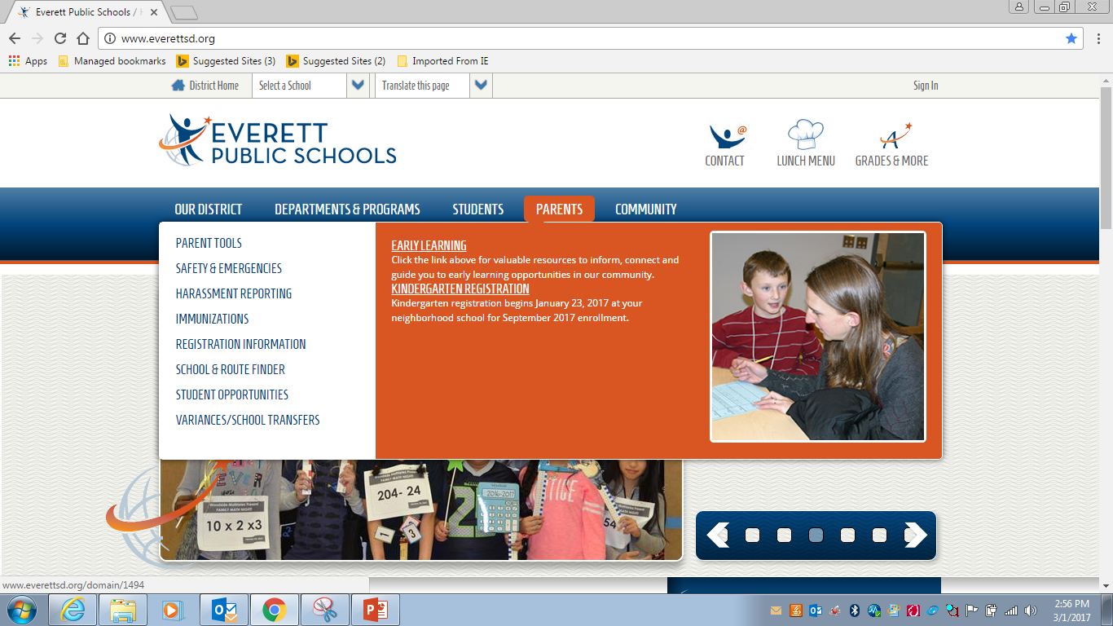

Visit the district Early Learning website
www.everettsd.org/earlylearning
Notes:
Our Early Learning site has lots of information for you. You can access it by hovering over the parents tab then clicking on Early Learning.
CLICK to switch to Early Learning website picture
On the website you will find kindergarten readiness information. (refer to slide and verbally tell about the page)
CLICK to animate the yellow circle around kindergarten readiness section
We have placed many fun interactive activities to support the kindergarten readiness guidelines.
CLICK on Kindergarten Readiness to follow the Hyperlink to show parents resource folders (you might want to show a few of the activities)

Slide 37
Additional Support
If you have concerns about your child’s development or readiness for kindergarten, please contact:
  Your School Principal
  Special Services
    425-385-5250
  Early Learning Department
    425-385-4024
    425-385-4068

Slide 38
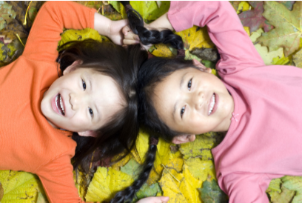
Spread the word about kindergarten
  Each year registration begins in January
  Tell your neighbors, family & friends
Notes:
Talk with friends, family and neighbors who have kindergarten-aged children. Let them know it’s important to register early so schools can keep you informed about opportunities for your child.

Slide 39
Questions?
Check with your school’s principal

