Slide 1


STATE OF SCHOOL REVIEW
Everett Public Schools
FINAL
MSP-SBA Data
October 2017
Student Data (n=5)
This report contains confidential student information.
These data must be kept secure at all times.
Notes:
Again, welcome. Time is precious, planning is essential. We are hear to share our story. You will hear how we use the data to strategically plan for individual students so time is used wisely. We continue to work from big picture to small and to align our work across grade levels. We continue to consider each individual student. This year we are looking closer at our special populations to see that not only as individuals but as a group these students are making equitable progress. We believe our abilities can be developed through dedication and hard work.

Slide 2
At-a-Glance
All data used to populate charts are provided by Everett Public Schools via ORS or EDS. These data may not be an exact match to OSPI Report Card due to test codes and other variables. State data are preliminary.
Notes:
We continue to score an average of 27% above the state. The red areas indicate 4 or 5 additional students who did not pass the assessment last year. This means we have to work hard this year to make up for that and meet our equity targets.

Slide 3
Demographic Trends
 | 2013 | 2014 | 2015 | 2016 | 2017 | 2018
Mill Creek Elementary | 2013 | 2014 | 2015 | 2016 | 2017 | Oct. 2017 | Change per Year (students)
Enrollment | 665 | 669 | 684 | 663 | 676 | 665 | 0
For the school year ending June of: | 2013 | 2014 | 2015 | 2016 | 2017 | Oct. 2017
Ethnic Percentages | Mill Creek Elementary | Mill Creek Elementary | Mill Creek Elementary | Mill Creek Elementary | Mill Creek Elementary | Mill Creek Elementary | Change per Year (in percentage points)
American Indian | 0.6% | 1.1% | 1.0% | 0.3% | 0.0% | 0.5% | -0.13
Asian | 20.6% | 19.7% | 18.9% | 19.5% | 20.1% | 22.4% | 0.31
Native Hawaiian / Pacific Islander | 0.3% | 0.3% | 0.7% | 0.2% | 0.3% | 0.2% | -0.04
Total of Asian / Native Hawaiian / Pacific Islander | 20.9% | 20.0% | 19.6% | 19.6% | 20.4% | 22.6% | 0.27
African American / Black | 2.1% | 2.8% | 2.8% | 3.5% | 3.3% | 2.9% | 0.16
Hispanic | 7.4% | 8.2% | 8.6% | 10.1% | 10.7% | 8.3% | 0.38
White | 59.1% | 58.3% | 59.4% | 57.3% | 57.4% | 57.3% | -0.39
Two or More | 9.9% | 9.6% | 8.6% | 9.2% | 8.3% | 8.6% | -0.29
Free-Reduced Meal Eligible | 15.7% | 16.3% | 14.4% | 13.7% | 9.8% | 8.7% | -1.58
Special Education | 12.3% | 11.3% | 11.4% | 9.9% | 9.1% | 10.5% | -0.49
Transitional Bilingual | 7.7% | 10.3% | 10.2% | 12.0% | 11.3% | 9.9% | 0.45
Migrant | 0.0% | 0.0% | 0.0% | 0.0% | 0.0% | 0.0% | 0.00
57
58
76
2013 to 2017 represents Spring demographics as published by OSPI. Oct. 2017 data provided by Everett Public Schools. Change per Year calculated with Oct. 2017 data.
Notes:
Our largest populations are Asian and Caucasian. We have 57 Hispanic students, 58 receive meal services. 76 students receive special education services. Interestingly, 1/3 are Resource Room, 1/3 Speech only and 1/3 in our self contained classes.

Slide 4
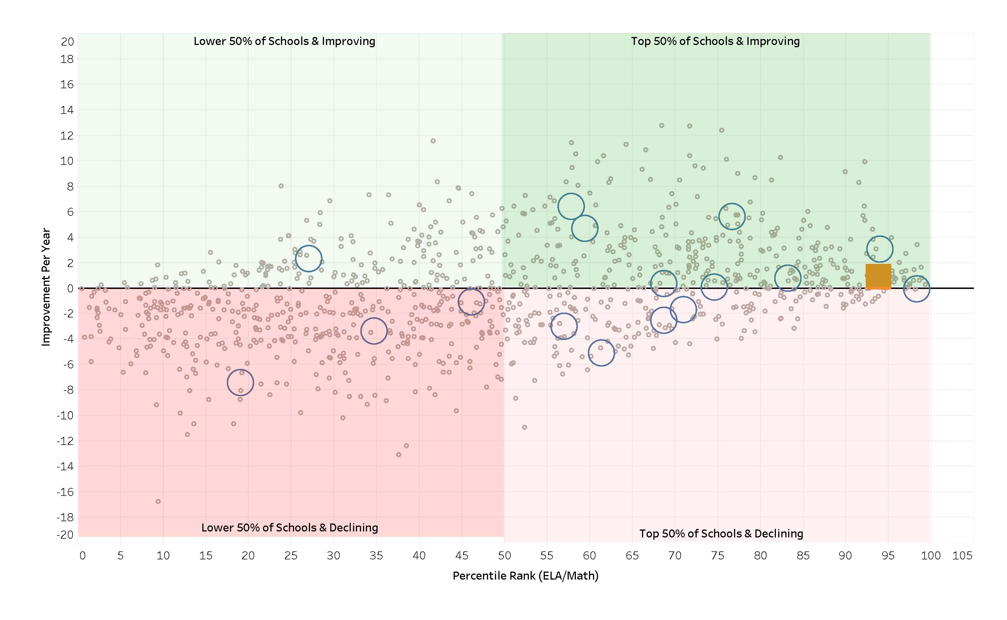
2017 Percentile vs. 5-Year Trend of Improvement
WA Elem
Everett Elem
Building
Notes:
This slide is always one to celebrate. Again this year we made progress when compared to last year when our orange box was slightly below the line.

Slide 5
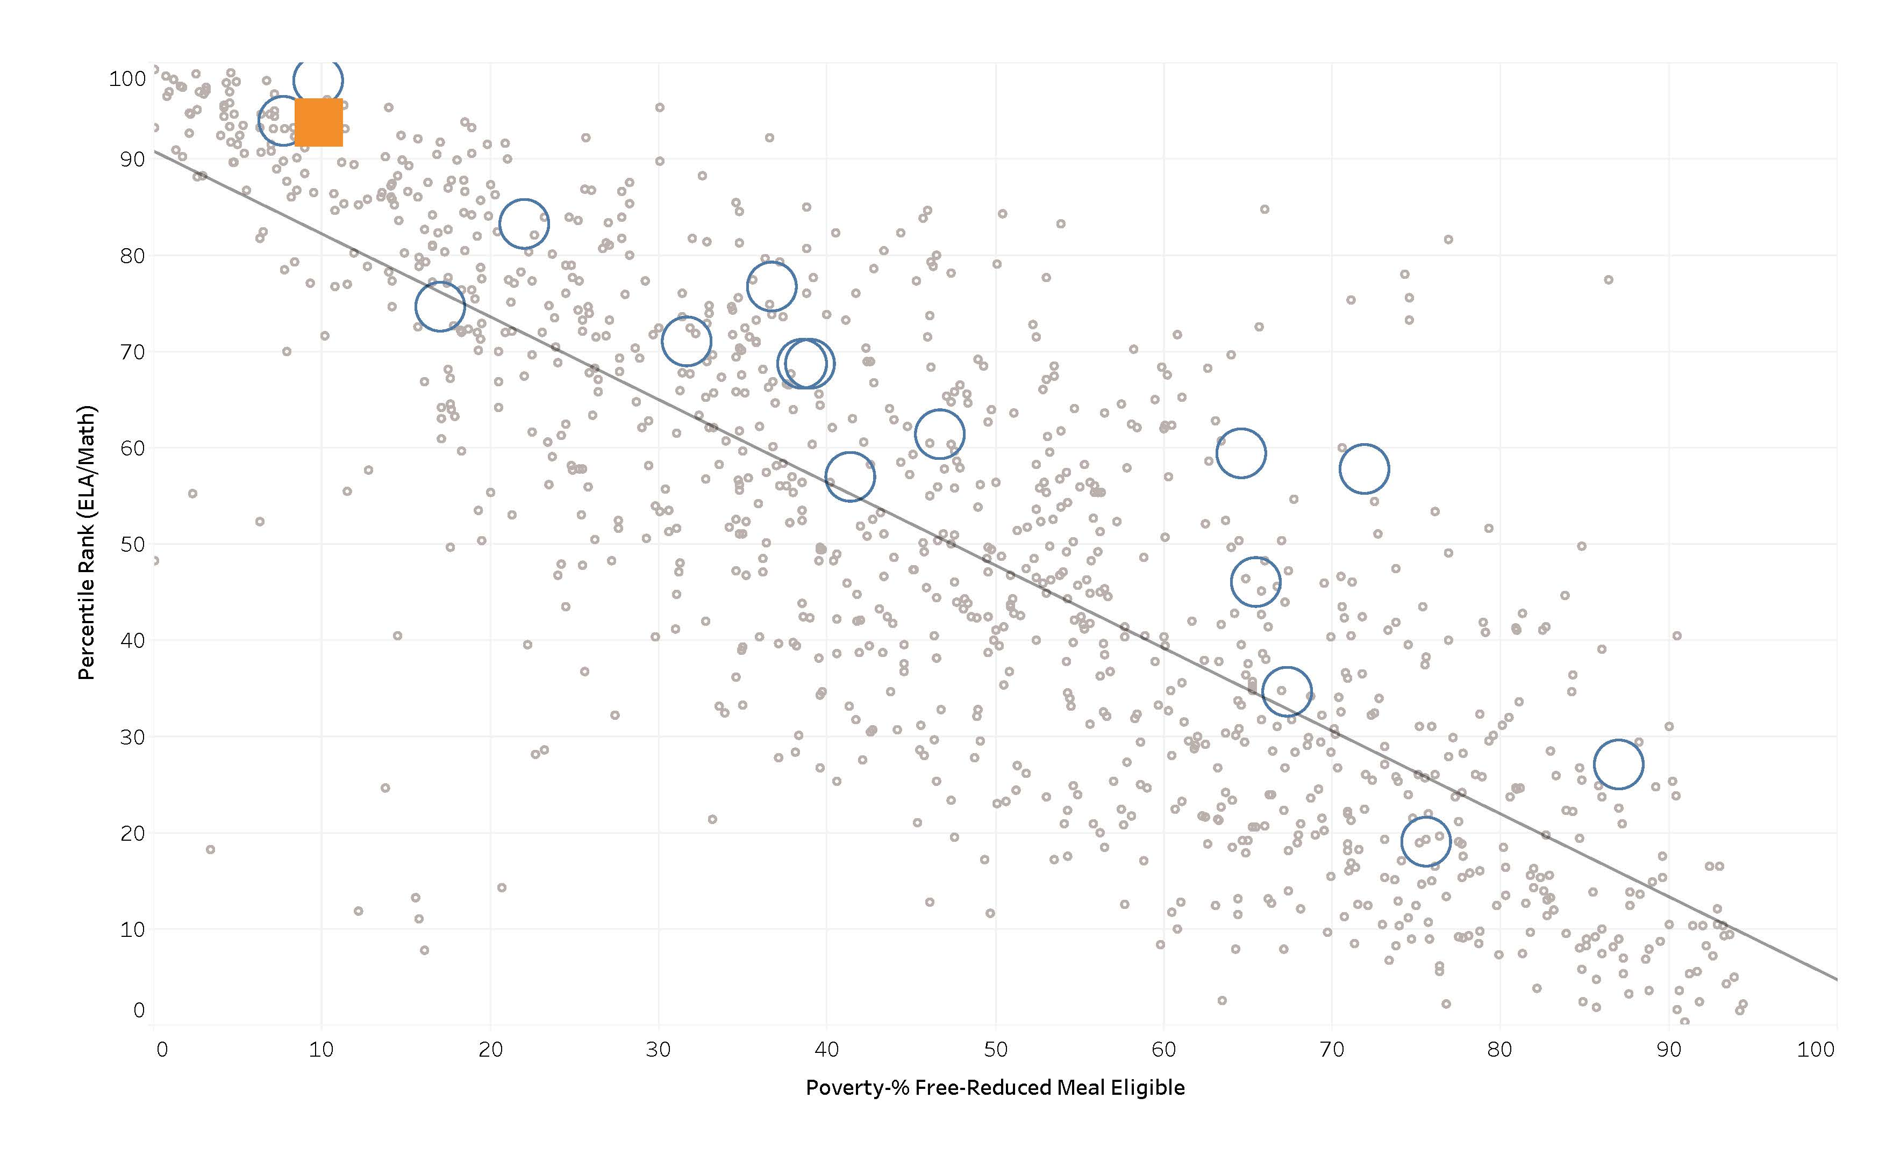
2017 Poverty vs. Percentile
WA Elem
Everett Elem
Building
Notes:
And another huge celebration. Mil Creek is in the top 5% of Washington Elementary Schools. We celebrate the lack of gray circles above us.

Slide 6


3rd Grade ELA
Notes:
Of the 30 students that did not pass, 23 were at Level 2 and 7 at Level 1. This is a large group for us. Focusing on reading performance in second grade will help prepare students for third grade. And access to iReady data currently gives us data for small group intervention.
Of the 23 scoring at L2, 5 receive sped services, 4 EL services, 1 is in HC and the others receive classroom or pull out support.
Jon and Lucus are sped students and scored at L1. Otoniel, Yutong and Vincent receive EL support. And Amelia and Lucas were in our reluctant readers group last year. They all continue to get pull out support this year.

Slide 7
4th Grade ELA
Notes:
Our fourth grade scores are certainly an area of celebration. We had a reduction in level 1s and 2s and increases in both levels 3 and 4. Looking at the students who are still in attendance, we have 6 special education students in this group. Three passed the assessment and Evan, Delaney and Austin did not. Mauricio, our only Hispanic student who did not pass is using iReady extensively this year.
Kael has some emotional needs and has his favorite teacher from third grade again. Ben is in our SIT/SPED referral process in need of more support than he is currently receiving. Brian is EL and has been on our radar since kindergarten. Kael’s problem is often a lack of desire. He has his favorite 3rd grade teacher again this year which is helping. Kaia is receiving pull out support. Ali’s family refuses services so we work with him in small group in the classroom. His sisters are both in college and his father has high regard for education, just doesn’t see Ali’s lack of skills at this time.

Slide 8
5th Grade ELA
Notes:
Our fifth graders did well last year. Our Hispanic students deserve recognition. I believe the drop in our special ed student performance is because of a teacher change. Many of our EL students are proficient by 5th grade. Of those that did not pass, 6 are sped, 3 EL, and two with attendance concerns. All received small group instruction and additional on-line support.

Slide 9
ELA Gender
Notes:
The interesting data here is that in 5th grade 100% of our females are at or near proficiency whereas only 90% of our boys are. Our new reading curriculum with the heavy emphasis on nonfiction should help.

Slide 10
ELA Growth
9
Students
Matched Cohort Growth
Notes:
We celebrate the progress students make the longer they attend Mill Creek. Looking at the low number of students, nine to be exact, below standard in 4th grade is a huge opportunity for our current 5th grade team.

Slide 11
3rd Grade Math
Notes:
Here we celebrate our special populations with the increase in sped, EL and low income. I attribute this to the rotations that take place in 3rd grade. Four students scored at Level 1, Youtong is a newcomer, Otoniel has received intervention for a couple of years now. Vincent struggles with language and academics and receives EL support. Manuela is a new concern. She has health concerns that can interfere with her learning, so we need to encourage her perseverance. Kellen, Autumn and Max see Janet for sped services in reading, Valeria gets help from EL, Lucas, Paton and Hailey received pull out services. Yesterday Hailey’s first grade teacher asked if she could tutor Hailey after school because it not only helps her academically, but helps get her to school.

Slide 12
4th Grade Math
90%
6
Std.
Notes:
90% of our students passed. Six did not, three of them are Hispanic and four receive special ed services.
Brian and Delaney have been on our radar since kindergarten. Mauricio was new to us last year and had a difficult time adjusting. He is making great progress with his teacher this year. Ben has not received services other than in the classroom, but is on our intervention list this year. Again, his teacher is being very proactive. Evan gets help from special ed. The sixth student is in our self-contained program.

Slide 13
5th Grade Math
Notes:
This group of Asian and Hispanic students did very well. As did our EL students. The longer students are at Mill Creek, the better they perform. We had a slight decrease in Level 4 and an increase in Level 1 to seven students. Many of the students who didn’t pass ELA also did not pass Math. 5 students were a surprise to us and very close to passing. 8 of the students received support from our part-time math teacher. Too bad there are not retakes for 5th grade.

Slide 14
Math Gender
Notes:
12 boys and 8 girls did not pass in 5th grade. One male and one female are Hispanic.

Slide 15
Math Growth
6
Students
Matched Cohort Growth
Notes:
Again we celebrate the growth from third to fourth and the opportunity that presents our current 5th grade. We can easily focus on six students who also did not pass ELA.

Slide 16
5th Grade Science
Notes:
16 students didn’t pass. These are mostly the same students that didn’t pass ELA and Math. You can see that they are sped and EL students. We did have 6 that passed the other assessments. These students need to further understand systems in science. Our new reading program with the heavy emphasis on Science and our work on vocabulary should be helpful.

Slide 17
Science Gender
Notes:
There is a slight gap, which could be attributed to written responses.

Slide 18
English Language Acquisition
12 Newcomers
Notes:
Last year we had 12 newcomers.

Slide 19
EES Staff Perceptions—2017
19
Notes:
We are pleased with the increase in staff responses which gives us more valid data. I plan to have a conversation with the leadership team about what monitoring teaching and learning means to them. When determining how much time we should spend on our responsibilities, Kristin and I made supervision and visibility a priority.

Slide 20
Resistance Factor, Change, Accountability
20
Notes:
When I talked with staff about being open to new ideas, their thought was that we are doing well and believe some are hesitant to change what is currently working.

Slide 21
EES Student Perceptions—Longitudinal
21
Notes:
We believe these results are because students took the survey in computer lab and not with their classroom teacher.

Slide 22
EES Parent Perceptions—Longitudinal
22
Notes:
Kristin and I are determined to get a better response this year!

Slide 23
STATE OF SCHOOL REVIEW
Everett Public Schools
Mill Creek Elementary

Slide 24
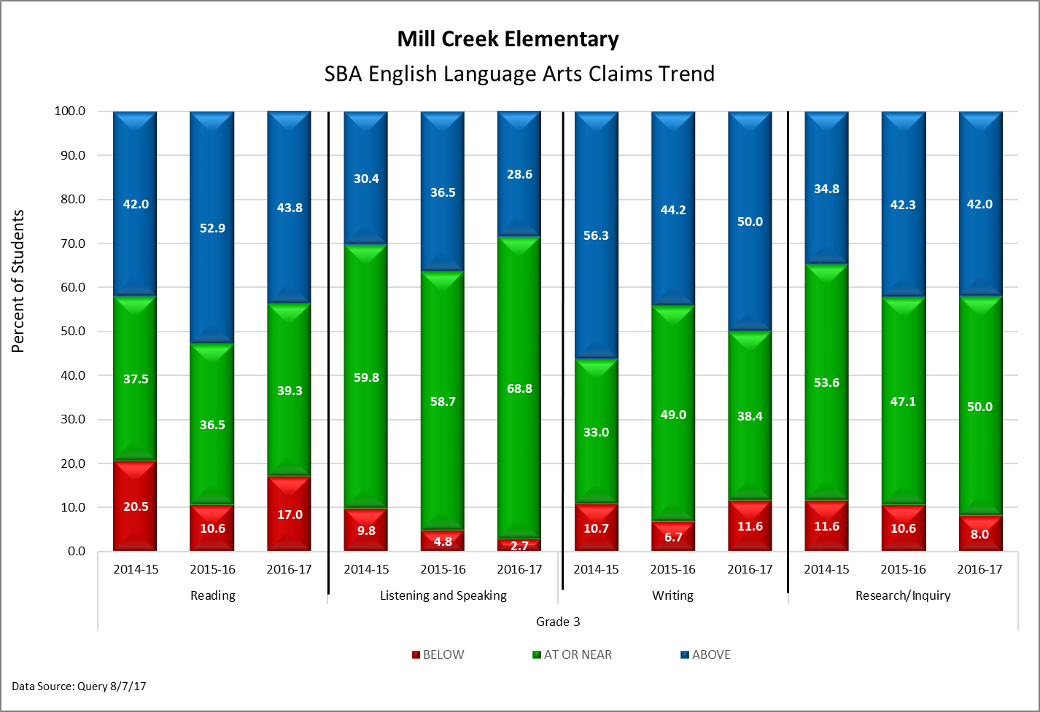
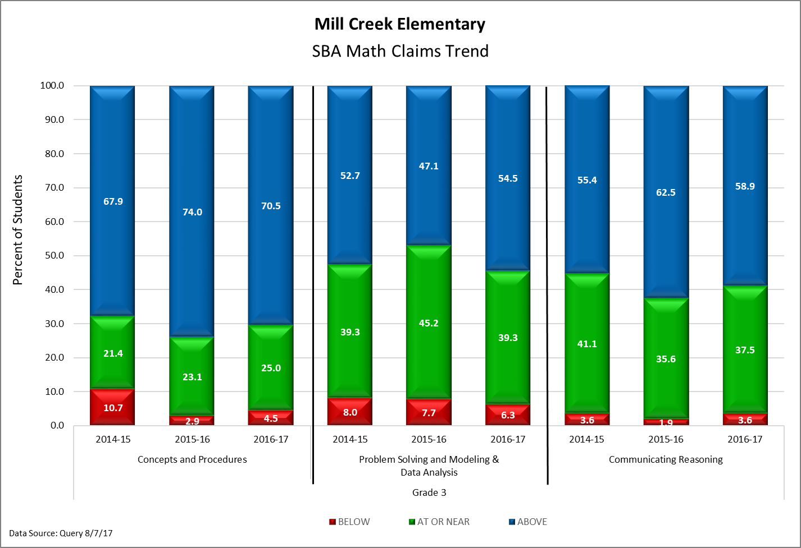
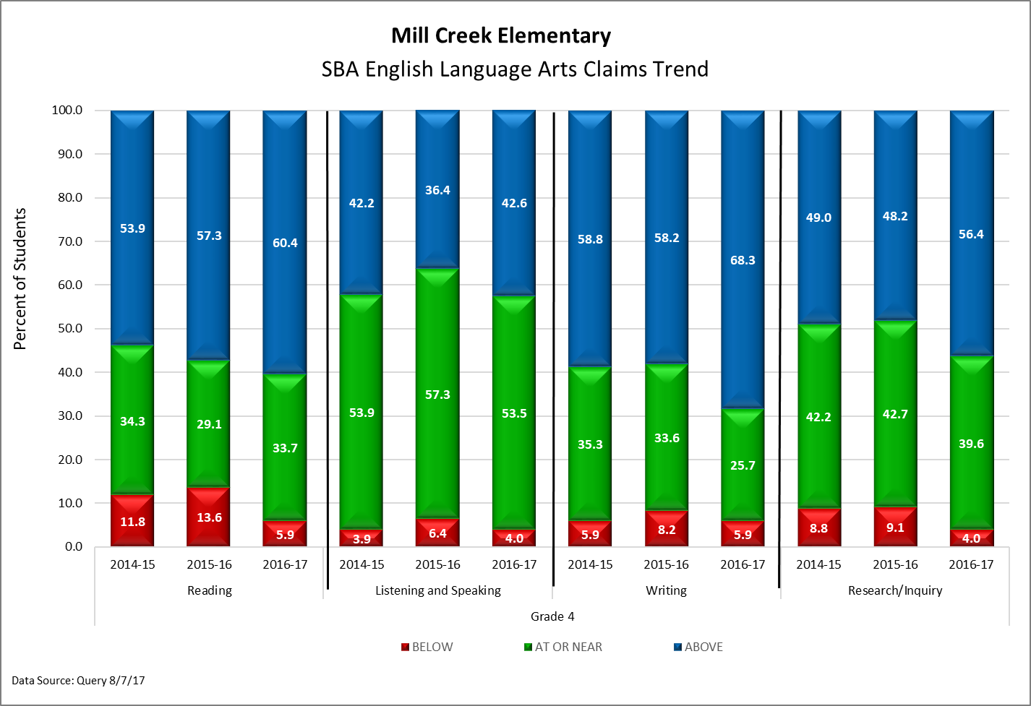
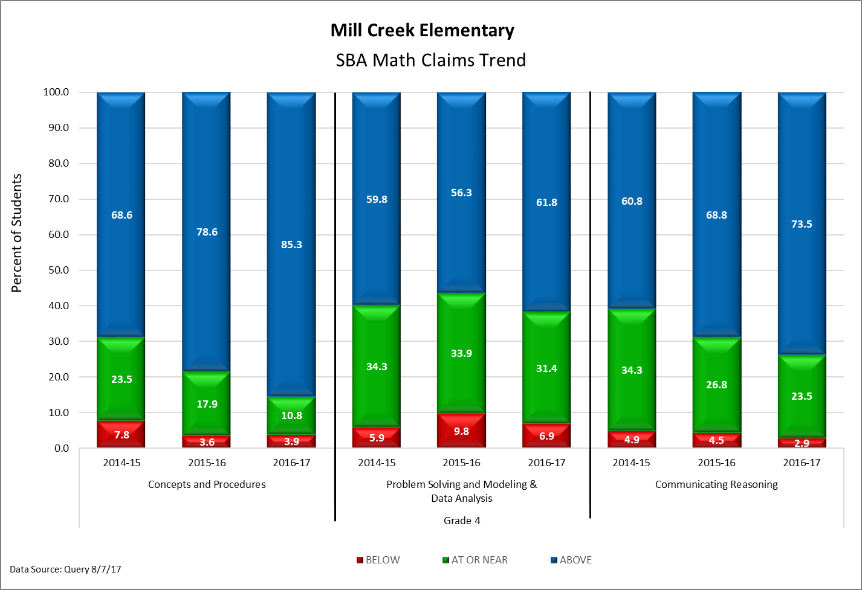
SBA Claims
3 Year Trend
Notes:
You will hear from the content teams how we use this information to determine our SIP goals.
Last year we focused on listening and speaking. These results show our success. Our focus in math was problem solving, which shows success, but still an area of need.

Slide 25
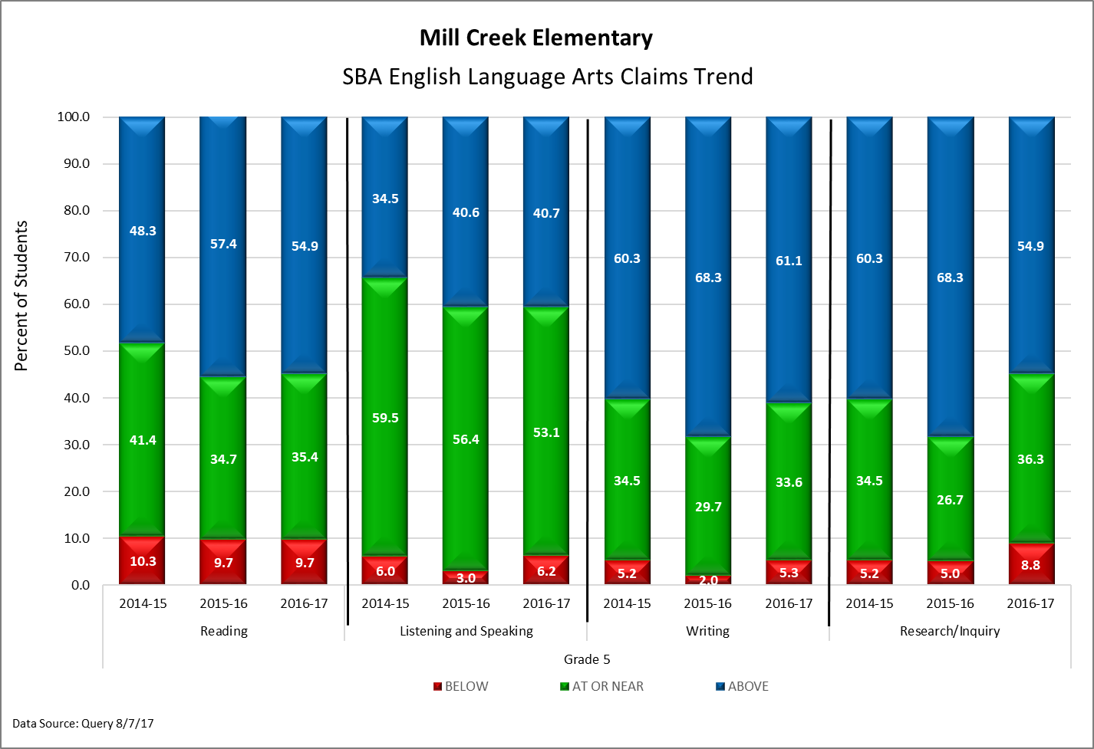
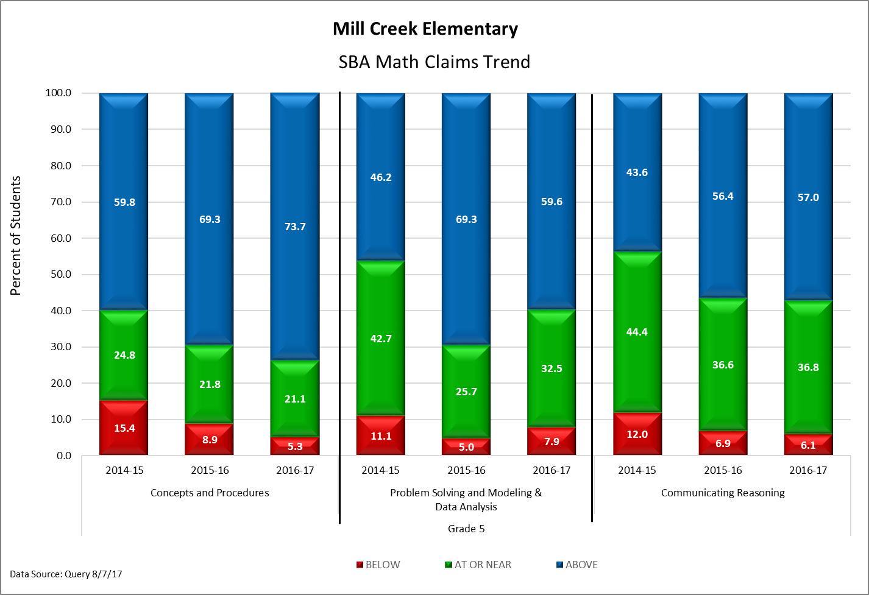
SBA Claims
3 Year Trend

Slide 26
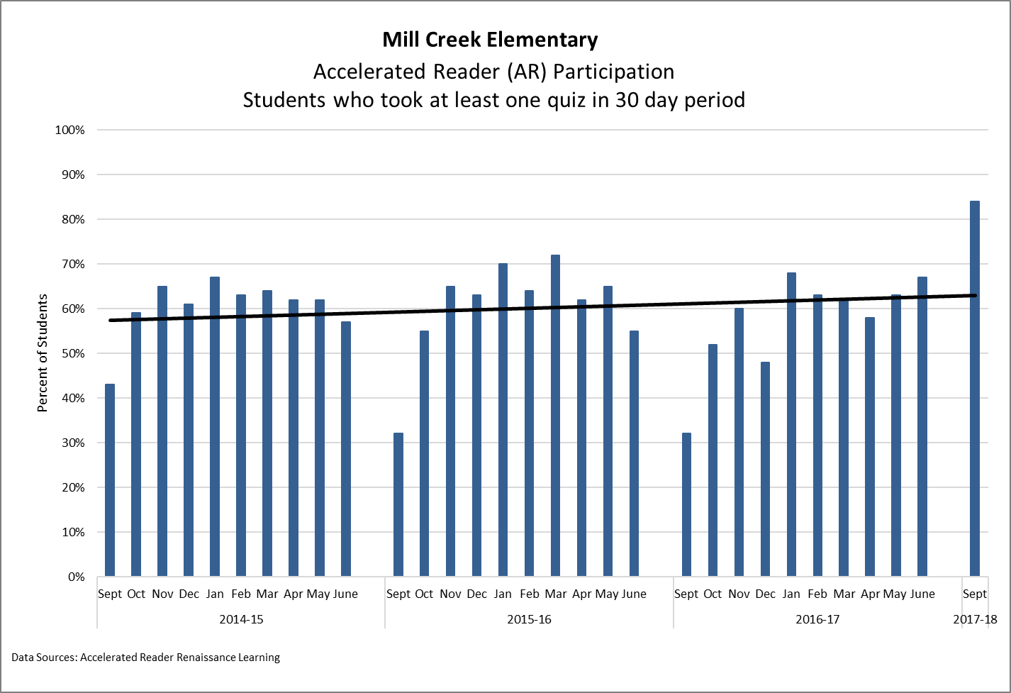
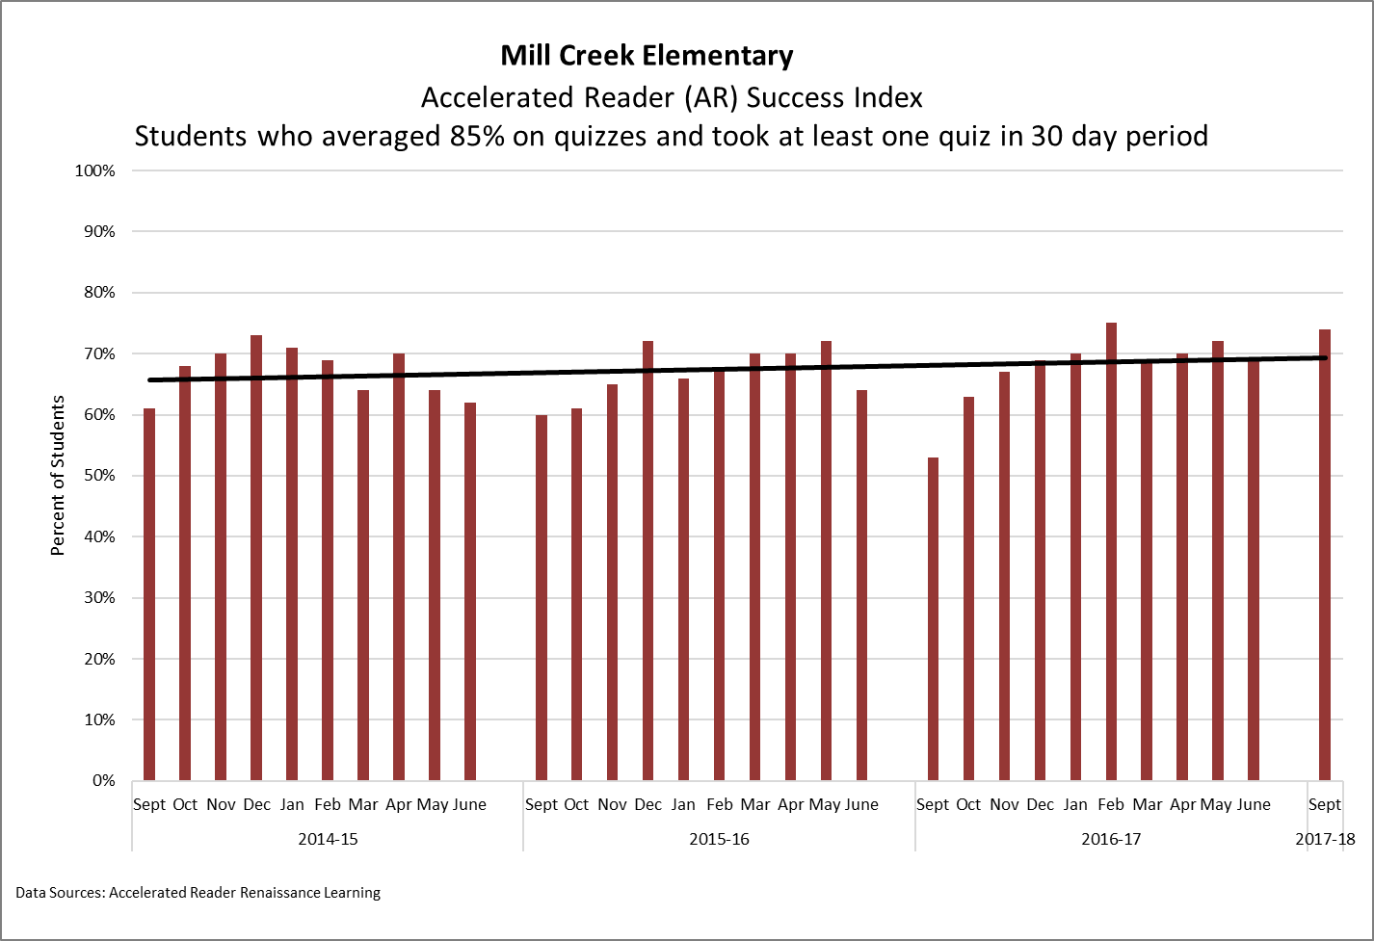
Accelerated Reader Data
Notes:
You will hear more about AR in the ELA rotation. What is most important here is the September data.

Slide 27
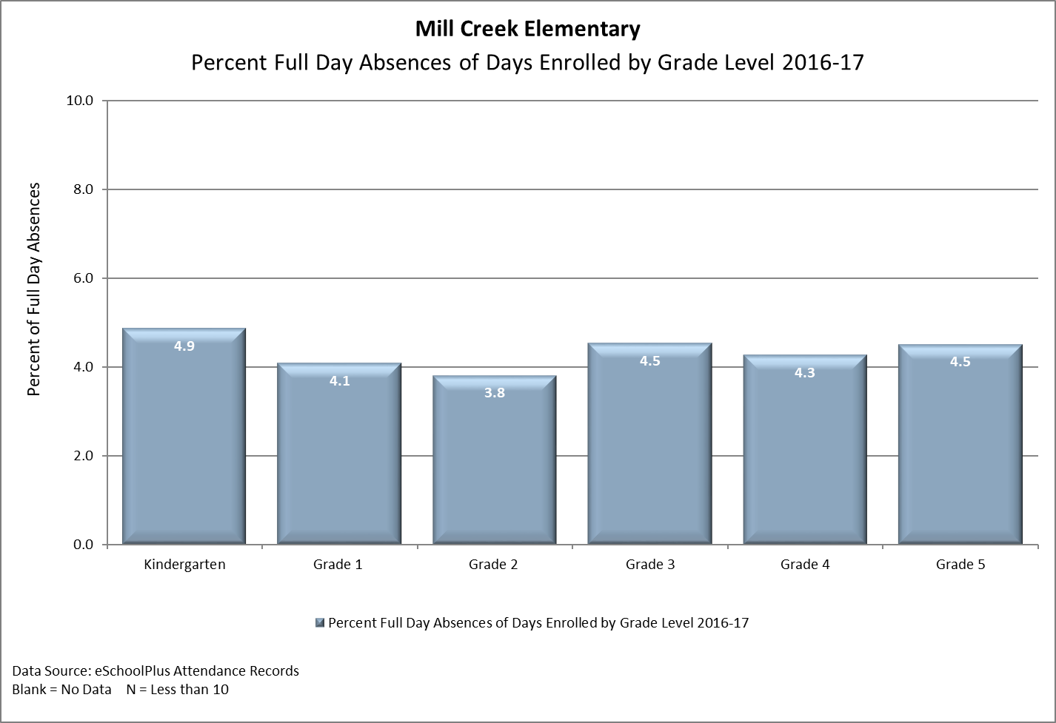
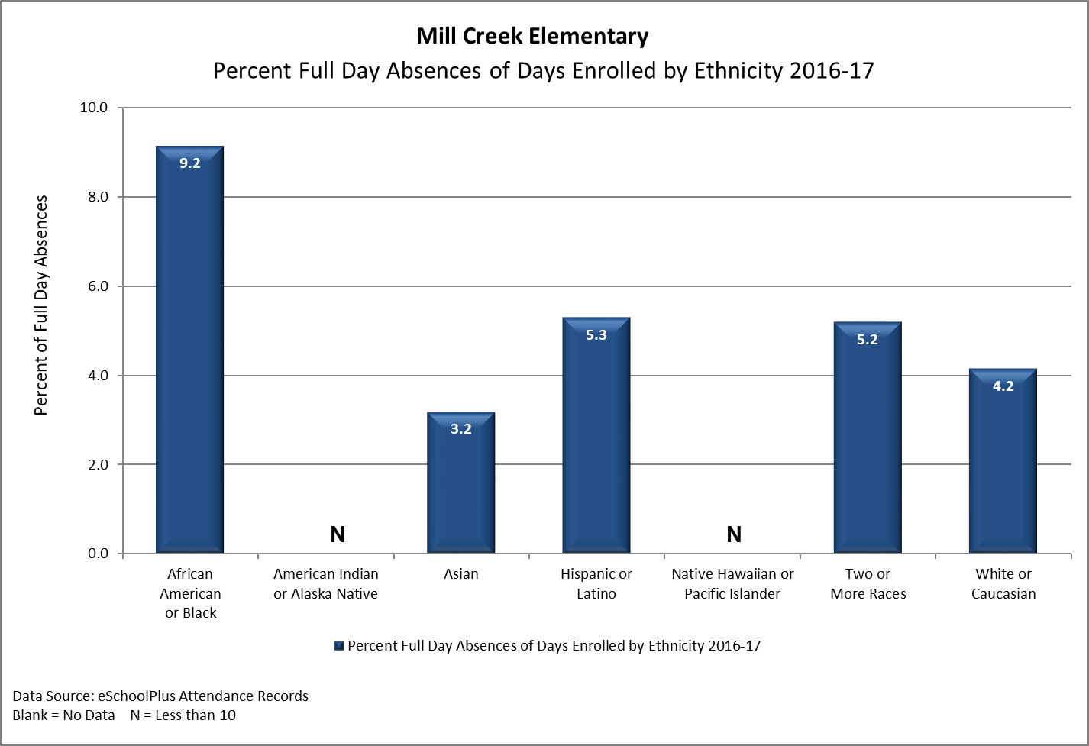
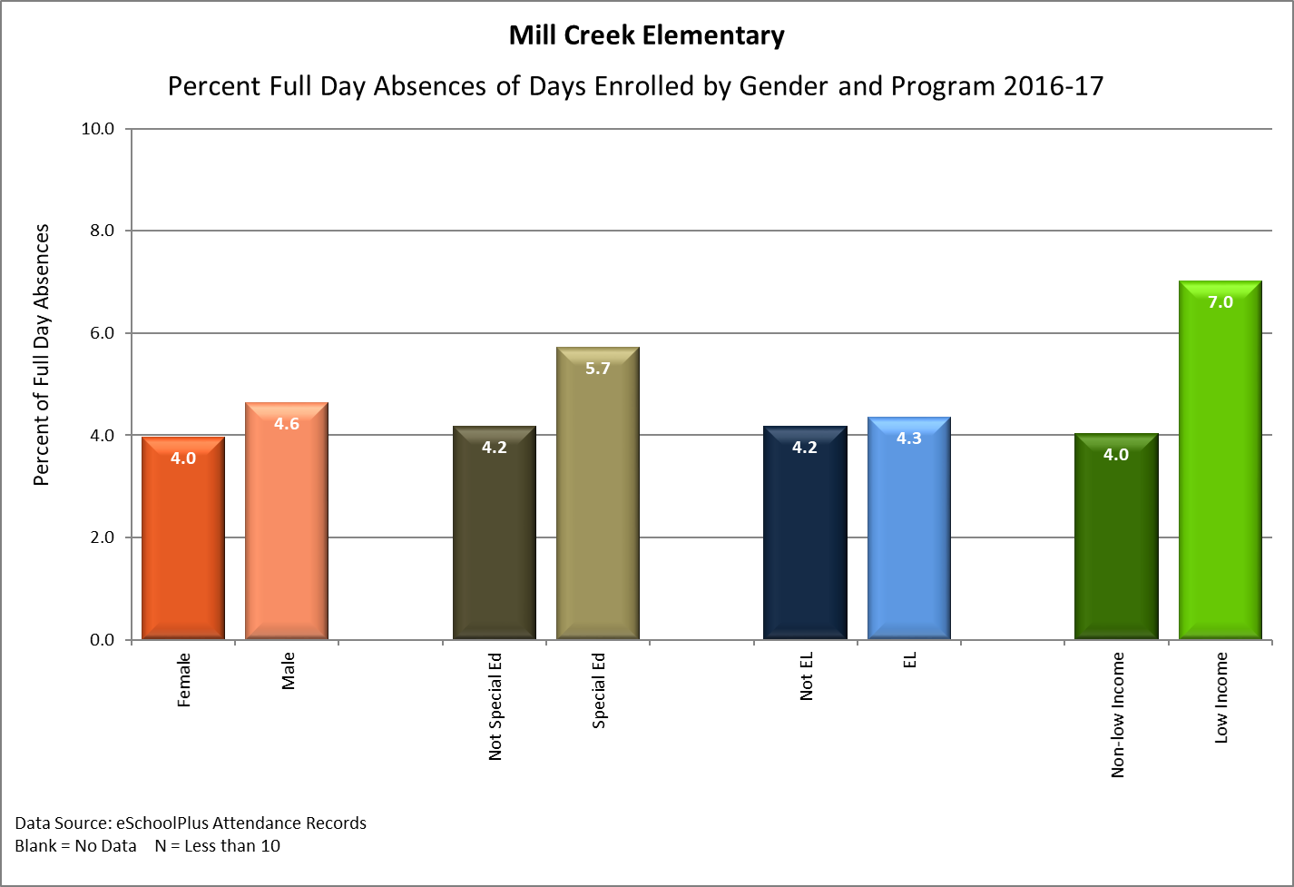
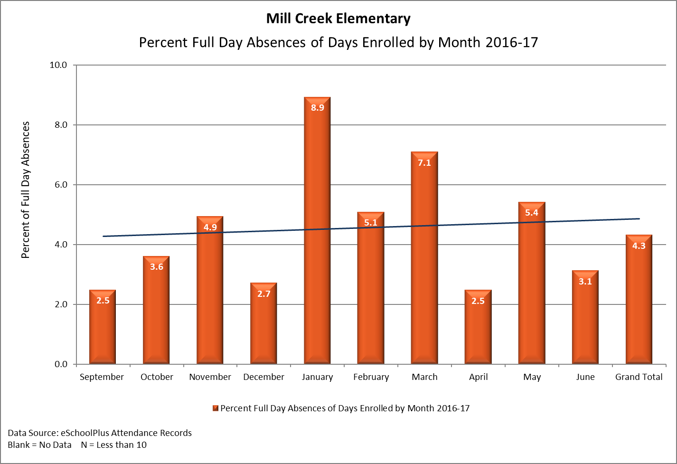
Attendance Data
Notes:
Kristin and Nicole will talk about our attendance efforts later in our presentation.

