Slide 1
“JHS CONNECT”
Jackson High School’s very own app!

Slide 2
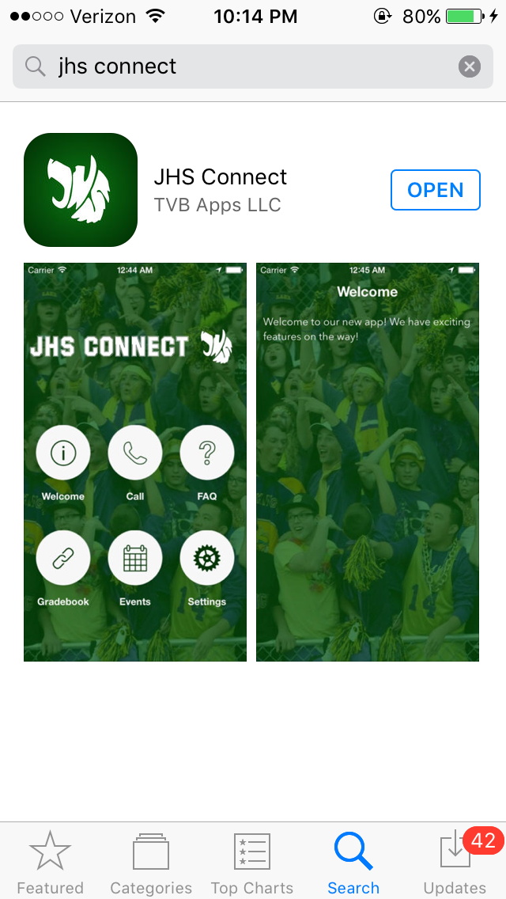
How do i get this?
It is free on the app store! Type in
“JHS connect”
Who is it for?
Students
Staff
Parents
Future JHS Students

Slide 3
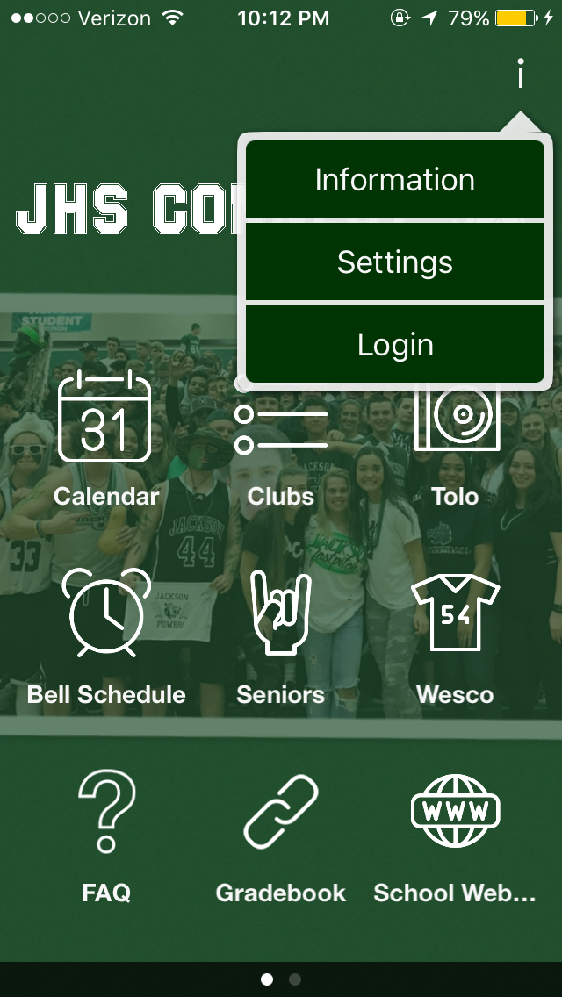
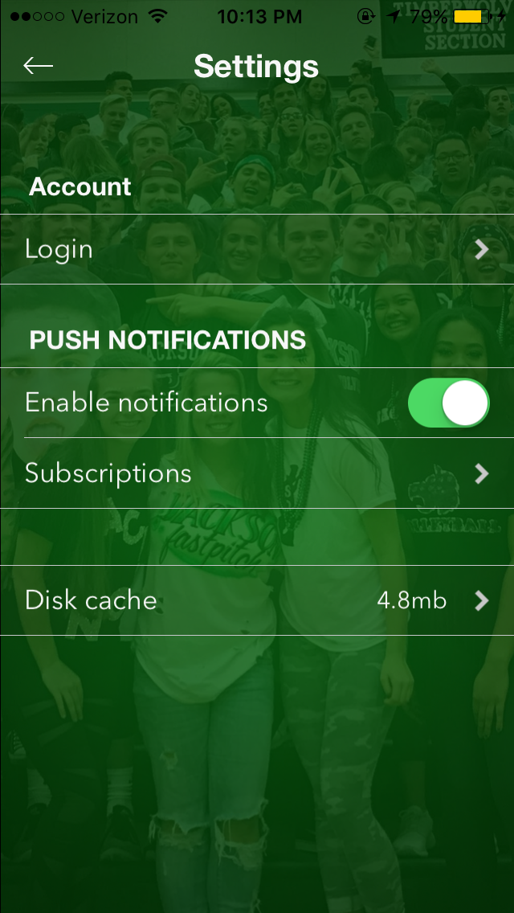
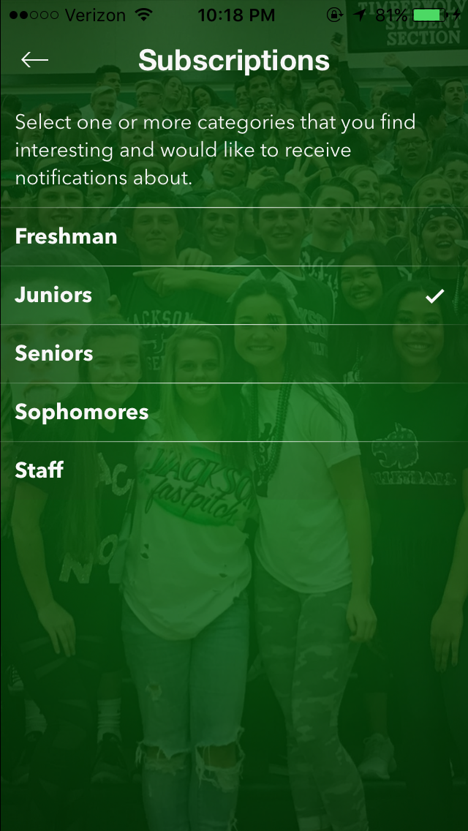
What does it do?
This can send out notifications from admin that notify you regarding important info.
Ex: Juniors SAT this week, or Seniors don’t forget money, cap and gown payments due today!
Download the app
Click the top right and choose SETTINGS
Click Subscriptions
Choose your current grade to start receiving notifications from Mr.Peters

Slide 4
What’s on it?
….YOU WILL HAVE TO EXPLORE IT FOR YOURSELF
ENJOY!

