Slide 1
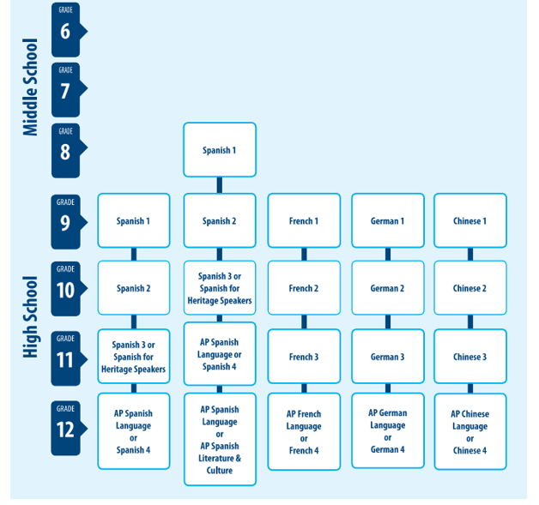


Notes:
These pathways reflect course sequences most students follow, and the recommended course sequence for language study is Level 1, Level 2, Level 3, and then the Advanced Placement course in that language.
Please note that Heritage Speakers with higher levels of proficiency in Spanish may take Spanish for Heritage Speakers in Grade 9.

