Slide 1

Frontline Fit Assessments
Overview Presentation
Applicant Tracking & Assessments
November 15, 2017
Presented by:
Mr. Jim O’Halloran
Dr. Lowell Ghosey

Slide 2
Frontline
Pre-Screening Assessments
Take the guesswork out of selecting the best fit

Slide 3
Fit Assessments in Context
?
?
?
?
?
?
?
?
?
?
?
?
?
?
“Top of the funnel” initial screening tool focused on narrowing large numbers of applicants
Designed to improve the probability of inviting best applicants into the interview process
Intended to be one important factor in selection; not the only factor.
Notes:
So what are AppliTrack Fit assessments all about ?
Top of the funnel, to start the process
NOT only factor in selection

Slide 4
Dimensions of Each Assessment
AdminFit | JobFit | TeacherFit | TeacherFit SE
Interpersonal Skills Judgment and Decision Making Learning Partnerships Multiculturalism Identifying Talent Team Leadership Time Management Leadership Style Optimism Service to Others | Cultural Competence Ease of Supervision Flexibility/ Openness to Change Interpersonal Skills Reasoning/ Cognitive Skills Reliability Stability/Stress Tolerance Student Focused | Fairness and Respect Concern for Student Learning Adaptability Communication and Persuasion Planning and Organizing Cultural Competence | Interpersonal Skills Communication Motivation Behaving as a Role Model Working Through Classroom Complexities Passion for Special Education
Notes:
Each Fit assessment as you can see, measures various dimensions. These have been researched both in educational literature as well as in-person interviews with hiring managers, and statistically validated so that you can have confidence in the results.
The applicant’s report provides both an overall score, as well as various dimension scores
This gives a better, more detailed look into the applicant, and sometimes those dimension scores are key in selection decisions

Slide 5
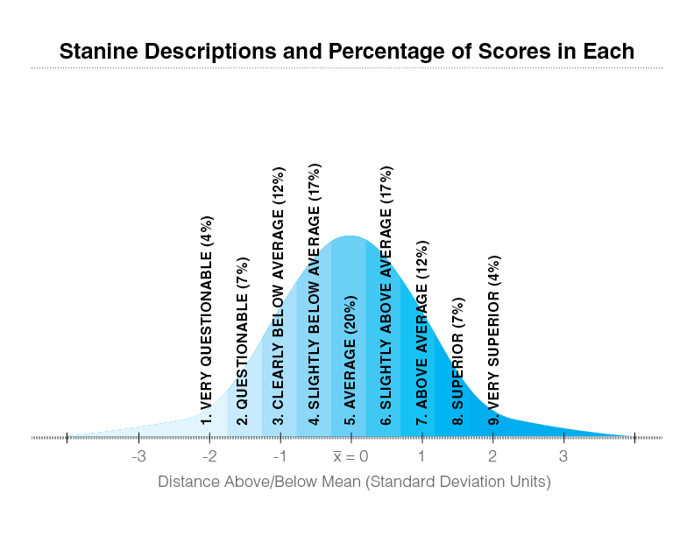
54% of respondents’ ratings
The assessments are continually validated as a means of DISTRIBUTING scores, not tied to a list of “single-best correct” answers (as some other products currently do.)
Notes:
5
All overall & individual dimension responses are put into stanine scores from 1-9, distributed across a normal bell curve, with 9 being highest probability of success.
So only about 4% of your applicants would score at a 9 level, matching known high performers for instance.
With most of your applicant scores falling in the center of a normal distribution (4-5-6) you can start your review of all applicant materials at whichever score level or above that you prefer.

Slide 6
The Candidate Reports:
TWO administrative tools
Summary Report
  A table with graphic profile of dimension sub-scores(represented on 1-9 stanine scale)
  Definitions for each dimension
  Score & dimension interpretation paragraphs
Interviewer Report
  A table profile summary of dimension sub-scores (represented as “High”, “Average”, “Low”, etc.)
  Two suggested interview questions for probing further on each dimension
  Items are custom selected based upon the candidate’s score rating
Notes:
Two reports are provided-- not just one total score as we know some others do—
Score summary
Interviewer report

Slide 7
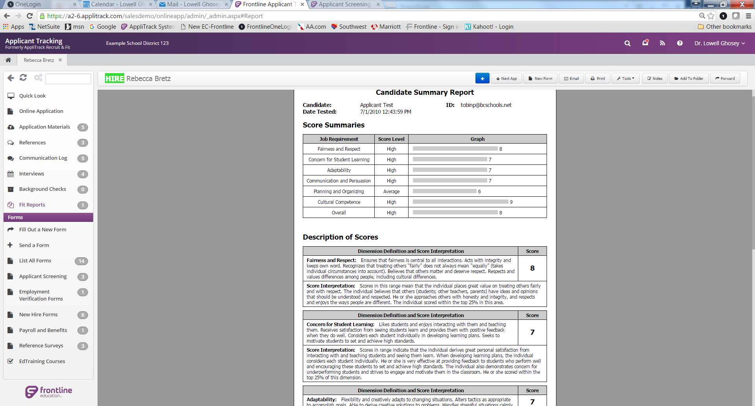
Notes:
This is a sample score report screenshot. At the top is a summary of each dimension, and the overall rating. The scores are determined by groups of the assessment items asked, so each dimension will have several items for which the responses make up this dimension score. As an example, Fairness and Respect might have been a focus on 6 or 8 items.
In the Description section, each dimension (like Fairness and Respect) is defined as used in this assessment, then to the right is how the person scored (1-9).
The Score Interpretation paragraph will differ with the score.
This simple format is easy for reviewers to understand, and doesn’t require the cost of having a trainer come on sight to help interpret the results !

Slide 8
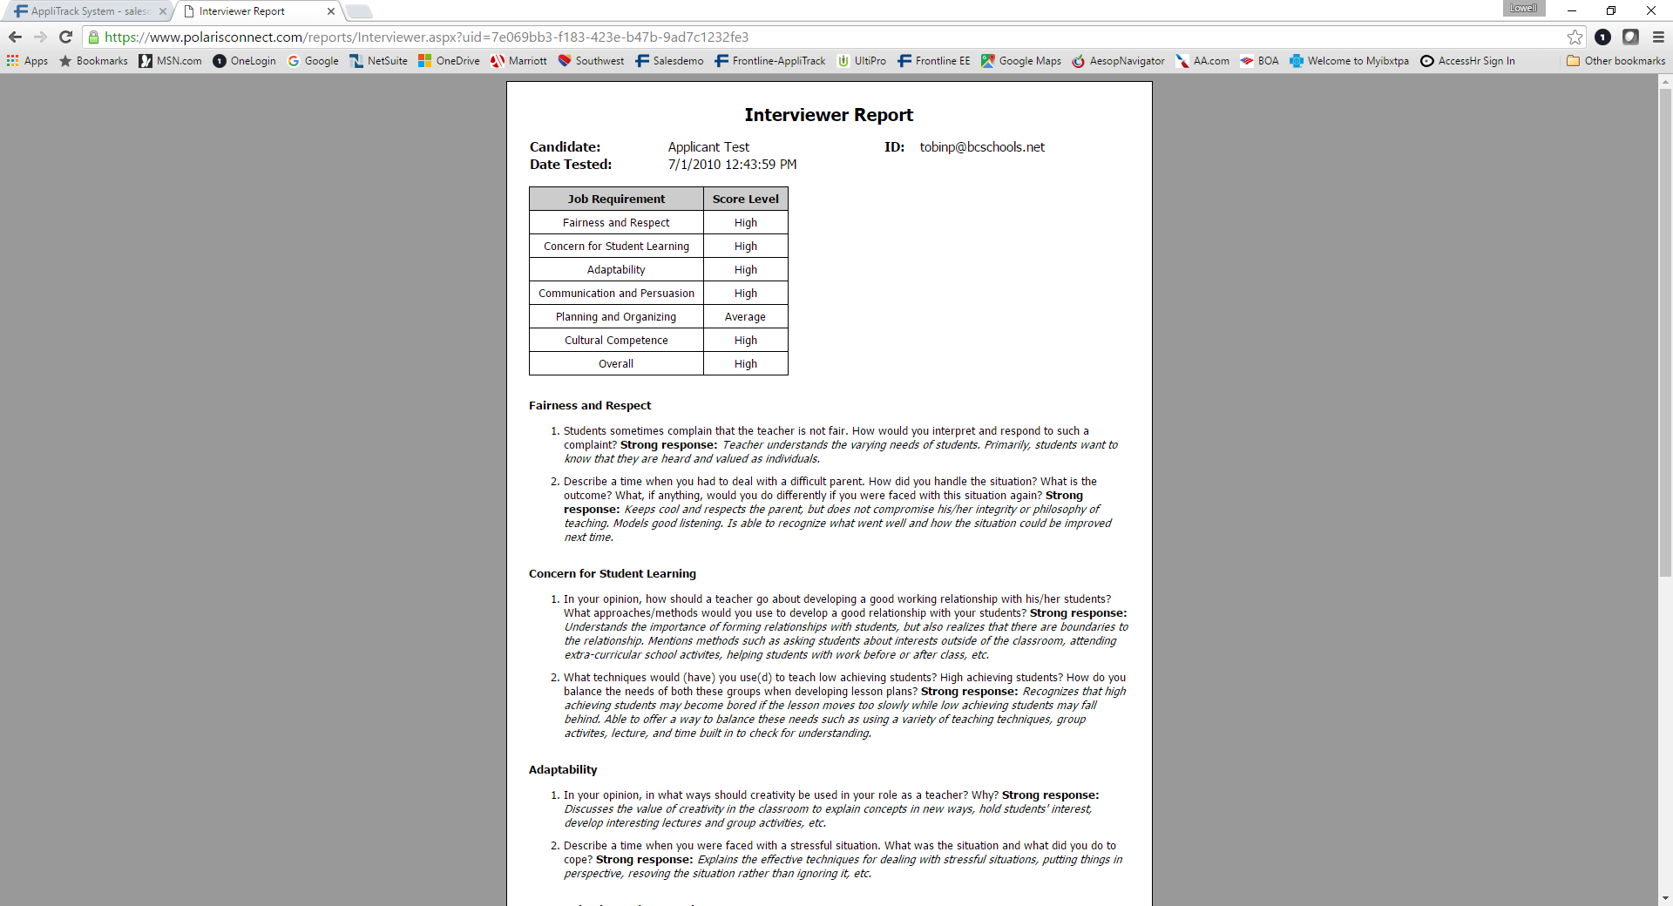
Notes:
Interviewer report
Provides questions for use in interviews, taken from the sub-dimensions where the applicant scored lowest in each dimension topic

Slide 9
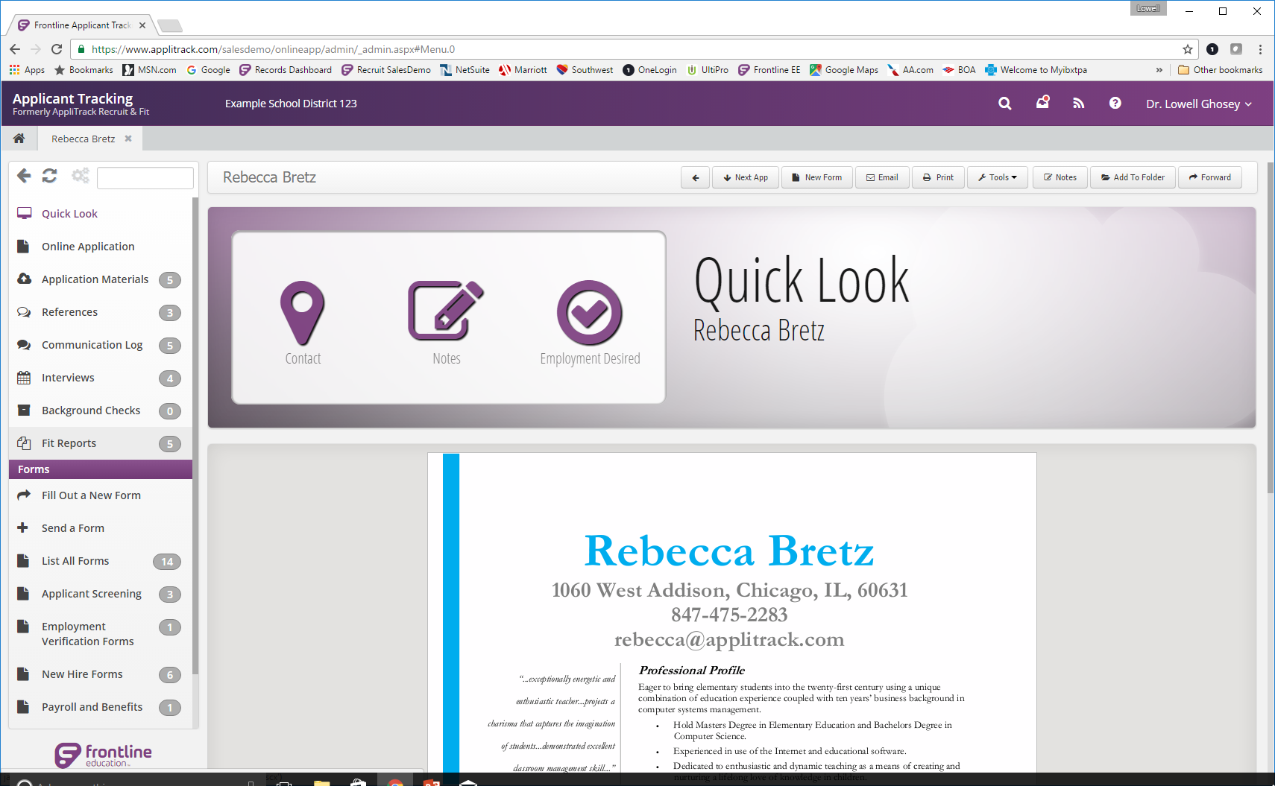
Notes:
These scores can be found on each applicant’s profile….

Slide 10
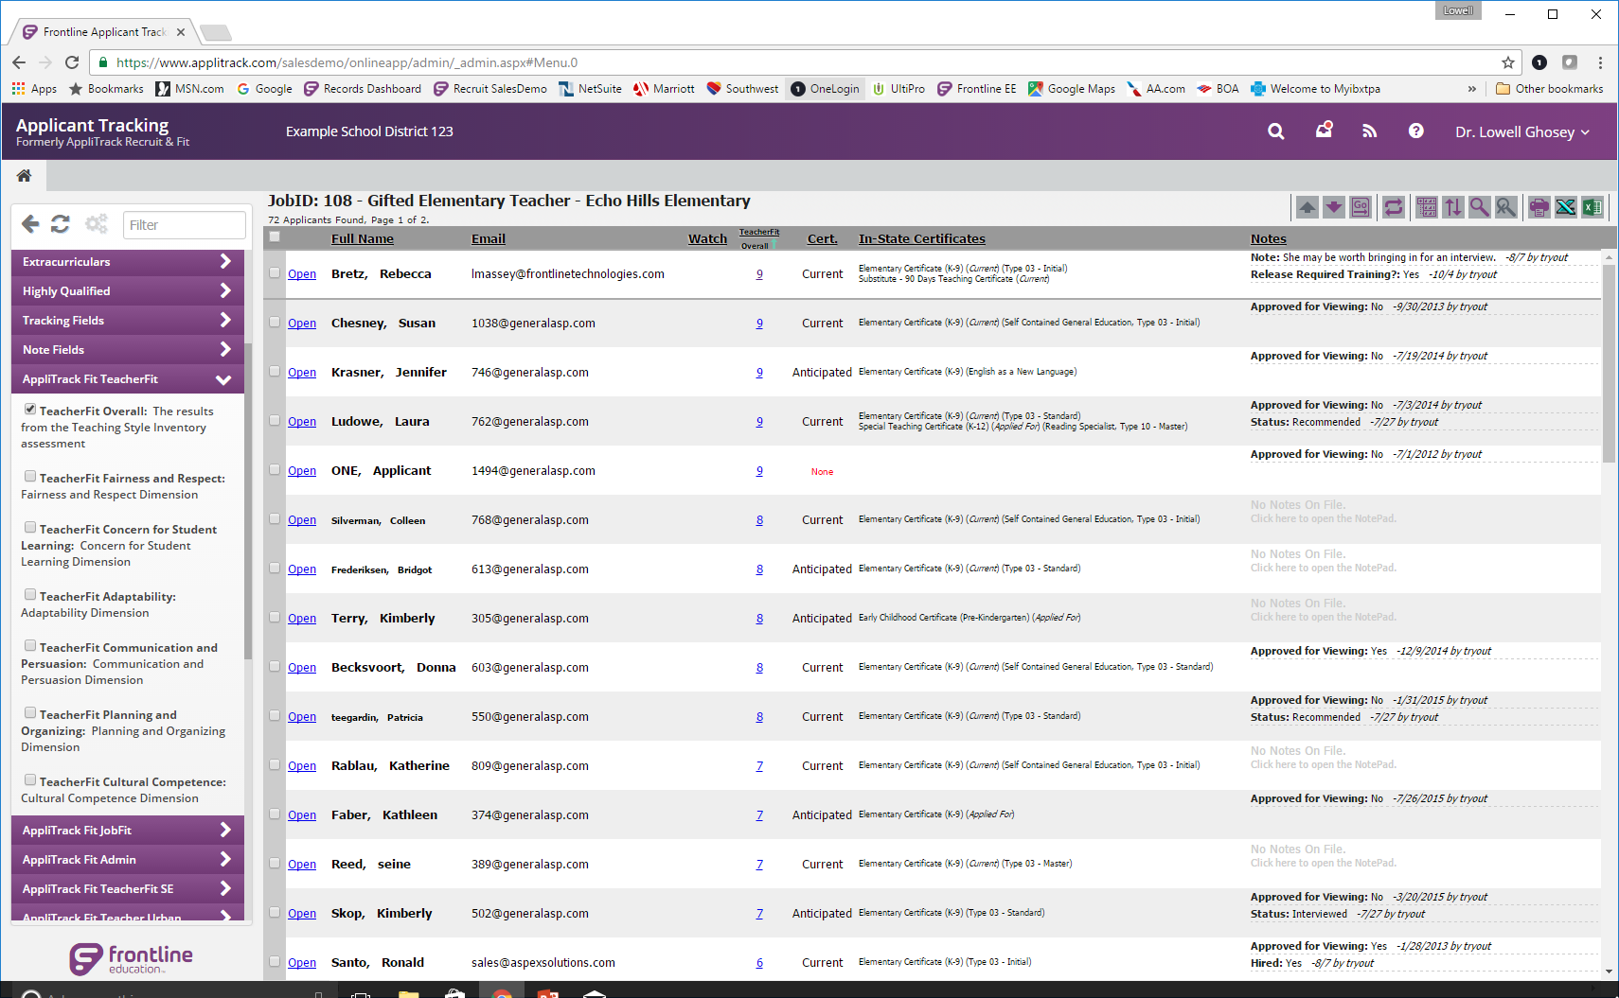
Notes:
Notes to presenter:
…Or scores can also be seen when looking at any applicant group is if desired
This slide shows how applicants can be quickly sorted by scores from 9 downward, in one click on the category label at top of the column.

Slide 11
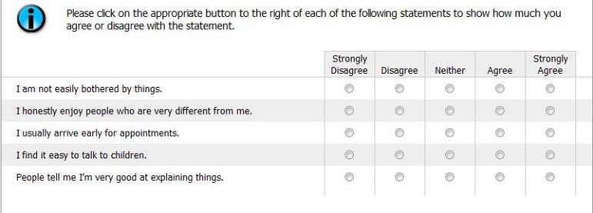

JobFit - Sample Question #1

Slide 12
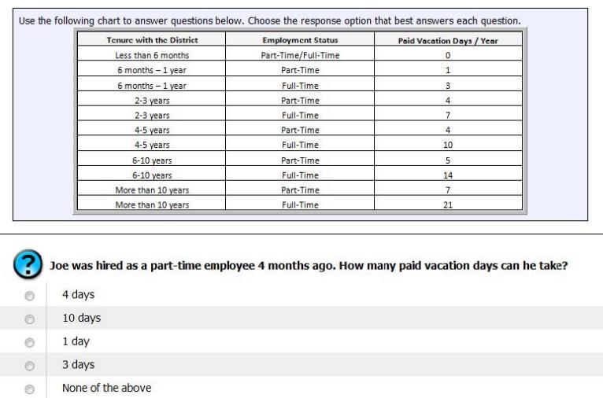
JobFit - Sample Question #2

Slide 13
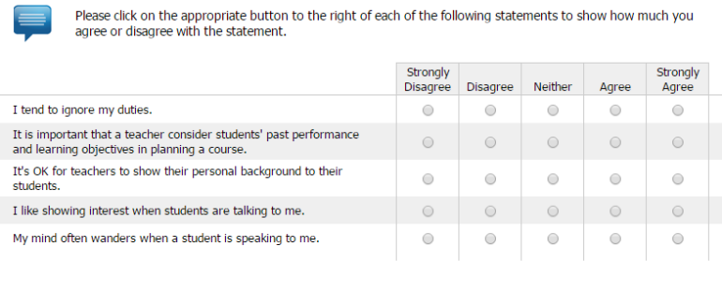
TeacherFit SE - Sample Question #1

Slide 14
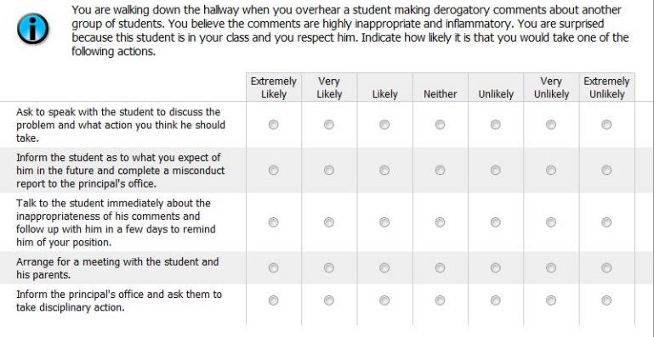
TeacherFit - Sample Question #2

Slide 15
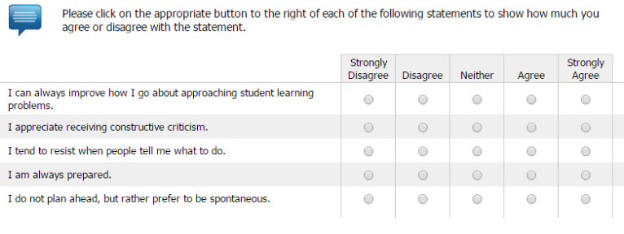
TeacherFit SE - Sample Question #2

Slide 16
Danielson Crosswalk with
TeacherFit Assessment

