Slide 1
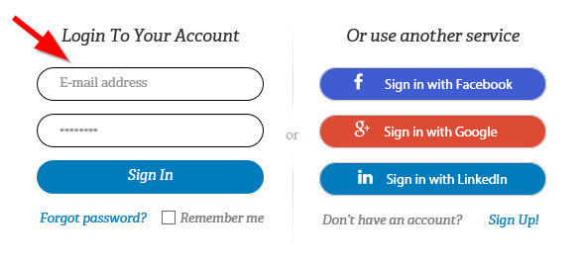
IMAGO Login Instructions for
STUDENT ACCESS:
Website: https://go.weareimago.com
Enter your everettsd.org STUDENT email address
Password: jackson

Slide 2
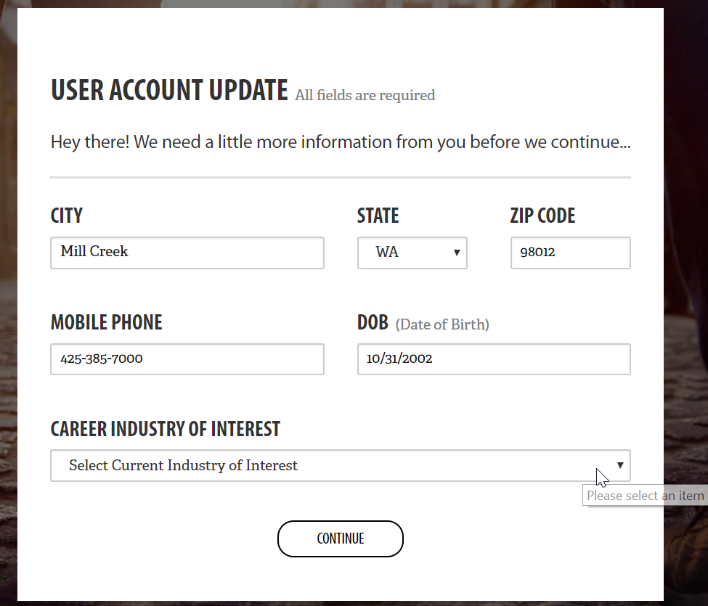
-Click on CAREER INDUSTRY OF INTEREST
-No need to change any contact info—this is JHS’s phone / address
-Please DO NOT change your EMAIL or PASSWORD for this account

Slide 3
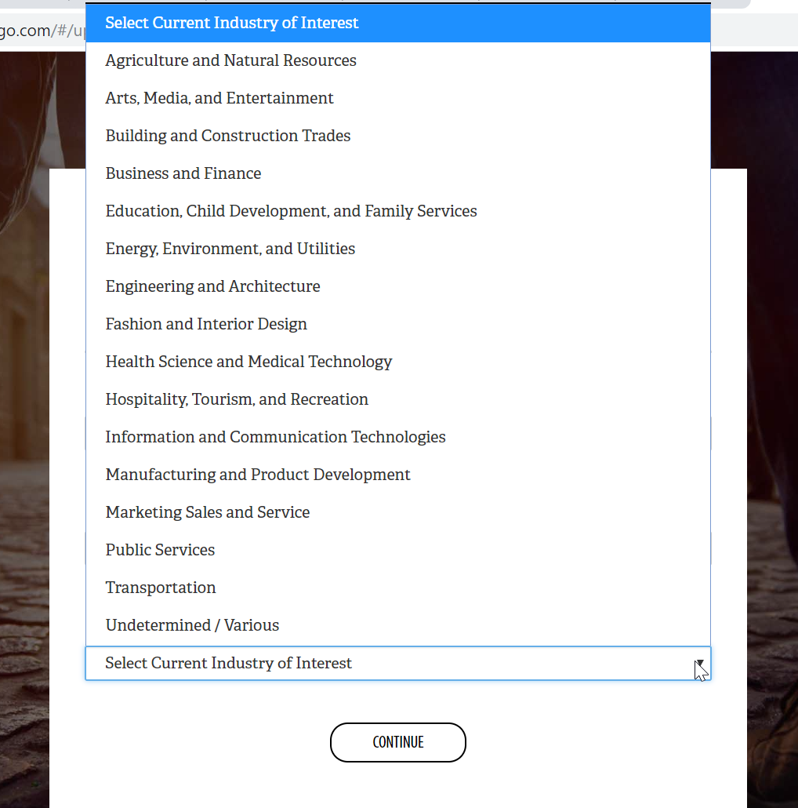
-Select a Career Industry of Interest from the drop-down box
-This can be “Undetermined / Various” (last option)
-Click CONTINUE

Slide 4
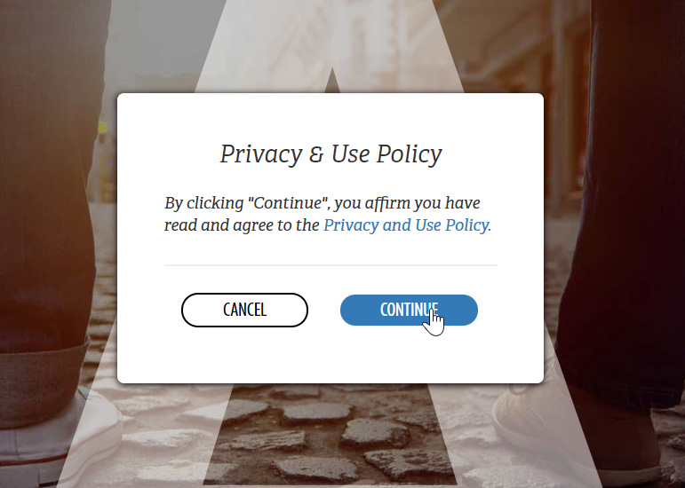
Confirm the Privacy & Use Policy by clicking CONTINUE

Slide 5
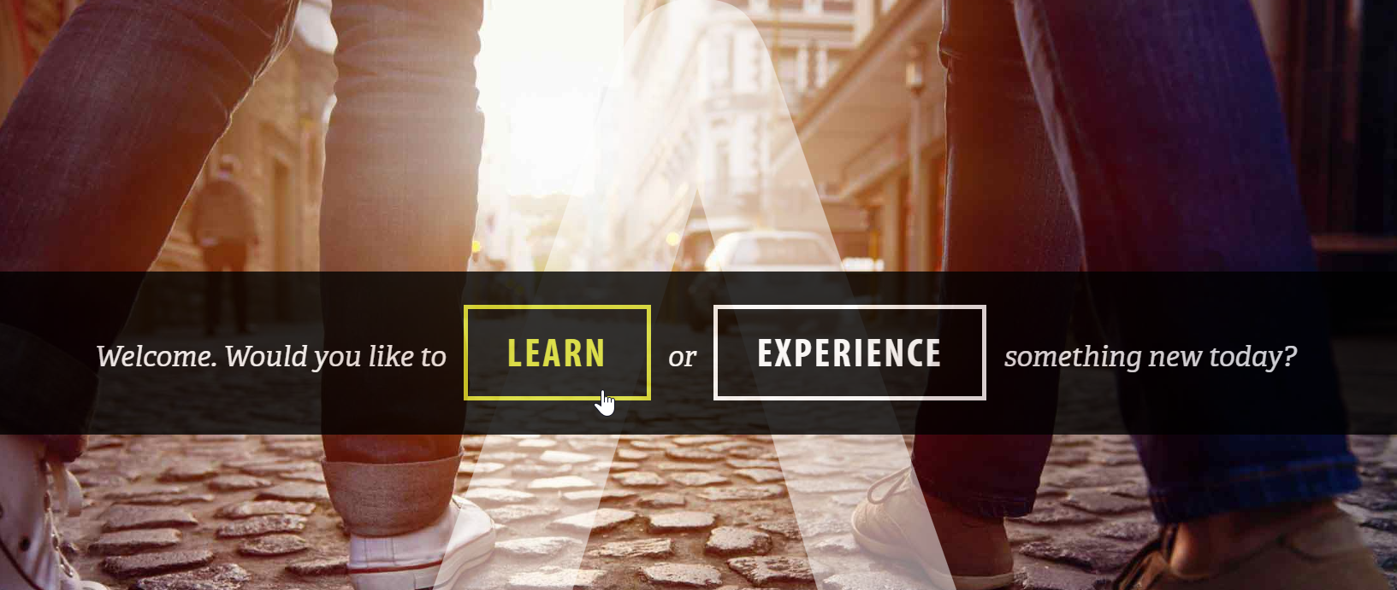
Choose LEARN

Slide 6
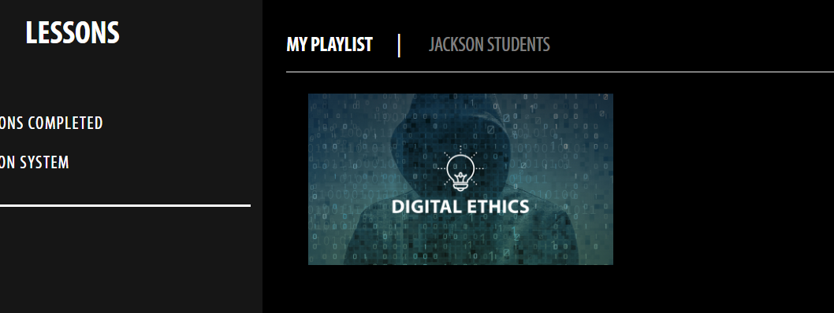
Click on assigned lesson under
MY PLAYLIST or under JACKSON STUDENTS
-This week’s lesson is DIGITAL ETHICS

Slide 7
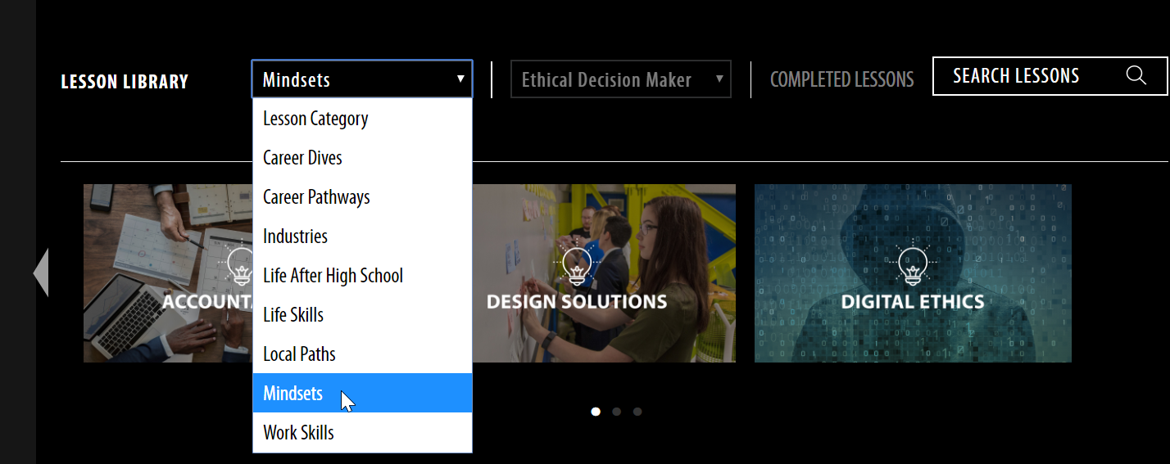
OR Go below to LESSON LIBRARY and choose:
-LESSON CATEGORY: Mindsets
-LESSON SUBCATEGORY: Ethical Decision Maker
-LESSON: Digital Ethics

Slide 8
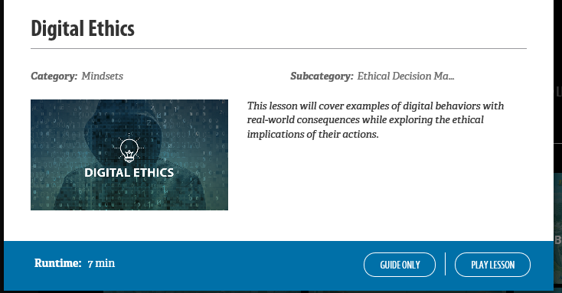
Choose PLAY LESSON to start

Slide 9
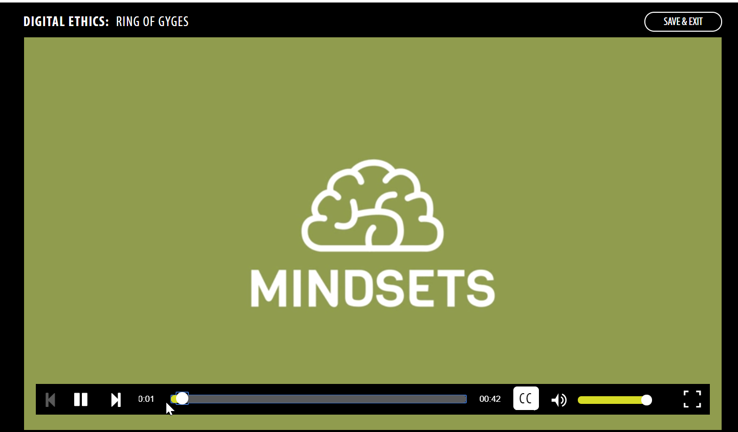
PLAYING THE LESSON:
THE VIDEO SEGMENTS

Slide 10
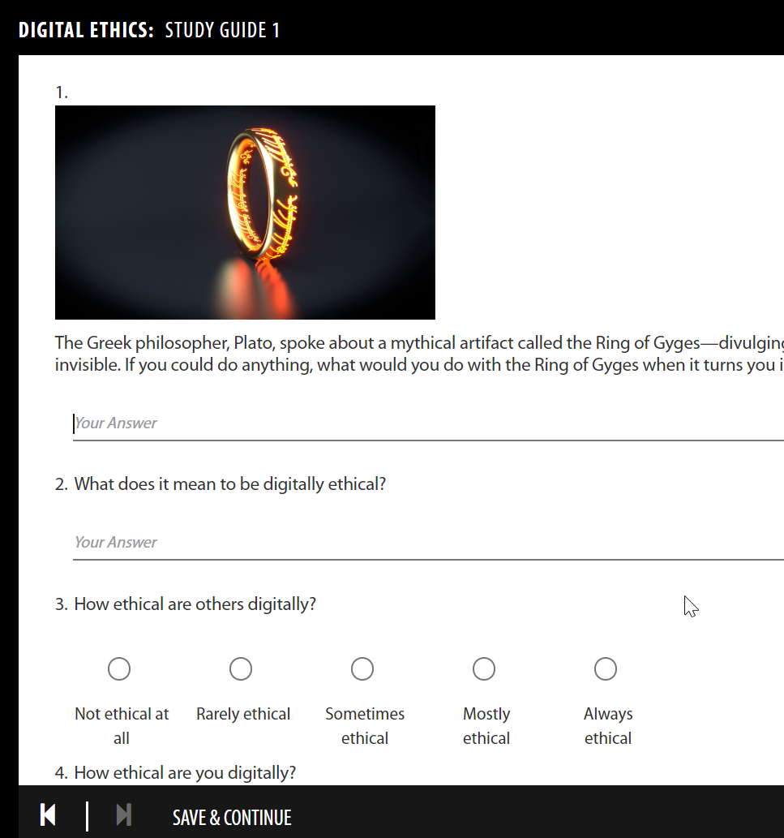
PLAYING THE LESSON:
THE STUDY GUIDES
You MUST type some text (even just a few letters) and click on answer choices as you go through the STUDY GUIDE in order to access the SAVE & CONTINUE button to move forward in the lesson

Slide 11
COMPLETING THE LESSON
Play all the VIDEO SEGMENTS and STUDY GUIDES of the lesson.
You can use the back button to replay any selection you choose.
You don’t have to move forward to the next video segment until the class has finished discussing the first segment and related questions.
It’s okay to expand the discussion as relevant to your class!

