Slide 1

Welcome To Cedar Wood.
Open Google Classroom to access all PDF handouts.
Grab a cup of coffee.
Enjoy our story.
Notes:
Bruce opening.

Slide 2
Group 1 (Library Main- Math & Reading)
Dr. Gary Cohn
Director Carol Andrews
Dr. Joyce Stewart
Alice Chao
Group 2: (Library Front- MTSS)
Dr. Sally Lancaster
Heather Brown
Anne Carnell
Mike Gunn
Group 3: (D-2- Science & Writing)
Director Traci Mitchell
Dr. Peter Scott
Larry Fleckenstein
Notes:
Good morning, everyone.
For the next 30 minutes, we will be engaging you in 3 rotations.
Math & ELA- (Main library)
Writing & Science- (D-2 classroom)
MTSS- Multi-Tiered System of Supports- (Front of the library)
Each rotation will last 7 minutes.
Once the 7 minutes is over, we will ask you to move clockwise to the next rotation. Both Mr. Smith and I will be helping with the time keeping and the transition.

Slide 3
Work of High Performing Teams
Notes:
Good morning everyone. Thank you for being here to learn about the great work of our staff and our various High Performing Teams.
Leading this school, Bruce and I have been extremely fortunate to see and experience our staff’s reflective practices and their commitment to student achievement that is woven in every classroom of our building.

Slide 4
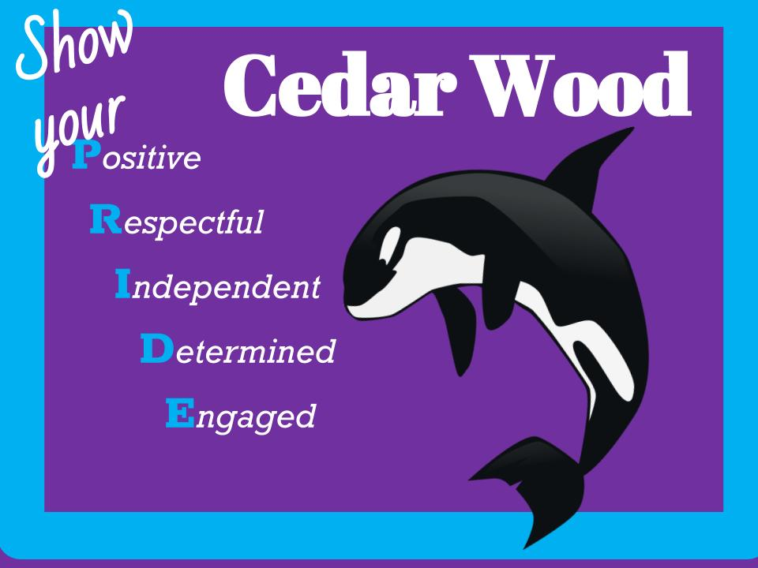
Cedar Wood’s Refresh
2 New Portables (12 total)
Security Upgrades- Gates & Keycards
Office Renovation
21 New Staff Members
780 students
New kindergarten class (converted tech classroom)
Piloting a New K-1 Spanish program
Notes:
Due to various changes at Cedar Wood, our theme for the year is “Refresh.”
Refresh of staff, a refresh of expectations, and a refresh of our vision.
On the screen is a list of changes that has led to our refresh.
Some of the big highlights are:
2 New portables
Office Renovation
The largest student and staff population in our building’ history.

Slide 5
Refresh of 21 New Cedar Wood Staff
Achieve- Paige Warfield
0.5 Resource Room- Elise Hillyer
Kinder- Vanessa White
0.2 Math (5th gr)- Melissa Whitley
1st gr- Carly Corbett & Orshi Nance
2nd gr Hi-Cap- Alicia Naig
3rd gr- Anna Moisant
4th gr- Laura Whitmore
5th gr-Tori Lyman & Stephanie Wilson
PE 0.5- Laura Gardner
Math Specialist- Sarah Poyner Wallis
Counselor- Amy Famelos
Counselor 0.5- Grace Horatis
Office Assistant- Stephanie Contreras
Achieve Para- Dave Braile
Achieve One-on-one Para- Allen Clark
Crossing Guard/ Para- Krystal Pagano-Pebles
Hi-cap Para- Rachelle Quarders
EL Para- Rebecah Ransom
Head Custodian- Rick Sisk
Principal- Bruce Rhodes
Notes:
A big part of our Refresh was the hiring of 21 new staff members since this this past summer.
Every grade level and department had at least one new staff member added to their team.
We’ve added a new math specialist, added 2 new counselors, a new head custodian, and a new principal.
Due to all these staff additions, there was a need to realign our work and seek clarity in our school’s vision.

Slide 6
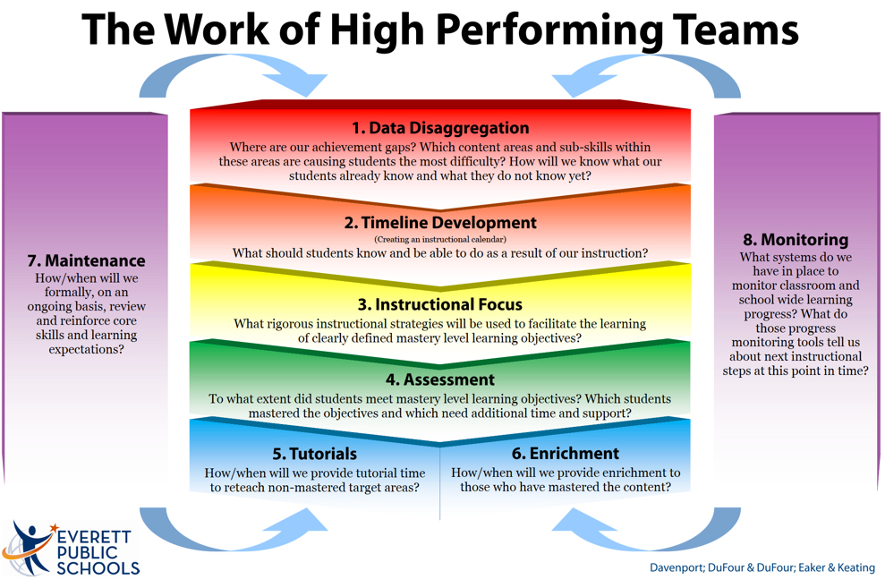
Professional Learning Requires Teamwork
Kristin Anderson- Fostering Clarity
Reach for Reading- Year 2
iReady- Year 2
PBIS- Year 2
Balanced Math- Year 2
Observing for Evidence of Learning- Year 2
Online Progress Reporting- Year 2
Math Workshop
Aligning Writing Instruction- Building Foundations That Last
NGSS: Best Practices (2 of 8)
Writing: High-leverage strategies and discourse
Notes:
With these changes, our various high performing teams have focused on fostering clarity in our professional learning goals.
As demonstrated from our 3 rotations today, our entire staff have been working hard with ongoing improvement in every aspect of Cedar Wood from our instructional focus, our real-time assessments, and our building’s culture.
Listed on the screen are several of the professional learning initiatives we have been engaging in to enhance student learning.
One thing I want to call out is how we are trying to strengthen our collective understanding as we support our new staff by looking deeper with year 2 of Reach for Reading, Balanced Math, PBIS implementation, and Next Generation Science Standards practices.

Slide 7
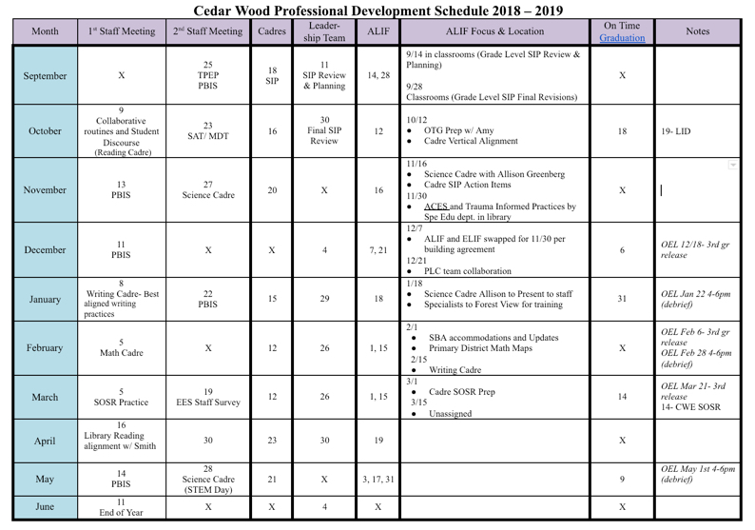
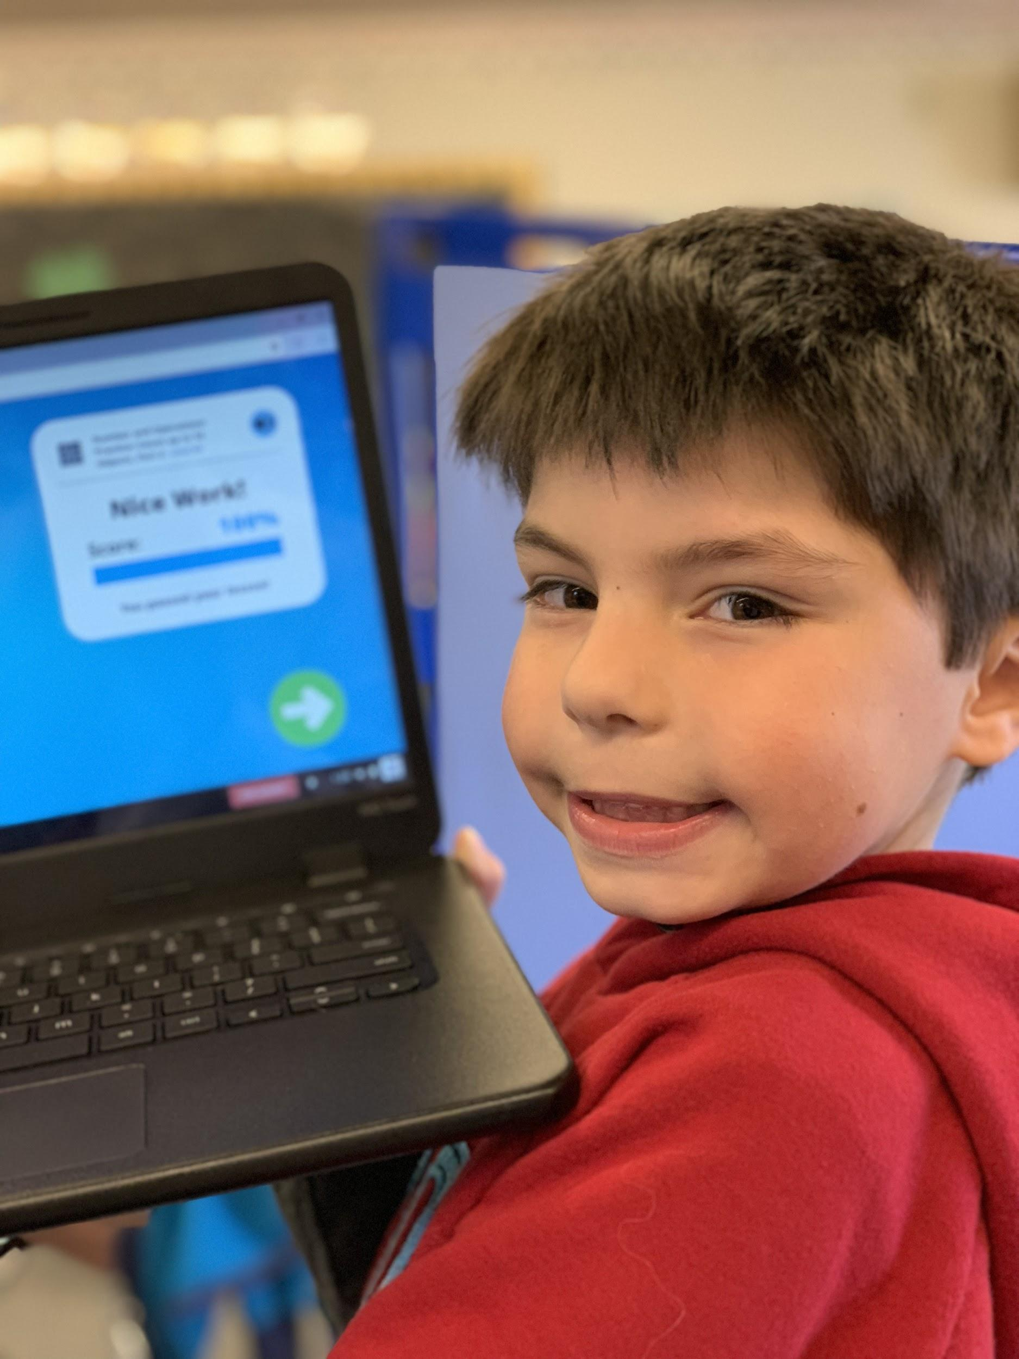
Professional Development Calendar
Notes:
If you ever have the chance to walk through our classrooms on a regular basis, you can feel a sense of urgency for student achievement.
When you talk to any of our staff members, they will tell you how precious our time is; our instructional time with students and our time together with our colleagues.
As you can see in this professional development calendar, every collaborative opportunity is purposeful and is aligned to our school improvement plan and our professional learning goals.

Slide 8
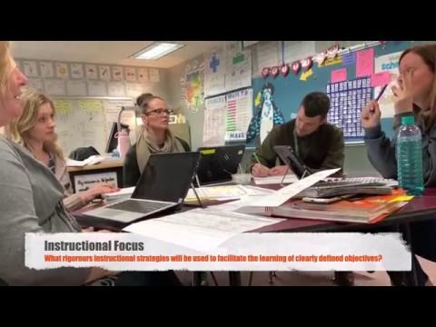
High-Performing Team in Action
1st Grade Team Planning a Reach Writing Unit
Notes:
A positive attribute of our various teams is how extremely intentional they are with their collaborative time and the use of available resources.
Here’s an example of one of our teams demonstrating this attribute.
In an ALIF organized by our writing cadre and reading specialist, a coach from Early Learning engaged our primary grades in several writing units and strategies that are aligned to the Reach for Reading curriculum.
During their first available collaboration time, our first grade team immediately re-connected and re-aligned their writing unit plan in response to this ALIF training.

Slide 9
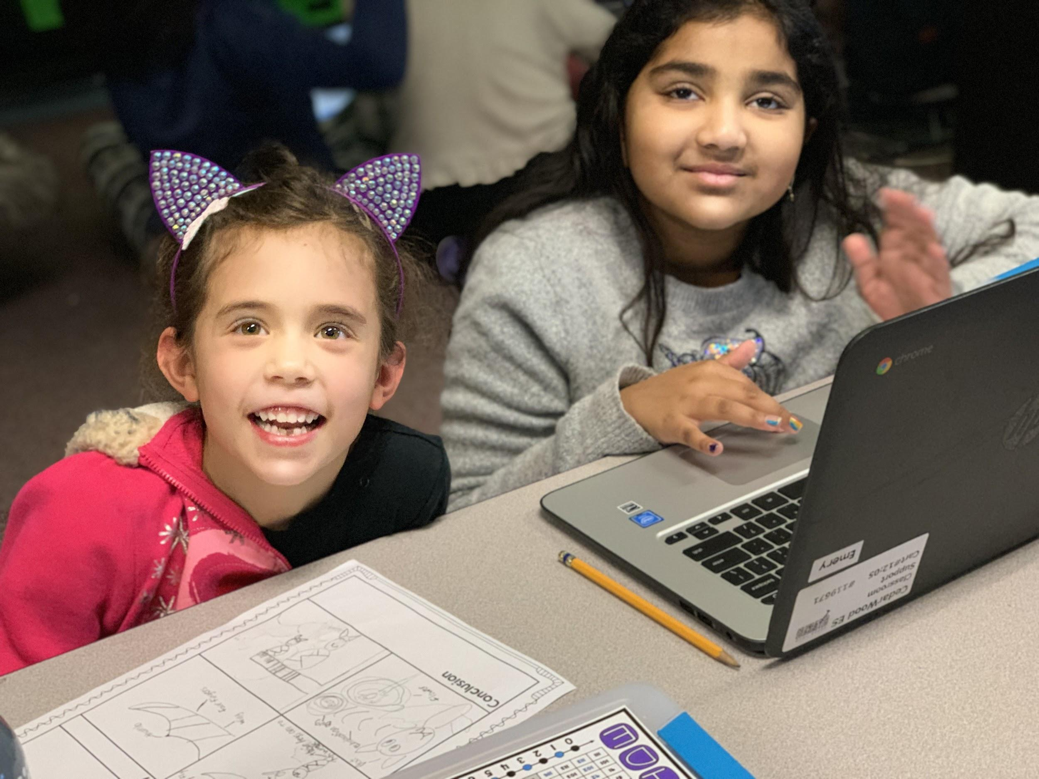
Reading Cadre- PLC Timeline
August 2018 | Reviewed, reflected, and provided feedback on 2017 - 2018 literacy data focusing on demographics such as gender, race, socio-economic status, special education students, English learners, 504 students, and Achieve students.
Sept 2018 | Administered Needs Assessment/Questionnaire, reviewed grade level SIP feedback, drafted 2018 - 2019 SIP, created LAP and EL intervention and support schedule.
Oct 2018 | Finalized 2018 - 2019 SIP, reviewed staff Needs Assessment/Questionnaire, implemented Reach for Reaching backward design bookmarks, began LAP and EL intervention and support groups.
 | Demonstrated Reach Collaborative Routines and Accountable Talk strategies.
 | Demonstrated integration of clarity, backward design, and GLAD EL strategies into Reach curriculum.
Nov 2018 | Reviewed district ELA Intervention/Reading Strategies, drafted CWE Systems of Support (Tier 1 - 3) for academics, and progress monitored LAP students.
Dec 2018 | Began planning LAP Parent Intervention/Strategy night, analyzed progress monitoring and ELPA21 data with grade level teams to determine that Systems of Support are being implemented equitably.
Jan 2019 | Reviewed and implemented CCSS vocabulary list, collected IEP/504 accommodation/support data for state assessments, continued to plan Parent ELA Intervention/Reading Strategy night, and shared expectations for district assessments.
2019 and Beyond | Demonstrate Reach for Reading and DMA connection, present at Parent Intervention/Strategy night, collaborate with writing cadre, and collect grade level support data for SBA, demonstrate how ebooks can be used to meet the needs of students in below or above standard guided reading groups, and continue progress monitoring and ELPA21 grade level team meetings to ensure that interventions and supports are being implemented equitably based on current data,
Notes:
Working with our grade level teams, our various cadres have led the professional learning in our building.
Their intentional and focused work have guided us in implementing our various SIP action items into our instructional practices that impact achievement.
On the screen is our reading cadre’s timeline for the year, as you can see, this cadre has been has been supporting our teams with aligning best practices with Reach for Reading to support all our student’s needs.

Slide 10
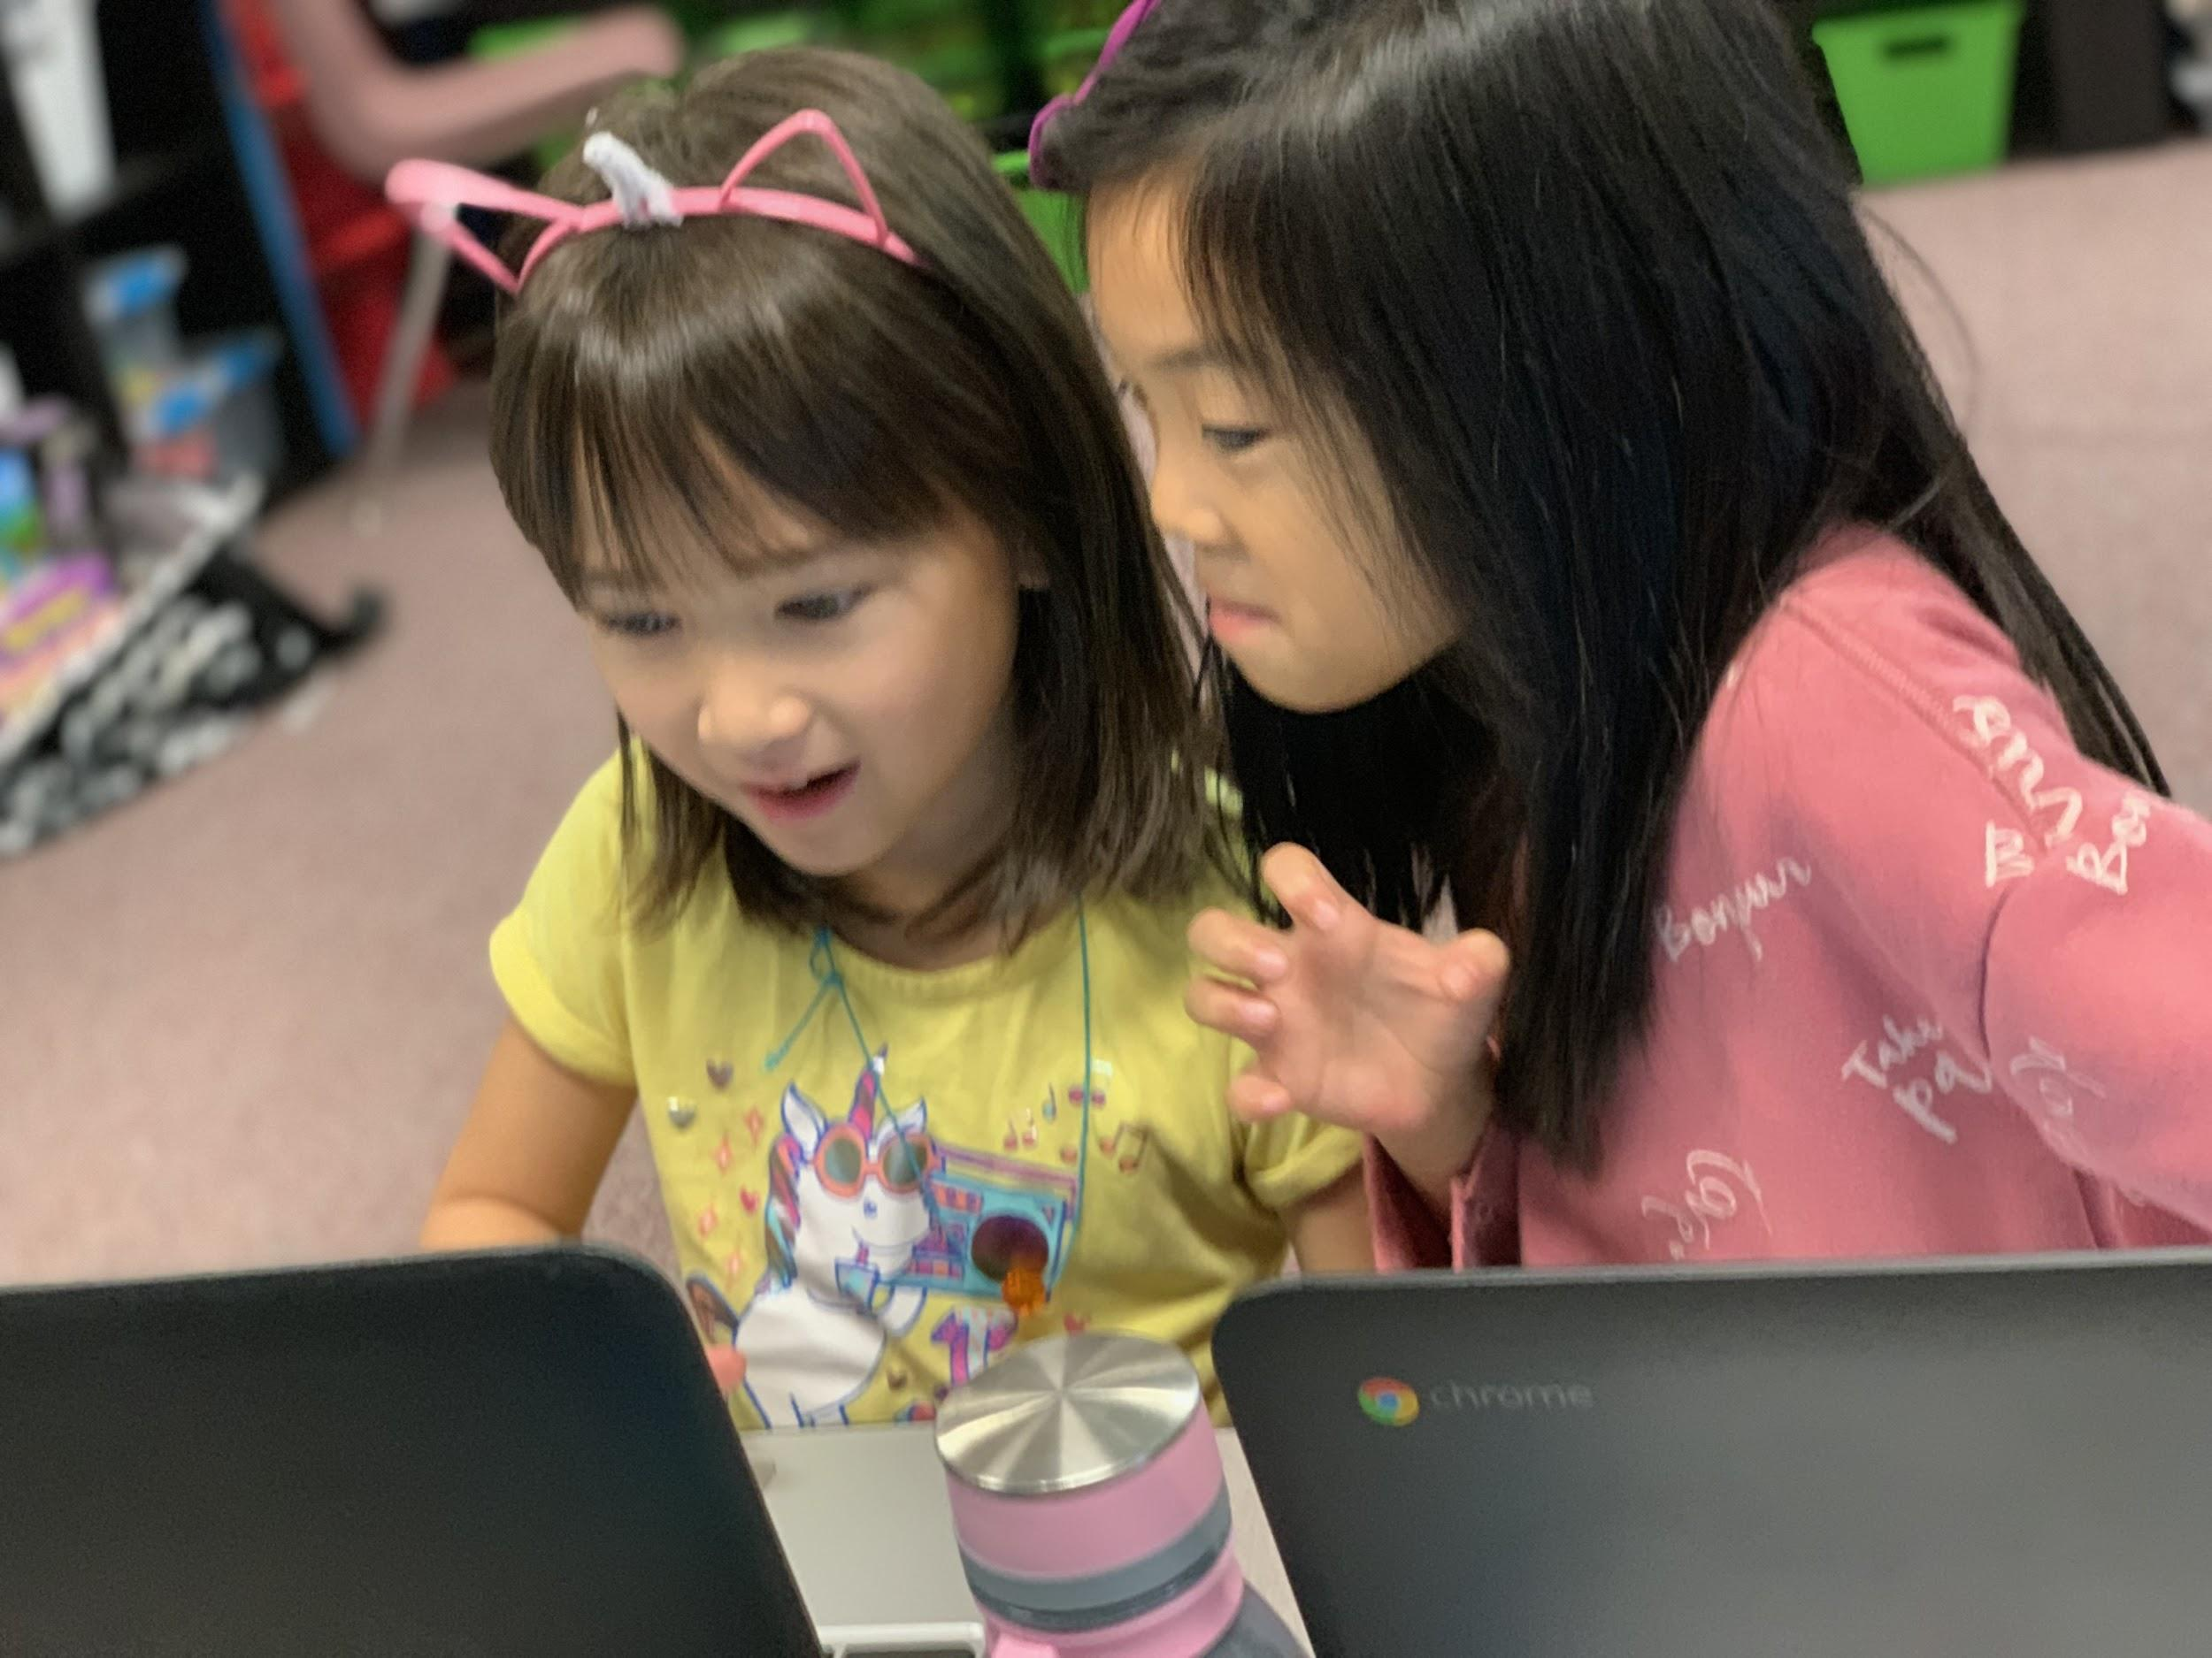
Math Cadre- PLC Timeline
2018-2019 | Study and Implementation of Math Workshop Model in conjunction with District Detailed Math Maps.
Aug 2018 | Reviewed, reflected, and provided feedback on 2017 - 2018 math data focusing on demographics such as gender, race, socio-economic status, special education students, English learners, 504 students, and Achieve students.
Sept 2018 | Drafted 2018-2019 SIP, Reviewed grade level SIP feedback, gathered staff feedback on discourse rubric.
Oct 2018 | Finalized 2018-2019 SIP.
 | Professional Development: Understanding Teacher Clarity Through Visible Learning.
 | Book study: Math Workshop Five Steps to Implementing Guided Math, Learning Stations, Reflection, and More by Jennifer Lemp.
Nov 2018 | Using district Balanced Math Maps in a Math Workshop Model, iReady instructional tools as an intervention.
Dec 2018 | Investigating Number Strings through the OEL process with 3rd grade, 2nd grade HC, Intermediate Achieve, and Special Education instructors.
 | Productive Math Routines: 3-Act Tasks, Choral Counting,
Jan 2019 | Using Balanced Math Maps and guided math groups to support in class intervention, using iReady data and classroom assessments to determine groups for extended day support.
2019 | Five Practices for Orchestrating Productive Mathematical Discussions, Revisiting the Discourse Rubric, continuing book study, planning and attending LAP Parent Intervention/Strategy Night. Capturing Quantities Routine.
Notes:
On this slide, we have our math cadre’s ongoing work this year with balance math and math workshop.
5 secs.

Slide 11
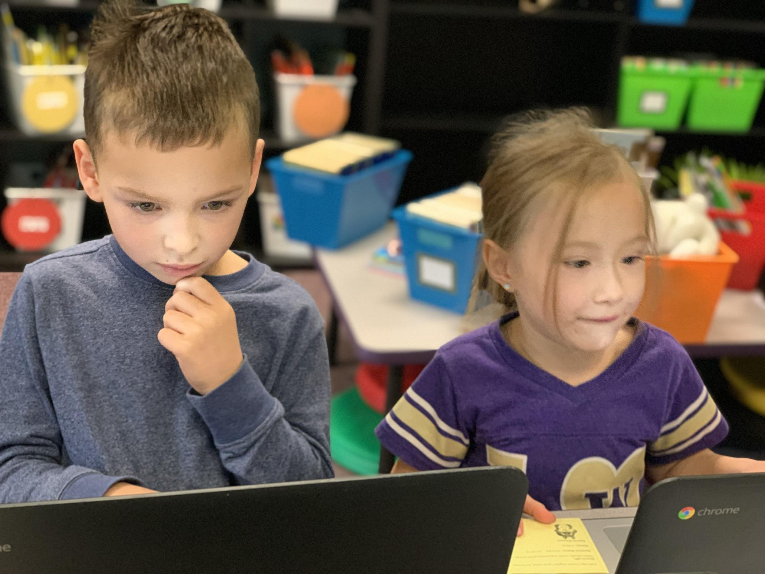
Writing Cadre- PLC Timeline
2018-2019 | Strategic use of common graphic organizers, including a placeholder for sources.
May 2018 | Review effectiveness of work, discuss needs for upcoming year.
Aug 2018 | Reviewed, reflected, and provided feedback on 2017 - 2018 SBA writing data.
 | Determined needs for current year, with particular emphasis on new staff, best practices and visible learning.
Sept 2018 | Drafted 2018-2019 SIP, based on August work.
Oct 2018 | Vertical alignment of best practice with emphasis on student discourse and rehearsal before writing.
Nov 2018 | Cadre work with grade-level teams.
Dec 2018 | Cadre work with grade-level teams.
Jan 2018 | Staff Meeting: shared article “15 Practices Proven Effective for Teaching Writing”, initial review of 3-5 SBA writing data.
Feb and beyond | K-2: work with Jaime and Mary Kay, aligning BFTL with Reach, planning. 3 - 5: Analyze SBA writing data using “Here’s What, So What, Now What” protocol.
Notes:
Here, we have our writing cadre’s work on aligning best practices between grade levels.
5 secs.

Slide 12
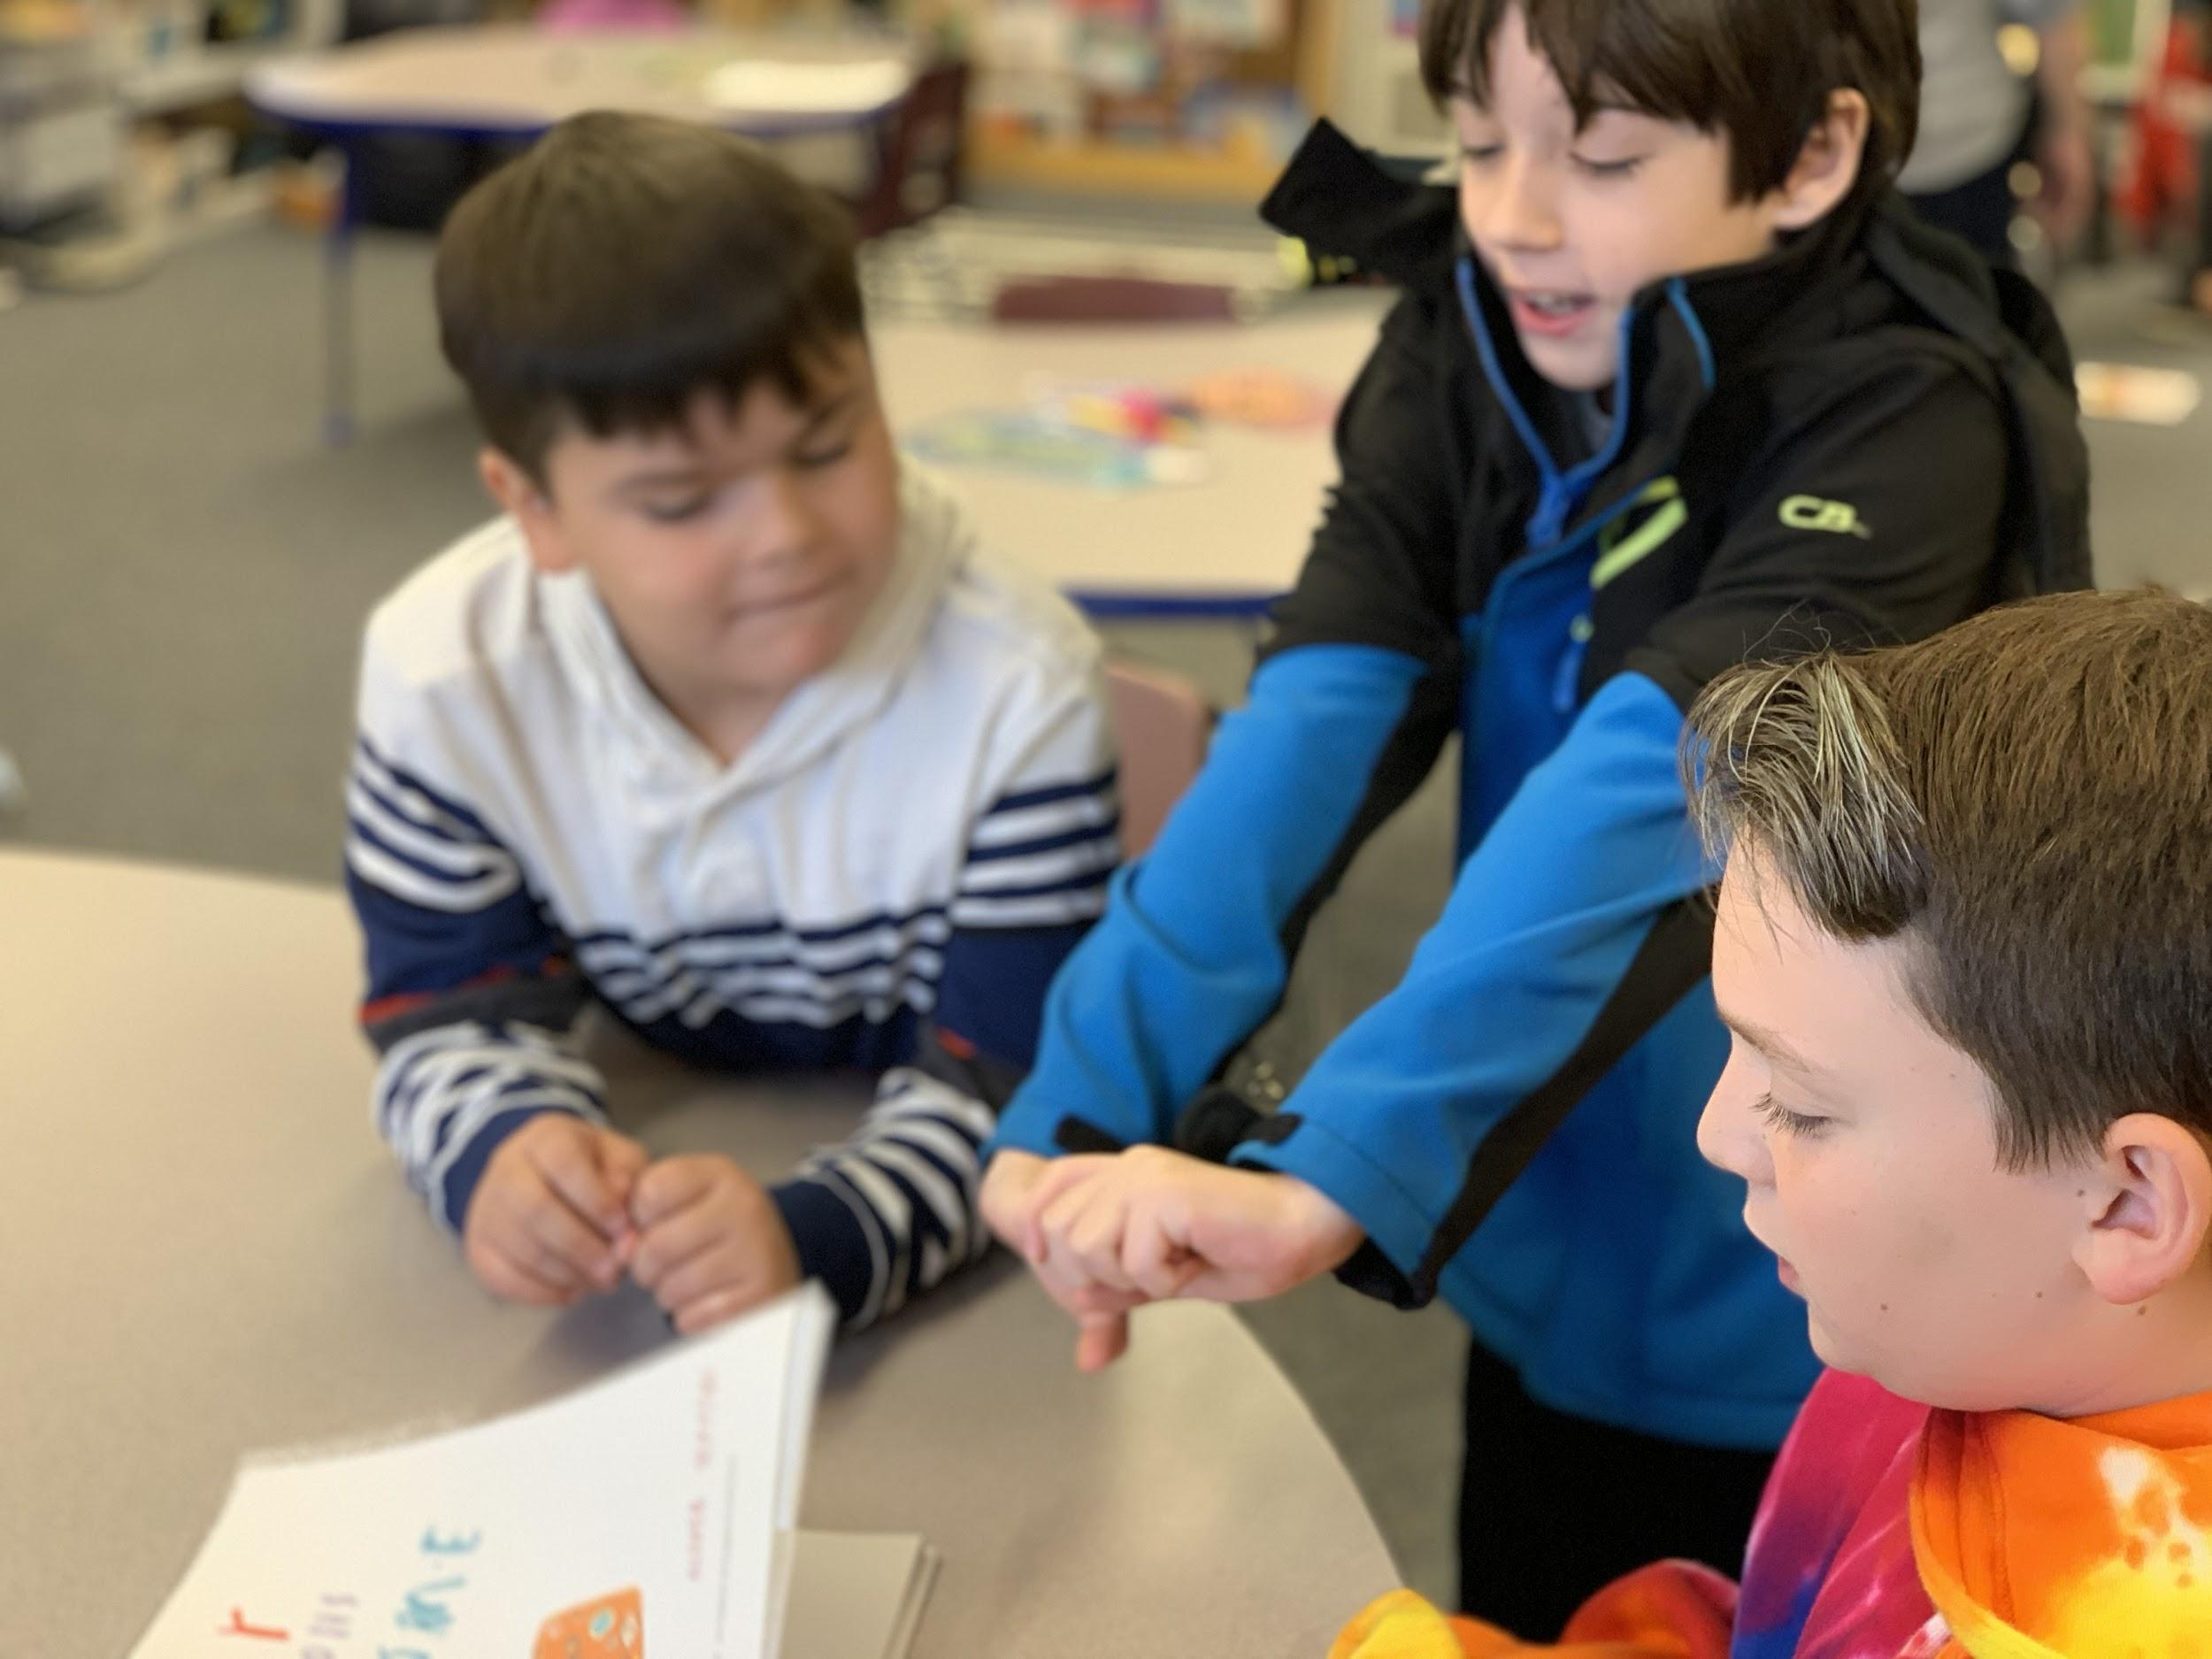
Science Cadre - PLC Timeline
2018-2019 | Integrate NGSS and 21st century skills in building science instruction.
Sept 2018 | Cadre team determine learning goals and timeline for implementation.
Oct 2018 | Collaborate with administrator to align work with SIP.
Nov 2018 | Cadre training by Allison Greenberg on two science practices focused on this year. Staff meeting training on two science practices focused on this year.
Dec 2018 | Revise original plan to accommodate the direct need of supporting 5th grade teachers through vertical alignment.
Jan 2019 | Staff meeting training on SBA with Allison Greenberg, followed by 5th grade specific SBA training and support.
March 2019 | SBA Science Interims. SBA Science Training for Fifth Grade Teachers at Woodside ES.
May 2019 | STEM Day & Science Board Display.
Notes:
This is the science cadre’s current work for the year on the integration of NGSS skills.
5 secs.

Slide 13
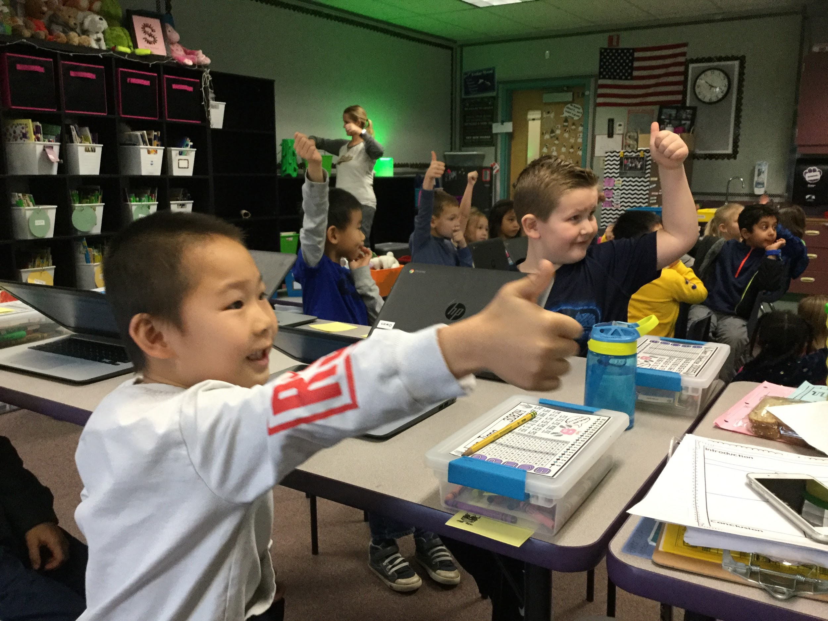
PBIS Cadre - PLC Timeline
2018-2019 | Implementing 2nd year of PBIS throughout the school
June-Aug 2018 | Cadre members attended PBIS conference in June. Team came up with ideas and drafts for Behavior Flowchart and Think Sheets. Cadre met and planned our September LID day.
Sept 2018 | Staff meeting reviewing and revising our matrix. All classrooms taught and implemented Matrix. Rotations used to teach expectations in common areas
Oct 2018 | Staff meeting sharing lessons, begin Pride recognitions, and cadre began creating drafts of Flowchart, Office Referral, and Think Sheets.
Nov 2018 | Met with district coach Lori Lynass who analyzed current implementation using a TFI assessment.
Dec 2018 | Finalized Flowchart, Office Referral, and Think Sheets during staff meeting.
Jan 2019 | Follow-up staff meeting that reviewed survey results PBIS coach, revised Flowchart, Office Referral, and Think Sheets. All staff agreed to implementing forms. Classroom behavior data is now tracked on SWIS.
March 2018 | PRIDE team will begin address phase 2 of coach’s TFI recommendations.
April and Beyond | Follow-up meeting with PBIS coach, Review student expectations after spring break, add a parent to be a member of our PRIDE Team, revisit the use of PRIDE cards, begin using SWIS data to drive next steps of team, and finalize PRIDE lesson folders.
Notes:
Next, here’s our PBIS cadre’s implementation plan for the year.
5 secs.

Slide 14
Special Education Team - PLC Timeline
2018-2019 | Building teacher capacity to increase the rigor of student learning and supports
Aug 2018 | Kristin Anderson Professional Development- Fostering Clarity
Oct 2018 | Simplifying Behavioral Intervention Plans and aligning classroom expectations- Achieve
Nov 2018 | Aligning Para-educator roles in supporting behavior management and social skills instruction through understanding student IEPs and BIPs (Training provided by Building Psychologist)
Dec 2018 | Positive Action and Social Thinking/Zones of Regulation- Resource Room ACES and Trauma Informed Practices by Spe Edu dept- Certificated staff (Training provided by Building Psychologist) District facilitated Observing Evidence of Learning (OEL) with Number Strings- Resource Room/ Intermediate Achieve
Jan 2019 | Understanding disabilities and aligning supports for inclusion- Specialist Staff(Training provided by Building Psychologist) Wired for Reading Professional Development- Resource Room OEL- Number Strings in Resource Room/ Intermediate Achieve
Feb 2019 | OEL- Number Strings in Resource Room/ Intermediate Achieve Math and Reading Coach release time for unit planning Intermediate Achieve SBA interim Training and Support for Intermediate Achieve
March and beyond | OEL- Number Strings in Resource Room/ Intermediate Achieve
Notes:
Finally, here is our special education team’s timeline.
This year we have been intentional in building our teacher’s capacity to increase the rigor and supports for special education students.
Working as a cadre team, our special education department has provided several professional development opportunities and workshops to our general education teachers and para-educators to increase the strategies in their instructional toolboxes.
Additionally, our resource room and Achieve teachers have engaged in several professional development workshops to strengthen their own practices and effectiveness.

Slide 15

Building teacher capacity to increase the rigor of student learning and supports- Special Education and Math
Notes:
As shared by our math specialist, our third grade team, second Highly-capable team, resource room teacher, and Achieve teacher have been participating in the OEL- Number strings coaching cycles.
In the following video, you will see our resource room teacher engaging her class with a number strings lesson.
What I want you to notice is that 2 of our Achieve students can be seen engaging in academic discourse with this resource room class.
This type of math-focused conversation is usually found in effective general education classes.
Prior to this lesson, these two students rarely showed confidence in their math abilities and very seldom participate.
At the end of the video, you will see the whole team (3rd grade, 2nd grade Hi-cap, our resource room teacher, and our Achieve teacher) engaging in a debrief of their experiences after the second coaching cycle of the OEL.

Slide 16
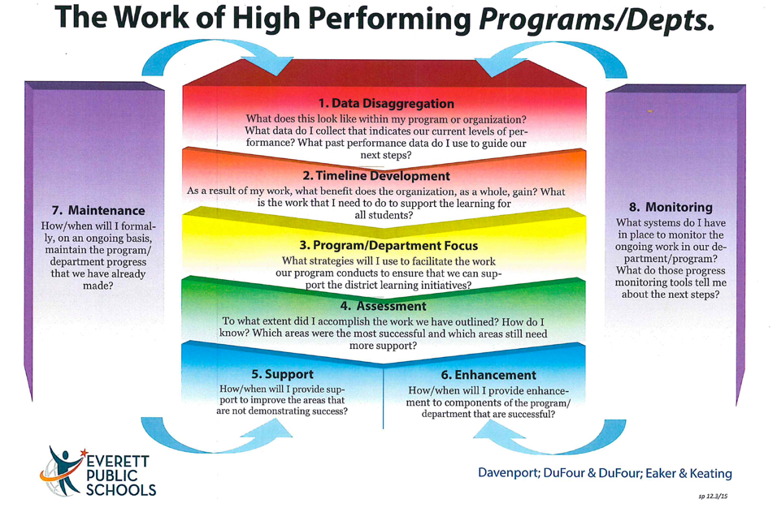
Cadre Focus and Impacts
Cadre | Focus | Impact on Instruction
Reading | Study and Implementation of Year 2 Reach focusing on integrating GLAD, DMA, Cooperative Learning, Accountable Talk, and technology Increasing collaboration with SpEd and Achieve programs Increasing family communication in the LAP program Increasing the monitoring of “bubble” students Ensuring equitable and appropriate interventions, accommodations, and supports are implemented | Providing integrated literacy instruction to meet the needs of diverse learners Ensuring special education and achieve students receive rigorous instruction that meets their needs Providing clarity for families receiving LAP services Frequently progress monitoring “bubble” students enabling appropriate interventions to be implemented sooner as needed Providing all qualifying LAP and/or EL students with services and supports that they need
Mathematics | Study and Implementation of Math Workshop Model in conjunction with District Detailed Math Maps | Providing engaging learning experiences that promote mathematical thinking and discourse
Science | Implementation of 2 science practices: Analyzing and Interpreting Data Using Mathematics and Computational Data | Utilizing all components of STEM instructional time to teach the science practices
Notes:
As seen in the timeline and demonstrated in the videos, our cadre teams have been impactful on student learning with their instructional focus.
Listed on this slide is a summary of each team’s overall focus and their impact on learning.
In reading, we have provided integrated literacy instruction to our diverse students.
In math, we have increased academic discourse in the classroom.
In science, we have been intentional with using 21st century skills in our daily practice.

Slide 17
Cadre Focus and Impacts
Cadre | Focus | Impact on Instruction
Writing | Identify high impact strategies and provide support for all staff to support student learning. | Use of high impact strategies across grade levels and modes of writing Collaboration within grade level teams to intentionally implement strategies
PBIS | Year 2 Implementation of PBIS Creating Behavior Flow Chart Creating intermediate and primary think sheets Integrating SWIS forms throughout the school | Consistency on handling minor and major issues Students and staff are clear of expectations Student intervention is more targeted.
Special Education | Building teacher capacity to increase the rigor of student learning and supports | Increased rigor in learning and alignment of mainstream instructional practices. Intentional mainstreaming of Achieve students Achieve students exiting program
Notes:
In writing, we are aligning our high impact strategies throughout the building.
In special education, we have been intentional in meeting the needs of our most at-risk students.

Slide 18
Work of High Performing Teams
Notes:
The basis for the ongoing academic success at Cedar Wood is the work of many high-performing teams. Our role as administrators is to establish, empower, and support those teams.
In turn, each of those teams supports the high performance of each and every staff member.
Thank you for listening and here’s Bruce to speak about the impact of previous district support on our achievements.

Slide 19
How are previous requests for support impacting Cedar Wood?
Assistant Principal and Administrative Paraeducator staffing has reduced the reactive mode, and increased our proactive work
Math PD with Observing for Evidence for Learning (OEL) is increasing teachers’ instructional and reflective skills in Balanced Math
Professional development and facilitation in Achieve program is creating the philosophical and practical foundation for an effective program
Robotics facilitator position has resulted in both Cedar Wood teams advancing to semi-finals at state
Notes:
Bruce slides

Slide 20
Prioritized supports based on data and challenges
Continue full time AP and Admin Para position, even if enrollment drops below 700
Special Education specific training and supports to build the capacity in teachers and paraeducators
Continue OEL coaching cycles to increase instructional effectiveness in math
NGSS Science Professional Development
Continue to support our Robotics Teams and increase ability for Junior Robotics
Notes:
Bruce slides

Slide 21
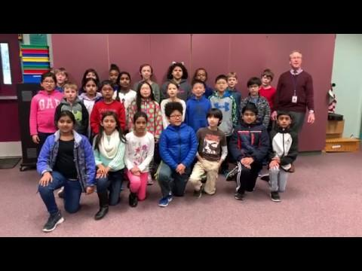
Thank you Dr. Cohn and Dr. Stewart

