Slide 1
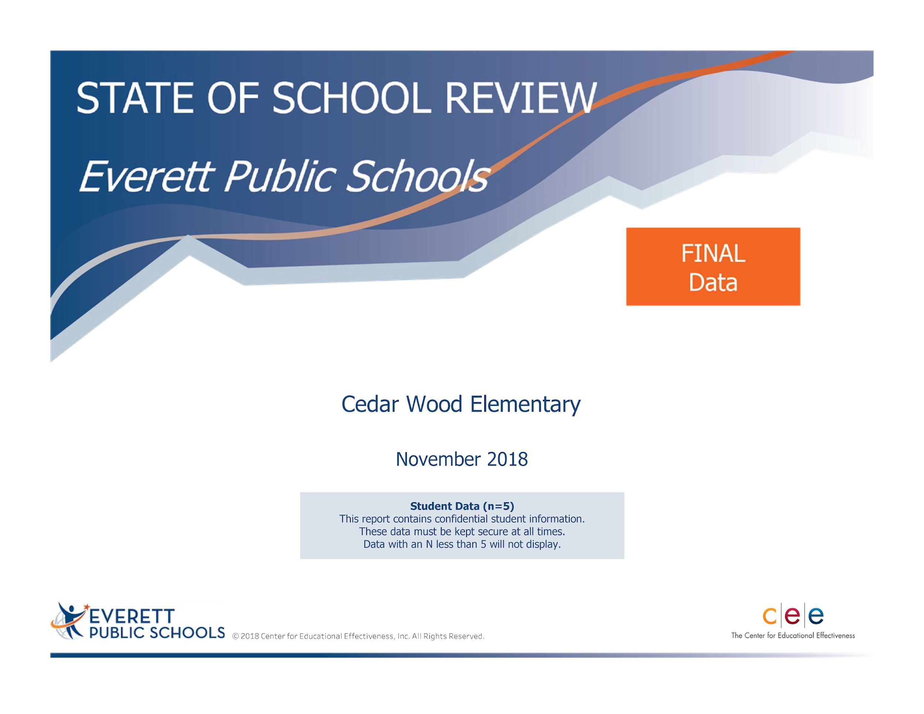
Notes:
Good morning, I want to welcome you to Cedar Wood SOSR this morning.

Slide 2
Welcome and Introduction
Cedar Wood Elementary School SORS Presenters 2019
ELA: Jaime Klontz, Reading Specialist
Barbara Tibbits, Fourth Grade Teacher
Andrea Barhanovich, Second Grade Teacher
MATH: Sarah Poyner-Willis, Math Specialist
SCIENCE: Janet Kim, Fourth Grade Teacher
Amy Yardley, Kindergarten Teacher
MTSS TEAM: John Pappas, Third Grade Teacher
Amy Famelos-Villars, Counselor
Rachel Linick, Intermediate Achieve
HIGH PERFORMING TEAMS: Daniel Natividad
Assistant Principal

Slide 3
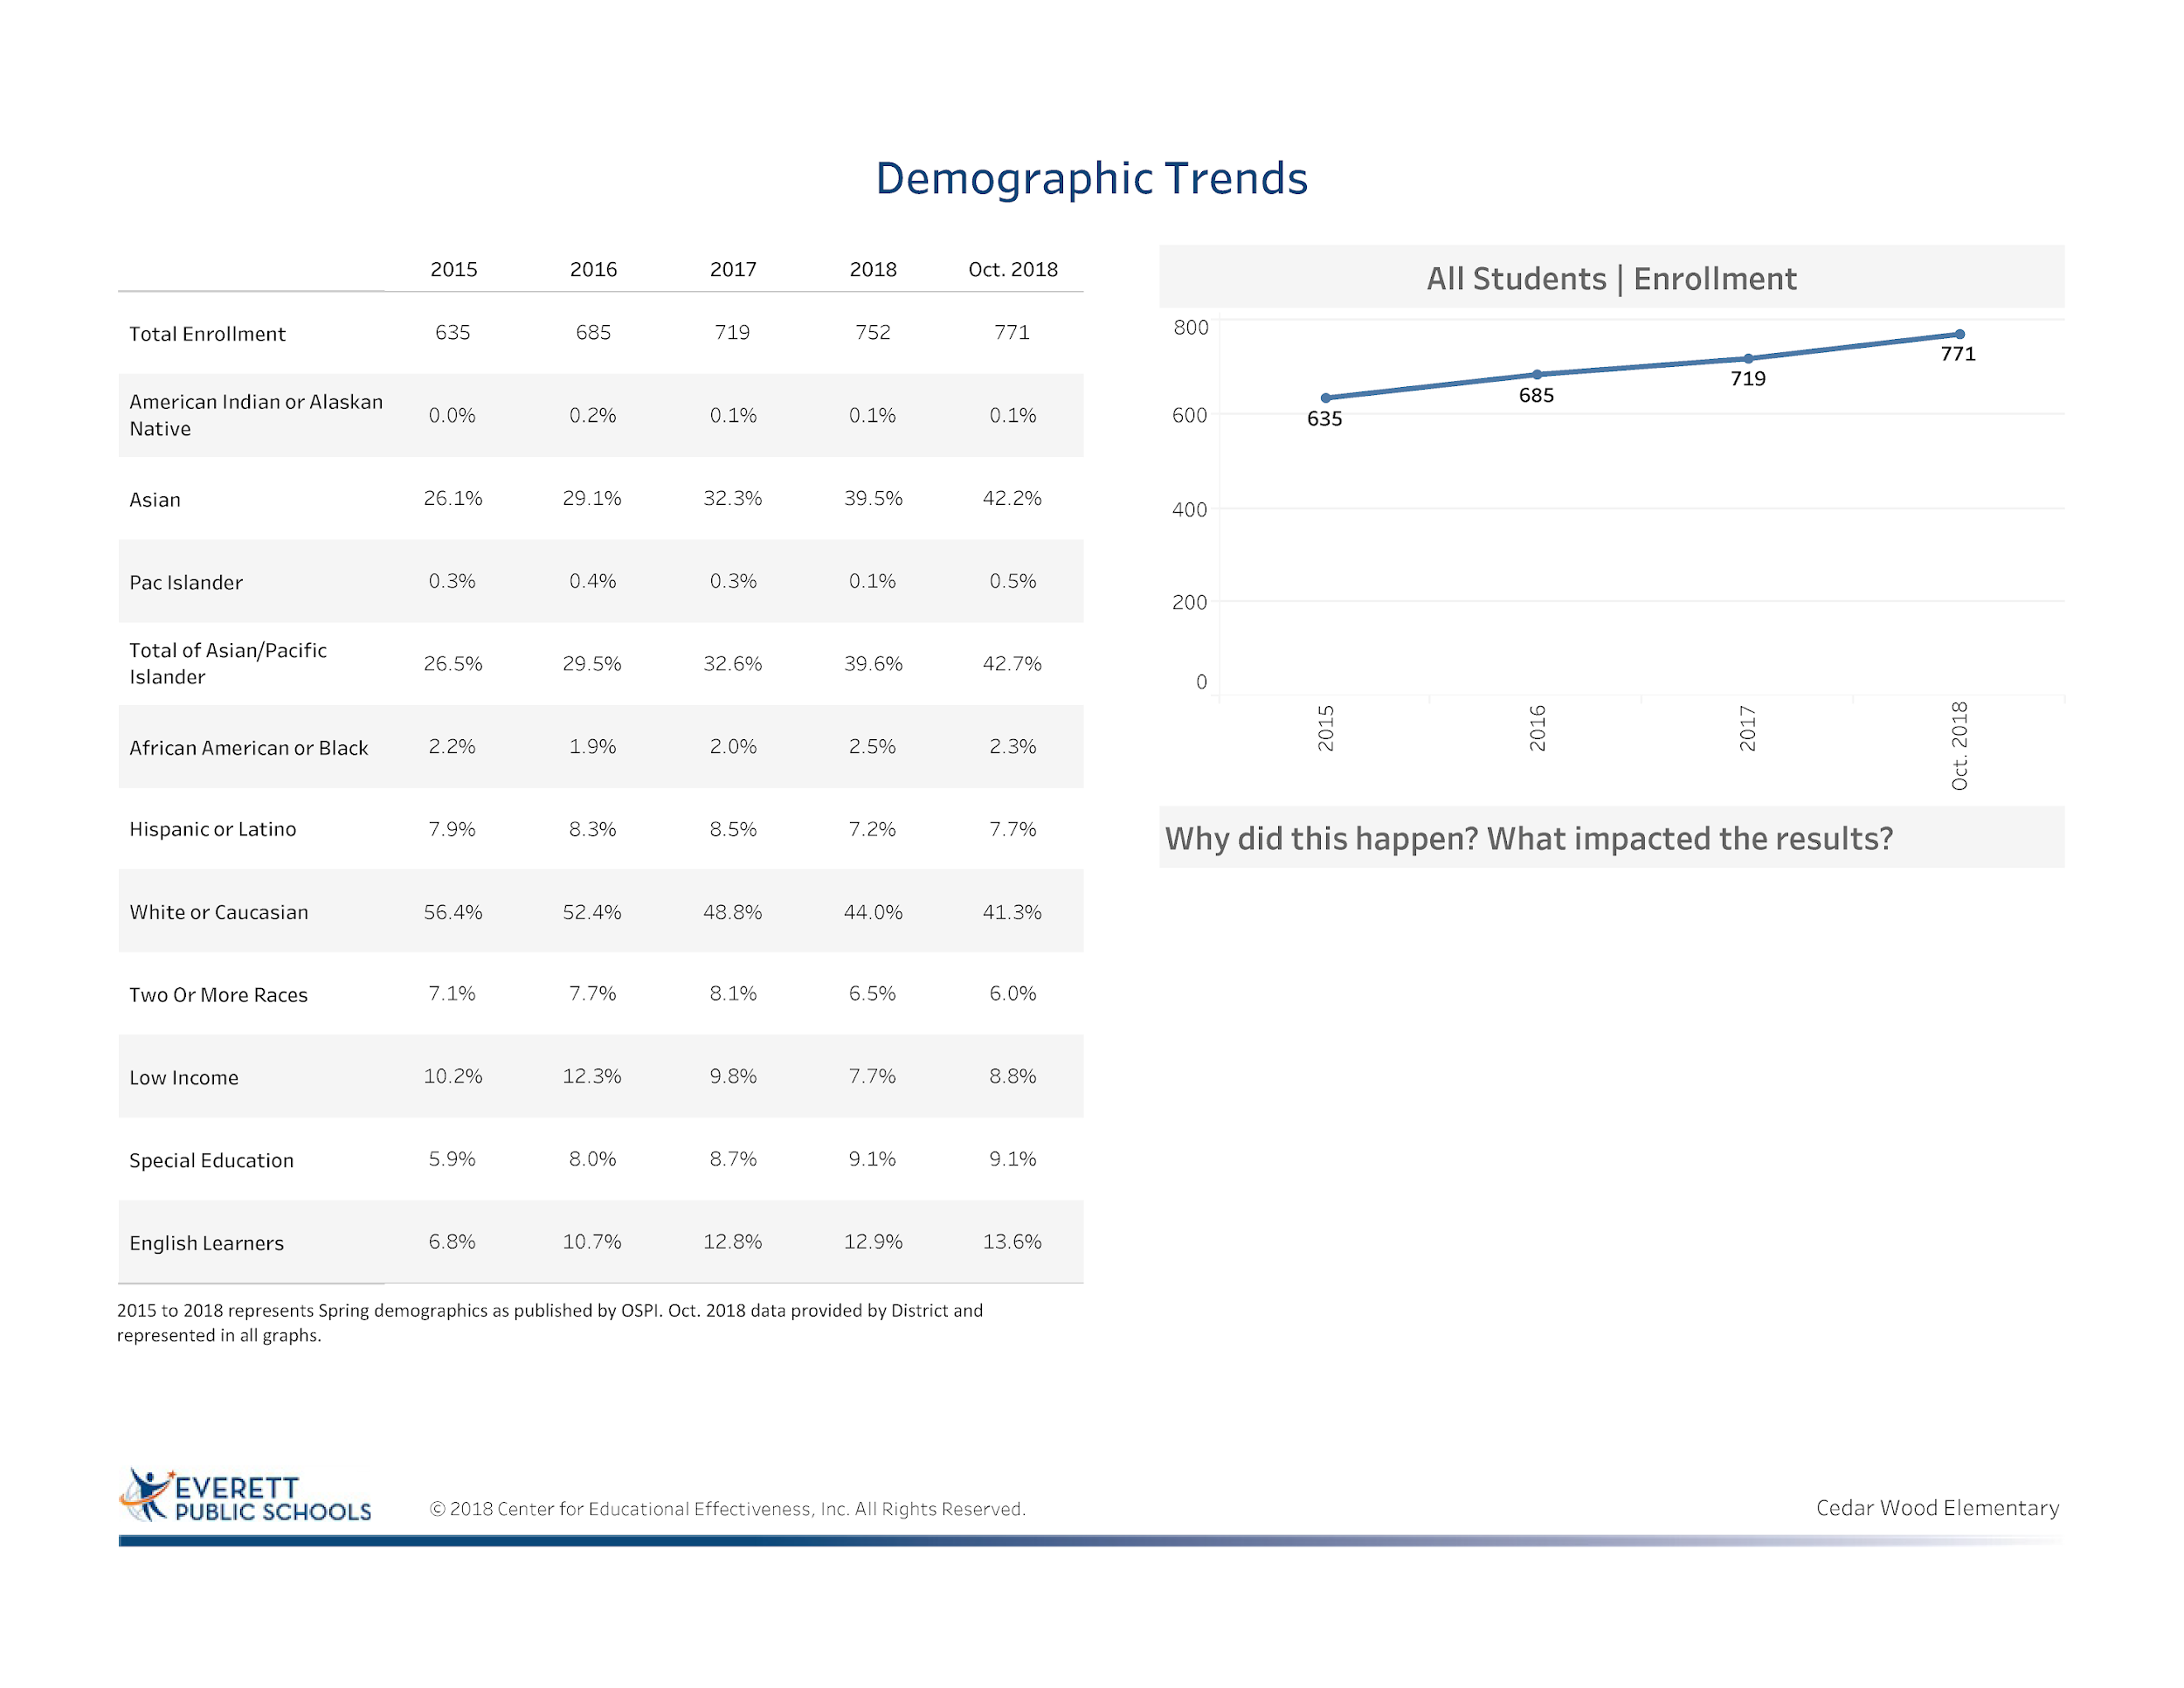
Construction increase of new homes in the area
Cedar Wood is a good place to learn – people from all over come to experience the Cedar Wood Way
Notes:
The increase of the number of students over the past four years has been significant 136 students. well above our building capacity
There are some areas I want to point out:
1. Significant increase in Asian population of 16% since 2015
2. Decrease of white students of 15%
3. Increase of Special Education Students of 3%
4. Increase of nearly 7% for ELL students

Slide 4
DATA ANALYSIS
Cedar Wood SOSR 2018-19

Slide 5
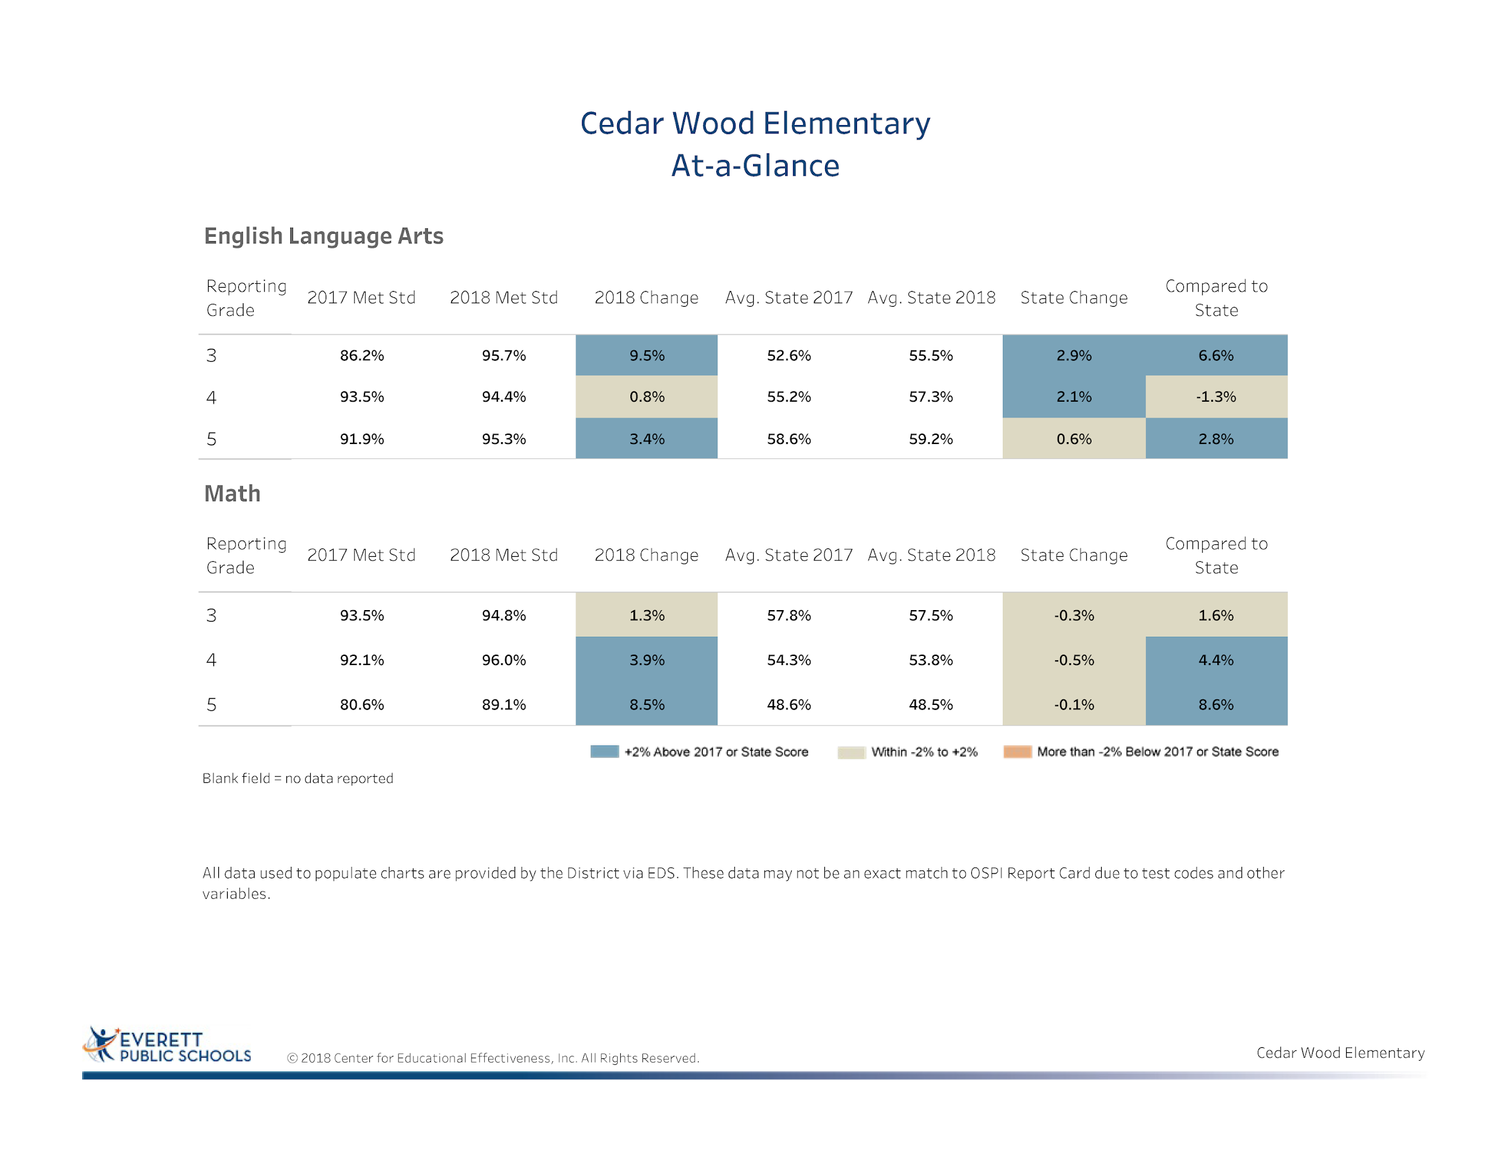
Notes:
Let’s start with a celebration of the significant growth which Cedar Wood did last school year.
In both reading and math we improved our performance and were significantly above the state average

Slide 6
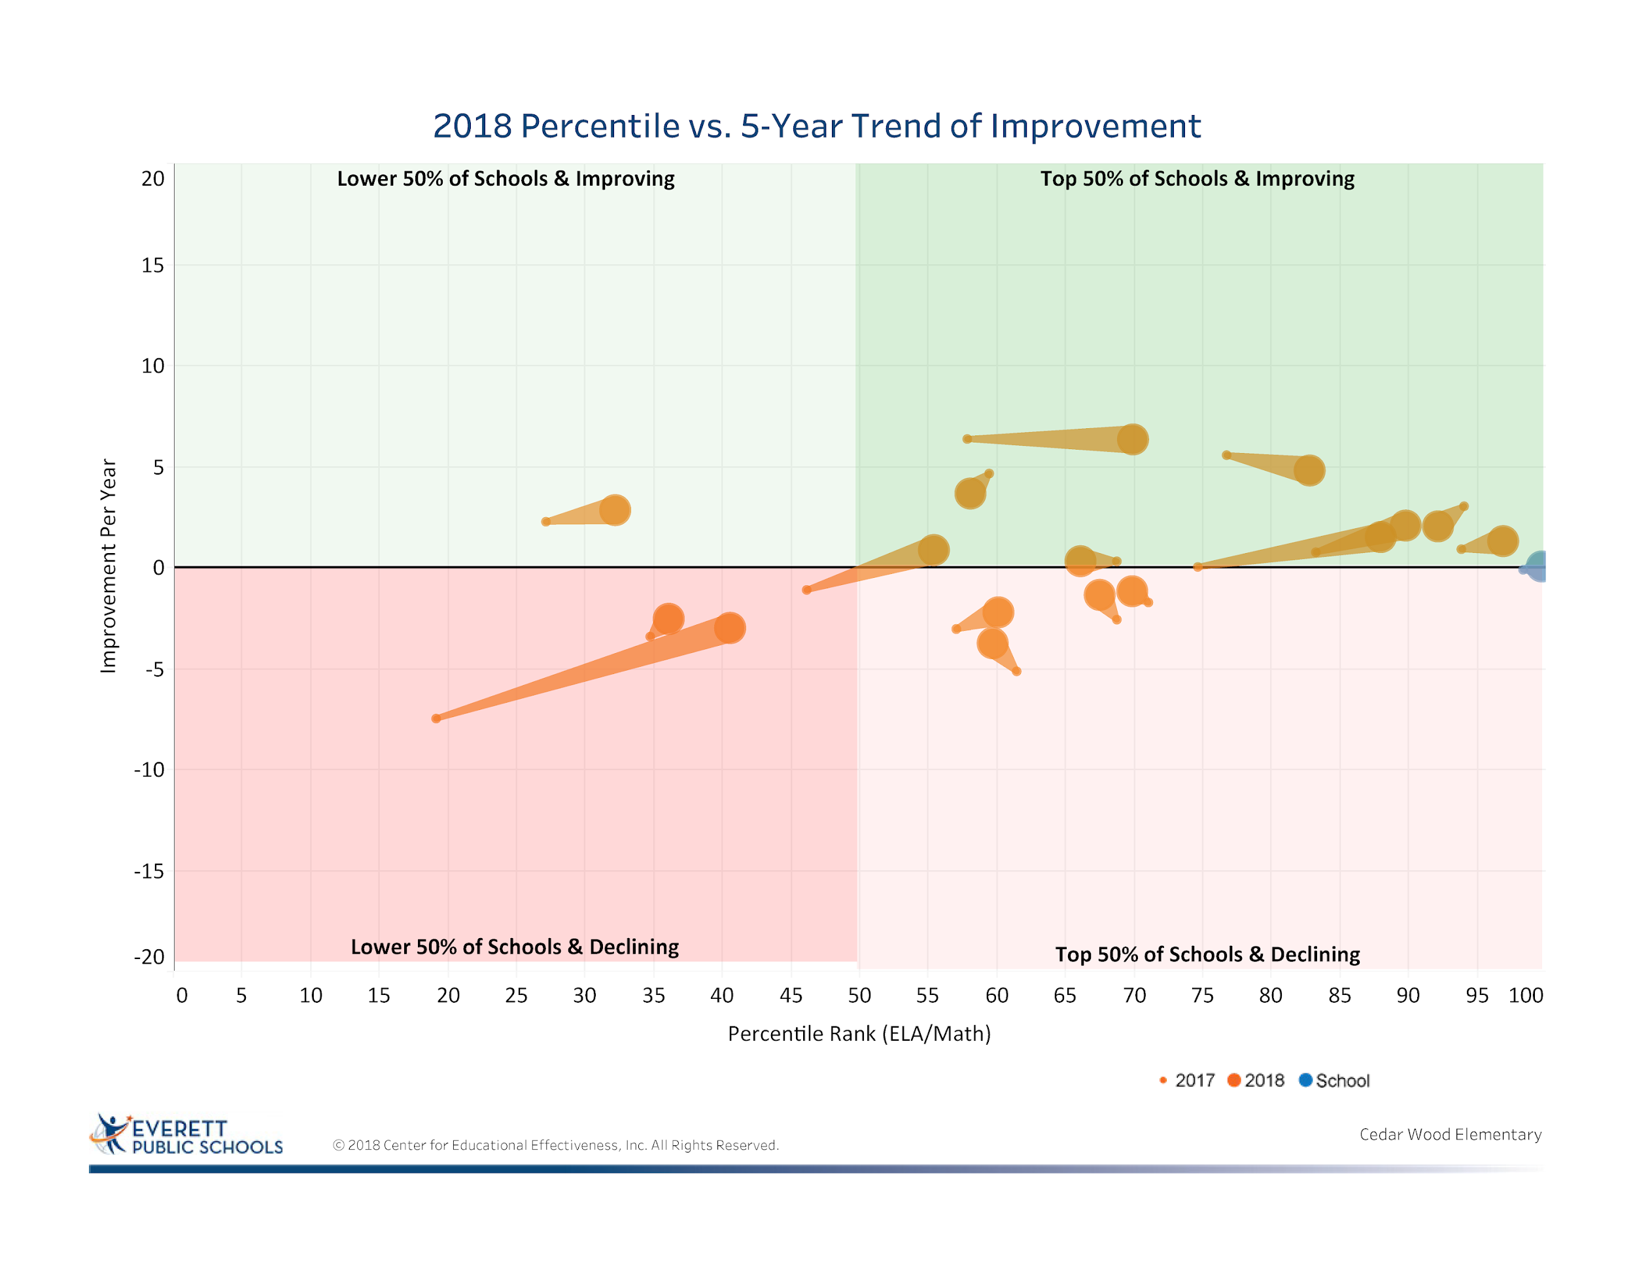
Notes:
Our school remains in the top 50 and improving quadrant and shows the on-going increase in performance from year to year

Slide 7
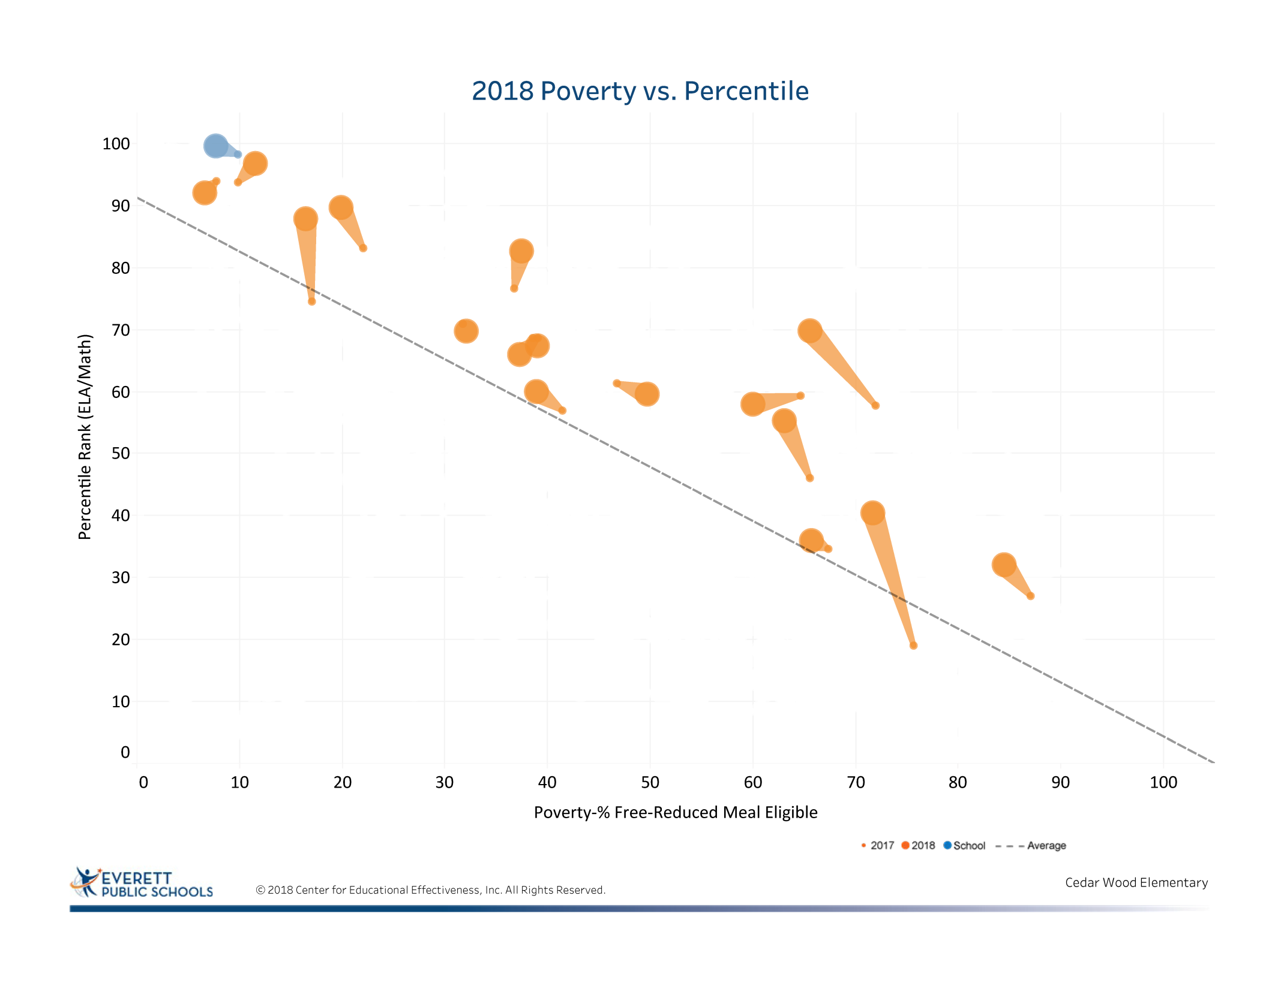
Notes:
This graph is showing us that our low income students have decreased by 1.5%.
Social-economic factors are a factor in some of our students progress toward academic progress.

Slide 8
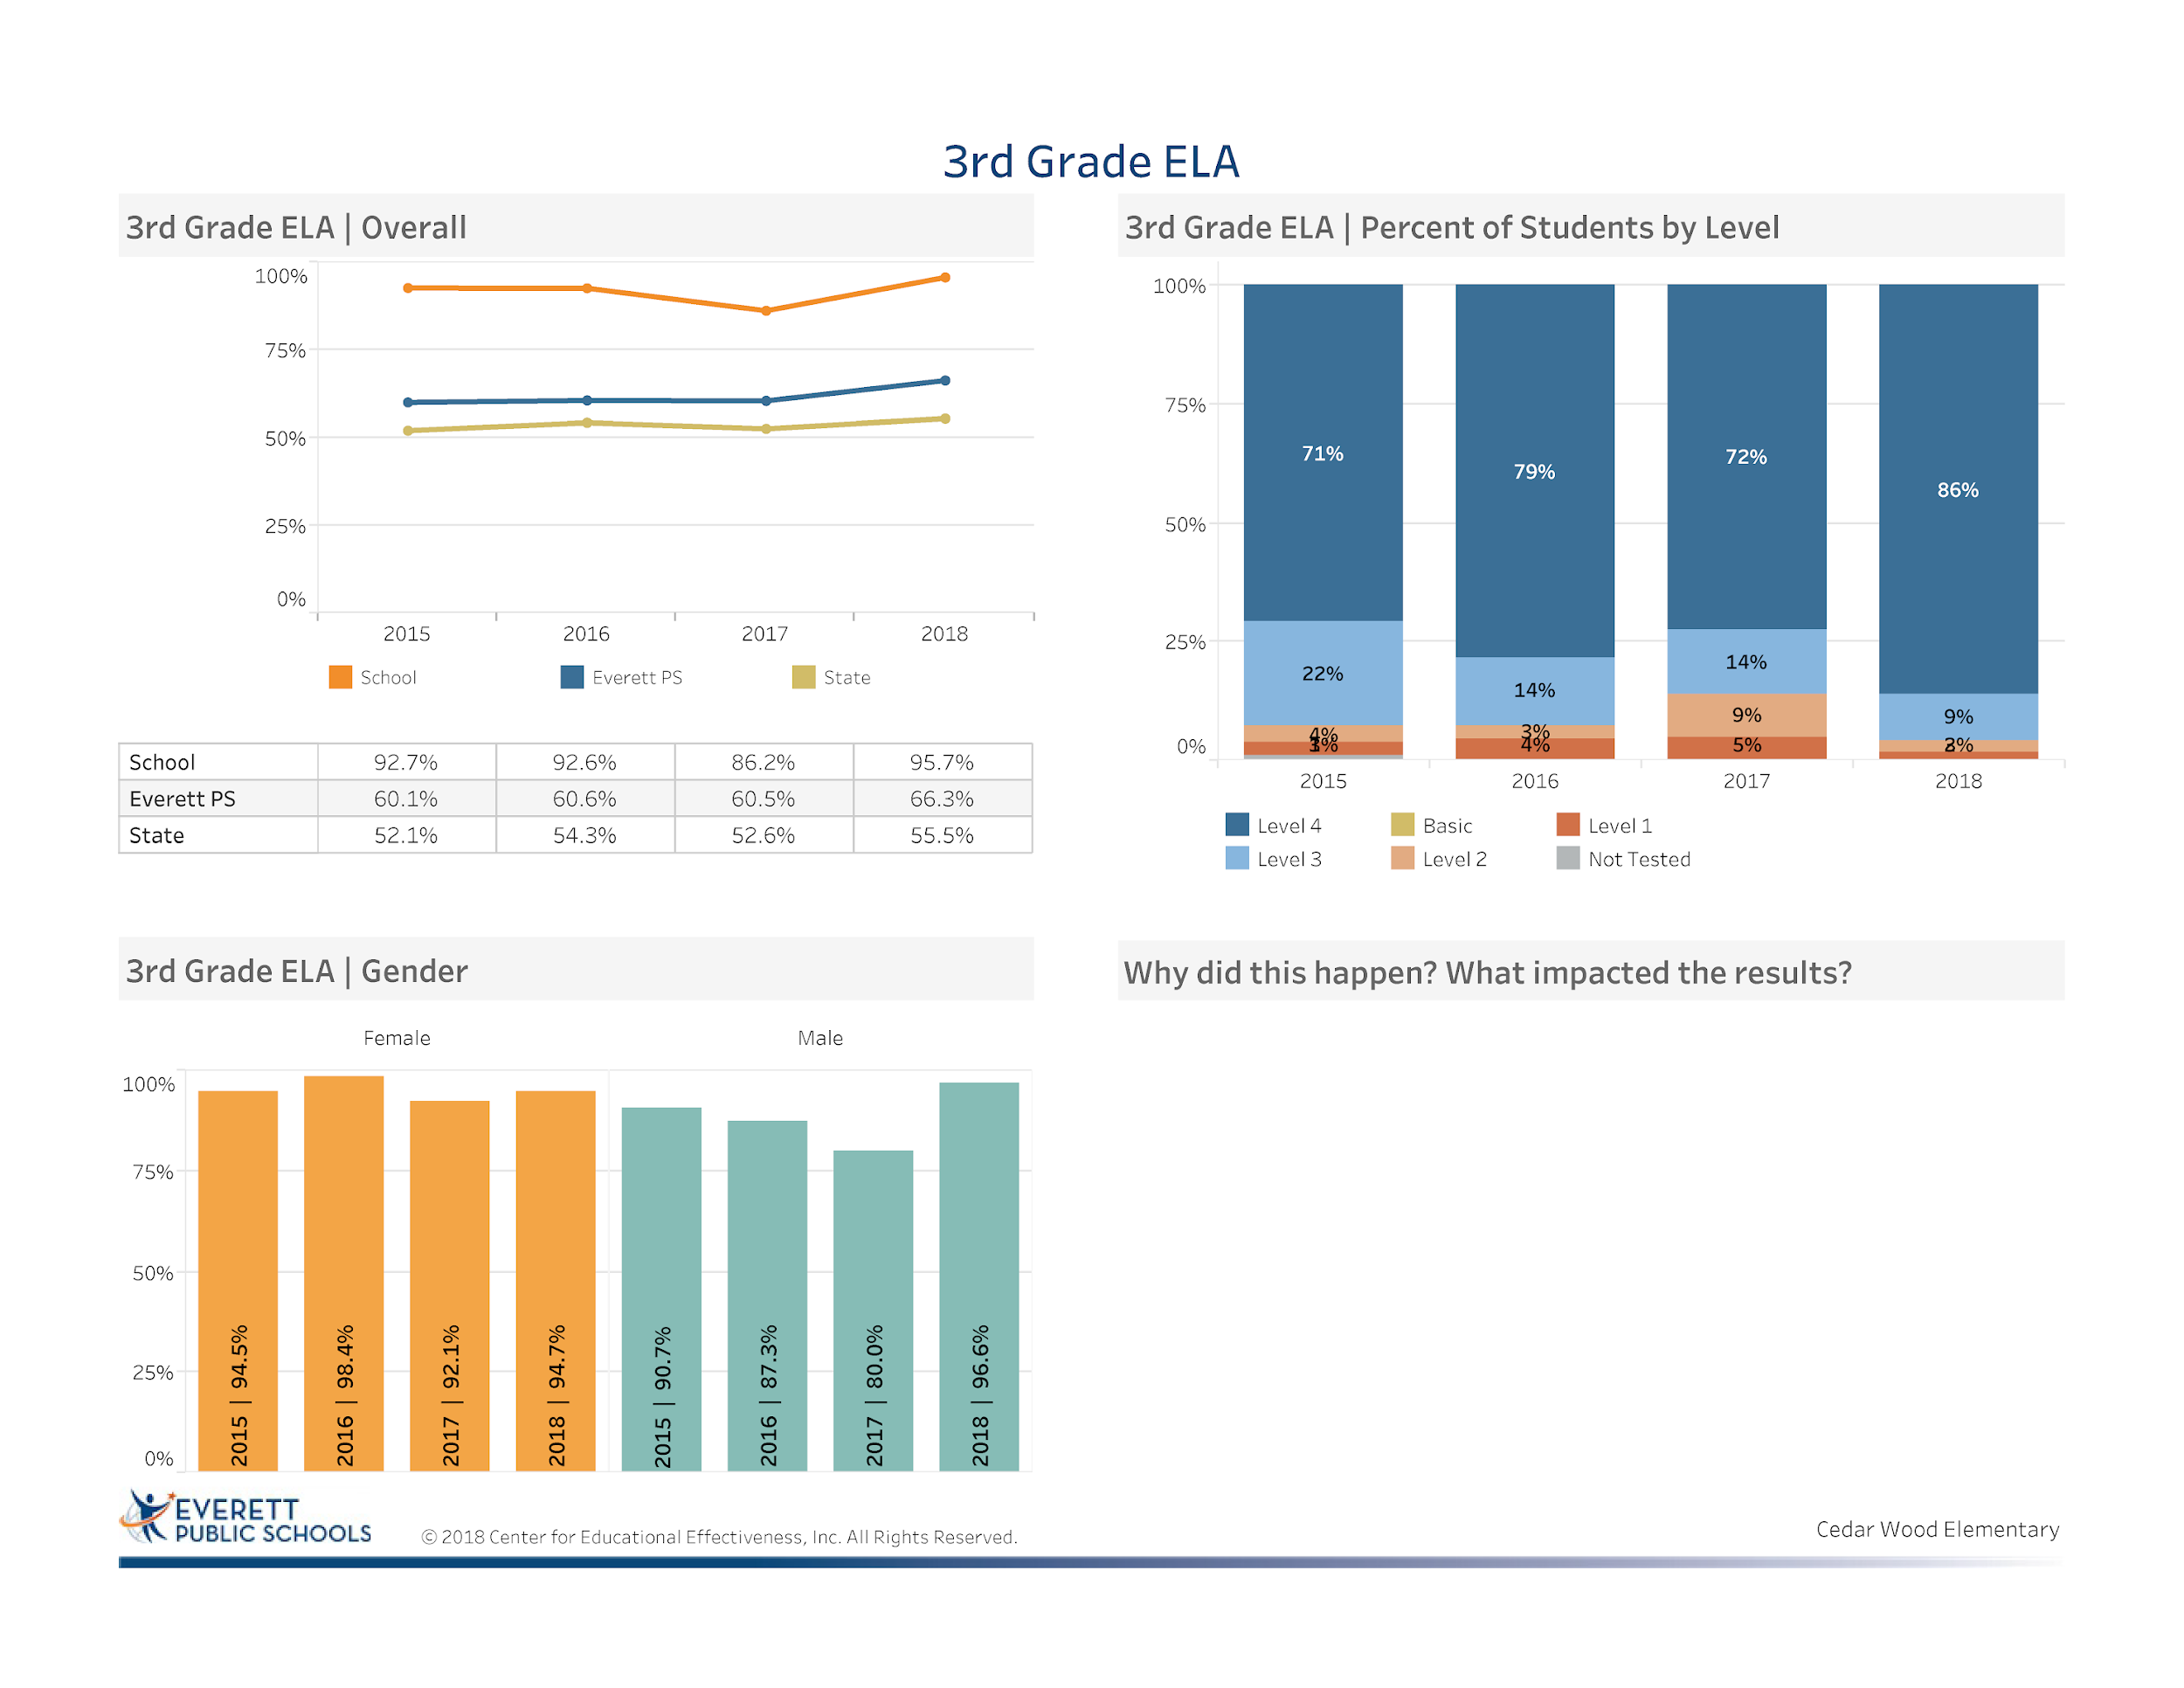
Focusing on the needs of every student
iReady Implementation use of this to support students gaps and to accelerate students proficiency
Implementation of the Reach Reading Curriculum
Smarter Balanced Focused Interim Assessments and Practice
Intentional SBA Parent Informational Night
Notes:
We are starting our data analysis with third grade ELA scores which has show an 9.5 increase from 2017.
40% above the state average
29% above the district average
We thought of some of the reasons for the increase :
Intentional focus on each student
iReady implementation to close gaps and accelerate learning
Implementation of Reach for Reading Curriculum
Smarter Balance Interim Assessments
Intentional 3rd grade SBA Parent Information Night

Slide 9
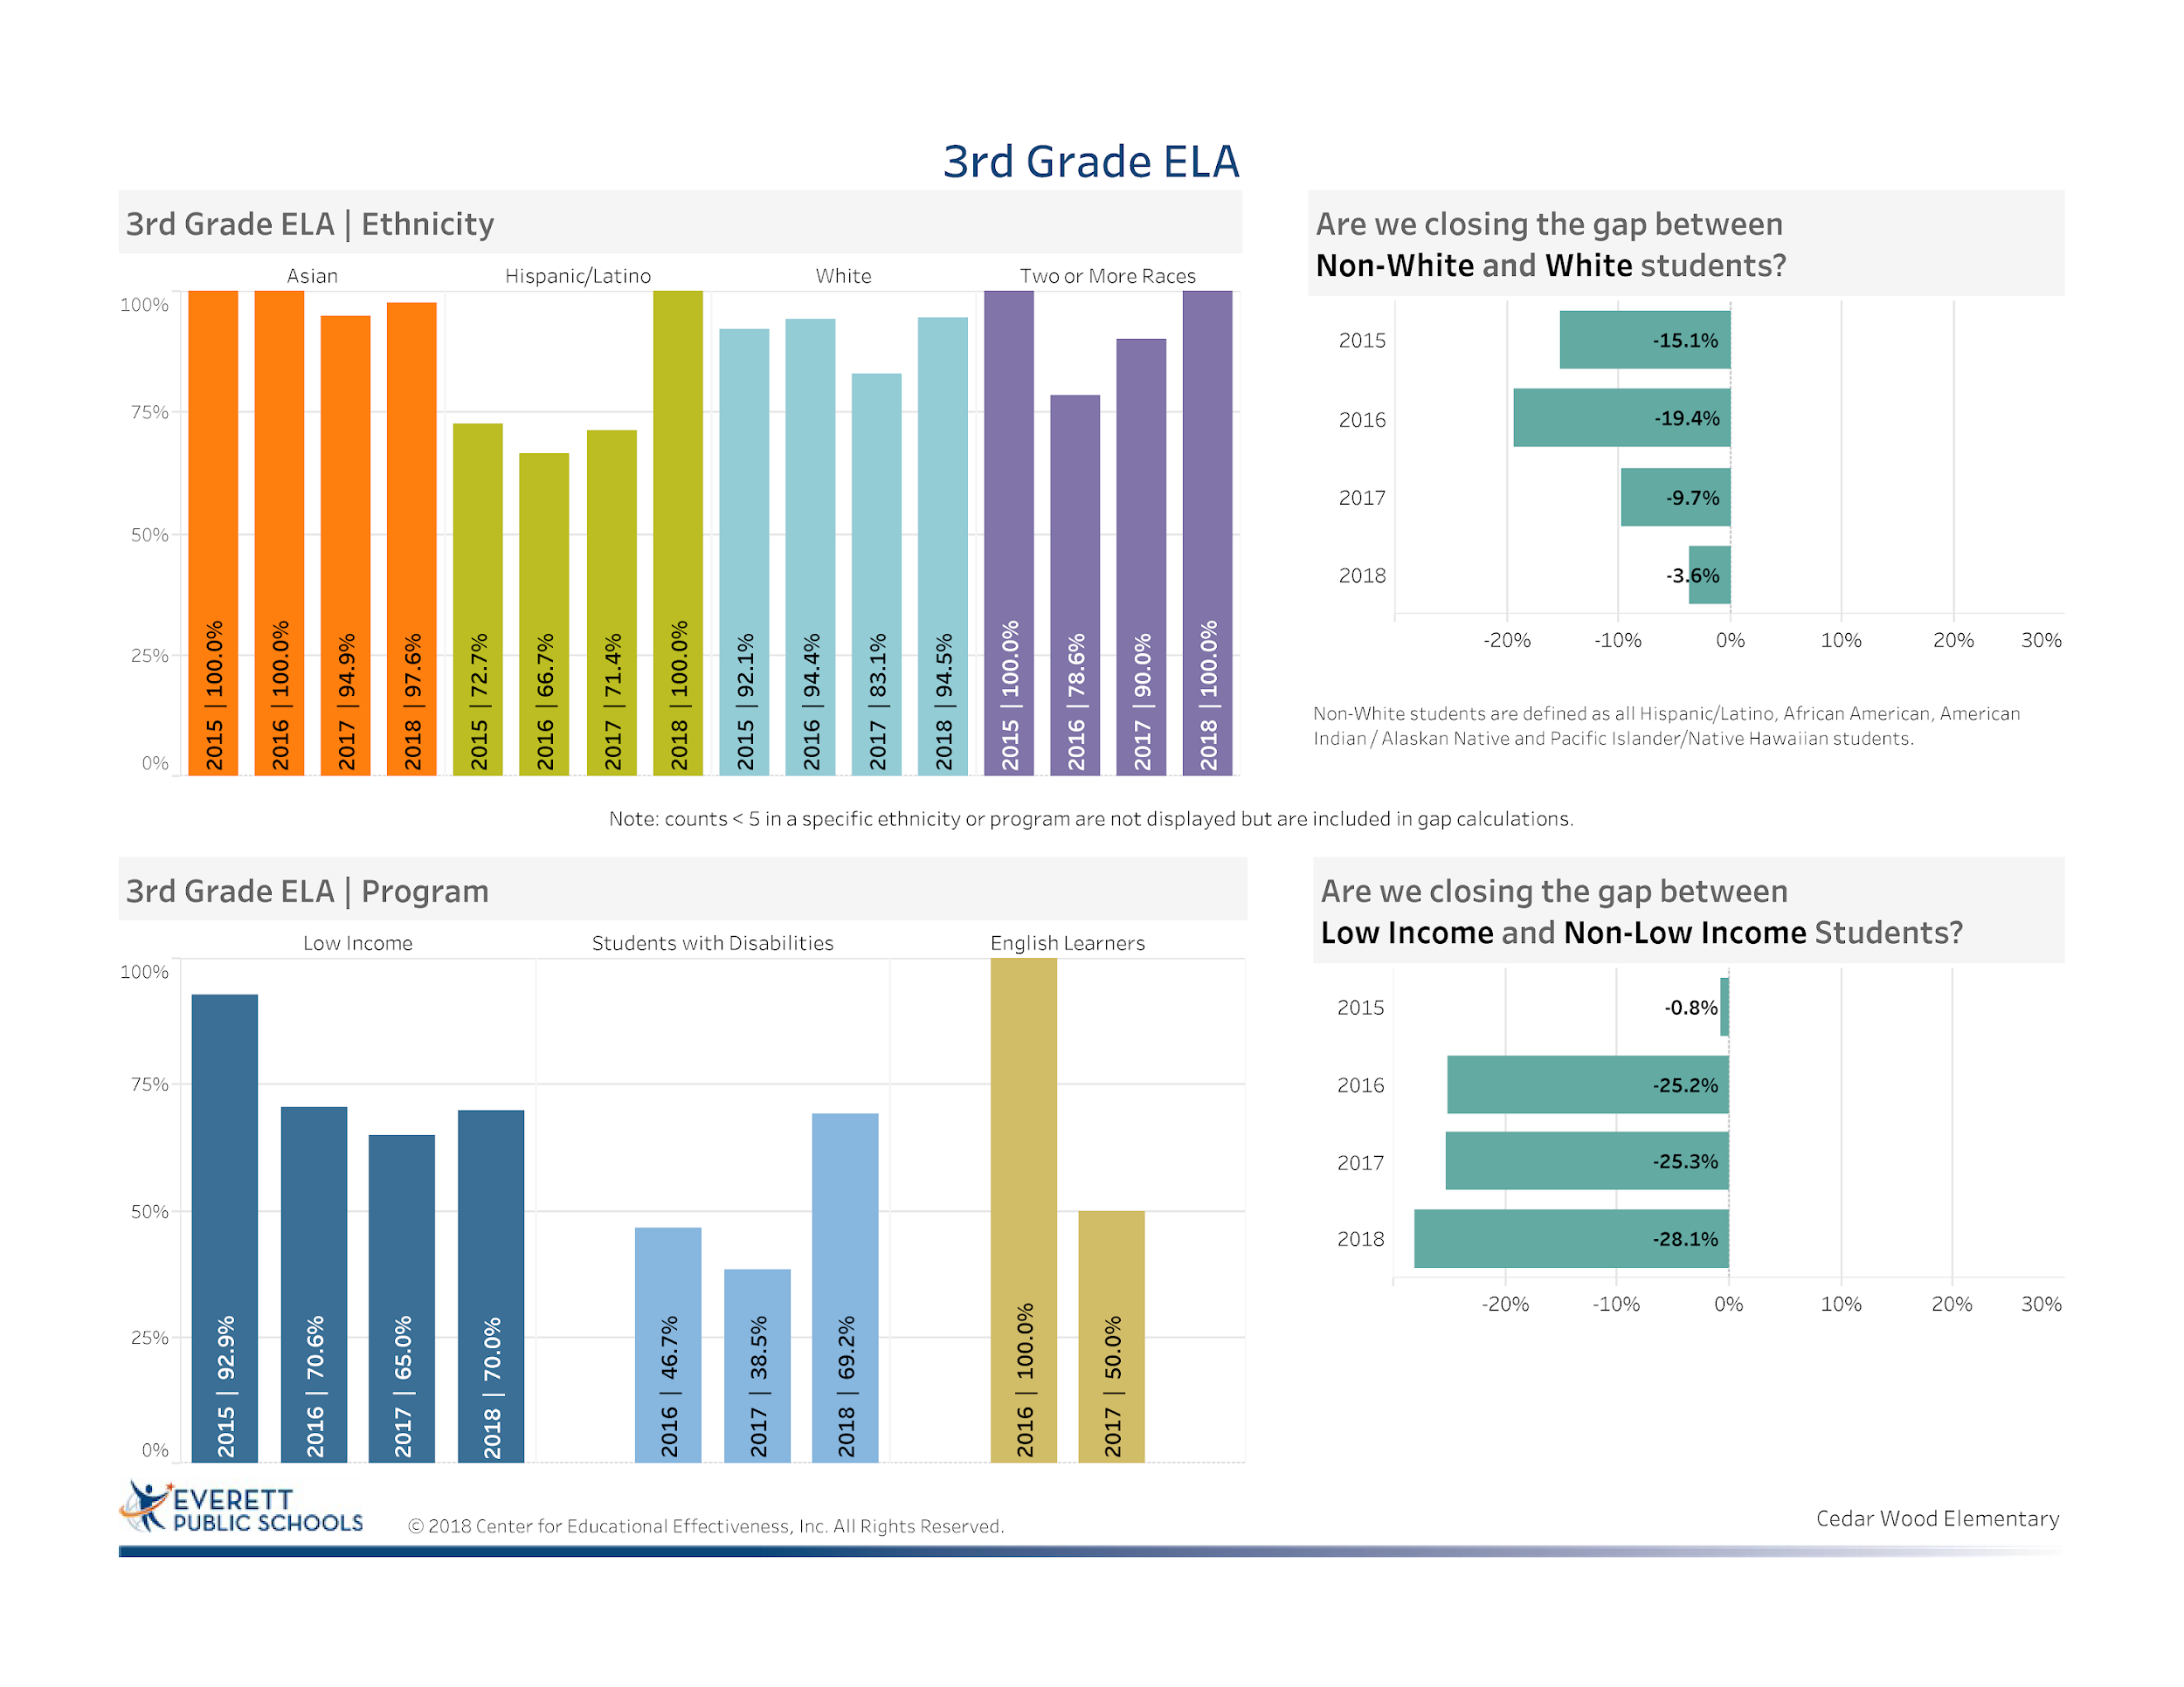
Notes:
A deliberate focus on our non-white students allowed us to decrease the percentage of student NOT making proficient or advanced and have significantly decreased the gap by 11.5% since 2015
Celebration for closing the gap in Special Education was done by more alignment to the Reach for Reading Curriculum and intentionally preparing students for the SBA assessment
An area of focus continues to be in closing the gap for our low income students -even though we had a slight increase in the performance of Low income of 5% the gap is widening over time.

Slide 10
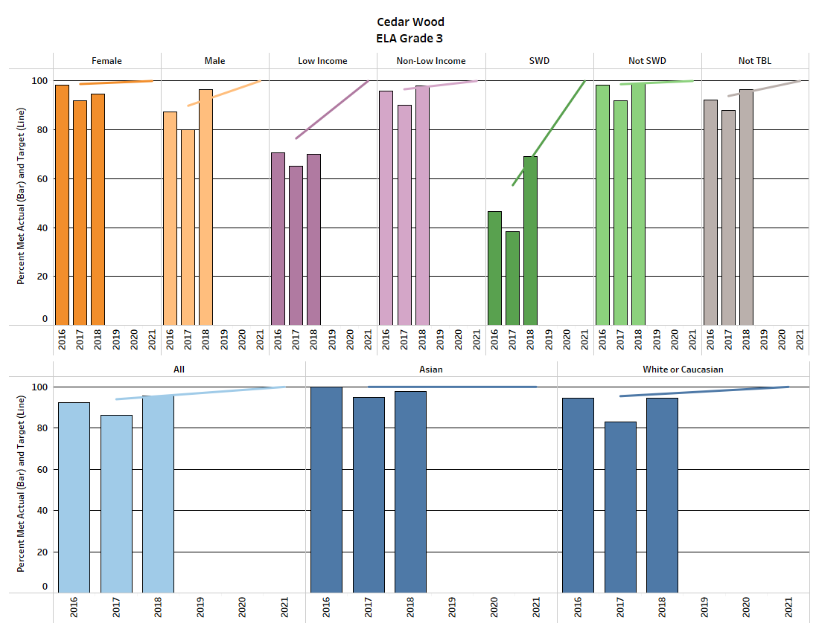

ELA Equity Target Data
Notes:
Our equity target data is in line with the the SBA Achievement Data we just reviewed.
We met 6 of our 10 equity targets
The data does highlight that we need to continue to be more intentional with supporting our Low Income Students. Even though our Low Income Students had a 5% increase from the previous year, this group is still12.4% behind the target for 2018.
We will continue to support students with interventions to ensure success.

Slide 11
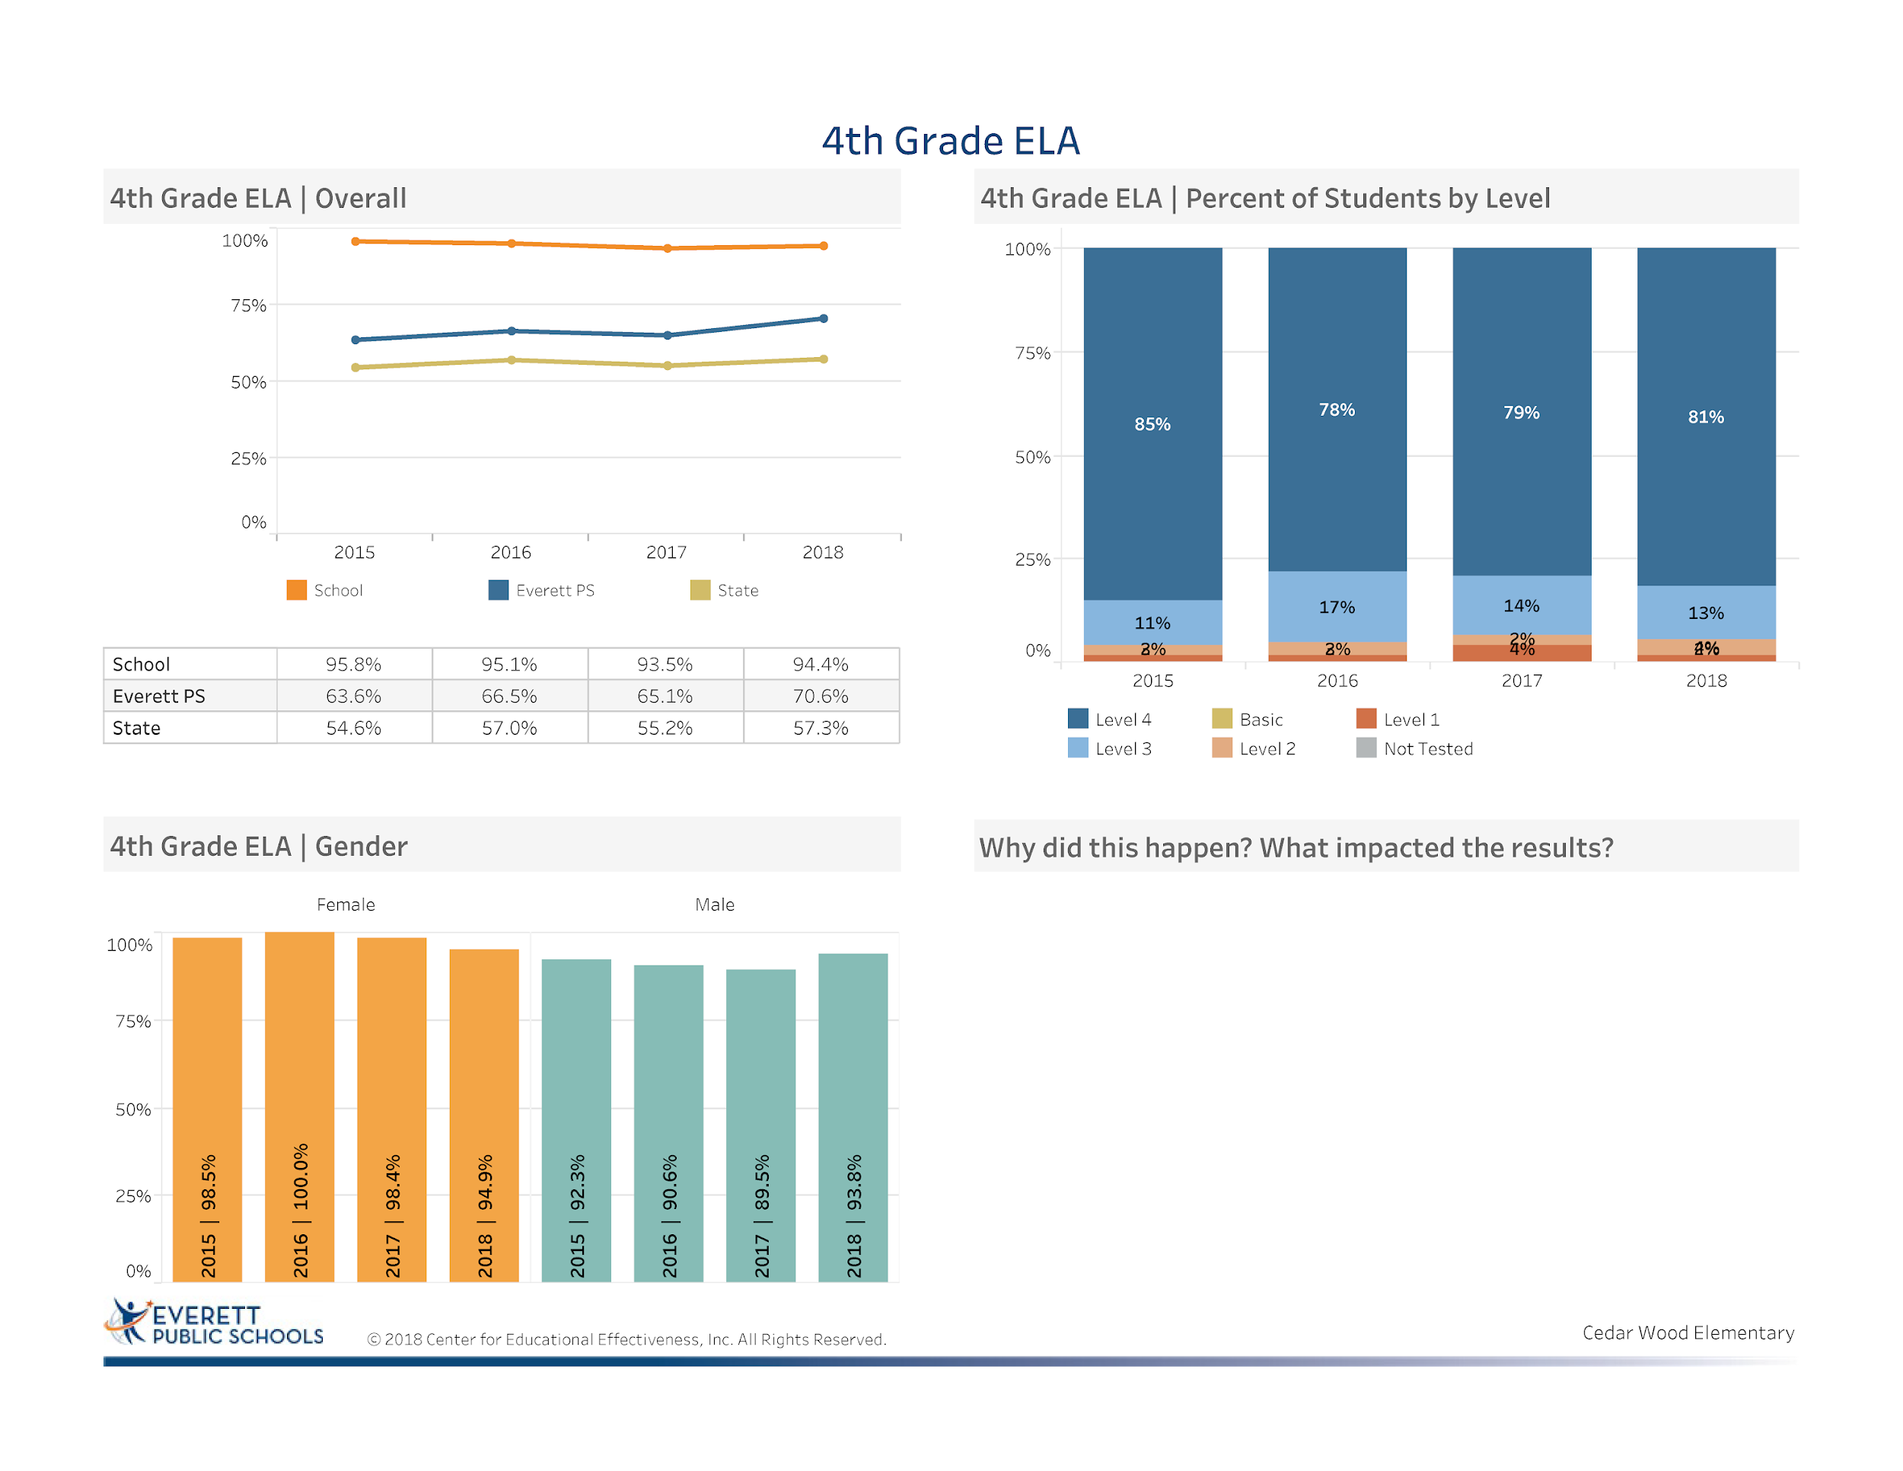
Alignment with the new Reach for Reading Curriculum
Intentional focus on individual students
Implementation of iReady to close achievement gaps and to accelerate learning for advanced students
Notes:
Celebration: Increase of 0.9 % from 2017 to 2018 Area of Focus: What has caused this flat line in 4th grade? Is it the rigor is more difficult for students- hope would be that this year’s fourth graders will do better due to the increases by our last year’s 3rd graders
Celebration: 23.8% above the district average
Celebration: 37% above the state average

Slide 12
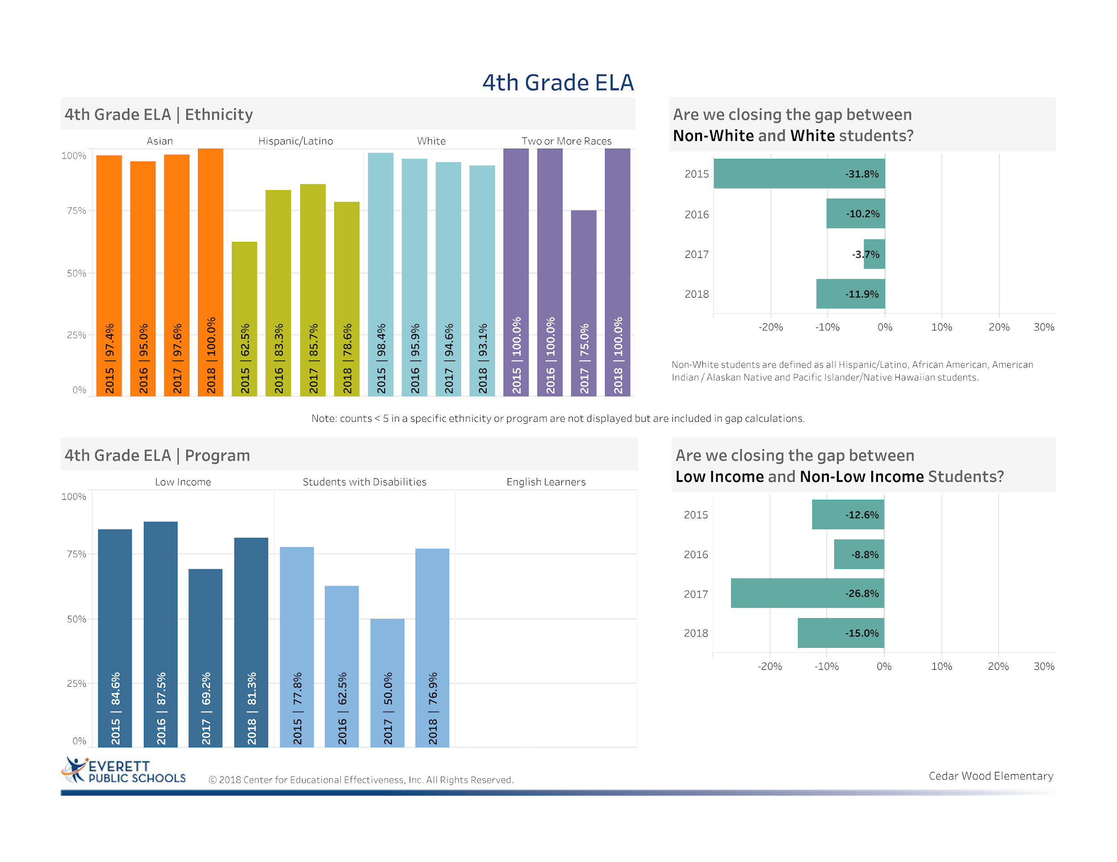
Notes:
Celebration: Decrease of nearly 12% in closing the gap for low income and non-low income students – Excellent results!
Due to increasing the instructional rigor and expectations in special education - a nice increase of 26.9 %
Area of growth: Although we have decreased the gap between non-white and white students by nearly 20% since 2015, we still need to focus on the needs of non-white students to close this gap. Especially our Hispanic population

Slide 13
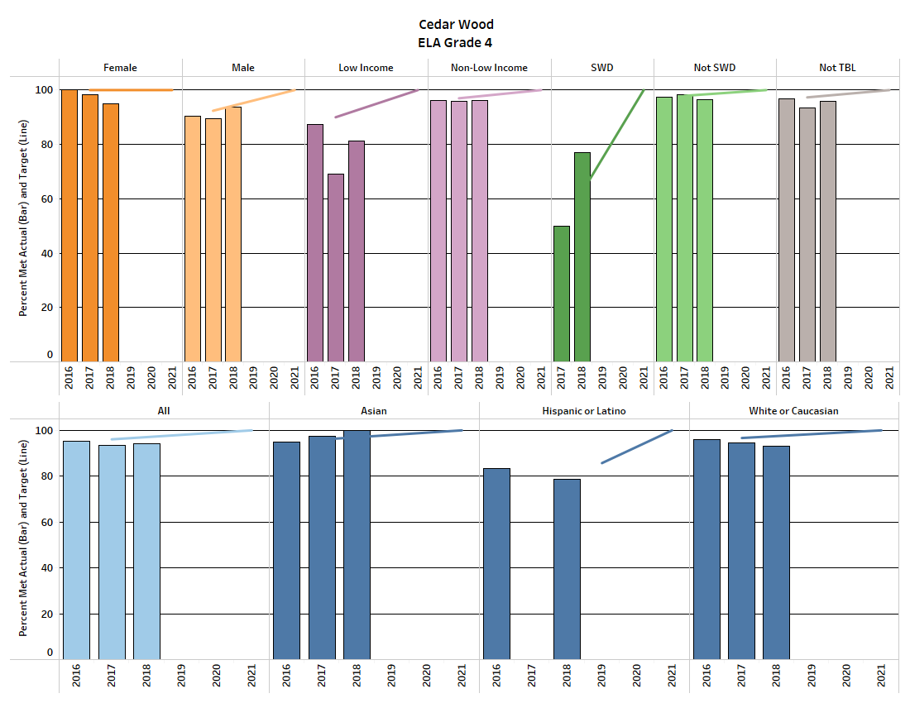
ELA Equity Target Data
Notes:
Our fourth grade increased in most areas but only 2 out of 10 equity targets were met for the 2018 target
We are celebrating the increase of 12% growth from 2017 to 2018 for our low income students but realize that we still have a gap of 11% from our 2018 target
We are also celebrating an increase of 27% growth from 2017 to 2018 for our Student with Disabilities and exceeding our 2018 target goal by 14%
Our achievement in fourth grade was great because of the complete implementation of Reach, focused interventions for students, increased instructional rigor to support all students.

Slide 14
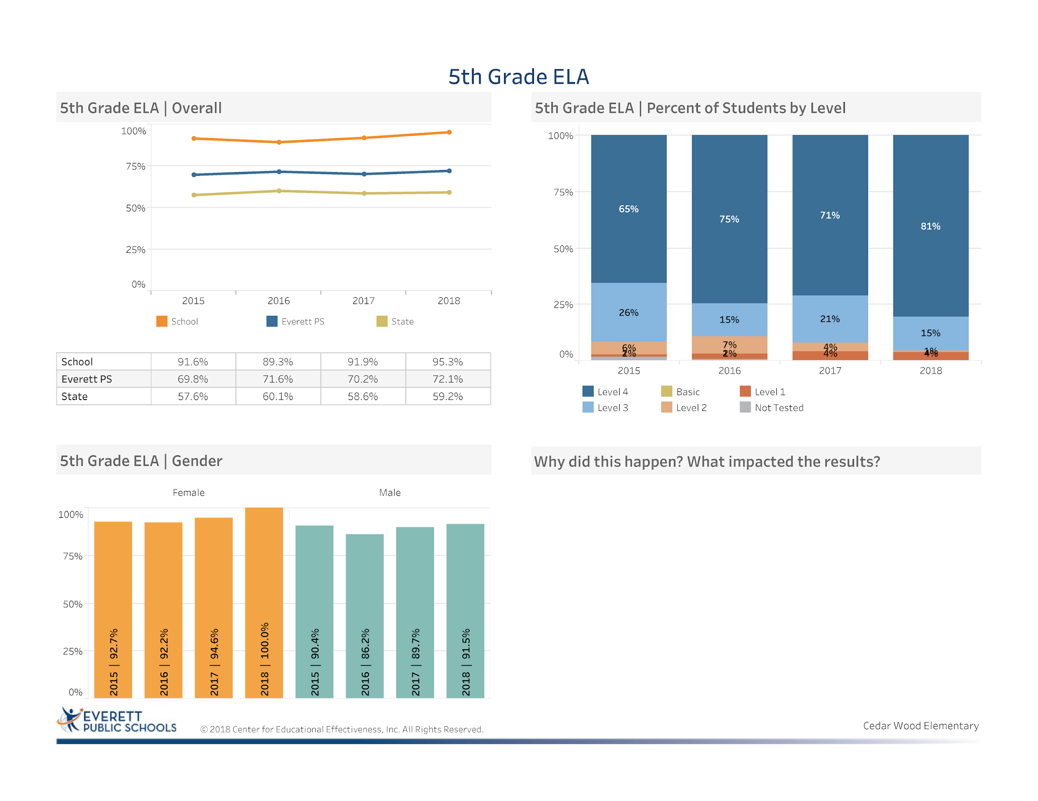
.
Alignment with the new Reach for Reading Curriculum
Implementation of iReady to close the gaps for some students and accelerate learning for others. Data meetings to identify students needed additional support
Strategic use of Smarter Balance Interim Assessments
Increase use of high leverage strategies to support student growth
Notes:
Celebration: Increase of 3.4% proficient or advanced from 2017 to 2018
Celebration: 23% above the district average
Celebration: 36% above the state average

Slide 15
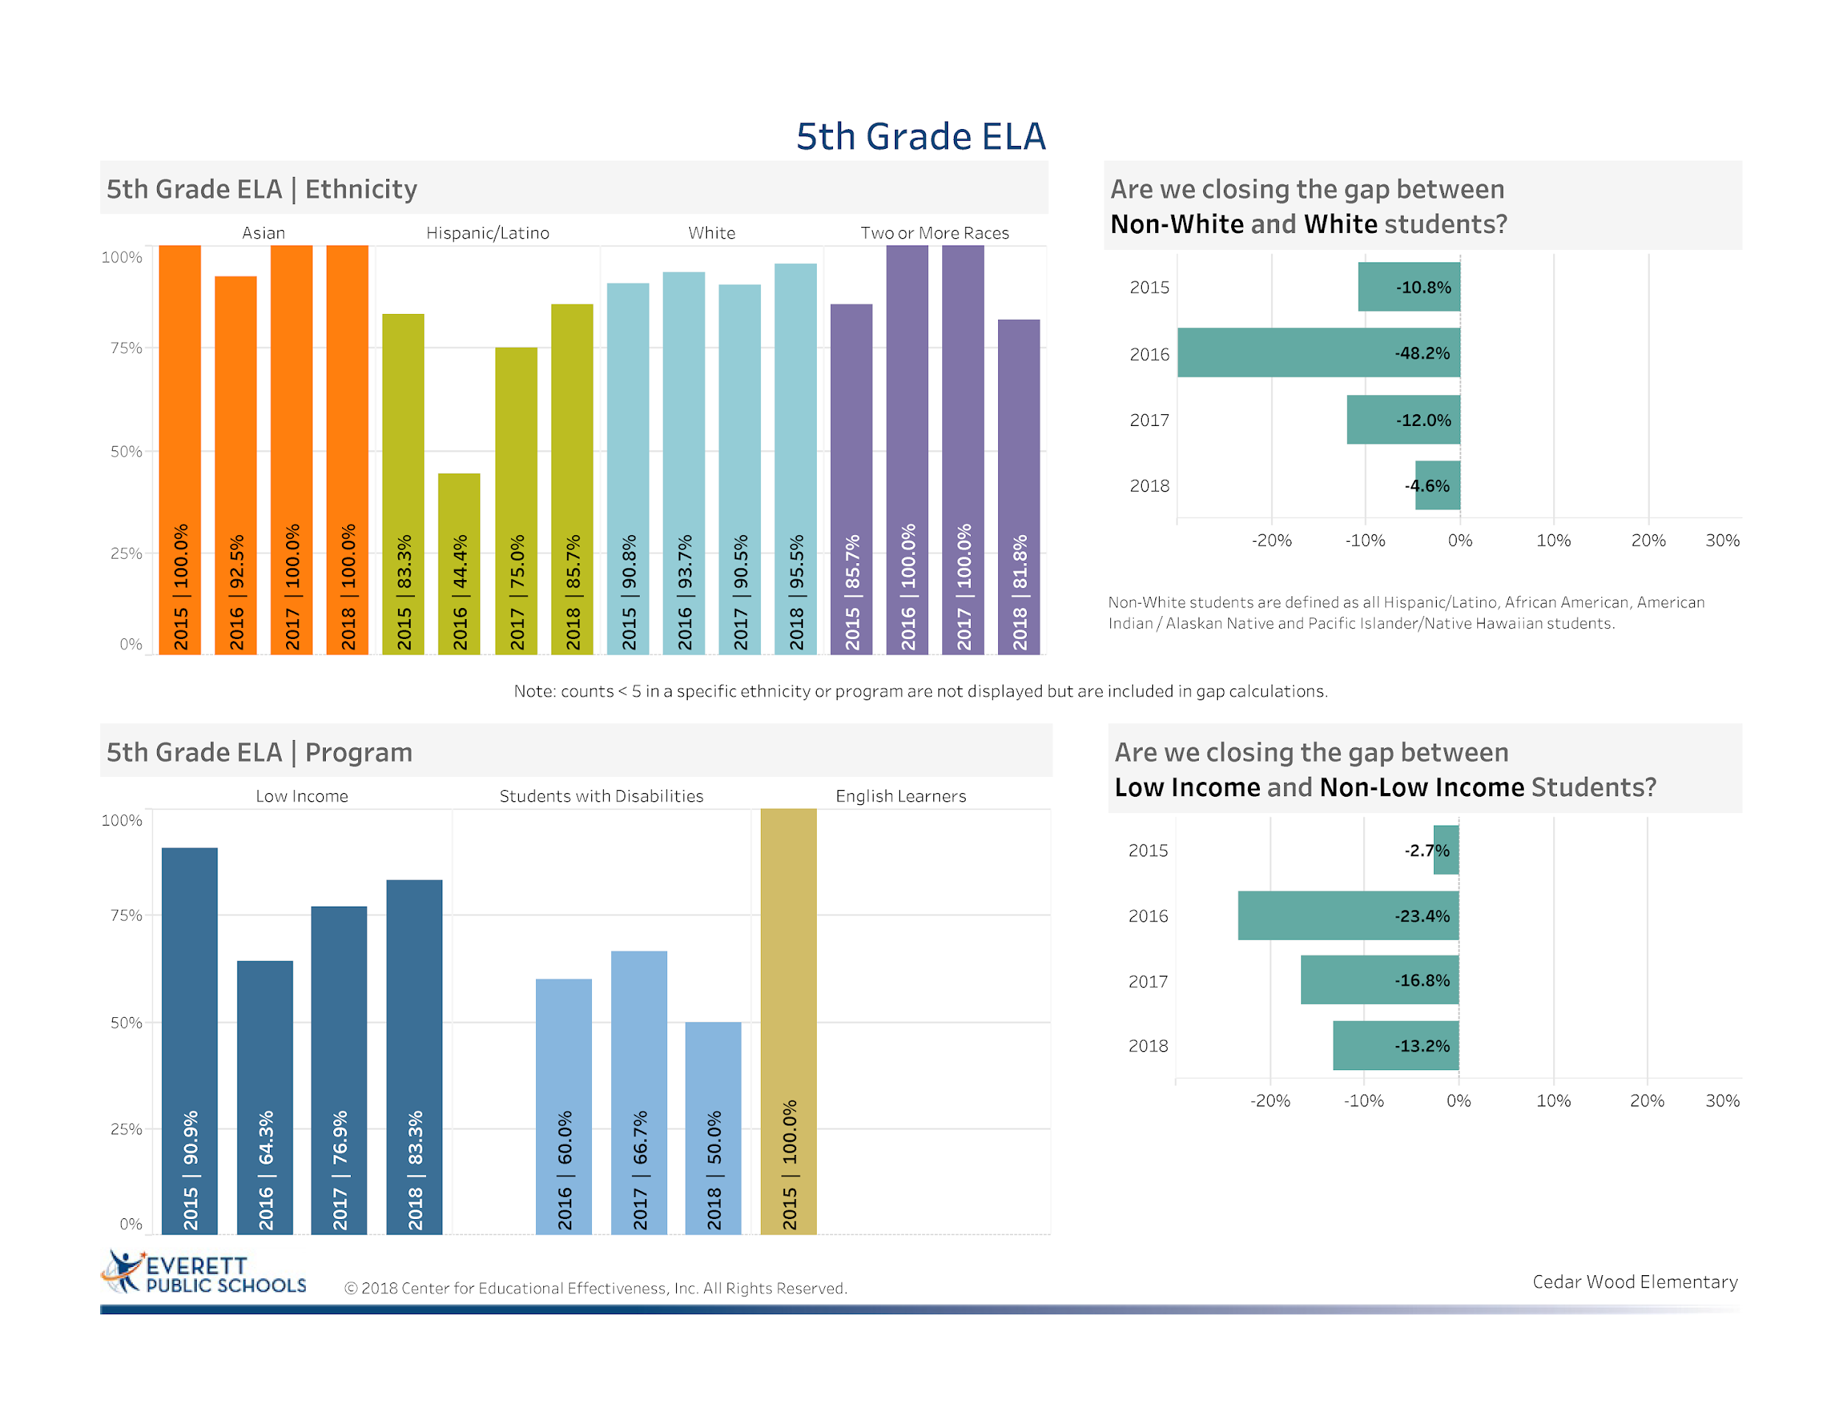
Notes:
Cedar Wood Fifth Grade team worked very hard to build purposeful strategies for each student that was at level 1 and 2 in fourth grade ELA to support their growth
Celebration closed the gap between non-whites and whites by 7.4%
Celebration closed the gap between non-low income students and low income students by 6.4% (from the 4th grade cadre increase of about 10%)

Slide 16
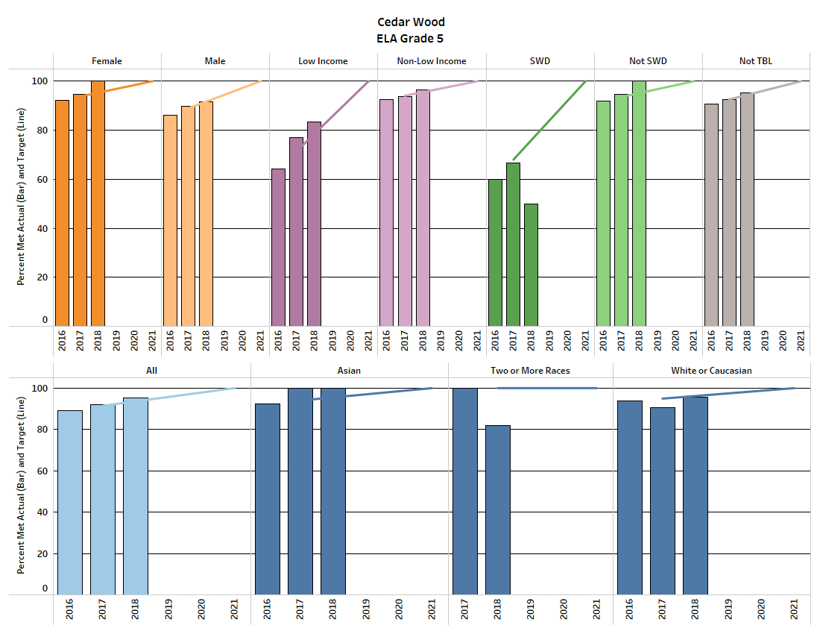
ELA Equity Target Data
Notes:
Fifth Grade ELA Equity targets were met in 7 of 10 categories which is a celebration
This was achieved by:Alignment with the new Reach for Reading Curriculum
Implementation of iReady to close the gaps for some students and accelerate learning for others. Data meetings to identify students needed additional support
Strategic use of Smarter Balance Interim Assessments
Increase use of high leverage strategies to support student growth
Areas of concern are still in the area of Students with Disabilities where only 6 of 12 students reaching proficiency.
Celebrations: Increases in the following areas: Females, males, low income, non-low income, non-students with disabilities, not TBL, all students white
Areas of Concern: Students with disabilities (Need further Reach for Reading PD for Achieve students) ; students of two or more races

Slide 17
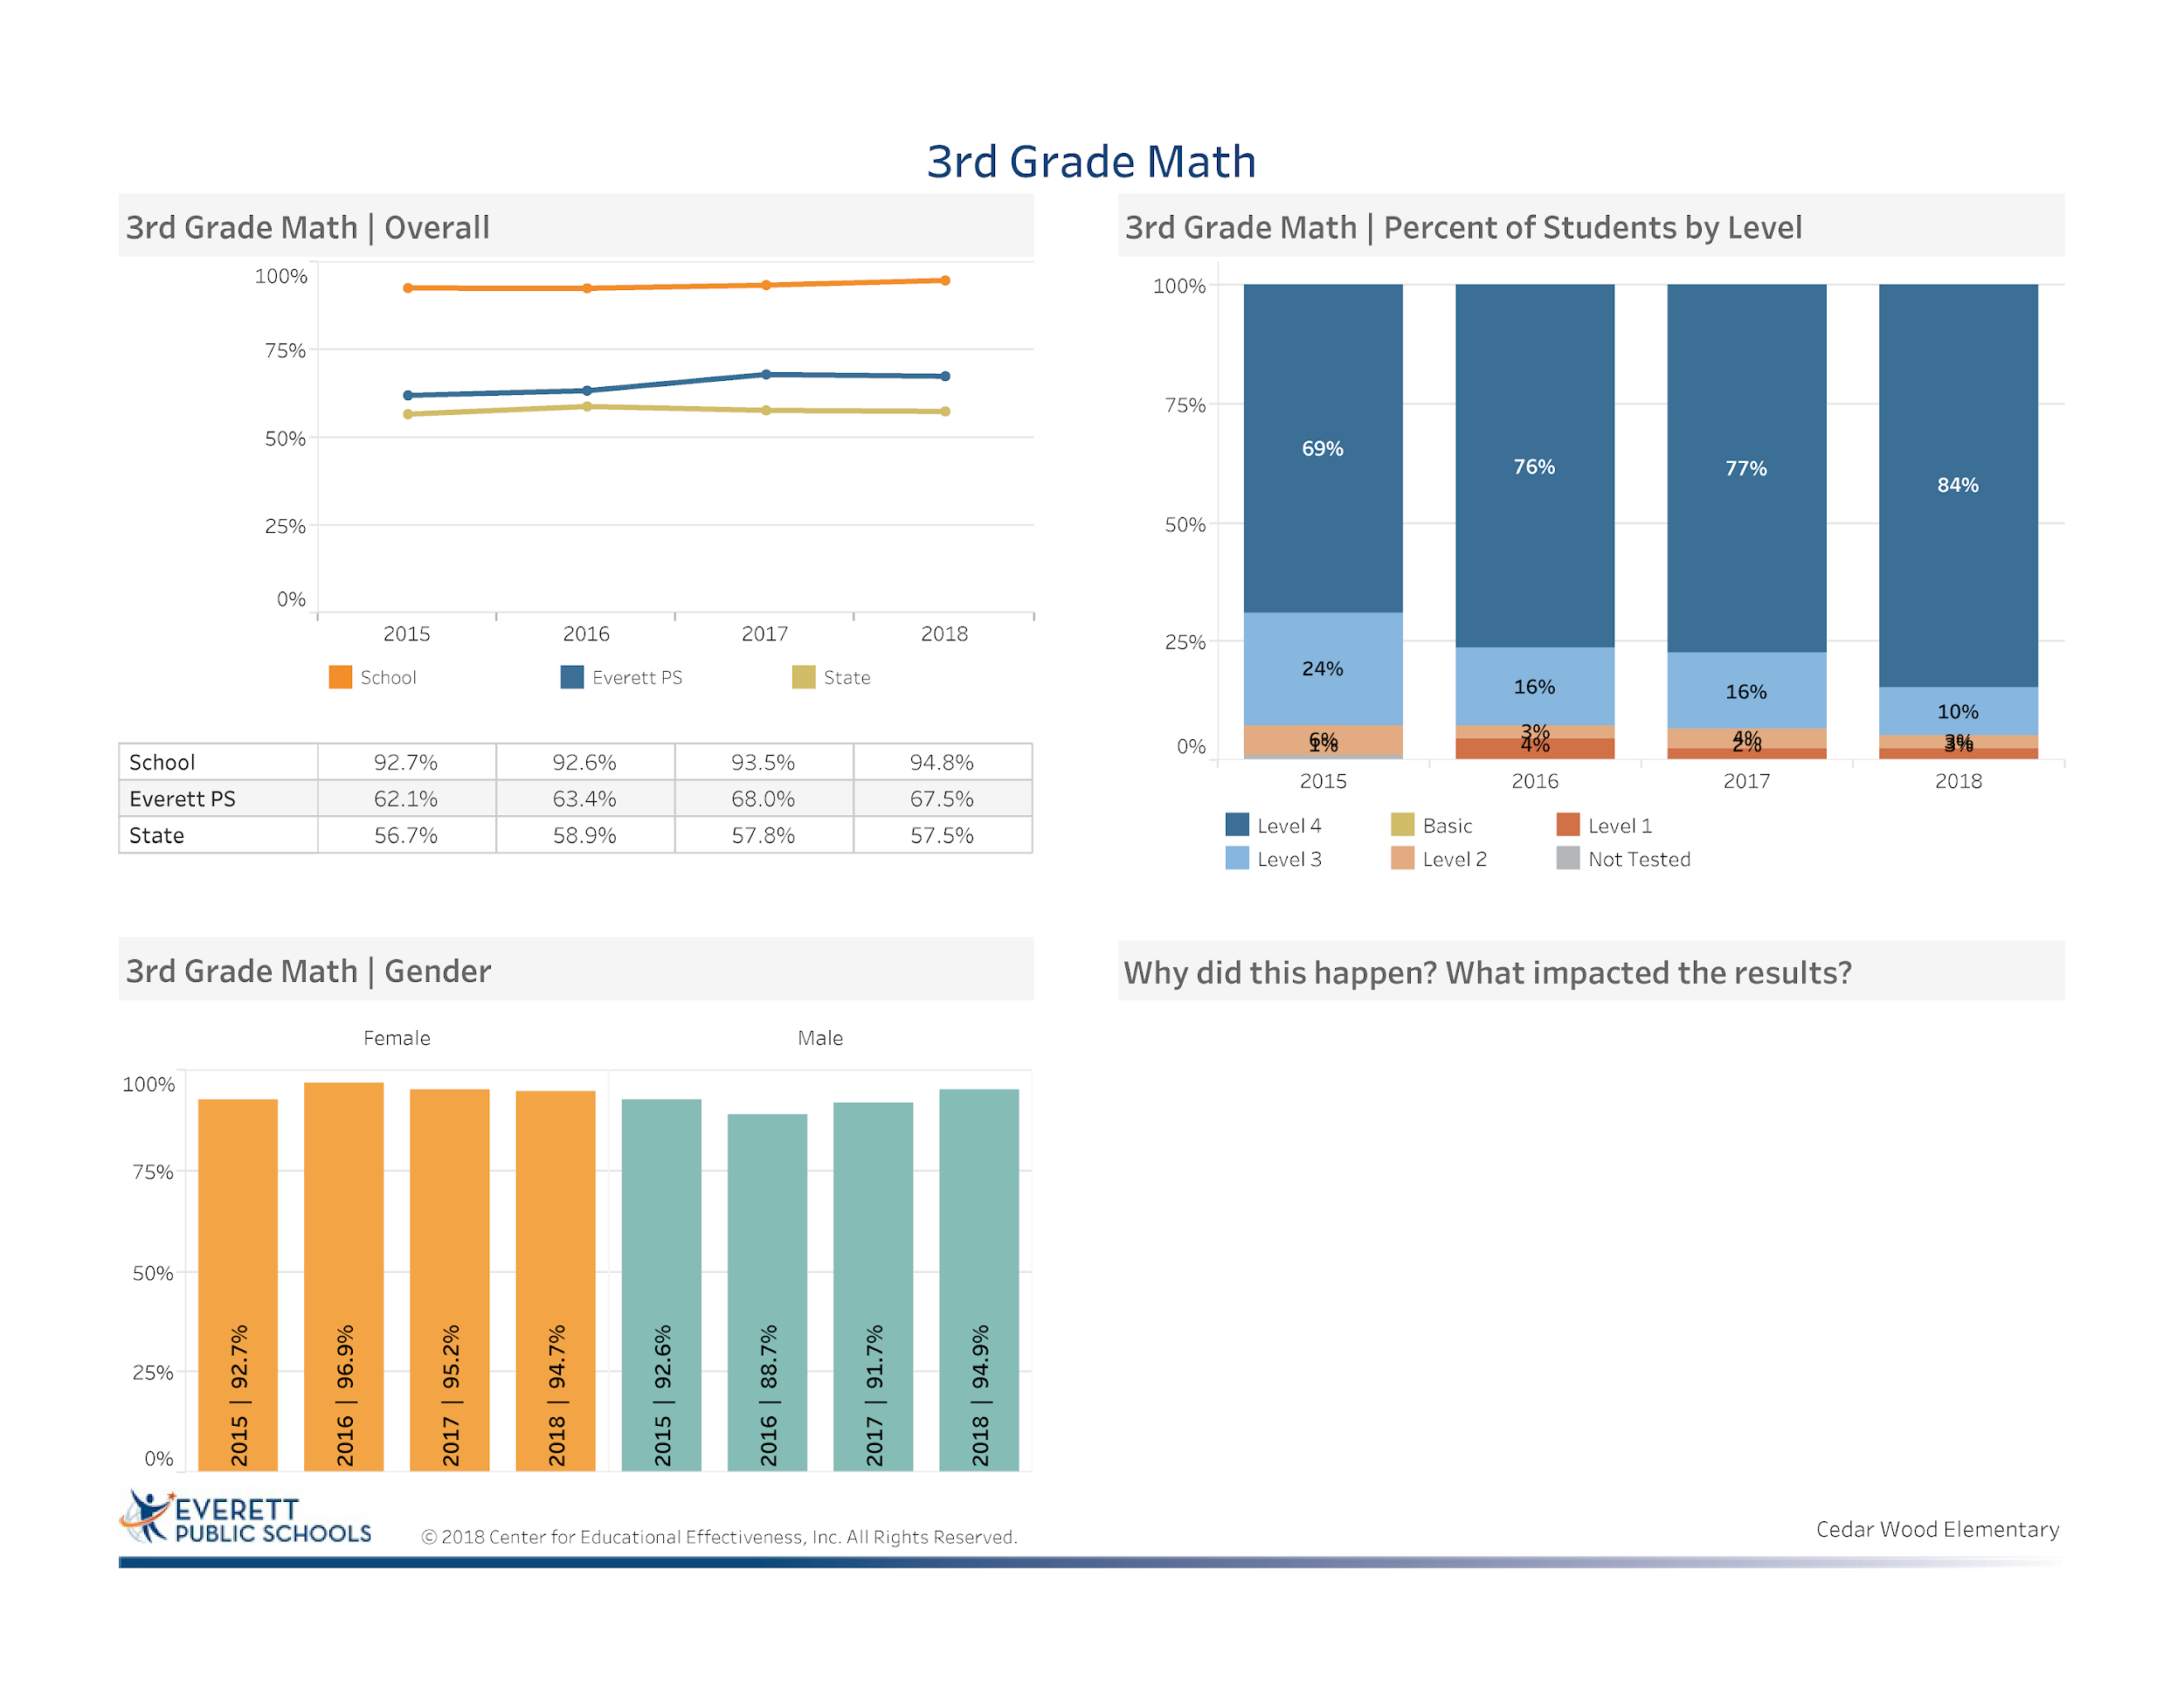
Implementation of Balanced Math Routines and using calendar for accountability
Implementation of iReady Math to eliminate students’ gaps and accelerate learning for other students
Strategic use of the Smarter Balance Interim Assessments to support students in preparation for the SBA
Strategically planned Parent SBA Information Event
Before school intervention groups
Notes:
We now shift to Mathematics
Celebration: Increase in the percentage of students proficient or advanced by 1.3%
Celebration: 27.3% above District Average
Celebration: 37.3 % above state average
Still concerned around the students at level 1

Slide 18
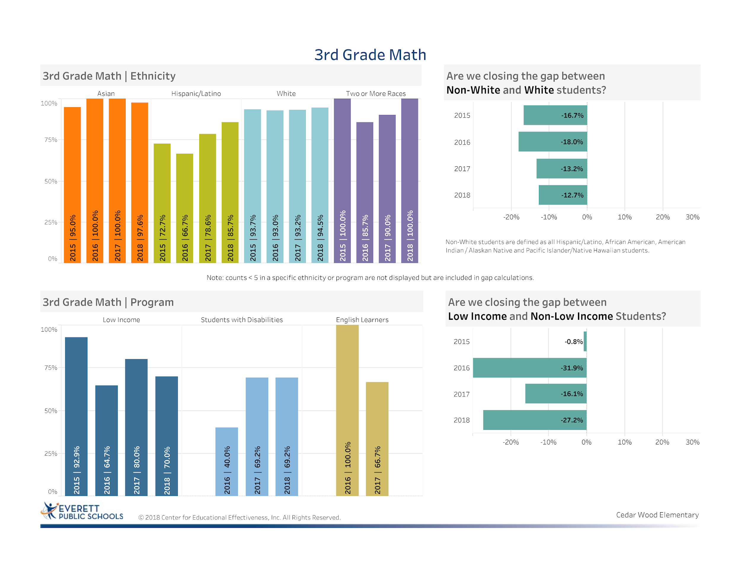
Notes:
Celebration: Closed the gap between non-white and white students by 0.5%
Celebration: Steady increase in performance of Hispanic Students
Celebration: 100 % of our students of two races (8 students) made proficiency
Area of Growth: Focus still remains on the performance of our low income and non-low income students. There was an increase of 11% from the previous year.

Slide 19
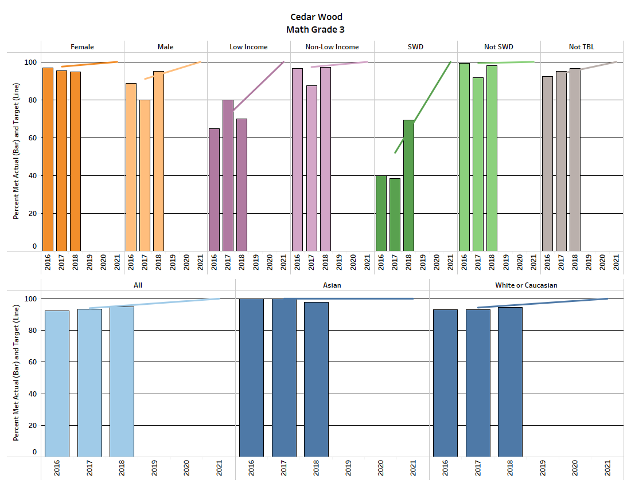
Math Equity Target Data
Notes:
Most areas stayed close to the same and some with increases when you look from year to year.
Celebration in the area of Students with Disabilities was 5.2% above the target for 2018
We met only 3 of our 10- 2018 equity targets
Low income students were 8.8% below the 2018 equity target
This reflection of not making target has been addressed in the current school year by professional development in Math Workshop and OEL Trainings as well as student work using iReady. We feel that based on the I Ready diagnostic scores and intentional practice in areas of need that students will be more successful in the 2019 SBA
Implementation of Balanced Math Routines and using calendar for accountability
Implementation of iReady Math to eliminate students’ gaps and accelerate learning for other students
Strategic use of the Smarter Balance Interim Assessments to support students in preparation for the SBA
Strategically planned Parent SBA Information Event
Before school intervention groups

Slide 20
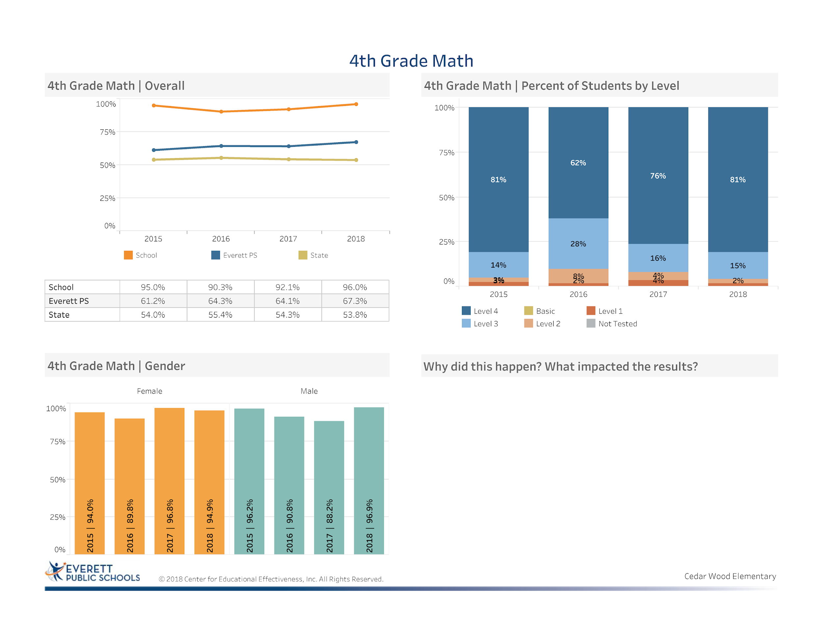
Implementation of Number Strings and Math Discourse
Implementation of iReady Math to eliminate students’ gaps and accelerate learning for other students
Strategic use of the Smarter Balance Interim Assessments to support students in preparation for the Smarter Balance Assessment
Notes:
Celebration: Increase of percentage of students obtaining proficient or advanced increased nearly 4%
Increase of 2% from third to fourth grade of males being proficient
Closed the gap for our level 1 and 2 students
Celebration: 28.7% above the district average
Celebration: 42.2% above the state average
Implementation of Number Strings and Math Discourse
Implementation of iReady Math to eliminate students’ gaps and accelerate learning for other students
Strategic use of the Smarter Balance Interim Assessments to support students in preparation for the Smarter Balance Assessment

Slide 21
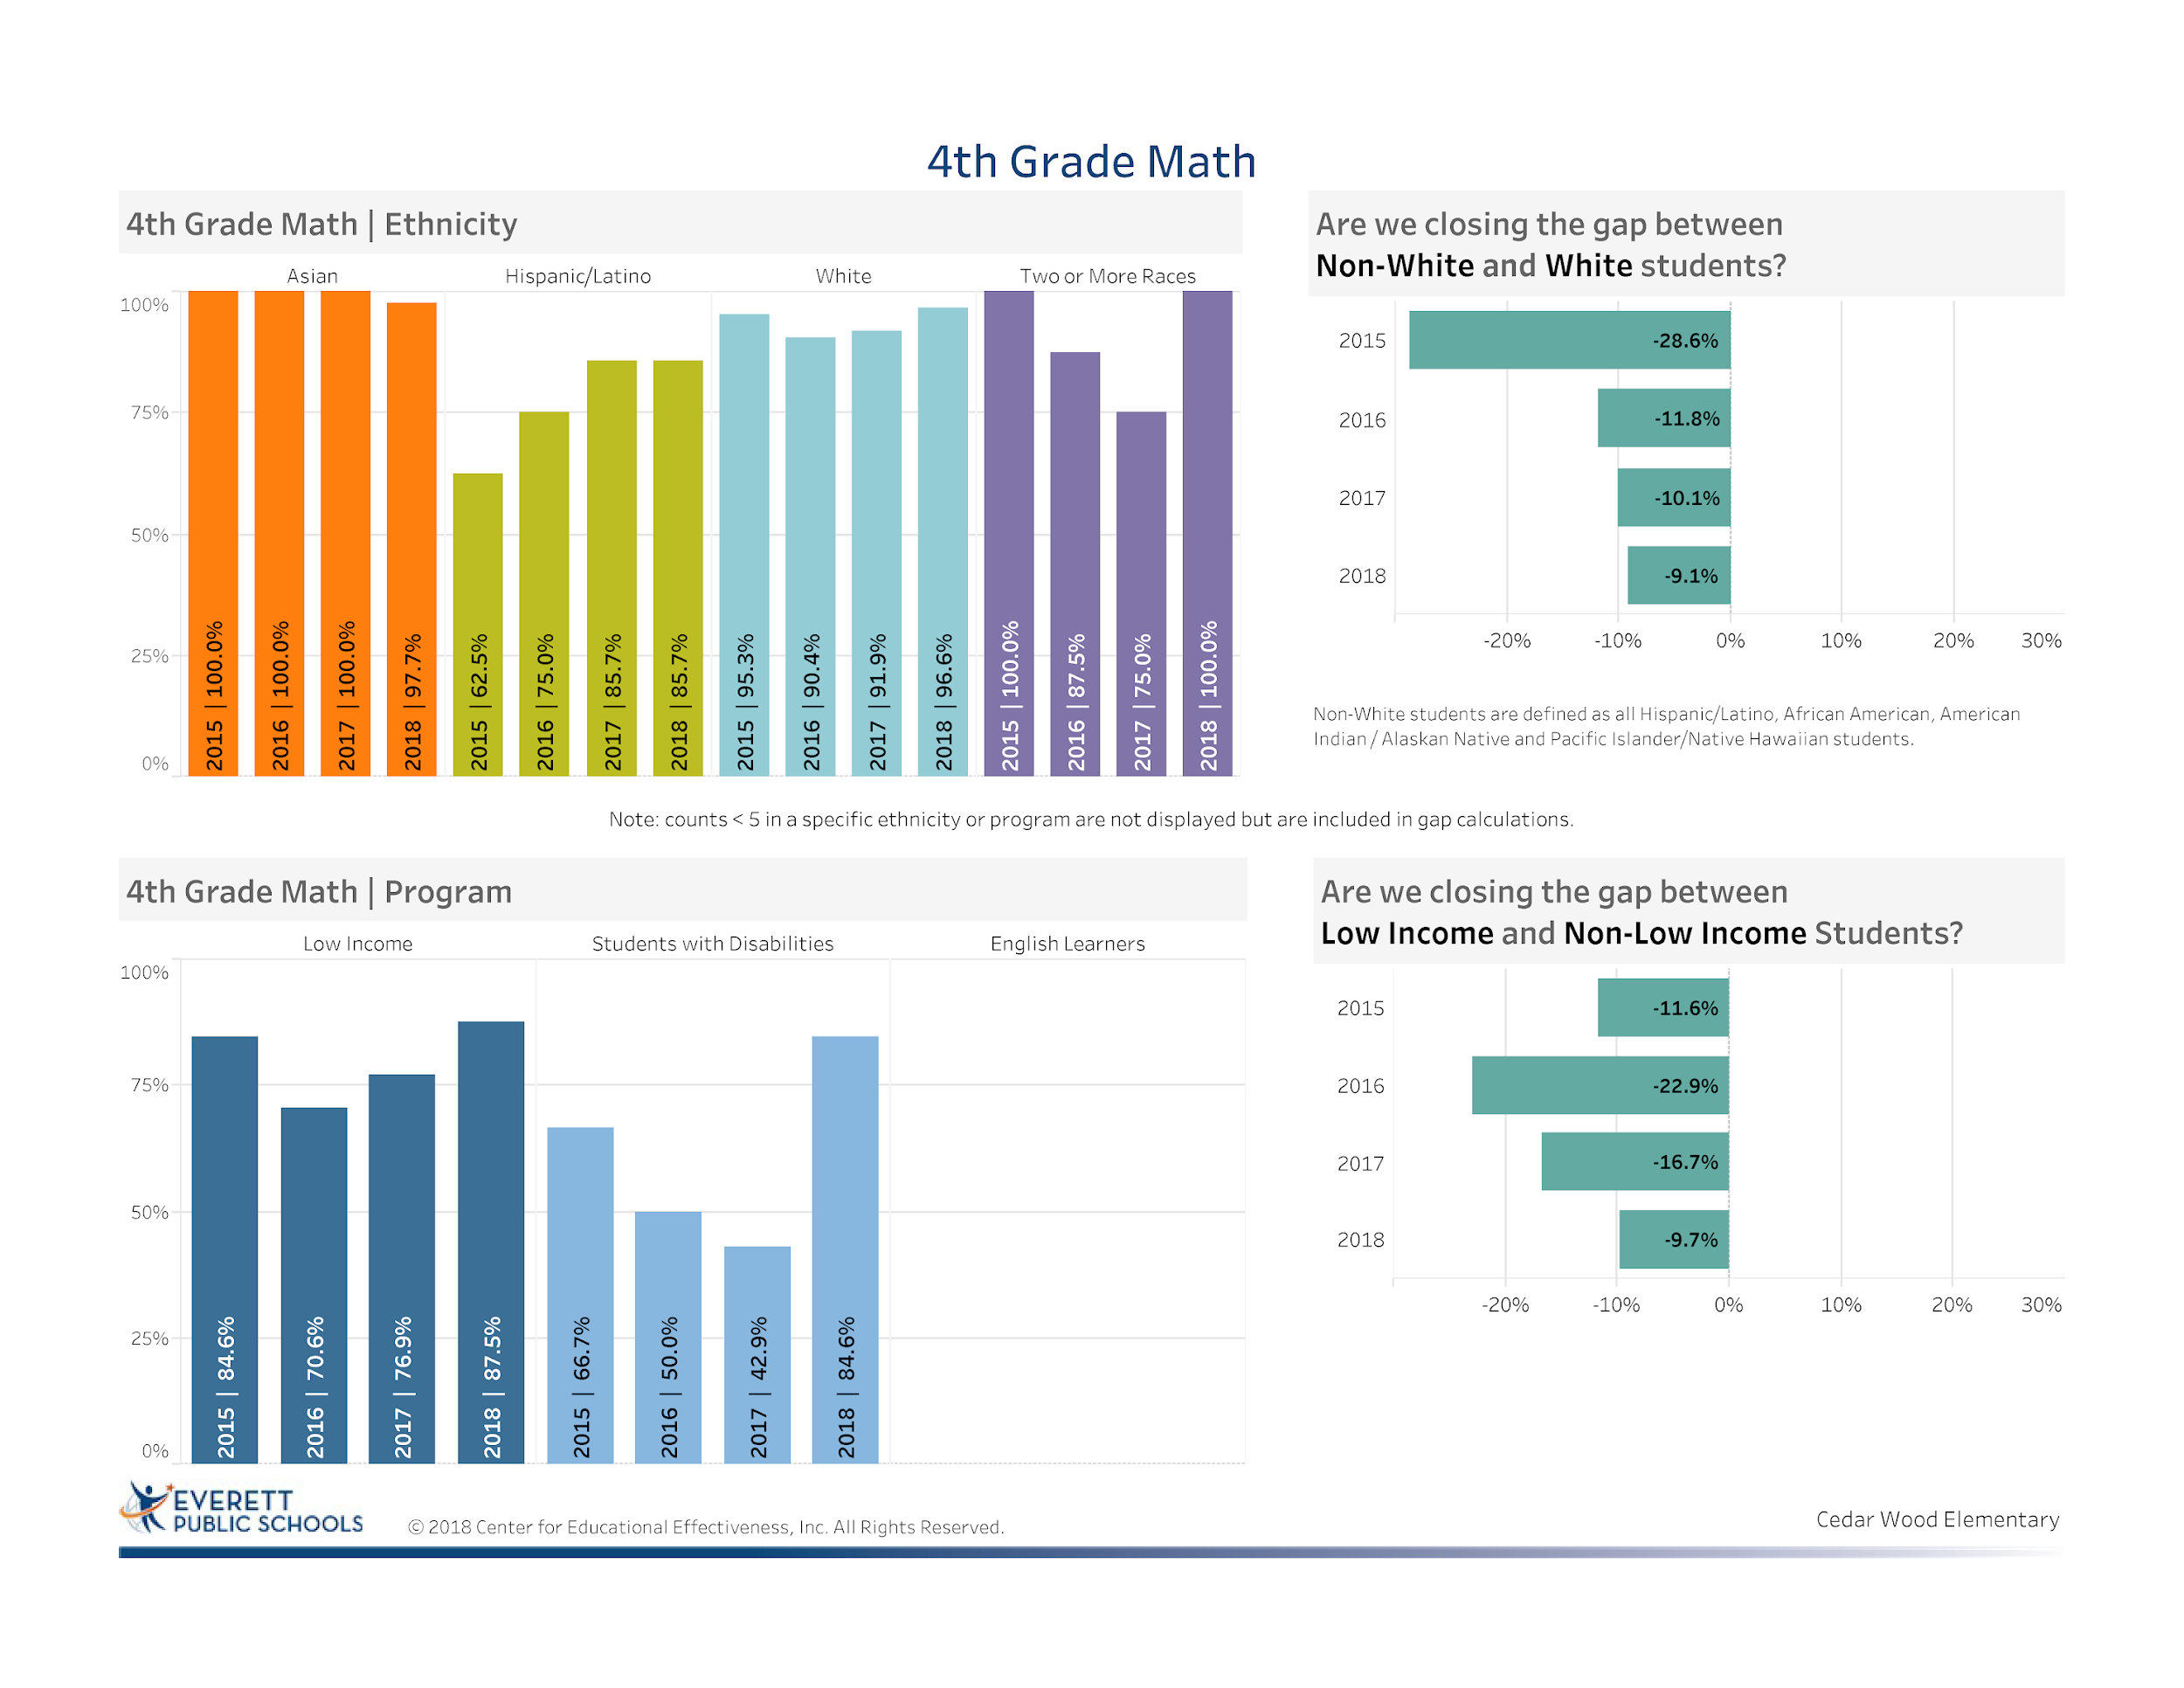
Notes:
Celebration closed the gap between non-white and white by 1% from 2017; overall gap closing 19.5% since 2015 (explanation)
Celebration closed the gap between low income and non-income students by 7% from 2017
Celebration of nearly 41.7% SWD from previous year - Cadre increase about 14%
Every sub group improved their performance except a slight decrease in our Asian population

Slide 22
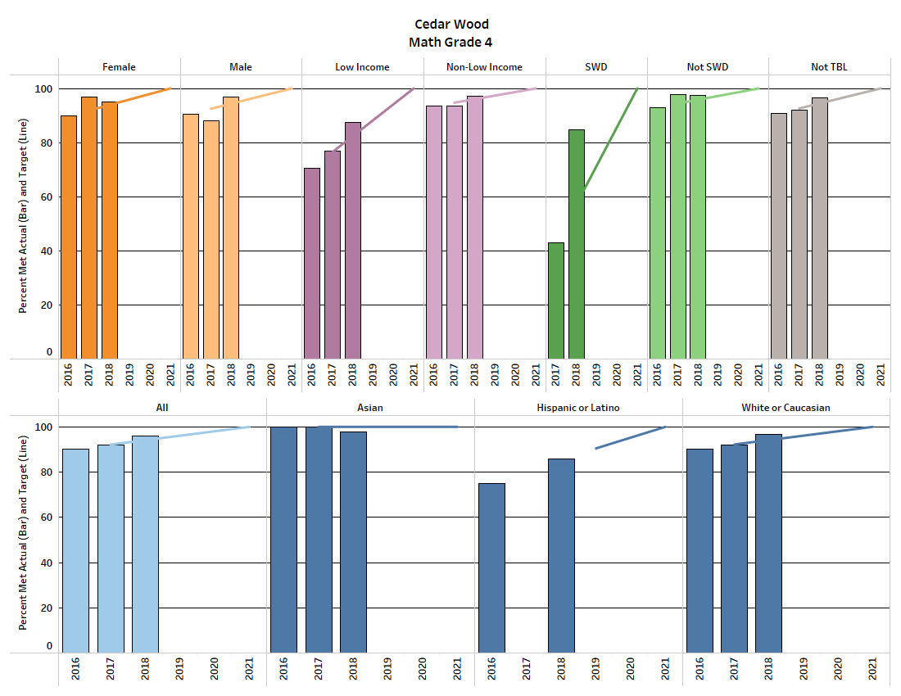
Math Equity Target Data
Notes:
Areas of concern: females, Asian students
Key is to continue to account for all students especially those that are in level 1 and 2
Cause for celebration. Due to the focused professional development in OEL, Number Strings, and increased dialogue, use of iReady 4th grade met 9 out of 10 equity targets for 2018.
Of significance are two areas that have been an area of growth for many years at CWE. Our low income students achieved 5.1% above the equity target and our Special Education students achieved 27.4% above the 2018 equity target
These data points have helped to establish the validity of guided math, math workshop model of instruction, focused professional development and the hard work of our 4th grade team in supporting the growth of all students.

Slide 23
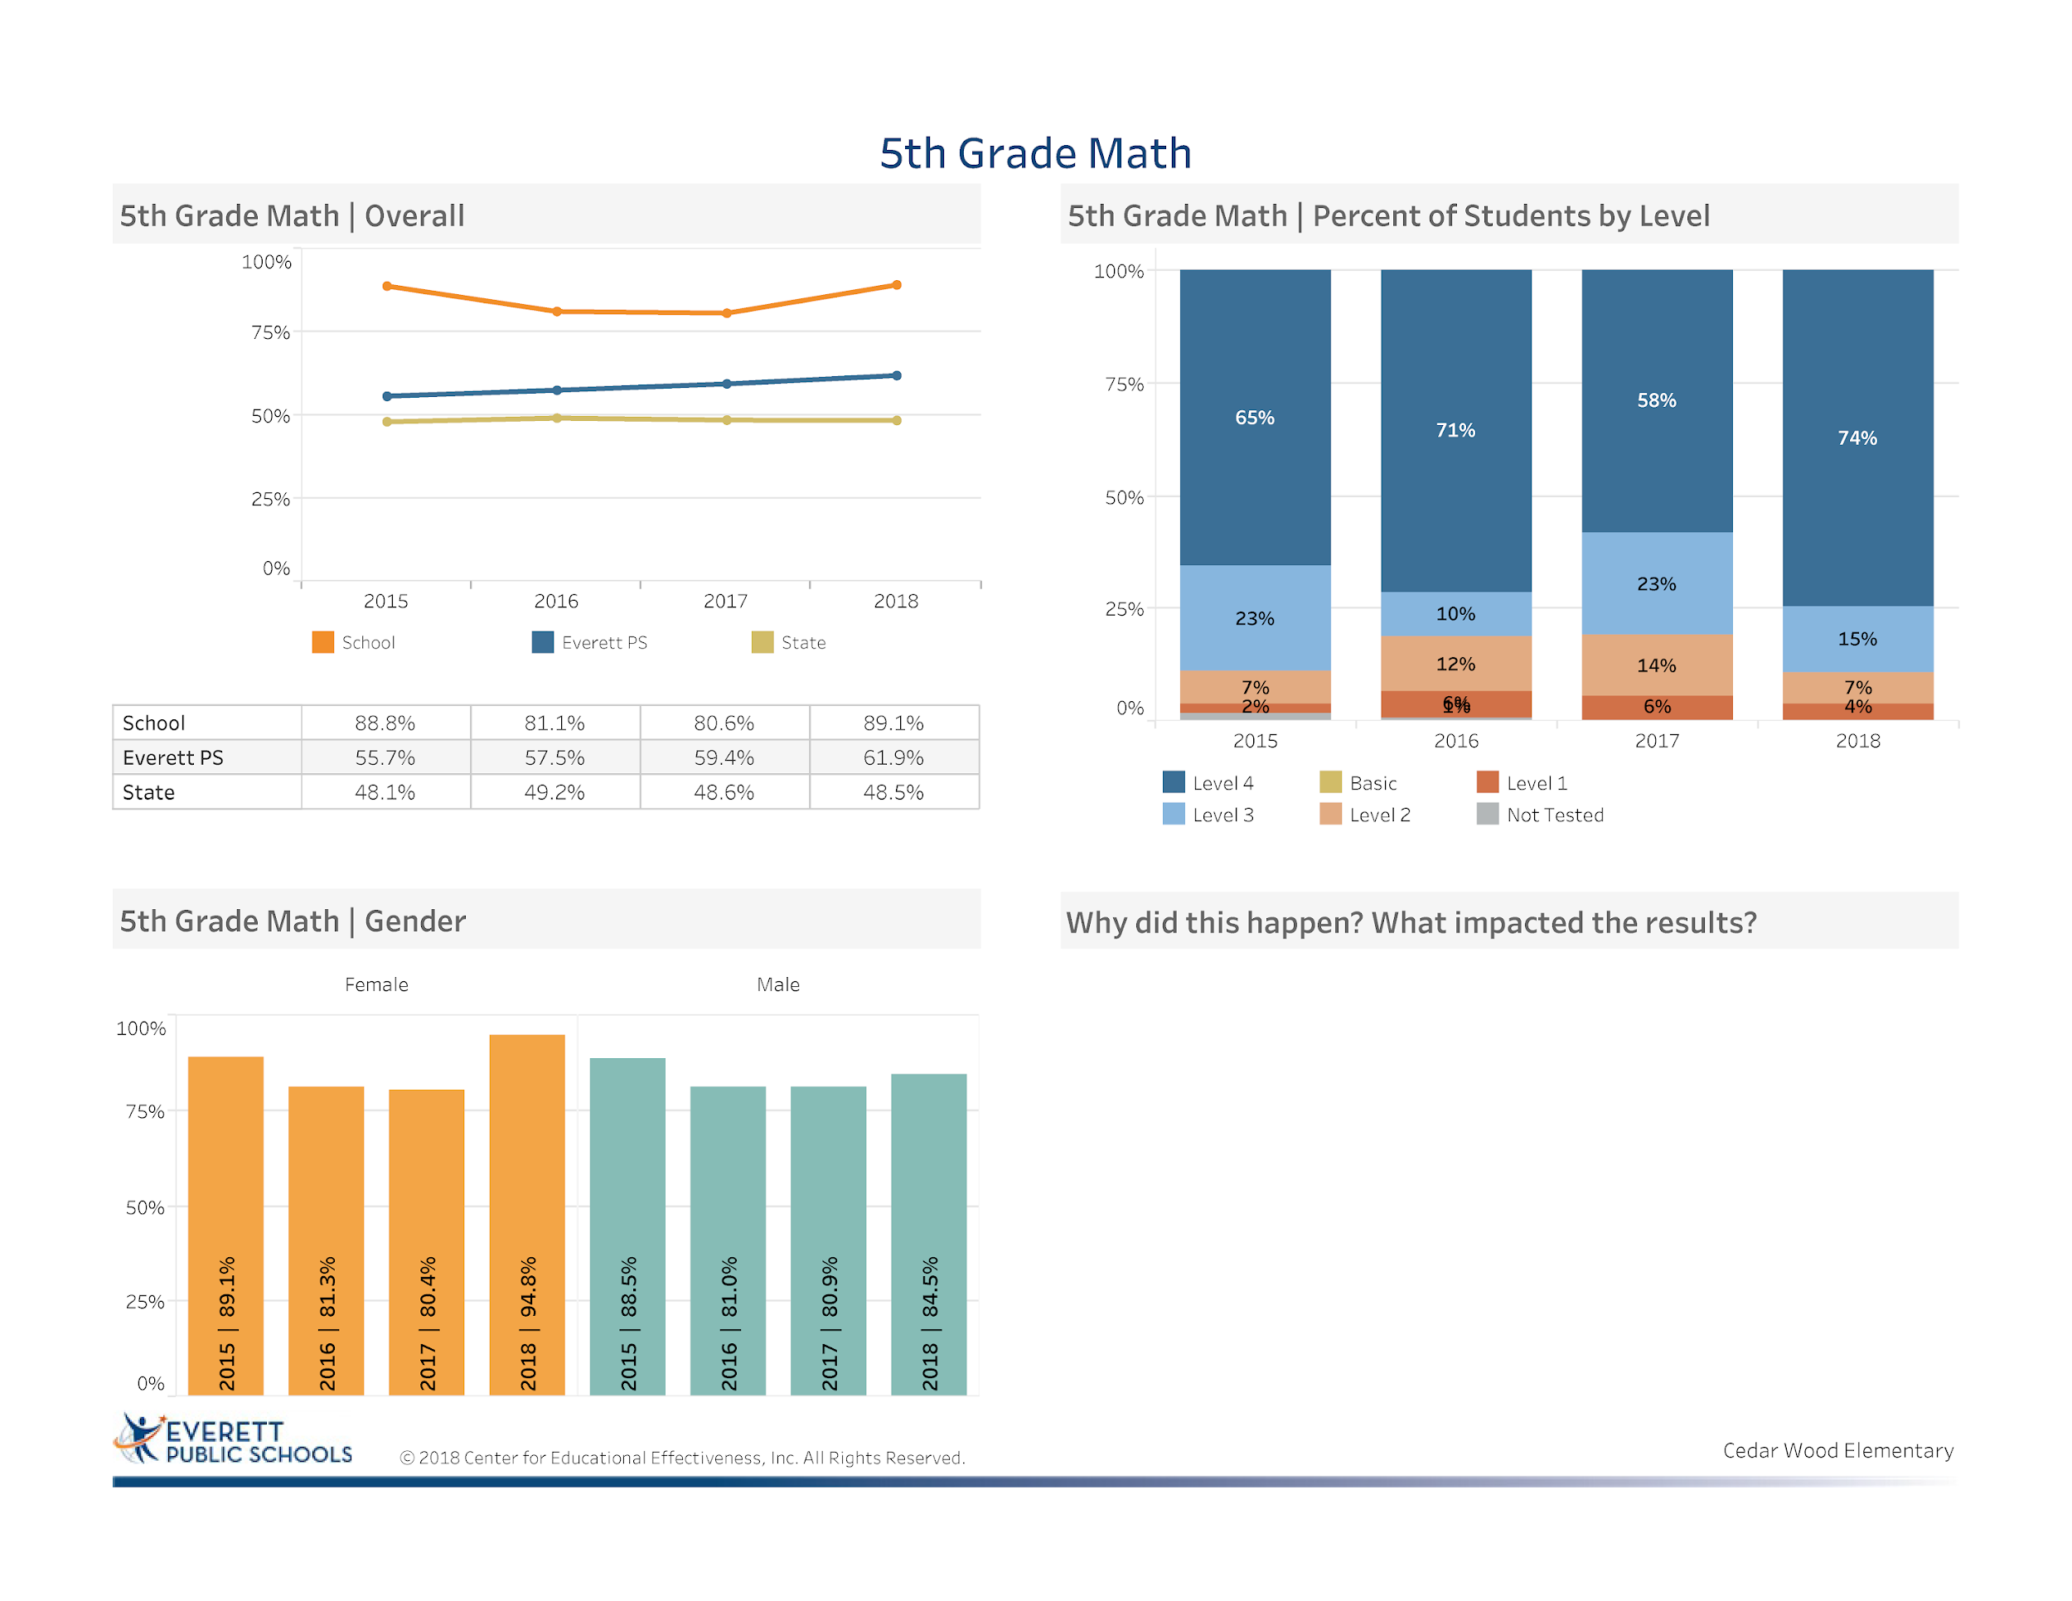
Implementation of Number Strings and Math Discourse
Implementation of iReady Math to eliminate students’ gaps and accelerate learning for other students
Strategic use of the Smarter Balance Interim Assessments to support students in preparation for the Smarter Balance Assessment
Leadership of Assistant Principal in supporting 5th grade
Notes:
Celebration: Increase of student percentage proficient or advanced was 8.5%
Celebration: 27.2% above the district average
Celebration: 40.6% above the state average
Implementation of Number Strings and Math Discourse
Implementation of iReady Math to eliminate students’ gaps and accelerate learning for other students
Strategic use of the Smarter Balance Interim Assessments to support students in preparation for the Smarter Balance Assessment
Leadership of Assistant Principal in supporting 5th grade

Slide 24
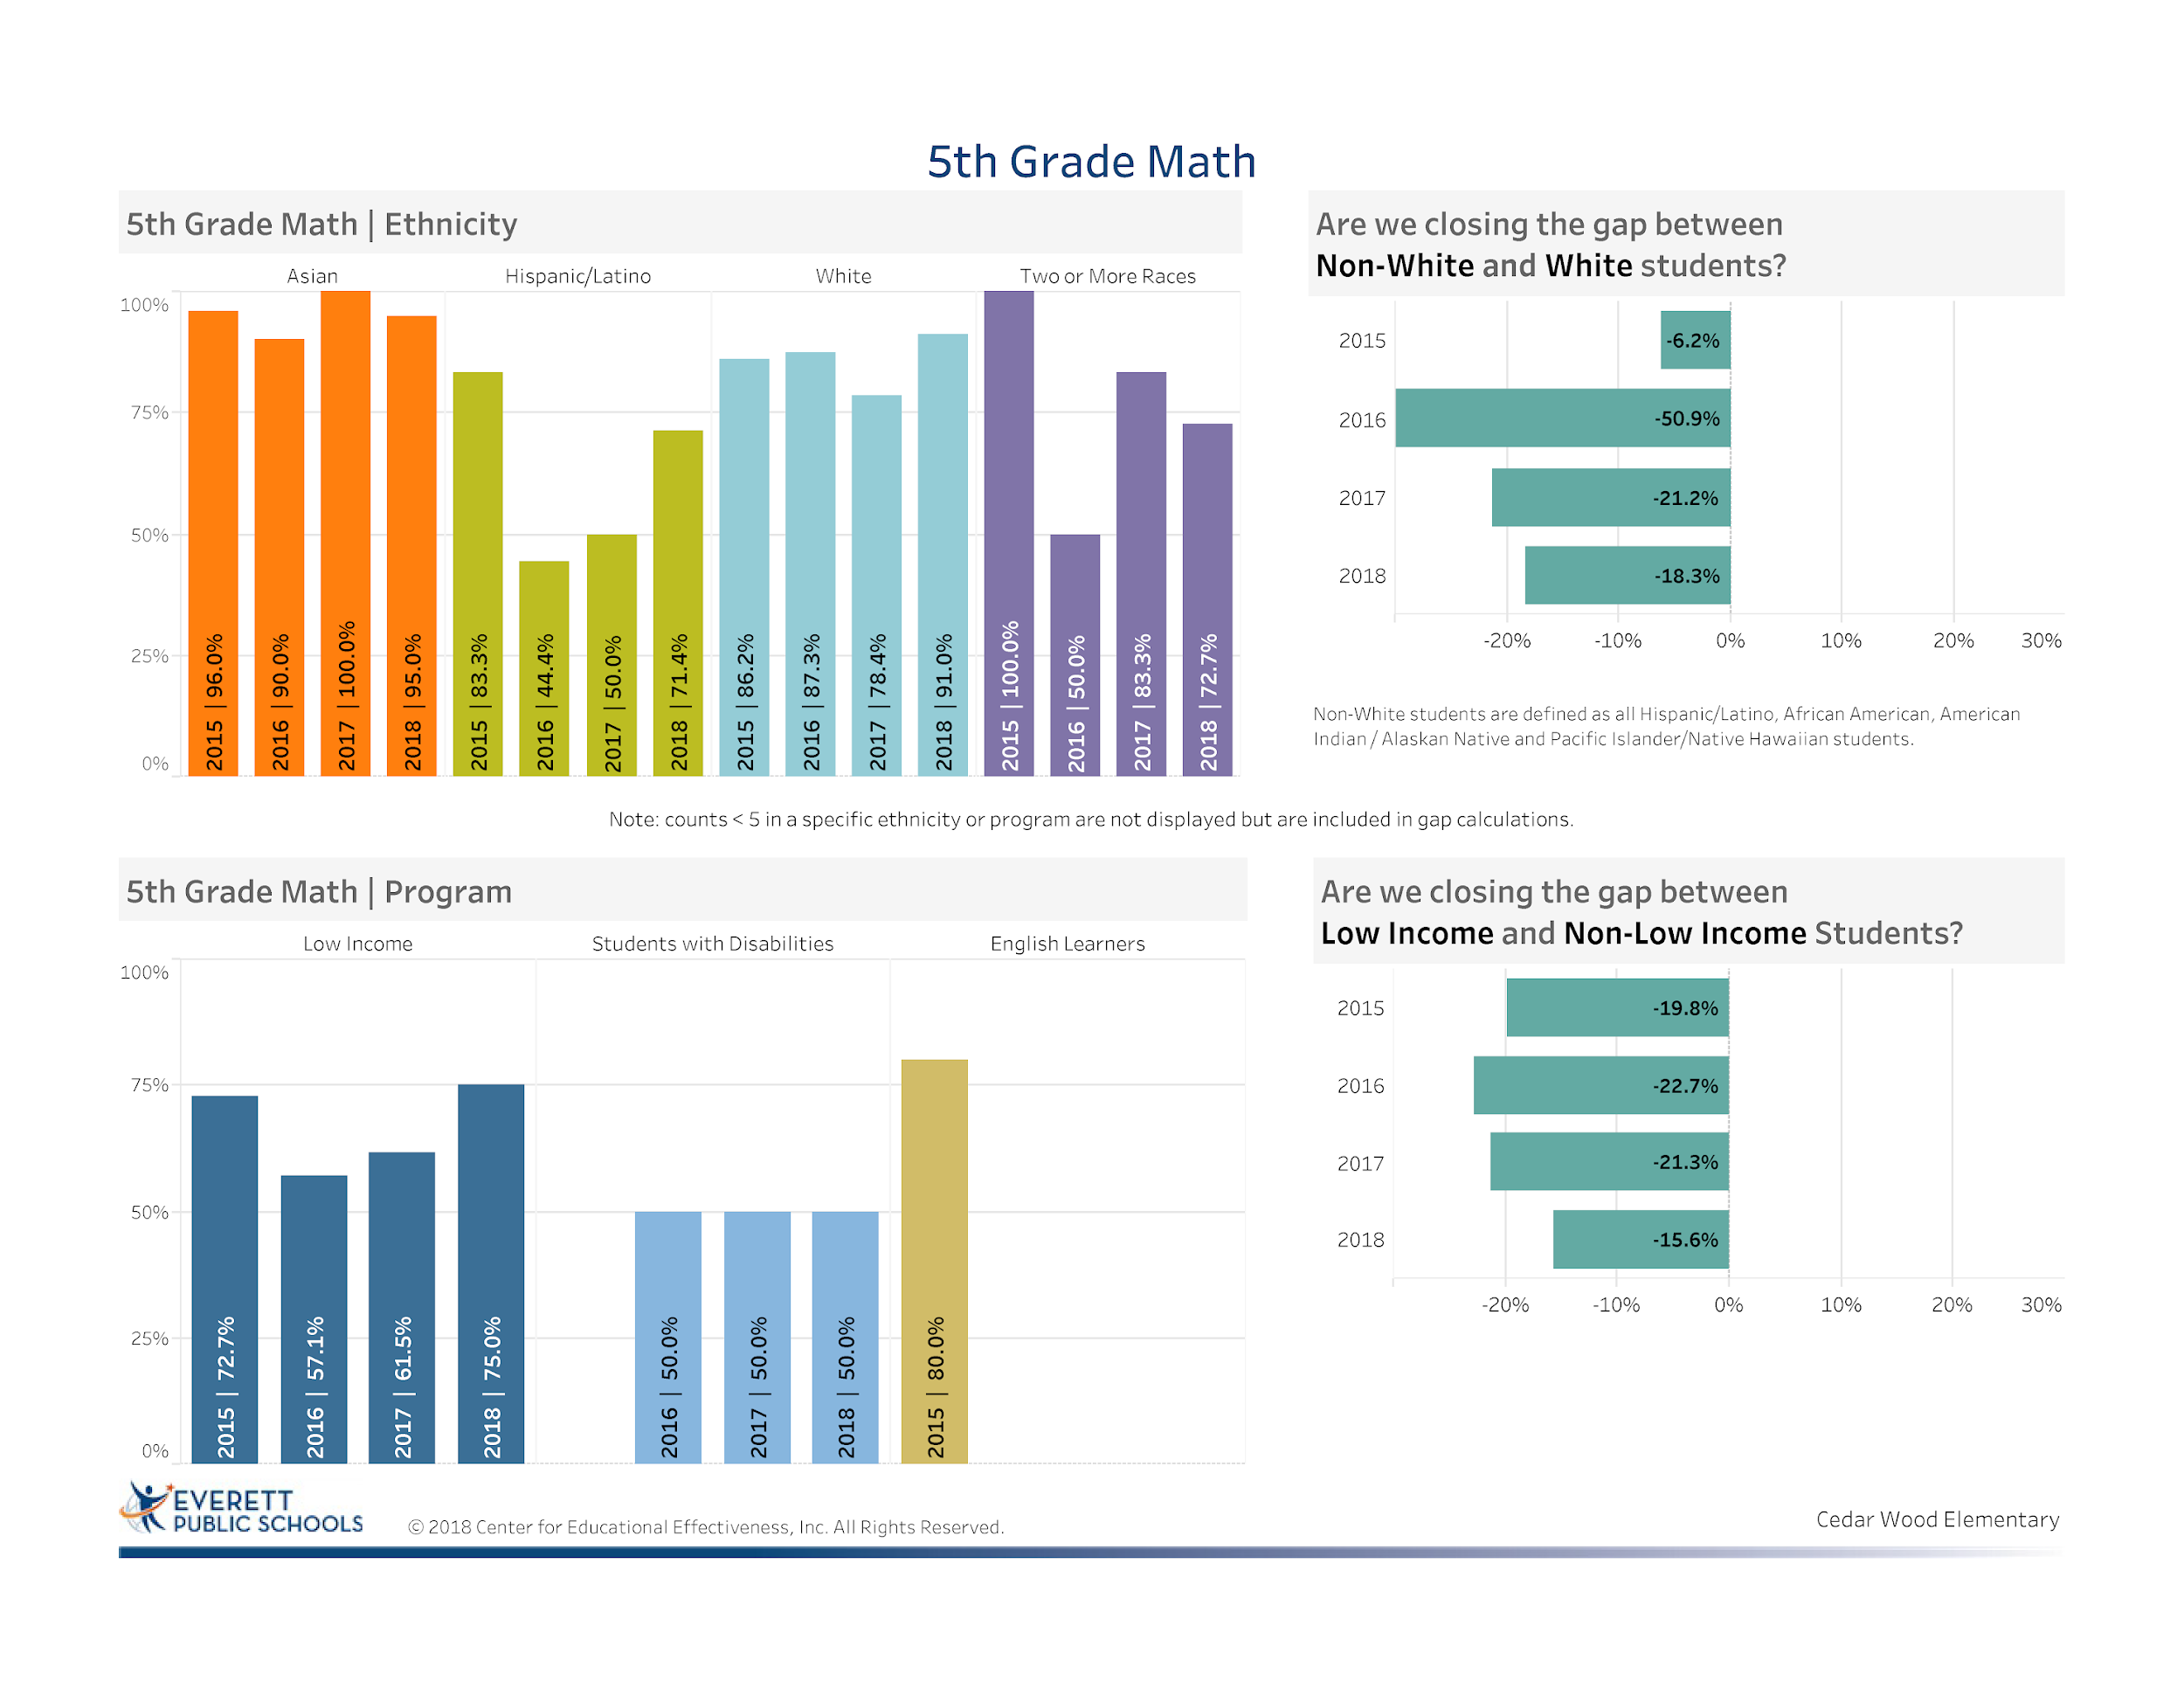
Notes:
Celebration: Closing the gap for non-white and white students was minimal- 2.9% gap closure
Celebration: Gap closure for low income and non-low income students was 5.7% (Explanation needed)
Continue area of focus is on students with disabilities- you will see how we are addressing that need later on in our presentation as we support teacher professional development to support student success

Slide 25
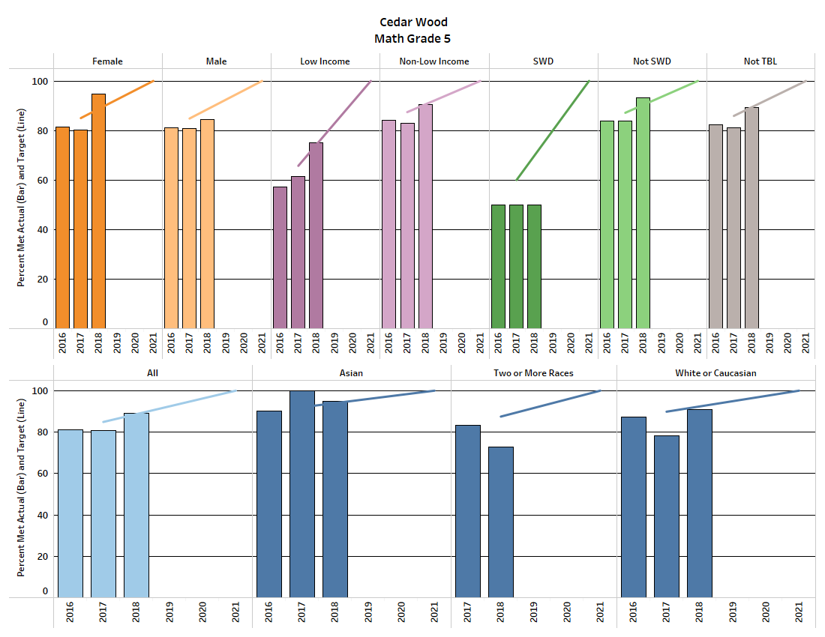
Math Equity Target Data
Notes:
Celebrations: Increases in females, males, low income, non-low income, non-students with disabilities, non-TBL, all students, white students
Areas of concern and to address: Students with Disabilities (Achieve students- 2018-19 staff getting trained in OEL); Asian students, two or more races
7 out of 10 of the equity targets for 2018 were met .
Increase in performance was due to focused professional development in Math workshop model, OEL, number strings and individual focus on students.
Areas of concern are students with disabilities and students of two or more races.

Slide 26
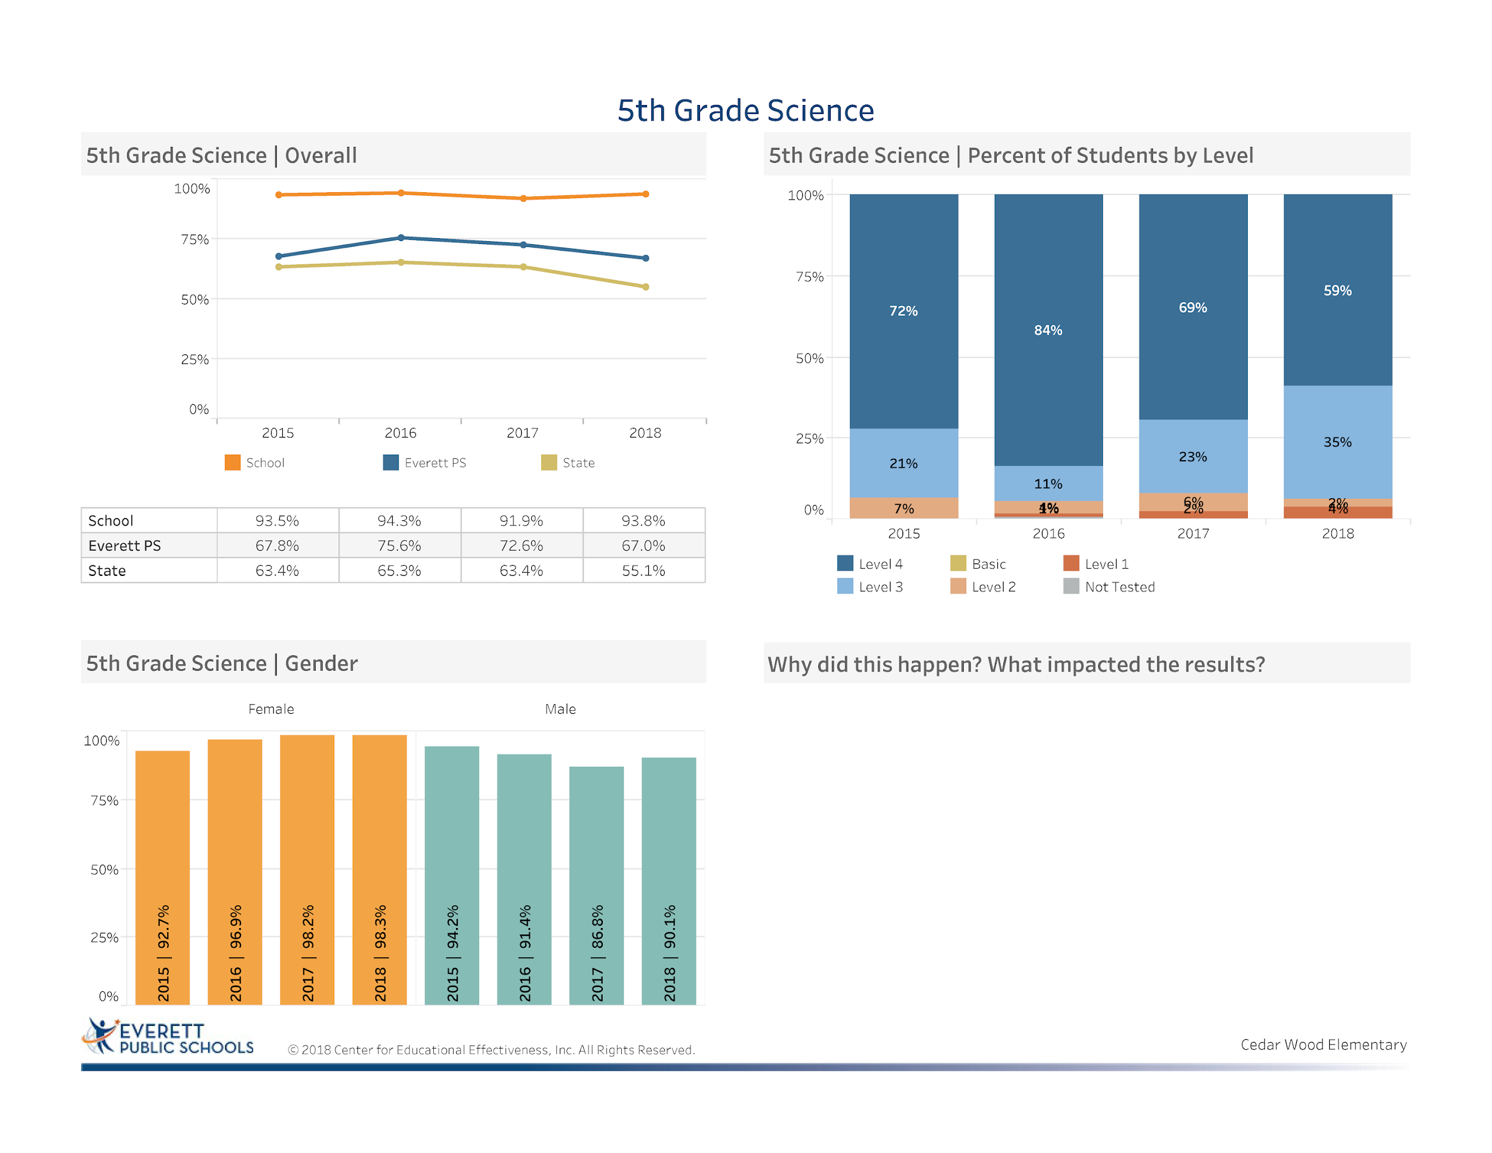
Professional development on NGSS
Students practices multiple times in preparation for the assessment
Science was embedded into the curriculum
Student discourse and discussion regarding Science was increased in correlation with Number Strings and Math Discourse
Notes:
Celebration- increase of percentage of students proficient or advanced increased 1.9%
Celebration: 26.8% above the district average
Celebration: 38.7% above the state average
Overall CWE is a building that is strong in science. Even though we made a slight increase we feel that there were factors that contributed to this: 1. New test format, late access to WCAS Prep and not all of the kits aligned to standards. This year our 5th grade team is working hard to implement the practice in a way to shows more growth for our students.

Slide 27
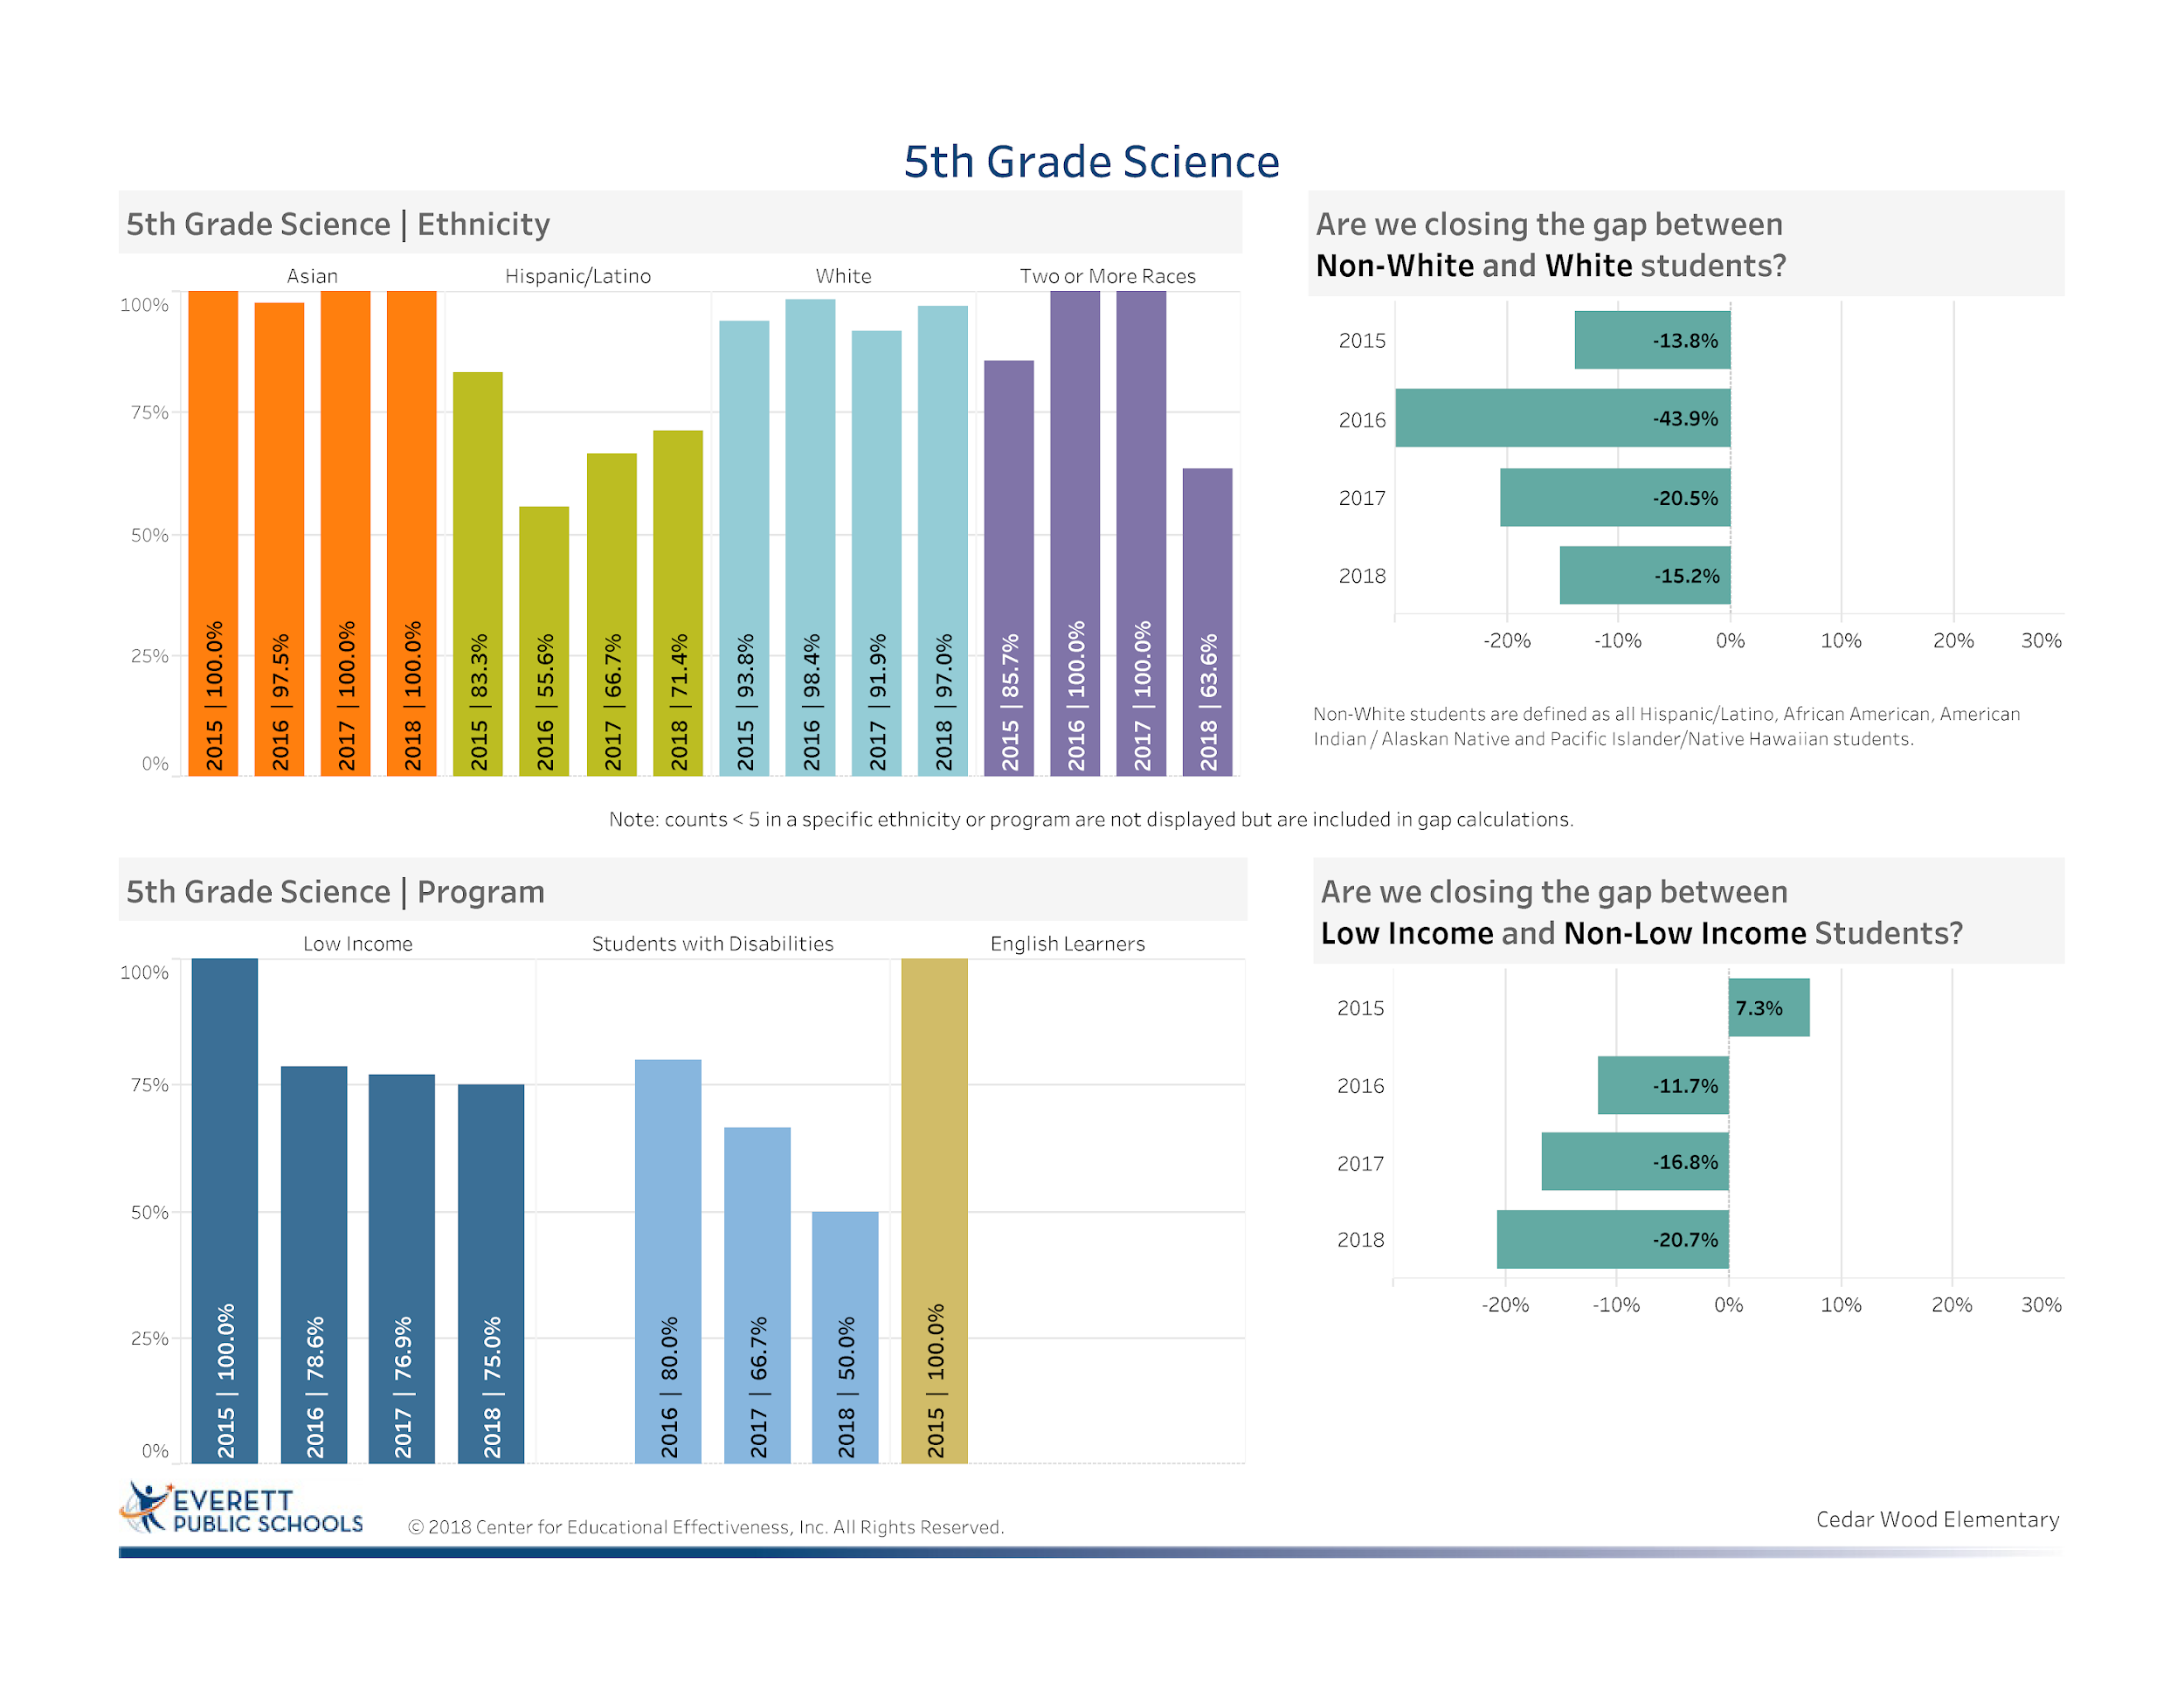
Notes:
Celebration: Gap closure non-white to white students decreased by 5.3%
Focus area: gap closure increase of 3.9% from 2017 and 28% gap increase since 2015 – more hands on experimentation and adding discourse to support student learning. (You will hear more about this later in the presentation of how we are addressing this need this school year

Slide 28
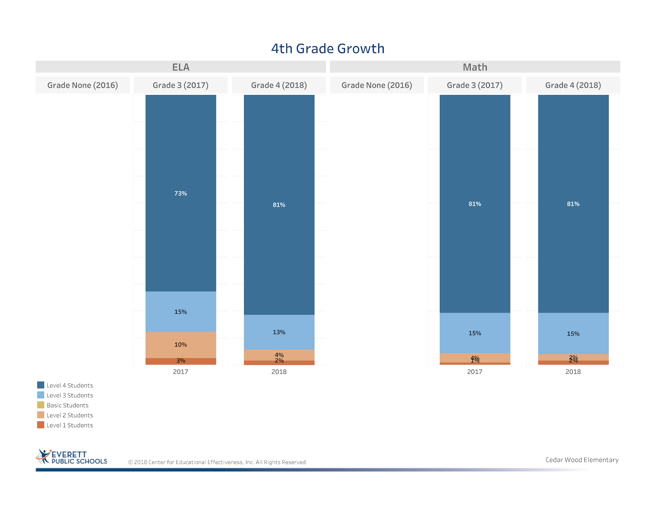
Notes:
Celebration ELA 3rd to 4th grade – increase of 8% level 4, and decrease of 7% in level 1 and 2 students. Explanation- clear alignment to the Reach for Reading Curriculum and implementation of iReady and following the trends of individual students through data analysis meetings and focusing on individual students
Math – stagnant and same as 3rd grade in 4th grade – Adding in Balanced Math Routines. 2018-19 we are addressing this with OEL training for 3rd grade staff and continued focus on iReady data, intervention groups with the Math Specialist, Math Workshop Model implementation.

Slide 29
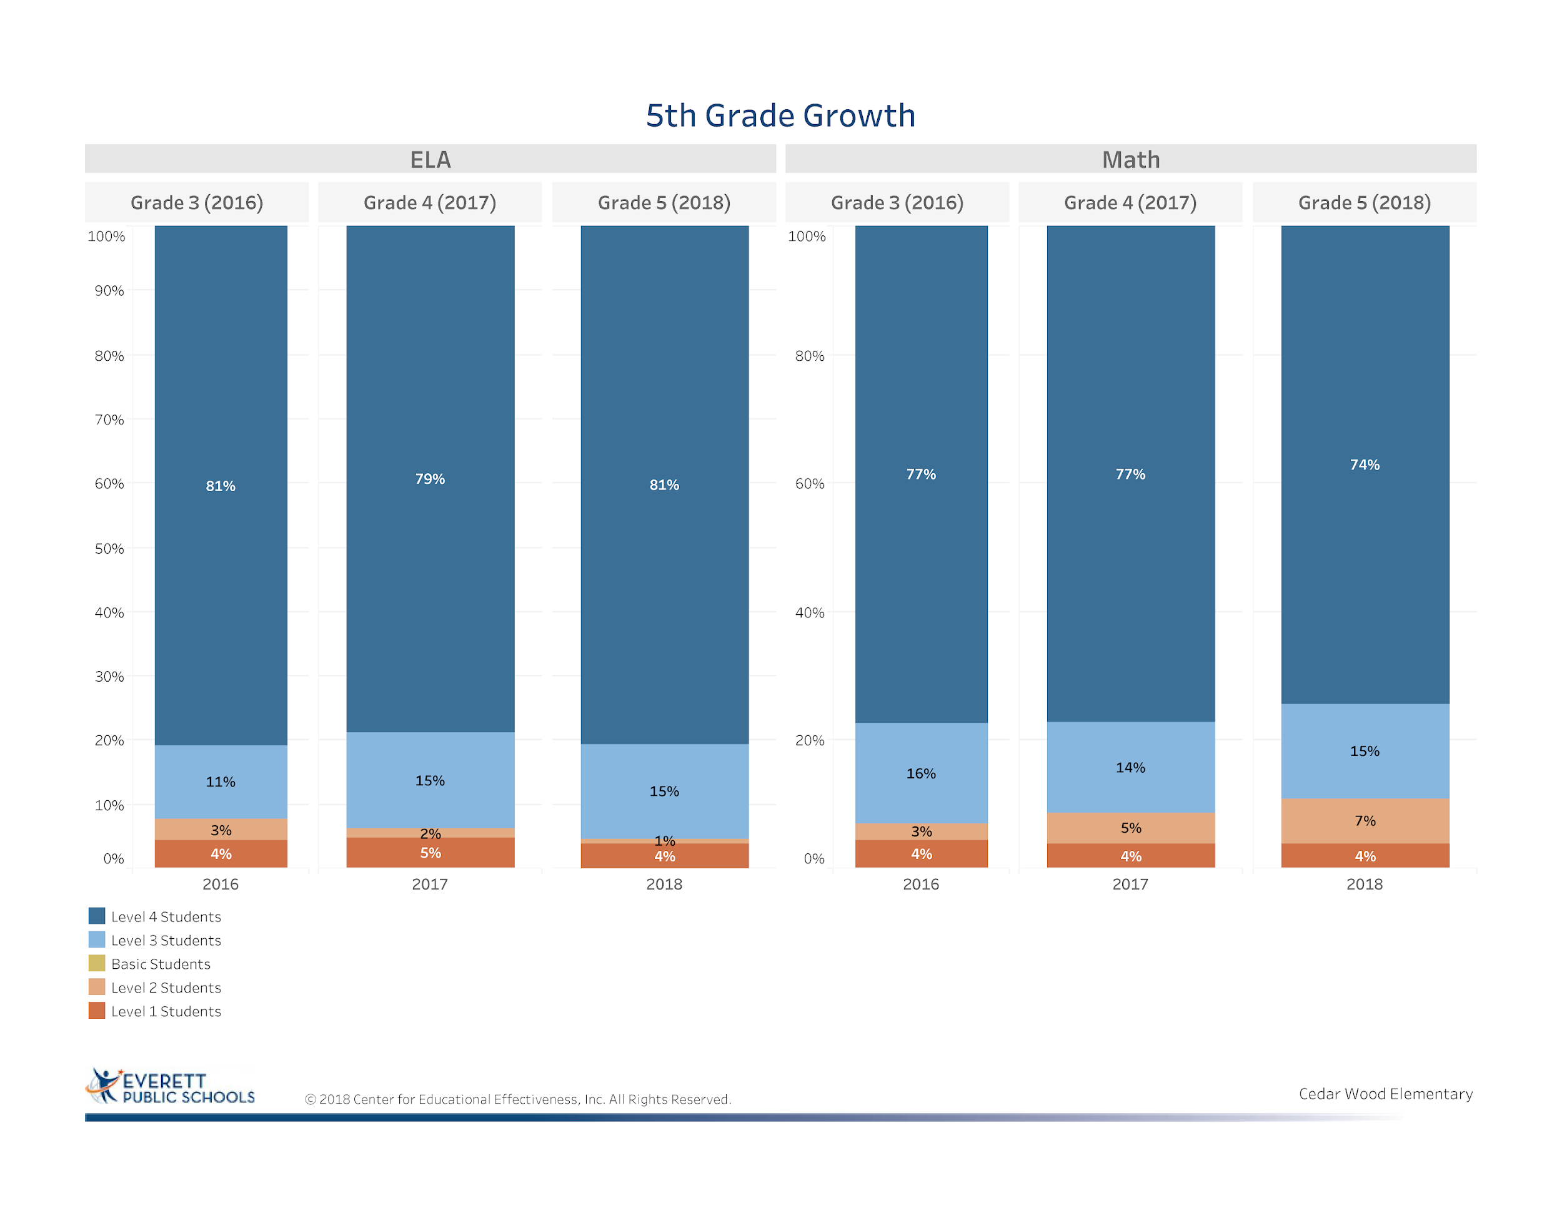
Notes:
Celebration: ELA Cohort data 3rd to 5th grade level 1 and 2 student decreased from 7% to 5%
Areas of Concern: Math Cohort data 3rd to 5th grade showed a steady decline in level 3 and 4 and increase in level 1 and 2- Implementation of OEL and Balanced Math Routines over the past 2 years should help address this trend in a more positive way.

Slide 30
English Learners

Slide 31
ELL Snapshot
Snapshot of October/November ELL Enrollment #'s
CWE | 08-09 | 09-10 | 10-11 | 11-12 | 12-13 | 13-14 | 14-15 | 15-16 | 16-17 | 17-18 | 18-19
Active | 25 | 20 | 22 | 17 | 18 | 23 | 40 | 68 | 92 | 93 | 103
Monitored | * | * | * | 5 | * | 9 | 23 | 35 | 41 | 86 | 113

Slide 32
Kindergarten ELPA Scores 2018

Slide 33
First Grade ELPA Scores 2018

Slide 34
Second Grade ELPA Scores 2018

Slide 35
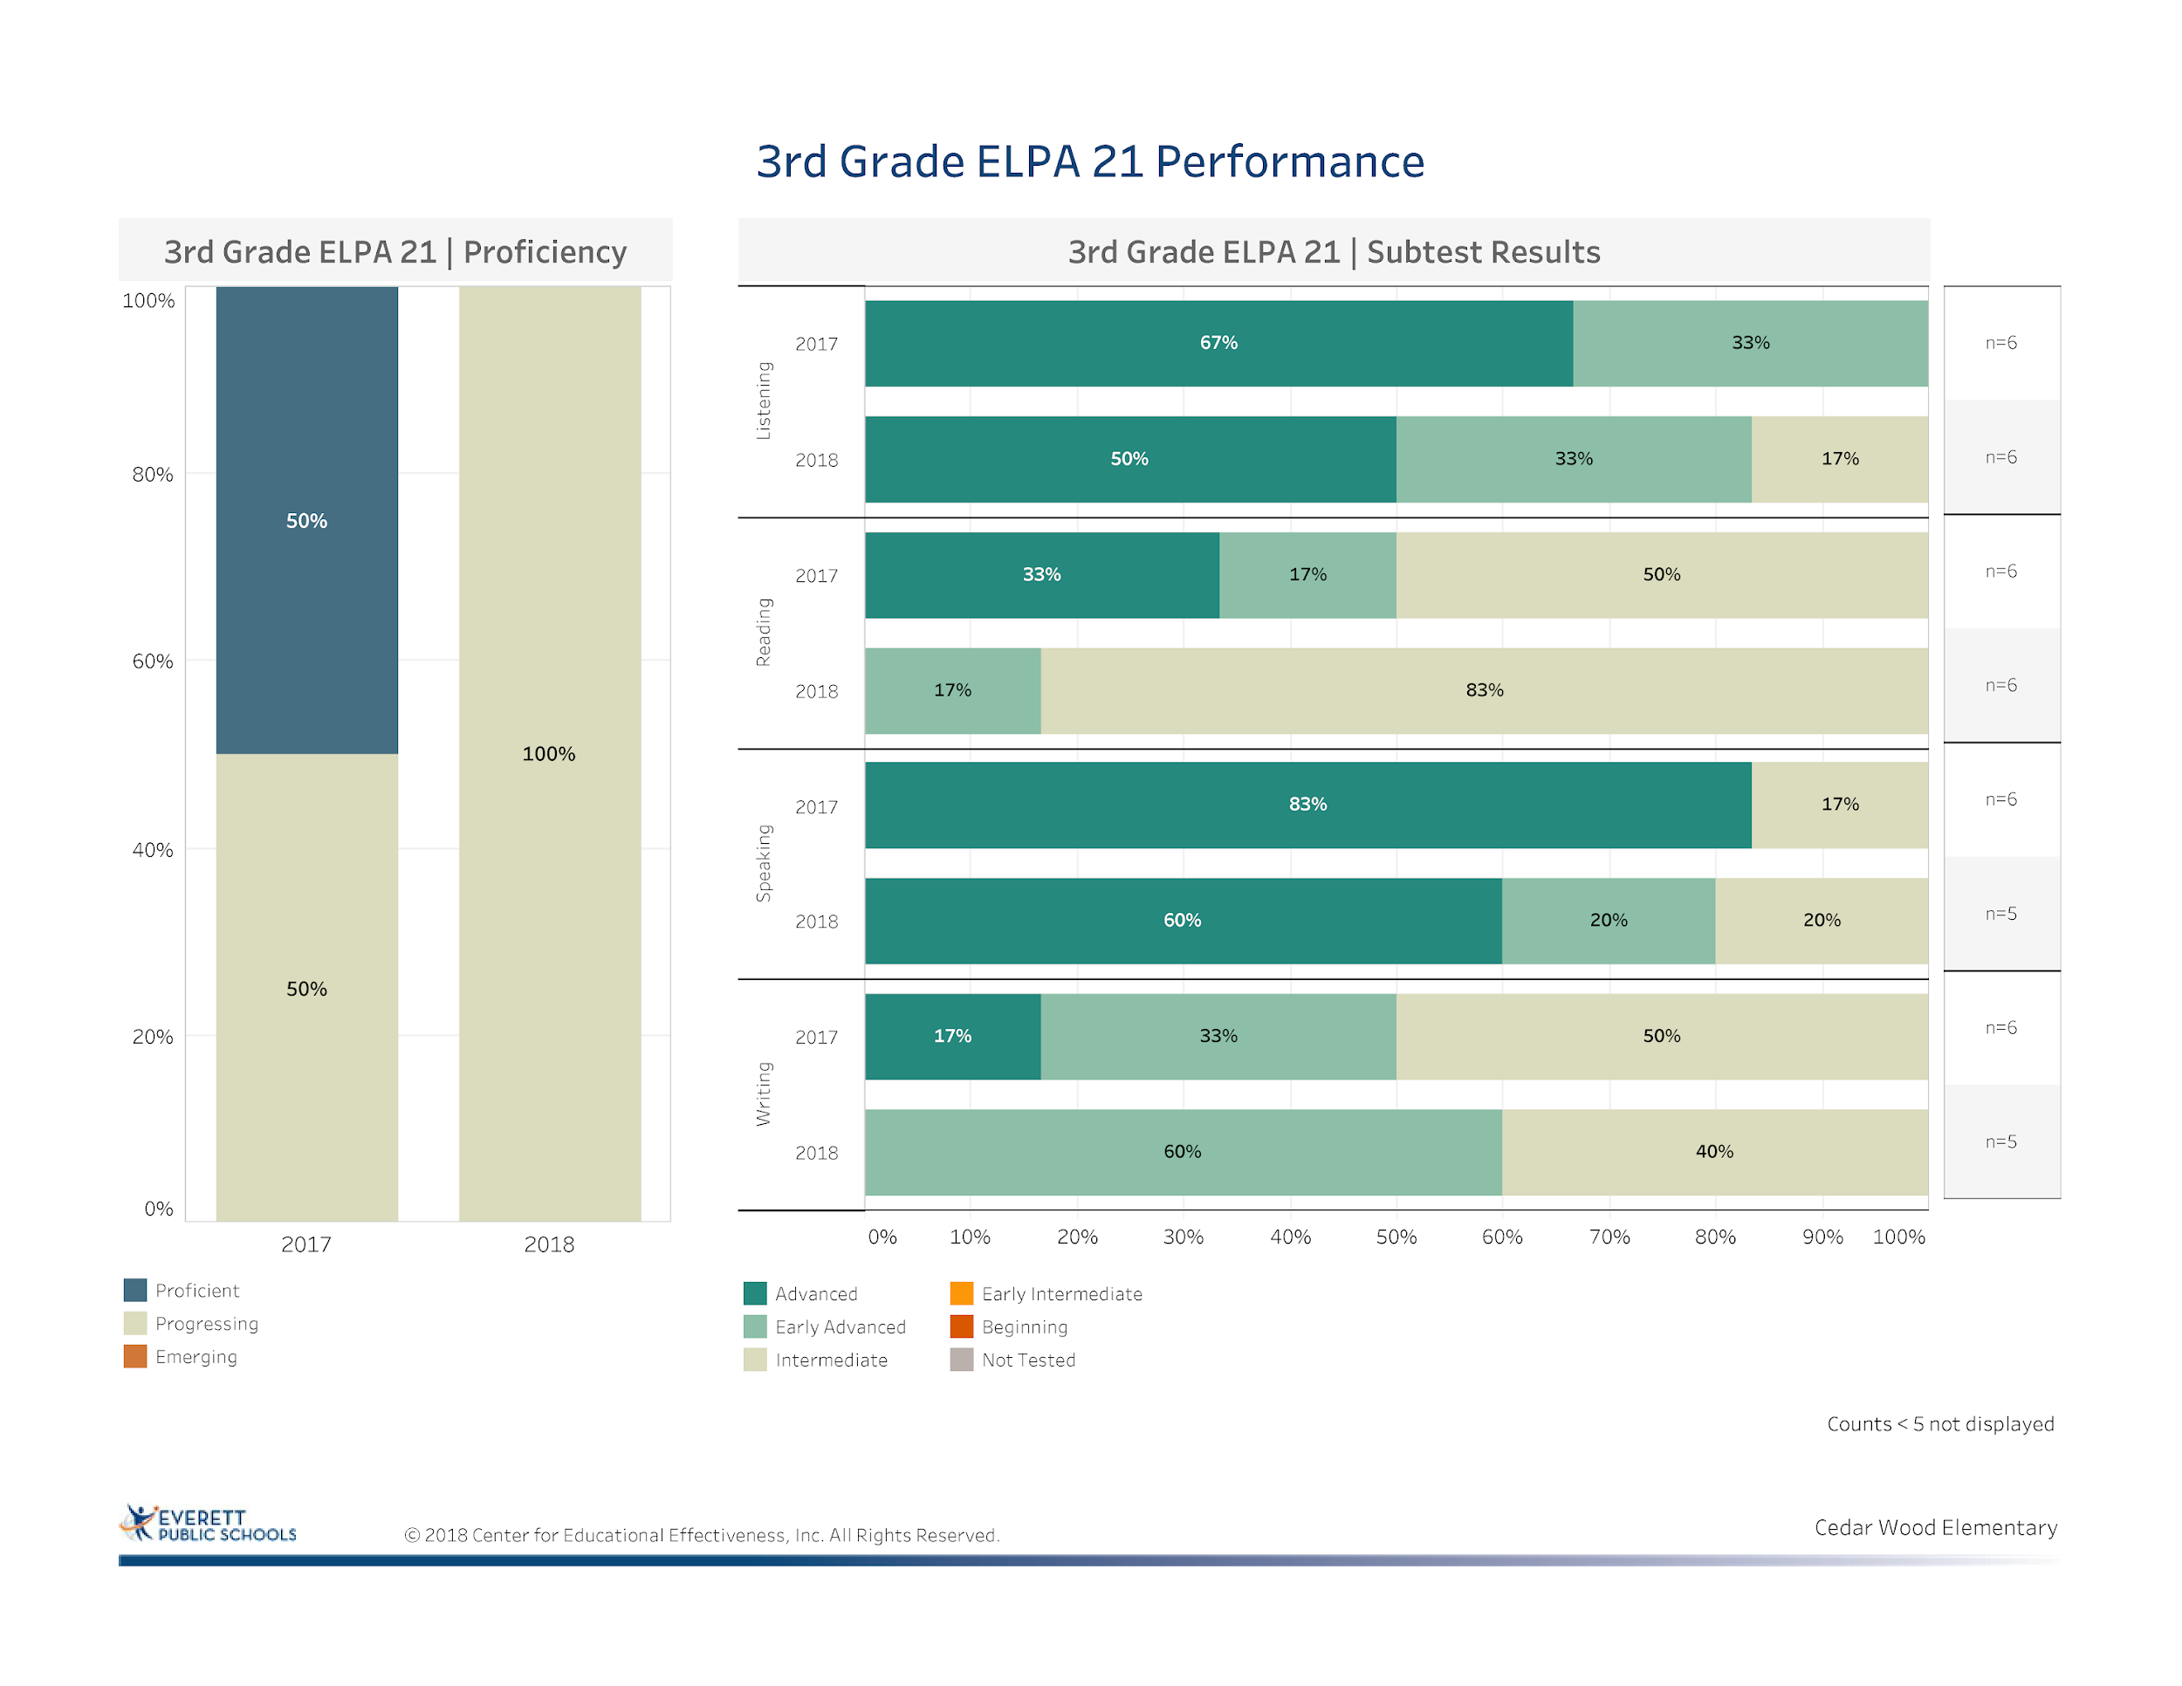
Notes:
Only 6 students- takes 5-7 years to acquire full academic language proficiency in English- shows a drop of students overall that are proficient but all are progressing. Greatest need is to support students in reading so more are advancing in reading. More interventions at primary grades as well as introducing more scaffolding for 3rd grade students.

Slide 36
Third Grade ELPA
Listening Component
4th Graders | ELPA21 2016 1st | ELPA21 2017 2nd | ELPA21 2018 3rd
A.R. | Early Advanced | Early Advanced | Intermediate
A.S. | Early Advanced | Advanced | Advanced
R.A. | Early Intermediate | Early Advanced | Advanced
M.M. | * | * | Early Advanced
A.K. | Advanced | Advanced | Early Advanced

Slide 37
Third Grade ELPA
Reading Component
4th Graders | ELPA21 2016 1st | ELPA21 2017 2nd | ELPA21 2018 3rd
A.R. | Early Intermediate | Intermediate | Intermediate
A.S. | Intermediate | Intermediate | Intermediate
R.A. | Early Intermediate | Intermediate | Intermediate
M.M. | * | * | Intermediate
A.K. | Intermediate | Early Intermediate | Intermediate

Slide 38
Third Grade ELPA
Writing Component
4th Graders | ELPA21 2016 1st | ELPA21 2017 2nd | ELPA21 2018 3rd
A.R. | Early Intermediate | Intermediate | Early Advanced
A.S. | Intermediate | Intermediate | Early Advanced
R.A. | Early Intermediate | Intermediate | Early Advanced
M.M. | * | * | Intermediate
A.K. | Intermediate | Early Intermediate | Intermediate

Slide 39
Third Grade ELPA
Speaking Component
4th Graders | ELPA21 2016 1st | ELPA 2017 2nd | ELPA 2018 3rd
A.R. | Early Intermediate | Intermediate | Advanced
A.S. | Early Intermediate | Early Advanced | Advanced
R.A. | Beginning | Intermediate | Early Advanced
M.M. | * | * | Advanced
A.K. | Early Intermediate | Early Advanced | Intermediate

Slide 40
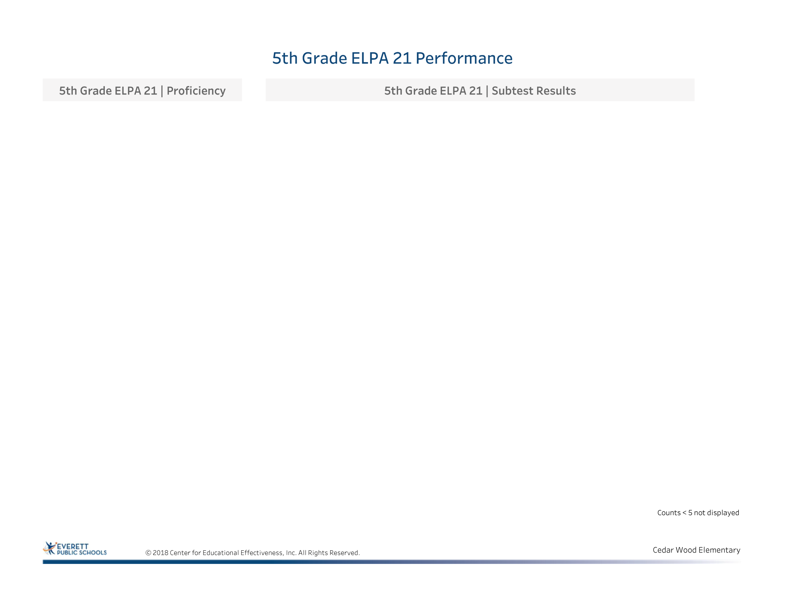

Slide 41
EES Survey and Equity Gap Data
Cedar Wood SOSR 2018-19

Slide 42
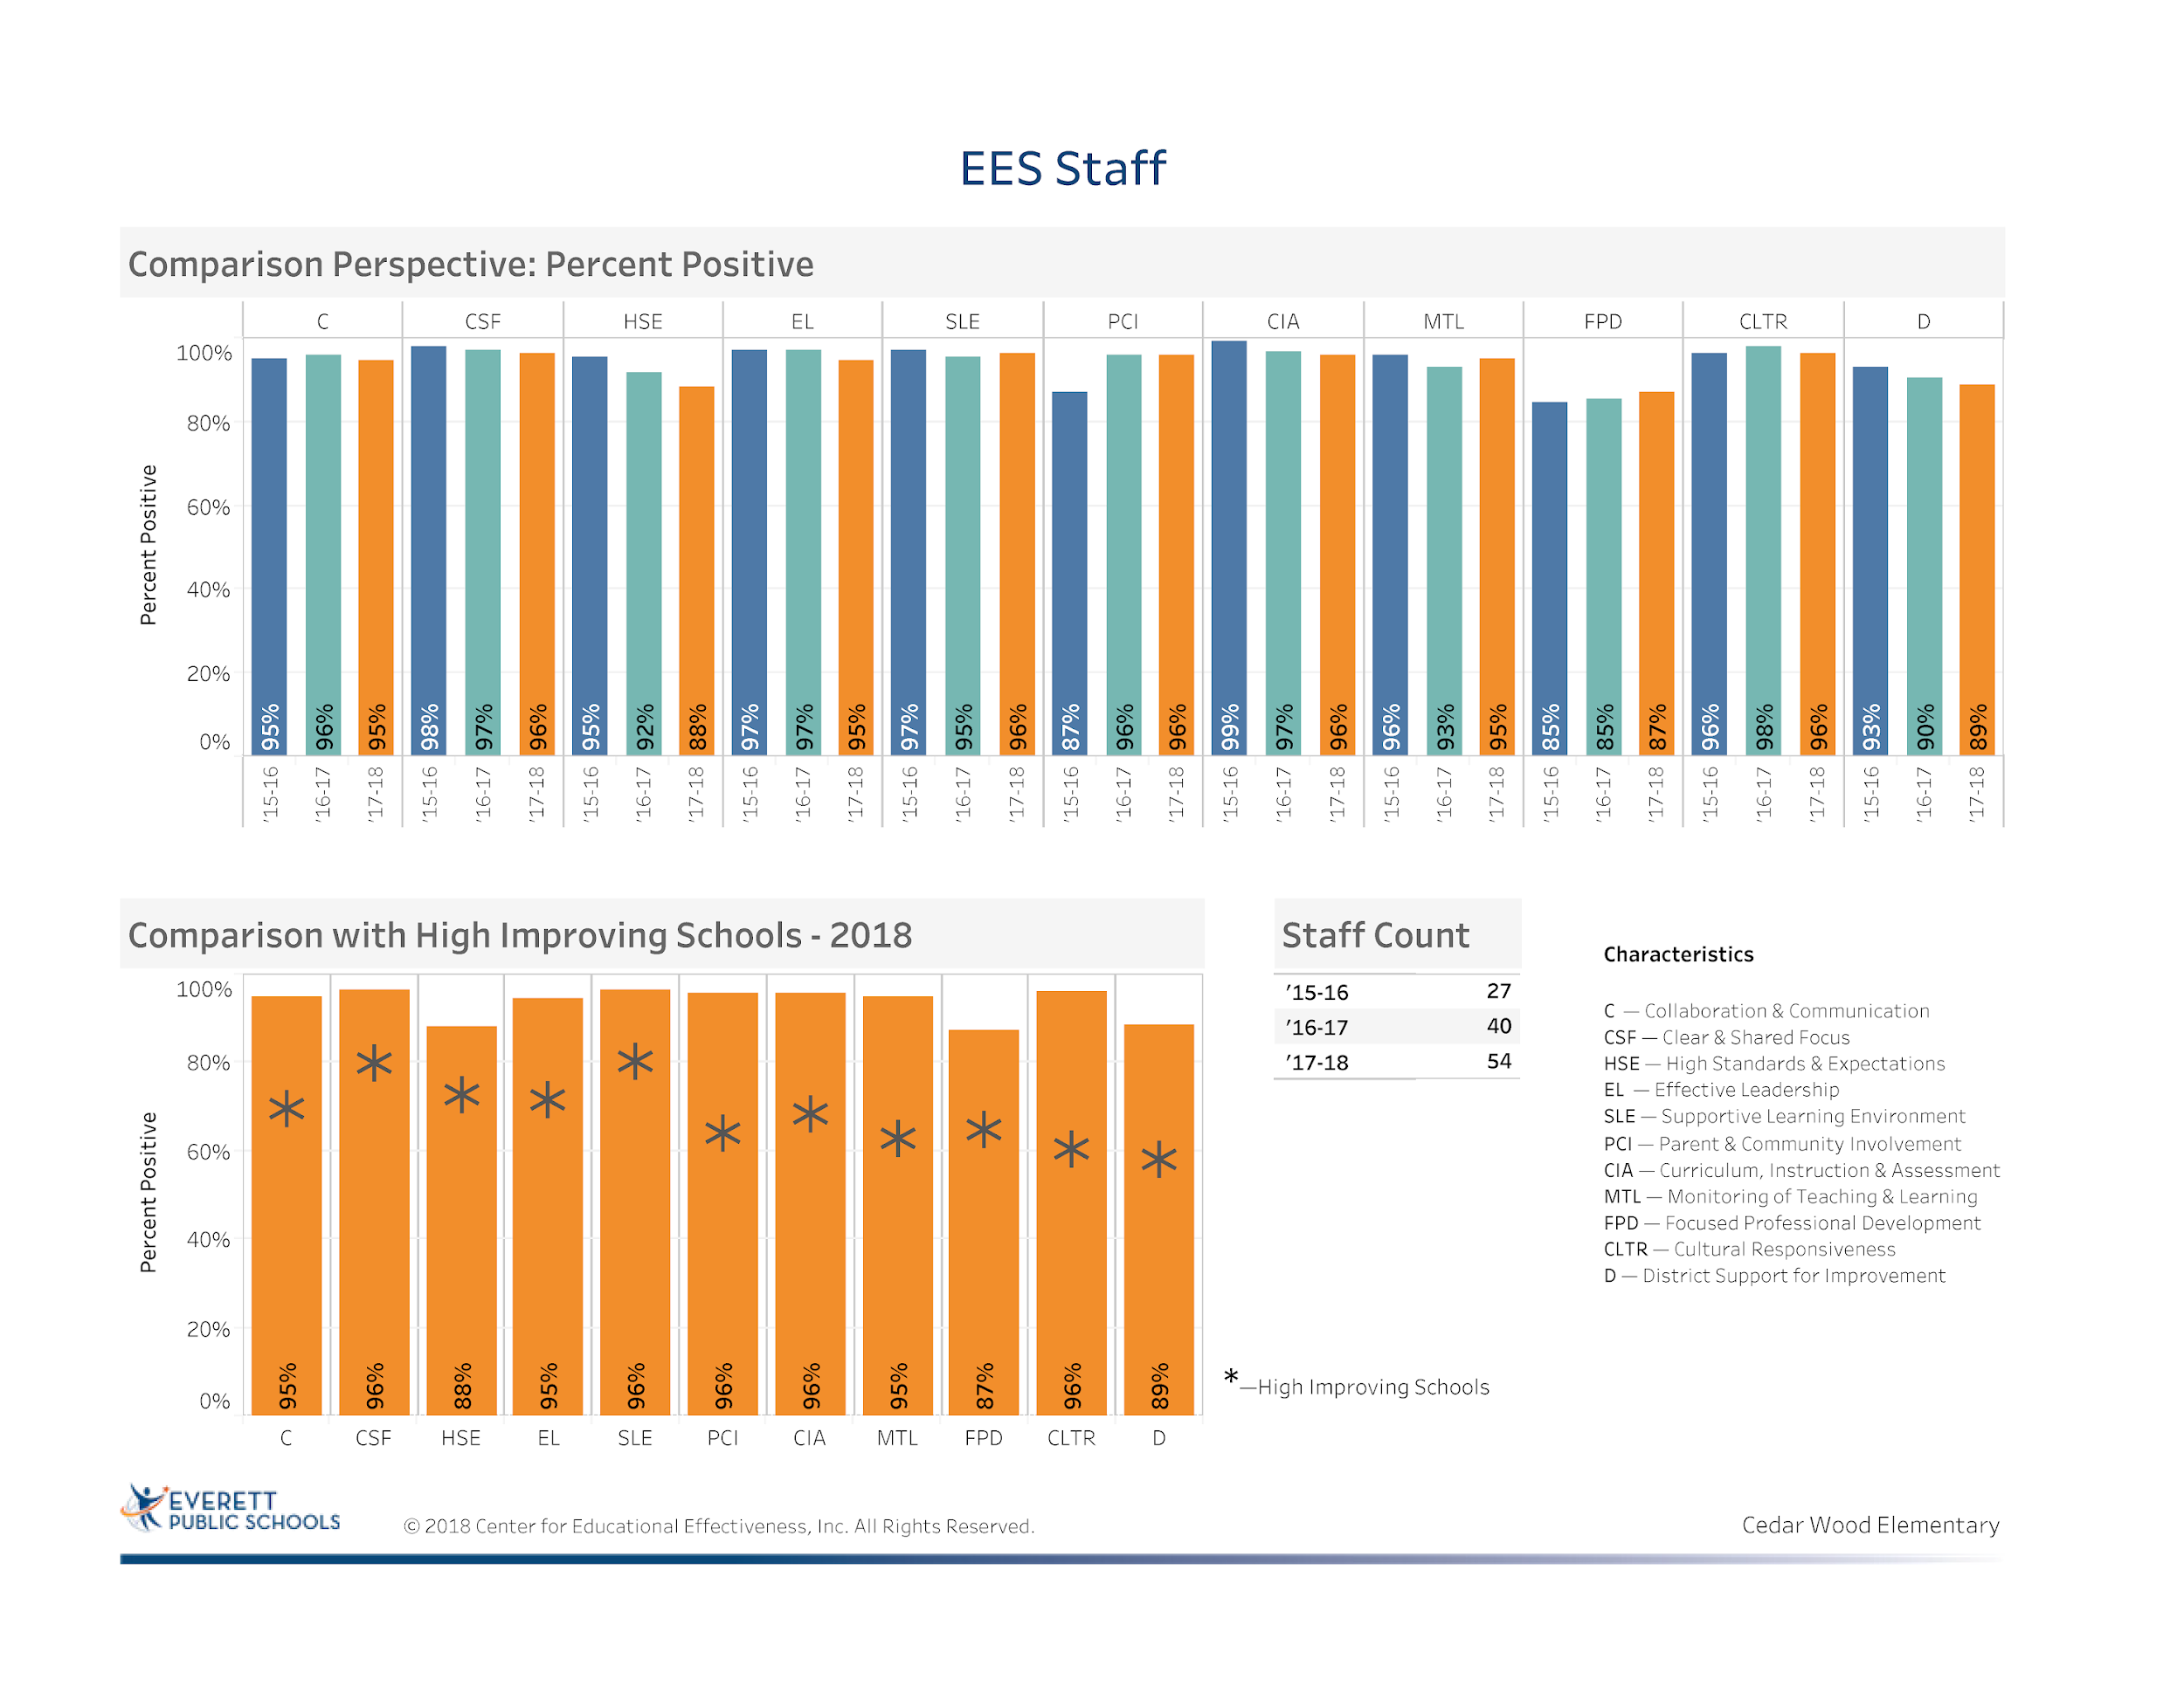
Notes:
Increase in the number of staff participation
Although there were some declines, we remain above in all areas in comparison to other high improving schools
Area of concern: High Standards and Expectations decline: 4%
We are doing well as a staff but will continue to work on focused professional development to meet the needs of all staff

Slide 43
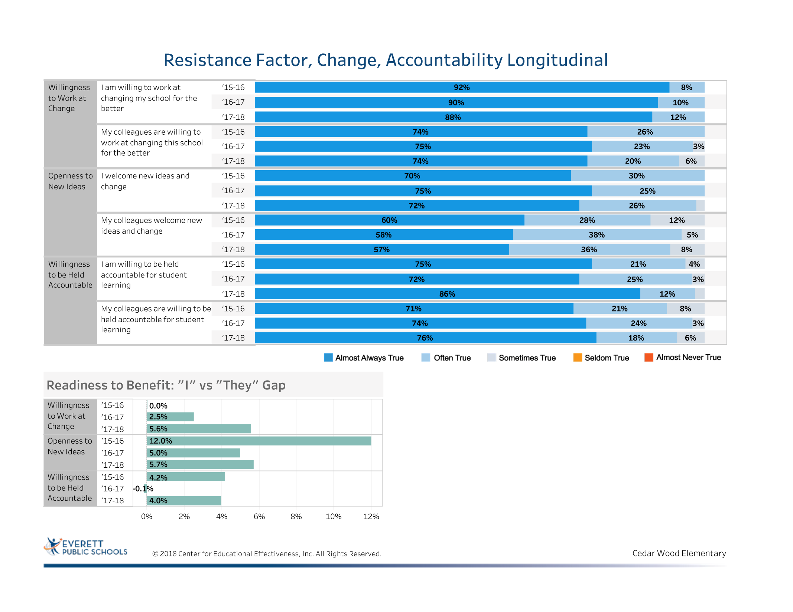
Notes:
The top part of the slide shows fairly consistent data over the past three years. There is no orange or yellow
Still a gap between individual need to change and they (colleagues) willingness to change across all segments. Change, openness, and accountability

Slide 44
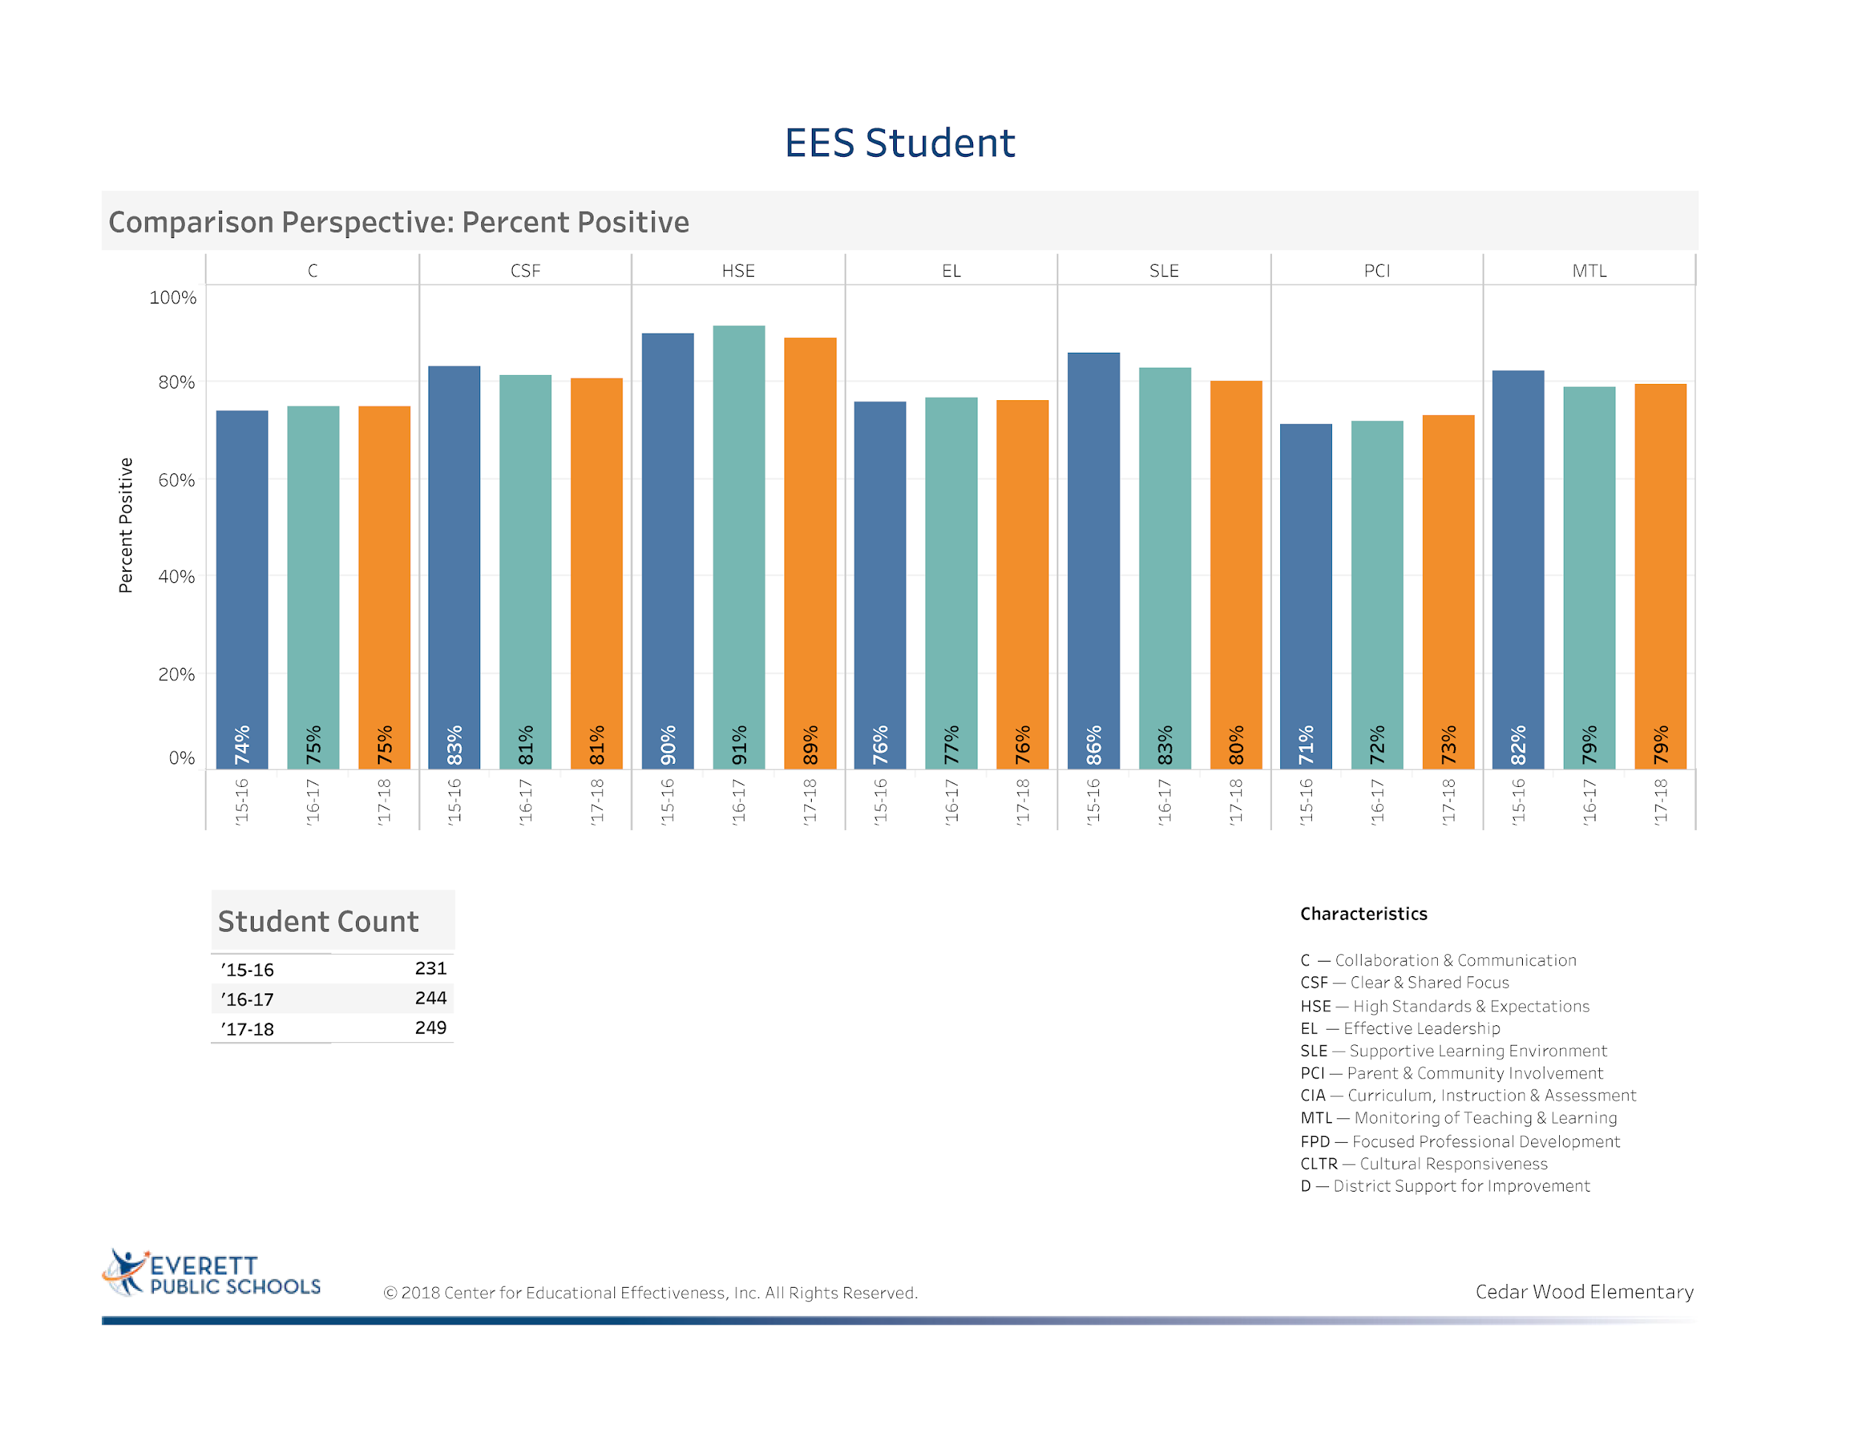
Notes:
Student data reveals areas to work on include effective leadership- interpretation- to have more student leadership that works with administration
Students feel that their learning should be monitored more frequently by educators- with teacher clarity and the work we have done with Kristen Anderson around visible learning and feedback the staff has been addressing this issue this year
Other areas have remained about the same- thus developing more ways for student involvement and insights into areas of growth is needed.
We have been looking at our Panorama Data more consistently to support emerging needs

Slide 45
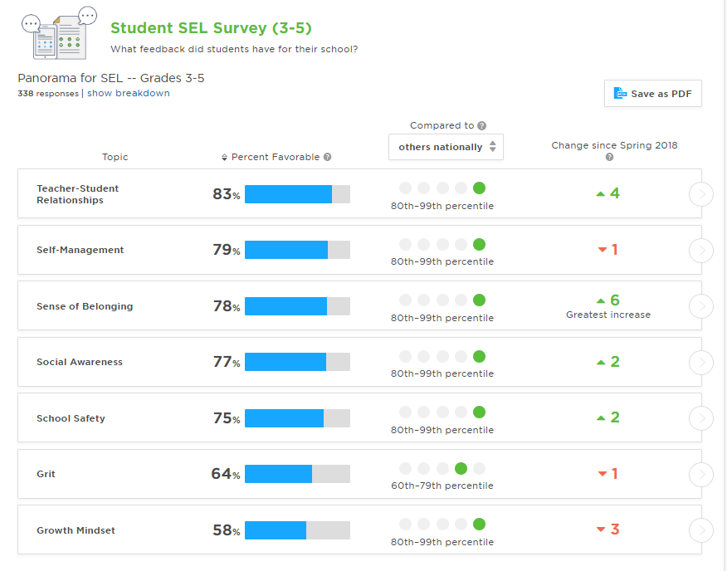
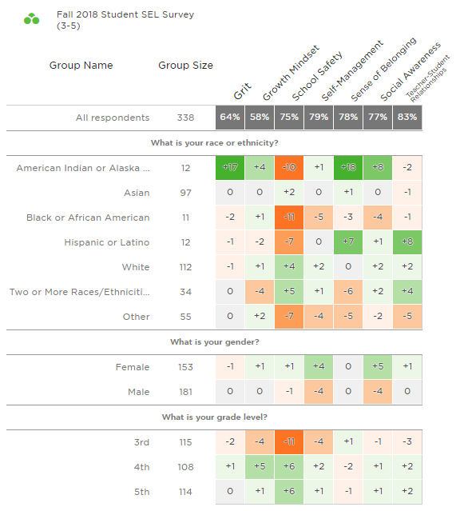
Social Emotional Learning Data
Notes:
Fall data areas of strength : Teacher-student relationships and sense of belonging, social awareness, school safety. Direct result from PBIS implementation, Social-Emotional Learning (Second Step)
Areas of concern: School safety, even though this went up in fall the following groups are not feeling as safe, American Indian, Black or African American, Hispanic and other, more from 3rd grade then other grades.
Third Grade Students may need more explanation of the survey to be able to get the clear results.

Slide 46
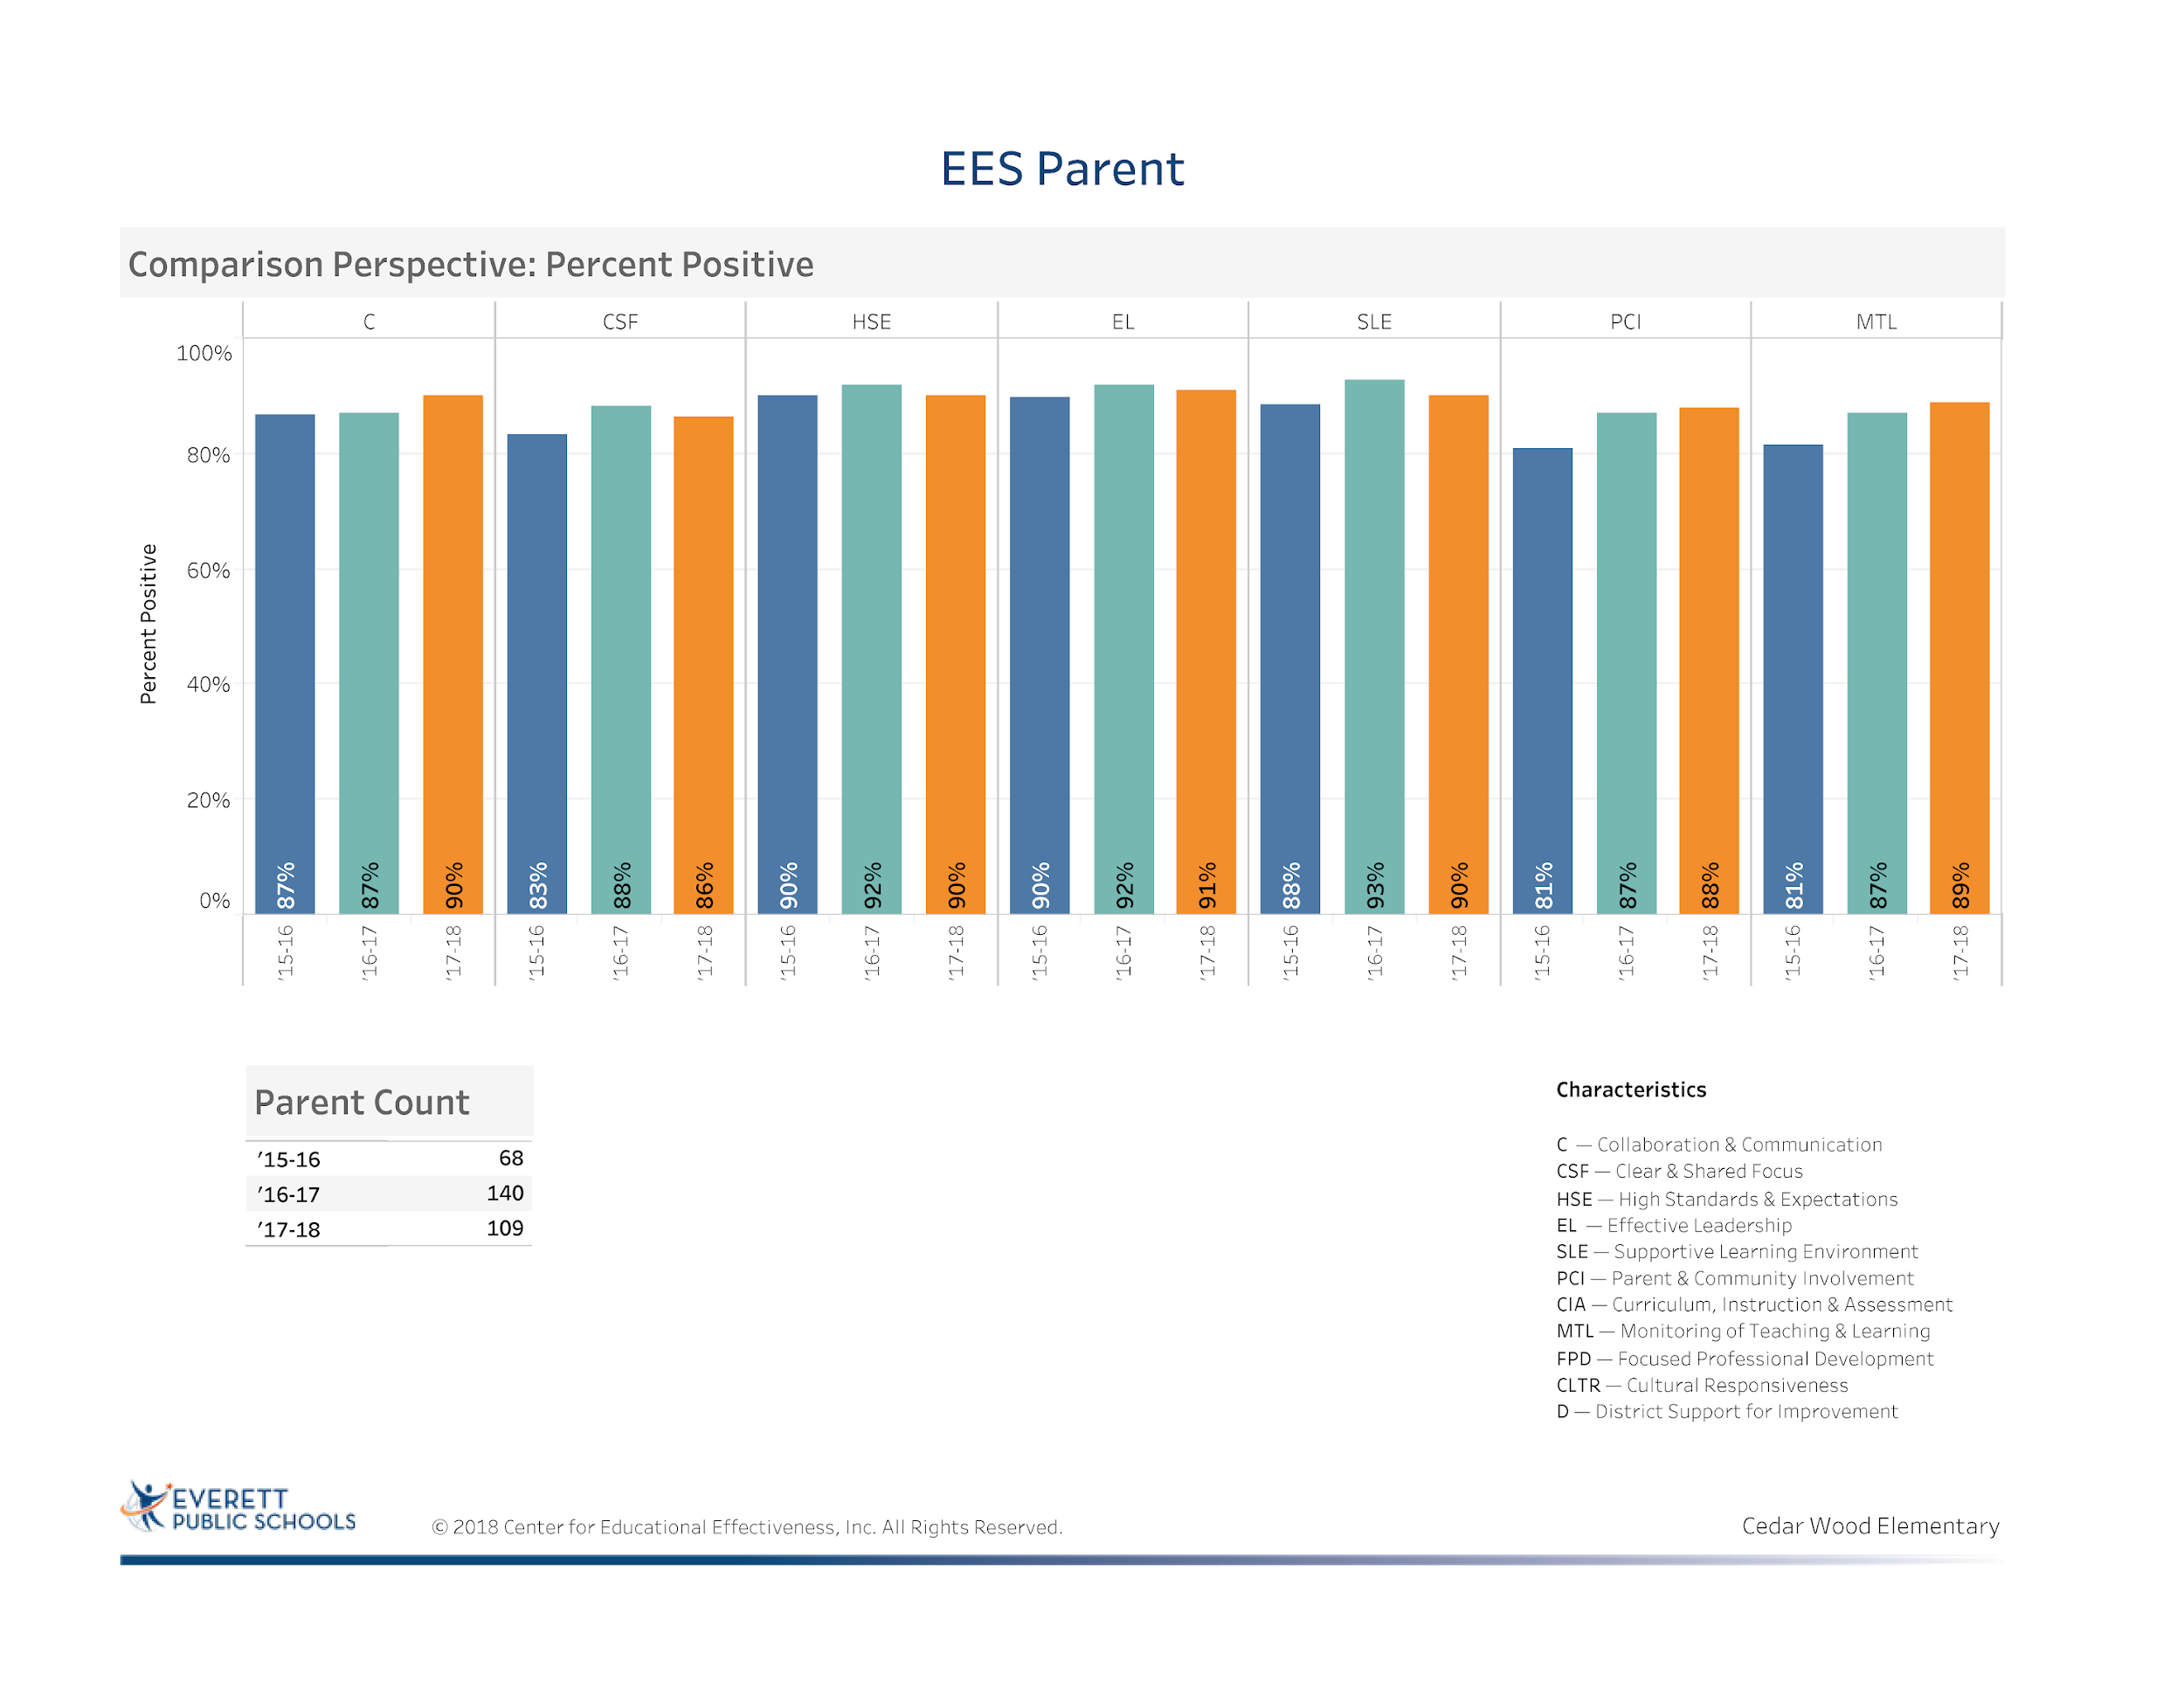
Notes:
Most areas have seen growth over the past 3 years
Areas of concern is clear and shared focus – getting more parents involved in the SIP process would be helpful in the future

Slide 47

STATE OF SCHOOL REVIEW
Everett Public Schools
STATE OF SCHOOL REVIEW
Everett Public Schools
Cedar Wood Elementary
Compiled by Everett Public Schools - Assessment & Research Department

Slide 48
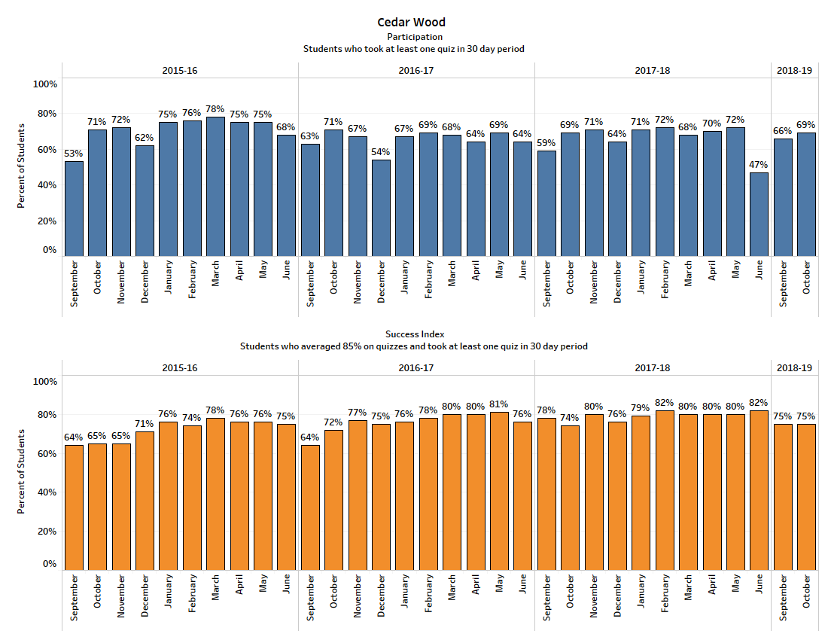
Accelerated Reader Data
Notes:
When looking at September and October 2017 and 2018- fairly the same data
Continue to monitor for just right books for students and monitoring by the teachers

Slide 49

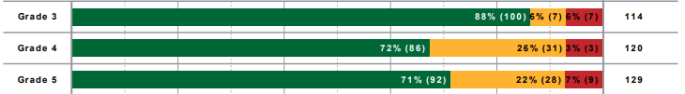
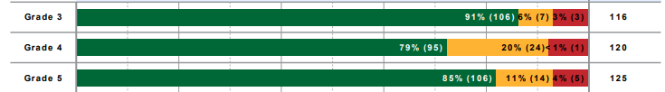
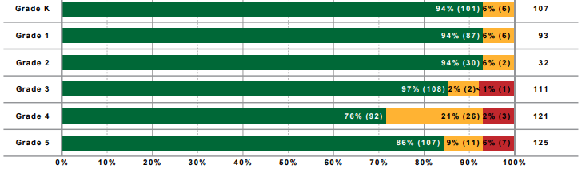
iReady 2017-18 Reading Data
Fall
Winter
Spring
Notes:
Strong correlation between iReady data and data progress monitoring my staff shows direct correlation to SBA results
Identify the few students that did not make growth- pictures
Third grade- 88%-91%-97% (SBA-95.7%)
Fourth grade – 72%-79%-76% (SBA-94.4%)
Fifth Grade- 71%-85%-86% (SBA-95.3%)

Slide 50

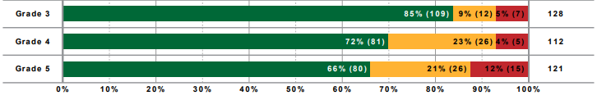
iReady Fall 2018 Reading Data
Notes:
Add to slide our Winter 2019 Data and add the information in a slide
Third Grade Diagnostic 85% -
Fourth Grade Diagnostic 72% -
Fifth Grade Diagnostic 66% -

Slide 51
iReady Winter 2019 Reading Data

Slide 52
iReady Reading Data
Fall 2018 and Winter 2019
Need comparison chart

Slide 53
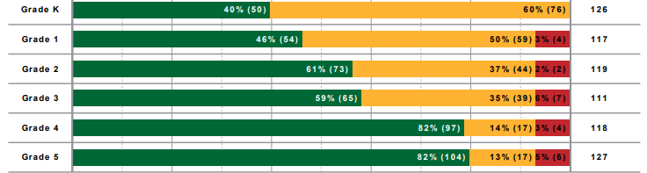
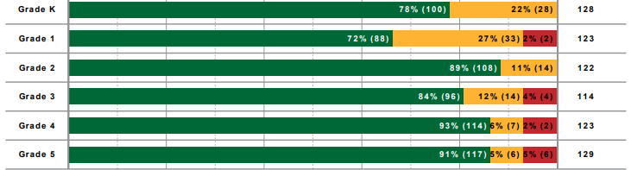
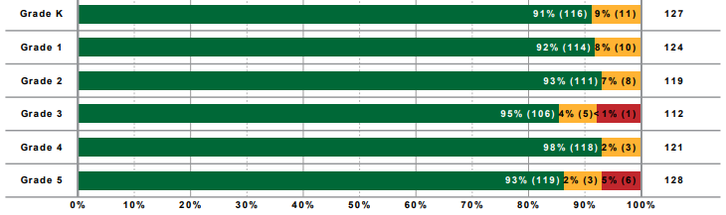
iReady 2017-18 Math Data
Fall
Winter
Spring
Notes:
Kindergarten – 40%-78%-91%
First Grade – 46%-72%-92%
Second Grade-61%-89%-93%
Third Grade- 59%-84%-95% (SBA -94.8%)
Fourth Grade- 82%-93%-98% (SBA- 96%)
Fifth Grade – 82%-91%-93% (SBA-89.1%)

Slide 54

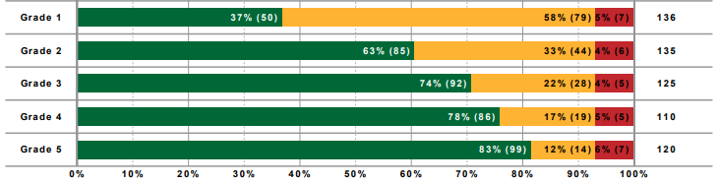
iReady Fall 2018 Math Data
Notes:
Add winter data for comparison
Grade 1 Diagnostic – 37%
Grade 2 Diagnostic -63%
Grade 3 Diagnostic – 74%
Grade 4 Diagnostic – 78%
Grade 5 Diagnostic -83%

Slide 55
iReady Math Data
Fall 2018 and Winter 2019

Slide 56
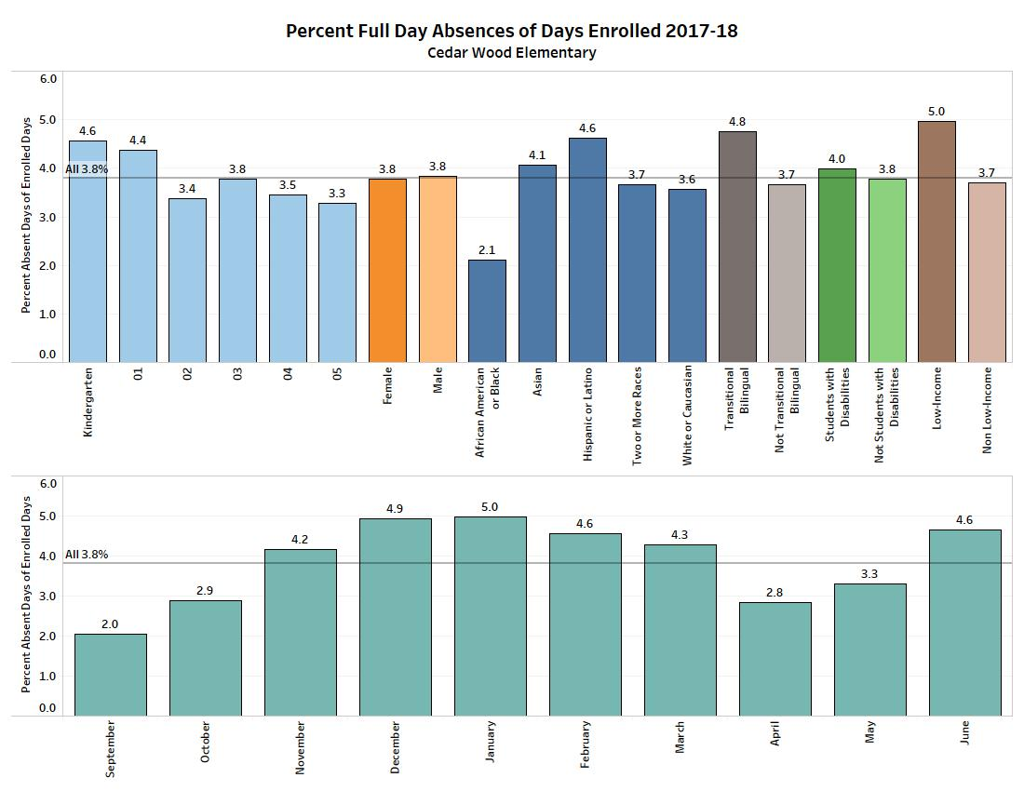
Attendance Data
Notes:
Most of our students that are over the bar are students that are traveling to other countries to see families
Areas to focus: Hispanics, transitional bilingual, low income, students with disabilities

Slide 57
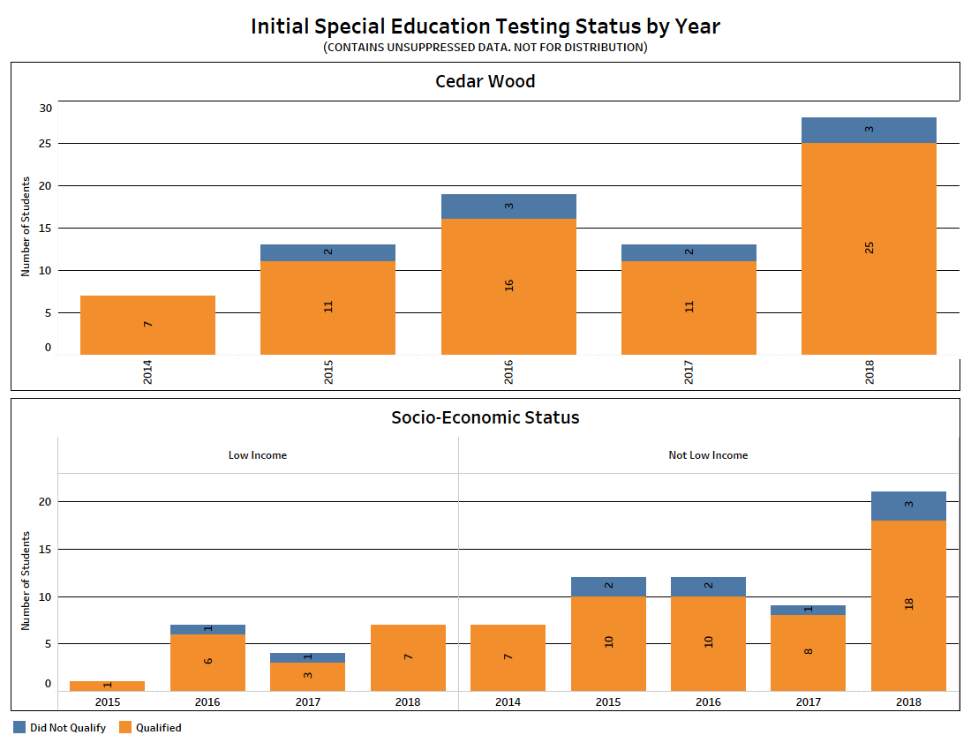
Initial Special Education Testing by Year
Notes:
Increase in the number of Special Education students that qualified- which areas? (SLP or Resource)

Slide 58
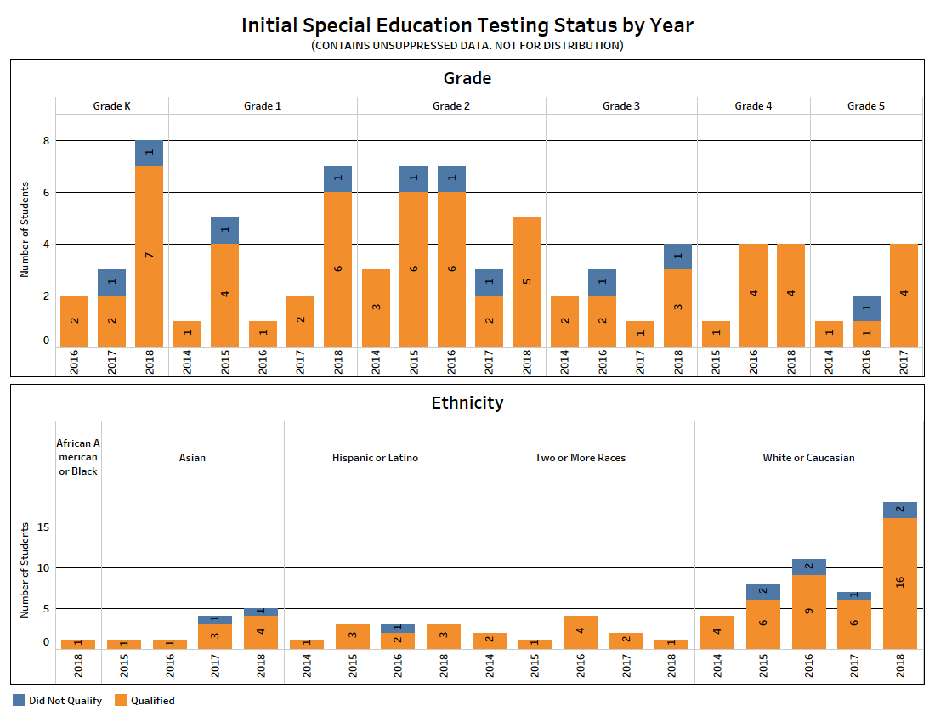
Initial Special Education Testing by Year
Notes:
Our SAT Process is working and we are putting interventions into place to make sure that the special education referrals have been initiated after interventions have not proven to show progress for the student.
Most of the referrals in each grade level were appropriate – There were 28 referrals and only 3 did not qualify. (Decide how many were academic and how many SLP and OT/PT

