Slide 1
Staff Clarity
School Plan
Timeline &
Instructional Focus
Focus on 2 practices a year to develop proficiency.
’17-’18 –
  Asking Questions & Defining Problems (Example of CWE vertical alignment provided)
  Developing and Using Models
’18-’19 –
  Analyzing & Interpreting Data
  Using Mathematics & Computational Thinking
Provide definitions of all 8 science practices to new staff.
Big Idea
There are 8 science practices within the NGSS (New Generation Science Standards). There are also 3 CCC (Cross Cutting Concepts) which are instructional strategies intertwined throughout.

Slide 2
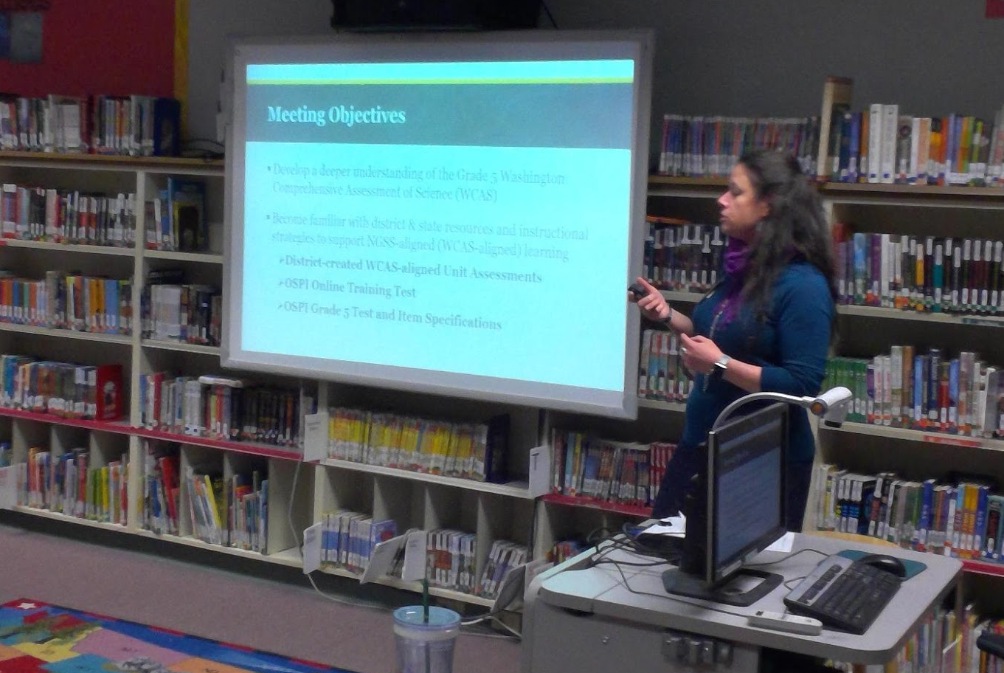
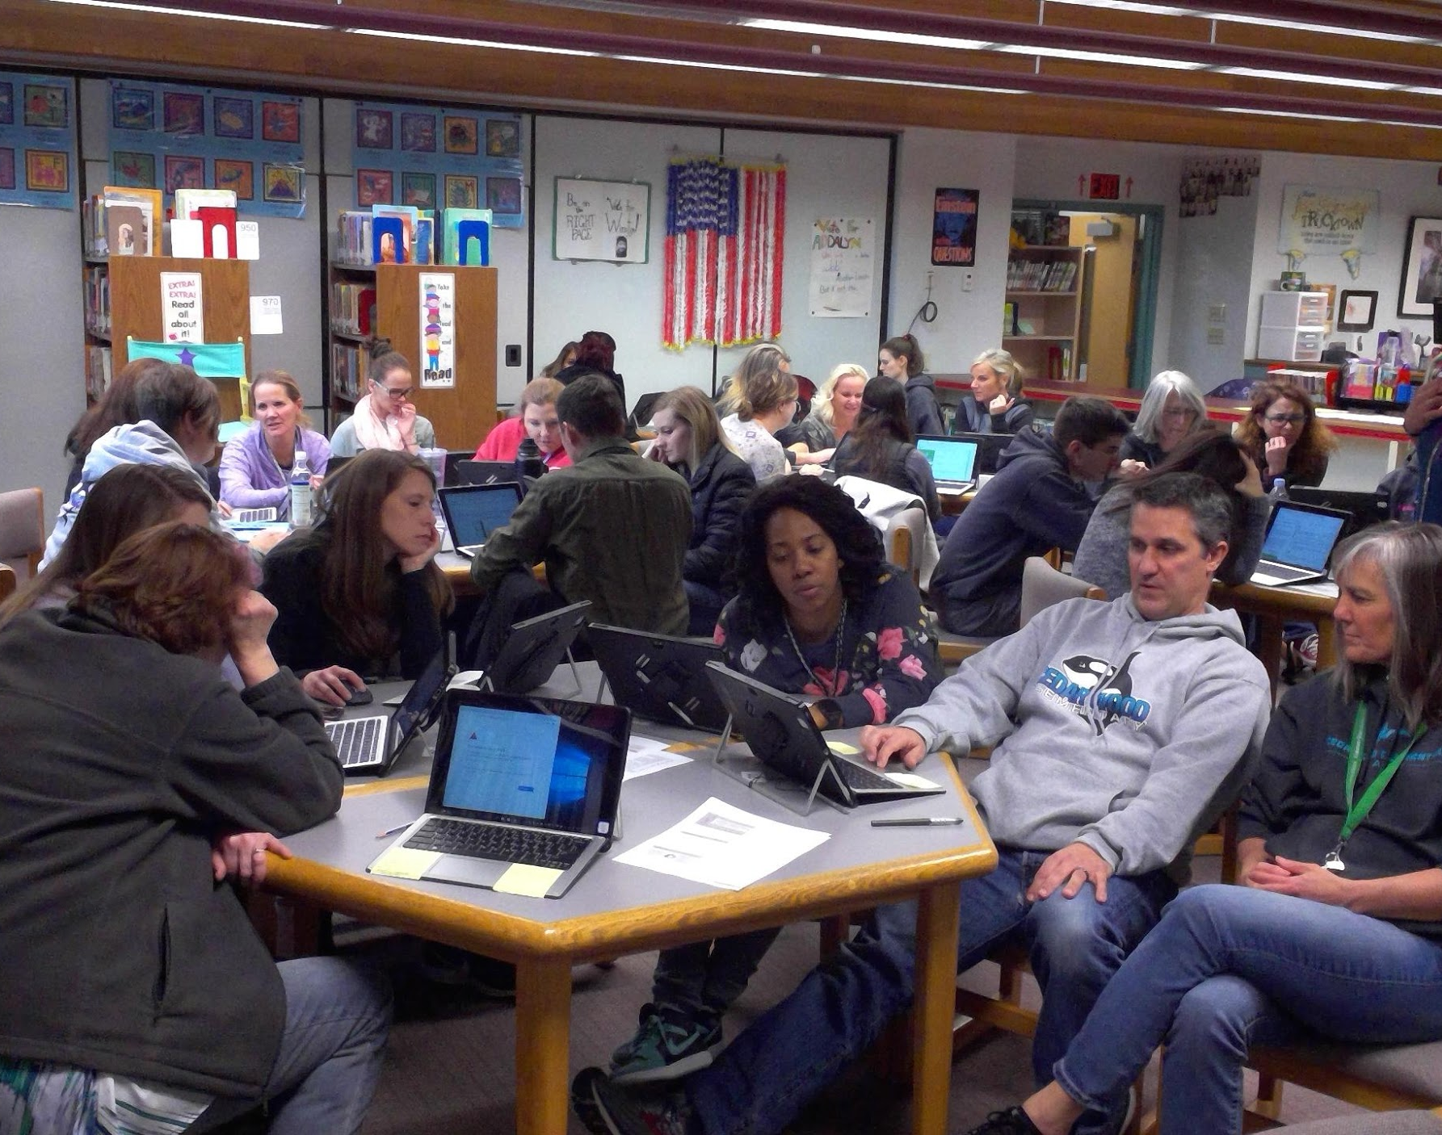
Training
Cadre training of 2 science practices by Allison Greenberg
Staff training of 2 science practices by science leads
Staff SBA vertical alignment training followed by 4th & 5th grade teacher more in depth training by Allison Greenberg
Lead attendance at District science trainings by Allison Greenberg
Notes:
TO better prepare and understand the two targeted practices, we had Allison come out and first train the cadre leaders, then we were able to lead the staff in a training where we intentionally vertically aligned skills and able to dig deeper into the practices

Slide 3
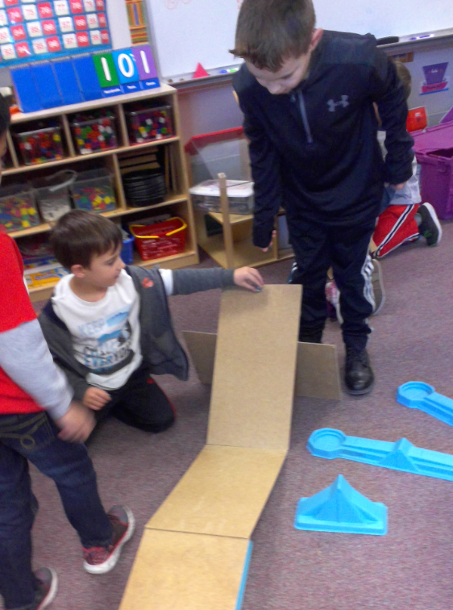

Investigation
Kindergarten
Use quantitative data to compare two alternative solutions to a problem
21st Century Skills
Critical Thinking
Communication
Collaboration

Slide 4
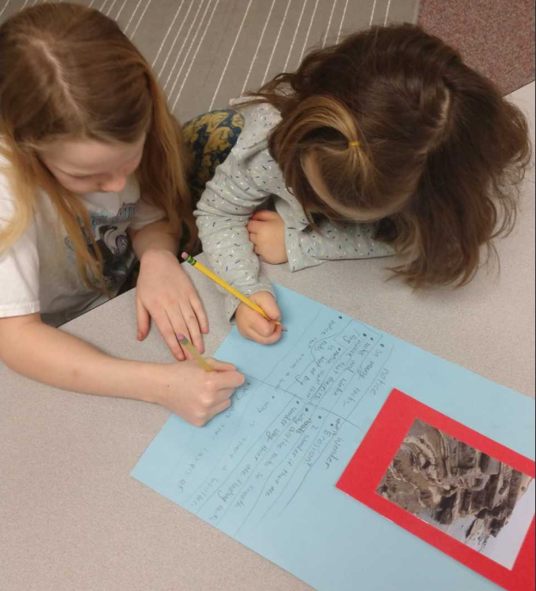
Notice & Wonder
1st Grade
Record information (observations, thoughts, and ideas)
Use and share pictures, drawings, and/or writings of observations
21st Century Skills
Critical Thinking
Communication
Collaboration

Slide 5

Share & Trade
2nd Grade
Analyze data from test of object or tool to determine if it works as intended
21st Century Skills
Critical Thinking
Communication
Collaboration

Slide 6
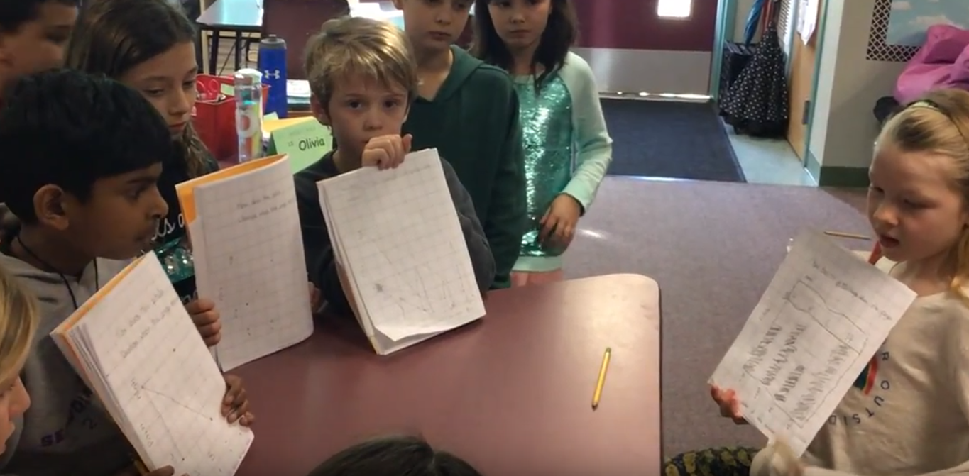
Board Meeting
3rd Grade
Compare/contrast data collected by different groups in order to discuss similarities/differences in their findings
21st Century Skills
Critical Thinking
Communication
Collaboration

Slide 7
Backwards Planning
4th Grade
State of Matter unit planning
Pre-Assessment
Students’ wonders integrated into lessons
STATE OF MATTER
WONDERS
Can concrete turn back to a liquid?
When cucumbers are mixed with chemicals, why does it become pickles?
How do bubbles form with just water?
How does matter change?
Why does some matter change and some cannot? Why some liquids and solids can freeze or melt, but be able to return to its former state
How many things are there that could not turn into solids again after they’re liquids?
How can matter change to its original state?
How are gases formed?
Does gases have shape?
When water becomes steam what happens to the steam? What’s vapor water?
21st Century Skills
Critical Thinking
Communication
Collaboration

Slide 8
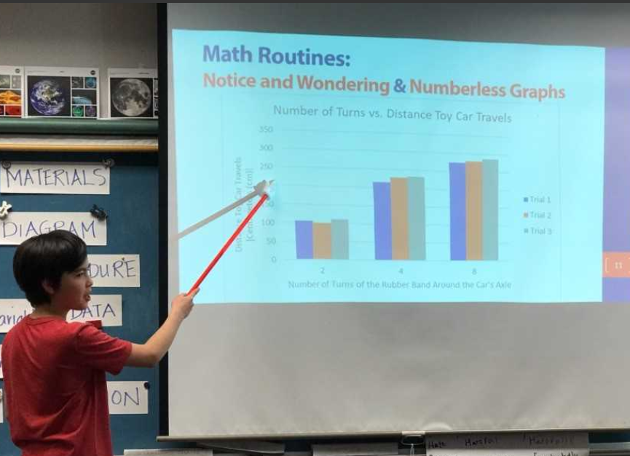
Numberless Graph
5th Grade
Analyze/interpret data to make sense of phenomena, using logical reasoning, mathematics, and/or computation
21st Century Skills
Critical Thinking
Communication
Collaboration

Slide 9
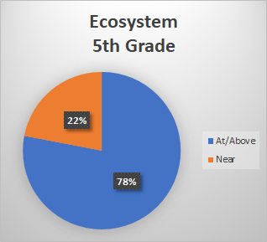
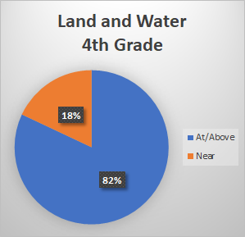
Assessment
Next Steps
Reiteration and highlight of previous practices throughout lessons
Show students own growth throughout year on current practices
Cadre leads are available to support
Notes:
Individual units will show whether a practice needs to be more heavily focused on. Grade level cadre representatives and cadre leads are available to help support.
Science practices are open-ended naturally leading students to higher-level thinking. Teachers are encouraged to use student directed lessons to create self-enrichment.

Slide 10
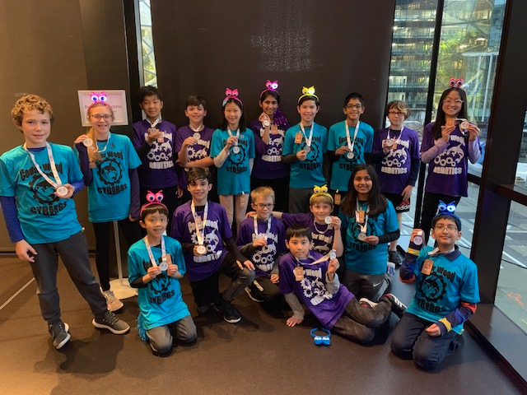
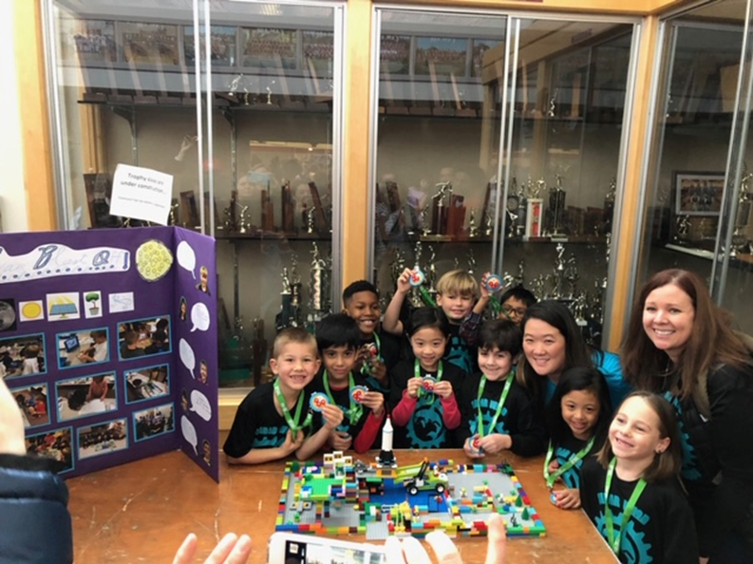
Robotics
FLL &
FLL Jr.

