Slide 1
SIP Writing Focus
Identify high impact strategies and provide support for all staff to support student learning.
  Create/share common documents and high impact strategies.
Notes:
Barb

Slide 2
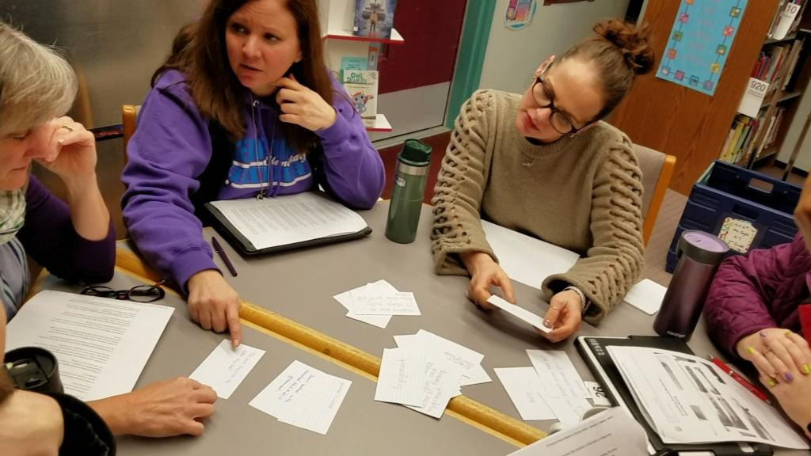
Connecting Pieces
Vertical Alignment
“15 Practices Proven Effective for Teaching Writing”
Analyze SBA data using “Here’s What, So What?, Now What?” protocol
Work with Jaime and Mary Kay to align BFTL with Reach
15 Practices Discussion
Notes:
Andrea - At the beginning of the year we worked as a building to vertically align high impact strategies by, discussing, and analyzing our own practices using the article shown. Just recently we were able to split up into two teams, grades k-2 worked on instructional focus and sequence and grades 3-5 disaggregated SBA data.

Slide 3
8 Step Process
Connecting Questions
Data Disaggregation | Our Students – Who are they as students? Where are they now, according to data, formative assessments, etc.? What do they need and in what order do they need it?
Timeline Development | Goals – What goals are appropriate for our students, at this time and in this setting?
Instructional Focus | What instructional sequence can we implement to attain our goals?
Assessment | What do formative and summative assessments provide to help us evaluate student learning as a result of our instruction?
Tutorials | As we reflect on student learning, what are our next steps with students? What are current needs for: Additional instruction / scaffolds / experiences? Students who have shown meeting standard? Ensuring students move forward with learning?
Enrichment
Maintenance
Monitoring | Considering student growth, what goals are now appropriate for our students at this time?
Notes:
Barb

Slide 4
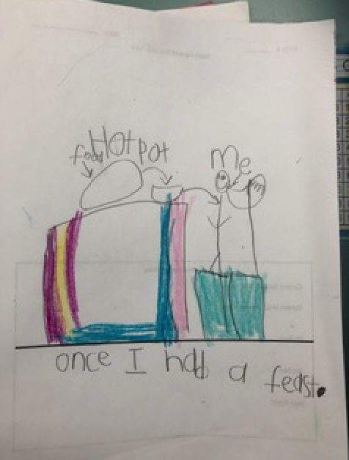
Kindergarten
Typical Student Sample
Notes:
Andrea - Here you see typical kindergarten work before instruction.

Slide 5
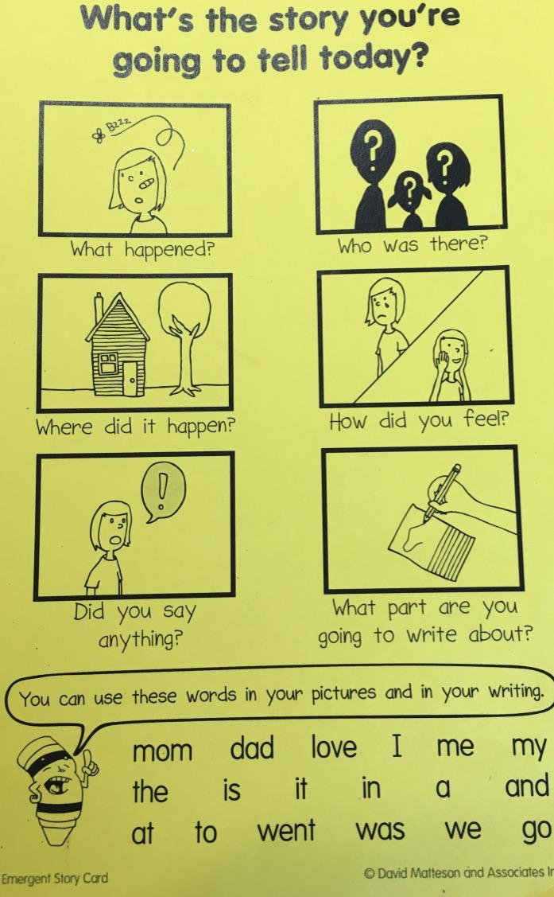
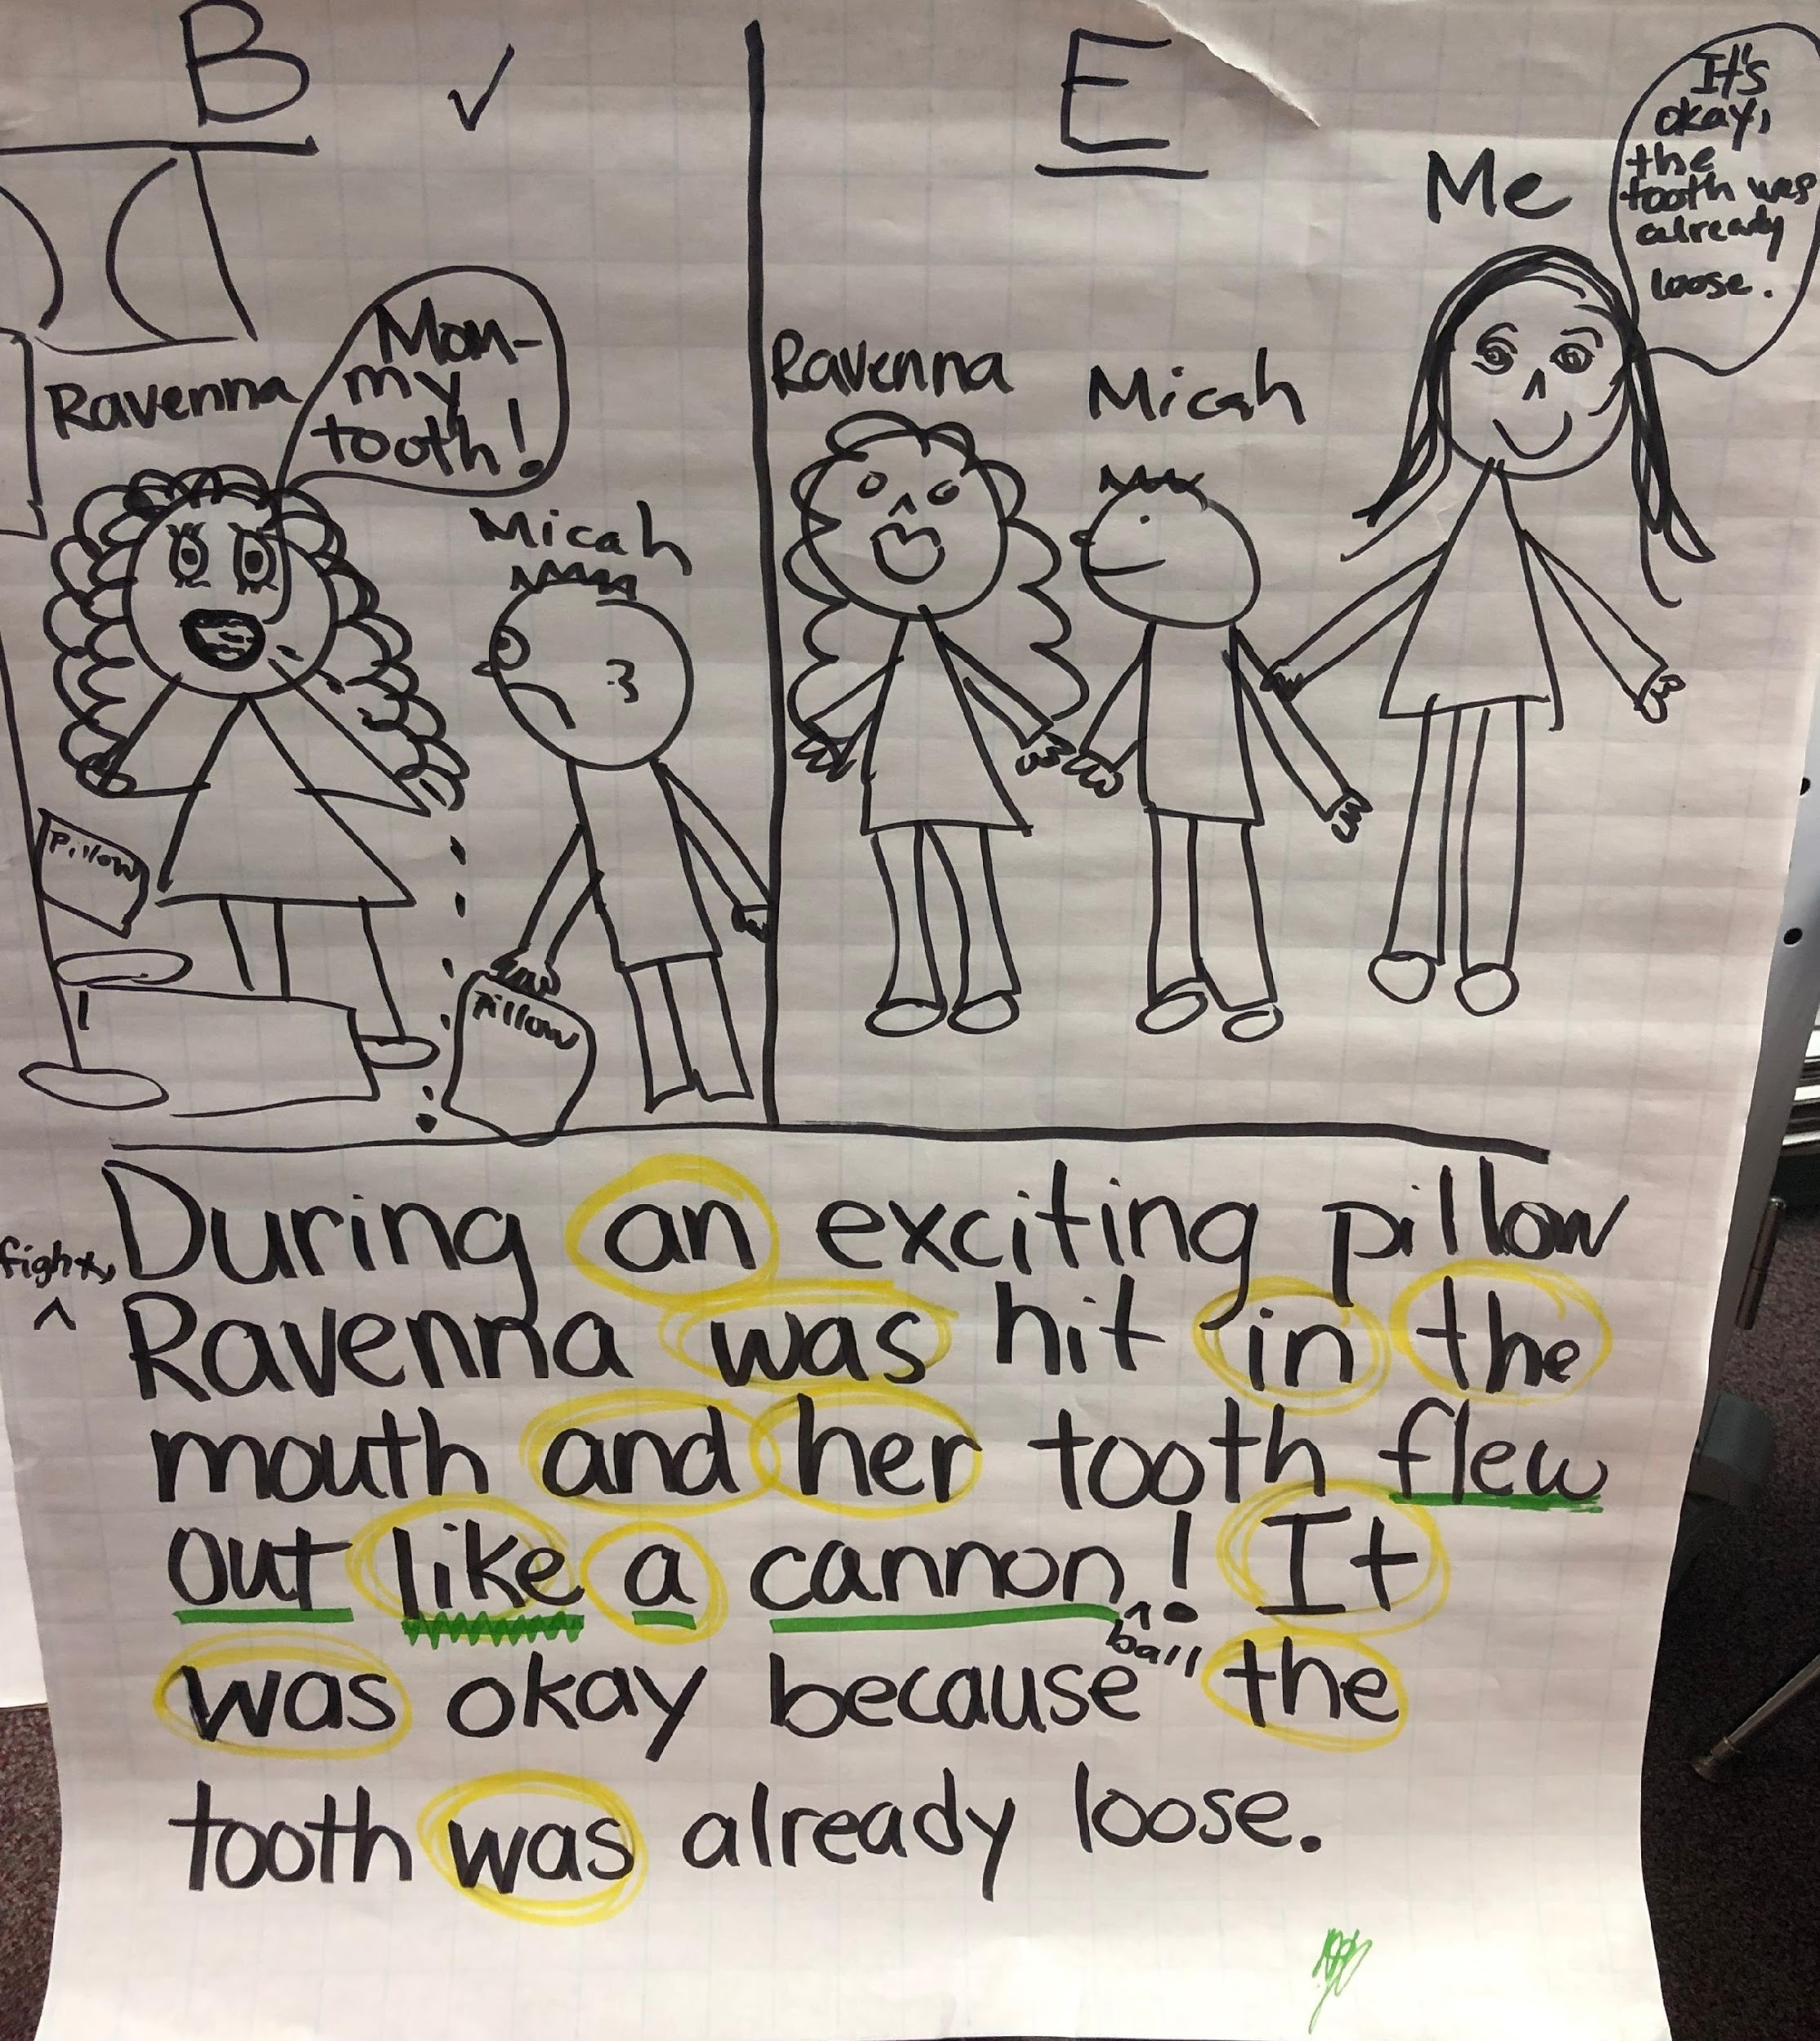
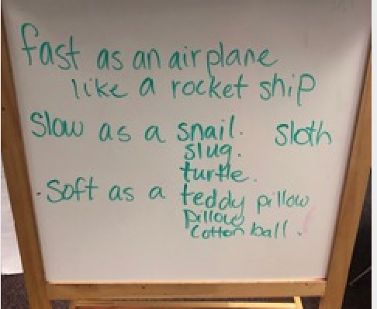
Instructional Strategies
Modeled and Shared Writing, BFTL
Note the shared similes!
Notes:
Andrea - Kindergarten teachers use intentional writing strategies that support the needs of their students and reflect the state standards. The team used this graphic from Building Foundations that last in conjunction with shared writing. This class also had a student who shared a simile, which became another anchor chart for students to use in their own writing. This is just an example of how teachers incorporate student readiness into their teaching to support their students.

Slide 6
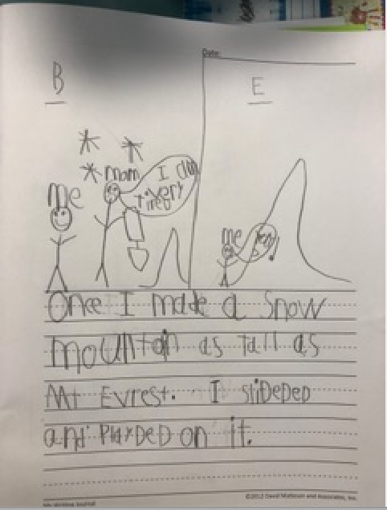
Final, Published Piece
Note the similes this author included!
Notes:
Andrea - Kindergartens made incredible growth in their writing forming complete sentences. Now, these teachers will be able to monitor where students are and then make necessary adjustments for their next writing task. Here we see how using the anchor chart supported other kindergarten writers - Once I make a snow mountain as tall as Mt. Everest.

Slide 7
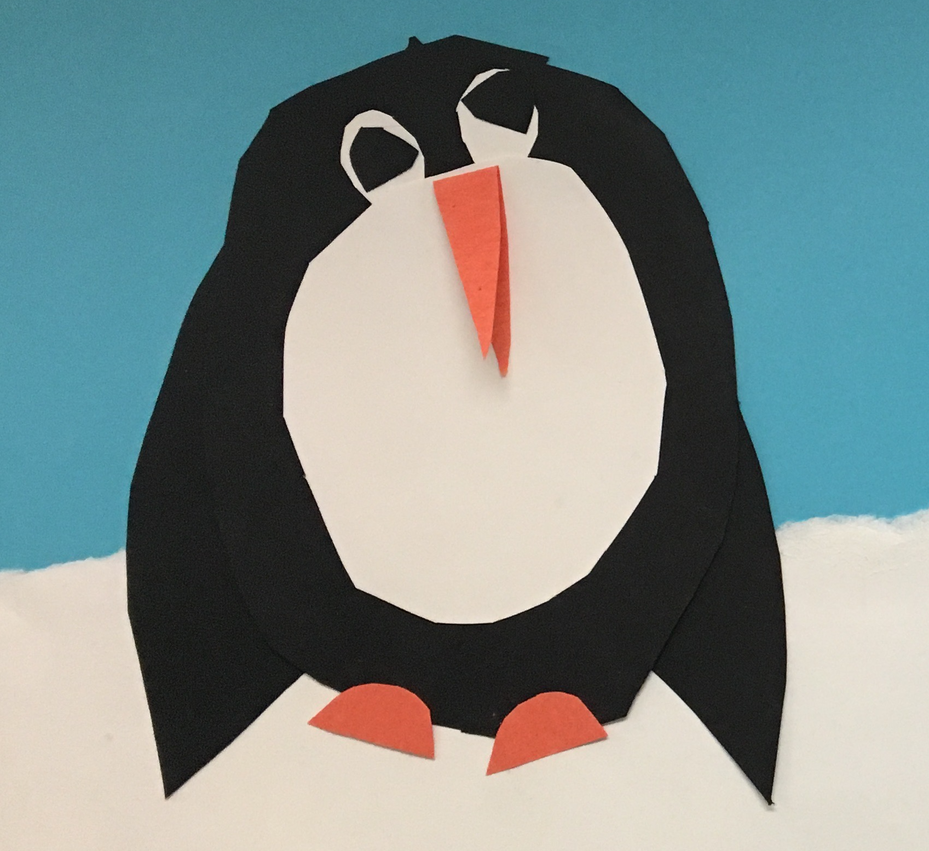
1st Grade
Informational Writing
Penguins
Notes:
Barb

Slide 8
Intentional Strategies ---
Multiple!
Experience complete writing process
Guidance through process
Model
Confer
Grammar within context
Peer collaboration
Use of fiction/non-fiction texts
Notes:
Barb

Slide 9
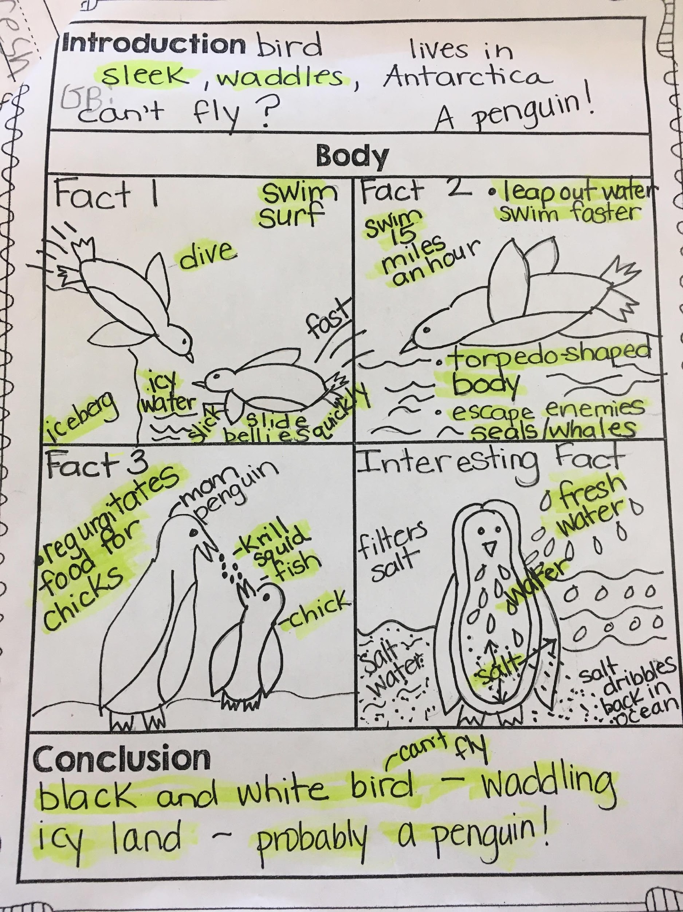
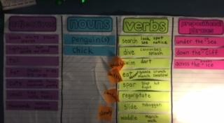
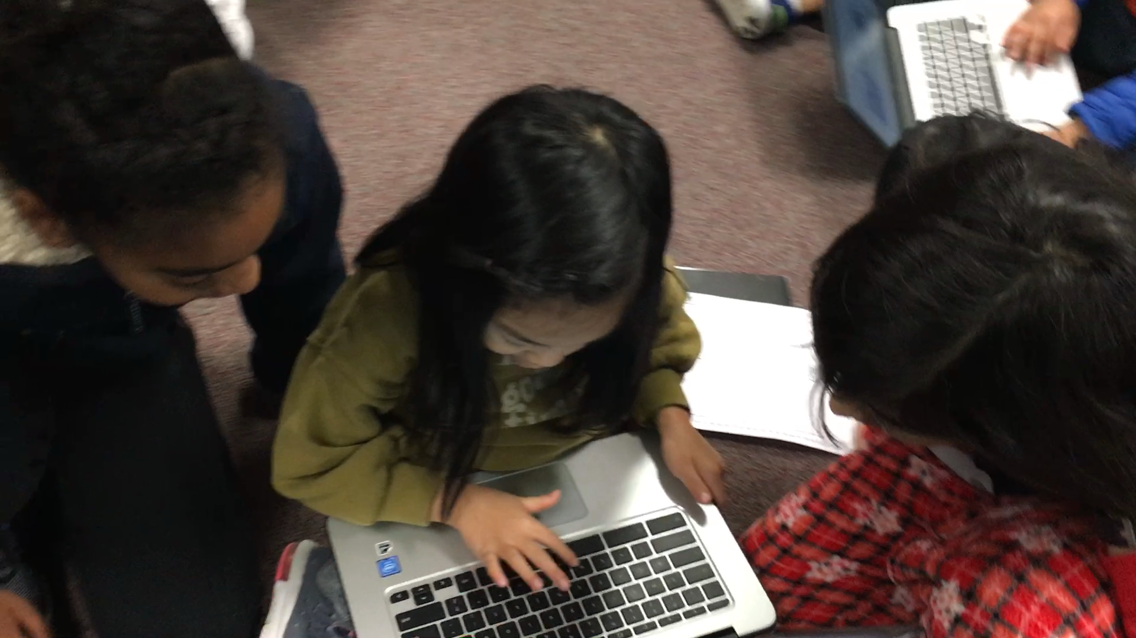
Notes:
Barb

Slide 10
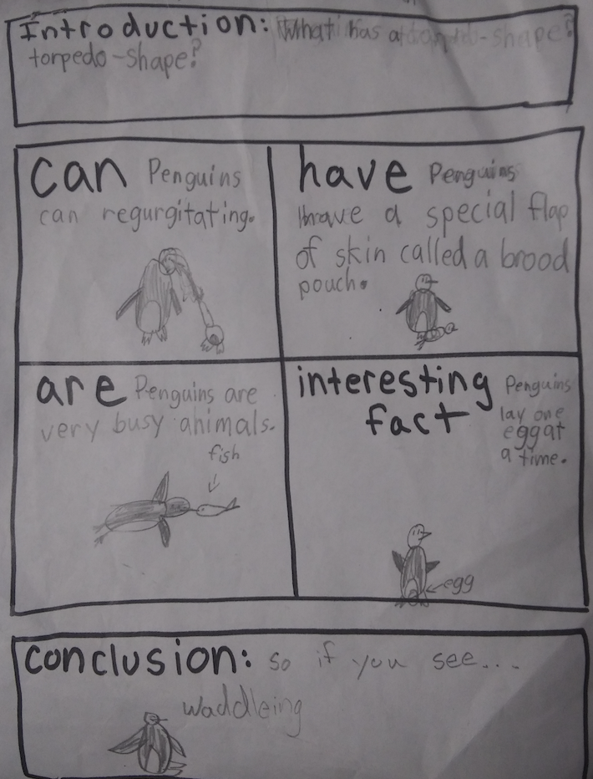
“Can, Have, Are” Shared Graphic Organizer (BFTL)
Notes:
Andrea - Using this strategy from our Building Foundations that Last, first grade teachers released responsibility to students who then completed the interesting fact section independently.

Slide 11
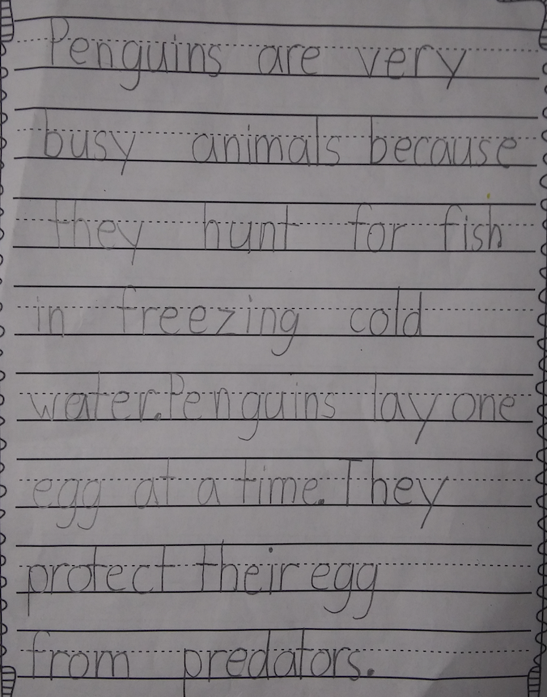
Final Shared Sample
Notes:
Andrea -Here is an example of student work with the shared writing strategy from the slides before.

Slide 12
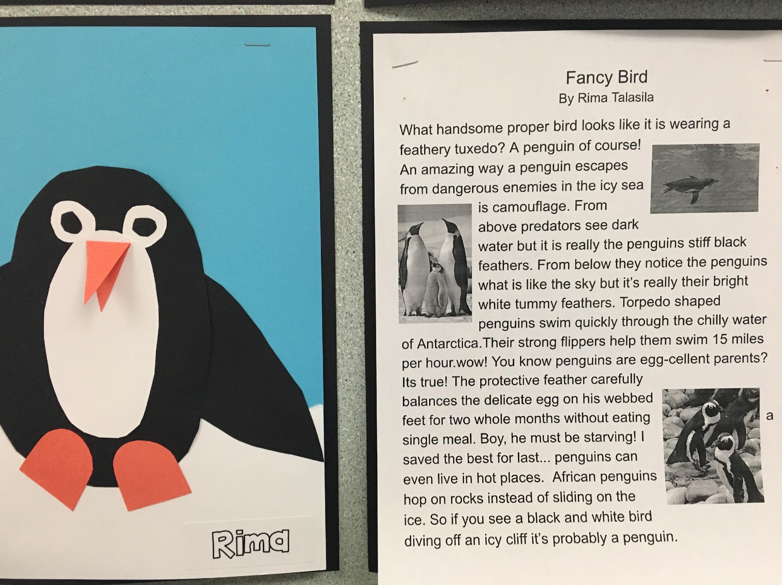
Shared, with 4th Grade Reading Buddies
Notes:
Andrea - This is the same writing prompt as we saw on the slide before. Students had help from their 4th grade reading buddies to implement technology into their writing using a Google Document.

Slide 13
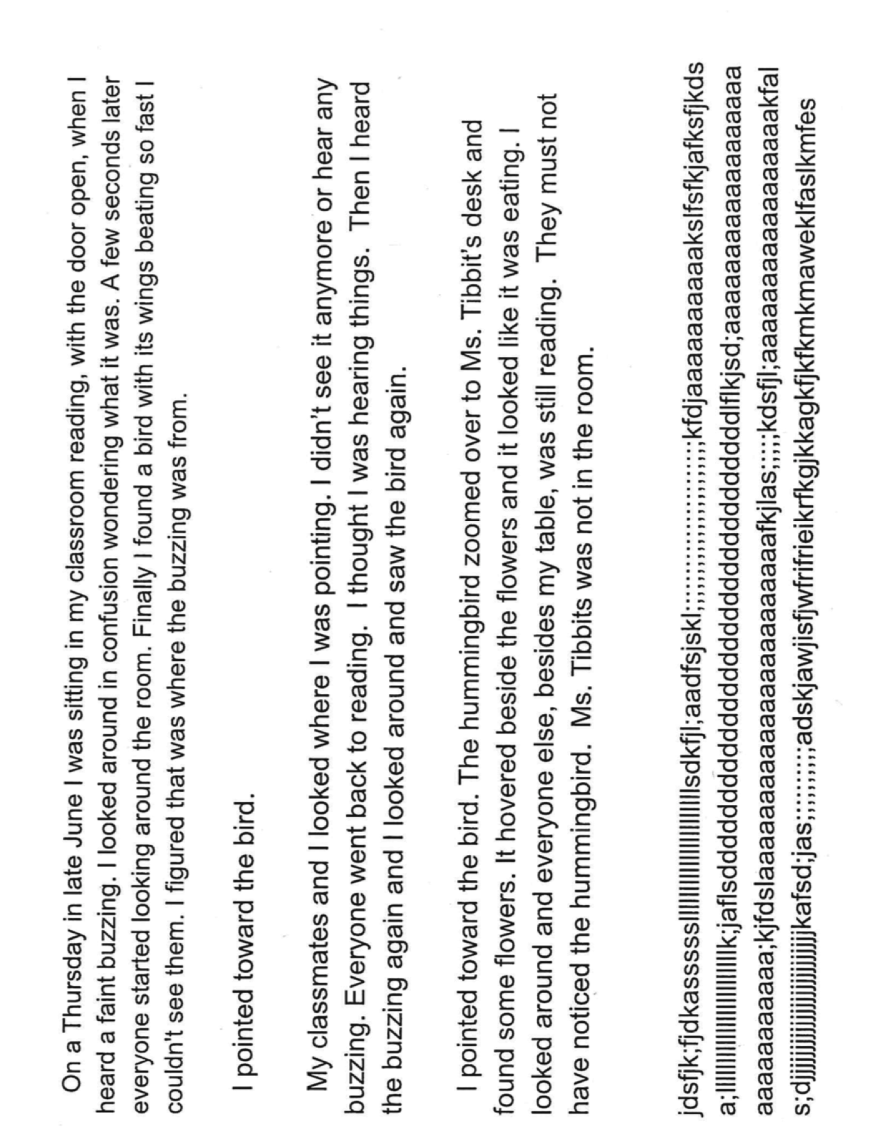
4th Grade
Hesitant Writer, 1st Draft
Notes:
Barb

Slide 14
Intentional Strategies:
Graphic organizer, including source documentation
Information from articles and videos
Conferences
Peer review
Dialogue rules within instructional sequence
Peer conference
Notes:
Barb

Slide 15
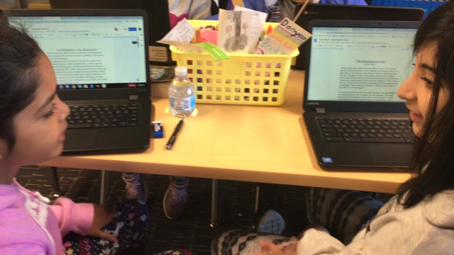
Peer Conferences
Notes:
Barb

Slide 16
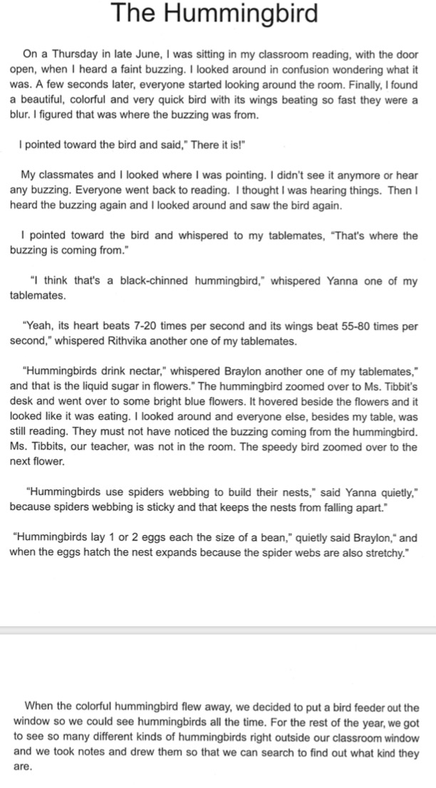
Final
Draft Narrative
Notes:
Barb

Slide 17
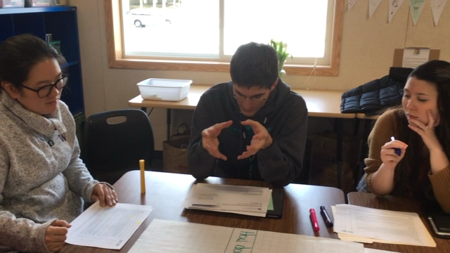
Final Considerations
Although 3 grade levels were spotlighted, similar strategies and results are typical throughout Cedar Wood.
Notes:
Andrea - even though we only were able to show you 3 grade levels - similar strategies and results are typical throughout Cedar Wood.

Slide 18
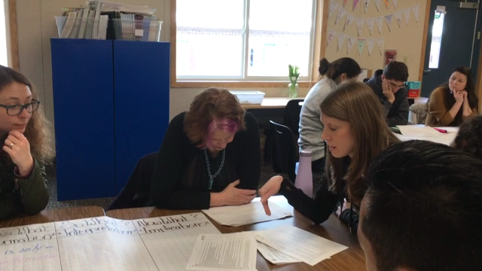
Final Considerations
One insight from this year ---
  We routinely use dialogue in reading, math and science.
  This year we’ve intentionally incorporated dialogue into writing instruction. Students writing has become stronger as evidenced by student writing, formative and summative assessments.
Notes:
Barb

