Slide 1




SIP Updates
2019-20

Slide 2
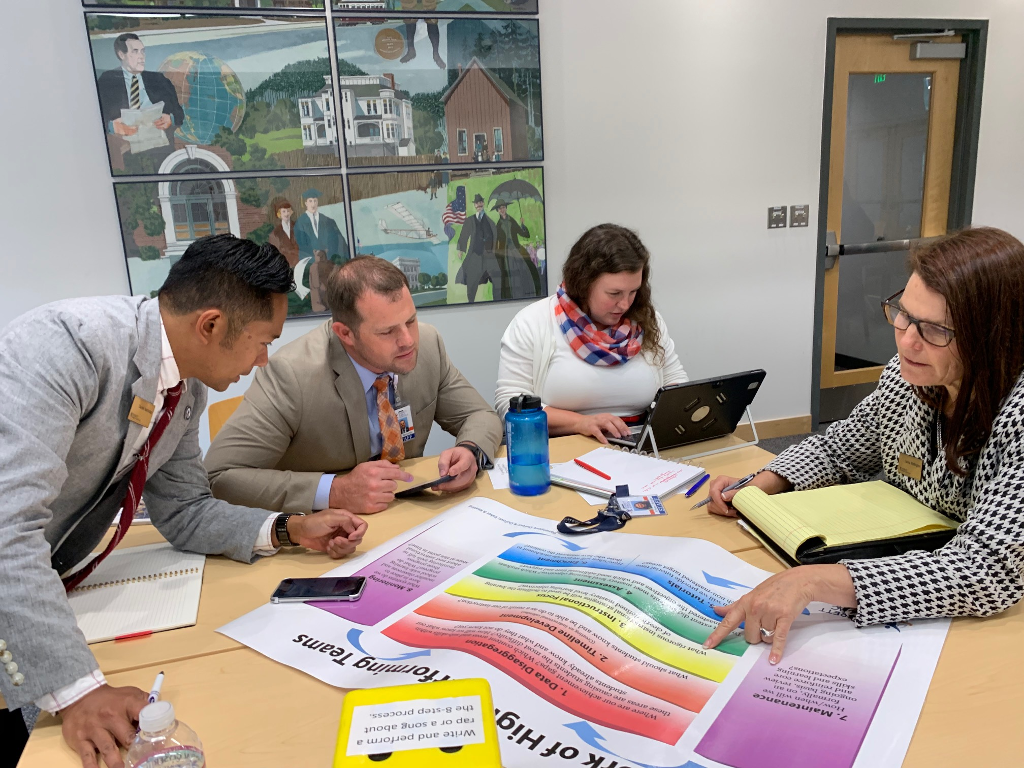
School improvement plan
Objectives
Explain the connection between SIP and SOSR.
Understand the data elements required in the SIP
  WSIF calculator
Make a plan for developing and finalizing the SIP by 10/30
  Establish staff activity for LID day
Review district models/exemplar actions for consideration in your SIP

Slide 3

School improvement plan
Activity
As a table group develop a 60 second elevator speech explaining the connection and importance of the SIP and the SOSR to a new administrator in Everett
OR
Create a 60 second infomercial explaining the connection and importance of the SIP and SOSR to a new administrator in Everett
Notes:
Begin with the end in mind.
SIP strategies will be central to the SOSR
Data monitoring should include areas of struggle used to write the SIP

Slide 4
School improvement plan
Understanding the data
Thinking back to Equipped to lead, what is one NEW action that you might include in your SIP?
What data led you to this action?
Understanding the WSIF framework- How is it calculated
Explain the target sheet
Identify targets with the highest leverage points
Whatever else Catherine wants to do

Slide 5
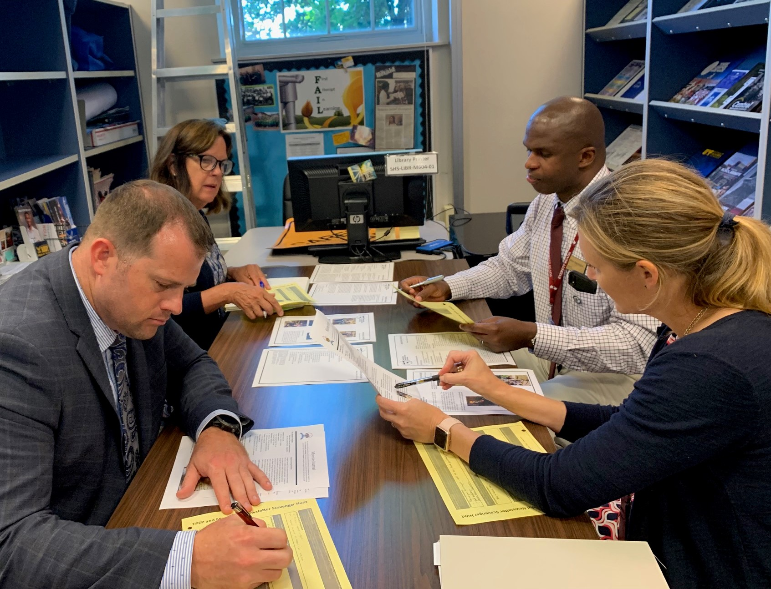
School improvement plan
Sharing Elizabeth Kelley Kevin Allen Kelly Shepherd

Slide 6
School improvement plan
Possible SIP actions Developed by curriculum department For your consideration Scan the SIP actions highlight in green those actions that you think you will use Highlight in yellow actions for consideration Leave blank the actions that may not align with your plan

Slide 7
School improvement plan
Work session Peer review the SIP work you currently have completed Begin to draft/revise your SIP Work Session for interpreting data Work Session on planning the LID activity with staff

Slide 8
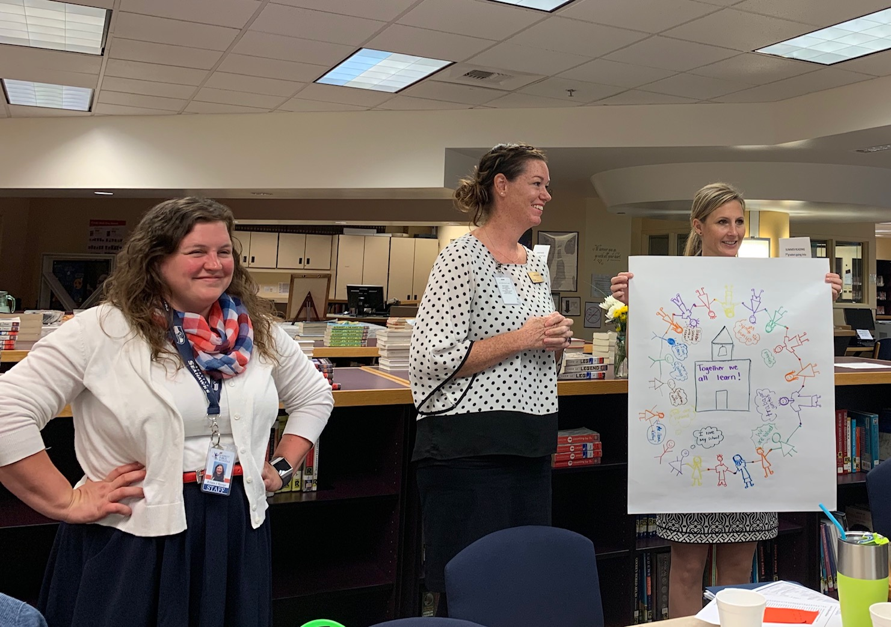
School improvement plan
Closure Share out Odds and Ends Website welcome pages ILT and LID day agendas Red Cross Video

