Slide 1


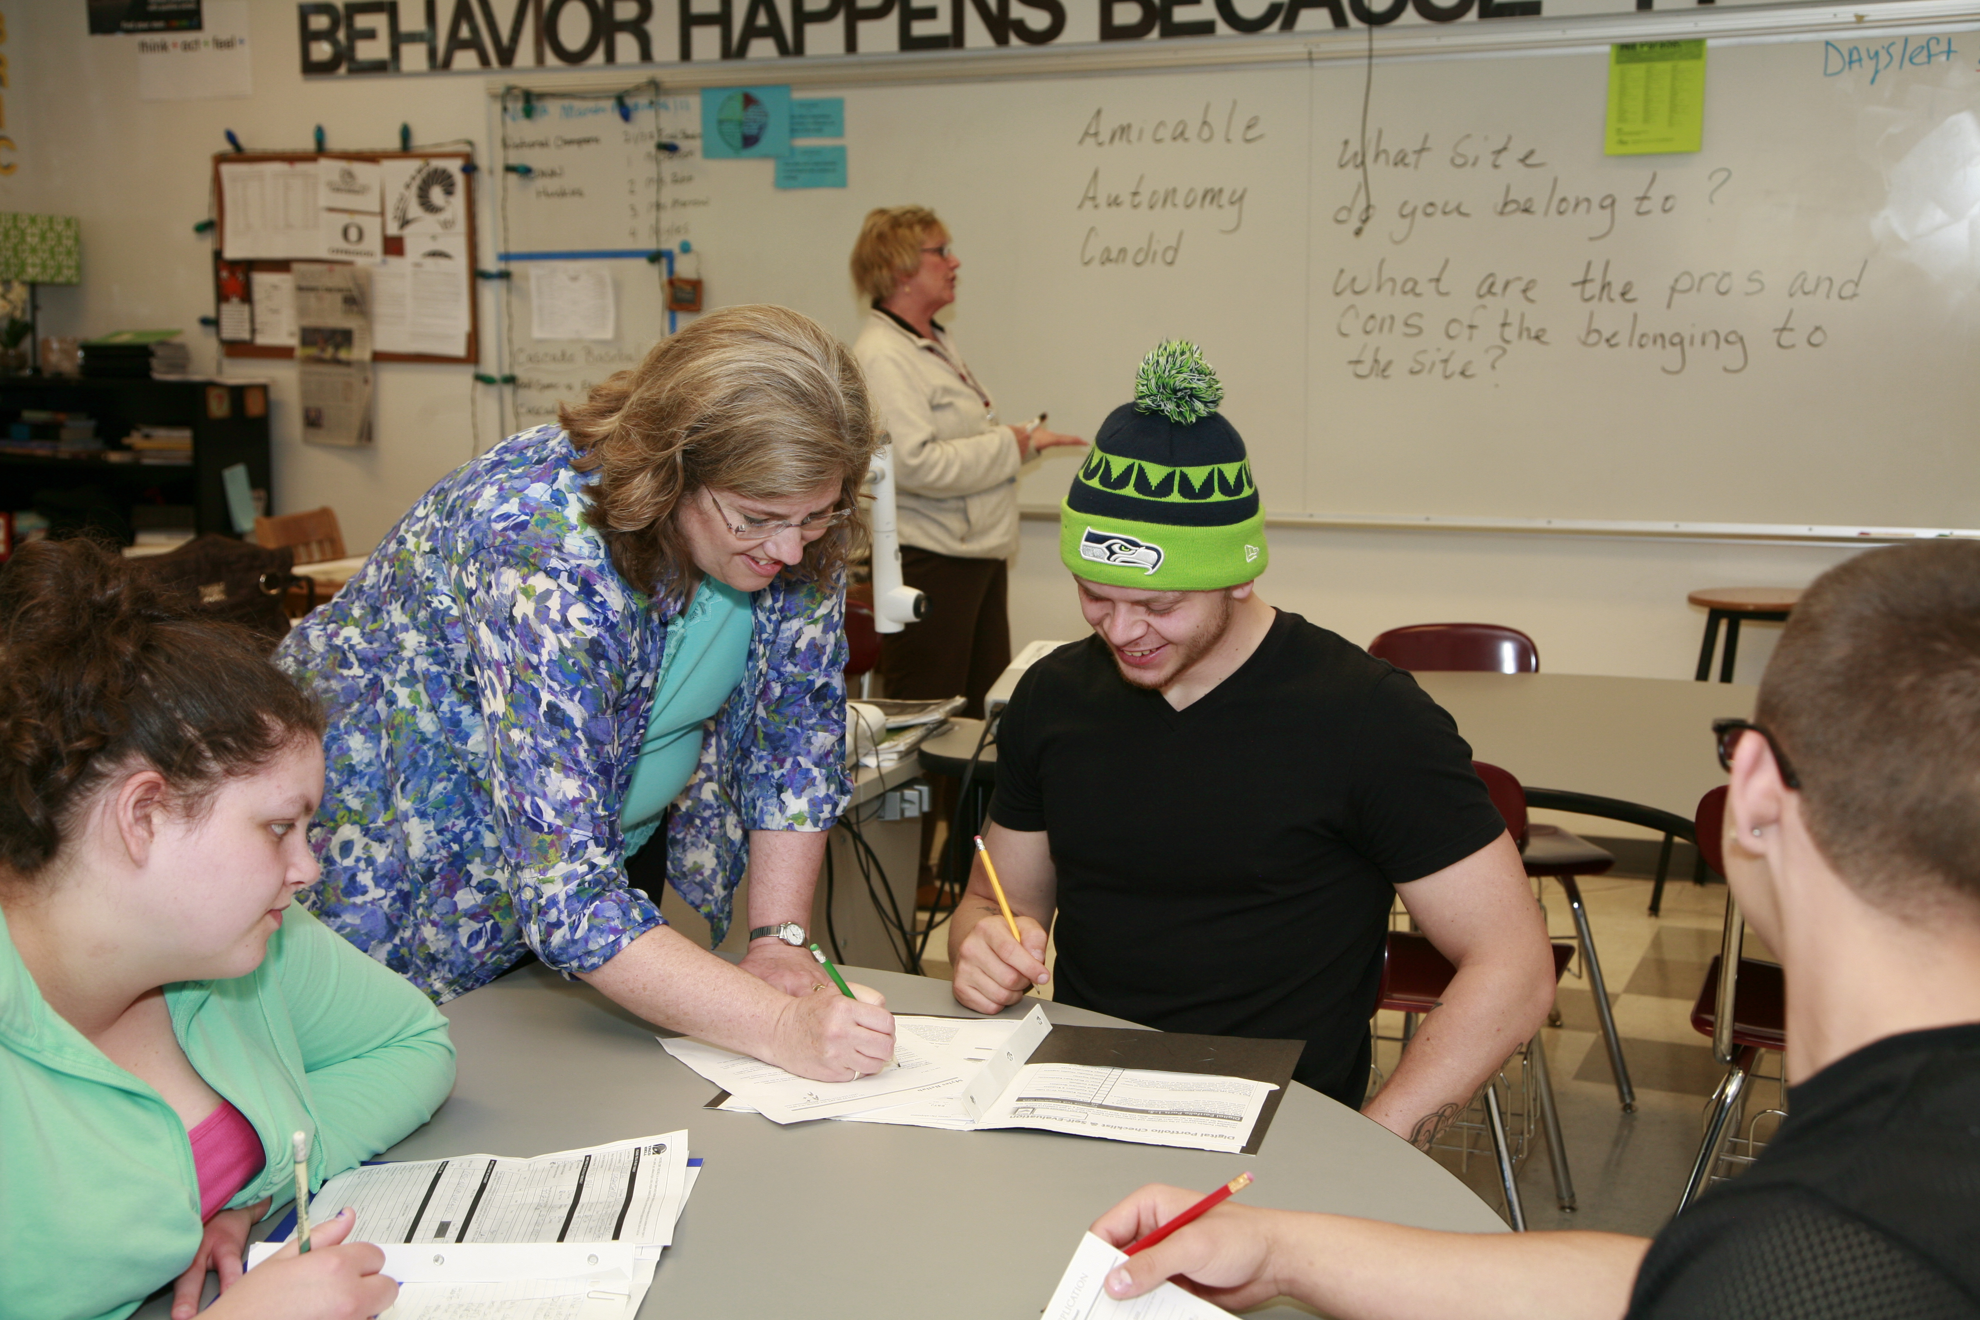

FCS:05 District Orientation of Roles and Responsibilities
Everett Public Schools – August 2019

Slide 2
Learning Objectives
  Review expectations from the Code of Professional Conduct as required in WAC181.87
  Review district policies and procedures for professional conduct expectations
  Be able to locate and access school policies and procedures
  Identify who has access to student’s confidential information
  Be able to define confidentiality and state the legal basis for confidentiality
  Describe ways for practicing and maintaining appropriate confidentiality
Notes:
The information we are presenting today, will go towards satisfying the state’s new paraeducator requirements, and specifically your three-hour requirement for Fundamental Course of Study (FCS) 05. This presentation will provide two of the three hours required. The remaining hour will be available through an online module later this year.
Today we will:
Review expectations from the Code of Professional Conduct as required in WAC 181.87 (District to also cover their specific policies and procedures)
Review district policies and procedures for professional conduct expectations (District to cover their policies and legal requirements)
Identify where to locate and access school policies and procedures
Identify who has access to student’s confidential information
Define confidentiality and state the legal basis for confidentiality
Describe ways for practicing and maintaining appropriate confidentiality
Define the roles and responsibilities required in the job description (District to include specific job descriptions)
Define the duties of a paraeducator in different environments including Special Education and ELL classrooms (District to add specific duties per Special Education and ELL classroom requirements)
Define the distinctions between the roles and responsibilities of paraeducators, teachers and administrative staff members
Discuss the relationship and legal requirements to be in direct supervision of a certificated employee. (District to add policy and supervision requirements)
At the end of the presentation, we have what we hope you will find to be an entertaining activity, with prizes. So hang in here with us for the next hour or so.

Slide 3
Learning Objectives
  Define the roles and responsibilities required in the job description
  Define the duties of a paraeducator in different environments including Special Education and ELL classrooms
  Define the distinctions between the roles and responsibilities of paraeducators, teachers and administrative staff members
  Discuss the relationship and legal requirements to be in direct supervision of a certificated employee

Slide 4
Code of Professional Conduct
WAC181.87
District Policies and Procedures
  Policy 5161 – Civility in the workplace
  Policy 5253/P – Professional boundaries
  Policy 5270 – Disciplinary action and discharge
  Policy 4310 – Contact with school/district staff
  Policies 3204, 3205, 3210, 5010/P, 5160/P – HIB, sexual harassment and discrimination
  Policy 3300/P – Student Discipline
Notes:
I am going to start by covering the expectations of both the state and the district with respect to your professional conduct.
Chapter 181-87 of the Washington Administrative Code (WAC) sets forth specific Acts of Unprofessional Conduct that require reporting to the State, which could affect your ability to work as a paraeducator:
181-87-050 Misrepresentation or falsification in the course of professional practice
181-87-055 Alcohol or controlled substance abuse
181-87-060 Disregard or abandonment of generally recognized professional standards
181-87-065 Abandonment of contract for professional services
181-87-070 Unauthorized professional practice
181-87-080 Sexual misconduct with students
181-87-085 Furnishing alcohol or controlled substance to students
181-87-090 Improper remunerative conduct
181-87-093 Failure to assure the transfer of student record information or student records
181-87-095 Failure to file a complaint
The district also expects our paraeducators to:
Recognize and adhere to appropriate roles and responsibilities (Mandy, Randi, Cynthia and Chad will discuss that in more detail)
Recognize and practice appropriate relationships with students and parents (Mandy, Randi, Cynthia and Chad will discuss that in more detail)
Recognize authority of and establish professional relationship with teachers (Mandy, Randi, Cynthia and Chad will discuss that in more detail)
Accept responsibility for improving skills, knowing school policies and procedures, and represent the school district in a positive manner
These expectations are found in our district policies and procedures [read slide]

Slide 5
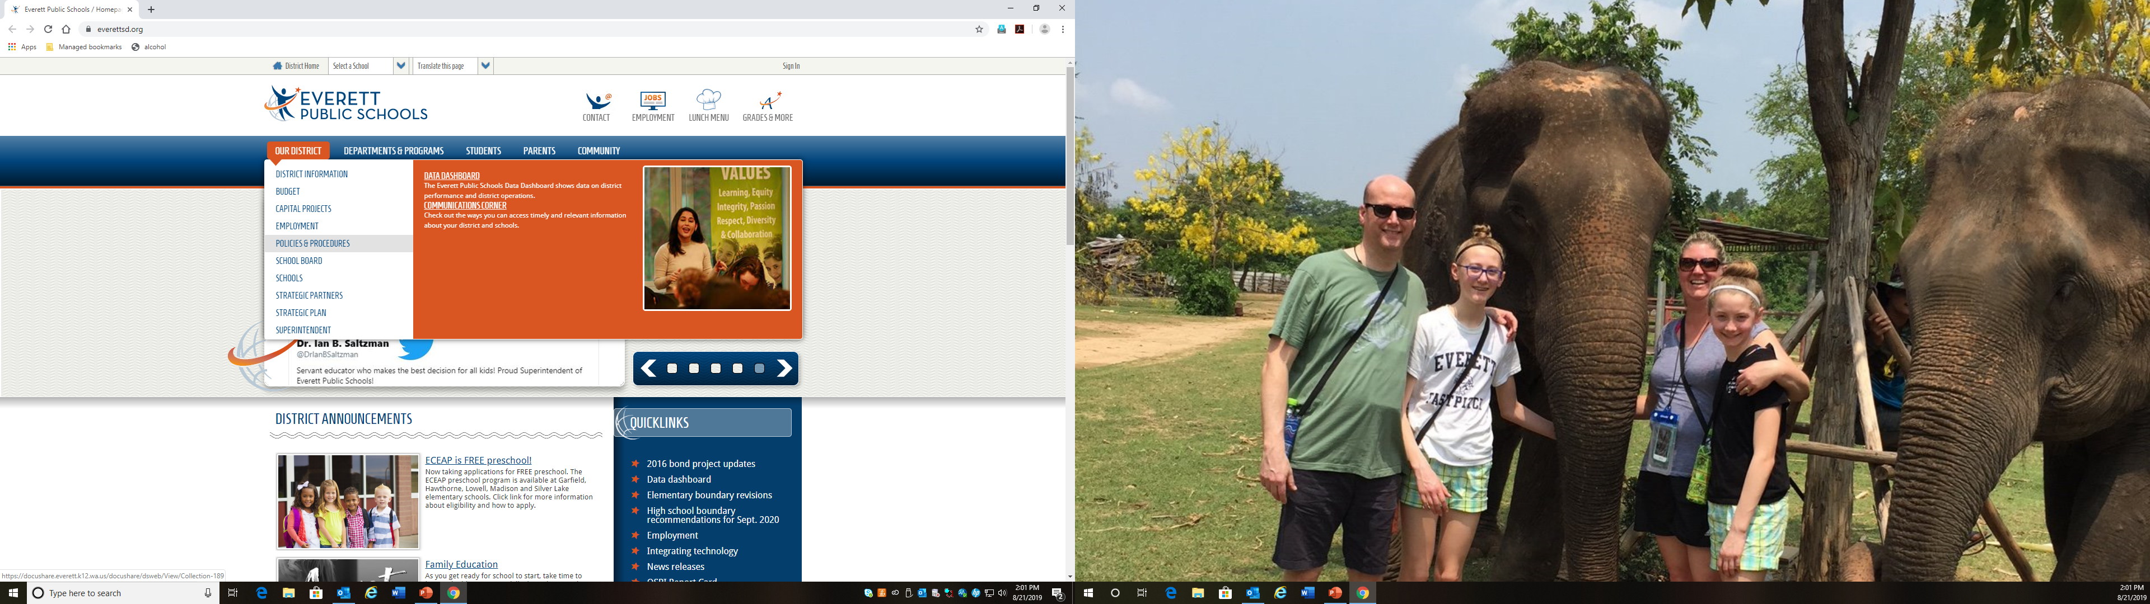
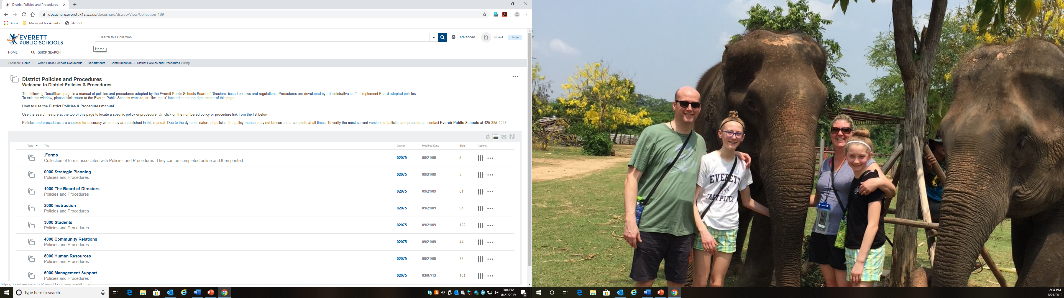
District Policies and Procedures
Notes:
To access the policies and procedures I just discussed, go to the district website at www.everettsd.org. This is reflected on the left. Under “Our District,” go to “Policies and Procedures” and click.
This will take you to a page that looks like the one on the right. Notice at the top you can enter a search term, and you can search by number or key word. You can also click on a specific folder (below) and search within a specific folder of policies and procedures.

Slide 6
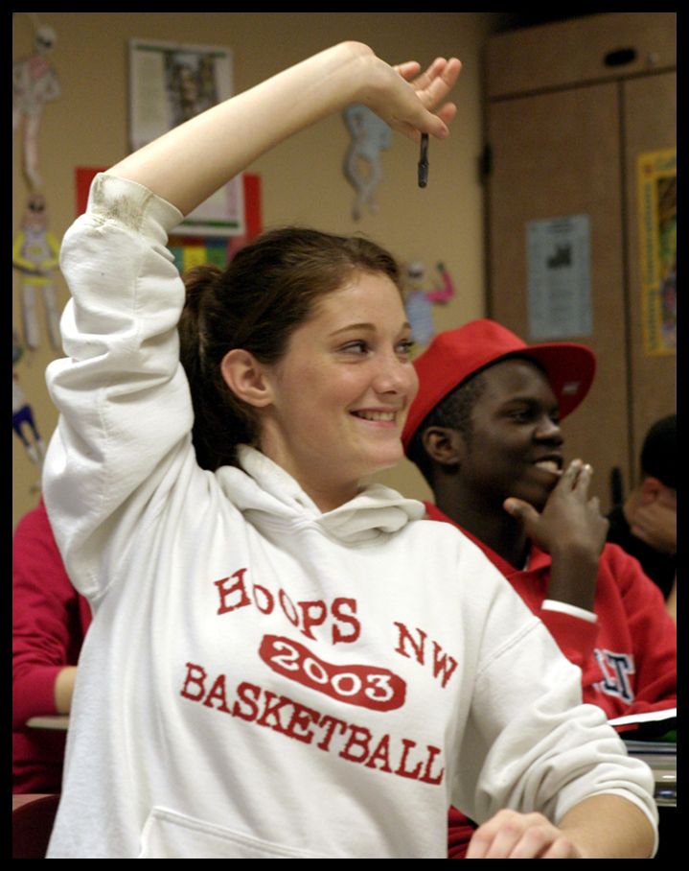
Questions?

Slide 7
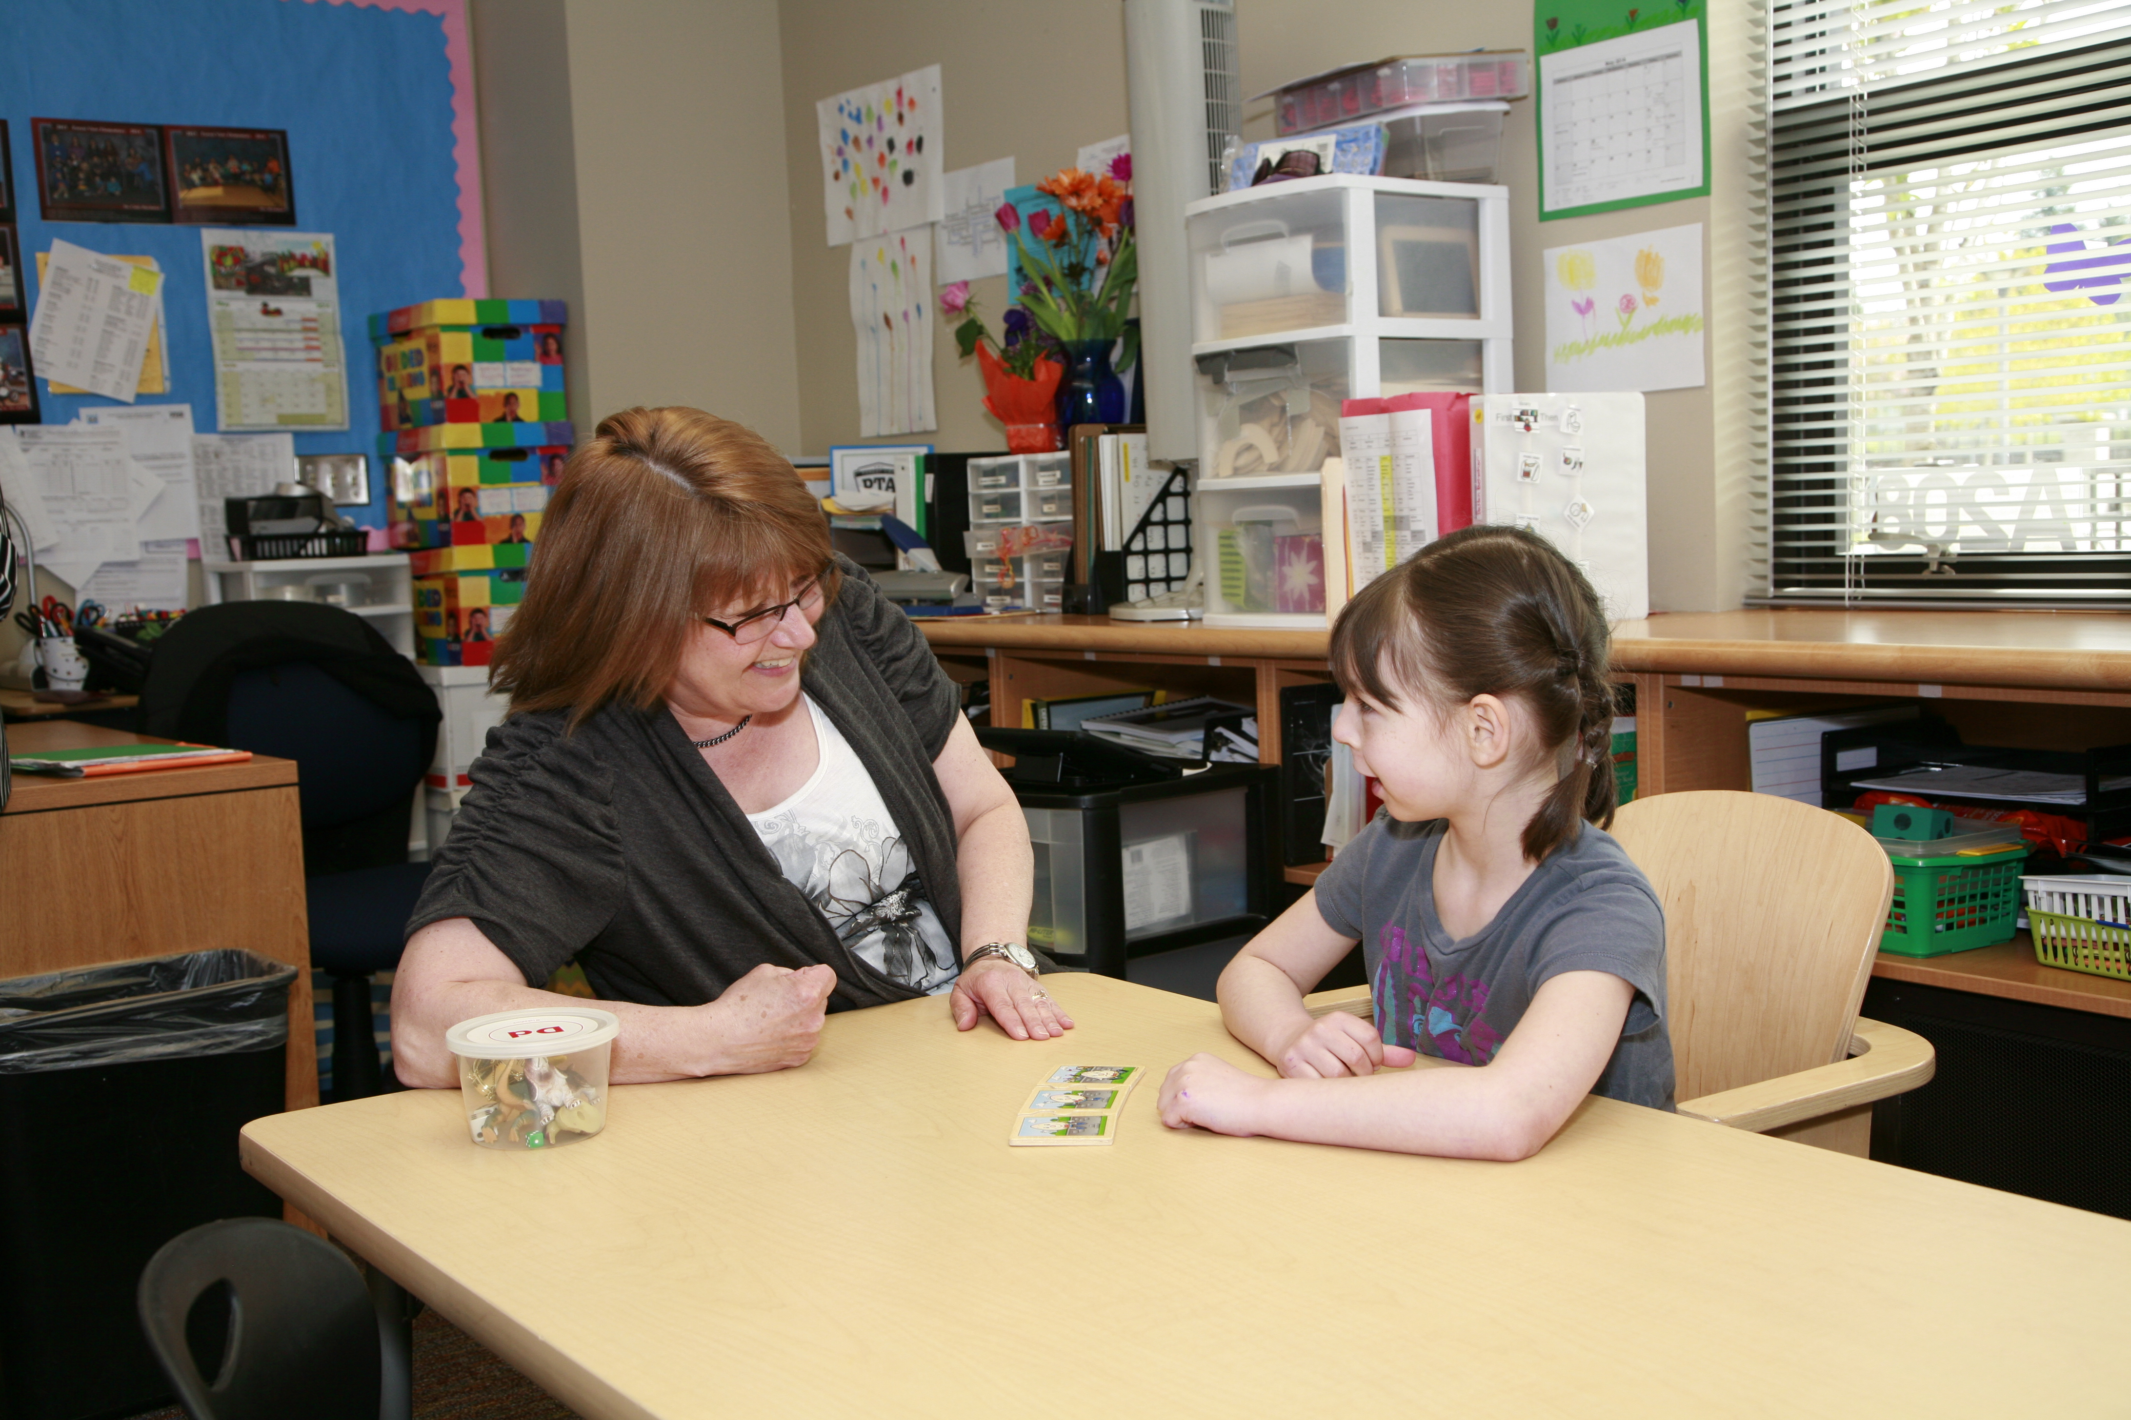
Confidentiality
Maintaining confidentiality is essential!
FERPA – Family Educational Rights and Privacy Act

Slide 8
Roles of the Paraeducator
  Monitor and assist students during teacher-directed, whole class instruction.
  Monitor and support students during independent work or cooperative learning activities under teacher direction.
  Provide follow-up instruction after teacher-directed instruction.
  Provide small group instruction (pre-teaching or alternative instruction) to students under teacher direction.
  Train others (peer partners, peer tutors, volunteers, parents) to provide instruction or assistance to students under the direction of a certificated staff member.
  Support students’ instructional program through the preparation of materials and the fulfillment of other clerical tasks.
  Monitor students in a variety of settings such as the cafeteria, bus loading area, playground, hallway or auditorium.

Slide 9
Roles of the Paraeducator
Task Roles Performed by Teacher Roles Performed by Paraeducator
Classroom Organization | Plans weekly daily schedule Plans lessons/activities for entire class and individual children Plans room arrangement and learning centers | Implements plan as specified by the teacher
Assessment | Assesses individual children Administers tests to entire class | Assists with monitoring and scoring objective tests
Setting Objectives | Determines appropriate objectives for class and for individual children | Implements lessons to meet child’s instructional objectives
Teaching | Teaches lessons for the entire class, small groups and individual children | Assists and monitors small groups and individuals with designated lessons
Behavior Management | Plans behavior management strategies for entire class and for individual children | Implements behavioral management strategies using the same emphasis and techniques as the teacher; reports progress
Working with Parents | Meets with parents Initiates conferences concerning child’s progress | May attend parent conferences and meetings when appropriate
Individual Educational Planning | Develops and implements IEP Revises instructional programs Designs instructional materials Attends inservice meetings and professional development trainings | Carries out teacher’s plans for child Monitors student progress in instruction programs and relates findings to supervising teacher Constructs materials designed by supervising teacher May attend professional development meetings for paraeducators
Roles Source: Archer, 1996. Chart Source: Gerlach, Pickett, Vasa, 1990.

Slide 10
Paraeducator Job Description
General Education Paraeducator job description
Part I: Position Summary
Paraeducators perform a variety of instructional, classroom support, and student supervision duties to assist the school and teachers in instruction, supervision and education of students.
Part II: Supervision and Controls over the Work
Paraeducators work collaboratively under the direction of the teacher, who assign specific responsibilities, and under the direct supervision of the principal or principal designee. Principal or principal designee provides training, direction, and guidance governing the performance of school-wide duties. Paraeducators are responsible for being familiar with the school/district policies and procedures which govern their work.

Slide 11
Paraeducator Job Description (continued)
Part III: Major Duties and Responsibilities
Duties may include, but are not limited to:
Works collaboratively by assisting teachers and specialists in assessment of student learning, supporting curriculum, student interactions, enforcing safe behaviors, and enhancing social growth of students in the classroom and other school settings.
Provides support to teachers with activities such as preparation of instructional materials, communications, student records, and grading documentation.
Provides instructional support to students in one-to-one, small, and large group settings at the direction of the teacher(s). Assesses and provides input to teacher(s) on student participation and progress. May administer and record student assessment results, to support the teacher.
Works with English Learners (EL) by using English and a second language if able, to assist with EL student’s learning.
Oversees student safety with activities such as recess and playground, lunch, bus duty, crossing guard duty, hallway supervision, in-school detention, etc.

Slide 12
Paraeducator Job Description (continued)
Communicates with students, parents, community members and other staff members, and exercises discretion and assures protection of student’s confidentiality consistent with building and district policies.
Monitors student behavior in classroom and non-classroom settings. Documents behavior and progress of students to assist teacher in assessing student progress with education plans.
Maintains or assists with student progress reports.
Takes steps to intervene when students may be in dangerous or unsafe situations.
Models appropriate behavior for students.
Provides students with guidance and reinforcement of rules and expected behaviors.
Performs clerical duties such as making copies, operating office equipment, answering telephones, ordering materials, and record keeping.
Performs food service assistance to students in ECEAP program.
Performs other duties as assigned.

Slide 13
Supervision
Paraeducators work under the direct supervision of a certificated teacher
The Title I Paraprofessionals, Non-regulatory Guidance, 2004 describes paraprofessionals as employees who work under the direct supervision of a teacher, and whose duties could include helping the teacher with reading, writing and math instruction.
Section D, Programmatic Requirements interprets “under the direct supervision of a teacher” this way: “(1) the teacher prepares the lesson and plans the instructional support activities the paraeducator carries out, and evaluates the achievement of the students with whom the paraprofessional is working, and (2) the paraprofessional works in close and frequent proximity with the teacher.”

Slide 14

Questions?

Slide 15
English Learner Enrollment Growth
Growth in number of English Learner (EL) students in Everett Public Schools

Slide 16
Languages Spoken in EPS
Languages spoken by active English Learners in Everett Public Schools, October 2018

Slide 17

Roles of the EL Paraeducator
  Provide instruction in English language under guidance of teacher
  Support implementation of English Language Proficiency Assessment (ELPA) screener and annual
  Maintain monthly record keeping and student EL files
  Facilitate connection to parents and family
  Provide supportive and welcoming atmosphere for EL students

Slide 18

Roles of the EL Paraeducator
  Whatever your specific role, you will probably interact with English Learners
    Social vs academic language
    Stages of language acquisition

Slide 19
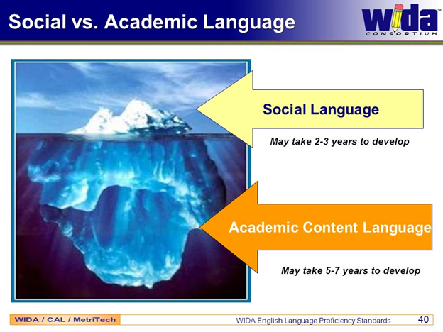

Slide 20
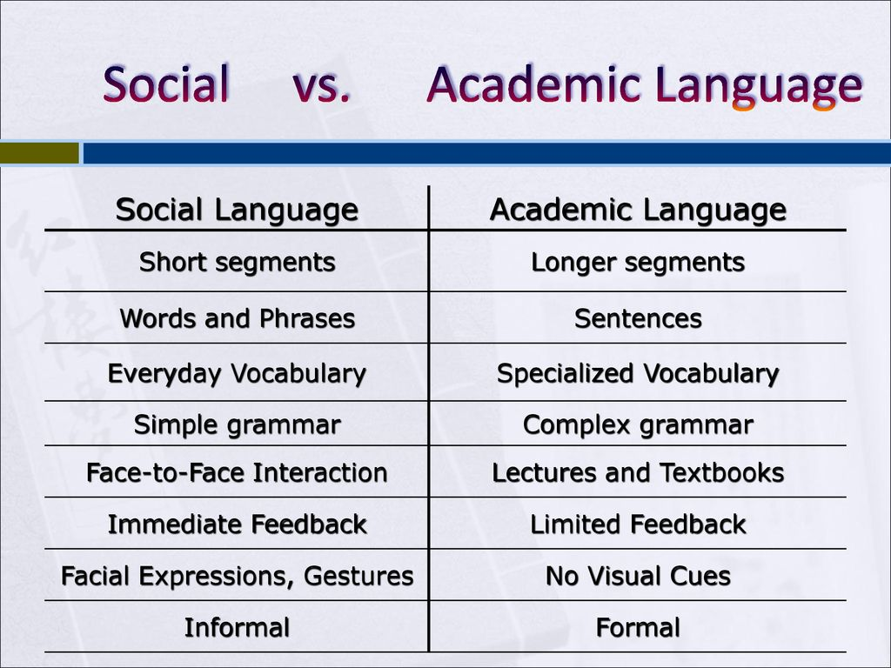
May take 2-3 years to develop
May take 5-7 years to develop

Slide 21
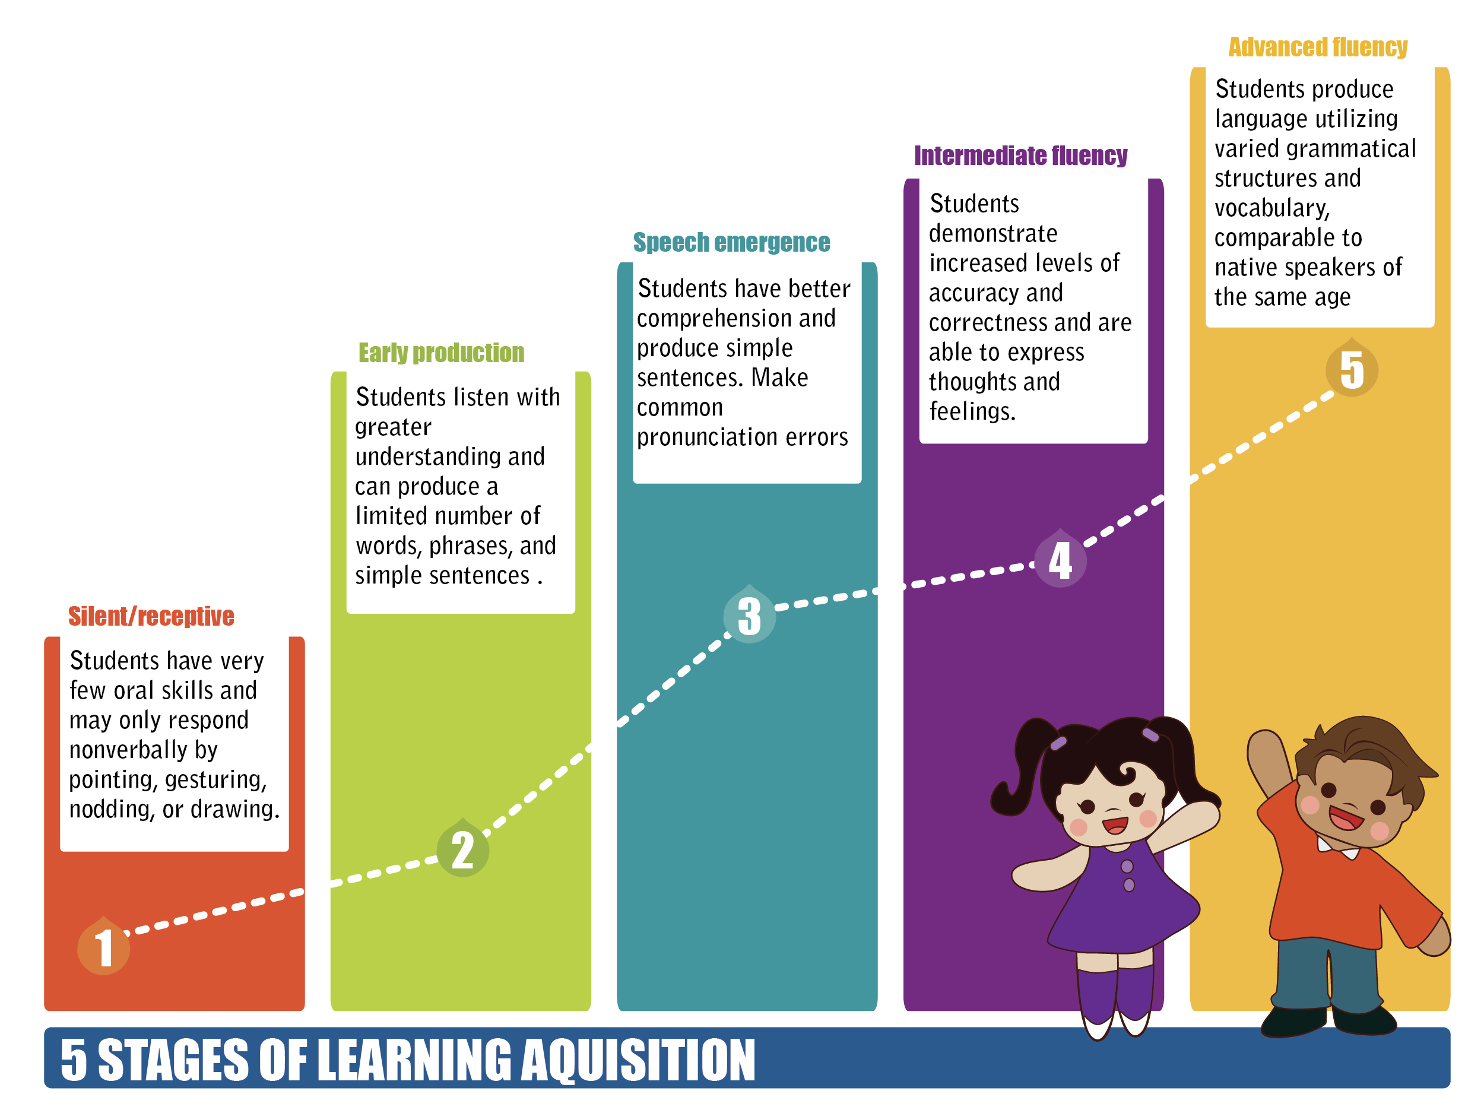
Stages of Language Acquisition

Slide 22
Silent/Receptive Stage
+/- 500 words; up to 6 months

Slide 23

Early Production
+/- 1,000 words; up to 6 months

Slide 24
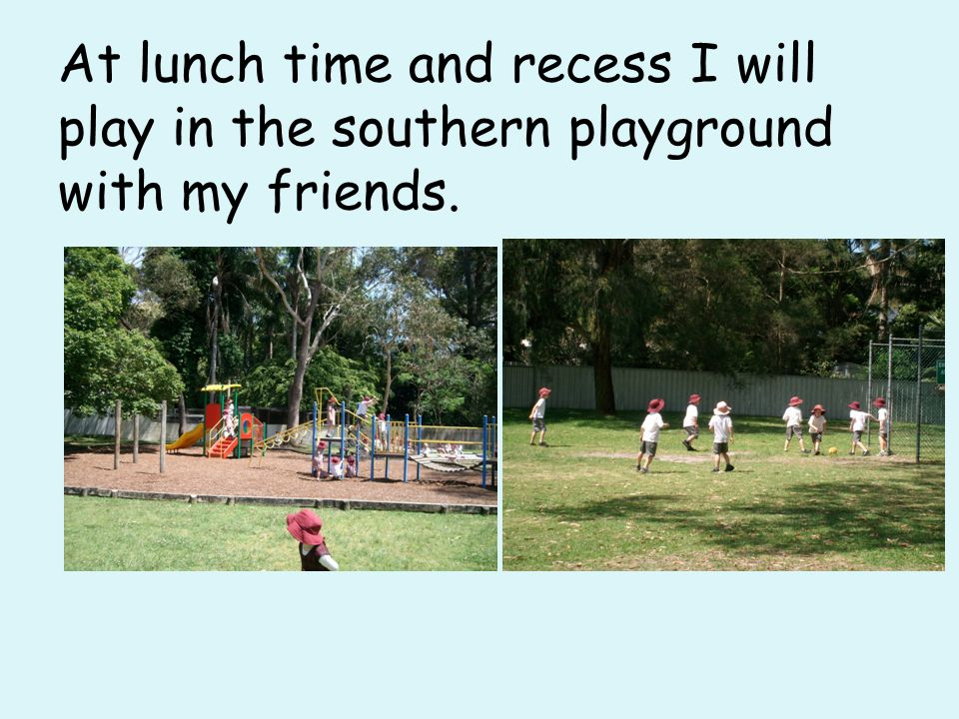
Speech Emergence
+/- 3,000 words;
1 – 3 years

Slide 25

Intermediate Fluency
+/- 6,000 words;
+/- 1 year
Based on what we read, I think it would have been more effective -

Slide 26

Advanced Fluency
5 – 7 years to reach advanced fluency

Slide 27
Students Experiencing Homelessness

Slide 28
Kids in Transition
  Recognize the signs of homelessness and report to your supervisor, school counselor or student or family support advocate, or district KIT office
  Protect student’s privacy
  Recognize that students’ behavior is a result of their background experiences, and is not directed at you
  Hold students accountable for what they can control (i.e., attitude); not what is outside their control (access to technology, purchase of supplies, etc.)
  Avoid taking away possessions

Slide 29

Questions?

Slide 30
Growth of Students with Special Education Services in EPS
 | Oct. 1, 2014 | Oct. 1, 2015 | Oct. 1, 2016 | Oct.1, 2017
Birth to three | 125 | 137 | 158 | 169
Preschool | 113 | 149 | 150 | 167
K-12 | 2,136 | 2,139 | 2,252 | 2,322
Total | 2,374 | 2,425 | 2,560 | 2,658
EPS total | 19,220 | 19,496 | 19,731 | 19,887
This demonstrate an increase in almost 300 students (excluding Oct. 1, 2018)

Slide 31
Role of Special Education Paraeducator

Slide 32
Responsibilities of Special Education Paraeducator
Provide instruction to students with disabilities under guidance of special education teacher
Lead small group or one to one instruction/support or data collection as well as assist the staff in implementing the student's services
Know the student(s)’s goals, accommodations/modifications, and behavior plans and reinforcement systems
Prepare the environment(s) and materials to support instruction.
Be aware of when support is needed and when to give time for the student to problem-solve or work independently (Be mindful of student’s goals for a particular settings or activities)
Aid the teacher in supervising assemblies and accompany students on outings/field trips

Slide 33
Special Education Paraeducator are not..
Case managing students' programs and plans
Lesson planning
Assigning final grades
Sole responsibility for a classroom or service/primary source of instruction
Being assigned to work with the most “challenging” students without appropriate support and supervision
Serve as the primary means of communication to parent
Transport or medicate students without proper trainings and authorization

Slide 34
Special Education Paraeducator Roles
Be aware that students with disabilities may need supports to access their environment (instructional and behavioral)
Become knowledgeable of accommodations, modification, and good practices to engage students with disabilities
If appropriate, coordinate supports with special education para colleagues
As appropriate, provide supports to students and/or reach out to the special education teacher to learn more about how to support

Slide 35
Role of Special Education Paraeducator
Nine Types of Curriculum Adaptations
Presentation
Time
Level of Support
Adapt the way student receives information
For example:
Provide notes for lecture or film, simplify wording or rephrase instructions, study guide, visual aids, enlarge text, provide hands-on options, groups
Adapt the time allotted and allowed for learning, task completion, or testing.
For example:
Prior notice of test, allow breaks, extra time on assignments/projects, allow breaks from work
Increase the amount of personal assistance with a specific student.
For example:
Assign peer buddies, paraeducators, peer tutors,
Setting
Adapt where/how the student receives instruction.
For example:
Read class materials out loud, provide models, assignments/test in different location, seat in front of room, allow mobility, allow frequent breaks
Difficulty
Response
Adapt the skill level, problem type, or rules on how the student may approach the work.
For example:
Allow use of a calculator; simplify task directions; change rules to accommodate student needs, amend assignment requirements, excuse from assignments
Adapt how the student can respond to instruction.
For example:
Allow a verbal response, scribe, or calculator, spelling and grammar devices, provide hands-on activity, amend assignment/project requirements
Participation
Alternate Goals
Substitute Curriculum
Adapt the extent to which a student is actively involved in the task.
For example:
Listening to group work instead of speaking
Adapt the goals or outcome expectations while using the same materials.
For example:
In social studies, expect a student to be able to locate just the states while others learn to locate capitals as well.
Provide different instruction and materials to meet a learner’s individual goals.
For example:
In Science, providing an interactive notebook for a student unable to complete fine motor activities

Slide 36
Special Education Paraeducator Roles
ACCOMMODATION | MODIFICATION
Changes how a student learns the material | Changes what a student is taught or expected to learn
“Level the playing field” | “Create a playing field”
Can be made for any student, not just students with a 504 plan or an IEP. An accommodation makes learning accessible to the student and allows the student to demonstrate what they know. | Generally made for students with significant cognitive or physical disabilities.
Does not alter what the student is expected to learn. | Does alter content knowledge expectations as well as assessment administration practices.

Slide 37
Accommodation
Adjust practices and procedures in:
  Presentation
  Response
  Setting
  Timing/Scheduling
Provide equitable access during instructions and assessments for students with disabilities
Reduce or eliminate effects of student’s disability
Maintain high learning expectations
Ensure instructional and assessment accommodations are consistently applied

Slide 38
Modifications
Reduce depth or breadth in the information/material covered
Shorten units or lessons, fewer pages or problems
Provide access to written material at student’s reading level rather than grade level (high-interest, within reading level books).
Utilize off-grade level and supplemental materials (6th grade math standards for a 10th grader)
Modify grading expectations (P or S instead of a letter)

Slide 39
Example: Math
Accommodation
Modification
Student uses calculator to solve the volume of prism.
Simplified problems
(meaning using one-step problem, when the expectation is two or more)
Accommodation and modification must be based on
the specific needs of the student!

Slide 40
Example: English
Accommodation
Modification
Student uses a laptop for a written assignment instead of hand-writing it.
Student produces shorter assignments on simplified topics.

Slide 41
Good Para-Student Relationships
ARE | ARE NOT
Proactive | Reactive
Strengths-based | Criticism, Sarcasm
Predictable, dependable | Unreliable
Based on praise and trust, flexible | Militant, Power struggles
Grounded in empathy | Based on sympathy

Slide 42
Maintaining Relationships
Consistency
Reliability
Praise
Continued engagement and encouragement
Planning, supporting, and celebrating goals

Slide 43
The Keys to Effective Praise
5 to 1 praise to feedback ratio
Behavior specific praise
Continued praise for improved behavior

Slide 44
Behavior Specific Praise
Do this | Not this
You’re really working hard at finishing that worksheet. | Good work.
Great job getting your book out and reading! | Great job!
Thank you for ignoring him while he is having a hard time. | Just ignore it.
You’ve been doing so great at meeting your goal to get 10 points each morning. Coming in and starting your work right away is really helping you get lots of points. | Awesome job meeting your goal yesterday!

Slide 45

Questions?

Slide 46
BINGO!

