Slide 1
Positive Behavior Interventions and Supports (PBIS)
Tier 2- Day 1
Bridget Walker, Ph.D.
Lori Lynass, Ed.D
Sound Supports
PBIS Coaches

Slide 2
Agenda:
Tier 2-Day 1
GOAL: Build a strong Tier 2 foundation
Review Tier 2 Readiness
Introduction to Tier 2 Systems
The Tier 2 Leadership Team
Student Identification for Tier 2
Function and Behavior- Foundations
Developing a Continuum of Tier 2 Supports (Part 1)

Slide 3

www.soundsupportsk12.com

Slide 4
Group norms and expectations
Be Responsible
  Avoid sidebars
  Be an active participant
  Return promptly from breaks/activities – Hand/Bell Signal
  Use cell phone/laptop to support learning
  Be Respectful
  Use time well & meaningfully
  Ask relevant/clarifying questions
  Leave no trace- clean up your space
  Be Professional
  Enter discussion with an open mind
  Share the Air with others- all voices heard
  Allow quiet think time for self and others FIRST
  Be The Student You Wish To Have

Slide 5
Everett Public Schools
PBIS Tier 2 KWL Warm-up Activity
As you arrive please consider the following questions and be prepared to discuss:
Positive Behavior Interventions and Supports (PBIS) Tier 2 Practices
1. What Do You Know About Tier 2 systems?
2. What Do You Want To Know or Wonder About Tier 2?
3. What aspects of Tier 2 do you already have in place?
Notes:
BW
5 minutes pair-share then whole group share 10 min-
Draw from article, experience, visit……Record on large post it.

Slide 6
The district is using the Multi-Tiered System of Support (MTSS) to help schools develop a continuum of supports for every EPS student.
Everett Public Schools Systems of Support 2020

Slide 7
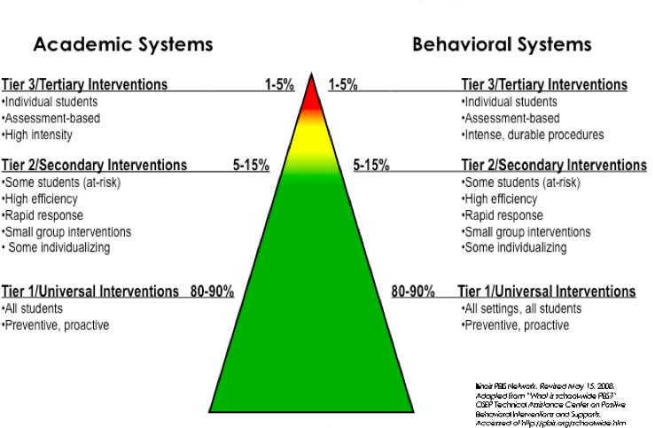
MTSS-B/PBIS Framework
Notes:
7

Slide 8
MTSS Today
PBIS Systems and Structures to Build Predictable, Positive School Climate
Teaching Practices, Activities & Curriculum that Support SEL Development
High Quality Teaching and Learning with Differentiated Approaches
Notes:
It seems we should use some version of this slide to highlight how important their role is across the model and to explain the MTSS/PBIS language thing.
Briefly review the 3 levels and concept of MTSS as integration of approaches.
Appear SEL image – universal = all kids, targeted = some/ small groups/short term,
Academic- a range of supports across needs to support academic development
Appear PBIS image- when you teach, reteach and acknowledge kids for expectations you are developing SEL. All integrates to support growth of whole child.

Slide 9
Why School-wide PBIS?
The fundamental purpose of PBIS is to make schools more effectve learning environments.
Predictable
Positive
Consistent
Safe
Notes:
The social culture of a school matters.
A continuum of supports that begins with the whole school and extends to intensive, wraparound support for individual students and their families.
Effective practices with the systems needed for high fidelity and sustainability
Multiple tiers of intensity

Slide 10
School-wide PBIS: Tier 1
Prevention
1. Common purpose & approach to discipline
2. Clear set of positive expectations & behaviors
3. Procedures for teaching expected behavior
4. Continuum of procedures for encouraging expected behavior
5. Continuum of procedures for discouraging inappropriate behavior
6. Procedures for on-going monitoring & evaluation
Notes:
10
Stress: Although most schools have a written code of conduct or discipline policy-- which is important-- it tends to focus on procedures for processing rule violations (#5 on the slide).
Effective school-wide discipline systems have a matching and strong proactive component that teaches and encourages pro-social behavior, and provides an on-going progress monitoring system.
The remaining five items are important but difficult to sustain without clear school-wide investments and structures in place.

Slide 11
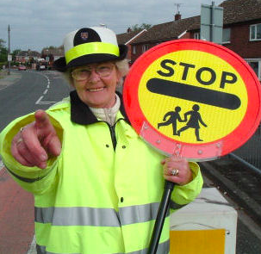
Are We Ready for Tier Two?
For Tier Two supports to be most successful, basic components of Tier One should be in place.
* Check Classrooms
Time must be dedicated for Tier 2 to be implemented.
Support from staff and admin must be available.
Professional development & staff collaboration must occur.

Slide 12
Is Tier 1 in Place in Your Classrooms? Classroom Self-Assessment/Danielson
Classroom-wide positive expectations taught, encouraged & reinforced and match school-wide expectations
Teaching classroom routines & cues taught & encouraged
Ratio of 4-5 positive to 1 negative adult-student interaction
Staff Agree with and Understand Classroom and Office Managed Behaviors and implement consistently
Active supervision
Clear redirections for minor, infrequent behavior errors
Frequent pre-corrections for chronic errors
Effective academic instruction & curriculum for all learners

Slide 13
Table for Two….
How well established is Tier 1 in your classrooms- how do you know?
Are you using any other tools or processes in your school to help all teachers implement Tier 1 effectively- how is it working?

Slide 14
Fidelity Assessment in PBIS
Measures of “Systems” Outcomes (fidelity)
  TFI – Tiered Fidelity Inventory > 80% on subscales
  SAS - Self-Assessment Survey
Measures of “Practice” Outcomes
  Office Referral Data (SWIS or similar system)
  Absentee & Truancy Data
  Academic Data
  School Climate Measures
  Staff, Parent and Student Perceptions (survey or Anecdotal Data)

Slide 15
Tier 2 – Secondary
Early intervention
Specialized, short term, group administered system for students who display indicators of high-risk problem behavior & are not responsive to universal interventions
  Basic functional based thinking intervention decisions
  Daily behavioral monitoring/feedback
  Regular & frequent opportunities for positive reinforcement
  Family & community connections
  Academic supports/strategies for academic success
  Planned, focused SEL, social skills instruction and support
  Evidence based interventions
  Match student to least intensive intervention that meets his/her need(s)

Slide 16
Tier 3 – Tertiary
Intensive & Individualized
Specialized, individually administered system for students who display the most challenging problem behavior(s) & are not responsive to targeted group interventions
  Simple request for assistance
  Rapid response
  Functional based planning
  Behavior support planning
  Team-based problem-solving process
  Data-based decision making
  Comprehensive service delivery derived from a wraparound process
  Not “just special education”
Notes:
I added this just to help put tier 2 in perspective, do you think we need it? It also completes an intro to the model. But if for time etc- we can let it gol

Slide 17
Who is Appropriate for Secondary Intervention?
APPROPRIATE
Low-level problem behavior (not severe)
2-5 referrals or internalizing issues
Behavior occurs across multiple locations
Examples
  talking out
  minor disruption
  work completion
INAPPROPRIATE
Serious or violent behaviors/ infractions
Extreme chronic behavior (6+ referrals)
Require more individualized support
  FBA-BIP
  Wrap Around Services

Slide 18

Evidence Based Practice
Tier 3: FBA/BSP (5%)
6+ Discipline Referrals
5 + Referrals
TIME & CHANGE in Staff behavior required to generate desired outcome
Tier 2: CICO (15%)
3-5 Discipline Referrals
2-4 Referrals
Tier 1: SW-PBIS (80%)
0-2 Discipline Referrals
0-1 Referrals
Notes:
At the bottom of the triangle we are teaching and asking kids to change their behavior. At the top we are changing our own.

Slide 19
Tier 2 Guiding Principles
Students who are at-risk benefit from MORE:
  Clearly defined expectations
  Frequent feedback from supportive adults
  Consistency and predictability
  Abundant positive reinforcement
Problem behavior and academic success are often linked
Behavior support strategies focus on building positive adult-student relationships

Slide 20
General Process for Tier 2 Systems
Establish Tier 2 Support Team to guide/lead process (not the same as your PBIS Leadership team).
Orient staff, families and students to the focus of the Tier 2 support system
Continue to establish behavioral competence, strategies within your school
Continue to develop/strengthen three tier system of school-wide behavior support

Slide 21
General Process Cont’d
Develop a continuum of evidence based Tier 2 supports with clear entry/exit criteria
Establish a data decision system for matching level of intervention to student
  Simple & direct request for assistance process for staff
  Data decision rule for requesting assistance based on number of major behavioral incidents and/or other established indicators
Establish a continuous data-based system to monitor, evaluate, & improve effectiveness & efficiency
  Are students displaying improved behaviors?
  Are staff implementing procedures with high fidelity?
  What can be modified to improve outcomes?
  What can be eliminated to improve efficiency?

Slide 22
Features of Tier 2 Interventions
(Hawken, Vincent, & Schumann, 2008)
Assumes Tier 1 School wide PBIS is in place – TFI, SAS
Involves a problem-solving focused behavior support team
Screening to identify % of students in need of more than Tier 1 supports
Readily available and easily accessible
Low time commitment from teaching staff
Adequate resources allocated (admin, team, time etc.)
Uses efficient, available evidence-based practices
Includes data-based progress monitoring & decisions
Have entry, progress monitoring & exit criteria, with non-responders moving to Tier 3
Notes:
22

Slide 23
Mapping Basic Tier 2 Interventions
Begin with Least Intensive Intervention possible that matches student need. Increase/adjust supports based on data.
Function Based Matching to Existing Supports
Basic Check In & Check Out Intervention
Small Group Academic, Social-Emotional, Groups
Integrated Interventions Tier 2 Interventions
Identify Students (SWIS, Screening, Referral etc.)
Mentoring or Make a Mentor
Least Intensive More Intensive
(Walker, B., 2016)

Slide 24

Tier 2: Sample Interventions
  Targeted SEL Groups
  Check In/Check Out, Check,
  Connect & Expect etc.
  Executive Functioning Skill Groups
  Learning Strategies and Study Skills
  Academic Support Groups
  Homework Club
  Self-Monitoring Plans
  Mentoring/Make a Mentor
  Behavior Contracts
  Class Pass System

Slide 26
Tier 2 Readiness Assessment &
Poster Activity
On Your Poster List:
  Ways Your School is Ready For Tier 2
  Readiness Steps That Need to Occur
  Challenges to Tier 2 Implementation
  Promoters to Tier 2 Implementation
  Look at indicators of Tier 2 readiness on page 5 of your Tier 2 packet to guide your thinking.

Slide 27

Tier 2 – Building the Support Team
The Tier II Team uses a range of data to regularly identify students in need of more social/behavioral supports and to establish and monitor the systems and practices that serve these students

Slide 28
Tier 1 and 2 Team Roles Compared
TIER 1 TEAM | TIER 2 TEAM
Addresses and prevents problem behavior for 80% to 90% of the students. | Designs early intervention programs for the remaining 10% to 15% of students who are at risk for academic or behavioral problems.
Determines areas of need within the school. | Conducts proactive, regular student screening and coordinates and shares information with the Tier 1 Team.
Uses schoolwide data to set priorities within the school. | Uses data to proactively determine which students need additional academic and/or social-behavioral support.
Identifies needed strategies, current and on-going staff training, and resources. | Identifies staff skilled in conducting brief functional assessments.
Designs positive behavioral interventions and supports for the classroom and the entire school. | Designs positive behavioral interventions and supports for small groups of students and/or specific classroom settings needing additional assistance.
Provides ongoing support for staff members implementing positive behavior support programs. | Consults with and provides ongoing support for school staff who have a student(s) with academic and/or behavior problems.
Shares schoolwide outcomes and makes program modifications as necessary. | Shares intervention outcomes and provides ongoing support for student, teacher and family.
Coordinates school and community schoolwide services. | Coordinates school and community services for groups of students at risk .
MOSWPBIS

Slide 29
Establishing the Tier 2 Team
May be part of the existing behavior leadership team
May be an extension of the existing behavior leadership team
May be a stand alone team, often these teams look at Tier II & III
* Such a team may already exist in your school
Notes:
May include academics, or may be separate

Slide 30
Two Team Format
Universal PBIS Team
Tier 1
PBIS Team
Tier 2 and Tier 3

Slide 31
3-Tiered System of Support
Universal
Team
Meeting
Secondary Systems Team
Meeting
Problem Solving Team Meeting
Tertiary Systems Team Meeting
Standing team; uses FBA/BIP process for one student at a time
Uses process data; determines overall intervention effectiveness
Plans schoolwide & classroom supports
Uses process data; determines overall intervention effectiveness
Universal Support
Check-In Check-Out
Skills Groups
Complex
FBA/BIP
Wraparound
Brief
FBA/BIP
Group w. individual
feature
Brief FBA/BIP
USDOE-OSEP Tertiary Demo Project
#H326M0060010
Notes:
31
31

Slide 32
Tier 2 Team Members
Tier 2 (Intervention) Coach
Counselor
Psychologist
Special education
Teachers
Administrator
Paraprofessionals
*FBA/BIP Knowledge

Slide 33
Tier 2 Teams: Meeting Smarter and More Efficiently
Assign Roles/Responsibilities and keep to them!
Structure an Agenda that allows the group to cover a number of items/students in each meeting.
Review FERPA and other confidentiality guidelines with the team.
Limit “Admiring the Problem” to no more than 10% of allotted time for discussion of that student (and keep to it).
Take minutes and share promptly with team
Identify indicators to begin a support and indicators student is ready/needs a change.
Build a Tier 2 Supports/Intervention Grid to guide decision-making

Slide 34
Establish Team Roles
Identify who will serve in each role.
Rotate every 3 months or so to develop capacity across team members and to provide some variety.
Each role needs to be filled for each meeting.
Identify who will step in for each role in the event someone is absent.
• Facilitator- runs the meeting (not the administrator)
• Time keeper- keeps group on time and on task
• Note taker/action plan recorder- records notes/decisions & shares with relevant others (per communication protocol)
• Data analyst- reviews and preps data ahead of meeting, shares with team
• Active team members- everyone participates and supports

Slide 35
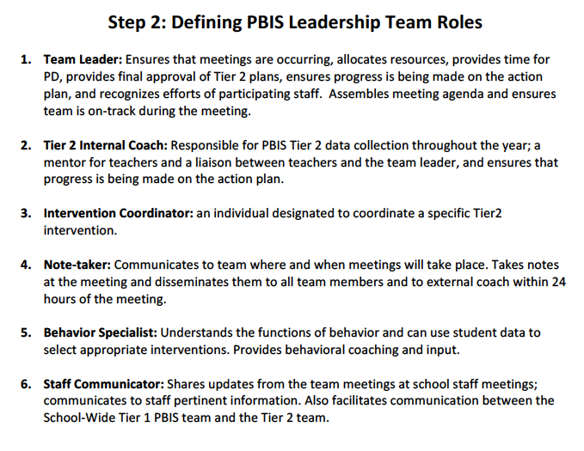
More on Team roles

Slide 36
MTSS Prompts A Shift in Thinking
What about the interaction of the curriculum, instruction, learners, and learning environment should be altered so that the student(s) will learn?
What about the student is causing a problem?
Instead
This shift alters everything else!
Adapted from Batsche and Elliott materials (citing Ken Howell)
Notes:
A major conceptual shift. This puts the problem in the context of alterable variables and moves it outside of the student. When the focus of team meetings is on the discovery of instructional changes that will enable learning, the content of the meeting is quite different from one focused on the discovery of a disability.
(*Sometimes allowing time for discussion of this slide can bring about significant “aha”s.)
Remember our MTSS approach where we are focusing on what we can do or what supports (i.e. instructional changes) we can put in place to help the student be successful. This is a major conceptual shift. This puts the problem in the context of alterable variables and moves it outside of the student
FSCP Ideas:
Use of out-of-school time is considered a major factor in the achievement gap; and can be altered with family and community partnering; coordinated before and after-school programs, summer learning, homework support, technology access – and their interaction with the other variables can be influential

Slide 37

Identifying Students For Tier 2/3 Supports:
Office Referral Data
Academic Data
Classroom Minors Data
Attendance Data
Frequency of Nurse’s Office Visits
Mental Health Concerns
Drug/Alcohol Concerns
Student Self Refers
Social Emotional Screening Data
Teacher/Counselor/Parent Request

Slide 38
Data Driven
4 majors in a two week period
6 minors=1 major
Team assists staff in completing Tier II Referral Form
Observation completed
Teacher Nomination
Problem Solving Team Referral
Screening
Document behaviors and interventions
Teacher completes Tier II Referral Form
Observation completed
Tier II Team meets within one week and makes decision
Tier II Team meets within one week and makes decision
Kirksville Public Schools
Early Childhood Learning Center
Lewis, T., PBIS.org

Slide 39
Comprehensive Screening
Attendance, Social, Emotional, Discipline & Behavioral Screening Data
Academic Records & Screening Data
Group of Students With Targeted Needs

Slide 40

Externalizing Behaviors
Behaviors focused outward towards others or environment
Typically occur too often or too much
Examples:
  aggression towards people, animals or objects
  arguing, defiant or non-compliant
  calling out or disruptive to learning
  high levels of movement
  Inattentiveness, distractibility

Slide 41

Internalizing Behaviors
Behaviors focused inwardly towards self
Typically self-imposed, may not occur frequently, and appear to allow the student to avoid social events
Examples:
  Not interacting with other people
  Withdrawing or frequently avoiding social situations
  Overly shy or timid
  Often fearful or submissive
  Appears frequently depressed
  Self harm at most intensive

Slide 42
Sample List of Students Identified Through Schoolwide Screening
How could this information help you determine where your limited support resources should focus?

Slide 43
Student Success Platform

Slide 44
Team Work: Tier 2 support Process
How are students currently identified for more intensive supports in your school?
  Request for assistance?
  Number of disciplinary referrals?
  Other types of data?
Are all staff and parents aware of the process?
Does your existing process focus more on identifying students with emerging issues or on students with more individualized needs?
How can the process be streamlined/improved based on what you just saw from the Student Success Platform?
Look over the samples on pages 22-24 in your Tier 2 packet
Notes:
Until 11

Slide 45


Meeting Foundations
Clear Purpose/ Authority
    How will we know if the meeting is effective?
    What is the impact we are to have on students/ families/ school?
Roles and responsibilities
    Facilitator
    Minute Taker
    Data Analyst
    Time Keeper
    Member/Participant
Agreement about process
    Start time/stop time
    Schedule
    Respect and commitment
Electronic Meeting Minutes/Agenda

Slide 46
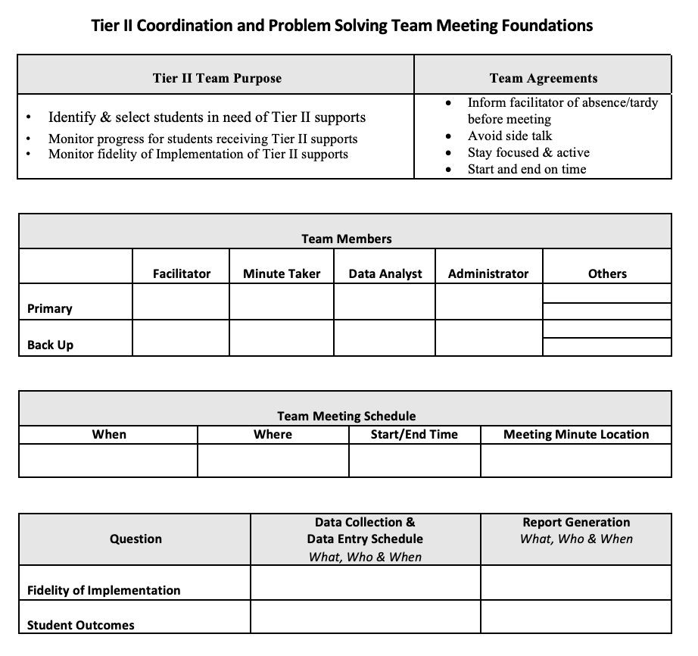

Slide 47
Team Roles
Facilitator (Counselor) | Data Analyst (Teacher) | Minute Taker (Social Worker) | Time-Keeper (Teacher) | Admin | Team Member (Teacher)
Lori | Jill | Nikki | Ryan | Dan | Jerome
Team Agreements
Stay Present
Strength Based Perspectives
Stay Focused on Topic
Start and End on Time
Share the Air
Speak Your Truth

Slide 48
Agenda
Time | Task
2:00-2:10 | Previous Tasks
2:10-2:25 | Targeted Intervention Summary
2:25-2:40 | Current Student Check
2:40-3:00 | New Students

Slide 49
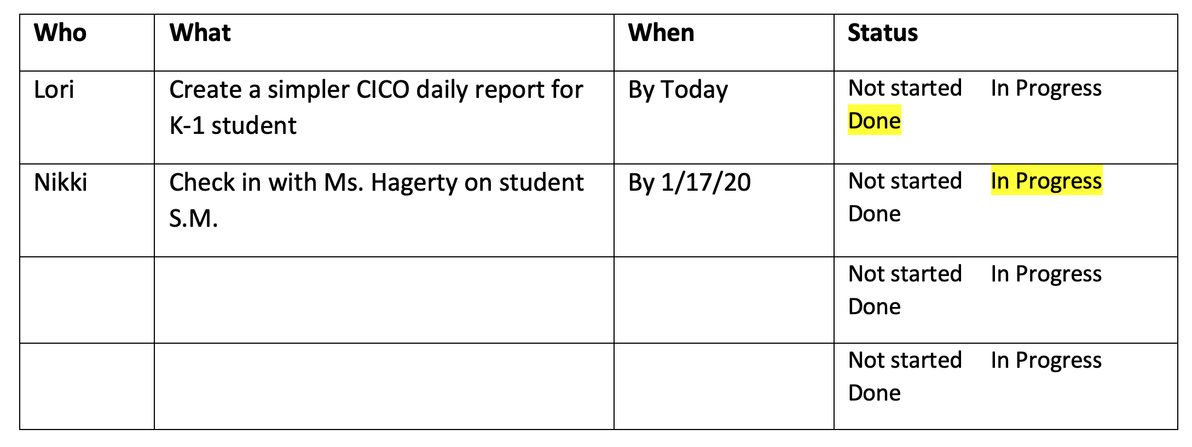
Previous Tasks

Slide 50
Targeted Intervention Summary
Intervention | # of Students Participating | # of Students Responding | # of Students with Variable Responsiveness | # of Students Not Yet Responding (meeting goal less than 50% of the time)
Check In Check Out | 12 | 10 = 83% | 1 | 1
Home Note | 8 | 5 = 62% | 0 | 3
Class Pass | 10 | 7 = 70% | 3

Slide 51
Class Pass
*Students not yet meeting goal, problem solve and determine next steps
1. Possible barrier: fidelity, intervention/function mismatch, intervention needs to be modified
2. Possible decisions: Meet with teacher, change interventions, P-BIP, change reinforcer
Students with Positive Response, Not Yet Ready for Fading (These students do not need to be discussed at this time) | Students with Positive Response Eligible for Fading or Graduating (Demonstrated positive response and meeting data-decision rule criteria for fading or graduating | Students with variable response (meeting goal between 55%-75% of the time) | Students Not Yet Responding Favorably (meeting goal 55% of the time or less)
K.S. | T.H. | G.K.
F.H. | L.L. | P.S.
J.S. | B.W. | C.M.
S.I.

Slide 52
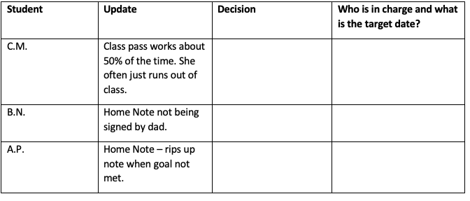
Current Students

Slide 53
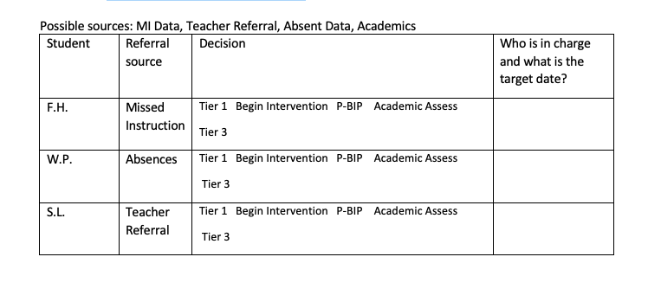
New Students

Slide 54
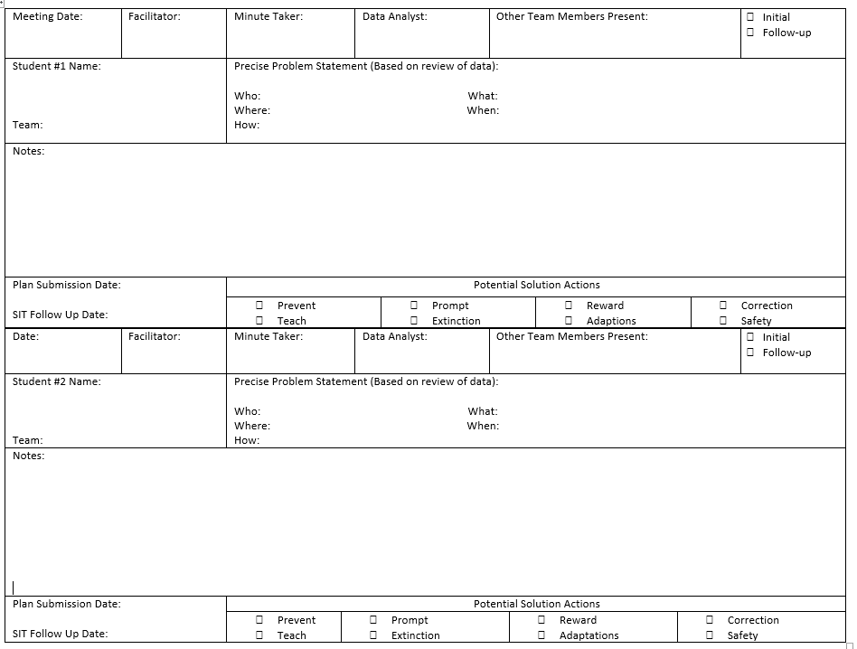

Slide 55
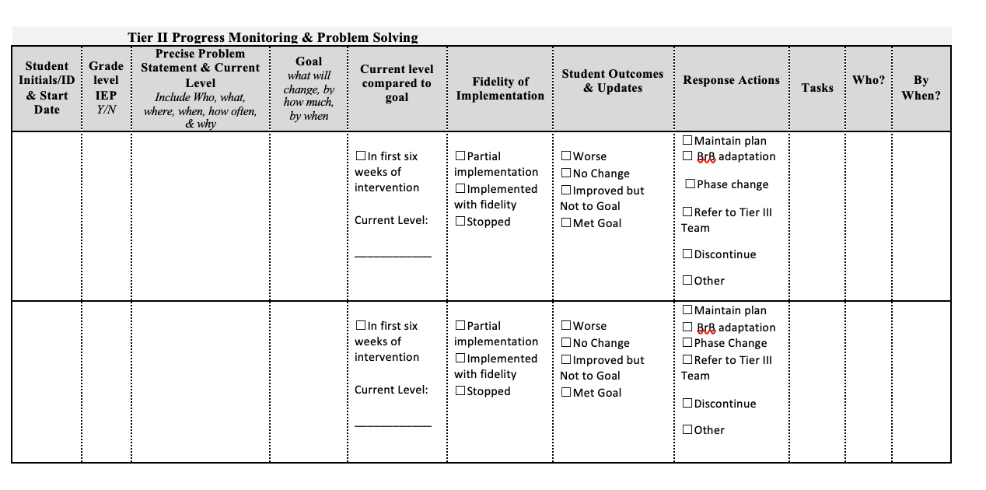

Slide 56
Tier 2 Team Meetings
What are the next steps to making your Tier 2 team meetings more efficient and effective? Do you have:
  Clearly Defined Roles and Purpose?
  Clear Agenda Process/Format?
  Someone to Monitor Each Intervention?
  Look at meeting supports in the Google Drive: https://drive.google.com/drive/folders/14Cmom9xKFQX8C5xpXZ-6JD5vwkPvLpPM?usp=sharing
Other question to consider:
  What is your building’s current process for requesting additional academic and/or social-emotional/behavioral support?
  Is there equitable access to supports and services? How do parents, students and educators access support/assistance?

Slide 57
Final Action Planning Tasks
Return to the Tier 2 Planning Checklist on pages 18-21.
Review items 1-3 and outline next steps in developing these aspects of Tier 2 foundational systems
Identify how your PBIS coach can help you with further development of these areas.
Goals by Next Training:
Identify Team & Assign Team Roles
Get Familiar with Student Success Platform
Review Tier 2 Flowchart Process & Referral Form

Slide 58
Tier 2: Agenda for Day 2
Overview of Tier 2 Supports: Students Matched to Function Based Supports Check in Check Out (CICO) Programs Self-Monitoring
• Class Pass/Break Pass Intervention • Targeted Social Skills • Behavior Pacts • School-Home Note
Sharing Implementation Ideas Across Schools
Review Tier 2 Action Plan Checklist
Team Action Planning

Slide 59
Thank you!
Lori Lynass, Ed.D.
lynassl@gmail.com
Bridget Walker, PhD.
bridgetwalkerphd@gmail.com

Slide 60


