Slide 1




Coaching
[date]

Slide 2

Coaching
[1]

Slide 3
Coaching
Today was the absolute worst day ever
And don’t try to convince me that
There’s something good in every day
Because, when you take a closer look,
This world is a pretty evil place.
Even if
Some goodness does shine through once in a while
Satisfaction and happiness don’t last.
And it’s not true that
It’s all in the mind and heart
Because
True happiness can be attained
Only if one’s surroundings are good
It’s not true that good exists
I’m sure you can agree that
The reality
Creates
My attitude
It’s all beyond my control
And you’ll never in a million years hear me say
Today was a very good day
[2]

Slide 4
Coaching
[3]

Slide 5
Coaching
Aggressive listening
[5]

Slide 6
Coaching
The importance of coaching
[4]

Slide 7
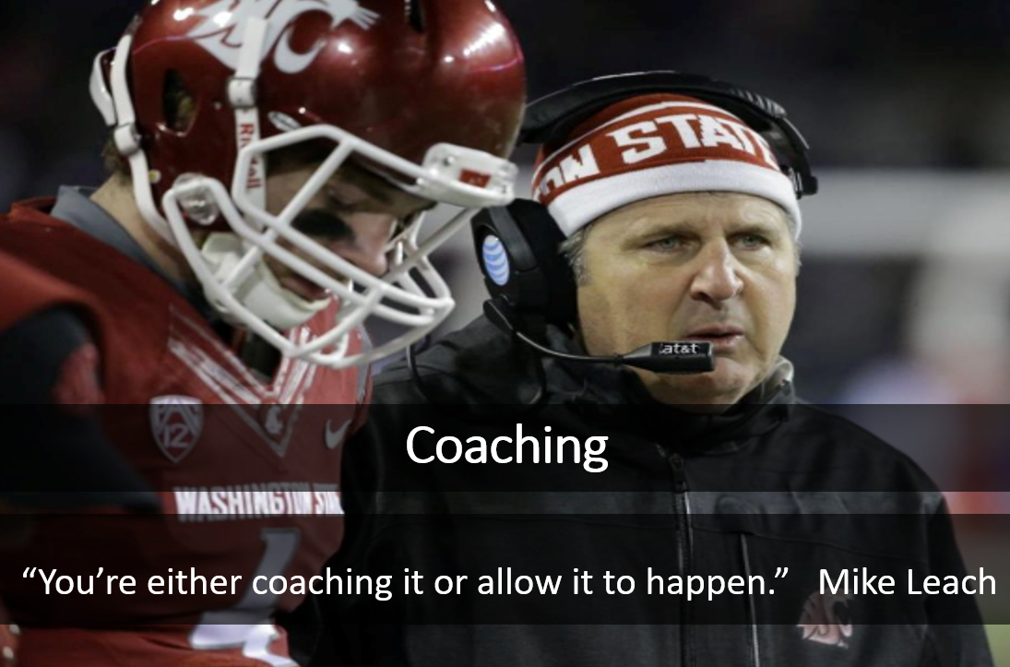
Coaching
[5]

Slide 8

Coaching
Speak Up – If you see something and don’t say something, you endorse it!
[6]

Slide 9
Coaching
Want to get great at something
Get a coach – Atul Gawande
[7]

Slide 10
Coaching
Coaching discussion
Review and annotate the article Top Athletes and Singers Have Coaches. Should You? By Atul Gawande
Focus on the following four questions:
  What Assumptions does the author of the text hold?
  What do you Agree with in the text?
  What do you want to Argue with in the text?
  What parts of the text do you want to Aspire to (or Act upon)?
[8]

